Slide 1
Enterprise innovation strategy
Ing. Žaneta Rylková, Ph.D.

Slide 2
Innovation strategy
Steps:
  Strategic thinking (objectives, types of innovation)
  Strategic analysis (external and internal environment, how to innovate)
  Strategic plan
  Implementation of strategy

Slide 3
Innovation management
Determine direction
Environment SWOT
Monitor, evaluate and control
External analysis and Internal analysis
Strategy implementation
Strategy formulation

Slide 4
BASIC APPROACHES OF INNOVATIONS STRATEGY CREATION
Finding the customer value opportunities
Objective is to identify needs for:
new products
improvements to existing products
improvements in production processes
improvements in supporting services
creation of new business models

Slide 5
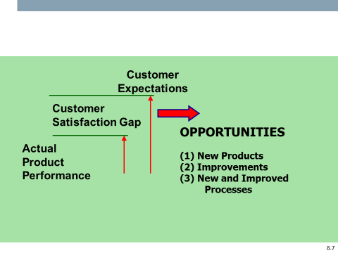
BASIC APPROACHES OF INNOVATIONS STRATEGY CREATION
Finding the cusomer value opportunities

Slide 6
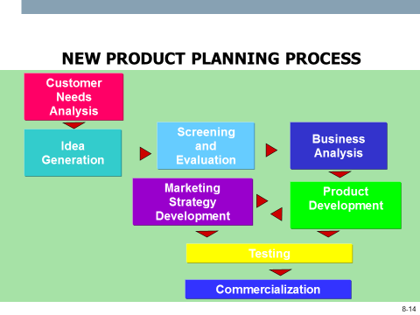
BASIC APPROACHES OF INNOVATIONS STRATEGY CREATION

Slide 7
Limiting factors for innovation strategy
Innovative competence (innovative experience, capabilities, capacities, skills, knowledge)
Innovation specification (improvement or significant improvement or even a whole new product, technology)
Innovation management (the definition of innovation - what to do, what problem should be solved, the product or technology vision, and another sequence of activities leading to successful commercialization, innovation culture)
Investment spending

Slide 8
Top management must create conditions
In direction:
  Proactive (creative) corporate culture
  Expenditure on R & D
  Efforts to quickly commercialize innovations
  Innovation chaining, innovation is seen as a continuous process

Slide 9
Identifying innovative goals
Changes in the structure of the product portfolio
radical - the introduction of new products, the creation of a new market space - a certain lead over the competition
Others - different product changes due to new customer requirements, adaptation to competition
Technological innovation - introduction of new technologies, production facilities, processes
Other innovations - organizational, marketing

Slide 10
Determining innovative strategies
Establishing procedures for achieving strategic goals such as radical innovations - how they will be achieved: own research, cooperation with external entities, license purchase
Decision-making will go hand in hand with consideration of financial dispositions

Slide 11
Innovative strategies
When strategic innovation intentions are identified, it is necessary to identify the innovation strategy, i.e. the strategic approaches that senior management favors and will apply when implementing innovation intentions

Slide 12
BASIC APPROACHES TOO INNOVATION STRATEGY CREATION
TRADITIONAL APPROACHES TO STRATEGY
STRATEGIC INNOVATION APPROACH
Adopt a “present to future” orientation, takes today as the starting point
Assume a rule-maker/taker (defensive/follower) posture
Accept established business boundaries/ product categories
Focus on incremental innovation
Follow traditional, linear business planning models
“Starts with the end in mind” – identifies long-term opportunities and then “bridges back to the present”
Assumes a rule-breaker (revolutionary) posture
Seeks to create new competitive space/ playing fields
Seeks breakthrough, disruptive innovation – while continuing to build the core
Marries process discipline with creative inspiration

Slide 13
BASIC APPROACHES TOO INNOVATION STRATEGY CREATION
TRADITIONAL APPROACHES TO STRATEGY
STRATEGIC INNOVATION APPROACH
Seek input from obvious, traditional sources
Seek articulated consumer needs
Are technology driven (seek consumer satisfaction)
May have a “one-size-fits-all” organizational model
“Seeks inspiration from unconventional sources
Seeks unarticulated consumer needs
Is consumer-inspired (seeks consumer delight)
May experiment with entrepreneurial “new venture” or other organizational structures

Slide 14
Breakthrough innovation strategies
Breakthrough, radical innovation - radically changes standard approaches to product features, technology, input materials, business models
  Blue ocean strategy
  Strategy fast second
  Open innovation strategy

Slide 15
Blue ocean strategy
Based on the creation of an elementally new space, usually given by a new product type that will generate new needs.
It does not focus on the distribution of existing markets, but on the creation of new demand and thus to deviate from the competition.
The goal is not to focus on fighting each other, gaining market share at the expense of competition.

Slide 16
Differences between red and blue ocean strategies
Red ocean strategy | Blue ocean strategy
Industry boundaries are firmly defined Attempting to perform better than an opponent, trying to gain a greater share of the already existing demand Reduce prospects for growth and profit | All today's non-existent sector and market space, which is not yet known Opportunity for highly profitable growth New concept, but new existence is not (e.g. smart phones)
Competition within an existing market space Take advantage of existing demand and gain an edge over existing competitors Choose between value and cost | Create sovereign market space Disqualify your competitors from the game Create a new demand and take advantage of it Focus on the differentiation strategy and break the decision dilemma between value and cost

Slide 17
Scenarios 6 ways to determine the innovation strategy
Look through the alternative industry
Looking through strategic groups across industries (by price and performance)
Look through the customer chain
Look around through offers of complementary products and services
Look through functional or emotional challenges addressed to customers
Looking over time

Slide 18
Strategy fast second
Modern succession of succession strategy
The principle is to quickly recognize the commercial potential of a successful pioneer and its radical innovation or product in the blue ocean of further innovation to improve
  Pioneering strategy - the first on the market, primary production, the creation of a market from scratch, but a risk strategy
  Rapid Second Strategy - based on the right timing

Slide 19
Fast second strategy
A good system for monitoring the market situation is necessary
It will be cost competition, product improvement, the second on the market must have production capacities, marketing, promotion, sales channels better than the pioneer
The second one has to acquire new technology.
The advantage is that it did not have to incur significant development costs, it does not risk the failure or entry costs of introducing the novelty to the market.

Slide 20
Open innovation strategy
Closed innovation - Creating a new product is an internal affair of the company
Open Innovation - Involves various external resources

Slide 21
Open innovation
Many forms:
  Announcement of the competition for ideas
  Involvement of suppliers
  Involvement of external actors in development
  Establishing strategic partnerships

Slide 22
Advantages and Disadvantages of Open Innovation
advantages | disadvantages
Lower costs for new products Integration of customers at an early stage of development Expanding fans of ideas that would remain under the lid Accelerating the creation of new products Possibility of venture capital involvement | Revealing information that is not for sharing Perhaps a loss of competitive advantage Design new channels for communication with external entities - a software platform Another model involving external entities

Slide 23
Reverse Innovation Strategy
Reverse innovation is innovation created in conditions and with a focus on the low-developed market (in the developing world), and if proven to be in this market, it is modified and distributed to other markets
Designed for the local (development) market, it can be modified and refined for other markets, including advanced ones.

Slide 24
Innovation strategy
FINANCING OF INNOVATIONS
PRIVATE SOURCES
PUBLIC SOURCES
ENTERPRISES
BANKS
JOINT VENTURES
technology-based innov.
INDIVIDUALS
BUSINESS ANGELS
wealthy, informal investors
STATE
grants
tax incentives
REGIONAL Grants
EU Grants
FRAMEWORK PROGR.
STRUCTURAL FUNDS

Slide 25
The key attributes of the business plan
Clear vision, business plan specification, goals
Product Specifications
Market positions (benchmarking studies)
Human Resources (Employee Competence)
Operating conditions (state of technology, intellectual property)
Financial Situation (Assets, Financial Flows)

Slide 26
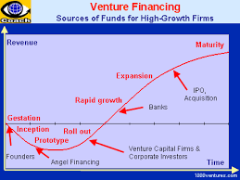
Financing of innovations

Slide 27
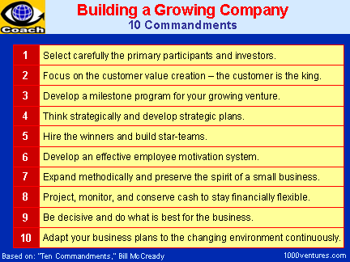
Financing innovations and innovation process

