Slide 1
Managing innovation
Seminar 10
Ing. Žaneta Rylková, Ph.D.

Slide 2
Content
Characteristics of successful innovative businesses

Slide 3
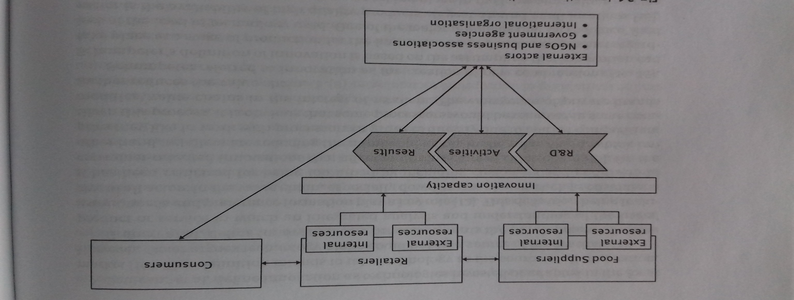
Characteristics of successful innovative businesses

Slide 4
Innovation and Business
The effects of intense global influences are felt in all economies:
Notes:
csvukrs

