Slide 1
Managing innovation
Seminar 6
Ing. Žaneta Rylková, Ph.D.

Slide 2
Content
Sources of innovtion incentives
Economic problem: Analysis of supply and storage activities of the company

Slide 3
Sources of innovaton incentives
external environment
internal environment

Slide 4
External environment

Slide 5
Internal environment

Slide 6
Evidence of ideas

Slide 7
Work with ideas

Slide 8
Innovative techniques

Slide 9
Inventory management and inventory optimization

Slide 10
Inventory management and inventory optimization

Slide 11
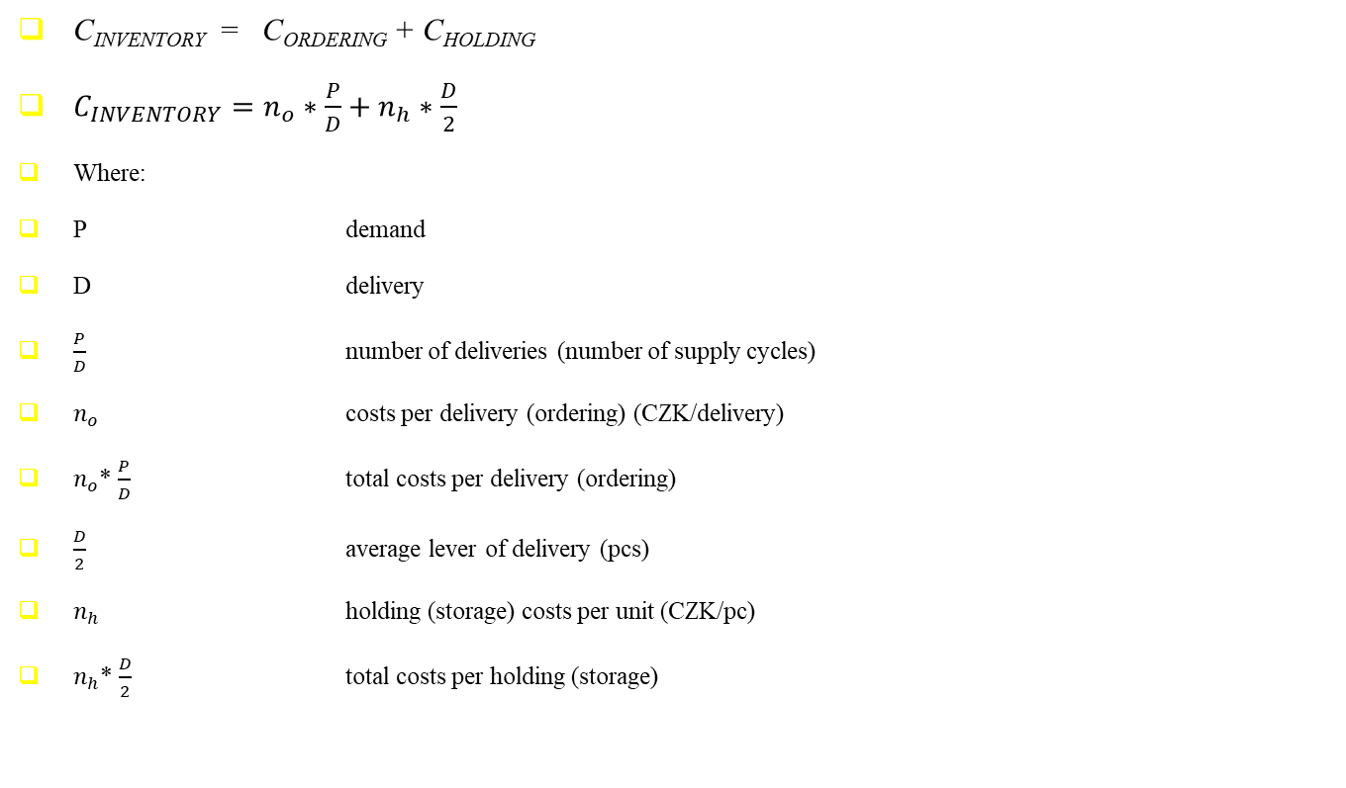
Inventory management and optimization

Slide 12
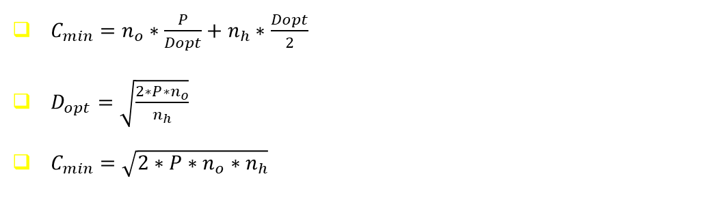
Inventory management and optimization

Slide 13
Economic problem: Analysis of supply and storage activities of the company
Fruta, joint-stock company produces beverages in two-liter plastic bottles in one of its plants. Production and distribution of these products is due to the demand regular during the year. Plastic bottles are collected from supplier in cartons (each contains 24 bottles) – the need of these cartons is planned at the amount of 36 000 pcs. Purchase price of one carton is 120 CZK. The bottles are ordered regularly in certain quantity, with each order is related „cost per delivery“ at the amount of 12 000 CZK. The purchase deadline of supply is fixed and it is ½ of month. Storage costs of one carton are 20 % of purchase price of the one carton per year.
The company has decided to analyze its warehouse management system in order to minimize the costs associated with ordering of material and storage of material.
For successful analysis, the company has decided to find out the following information:
Calculated costs associated with the existing system of ordering and holding of the cartons.
Costs associated with the implementation of „Strategy I“ or „Strategy II“, which are specified as follows:
Strategy I: 2 deliveries per year
Strategy II: 12 deliveries per year
Costs corresponding to the optimum amount of supplies.
For calculations please use the formula for calculating „inventory costs“, which are the sum of costs „delivery (ordering)“ and „storage (holding)“ costs.

Slide 14
Economic problem: Analysis of supply and storage activities of the company
 | Current situation | Strategy I | Strategy II | Optimal level of deliveries
demand P (pcs)
delivery D (pcs)
Number of supply cycles P/D (number of deliveries)
costs per delivery (ordering) n_{o} (CZK/delivery)
Total costs per delivery (ordering) n_{o}.P/D (CZK)
Average level of delivery D/2 (pcs)
Holding (storage) costs per unit n_{h} (CZK/carton)
Total costs per holding (storage) n_{h}.D/2
Total inventory costs: n_{o}.P/D + n_{h}.D/2

Slide 15
Economic problem: Analysis of supply and storage activities of the company: Solution
Table Calculation procedure
 | Current situation | Strategy I | Strategy II | Optimal level of deliveries
demand P (pcs)
Delivery D (pcs)
Number of supply cycles P/D (number of deliveries)
Costs per delivery n_{o} (CZK/delivery)
Total costs per delivery n_{o}.P/D (CZK)
Average level of delivery D/2 (pcs)
Holding (storage) costs per unit n_{h} (CZK/carton)
Total costs of storage n_{h}.D/2
Total inventory costs: n_{o}.P/D + n_{h}.D/2

Slide 16
Economic problem: Analysis of supply and storage activities of the company

Slide 17
Economic problem: Analysis of supply and storage activities of the company
Or using the formula:
Using the procedure in the table, using the formula:
C_{MIN} = 144 000 CZK

