Slide 1
Managing innovation
Seminar 7
Ing. Žaneta Rylková, Ph.D.

Slide 2
Content
Production capacity innovations
Economic problem

Slide 3
Production capacity
Volume of products that can be generated by a production plant or enterprise in a given period by using current resources (usually year, day or hour). Production capacity is determined primarily by fixed production factors (buildings, production facilities). Within production capacity planning, the following issues are solved:
what kind and size of production capacity is needed,
how production capacities will be deployed.

Slide 4
Time fund
The time fund of the production facility is a planned number of days (hours) of its activity per year. It depends on the peculiarities of individual sectors and fields (e.g., the continuity of time and continuity of production processes), natural conditions (e.g. seasonality of operation), etc.

Slide 5
Time fund
Calendar time fund T_{C} - is given by the number of days per year. It can usually be expressed in hours. This fund is used to calculate production capacity in continuous production processes. In other productions (batch), the calendar time fund is the basis for calculating the nominal time fund.
Nominal time fund T_{N} - we find out from the calendar time fund by deducting non-working days (Sundays, Saturdays and public holidays). If a holiday is organized in the company, we also deduct the number of days of its duration. We find the Nominal Time Fund in hours by multiplying the number of days of the nominal time fund by the number of shifts in one working day and the number of working hours per shift. The number of shifts per working day is dependent on the accepted work mode.

Slide 6
Time fund
Productive (usable, efficient) time fund T_{P} - we calculate it from the nominal time fund by subtracting scheduled (planned) downtime. Planned downtime means the time for scheduled repairs and relocation of equipment that is performed during working hours. Planned downtime can also be considered as time for products of varied quality (when the machine is adjusted).

Slide 7
Time fund chart

Slide 8
Production capacity
In general, we can express the capacity of the production unit as a result of the multiplication of its output and the time when the production facility is active. We express time of activity with using time funds.
Q_{P} production capacity in natural units
T_{PP} productive (usable) time fund
V_{P} output (operation) in natural units

Slide 9
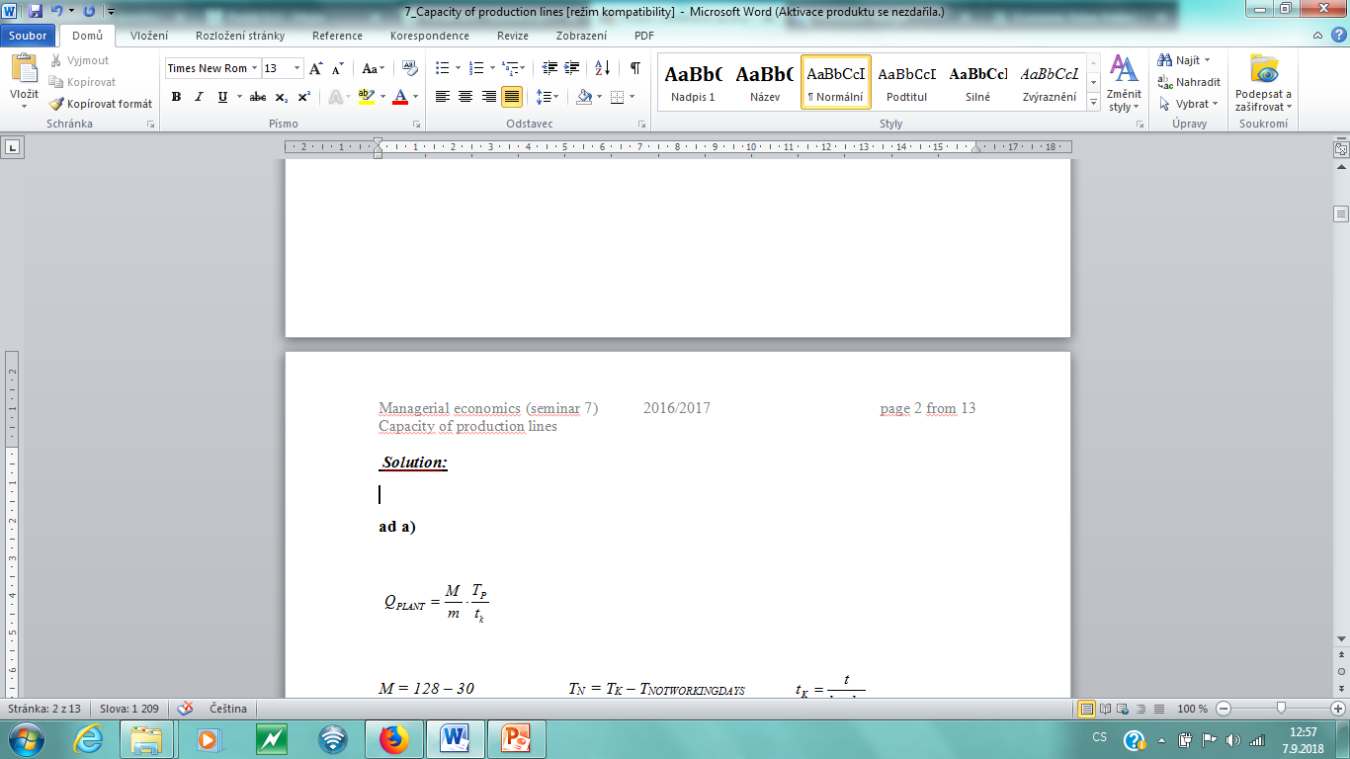
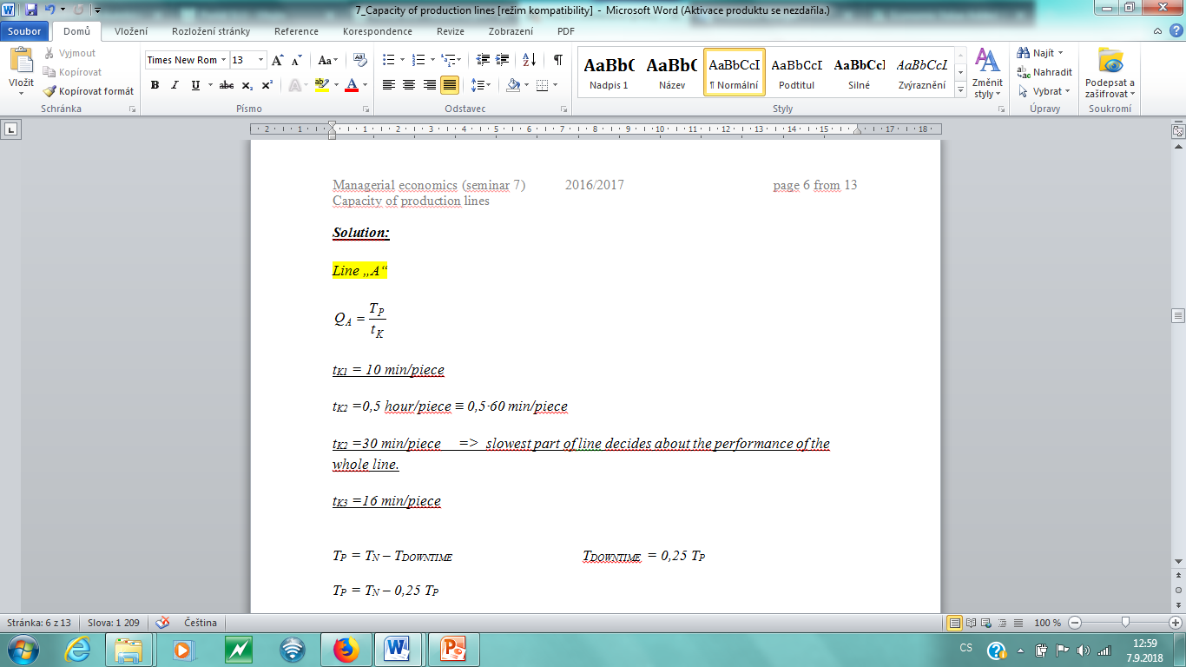
Production capacity
M – total area of workplace
m – workplace of one production unit
tK - standard laboriousness of one production unit

Slide 10
Production capacity
Output (operation) of production equipment is always considered as the maximum production per unit of time, usually one hour, at the standardized quality of the raw materials and the precise adherence to the technological process and the quality of the products. When determining it, it is based on the rating (rated output - indicated on a machine label), taking into account specific conditions. The output of the production equipment is needed to be expressed in the products as well as the production capacity.
The output of the production facility is determined on the basis of capacities that determine the maximum quantity of products which can be produced per unit of time on a given production facility.

Slide 11
Capacity of production units
When determining the production capacity of plants and other production units, into the account there must be taken how the sub-production capacities (machines, plants) are organized (sorted), that means if they are sorted:
parallel
serial

Slide 12
Capacity of production unit: parallel sorting of production aggregates

Slide 13
Serial sorting of production aggregates

Slide 14
Combined assembly of production units
Linka A

Slide 15
Economic problem: Production process in serially embossed manufacturing units
Equipment for the production of childeren´s inflatable mattresses consists of nine series-connected production units. The output of individual workplaces is listed in the „Scheme of manufacturing facility with series-connected units“
Production capacity of the plant is 4 200 pieces per month.
Determine:
a) The value of productive time fund T_{P}
b) How to change performance of selected production units in order to increase production capacity by 14,3 %?
c) Determine value of unfinished production in front of individual workplaces.
d)Determine production capacity of the device if the first workplace increase the operation (output) from 35 pieces/hour to 40 pieces/hour (using a new manufacturing technology).
e) Determine values of unfinished production in front of individual workplaces if operation of the first workplace increases the output from 35 pieces/hour to 40 pieces/hour?

Slide 16
Combined assembly of production units
Flowsheet of nodes in serially embossed manufacturing units
V = 43 pcs/ho 3
V = 45 pcs/hour 4
V = 40 pcs/hour 2
V = 42 pcs/hour 5
V = 41 pcs/hour 7
V = 39 pcs/ho 6
V = 39 pcs/ho 8
V = 38 pcs/ho 9
output
input
V=35 pcs/hour 1

Slide 17
Economic problem: Production process in serially embossed manufacturing units

Slide 18
Economic problem: Production process in serially embossed manufacturing units

Slide 19
Economic problem: Production process in serially embossed manufacturing units

Slide 20
Economic problem: Production process in serially embossed manufacturing units

Slide 21
Economic problem: Production process in serially embossed manufacturing units

