Slide 1

Development and Challenges of the European Economy
World Economy
Ingrid Majerova
Department of Economics and Public Administration
BASVE

Slide 2

Outline of the Lecture
History of European Economy before 1950
Development of „Modern“ European Economy
Challenges of EU
  – Economic Growth and Income Inequality
  – Digitalization and Knowledge Economy
  – Migration and Development Cooperation

Slide 3
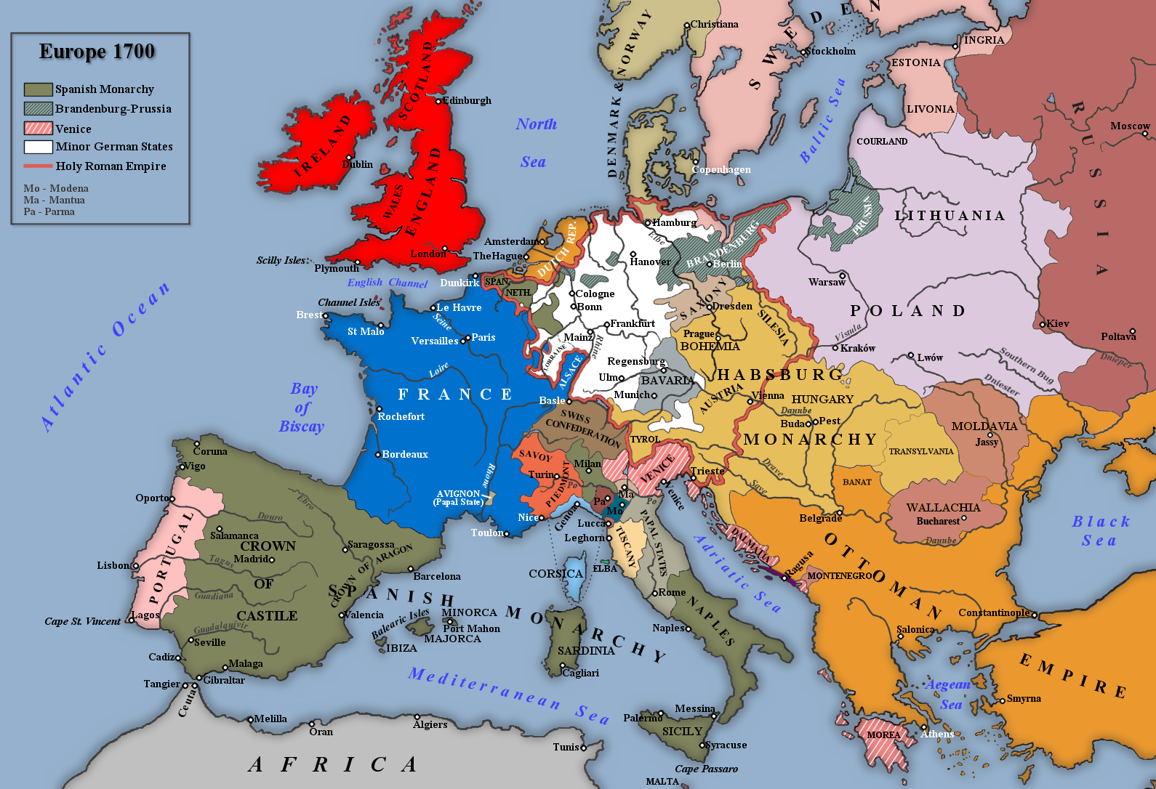
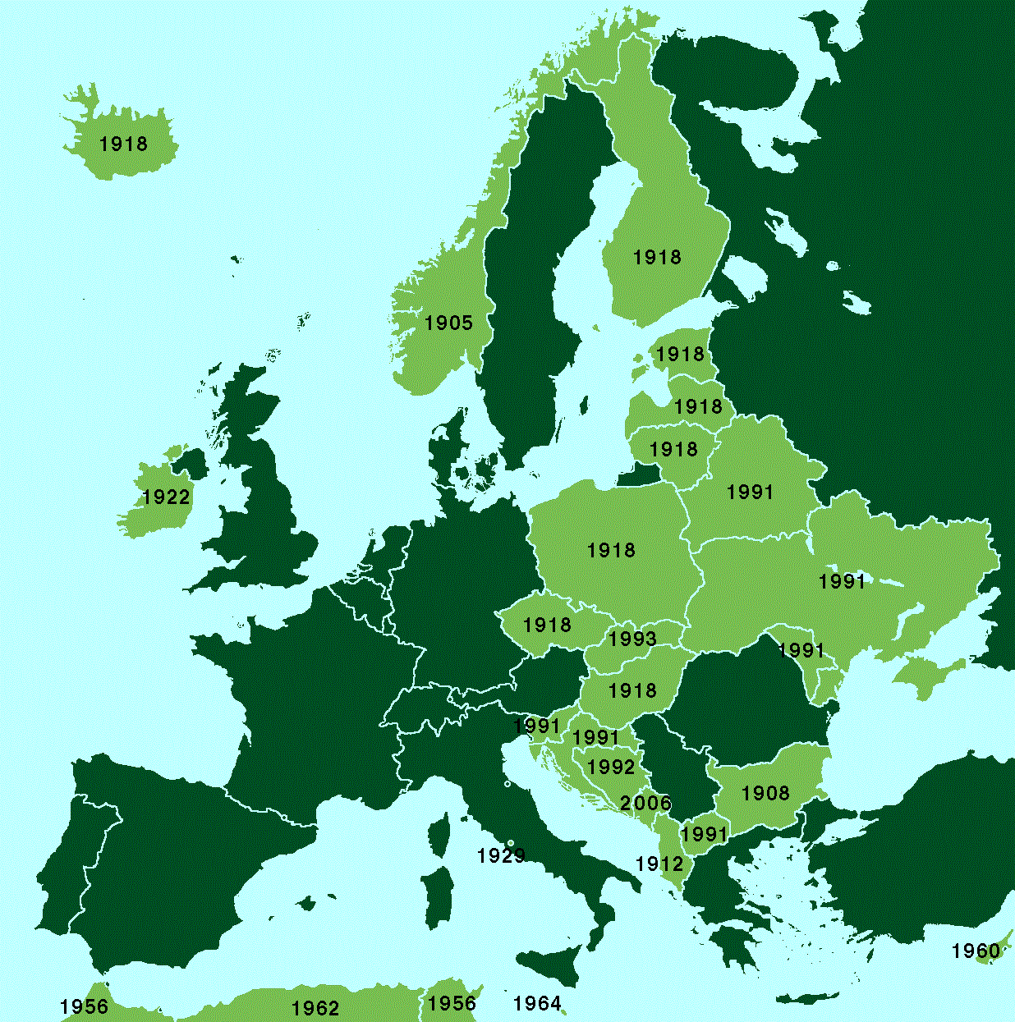
History of European Economy before 1950
Medieval
New Age
  to 19th Century
  1900-1945
  1945-1950

Slide 4
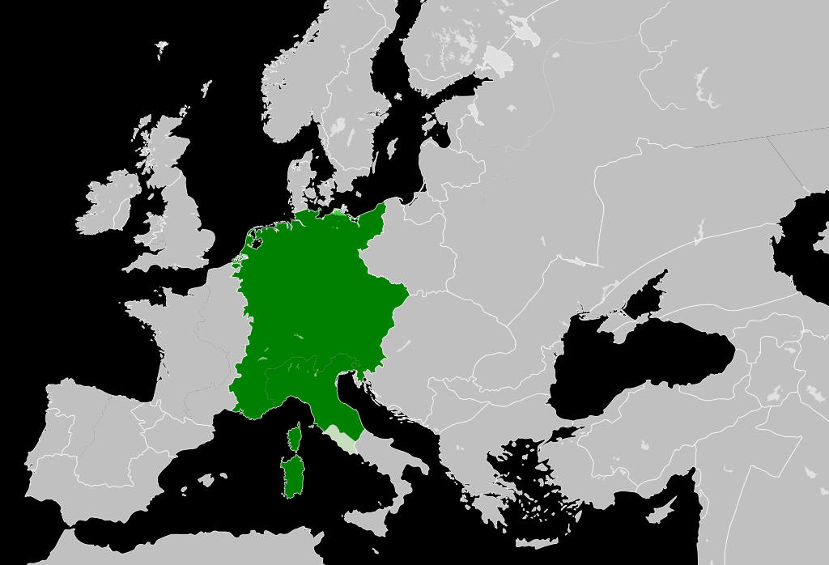
History of European Economy before 1950
The history of European integration is very extensive.
The effort to unite different European territories is as old as the history of European settlement. At this time, however, it was primarily a matter of the rulers' desire for power, rather than bringing European nations closer together for cooperation.
MEDIEVAL
Charlemagne (Charles the Great), the emperor of the Holy Roman Empire, initiated in 800 an attempt to re-create the Roman Empire.
The empire of Charlemagne included today's France, Switzerland, West Germany, Belgium, Luxembourg and the Netherlands. With the exception of Switzerland, these are the five founding members of the current European Community, only Italy is missing, wich was also part of the empire in the north.
Charlemagne introduced the single currency, which was only introduced again in the form of the euro after 1,200 years.
After his death in 814, the group began to disintegrate and in 843 it was divided.

Slide 5
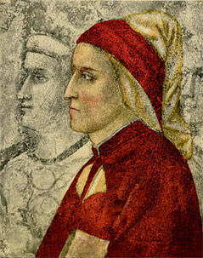
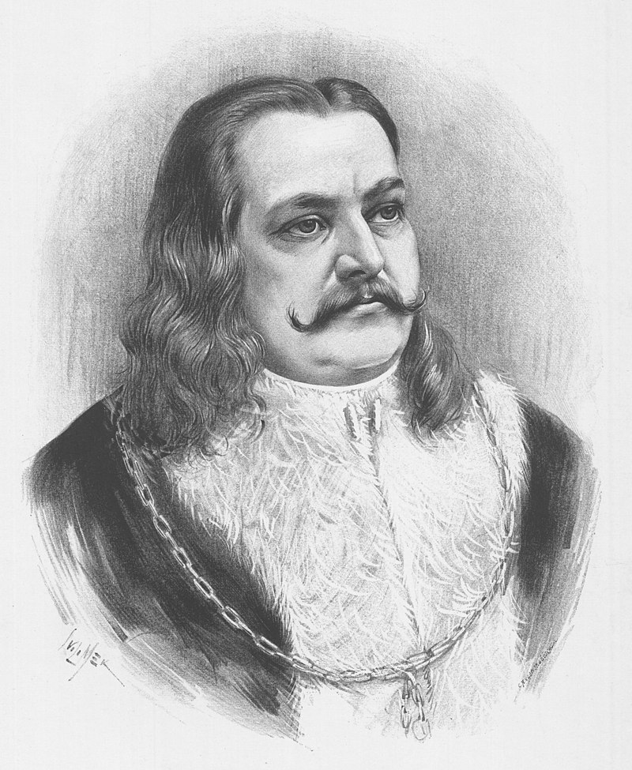
History of European Economy before 1950
In 1310, Dante Alighieri, in his book The Monarch, called for the creation of European institutions to prevent wars in Europe.
  The most important representative of world literature (Author of the Divine Comedy), the father of standard Italian.
George of Podebrady was the Czech king who in 1462 proposed the creation of a European confederation to face the advancing Turks. The Confederate organization was to meet regularly with a five-year presidential rotation (today's EU presidency is six months).
For its realization, serious diplomatic negotiations took place among European states in the years 1462-1464.
The plan of King George of Podebrady was proposed in the form of a multilateral agreement (common were the bilateral agreement).

Slide 6
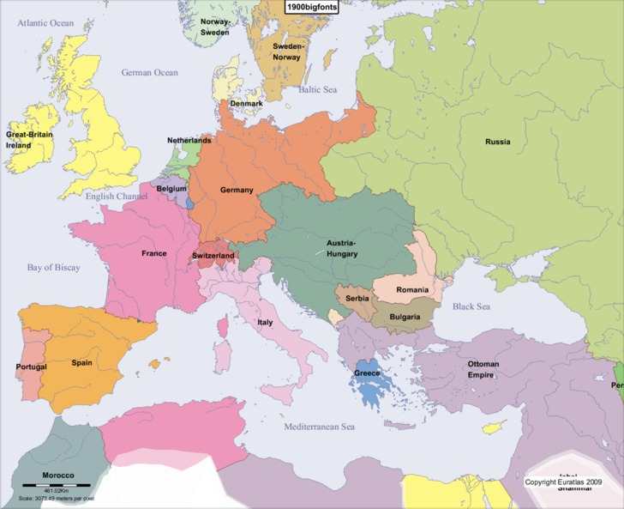
History of European Economy before 1950
NEW AGE (till the year 1900)
The French statesman Maximilien de Béthune, Duke de Sully, the first minister of King Henry IV, presented his "Grand Design" in 1638, which consisted of redrawing the borders to ensure a balance of power in Europe.
In 1693, William Penn proposed a provision for a European Parliament that resolved disputes between European states using a qualified majority.
  The number of votes of individual states corresponded to their economic strength (for example, Germany - 12 votes, France - 10 votes, England - 6 votes).
In 1717, the Abbé de Saint-Pierre published a three-volume project called the Project for the Establishment of Lasting Peace in Europe, which was to promote free trade, the establishment of a European Senate and common defense.
From 1712 to 1778, Jean-Jacques Rousseau was a supporter of the European Federal Union of Nations.
In 1795, Immanuel Kant proposed the adoption of a European constitution, as well as a unified legal system. He saw the creation of a federation as the only way to peace in Europe.

Slide 7
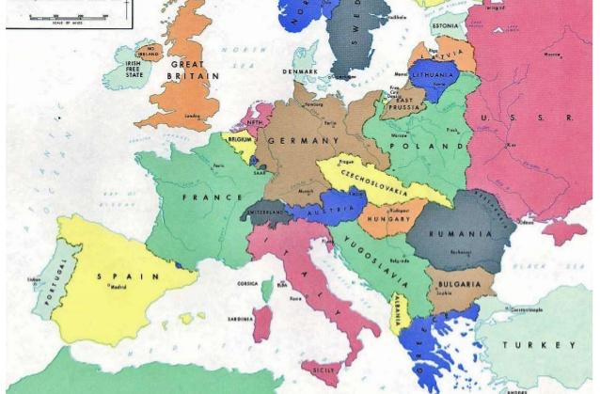
History of European Economy before 1950
NEW AGE (1900-1945)
In 1921, BLEU (Belgian-Luxembourg Economic Union), which had a common central bank, a strong exchange of currencies and a common foreign trade.
In 1930, Aristide Briand, the French Foreign Minister, advocated the idea of creating a European Confederation to operate within the United Nations.
In 1940, Franco-British Union - Jean Monnet, who was the economic agent of French General Charles de Gaulle and Winston Churchill, Prime Minister of the United Kingdom, proposed that the French and British governments establish common defense policies and common foreign policies.
1939-1945 - World War II was a strong impetus for Europeans to create interconnections between European nations, mainly to prevent further possible bloodshed.

Slide 8
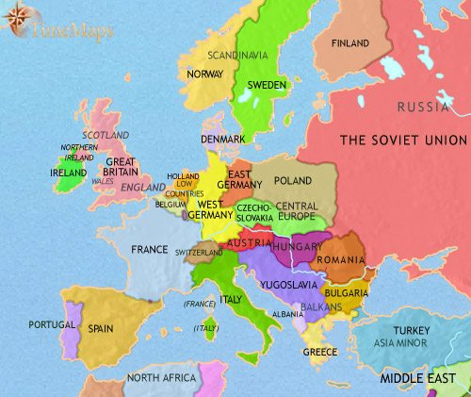
History of European Economy before 1950
NEW AGE (1945-1950)
In 1943, Jean Monnet said: "European states must form a federation together", similar as Whinston Churchill in 1946.
In 1944, Belgium, the Netherlands and Luxembourg (Benelux) agreed to create a customs union, which was not created until 1948.
The Council of Europe was established in 1949 as a result of an international conference attended by representatives of Belgium, Denmark, France, Italy, Ireland, the Netherlands, Luxembourg, Sweden, Norway and the United Kingdom. All these representatives signed the so-called London Treaty.
The Council of Europe was to promote economic, cultural development, human rights and democratic values.
Gradually, these rights were transferred to other organizations, leaving only the area of cultural knowledge of European nations and the promotion of democracy in the newly democratizing states to the Council of Europe.

Slide 9
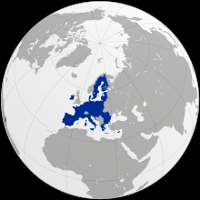
Development of „Modern“ European Economy
The first period - 50s to 60s
The second period - 70s and 80s
The third period - from the 90s

Slide 10
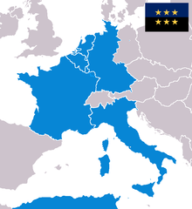
Development of „Modern“ European Economy
First Period (50th – 60th of 20th Century)
In 1950, Robert Schuman, the French Foreign Minister, symbolically presented a proposal for a united Europe, now known as the Schuman Declaration - beginning with the creation of the Montan Union, which will result in the creation of the European Federation.
  Based on the ideas of J. Monnet.
The European Coal and Steel Association (ECSC), sometimes referred to as the Montan Union (from the word "montanní" - mining) was established by the Treaty of Paris as an international organization between 6 states in 1952 for a period of fifty years.
  It can be considered the basis of the European Union.
The ECSC was to create a common market between the states for trade in coal and steel and to control their production in Germany (to eliminate the danger of another war).

Slide 11
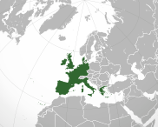
Development of „Modern“ European Economy
First Period (50th – 60th of 20th Century)
In 1957, the so-called Treaties of Rome (in force since 1958) establishing the European Economic Community (EEC) and the European Atomic Energy Community (Euratom) were signed.
The EEC was tasked with establishing a common market and Euratom cooperation in the peaceful uses of nuclear energy.
From 1 November 1993, the EEC became the European Community, ceased to exist in 2009 and was succeeded by the EU.
The founding members of the EEC and EURATOM were the same countries as in the case of the ECSC: France, Germany, Italy and the Benelux countries.

Slide 12
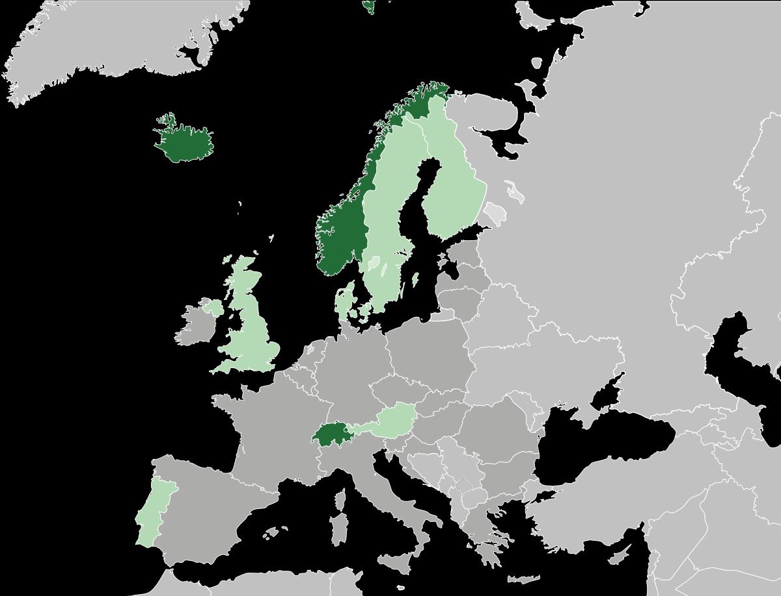
Development of „Modern“ European Economy
First Period (50th – 60th of 20th Century)
In 1960, the European Free Trade Association (EFTA) was established.
EFTA was created as a counterweight to the EEC and its mission is to promote prosperity and economic cooperation between its members.
The founding members were Denmark, Norway, Portugal, Austria, Sweden, Switzerland and the United Kingdom; now Iceland, Liechtenstein, Norway and Switzerland.
The European Union concluded an agreement with the European Free Trade Association in Porto in 1992 to establish a common European Economic Area.
In 1967, the Treaty on the Merger of the EEC, Euratom and ECSC Institutions (the so-called Merger Treaty) entered into force, but their legal personality was not affected. Since then, the three groupings have come to be collectively called the European Communities.

Slide 13
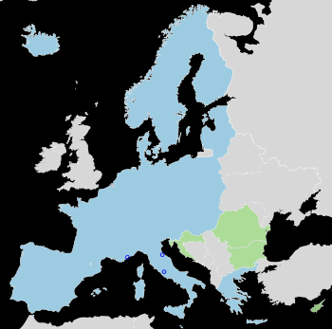
1975 byl zřízen Účetní dvůr
Development of „Modern“ European Economy
Second Period (70th – 80th of 20th Century)
The 1970s were marked by a raw material and energy crisis caused by a drastic reduction in oil supplies from the Gulf states.
In 1975, the Court of Auditors was set up.
In 1979, the first direct elections to the Parliamentary Assembly took place.
The European Monetary System (EMS), which existed in the countries of the European Economic Community from 1979 to 1999, in order to maintain stable exchange rates between the currencies of these countries.
ECU European Currency Unit - 1979 to 1999 - replaced by EUR.
In 1985 - Schengen area - 26 member states (persons can cross borders without border control) - not only the member states of the EU (Iceland, Norway, UK (partly), Switzerland, Liechtenstein)
  The signatory countries were Germany, France, Belgium, the Netherlands and Luxembourg.

Slide 14
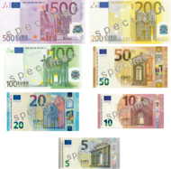
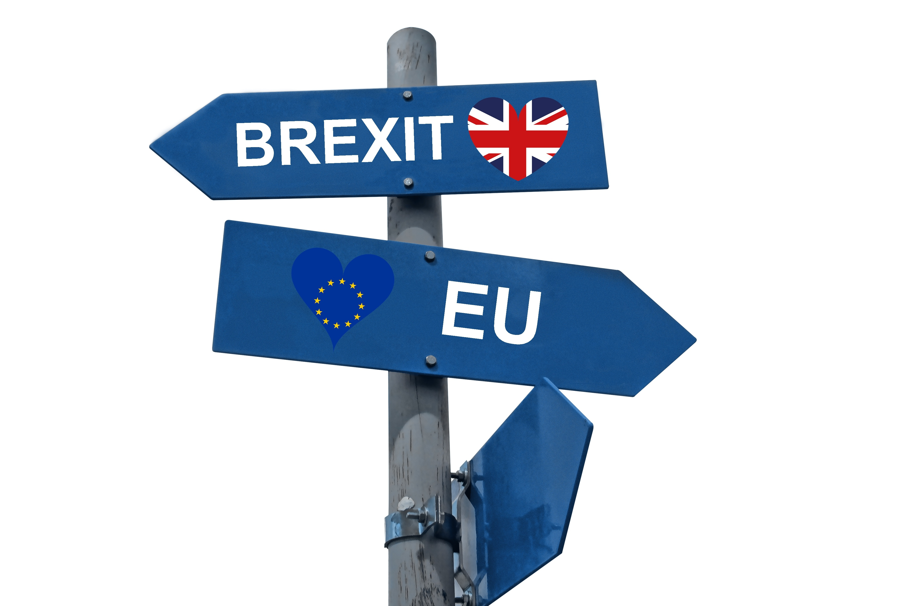
Development of „Modern“ European Economy
Third Period (from the 90th of 20th Century)
In 1993 Maastricht - the common foreign and security policy and justice
The European Union was created with the signing of the Maastricht Treaty.
In January 1999, 11 European Union countries (Benelux, Finland, France, Ireland, Italy, Germany, Portugal, Austria, Spain) agreed to adopt the single currency and to stop using their national currencies (cashless transactions).
  From 1 January 2002, euro coins and banknotes went into circulation.
As of 31 January 2020, the United Kingdom withdrew from the European Union = BREXIT (discussions about it from 1973).
From 1 February 2020, the United Kingdom was in a so-called transitional period, during which a number of commitments to the EU were needed - it ended on 2 January 2021.

Slide 15
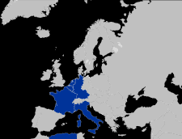
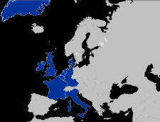
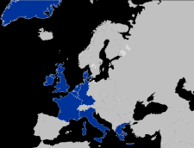
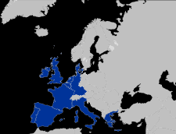
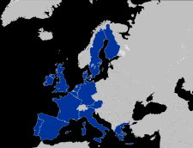
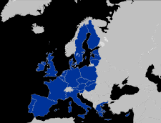
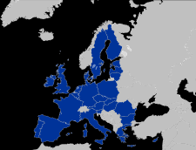
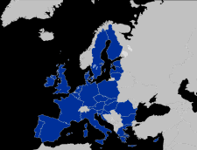
Development of „Modern“ European Economy
The Process of EnlargemEnt of European Economy
1952–58: founding states: Belgium, France, Italy, Luxembourg, Germany, the Netherlands
1973 – first enlargement: Denmark*, Ireland, UK
(*Greenland resigned 1985)
1981 – second enlargement ("southern"): Greece
1986 – third enlargement ("southern"): Portugal, Spain
2004 – fifth enlargement ("eastern"): Czechia, Estonia, Cyprus, Lithuania, Latvia, Hungary, Malta, Poland, Slovakia and Slovenia
2007 – sixth enlargement ("second east"): Bulgaria, Romania
2013 – seventh enlargement: Croatia
1995 – fourth enlargement ('northern'): Finland, Austria, Sweden

Slide 16
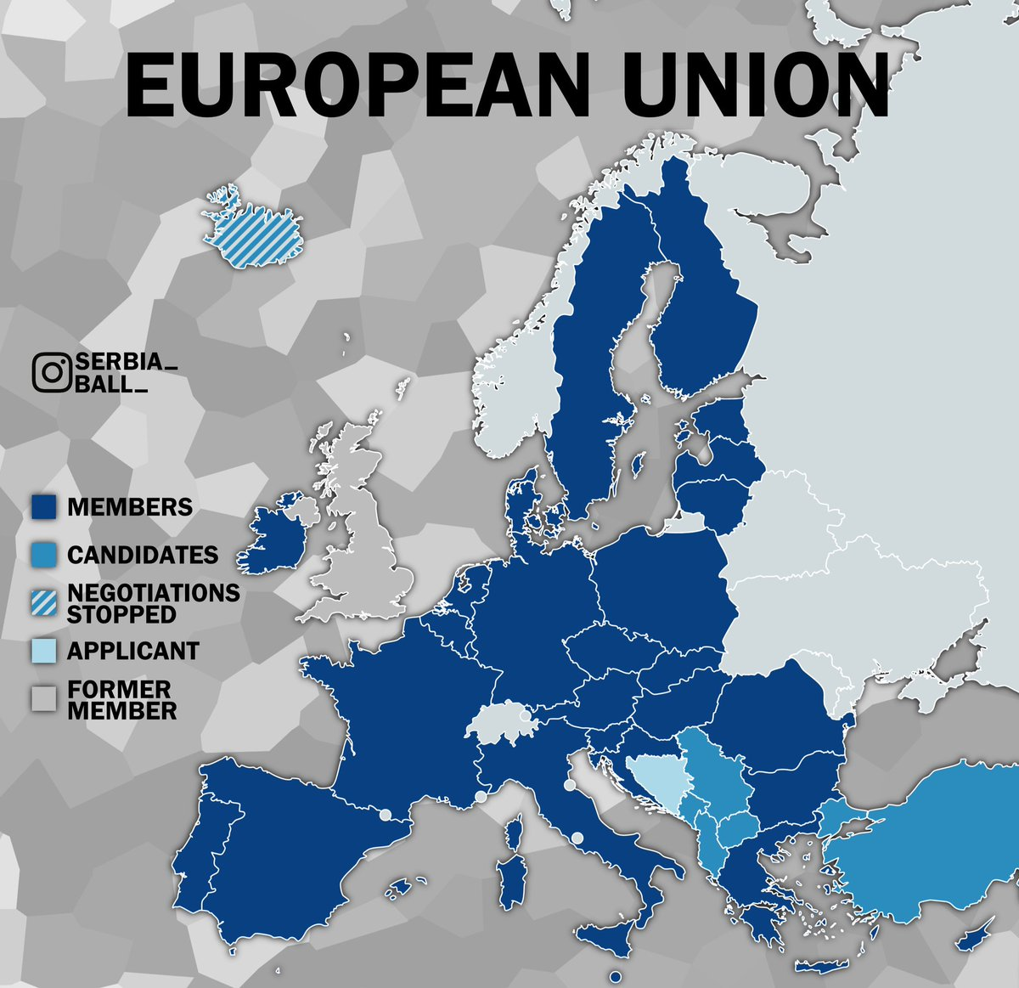
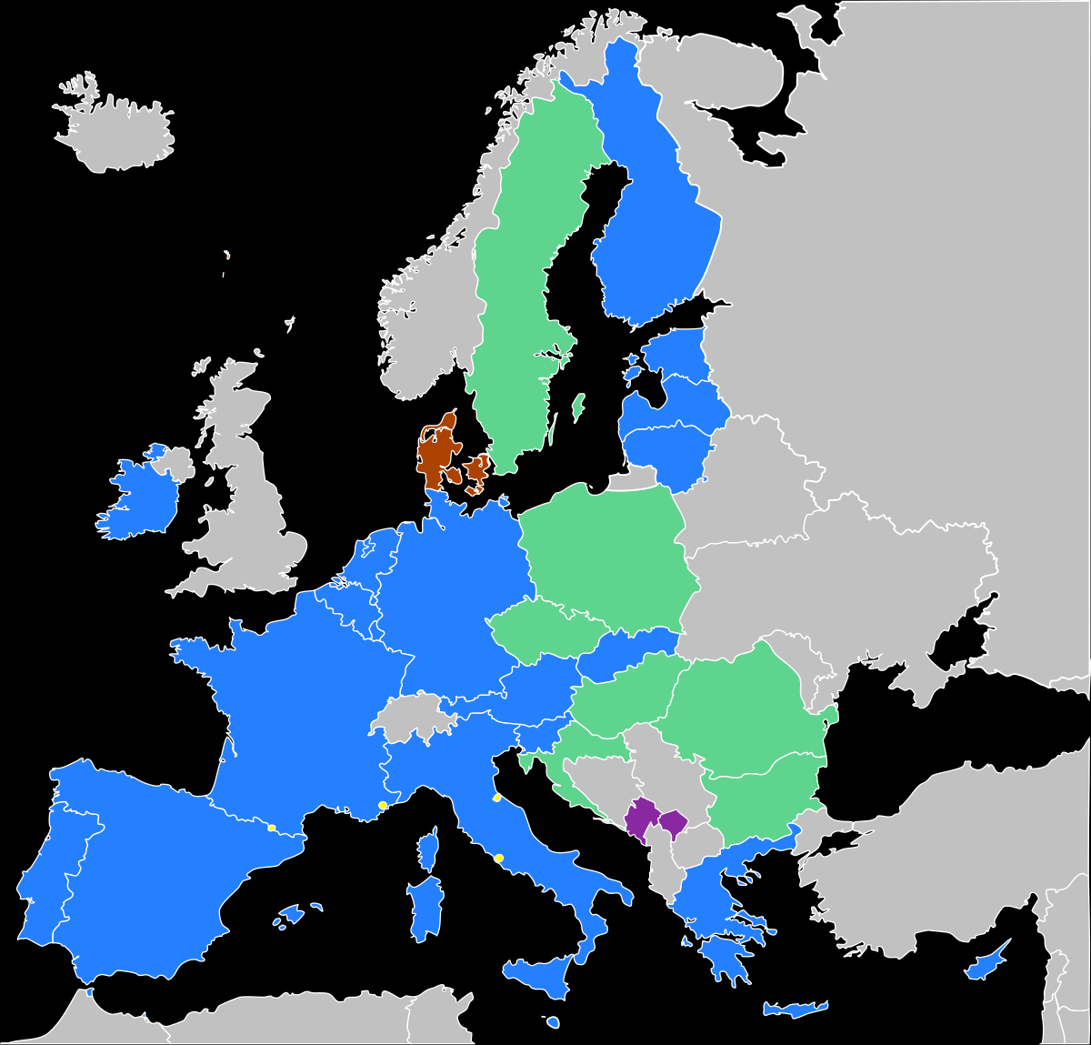
Development of „Modern“ European Economy
European Union in 2021 (27)
Eurozone (19)

Slide 17

Challenges of European Union
Economic Growth and Income Inequality
Digitalization and Knowledge Economy
Migration and Development Cooperation

Slide 18
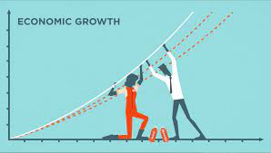
Economic Growth and Income Inequality
Economic growth is connected with decrease in poverty, but as inequalities in income increase, poverty also increases.
The connection between economic growth, inequality and poverty represents one of the most discussed topics in world economics.
  A high level of inequality in conjunction with economic growth in some EU countries may lead to greater levels and occurrences of relative poverty. As such, reducing the number of people who live below the at-risk-of-poverty threshold represents one of the main goals of the European policy.
The less economically developed countries have tended to record the most significant economic growth, owing in large part to their relatively cheap labour force and low economic ‘start’ position. In general, a positive correlation exists between location in the East and relative GDP growth per capita.
From 2005 until 2015, few countries recorded a growth of more than 100 per cent:
  Romania (113 per cent), Lithuania (105 per cent), Bulgaria (103 per cent) and Latvia (102 per cent), followed by Slovakia (99 per cent) and Estonia (86 per cent).
The lowest GDP growth was primarily recorded in Southern European (Mediterranean) countries:
  Cyprus (2 per cent), Italy (5 per cent), Spain (9 per cent), as well as Portugal (15 per cent), France (17 per cent) and the United Kingdom (UK) (19 per cent).

Slide 19
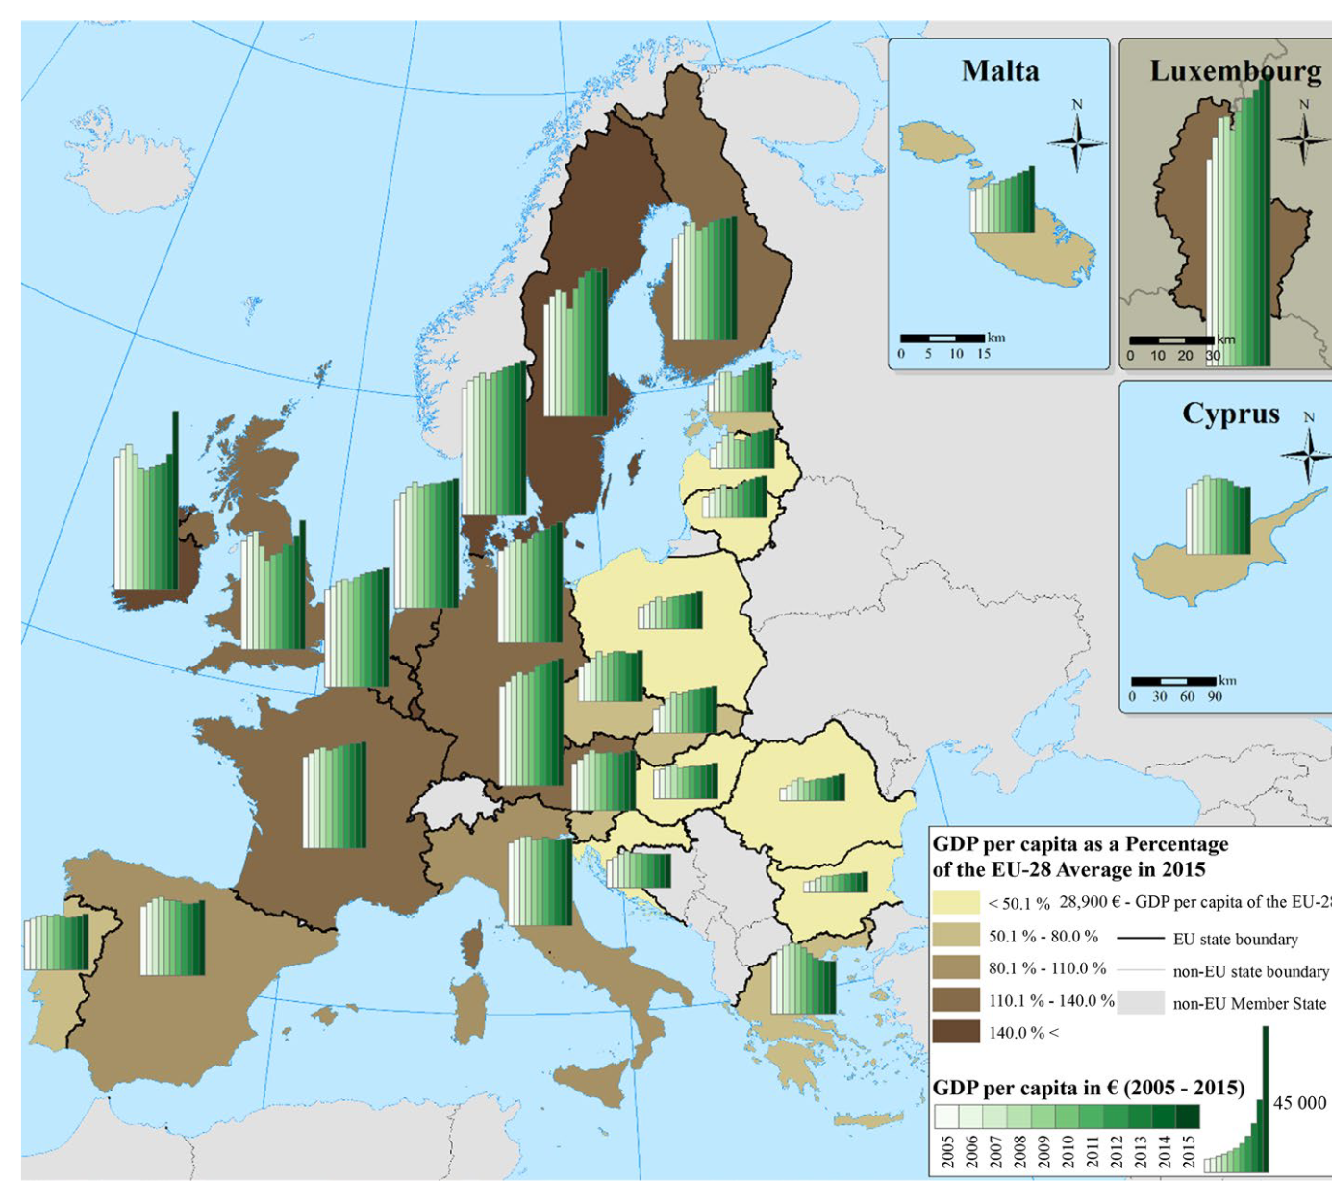
Economic Growth and Income Inequality
Fig. 1: GDP per capita across EU member states Source: Eurostat (2017)
The average GDP growth within the EU was 24 per cent during this period (2005-2015).

Slide 20
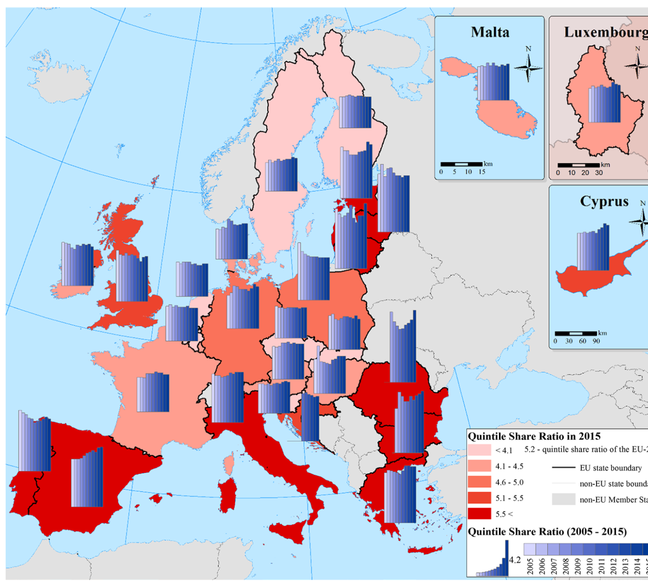
Economic Growth and Income Inequality
Fig. 2: Quintile share ratio in EU member states Source: Eurostat (2017)
The highest rates of inequality might be seen in the countries with both, very high and very low (or even negative) GDP growth.
  the highest quintile share ratio was recorded in Romania in 2015 (8.3)
  the lowest values in 2015 were recorded in the Czech Republic and Slovakia (both 3.5)

Slide 21
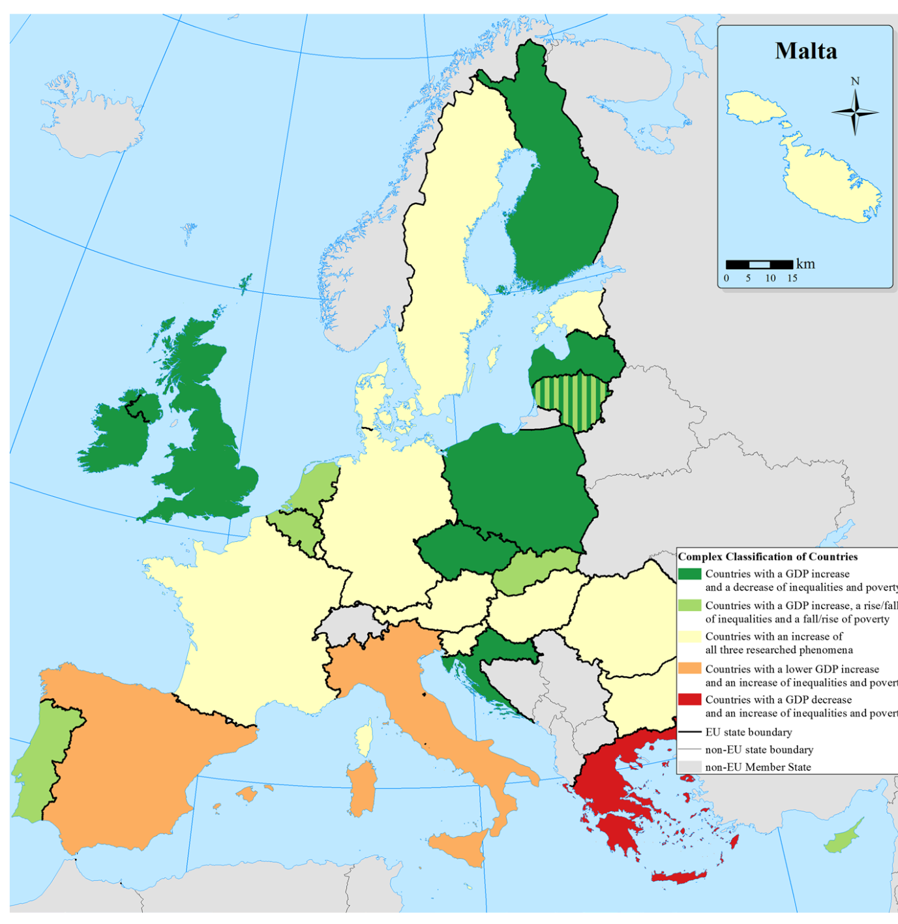
Economic Growth and Income Inequality
Fig. 3: The complex classification of EU member states by the three indices Source: Michalek and Vybostok (2019)
Seven countries with high relative GDP growth and a decrease of inequalities and poverty - ‘the most positive’ development of three phenomena (GDP, inequality and poverty) in dark green colour.

Slide 22


Digitalization and Knowledge Economy
Digital economy
Economy that is based on digital computing technologies, although we increasingly perceive this as conducting business through markets based on the internet.
Internet Economy, New Economy, or Web Economy
It is based on the interconnectedness of people, organizations, and machines that results from the Internet, mobile technology and the internet of things (IoT).
Knowledge-based economy
Economy, where knowledge is created, acquired, transmitted and used effectively by businesses, organizations, individuals and communities.
  An educated and skilled labour force
  Easy access to ICT
  A great level of innovations

Slide 23
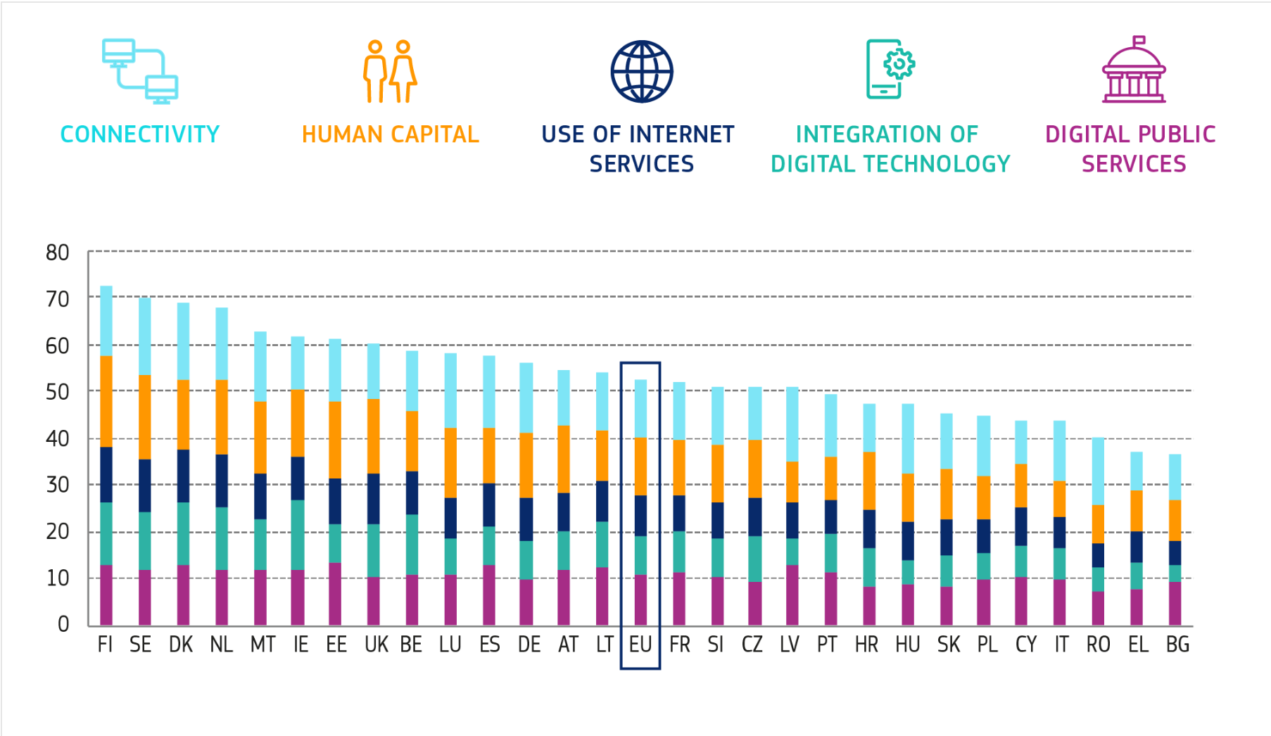
Digitalization and Knowledge Economy
Since 1995, information and communication technologies (ICTs) have driven productivity gains and growth in the EU
The Digital Economy and Society Index (DESI) is a composite index that summarises relevant indicators on Europe’s digital performance and tracks the evolution of EU Member States in digital competitiveness.

Slide 24
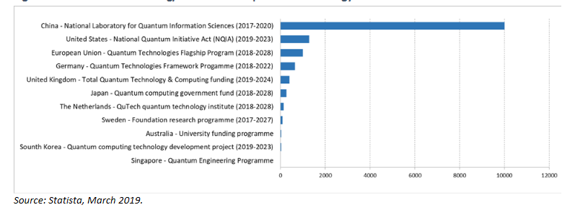
Digitalization and Knowledge Economy
Quantum technology
  exploit the properties of quantum mechanics and physics to solve complex problems much faster or much better than traditional methods.
  They make (properties) possible the development of radically new technologies in computing, communication, security, and sensing.
Fig. 4: Government funding/investment in quantum technology

Slide 25
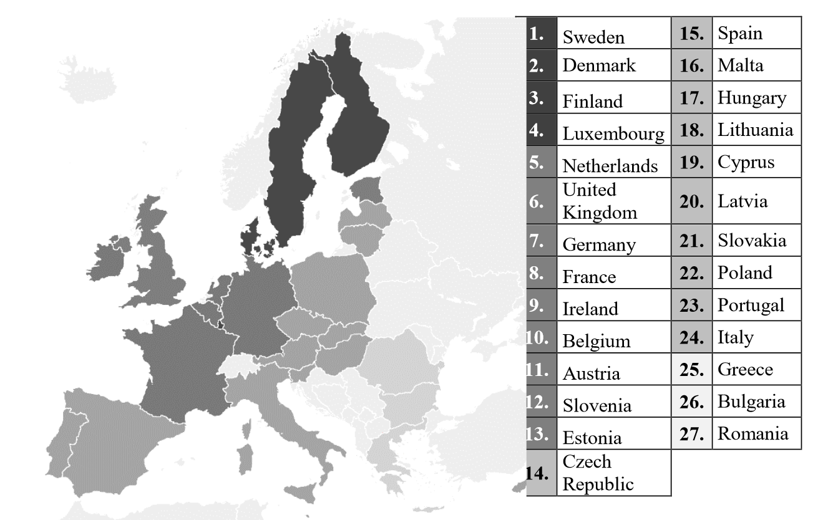
Digitalization and Knowledge Economy
Knowledge-based Economy
  Measurement/Index with Indicators as FDI, exports, R&D expedintures, tertiary educated people, share of researchers, internet access, GDP per capita, GINI coefficient
Fig. 5: The level of development of the knowledge-based economy in the EU

Slide 26
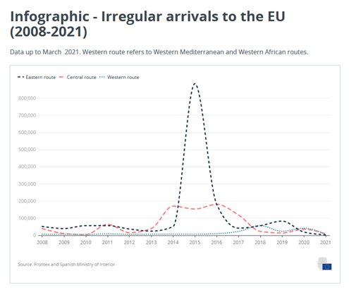
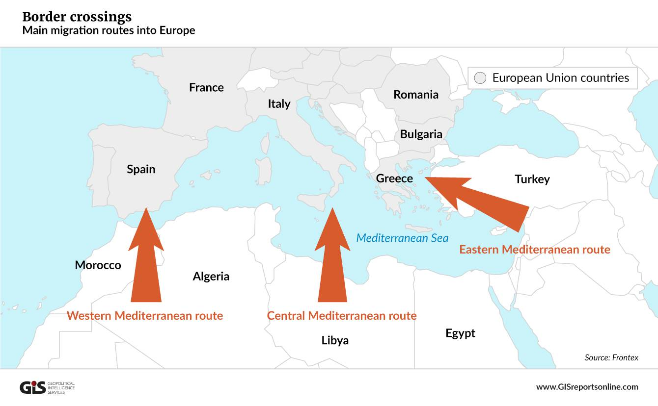
Migration and Development Cooperation
IRREGULAR ARRIVALS
In 2021, the top nationalities of irregular arrivals were:
  Tunisia (2 374) on the Central route,
  Syria (583) on the Eastern route and
  Algeria (1 748) on the Western route
Total irregular arrivals to the EU have dropped from 1.04 million in 2015 to 96 449 in 2020.
In 2021, 18 263 irregular arrivals have been registered.

Slide 27
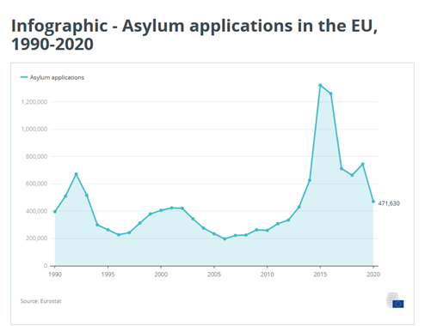
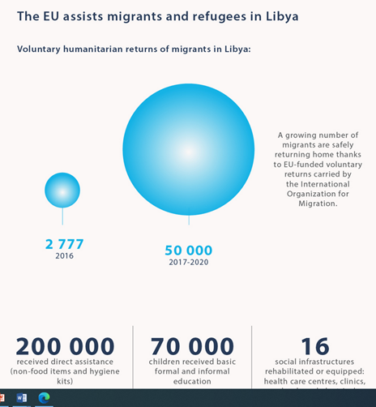
Migration and Development Cooperation
Asylum
The applications reached a peak in 2015 and 2016 and dropped between 2017 and 2020.
The decrease in 2020 is partly due to the fact that the UK is no longer part of the EU.

Slide 28
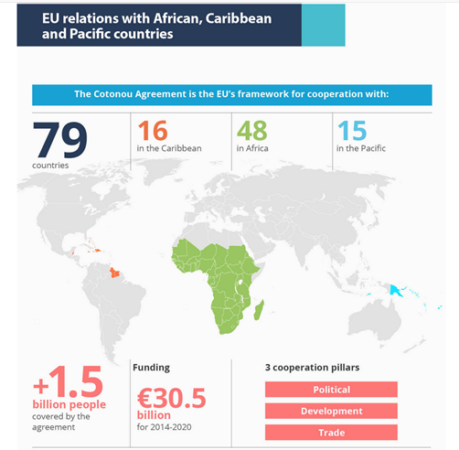
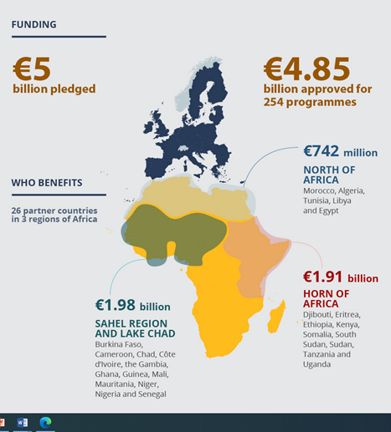
Migration and Development Cooperation
The Emergency Trust Found for Africa

Slide 29
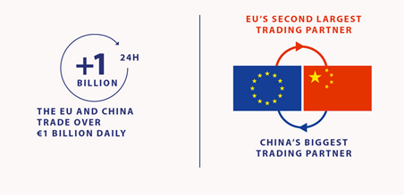
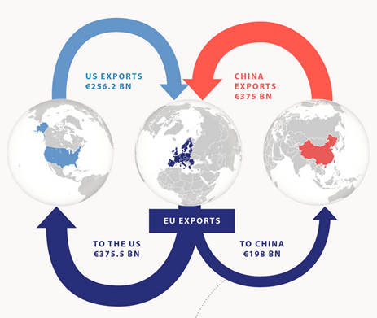

EU and China Relationships

Slide 30
The End….
THANKS FOR YOUR ATTENTION….

