Slide 1

MACROECONOMICS AND MACROECONOMIC MODELS
LESSON I
Dr. Ingrid Majerová
MACROECONOMICS/EVS/NAMAB

Slide 2
INTRODUCTION TO MACROECONOMICS
Outline of the lecture
History of Macroeconomics
Macroeonomic Concerns
Components of Macroeconomy
Overview of Macro Models

Slide 3
INTRODUCTION TO MACROECONOMICS
MICRO AND MACRO ECONOMICS
Microeconomics examines the behavior of individual decision-making units—business firms and households.
Macroeconomics deals with the economy as a whole
  It examines the behavior of economic aggregates such as aggregate income, consumption, investment, and the overall level of prices.
  Aggregate behavior refers to the behavior of all households and firms together.
Macroeconomics often reflects on the microeconomic principles underlying macroeconomic analysis, or the microeconomic foundations of macroeconomics.

Slide 4
INTRODUCTION TO MACROECONOMICS
MICRO AND MACRO ECONOMICS
Microeconomists generaly conclude that markets work well.
Macroeconomists observe that some important prices often seem „sticky“.
Sticky prices are prices that do not always adjust rapidly to maintain the equality between quantity supplied and quantity demanded.

Slide 5
INTRODUCTION TO MACROECONOMICS
History of macroeconomics
Classical economists applied microeconomic models, or “market clearing” models, to economy-wide problems.
However, simple classical models failed to explain the prolonged existence of high unemployment during the Great Depression.
  This provided the impetus for the development of macroeconomic.
The Great Depression was a period of severe economic contraction and high unemployment that began in 1929 and continued throughout the 1930s.

Slide 6
INTRODUCTION TO MACROECONOMICS
great depression IN US

Slide 7
INTRODUCTION TO MACROECONOMICS
History of macroeconomics
In 1936, John Maynard Keynes published The General Theory of Employment, Interest, and Money.
Keynes believed governments could intervene in the economy and affect the level of output and employment.
  During periods of low private demand, the government can stimulate aggregate demand to lift the economy out of recession.
Walter Heller used the phrase fine-tuning to refer to the government’s role in regulating inflation and unemployment.
  The use of Keynesian policy to fine-tune the economy in the 1960s, led to disillusionment in the 1970s and early 1980s.

Slide 8
INTRODUCTION TO MACROECONOMICS
History of macroeconomics
Lord Keynes developed a theory in which prices failed to adjust quickly so that a fall in corporate investment or a rise in savings leads to a decline in output.
Hicks developed IS-LM model, a mathematical version of Keynes thinking which is still the baseline framework for thinking about business cycles.
For 20-30 years, most macroeconomics was about measuring the gap between demand and potential output and stimulating demand sufficiently to reach potential.

Slide 9
INTRODUCTION TO MACROECONOMICS
History of macroeconomics
During the 1950’s, macro conceptually split changes in output into two parts:
Long-term growth which would be studied in models in which prices adjust perfectly to economic conditions.
Business Cycles which would be studied in models in which they would not. Advances in computation and statistics meant that large models could be constructed meant to represent large economies.

Slide 10
INTRODUCTION TO MACROECONOMICS
History of macroeconomics
Internationally, 1950’s and 1960’s were a period when output growth was at a faster pace than before the war.
Also a period in which there was relatively little international trade in goods and capital compared to pre-war period.
Fixed exchange rates under Bretton Woods agreement.

Slide 11
INTRODUCTION TO MACROECONOMICS
History of macroeconomics
Neo-classical synthesis
Growing prominence of optimization theory and marginal analysis in microeconomics led to incorporation into macroeconomic models.
Optimal models of saving, investment and demand for liquidity were used to describe a medium term equilibrium around which the economy would fluctuate in the short-run.

Slide 12
INTRODUCTION TO MACROECONOMICS
History of macroeconomics
Monetarism
In 1960’s, monetarists led by Milton Friedman began to emphasize the role of the money supply (as opposed to real demand factors) as determinants of fluctuations in output and especially inflation.
In particular, Friedman pointed out the way that demand stimulus, once it becomes expected may lose its effectiveness.

Slide 13
INTRODUCTION TO MACROECONOMICS
History of macroeconomics
Stagflation
During 1970’s, oil price shocks led to rapid price rises and low production levels called stagflation.
In many country’s, inflationary expectations led to wage-price spirals and historically high inflation rates.
Developed economies begin 20 year slowdown in productivity growth rates.

Slide 14
INTRODUCTION TO MACROECONOMICS
History of macroeconomics
Rational Expectations
Robert Lucas develops economic theories which rigorously incorporate the formation of expectations of future in economic models.
Rational expectations models offer theoretical challenges but also explanations for rise of inflationary spirals and seeming ineffectiveness of monetary policy.
Expectations based models also offer explanation for volatility of exchange rates.

Slide 15
INTRODUCTION TO MACROECONOMICS
History of macroeconomics
Real Business Cycles
Finn E. Kydland and Edward Ch. Prescott developer real business cycle (RBC) models which unify long-run, medium-run and short-run into single coherent model.
One shortcoming of these models is that money plays no role in short-run.
Model does not capture short-run dynamic well.

Slide 16
INTRODUCTION TO MACROECONOMICS
History of macroeconomics
New Keynesian Models
Using rigorous models of monopoly, a number of economists develop rigorous models in which prices are sticky because of adjustment costs.
Unlike RBC models, these models can explain why monetary policy has significant effects on output.
These models are typically static and cannot explain dynamics or long-run at all.

Slide 17
INTRODUCTION TO MACROECONOMICS
History of macroeconomics
New Neo-classical Synthesis
Economists begin to incorporate New Keynesian models of price stickiness into unified RBC framework.
These models explain which type of policies can offset effects of price-stickiness which might lead to underemployment without leading to wage-price spirals.
Economists also incorporate models of financial market imperfections into unified framework to explain financial crises in emerging markets.

Slide 18
INTRODUCTION TO MACROECONOMICS
MACROECONOMIC CONCERNS
Three of the major concerns of macroeconomics are:
  Inflation
  Output growth
  Unemployment

Slide 19
INTRODUCTION TO MACROECONOMICS
INFLATION….
Inflation is an increase in the overall price level.
Hyperinflation is a period of very rapid increases in the overall price level. Hyperinflations are rare, but have been used to study the costs and consequences of even moderate inflation.
Deflation is a decrease in the overall price level. Prolonged periods of deflation can be just as damaging for the economy as sustained inflation.
Stagflation occurs when the overall price level rises rapidly (inflation) during periods of recession or high and persistent unemployment (stagnation).

Slide 20
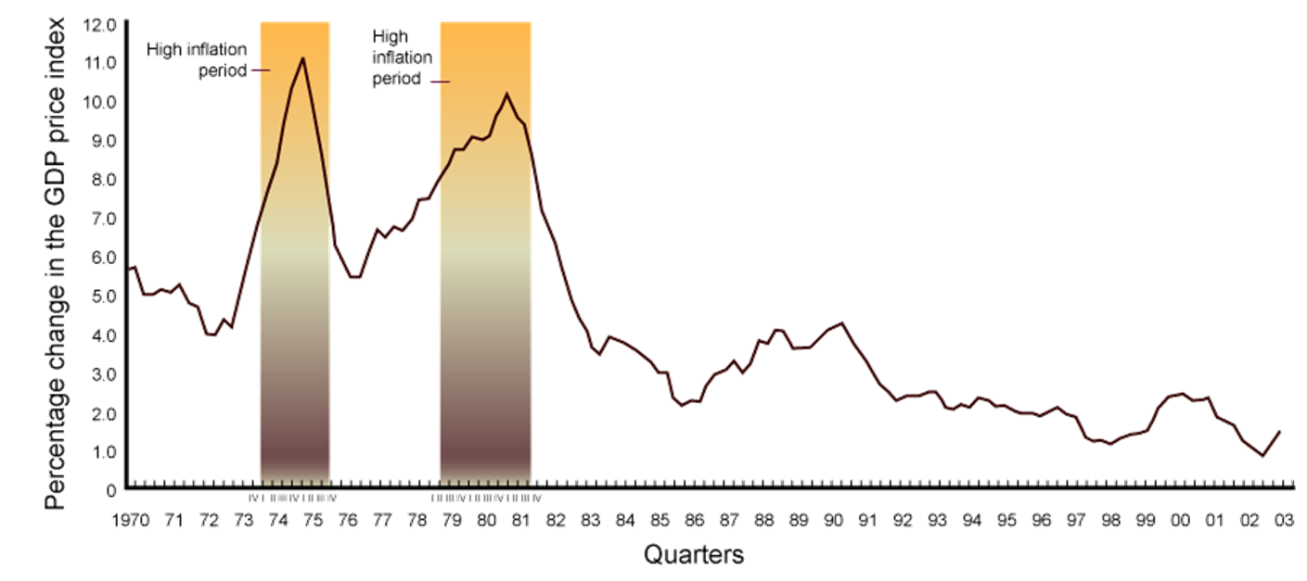
INTRODUCTION TO MACROECONOMICS
INFLATION (% change of GDP deflator) of usa

Slide 21
INTRODUCTION TO MACROECONOMICS
OUTPUT GROWTH – SHORT RUN
The main measure of how an economy is doing is aggregate output:
  Aggregate output is the total quantity of goods and services produced in an economy in a given period.
The business cycle is the cycle of short-term ups and downs in the economy.

Slide 22
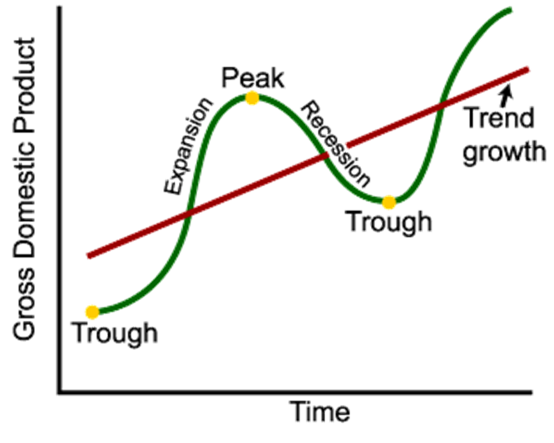

INTRODUCTION TO MACROECONOMICS
OUTPUT GROWTH – SHORT RUN
An expansion, or boom, is the period in the business cycle from a trough up to a peak, during which output and employment rise.
A contraction, recession, or slump is the period in the business cycle from a peak down to a trough, during which output and employment fall.

Slide 23
INTRODUCTION TO MACROECONOMICS
OUTPUT GROWTH – LONG RUN
A recession is a period during which aggregate output declines. Two consecutive quarters of decrease in output signal a recession.
A prolonged and deep recession becomes a depression.
Policy makers attempt not only to smooth fluctuations in output during a business cycle but also to increase the growth rate of output in the long-run.

Slide 24
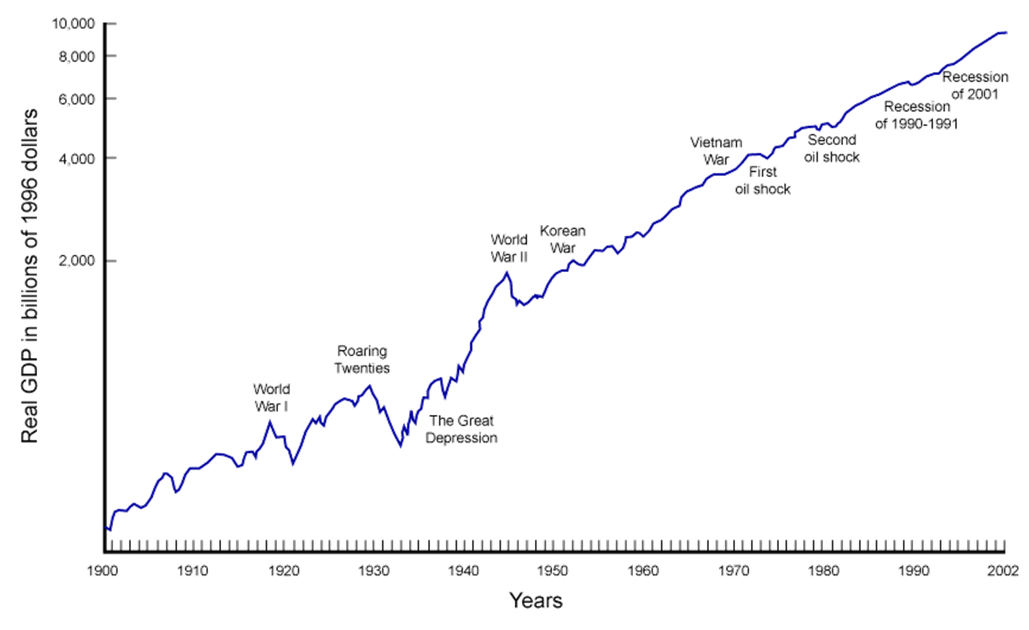
INTRODUCTION TO MACROECONOMICS
OUTPUT GROWTH of usa

Slide 25
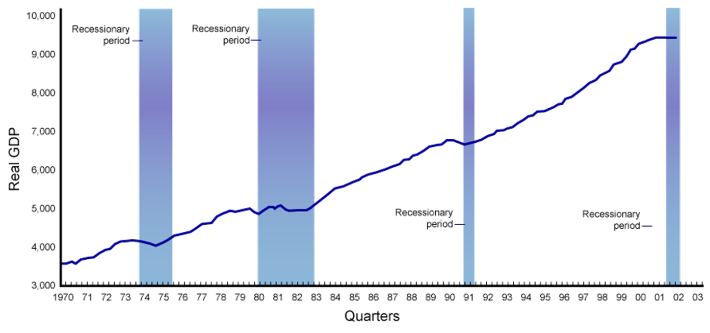
INTRODUCTION TO MACROECONOMICS
OUTPUT GROWTH of usa

Slide 26
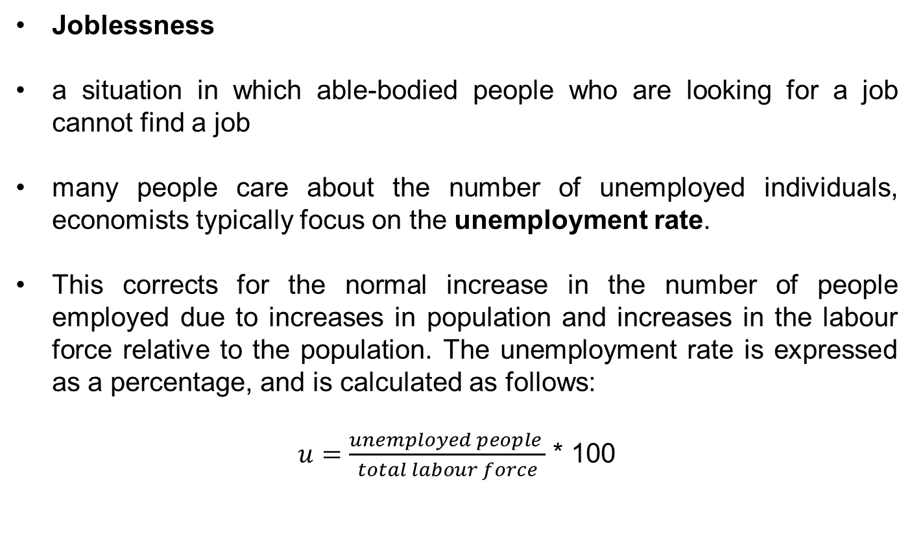
INTRODUCTION TO MACROECONOMICS
UNEMPLOYMENT
Joblessness
a situation in which able-bodied people who are looking for a job cannot find a job
many people care about the number of unemployed individuals, economists typically focus on the unemployment rate.
This corrects for the normal increase in the number of people employed due to increases in population and increases in the labour force relative to the population. The unemployment rate is expressed as a percentage, and is calculated as follows:
$u=\frac{unemployed people }{total labour force}$ * 100

Slide 27
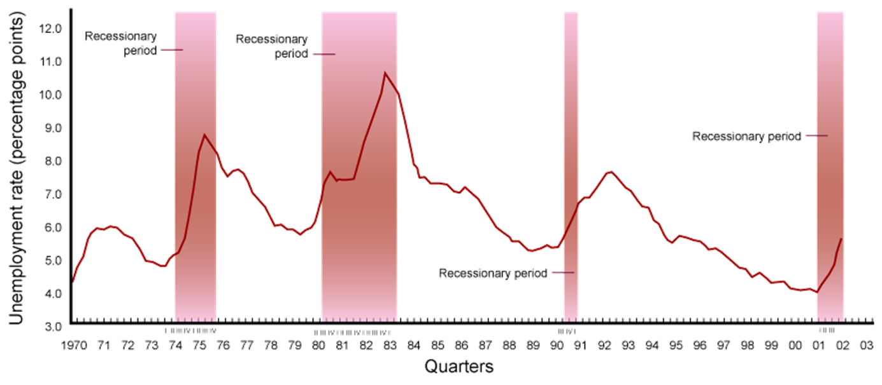
INTRODUCTION TO MACROECONOMICS
UNEMPLOYMENT rate of usa

Slide 28
INTRODUCTION TO MACROECONOMICS
COMPONENTS OF MACROECONOMY
The circular flow diagram shows the income received and payments made by each sector of the economy.
Everyone’s expenditure is someone else’s receipt.
Every transaction must have two sides.

Slide 29
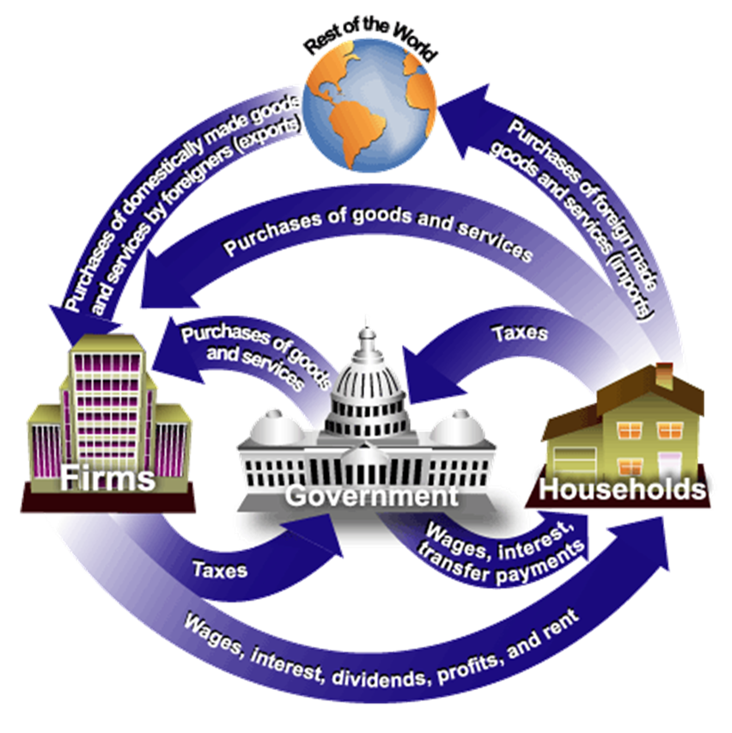
INTRODUCTION TO MACROECONOMICS
COMPONENTS OF MACROECONOMY

Slide 30
INTRODUCTION TO MACROECONOMICS
THREE MARKETS
Households, firms, the government, and the rest of the world all interact in three different market arenas:
Goods-and-services market
Labour market
Money (financial) market
Inside and outside of economy

Slide 31
INTRODUCTION TO MACROECONOMICS
THREE MARKETS
Households and the government purchase goods and services (demand) from firms in the goods-and services market, and firms supply to the goods and services market.
In the labour market, firms and government purchase (demand) labor from households (supply).
The total supply of labor in the economy depends on the sum of decisions made by households.

Slide 32
INTRODUCTION TO MACROECONOMICS
THREE MARKETS
In the money market - sometimes called the financial market - households purchase stocks and bonds from firms.
Households supply funds to this market in the expectation of earning income, and also demand (borrow) funds from this market.
Firms, government, and the rest of the world also engage in borrowing and lending, coordinated by financial institutions.

Slide 33
INTRODUCTION TO MACROECONOMICS
connection to microeconomics
Macroeconomic behavior is the sum of all the microeconomic decisions made by individual households and firms.
We cannot understand the former without some knowledge of the factors that influence the latter.

Slide 34
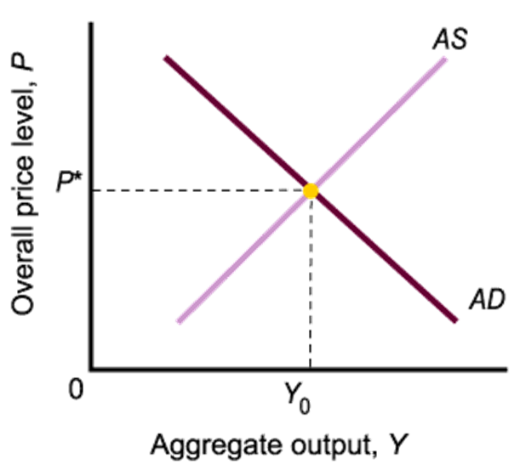
INTRODUCTION TO MACROECONOMICS
AS-AD
Aggregate demand is the total demand for goods and services in an economy
Aggregate supply is the total supply of goods and services in an economy
Aggregate supply and demand curves are more complex than simple market supply and demand curves

Slide 35
INTRODUCTION TO MACROECONOMICS
THANK YOU FOR YOUR ATTENTION…

