Slide 1

International Trade Agreements and Commercial Treaties
Lesson VI
Ingrid Majerova
International Economics
NAMEE

Slide 2

Outline of the Lecture
Contractual Instruments
History of International Agreements and Commercial Treaties
The General Agreement of Tariffs and Trade
The World Trade Organization
  Doha Round

Slide 3
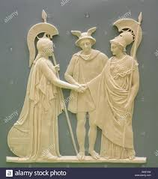
CONTRACTUAL INSTRUMENTS
A commercial treaty is a framework agreement between the two states, which contains the general principles of mutual handling of the parties in the field of economic relations.
These treaties are concluded at the highest level (head of state) and they are long-term.
They contain provisions on conditions of import and export of goods and customs, tax and fee issues.

Slide 4

CONTRACTUAL INSTRUMENTS
Using the clause sets these provisions, where the most important clauses are:
A reciprocal clause that commits the partners to provide to each other the same or equivalent benefits.
  This is a direct contractual arrangement because the scope of the rights and obligations arises directly from the agreement.
  These rights and obligations are interconnected so that the parties are deemed to be equivalent and mutually conditional.
  Reciprocity may refer to the same thing (both sides are agreed to the same process) and the various things that the parties are stipulating.

Slide 5

CONTRACTUAL INSTRUMENTS
Using the clause sets these provisions, where the most important clauses are:
A parity clause (equal treatment or national treatment), which expresses the same commitment to the treat the people and goods in the other country as in own country.
  This clause eliminates discrimination in the treatment of foreign persons and things in comparison to national. GATT governs by this clause in Article III of the Treaty.

Slide 6
CONTRACTUAL INSTRUMENTS
Using the clause sets these provisions, where the most important clauses are:
The most-favoured-nation clause (equal treatment or national treatment), which commit the country to provide each other with all the benefits, which were provided or will be provided in a future to the third country.
  This clause can be defined positively or negatively. In the first case, countries undertake to provide all the benefits granted to third parties, in the second case, undertake to not treat the goods and persons worse than in the third countries.
  This is the most important clause in international trade. Its application has contributed significantly to the liberalization of world trade.
  The use of this clause is binding on all member countries of GATT.

Slide 7
CONTRACTUAL INSTRUMENTS
A trade agreement is also bilateral in nature and is based on commercial treaty.
Trade agreements specify the commercial treaties for a given period (usually one year).
They adjust the trade relations, set the scope and commodity structure of the exchange of goods.
Annexes contain lists of traded commodities, which are either contingent (includes fixed amount of each commodity) or non-contingent that have only indicative nature with showing such commodities can be traded.
A contingent agreement sets only the commitment that state will not prevent the imports or exports as well as it issue an import license.

Slide 8
CONTRACTUAL INSTRUMENTS
Payment agreements are concluded if the issue of payments is not addressed in the payments commercial treaty.
  An agreement between states or central banks about ways of settlement of claims and liabilities arising from mutual relations.
  The agreement specifies the currency in which it will be charged, the number of accounts, payment titles, interest yield, credit limit, etc.
There are two types of credit agreements: a payment agreement in free convertible currency or agreement of payments in clearing currency.
  The clearing is the situation that is used if the currency of one or both countries is not freely convertible.
  In clearing payments, the settlements do not pass the state borders. Importers of participating countries refer their salaries to the clearing bank of their country and exporters getting paid from the same bank in terms of national currency.
  After a certain period of time (usually at the end of the year) the balance between authorized banks is just adjusted by the agreed way.

Slide 9
HISTORY OF INTERNATIONAL AGREEMENTS AND COMMERCIAL
TREATIES
International trade is the oldest form of external economic relations.
At the dawn of modern history, the long-distance trade was linked at that time known civilizations.
Silk Road linked China and the Middle East, which was the trade that connected the Mediterranean region and Europe.
  The successful development of this trade required stable conditions and rules under which it could take place.
These should be ensured by contracts concluded between parties concerned – states (in the Middle Ages they were also various port cities and their groupings, such as "Hansa") – to the ensuring these conditions.
  In these contracts were reflected both the approaches of the concerned parties to the trade as a source of wealth and their power-political interests.
A huge impetus to the further development of international trade was represented by overseas voyages of discovery.

Slide 10

HISTORY OF INTERNATIONAL AGREEMENTS AND COMMERCIAL
TREATIES
Mercantilism X the doctrine of free trade (lazess faire)
both tariff protection and free conditions for trade, while refusing
by promoting unequal treaties the state intervention in foreign trade
Treaty of Tordesillas concluded in 1494 between Portugal and Spain. In this treaty, they defined spheres of influence in the Western Hemisphere.
Another agreement of a similar sense was the Methuen Treaty concluded between England and Portugal in 1703. In this treaty, England enforced the increase of its exports to Portugal in exchange for a reduction in customs duties on imports of Portuguese wine.
  This treaty basically meant a partial economic subordination of Portugal by England.

Slide 11
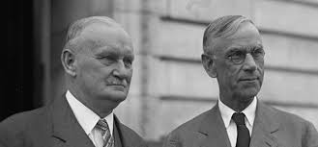
HISTORY OF INTERNATIONAL AGREEMENTS AND COMMERCIAL
TREATIES
An example of liberal agreements is an agreement on the establishment of the German Customs Union in 1850 or Cobden-Chevalier Treaty concluded in 1860 between France and England, which removed all tariffs between these countries.
The protectionism was very massive applied mainly between the two world wars, when it was one of the causes of slow economic recovery of economies from the crisis in 30s of the last century.
The impulse for introduction of general tariff war was the adoption of Smooth-Hawley Tariff Act in 1930, which introduced the highest tariffs in their previous history in the U.S.

Slide 12
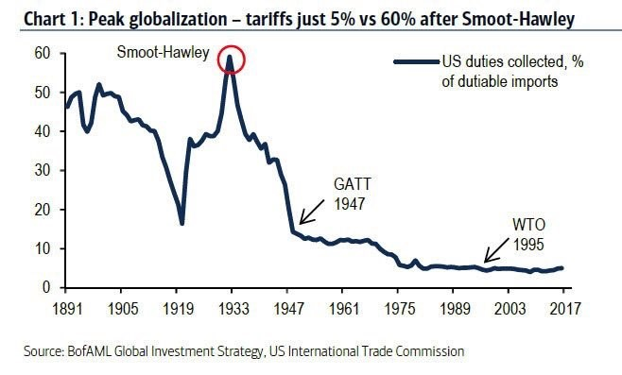
HISTORY OF INTERNATIONAL AGREEMENTS AND COMMERCIAL
TREATIES
Impact of Smooth-Hawley Tariff Act in 1930

Slide 13

HISTORY OF INTERNATIONAL AGREEMENTS AND COMMERCIAL
TREATIES
After the World War II. can again experienced the attempts to limit the regimentation of foreign trade.
  The level of tariffs became the obstacle of mutual trade and hence the economic growth of individual countries.
This activity is associated with the signing of the General Agreement on Tariffs and Trade (GATT) and the attempt to create the International Trade Organization (ITO).
  Only in this context we can talk about the emergence of international trade policy as such, since only GATT brought rules and principles, which signatory countries committed to follow in their trade policies.

Slide 14
THE GENERAL AGREEMENT ON TARIFFS AND TRADE
General Agreement on Tariffs and Trade – GATT signed September 23, 1947.
This is a multilateral trade agreement containing a set of rules to be followed by the concerned parties in the modification and implementation of foreign trade relations.
The original GATT was signed by 23 countries, including the Czechoslovakia and in 1992, the GATT had 116 countries, which accounted 90 % of world trade. GATT is the basis of international trade policy.
To check the implementation of the agreements and organizing other meetings has been established the GATT secretariat, which was settled in Geneva.

Slide 15

THE GENERAL AGREEMENT ON TARIFFS AND TRADE
GATT principles were based on neo-liberalistic ideas of the benefits of liberalized world trade for all countries that have sought to eliminate all barriers to international trade:
International trade should be pursued without discrimination, what should be ensured by the granting of most-favoured-nation clause
Domestic industry may be protected only by tariffs and use of quantitative restrictions should be exceptional
Controversial issues should be solved through consultations between the concerned parties.

Slide 16
THE GENERAL AGREEMENT ON TARIFFS AND TRADE
Integral parts of the GATT agreement are so-called schedules of concessions.
  Documents in which the specific commitments of countries are listed.
  These documents contain mainly import tariffs of each member country, which this country has undertaken to apply to imports of products originating in any other member country of GATT.
  Unification of these multilateral concessions was a difficult process, based on reciprocity.
    The schedule of concession of each member country is relatively stable and cannot be modified on the basis of the requirements of importers or manufacturers.
The process of reducing tariffs and removing obstacles was carried out through the GATT negotiating rounds (tariff conferences).
  The meetings were led on the basis of reciprocity and results of arrangements – a reduction of duties to other participants in GATT – were transmitted through the most-favoured-nation clause.
  From 1947 to 1960, the fourth tariff conferences took place.
  Further negotiations took longer time than one year and for this reason they were marked as GATT negotiation rounds.

Slide 17
THE GENERAL AGREEMENT ON TARIFFS AND TRADE
The first was the Dillon Round, which took place in the years 1960-61 and aims to reduce tariffs.
  Negotiations in this round were carried out by representatives of producers, who accounted for 80 % of world production of the given commodity and they agreed with major customers to reduce tariffs.
The other round was the Kennedy Round took place from 3 May 1964 to mid-May 1967.
  During the negotiation round, the gradually reduction of tariffs by an average of 50 % was achieved.
  In addition, this round also dealt with the issue of antidumping measures.
The great importance has the Tokyo Round (1973-1979), where alsonon-tariff measures and framework trade agreements were discussed.
  Tariffs were reduced by another 20 %.
  This round had to deal with a new phenomenon – the rise of the use of technical barriers to trade, which often had more restrictively effect than custom duties.

Slide 18
THE GENERAL AGREEMENT ON TARIFFS AND TRADE
The Agreement on Technical Barriers (TBT), which aimed to eliminate confusion of technical law, was adopted.
  An obligation of notification, i.e. the obligation of country to provide the prepared technical standard or regulation for comment and assessment to other member states.
  The requirement to base on the existing international standards adopted by the ISO (International Organization for Standardization) and IEC (International Electrotechnical Commission) while when formation of the national standards and regulations.
  Entities that are interested in a particular market or are established on it, are in time informed about the technical terms and their changes, what reduces their costs and increase their competitiveness.
The drawback of the Tokyo round was a lack of institutional ensuring of agreement and thus the possibility of continuing discrimination.

Slide 19
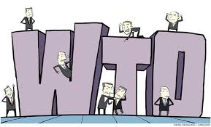
THE GENERAL AGREEMENT ON TARIFFS AND TRADE
The last GATT round of negotiation was the Uruguay Round, which took place from 1986 to 1992.
  This round was focused on:
    the conclusion of the most comprehensive agreement on intellectual property and trade in services and furthermore
    enforcement of proposal for further reduction of tariffs by one-third, but also reduction of government subsidies on agricultural production and the liberalization of agricultural trade.
  Negotiations came to a dispute between the USA and the EU.
    The Blair House Agreement (November 1992) agreement between the United States and the European Union on export subsidy and domestic subsidy reduction commitments

Slide 20
THE GENERAL AGREEMENT ON TARIFFS AND TRADE
The Uruguay Round constituted the following problems:
  The reduction of tariffs by 30%
  The liberalization of trade in tropical plants
  The liberalization of trade in fish, wood, non-ferrous metals and minerals
  The reduction in subsidies, tariff reduction and reducing of the impacts of sanitary standards in agricultural production
  The change the trading rules of intellectual property
  The development of a framework of rules for trade liberalization in services and audio-visual equipment
  A simplification of procedural forms in resolving disputes
  And institutional reorganization of GATT with the aim to establishing the World Trade Organisation, which should replace GATT.

Slide 21

THE GENERAL AGREEMENT ON TARIFFS AND TRADE
The Uruguay round was completed on April 15, 1994 in Marrakesh (Morocco), where was signed the Marrakesh Declaration appreciating the results of the Uruguay Round and also signed the Final Act summarizing the results of the negotiations.
They are covered in the Agreement establishing the World Trade Organization and its attachments are all accepted multilateral agreements.
The Uruguay Round did not solve the problem that shown as fundamental for the functioning of world trade and that is the issue of protectionism of agriculture production from the EU and the USA.

Slide 22
THE WORLD TRADE ORGANIZATION
GATT negotiations were marked by that it was initially created as a temporary business arrangement.
Various subsidiary bodies were created as well as the rules of negotiations were set. These facts gave to GATT the character of an international organization. This situation did not complicate the GATT activities, if only a few countries signed the agreement.
In the 60s of the last century, a significant number of countries – especially developing countries – acceded to an agreement and they have brought their economic problems, but also customs and traditions.
As a critical was shown the situation during the Tokyo Round, when the contracting parties stood in front of virtually insurmountable procedural problems especially in non-tariff area was adopted a number of side agreements and arrangements.

Slide 23
THE WORLD TRADE ORGANIZATION
In December 1995, in Marrakech held 51st meeting of the GATT member countries that decided to terminate the activities of the secretariat and the replacement of the activities of the World Trade Organisation (WTO).
  It commenced operations on 1 January 1995.
  WTO is a new entity in the world economy and has a role to play third pillar affecting world trade and the world economy along with the IMF and the IBRD.
  WTO is a full-fledged organization, while the GATT was the only intergovernmental agreement.
  The core of the WTO action is the issue groomed by GATT, but expanded to all changes and arrangements that were added to the original agreement during its existence.
  WTO unlike GATT has a wider scope, brings to the regulation of international trade in services, intellectual property and investment issues.

Slide 24
THE WORLD TRADE ORGANIZATION
The agreement establishes a common institutional framework for trade relations of member countries to all agreements that annexed to the agreement. This is the current GATT adjusted in the Uruguay Round.
WTO has legal personality and it is built on the approach of the single commitment, where WTO members must adopt a set of commitments.
This principle allows avoiding the free-riding of some members on the benefits without providing appropriate reciprocity.
A membership is conditioned by participation in the four multilateral agreements (Agreement on Trade in Civil Aircraft, Agreement on Government Procurement, Agreement on meat and Agreement on dairy products).

Slide 25
THE WORLD TRADE ORGANIZATION
The activities of the WTO are based on the following principles:
The principle of liberalization – the effort of permanent removal of tariff and non-tariff barriers to trade)
The principle of multilateralism – it expresses the situation when the discussion of problems involving more participants
The principle of consolidation – it lays in the fixation of the existing tariff level, the signatory countries can not arbitrarily change their amount
The principle of non-discrimination – lays in the providing of the same treatment in comparison with other entities and is promoted through the most favoured-nation clause
The principle of parity – the same treatment to foreign goods and persons as with the domestic from the moment they cross the country's borders.

Slide 26
THE WORLD TRADE ORGANIZATION
The supreme body of the WTO is Ministerial Conference, which addresses the issues of paramount importance, meets at least once a year.
The first meeting was held in 1996 in Singapore. Individual countries then represent permanent representatives at the WTO.
The General Council is highest-level decision-making body, which carry out the functions of the WTO.
There are other permanent bodies subordinated to the General Council – the Council for Trade in Goods, the Council for Trade in Services and the Council for Trade-Related Aspects of Intellectual Property Rights.
  Ministerial Conference and the General Council have the exclusive right to make the interpretation of the WTO Agreement and all multilateral agreements.
  At meetings of the Ministerial Conference and the General Council, each country has one vote and decisions are taken by majority of votes.

Slide 27
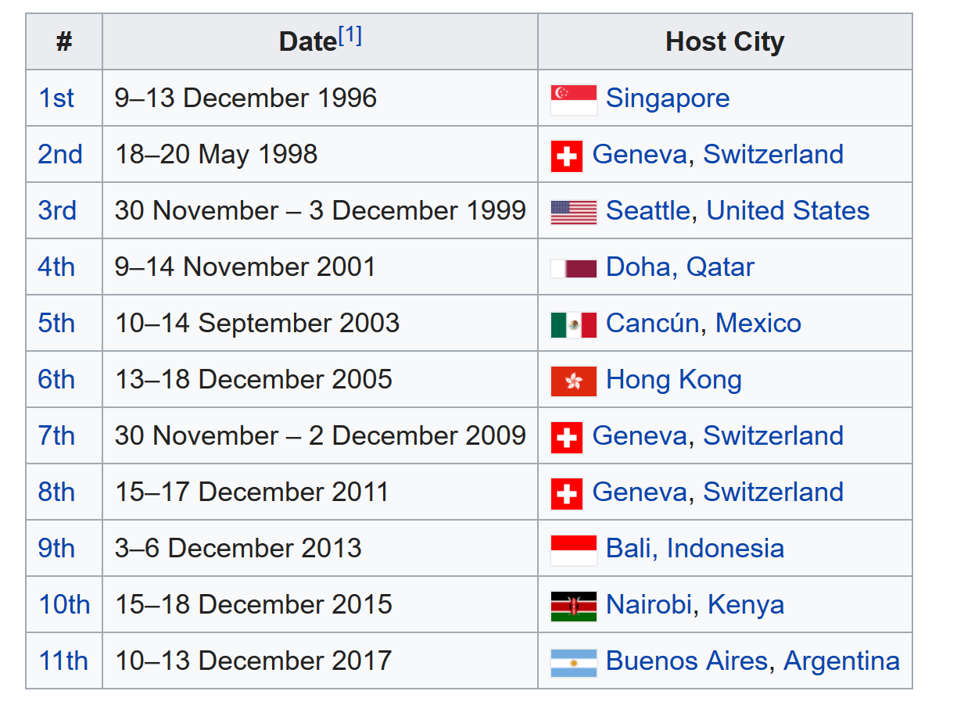
THE WORLD TRADE ORGANIZATION
Since the establisment of WTO was held by 11th Conferences:

Slide 28
THE WORLD TRADE ORGANIZATION
THE DOHA DEVELOPMENT ROUND
Fundamental text that was adopted at the meeting in Doha, is so-called the Doha Development Agenda, which represents the first working program of multilateral trade liberalization and the adoption of new rules since the establishment of WTO.
Previous negotiations were still in progress under the GATT.
The Doha Development Round has chosen an ambitious goal to resolve the most contentious area of protection of agricultural markets, namely the reduction of subsidies to farmers that distort the free market, reduction of import duties on agricultural production and the reduction of the export subsidies, both on the side of economically developed countries and in developing countries.

Slide 29
THE WORLD TRADE ORGANIZATION
THE DOHA DEVELOPMENT ROUND
The service market should be released, the competitive environment for foreign investment should be strengthened and there should be an increase in transparency of government procurement and non-tariff barriers to trade should be disposed, the so-called Singapore issues.
They are mainly related to:
  The guaranteeing the rights of foreign investors in the host country
  The ensuring of equal conditions of free competition for domestic and foreign firms
  The simplification of procedures when moving goods across borders and reducing the cost of customs procedures
  And ensuring of possibilities allowing foreign companies to bid for government contracts.

Slide 30
THE WORLD TRADE ORGANIZATION
THE DOHA DEVELOPMENT ROUND
A key milestone in the negotiations was an agreement the U.S. and the EU in June 2003, when they agreed on a common approaches certain issues.
  They committed themselves in Doha to substantially reduce subsidies to farmers, which reach 300 billion USD per year, what is six times more than the economic aid to developing countries.
Developing countries formed a pressure group known as the G21 and they categorically rejected the conditional reduction of agricultural subsidies by concessions on Singapore issues from their side.
  The members of the G21 were the following countries: Argentina, Bolivia, Brazil, Chile, Ecuador, Egypt, the Philippines, Guatemala, India, Indonesia, South Africa, Cuba, Costa Rica, Colombia, Mexico, Nigeria, Pakistan, Paraguay, Peru, Thailand, Venezuela. These countries represented in 2002 8.1% of world exports.
  Although the EU has offered a compromise and excluded the issues of investments and competition from negotiations, the agreement was not reached because Japan and South Korea protested and conference was ended.

Slide 31
THE WORLD TRADE ORGANIZATION
THE DOHA DEVELOPMENT ROUND
A key milestone in the negotiations was an agreement the U.S. and the EU in June 2003, when they agreed on a common approaches certain issues.
  They committed themselves in Doha to substantially reduce subsidies to farmers, which reach 300 billion USD per year, what is six times more than the economic aid to developing countries.
Developing countries formed a pressure group known as the G21 and they categorically rejected the conditional reduction of agricultural subsidies by concessions on Singapore issues from their side.
  The members of the G21 were the following countries: Argentina, Bolivia, Brazil, Chile, Ecuador, Egypt, the Philippines, Guatemala, India, Indonesia, South Africa, Cuba, Costa Rica, Colombia, Mexico, Nigeria, Pakistan, Paraguay, Peru, Thailand, Venezuela. These countries represented in 2002 8.1% of world exports.
  Although the EU has offered a compromise and excluded the issues of investments and competition from negotiations, the agreement was not reached because Japan and South Korea protested and conference was ended.

Slide 32
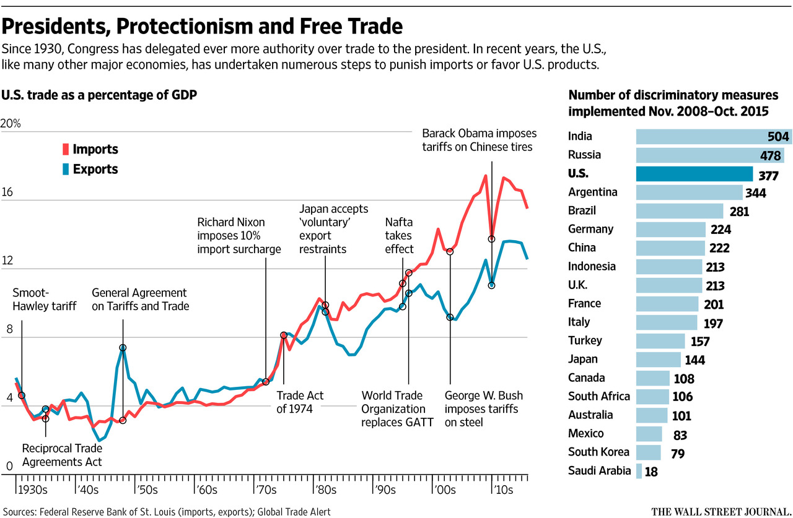
THE WORLD TRADE ORGANIZATION

Slide 33
THANK YOU FOR YOUR ATTENTION!

