Slide 1
Global Entrepreneurship
Presentation No.12
Jarmila Šebestová
Entrepreneurship

Slide 2
Outline of the lecture
Global business definitions
Explaining procedures

Slide 3
Differences
Entrepreneurship differs in various countries; for instance, it is easier to do business in some countries than others, and this would likely have an impact on the level of entrepreneurship in each country.
The Doing Business and Global Entrepreneurship Monitor resources offer insights into everything from a quantitative measure of regulations for starting a business to an assessment of the national level of entrepreneurial activity.
Citizens of different countries vary in terms of their attitudes toward entrepreneurs and entrepreneurship. For example, a country where people viewed entrepreneurs as positive role models and entrepreneurship as a viable career alternative might also encourage others to become entrepreneurs. A country’s stage of development also influences its nature of entrepreneurial activity.

Slide 4
Global Start-ups and Born-Global Firms
The born global firm is defined as a business organization that, from inception, seeks to derive significant competitive advantage from the use of resources and the sale of outputs in multiple countries.
In contrast to the traditional pattern of businesses that operate in the home country for many years and gradually evolve into international trade, born global begin with a “borderless” view of the world and develop the strategies needed to expand abroad at or soon after the firm’s founding.

Slide 5
Two Phases of Global Start-up Assessment
If you can answer yes to all or most of the questions from Phase 1, then you need to be sure that you can quickly build the resources and capabilities identified in Phase 2.
Research has shown that firms unable to connect the dots in Phase 2 are forced to cease operations after a short, but lively, period of time.

Slide 6
Phase 1: Should my firm be a global start-up?
Do I want to build the brand around the world right from the start?
Do I need human resources from other countries for my company to succeed?
Do I need financial capital from other countries for my company to succeed?
Will my target customers prefer the services of my company to the services of my competitors if I am global?
Can I put an international system in place more quickly than domestic competitors?
Do I need global scale and scope to justify the financial and human capital investment in the venture?
Will a purely domestic focus now make it harder for me to go global in the future?

Slide 7
Phase 2: Now that you have committed to going global, here is what you need
A strong management team with international experience
A broad and deep international network among suppliers, customers, and complements
Preemptive marketing or technology that provides you with a first-mover advantage with customers and can lock out competitors from key suppliers and complements
Strong intangible assets (e.g., both Logitech and Skype have style, hipness, and mindshare via their brands)
The ability to keep customers locked in by linking new products and services to the core business while constantly innovating in the core product or service itself
Close worldwide coordination and communication among business units, suppliers, complements, and customers

Slide 8
Discussion questions
What are the characteristics of a global start-up?
What might explain the increasing number of global start-ups?
Why might a global start-up be harder to manage than a purely domestic company?
What key pieces of information would you need to assess whether you should launch a global start-up?
Once you have decided to launch a global start-up, what key resources and capabilities must you begin putting into place?

Slide 9
Global strategy setting
A firm’s strategy can be defined as the actions that managers take to attain the goals of the firm
To maximize the value of a firm, managers must pursue strategies that increase the profitability of the enterprise and its rate of profit growth over time
Profitability can be measured in a number of ways, but for consistency, we shall define it as the rate of return that the firm makes on its invested capital (ROIC), which is calculated by dividing the net profits of the firm by total invested capital.
Profit growth is measured by the percentage increase in net profits over time

Slide 10
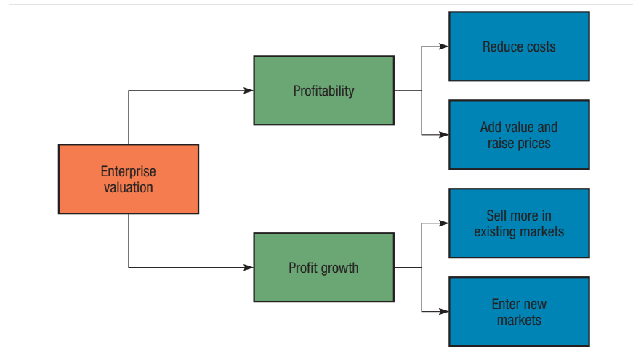
Value of firm

Slide 11
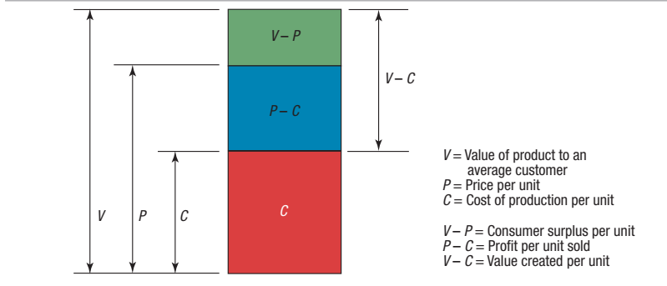
How to calculate the value?

Slide 12
Value calculation
The firm’s value creation is measured by the difference between V and C (V - C); a company creates value by converting inputs that cost C into a product on which consumers place a value of V.
A company can create more value (V - C) either by lowering production costs, C, or by making the product more attractive through superior design, styling, functionality, features, reliability, after-sales service, and the like, so that consumers place a greater value on it (V increases) and, consequently, are willing to pay a higher price (P increases).
This discussion suggests that a firm has high profits when it creates more value for its customers and does so at a lower cost. We refer to a strategy that focuses primarily on lowering production costs as a low-cost strategy.

Slide 13
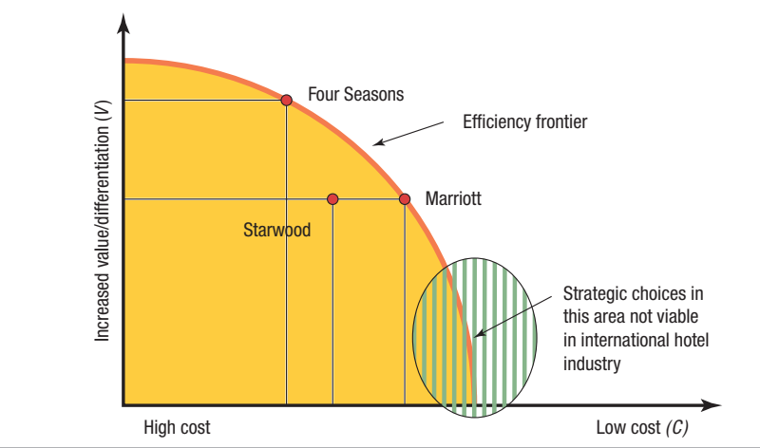
Strategic Choice in the International Hotel Industry - example
Four Seasons positions itself as a luxury chain and emphasizes the value of its product offering, which drives up its costs of operations.
Marriott and Starwood are positioned more in the middle of the market.
Both emphasize enough value to attract international business travelers, but are not luxury chains like Four Seasons

Slide 14
Strategic Choice in the International Hotel Industry – example 2
Four Seasons and Marriott are shown to be on the efficiency frontier, indicating that their internal operations are well configured to their strategy and run efficiently.
Starwood is inside the frontier, indicating that its operations are not running as efficiently as they might be and that its costs are too high.
Starwood is less profitable than Four Seasons and Marriott and that its managers must take steps to improve the company’s performance.

Slide 15
How to maximize profitability
1) pick a position on the efficiency frontier that is viable in the sense that there is enough demand to support that choice;
2) configure its internal operations, such as manufacturing, marketing, logistics, information systems, human resources, and so on, so that they support that position;
3) make sure that the firm has the right organization structure in place to execute its strategy.
4) The strategy, operations, and organization of the firm must all be consistent with each other if it is to attain a competitive advantage and garner superior profitability.

Slide 16
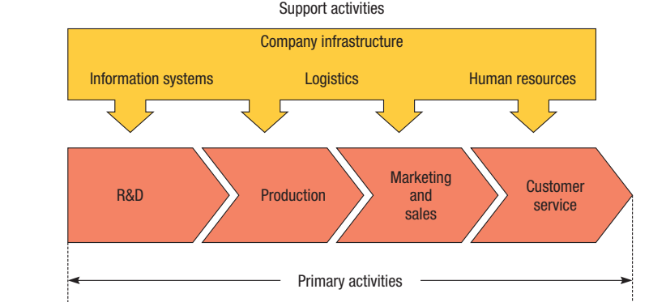
Company as value chain
The operations of a firm can be thought of as a value chain composed of a series of distinct value creation activities

Slide 17
Is Education Creating Value for You?
The concept of a value chain can be used to examine the role your education plays in your life plans, if you look closely at your personal development plans (education, internship, work, physical and emotional fitness, and extracurricular activities) and think about them in terms of primary and support activities.
If we use the logic that the amount of value you receive from your education is the difference between the costs (e.g., tuition, time, lost income) and what you receive in the form of education (e.g., knowledge, tools, networks), how does your choice of major area of focus in your education fit into your personal development strategy?
How do your choices of how you spend your time fit into your value chain? Do you ever spend time doing things that do not support the strategic goals of your personal value chain? But, most importantly, what is the one thing you should do more of to drive the value higher for yourself today and in the future?
Place for additional remarks

Slide 18
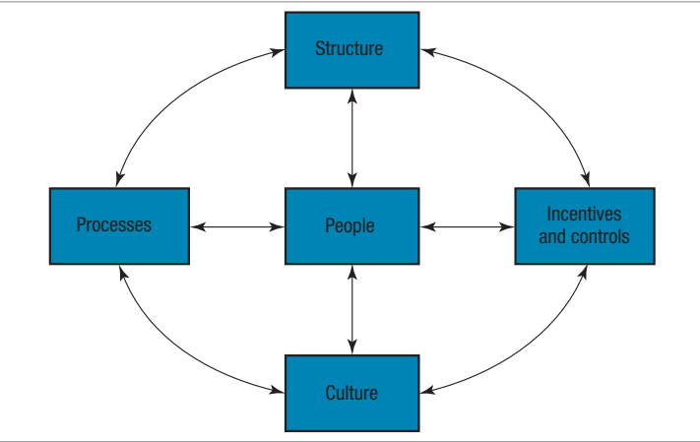
The Implementation of Strategy
The strategy of a firm is implemented through its organization.
For a firm to have superior ROIC, its organization must support its strategy and operations.
The term organization architecture can be used to refer to the totality of a firm’s organization, including formal organizational structure, control systems and incentives, organizational culture, processes, and people.

Slide 19
Components
Controls The metrics used to measure the performance of subunits and make judgments about how well managers are running those subunits.
Incentives The devices used to reward appropriate managerial behavior.
Processes The way decisions are made, and work is performed within any organization.
Organizational Culture The values and norms shared among an organization’s employees.
People The employees of the organization, the strategy used to recruit, compensate, and retain those individuals and the type of people that they are in terms of their skills, values, and orientation

Slide 20
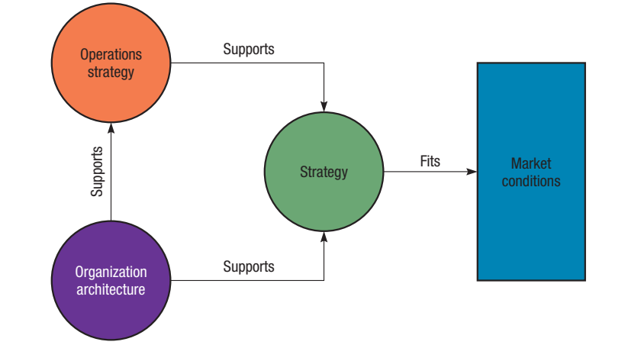
Strategy process

Slide 21
Global Expansion, Profitability, and Profit Growth
Expanding globally allows firms to increase their profitability and rate of profit growth in ways not available to purely domestic enterprises. Firms that operate internationally are able to:
1. Expand the market for their domestic product offerings by selling those products in international markets. 2. Realize location economies by dispersing individual value creation activities to those locations around the globe where they can be performed most efficiently and effectively. 3. Realize greater cost economies from experience effects by serving an expanded global market from a central location, thereby reducing the costs of value creation. 4. Earn a greater return by leveraging any valuable skills developed in foreign operations and transferring them to other entities within the firm’s global network of operations.

Slide 22
Expanding The Market: Leveraging Products and Competencies
A company can increase its growth rate by taking goods or services developed at home and selling them internationally.
The returns from such a strategy are likely to be greater if indigenous competitors in the nations that a company enters lack comparable products.
The success of many multinational companies that expand in this manner is based not just upon the goods or services that they sell in foreign nations, but also upon the core competencies that underlie the development, production, and marketing of those goods or services.

Slide 23
Location Economies
Cost advantages from performing a value creation activity at the optimal location for that activity.
For a firm that is trying to survive in a competitive global market, this implies that trade barriers and transportation costs permitting, the firm will benefit by basing each value creation activity it performs at that location where economic, political, and cultural conditions—including relative factor costs—are most conducive to the performance of that activity .
Locating a value creation activity in the optimal location for that activity can have one of two effects. It can lower the costs of value creation and help the firm to achieve a low-cost position, and/or it can enable a firm to differentiate its product offering from those of competitors.
When different stages of value chain are dispersed to those locations around the globe where value added is maximized or where costs of value creation are minimized.

Slide 24
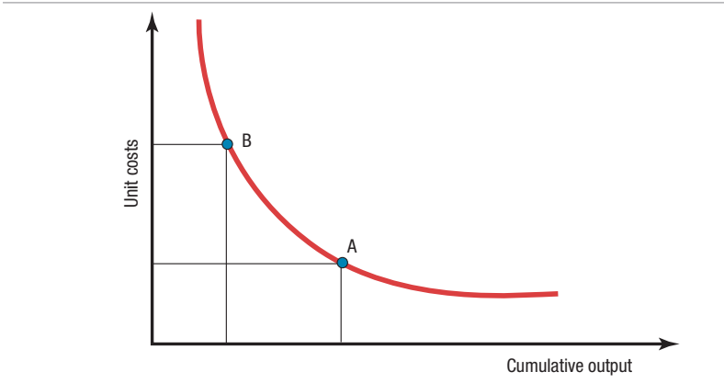
Experience Effects
The experience curve refers to systematic reductions in production costs that have been observed to occur over the life of a product. A number of studies have observed that a product’s production costs decline by some quantity about each time cumulative output doubles
Learning effects refer to cost savings that come from learning by doing
Economies of scale refer to the reductions in unit cost achieved by producing a large volume of a product
The strategic significance of the experience curve is clear. Moving down the experience curve allows a firm to reduce its cost of creating value (to lower C in Figure) and increase its profitability

Slide 25
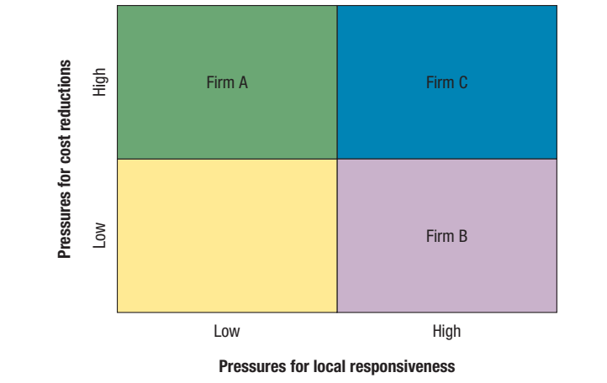
Pressures for Cost Reductions and Local Responsiveness
Pressures for cost reduction can be particularly intense in industries producing commodity type products where meaningful differentiation on nonprice factors is difficult and price is the main competitive weapon
Pressures for local responsiveness arise from national or regional differences in consumer tastes and preferences, infrastructure, accepted business practices, and distribution channels and from host-government demands.

Slide 26
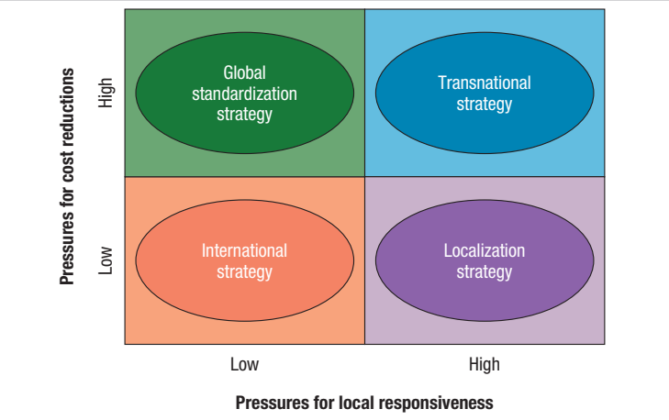
Global Standardization Strategy
A firm focuses on increasing profitability and profit growth by reaping the cost reductions that come from economies of scale, learning effects, and location economies.

Slide 27
Global Standardization Strategy
Firms that pursue a global standardization strategy focus on increasing profitability and profit growth by reaping the cost reductions that come from economies of scale, learning effects, and location economies
Strategic goal is to pursue a low-cost strategy on a global scale. The production, marketing, and R&D activities of firms pursuing a global standardization strategy are concentrated in a few favorable locations
Firms pursuing a global standardization strategy try not to customize their product offering and marketing strategy to local conditions because customization involves shorter production runs and the duplication of functions, which tends to raise costs

Slide 28
Localization Strategy
A localization strategy focuses on increasing profitability by customizing the firm’s goods or services so that they provide a good match to tastes and preferences in different national or regional markets.
Localization is most appropriate when there are substantial differences across nations or regions regarding consumer tastes and preferences and where cost pressures are not too intense.
By customizing the product offering to local demands, the firm increases the value of that product in the local market.
The strategy may make sense, however, if the added value associated with local customization supports higher pricing, which enables the firm to recoup its higher costs, or if it leads to substantially greater local demand, enabling the firm to reduce costs through the attainment of some scale economies in the local market.
At the same time, firms still have to keep an eye on costs.

Slide 29
Transnational Strategy
Attempt to simultaneously achieve low costs through location economies, economies of scale, and learning effects while also differentiating product offerings across geographic markets to account for local differences and fostering multidirectional flows of skills between different subsidiaries in the firm’s global network of operations.

Slide 30
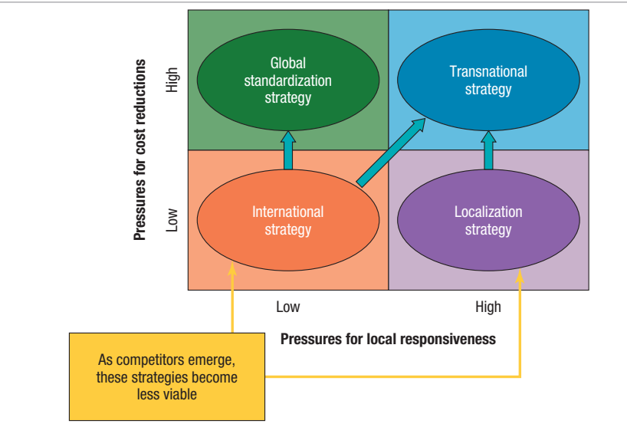
International Strategy
Trying to create value by transferring core competencies to foreign markets where indigenous competitors lack those competencies.

Slide 31
Summary
Firms pursuing a localization strategy customize their product offering, marketing strategy, and business strategy to national conditions.
Firms pursuing a global standardization strategy focus on reaping the cost reductions that come from experience curve effects and location economies.
Many industries are now so competitive that firms must adopt a transnational strategy. This involves a simultaneous focus on reducing costs, transferring skills and products, and boosting local responsiveness. Implementing such a strategy may not be easy.
Strategic alliances are cooperative agreements between actual or potential competitors. The advantages of alliances are that they facilitate entry into foreign markets, enable partners to share the fixed costs and risks associated with new products and processes, facilitate the transfer of complementary skills between companies, and help firms establish technical standards.

