Slide 1
Small and Medium-Sized Enterpreneurship
Jarmila Duháček Šebestová, M.Sc., Ph.D.
sebestova@opf.slu.cz

Slide 2
Entrepreneurship
Chapter 1

Slide 3
Entrepreneurship definition
Entrepreneurship – is a way of thinking, reasoning, and acting that is opportunity obsessed, holistic in approach, and leadership balanced (Timmons)
or
Entrepreneurship – is the process of creating something new, with value, by devoting the necessary time and effort, assuming the accompanying financial, psychic, and social risks, and receiving the resulting rewards of monetary and personal satisfaction and independence (Robert D. Hisrich,1988)
Entrepreneur - French, literally “between taker” or “go-between” actor and person in charge of production
Entrepreneur is risk taker

Slide 4
Economists define an entrepreneur as one who brings resources, labour, raw material and other assets into combinations that increase their value.
Psychologists define an entrepreneur as a person, who is driven by some forces, which create a desire to obtain or attain something.
Sociologists define ‘entrepreneur’ as a person whose actions would determine his social status and who contributes to the development of society.
Management experts define ‘entrepreneur’ as a person who has a vision and generates an action plan to achieve it.

Slide 5
Small Business is defined…
independently owned and operated and is not dominant in its field (Small business Act,1953)
Or EUROSTAT:
1. Independent ownership, only 25% share of another investor or network
2. Owner supplied capital
3. Mainly local operation
4. Relatively small size in the industry

Slide 6
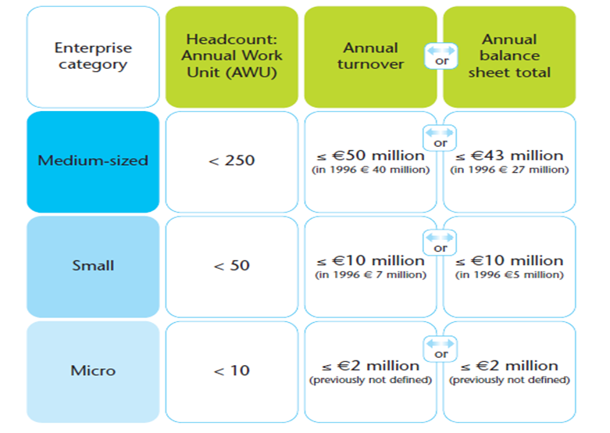
Other possibility – by number of employees

Slide 7
Support of SME in European Union

Slide 8
In 2008, the European Commission introduced the Small Business Act for Europe, support for Small businesses.

Slide 9
EU 2020 strategy for SME
a) Smart Growth – digital agenda and mobility
b) Sustainable Growth - industrial policy, resouce efficient Europe
c) Inclusive Growth –new agenda, new skills

Slide 10
EU funds
The European Union has three key funding instruments to support SMEs.
Support is available in different forms such as grants, loans and guarantees.
Most of the support is given indirectly to SMEs through programmes managed at national or regional level but direct funding of specific projects.
Structural Funds
European Regional Development Fund – ERDF and European Social Fund - ESF is to strengthen economic, social and territorial cohesion by reducing disparities in the level of development among regions and Member States. Furthermore, some isolated thematic funds are available.

Slide 11
Types of support
Direct
Loans, guarantees, grants
focus support on actors or activities
Indirect
they are non-discriminatory and widely available across firms, sectors, fields and activities
Tax reduction, bureacracy…

Slide 12
Vision, mission…Goals

Slide 13
Evaluate your own idea of start up!
What could be the source of inspiration?

Slide 14
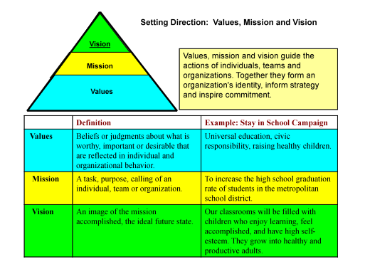

Slide 15
Vision…
A vision statement is a declaration of a company's goals for the midterm or long-term future

Slide 16
examples
“Music House” will be an interesting shop for interesting people
The main idea is providing short-term Rent and short-term exchange of vehicle Rental period from 30 minutes.

Slide 17
Here are five tips to keep in mind:
When describing goals, project five to 10 years in the future.
Dream big, and focus on success.
Use the present tense.
Infuse your vision statement with passion and emotion.
Paint a graphic mental picture of the business you want.

Slide 18
Mission
A mission statement defines what an organization is, why it exists, its reason for being

Slide 19
Our mission is to provide a constant improving smart phone device which would allow to create better entertainment offer in area of small and medium, local events, as well as open a channel of contact between event organizers and participants, while ensuring values necessary in economic growth.

Slide 20


Slide 21


Slide 22
Goals –music shop…do you agree?
As a long term business goal we aim to a stable growth of market share each year and a constant increase of our notoriety. Also, we plan to expand our business on the national level by opening 2 more stores, our own store and we plan to launch an internet shop with the possibility of delivery in all the country.
Gain 25% of the local market share within the first three years.
Maintain a minimum gross profit margin of 40%.
Create a hands-on, educational approach to musical instrument merchandising.
Target the large number of school band instrument customers who currently bypass local music stores for catalog or internet sales, due to poor service, selection and prices.
aggressively target the public school system and local religious organizations.

Slide 23
Car rental
Our main goal over the next 3 years is to increase sales, and number of operations, primarily in the terms of short-term rental car.
The ultimate goal over the next 5 years is to achieve 50% of market while developing internal resources.

Slide 24
