Slide 1
Business Environment of a Family business
Lecture/17.5.2022
Lucie Reczková

Slide 2
Learning objectives
What is a family business
Definitions
Family business around the world
General objectives of a family business
Some interesting facts
Theories of family business
Three circle family business model
Architecture of family business
Conflict management in family business

Slide 3
Introduction
Family businesses are important for economies throughout the world and have impact on the global economy as well.
The estimation in most countries is that family businesses represent two-thirds of all businesses (Howorth, Rose and Hamilton, 2006).
IKEA, WalMart or Haribo are family-owned businesses and large corporations.
For many, family business is associated with small and medium-sized enterprises (SMEs).
Family enterprises differ from other SMEs in the way that they are influenced not just by family, but by business (objectives, values) and relationships as well.
In all family businesses, the values, relationships and family history will influence the organisational culture as well as how the firm operates.

Slide 4
Definitions
According to study of a group of family business experts in Europe, there is agreed definition of family business:
the majority of decision-making rights are in the possession of the natural person(s) who established the firm or in the possession of the natural person(s) who has/have acquired the share capital of the firm or in the possession of their spouses, parents, child/children or their direct heirs
the majority of decision-making rights are indirect or direct
at least one representative of the family or kin is formally involved in the governance of the firm
listed companies meet the definition of family enterprise of the person who established or acquired the firm (share capital) or their families or descendants possess 25 per cent decision-making rights mandated by their share capital.

Slide 5
Family business around the world
Countries with a stronger collectivist culture appear to have more family businesses relative to countries with more individualistic culture.
Rates of Family Involvement in Entrepreneurship:
In East and South Asia, Thailand shows the highest total entrepreneurial activity (TEA) with all established entrepreneurs involving family.
In Europe and North America, family involvement ranges from 54% in Turkey to 90% in Poland.
In every participating Latin American and Caribbean economy, over three-fourths of entrepreneurs involve family in their startups.
The highest necessity motives among family entrepreneurs can be found in two low-income countries: Egypt (50%) and India (46%).
On the other hand, Poland, Sweden, Switzerland, Luxembourg, Netherlands, and the United States—all high-income economies—report necessity motives of 10% or less among family entrepreneurs.

Slide 6
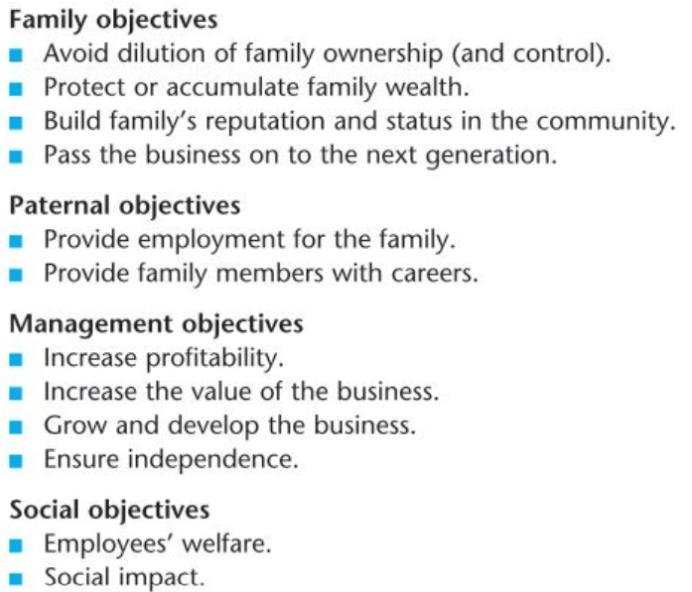
General objectives of a family business

Slide 7
Some interesting facts
The oldest recorded family business in the world is Hoshi Onsen – keeping inns in Japan for nearly 1500 years.
In the UK, R. Durtnell & Sons the Britain’s oldest builder established in 1591.
Family Whitaker in Lancashire has been farming since 12th century.

Slide 8
Theories of family businesses
The key theoretical approaches to understanding family businesses are:
1. Three circles family business model
2. Three-dimensional development model,
3. Johannisson’s model of the three ideologies,
4. the F-PEC model.

Slide 9
Three circles family business model
Most commonly used model
Captures interwoven dynamics of family and business
It highlights the overlapping nature of the three main groups in family businesses – the owners, family and managers.
It is used to examine and explain relationships, motivations, communication, governance and decision-making within family businesses.
An examination of the model as a whole can help to identify where there might be individuals on the periphery, which could have implications for inclusion, engagement, and motivation.

Slide 10
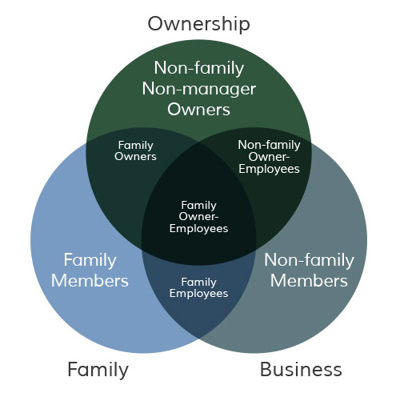
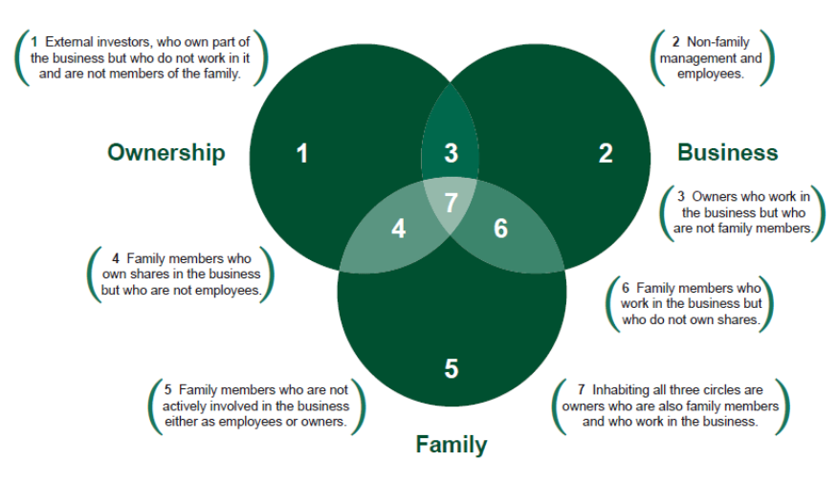
Three circles family business model

Slide 11
Three circles family business model – an example of how to use it
If communication is being examined, we plot first each person’s location on the model and then
examine how communication occurs in each of the circles.
Communication about business issues often occurs within the family circle, in social settings, such as over the dinner table or at family events.
If anyone is in the management circle, but not also in the family circle, they would be likely excluded form these discussions and could feel they are not involved in the decisionmaking and this might lead to disengagement and reduced motivation.

Slide 12
Three circles family business model
The Three-circle model helps clarify the tasks and purposes of governance in reference to each of the key subsystems, the essential work that governance must accomplish if the family business is to succeed, and therefore the basis for evaluating governance implementation in research and practice.

Slide 13
Architecture of family business
Architecture of family business consists: family structure, business structure, ownership structure.
Family
Family council (Family forum)
Family assemblies
Business
Board of directors
Leadership structure
Management team
Ownership
Shareholder´s council
Notes:
https://www.edrawsoft.com/6m-method.html

Slide 14
Architecture of family business – Family council
Family council is the board of directors for the family circle.
It can be an all-inclusive, self-appointed or elected work group of family members, whose main tasks are to make decisions about the business of the family and to educate families about the business.
The fundamental purpose of a family council is to provide a forum in which family members can articulate their values, needs and expectations vis-á-vis the business and develop policies that safeguard the long term interests of the family.
Family council includes:
Family members who have ownership or employment in the business
Spouses of these people
Family members who have a interest in future employment or ownership
Younger family members.

Slide 15
Architecture of family business - Functions of family council
Forging family consensus, counteracting declining family bonds, low identification with the business, as families grow and spontaneous social contacts among family members decrease.
Articulating a family strategy for business and wealth management (including planning, rule setting, collaborative asset allocation).
Limiting family conflicts that could negatively affect the business.
Supporting succession planning, particularly in facilitating the family´s exploration of their collective dream of continuity and in conveying a policy-driven, stewardship culture and enthusiasm for the business.
Educating and welcoming younger generations as a forum for lifelong learning.

Slide 16
Architecture of family business - Family assemblies
Family assemblies are the periodic (typically annual) gathering of an extend family.
These events often include formal meetings where information is shared about investments and operating companies, speakers and facilitated discussions and other recreational activities that are common in family reunions.
Family meetings can help families achieve consensus regarding family mission and family values for the sustainability of the family business over generations.
Family assemblies are often recommended as particularly useful in large family groups with broad geographic dispersal, highly diffused ownership and a desire to sustain economic interdependence through subsequent cousin generations.

Slide 17
Architecture of family business – board of directors
In contemporary enterprise economies, nearly all legal systems specify some kind of board of directors as the ultimate governance authority in a company.
Board size – has been relatively stable averaging just over 10 members, including the CEO and one or two other insiders. Lane et al. (2006) summarize a group of studies and conclude that the optimal range for family-controlled businesses is 7 – 12 directors.
Categories of directors – optimal mix of directors from management, ownership and outside the company.

Slide 18
Architecture of family business - Structure of board of directors
Board of directors consists usually of inside directors and outside directors.
Inside directors consist of the CEO who is typically:
Family member
Director elected by the Family council (Family forum)
Director elected by the Shareholder´s council.
Outside directors are business executives in companies that are currently of the size and organization that family business desires to be in the future.
These outside directors are not, usually, the CEOs of other companies but they are at the second or even third tier of management.
Board meetings of established multigenerational family businesses are best held quarterly even though it appears that more than 50 percent of all family business boards.

Slide 19
Architecture of family business – Leadership structure
The purpose of the family business leadership structure is to accomplish the following objectives:
Make sure that the company develops and successfully implements a long range plan through which it anticipates and creates the future.
Assure that all of the functional areas are operating effectively and in coordination with each other.
Maintain significant external relationships with the industry, customers, suppliers and the community.
Generate positive and productive employee morale throughout the company.
Be a guardian of the company´s financial and human resources, protecting and allocating them.
Typically, leadership structure incorporates a CEO or president and reporting to the CEO/president, one or more vice presidents and an executive vice president, or chief operating officer.

Slide 20
Architecture of family business – Management team
The strategic planning process is implemented in family businesses through the management team (management structure).
The management team structure consists of a number of specific management teams at various levels in a various places throughout the company.
The top two or three executive levels often comprise the executive management team. Some of them establish management teams with managers and supervisors that report to them.
Management team provides the support and channels of implementation needed by the leadership structure to assure that plans are carried out.
The purpose of the management team is to make sure there is good alignment between goals, priorities and operations.

Slide 21
Architecture of family business – Shareholders’ council
Shareholders´ council representing the interests of owners in overseeing the well-being and management of their investment.
Members of the Shareholders´ council are all those who own stock in the family business.
In smaller owner-managed family businesses there is no need for a Shareholders´ council unless the owner is for some reason partial to meetings of one person.
Even in a partnership of two family members, ownership issues are likely handled in more informal partner meetings over lunch or a cup of coffee.
The Shareholders´ council typically meets only once a year unless more frequent or special meetings are needed to draft or revise the Shareholdrs´s Agreement, deal with potential sale of the business, discuss a merger or major acquisition or respond to a crisis.

Slide 22
Conflict management in family businesses
The success of family-owned company is evidence that orderly governance and resolution of problems within the family or in the family´s relationship to the business were provided before they overwhelmed the enterprise.
Conflict is inevitable in families, and more so in families that live, work and control assets together.
Significant problems addressed in family meetings are:
Frustration over alienation or lack of inclusion – source of the conflict is widespread as a result of the emotional distance between family members who are active in management and those who are not and between members of the powerful current generation and those of the significantly less powerful next generation.
Anger over unfairness of hiring practices, promotions, family benefits and other opportunities enjoyed by some but not by others.
Frustration over dividend policies and lack of liquidity.
Notes:
Na základě SWOT analýzy můžeme vytvořit strategie

Slide 23
Conflict management in family businesses
In family businesses there are different sources and types of conflict.
Sources and types of conflicts in family system:
Source: family quarrels
Types: usually emotion based, stay at home.
Sources and types of conflicts in business system:
Source: professional disagreements
Types: usually logic based, stay at work.
Notes:
Na základě SWOT analýzy můžeme vytvořit strategie

Slide 24
References
Carter, S. (2012). Enterprise and small business: principles, practice and policy. Pearson Education.

