Slide 1

External Business Environment
Task Environment
3. lecture
Ing. Šárka Zapletalová, Ph.D.
Department of Business Economics and Management
BUSINESS ENVIRONMENT

Slide 2

Outline of the lecture
Task environment
Industry
Market

Slide 3
Introduction
An external environment is composed of all the outside factors or influences that impact the operation of business.
Task environment involves those aspects which may require day-to-day or regular decisions and actions.
The task environment consists of the actors close to the organization that affect its ability to serve its customers.
The task environment covers the forces relevant to an individual organization within an industry and market. These include customers, suppliers, competitors, and organizations.

Slide 4
Task Environment
Task environment (microenvironment, market environment) – this environment has an immediate and firsthand impact upon the organization. Directly interactive forces include owners, customers, suppliers, competitors, employees, employee unions, and public. Management has a responsibility to each of these groups.
The task environment includes those elements or groups that directly affect a corporation and, in turn, are affected by it.
  These are governments, local communities, suppliers, competitors, customers, creditors, employees/labor unions, special-interest groups, and trade associations.
A corporation’s task environment is typically the environment within which the firm operates.
  industry;
  market.

Slide 5
Task Environment
Organizations sit back and wait for the environment to change, without attempting to predict its behavior, and then react to changes as they happen – reactive style (constantly fire-fighting immediate problems).
Organizations they can identify and foresee changes in the business environment, and plan their responses before these changes happen – proactive style (planning for future).

Slide 6
Task Environment
Organizations sit back and wait for the environment to change, without attempting to predict its behavior, and then react to changes as they happen – reactive style (constantly fire-fighting immediate problems).
Organizations they can identify and foresee changes in the business environment, and plan their responses before these changes happen – proactive style (planning for future).

Slide 7
Industry
An industry is a group of firms that produces a similar product or service, such as soft drinks or financial services. An examination of the important stakeholder groups, such as suppliers and customers, in a particular corporation’s task environment is a part of industry analysis.
An industry exists to serve a market. An industry is a group of organizations that are similar in terms of their primary business activities.
Dozens of industry classifications exist, and these are typically grouped into larger categories known as sectors.
Organizations operating in the same industry can also be compared to each other to evaluate the relative attractiveness of a organization within that industry.

Slide 8
Industry
Typology of industries
Industries according to dependence on the economic cycle:
  Cyclical industry;
  Anti-cyclical industry;
  Neutral industry.
Industries according to the intensity of production factors:
  Labor intensive;
  Capitally intensive;
  Investment intensive.
Industries according to the number of available competitive advantages:
  Volumetric;
  At an impasse;
  Fragmented;
  Specialized.

Slide 9
Industry
Industry and economic sectors
Dozens of industry classifications exist, and these are typically grouped into larger categories known as sectors. A sector is a group of closely related industries.
Economic sectors:
  Primary sector – agriculture, mining and other natural resource industries;
  Secondary sector – covering manufacturing, engineering and construction;
  Tertiary sector – service industries;
  Quarternary sector – intellectual activities involving education and research;
  Quinary sector – high level decision makers in government and industry.

Slide 10
Industry
Industry classification
Statistical classification of economic activities in the European Community (NACE) is a four-digit classification providing the framework for collecting and presenting a large range of statistical data according to economic activity in the fields of economic statistics.
Economic activities:
  A Agriculture, forestry and fishing;
  B Mining and quarrying;
  C Manufacturing;
  D Electricity, gas, steam and air conditioning supply;
  E Water supply, sewerage, waste management and remediation activities;
  F Construction;
  G Wholesale and retail trade, repair of motor vehicles and motorcycles;
  H Transportation and storage;

Slide 11
Industry
Industry classification
  I Accommodation and food service activities;
  J Information and communication;
  K Financial and insurance activities;
  L Real estate activities;
  M Professional, scientific and technical activities;
  N Administrative and support service activities;
  O Public administration and defense, compulsory social security;
  P Education;
  Q Human health and social work activities;
  R Arts, entertainment and recreation;
  S Other service activities;
  T Activities of households as employers, undifferentiated goods; and services producing activities of households for own use;
  U Activities of extra territorial organizations and bodies.

Slide 12
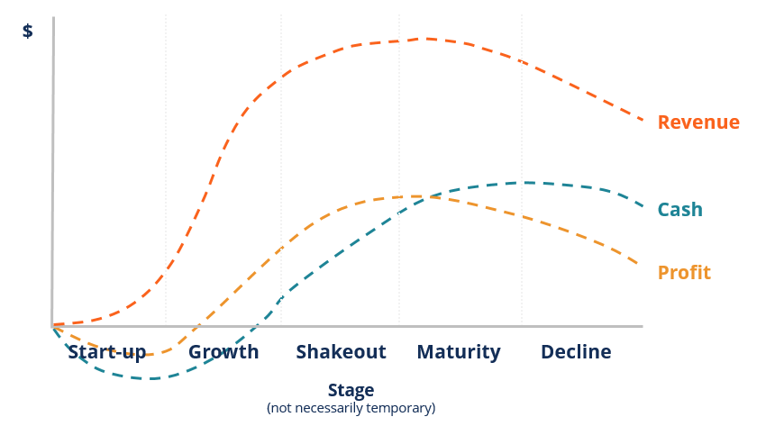
Industry
Industry life cycle: Revenue, cash and profit

Slide 13
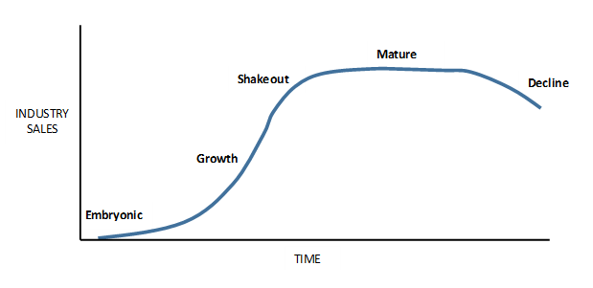
Industry
Industry life cycle

Slide 14
Industry
Industry life cycle: Embryonic industries
Embryonic industries are just beginning to develop.
Growth at this stage is slow because of the factors such as buyers´ unfamiliarity with the industry´s product, high prices due to the inability of organizations to reap any significant economies of scale, and poorly developed distribution channels.
Barriers to industry enter can be quite high. Established organizations will be protected from potential competitors.
Rivalry can be intense. Rivalry in embryonic industries is based on educating customers, opening up distribution channels and perfecting the design of the product.
An embryonic industry may also be the creation of one organization´s innovative efforts.
The company has a major opportunity to capitalize on the lack of rivalry and build a strong position on the market.

Slide 15
Industry
Industry life cycle: Growth industries
An industry grows when customers become familiar with the product.
Prices fall because experience and economies of scale have been attained and distribution channels develop.
In a growth industry, first-time demand is expanding rapidly as many new customers enter the market.
Few companies have yet achieved significant economies of scale or built brand loyalty, other entry barriers tend to be relatively low as well, particularly early in the growth stage.
Threat from potential competitors is highest.
High growth usually means that new entrants can be absorbed into an industry without a marked increase in the intensity of rivalry. Rivalry tends to be relatively low.

Slide 16
Industry
Industry life cycle: Industry shakeout
Explosive growth cannot be maintained indefinitely. Sooner or later, the rate of growth slows, and the industry enters the shakeout stage.
In the shakeout stage, demand approaches saturation levels.
Most of the demand is limited to replacement because there are few potential first-time buyers left.
As an industry enters the shakeout stage, rivalry between organizations becomes intense.
Typically, companies that have become accustomed to rapid growth continue to add capacity at rates consistent with past growth.
Organizations often cut prices. The result can be a price war, which drives many of the most inefficient organizations into bankruptcy, which is enough to deter any new entry.

Slide 17
Industry
Industry life cycle: Mature industries
The market in mature stage is totally saturated. Demand is limited to replacement demand and growth is low or zero.
As an industry enters maturity, barriers to entry increase, and the threat of entry from potential competitors decreases.
Industry mature surviving organizations are those that have brand loyalty and efficient low-cost operations.
Most industries in the maturity stage have consolidated and become oligopolies.
In mature industries, organizations tend to recognize their interdependence and try to avoid price wars.

Slide 18
Industry
Industry life cycle: Declining industries
Most industries enter a decline stage. Within a declining industry, the degree of rivalry among established organizations usually increases.
Depending on the speed of the decline and the height of exit barriers, competitive pressures can become as fierce as in the shakeout stage.
The main problem in a declining industry is that falling demand leads to the emergence of excess capacity.
The greater the exit barriers, the harder it is for organizations to reduce capacity and the greater is the threat of severe price competition.

Slide 19
Market
Market consists of individuals and organizations which are interested and willing to buy a particular product to obtain benefits that will satisfy a specific need or want and who have the resources to engage in such a transaction.
In the market we can to find these market subjects: buyers, organizational buyers, competition, publics.
A market is made up of individual consumers and costumers. They can be categorized by their buying habits. Consumers – buyers – are the individuals who use the products purchased for a household. Customers – organizational buyers – are companies that buy products and then resell them with or without reprocessing to other organizations or ultimate consumers.

Slide 20
Consumer Markets
Consumer market consists of individuals and households that buy goods and services for personal consumption. Consumer is an end-user of goods and services. The world consumer market consists of more than 6 billion people.
Consumer market is characterized by aggressive marketing campaigns, for consumers tend to be disloyal to brands and can easily switch from one to another.
Within this category several sub-types exist:
  Fast-moving Consumer Goods (FMCGs) – generally high volume, low unit value goods that have a fast repurchase cycle;
  Consumer durables – these goods have low volume but high unit value.

Slide 21
Business Markets
Business buyers are divided into three different markets – industrial, reseller and government markets:
Industrial markets – industrial organizations in some way reprocess a product they buy before selling it again to the next buyer.
Reseller (business) markets – wholesalers and retailers who buy physical products and resell them again without any reprocessing are resellers.
Government markets – government units are the state and local agencies that buy products for the constituents they serve.

Slide 22
Market Structures
Economists classify market structures by the number of organizations within the market:
Perfect competition – this is a market when no producer has an advantage over any other producers. There are many producers and also a large number of buyers.
Monopolistic competition – many organizations will compete in a market, but each will sell a slightly different product.
Monopoly – a organization has a monopoly if it is the only organization supplying the market.
Oligopoly – it exists when a few large producers control a market between them. The number of organizations may vary between two and about a dozen, and the products can be homogenous or diversified.

Slide 23
Market Subjects
In the market we can to find these market subjects:
Buyers – ultimate consumers – are the individuals who use the products purchased for a household.
Organizational buyers – customers – are companies that buy products and then resell them with or without reprocessing to other organizations or ultimate consumers.
Intermediaries help the organization to promote, sell and distribute its goods to final buyers. Types of intermediaries: middlemen, marketing agencies, financial intermediaries, physical intermediaries
Competitors are defined as direct and indirect ways customers can satisfy needs apart from making and exchange for a particular offering.

Slide 24
Market Subjects
Publics are individuals, groups and organizations that take an interest in the organization. Publics can help or harm an organization and their needs and interests must be served of accommodated. An organization is really a coalition of several groups, each giving different things to and seeking different things from the organization. Publics can be classified by their functional relation to the organization: media public, local public. An organization can be viewed as a resource-conversion machine in which certain input publics (donors, suppliers) supply resources that are converted by internal publics (staff, board of directors) into useful goods and services that are carried by intermediary publics (advertising agencies) to consuming publics (media, consumers). Not all publics are equally active or important to an organization.

Slide 25
Market Subjects
Competitors are defined as direct and indirect ways customers can satisfy needs apart from making and exchange for a particular offering.
Publics are individuals, groups and organizations that take an interest in the organization. Publics can help or harm an organization and their needs and interests must be served of accommodated. An organization is really a coalition of several groups, each giving different things to and seeking different things from the organization. Publics can be classified by their functional relation to the organization: media public, local public.
Intermediaries help the organization to promote, sell and distribute its goods to final buyers. Types of intermediaries: middlemen, marketing agencies, financial intermediaries, physical intermediaries

Slide 26
Market Measurement
Market is usually measured by dollar (euro) sales and/or unit sales for a defined product-market and specified time period.
For measurement of market we can use these three measures:
  Market potential is an estimate of the maximum possible sales of a product, a group of products or a service for an entire industry during a specified time period.
  Market size (market capacity) is total sales of product, a group of product or a service of the defined industry during a specified time period.
  Market share is defined as the sales of product, a group of product or a service of the particular company in the defined industry during a specified time period.

Slide 27
Market Segments
Market segments are distinct groups of customers within a market that can be differentiated from each other on the basis of their distinct attributes and specific demands.
Each segment contains people who are relatively homogenous in their needs, wants and the product benefits they seek. Also, each segment seeks a different set of benefits from the same product category.
The aim of segmentation is to identify groups within a heterogeneous market who share distinctive needs, preferences and behaviors.

Slide 28
Market Segmentation
Segmentation aims to identify broad groups for whom specific offers can be developed.
Steps in market segmentation:
  Marketing research;
  Identifying bases for segmenting the market;
  Developing profiles of resulting segments.
Criteria for market segmentation:
  Mutual exclusivity;
  Exhaustiveness;
  Measurability;
  Substantiality;
  Actionability;
  Quantity decisions;
  Quality decisions;
  Timing decisions.

