Slide 1
Analytical Methods of Business Environment 3
Synthesis of External and Internal Factors of Business Environment
Lecture 9
Lucie Reczková

Slide 2
Learning objectives
Synthesis of External Factors
Synthesis of Internal Factors
SFAS Matrix
SWOT analysis
TOWS analysis
SPACE Matrix

Slide 3
Introduction
Companies use various business planning tools to help them decide on market and industry positioning.
One approach of strategic planning is to create Industry matrix in the form of IFAS and EFAS tables.
Based on the IFAS and EFAS tables, we generate SFAS Matrix and find a Propitious Niche.
Lastly, it is necessary to generate alternative strategies using TOWS matrix.

Slide 4
Synthesis of External Factors
Using key success factors to create an industry matrix - within any industry there are usually certain variables - key success factors - that a company’s management must understand in order to be successful.
Key success factors are variables that can significantly affect the overall competitive positions of companies within any particular industry.
An industry matrix summarizes the key success factors within a particular industry. The matrix gives a weight for each factor based on how important that factor is for success within the industry.
The matrix also specifies how well various competitors in the industry are responding to each factor.
To generate an industry matrix using two industry competitors (called A and B), complete the following steps for the industry being analyzed:

Slide 5
Synthesis of External Factors
Using key success factors to create an industry matrix - within any industry there are usually certain variables - key success factors - that a company’s management must understand in order to be successful.
Key success factors are variables that can significantly affect the overall competitive positions of companies within any particular industry.
An industry matrix summarizes the key success factors within a particular industry. The matrix gives a weight for each factor based on how important that factor is for success within the industry.
The matrix also specifies how well various competitors in the industry are responding to each factor.
To generate an industry matrix using two industry competitors (called A and B), complete the following steps for the industry being analysed:

Slide 6
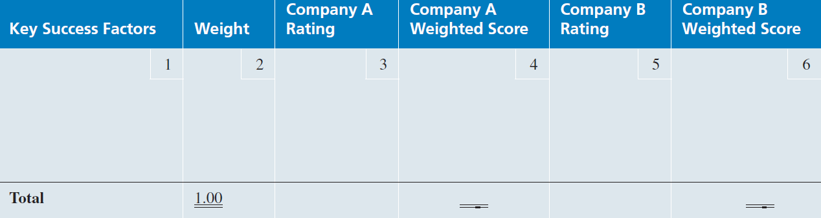
Synthesis of External Factors
To generate an industry matrix using two industry competitors (called A and B), complete the following steps for the industry being analyzed:
1. In Column 1 (Key Success Factors), list the 8 to 10 factors that appear to determine success in the industry.
2. Column 2 (Weight), assign a weight to each factor, from 1.0 (Most Important) to 0.0 (Not Important) based on that factor’s probable impact on the overall industry’s current and future success. (All weights must sum to 1.0 regardless of the number of strategic factors.)

Slide 7
Synthesis of External Factors
3. In Column 3 (Company A Rating), examine a particular company within the industry.
for example, Company A. Assign a rating to each factor from 5 (Outstanding) to 1 (Poor) based on Company A’s current response to that particular factor. Each rating is a judgment regarding how well that company is specifically dealing with each key success factor.

Slide 8
Synthesis of External Factors
4. In Column 4 (Company A Weighted Score), multiply the weight in Column 2 for each factor by its rating in Column 3 to obtain that factor’s weighted score for Company A.
5. In Column 5 (Company B Rating), examine a second company within the industry – in this case, Company B.
Assign a rating to each key success factor from 5.0 (Outstanding) to 1.0 (Poor), based on Company B’s current response to each particular factor.
6. In Column 6 (Company B Weighted Score), multiply the weight in Column 2 for each factor times its rating in Column 5.
7. The total weighted score indicates how well each company is responding to current and expected key success factors in the industry’s environment.
Presutti, W. D. & Mawhinney, J. (2013). Understanding the dynamics of the value chain. Business Expert Press

Slide 9
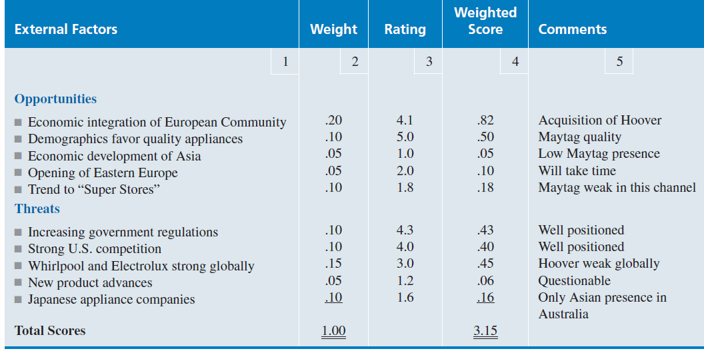
Synthesis of External Factors
Using an EFAS (External Factors Analysis Summary) Table is one way to organize the external factors into the generally accepted categories of opportunities and threats as well as to analyze how well a particular company’s management (rating) is responding to these specific factors in light of the perceived importance (weight) of these factors to the company.

Slide 10
Synthesis of Internal Factors
This IFAS (Internal Factor Analysis Summary) Table is one way to organize the internal factors into the generally accepted categories of strengths and weaknesses as well as to analyse how well a particular company’s management is responding to these specific factors in light of the perceived importance of these factors to the company.
Use the VRIO framework (Value, Rareness, Imitability, & Organization) to assess the importance of each of the factors that might be considered strengths.
Except for its internal orientation, this IFAS Table is built the same way as the EFAS Table.

Slide 11
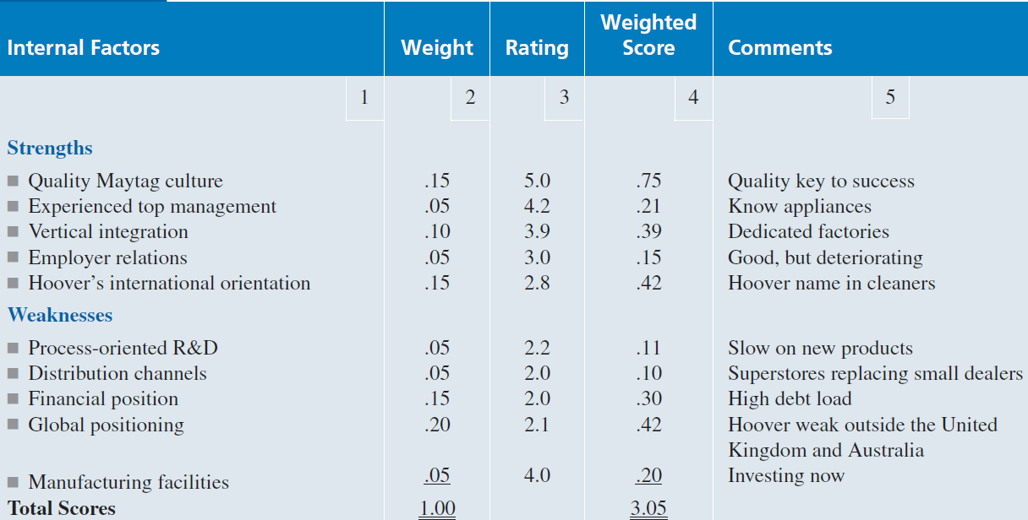
Synthesis of Internal Factors
Example of Internal Factor Analysis Summary (IFAS Table)

Slide 12
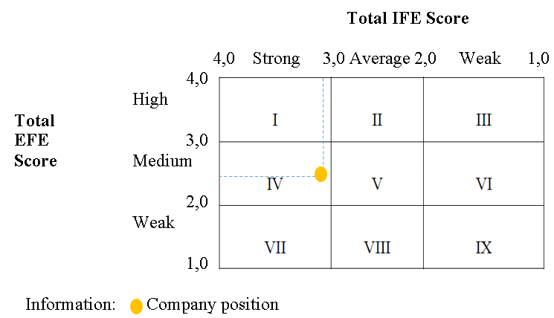
VRIO analysis
The IE Matrix is a strategic management tool which is used to analyze the current position of the divisions and suggest the strategies for the future.
The Internal-External (IE) Matrix is based on an analysis of internal and external business factors which are combined into one suggestive model.

Slide 13
Generating Strategic Factors Analysis Summary - SFAS Matrix
The EFAS and IFAS Tables plus the SFAS Matrix have been developed to deal with the criticisms of SWOT analysis.
When used together, they are a powerful analytical set of tools for strategic analysis.
The SFAS (Strategic Factors Analysis Summary) Matrix summarizes an organization’s strategic factors by combining the external factors from the EFAS Table with the internal factors from the IFAS Table.

Slide 14
Generating a Strategic Factors Analysis Summary - SFAS Matrix
The SFAS Matrix requires a strategic decision maker to condense these strengths, weaknesses, opportunities, and threats into fewer than 10 strategic factors.
This is done by reviewing and revising the weight given each factor. The revised weights reflect the priority of each factor as a determinant of the company’s future success.
The highest-weighted EFAS and IFAS factors should appear in the SFAS Matrix.

Slide 15
Generating a Strategic Factors Analysis Summary SFAS Matrix – the steps to create
1. In Column 1 (Strategic Factors), list the most important EFAS and IFAS items.
After each factor, indicate whether it is a Strength (S), Weakness (W), an Opportunity (O), or a Threat (T).
2. In Column 2 (Weight), assign weights for all of the internal and external strategic factors. This means that the weights calculated earlier for EFAS and IFAS will probably have to be adjusted.
3. In Column 3 (Rating), assign a rating of how the company’s management is responding to each of the strategic factors.
These ratings will probably (but not always) be the same as those listed in the EFAS and IFAS Tables.
4. In Column 4 (Weighted Score), multiply the weight in Column 2 for each factor by its rating in Column 3 to obtain the factor’s rated score.
5. In Column 5 (Duration), indicate short-term (less than one year), intermediate-term (one to three years), or long-term (three years and beyond).
6. In Column 6 (Comments), repeat or revise your comments for each strategic factor from the previous EFAS and IFAS Tables. The total weighted score for the average firm in an industry is always 3.0.

Slide 16
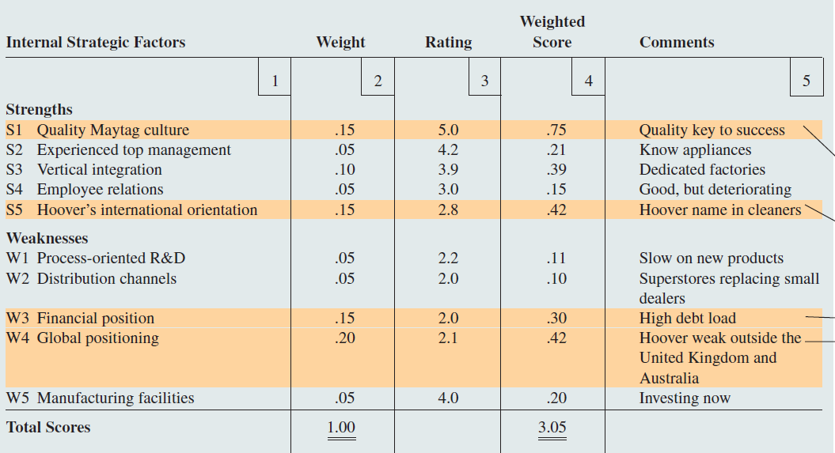
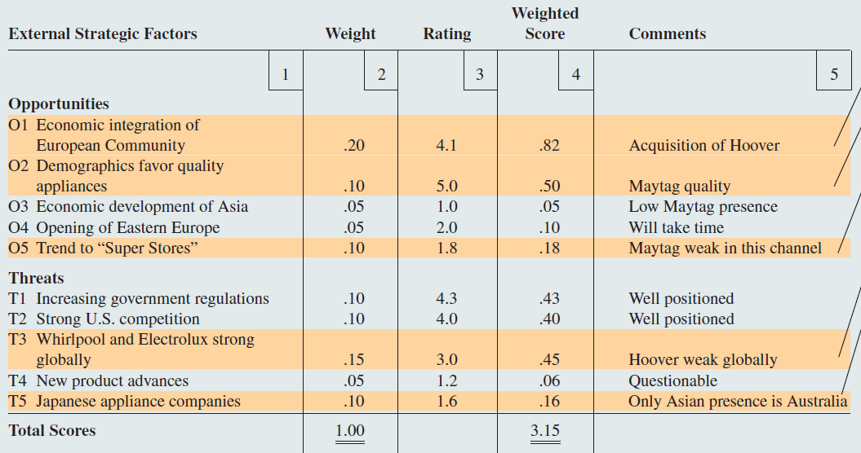
Summary of SFAS Matrix

Slide 17
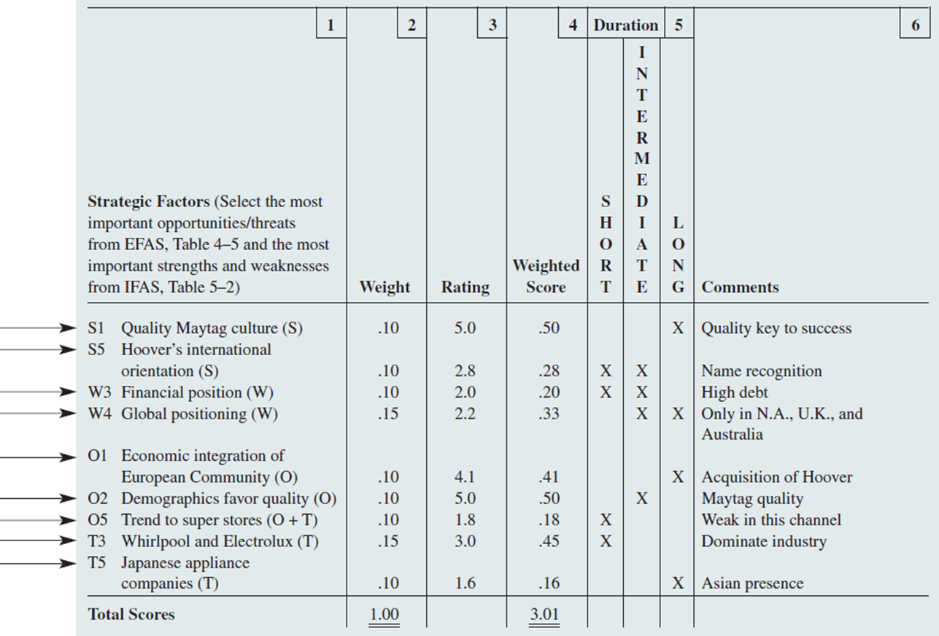
Generating SFAS matrix

Slide 18
SWOT Analysis
Strengths (S) and weaknesses (W) refer to internal factors, which are the resources and experience readily available to you. These are some commonly considered internal factors:
financial resources (funding, sources of income and investment opportunities);
physical resources (location, facilities and equipment);
human resources (employees, volunteers and target audiences);
access to natural resources, trademarks, patents and copyrights;
current processes (employee programs, department hierarchies and software systems).
External forces influence and affect every company, organization and individual. Whether these factors are connected directly or indirectly to an opportunity (O) or threat (T), it is important to note and document each one. External factors are typically things you or your company do not control, such as the following:
market trends (new products, technology advancements and shifts in audience needs);
economic trends (local, national and international financial trends);
funding (donations, legislature and other sources);
Demographics;
relationships with suppliers and partners;
political, environmental and economic regulations.

Slide 19
TOWS Analysis
Was developed by Weihrich.
The TOWS matrix lists not only the strengths, weaknesses, opportunities and threats, but also links them together.
Such links bring additional knowledge and create a good basis for identifying strategic challenges.
It is intelligent SWOT analysis.
The link of strengths and weaknesses to the opportunities and threats can be done by analytical way or a verbal qualitative way.
Grünig, R., & Kühn, R. (2015). Strategieplanungsprozess : Analysen, optionen, projekte : analyses, options, projects. Springer.

Slide 20
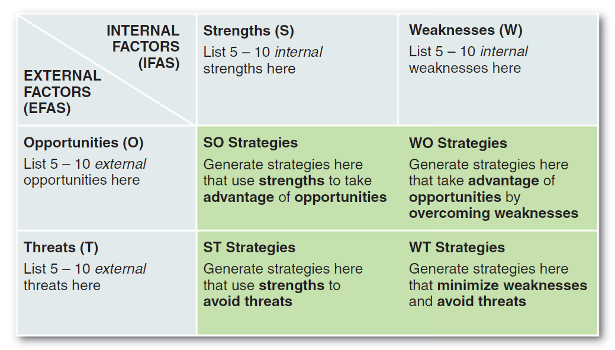
TOWS Analysis

Slide 21
TOWS Analysis
Top build a TOWS Matrix, take the following steps:
Generate a series of possible strategies for the company or business unit under consideration based on particular combinations of the four sets of factors:
SO Strategies are generated by thinking of ways in which a company or business unit could use its strengths to take advantage of opportunities.
ST Strategies consider a company’s or unit’s strengths as a way to avoid threats.
WO Strategies attempt to take advantage of opportunities by overcoming weaknesses.
WT Strategies are basically defensive and primarily act to minimize weaknesses and avoid threats.

Slide 22
TOWS Analysis
The TOWS analysis was developed on the basis of the criticism SWOT analysis:
It generates lengthy lists.
It uses no weights to reflect priorities.
It uses ambiguous words and phrases.
The same factor can be placed in two categories (e.g., a strength may also be a weakness).
There is no obligation to verify opinions with data or analysis.
It requires only a single level of analysis.
There is no logical link to strategy implementation.

Slide 23
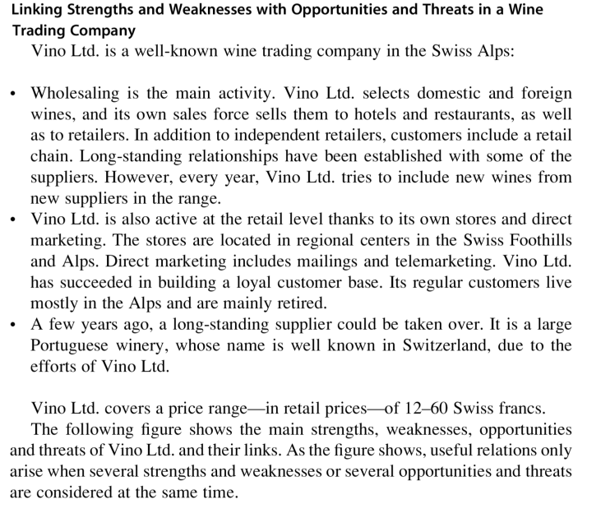
TOWS Analysis – Case study
Grünig, R., & Kühn, R. (2015). Strategieplanungsprozess : Analysen, optionen, projekte : analyses, options, projects. Springer.

Slide 24
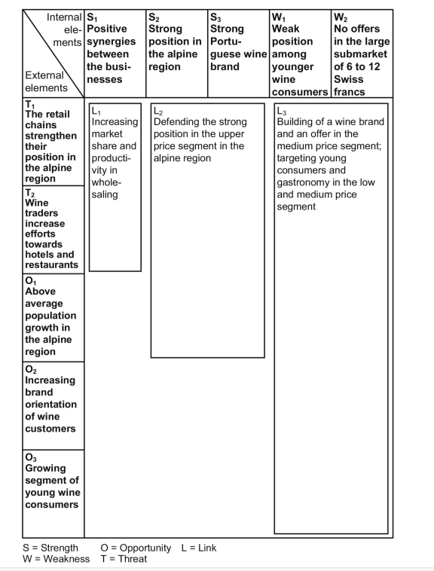
TOWS Analysis
- Case study
Linking strengths and weaknesses with opportunities and threats
Grünig, R., & Kühn, R. (2015). Strategieplanungsprozess : Analysen, optionen, projekte : analyses, options, projects. Springer.

Slide 25
Using the TOWS Matrix to identify a propitious niche
Using the TOWS Matrix to identify a propitious niche is one way to develop a sustainable competitive advantage using those strategic factors.
The goal is to find a propitious niche - an extremely favorable niche - that is so well suited to the firm’s internal and external environment that other corporations are not likely to challenge or dislodge it.
A niche is propitious to the extent that it currently is just large enough for one firm to satisfy its demand. After a firm has found and filled that niche, it is not worth a potential competitor’s time or money to also go after the same niche.
Such a niche may also be called a strategic sweet spot where a company is able to satisfy customers’ needs in a way that rivals cannot, given the context in which it operates.

Slide 26
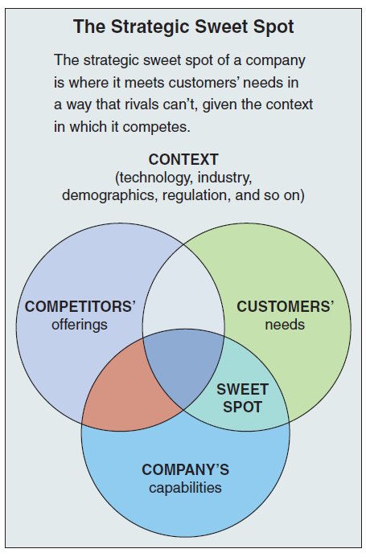
Using the TOWS Matrix to identify a propitious niche

Slide 27
SPACE matrix
The Strategic Position & Action Evaluation matrix or short a SPACE matrix is a strategic management tool that focuses on strategy formulation especially as related to the competitive position of an organization.
The SPACE matrix can be used as a basis for other analyses, such as the SWOT analysis, BCG matrix model, industry analysis, or assessing strategic alternatives (IE matrix).
The SPACE Matrix analysis functions upon two internal and two external strategic dimensions in order to determine the organization´s strategic posture in the industry.
The SPACE matrix is based on four areas of analysis: internal strategic dimensions (financial strength FS and competitive advantage CA), external strategic dimensions (environmental stability ES and industry strength (IS).
The SPACE matrix calculates the importance of each of these dimensions and places them on a Cartesian graph with X and Y coordinates.

Slide 28
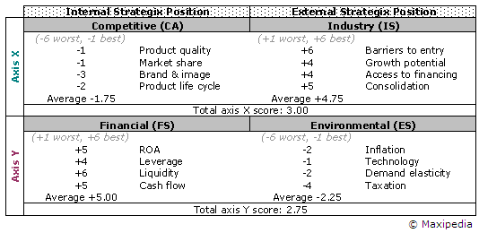
SPACE matrix

Slide 29
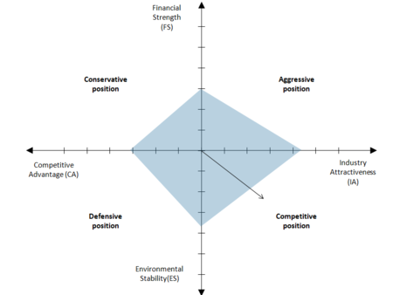
SPACE matrix

