Slide 1

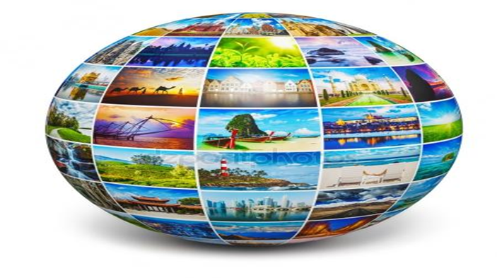

7. Tourist attractions in the Southern European countries
.
Předmět:
The Tourist Attractions in the Czech Republic and in the World

Slide 2
Geography of Portugal
Mountains and high hills cover the northern third of Portugal, including an extension of the Cantabrian Mountains from Spain.
The mainland's highest point is a peak in the Serra da Estrela, at (1,991m). Portugal's lowest point is along the Atlantic Ocean coastline.
Portugal's overall highest point (Pico Volcano ) is located in the Azores (an autonomous region) on the island of Pico. It stands at (2,351 m).
Further south and west, the land slopes to rolling hills and lowlands, and a broad coastal plain.
The Algarve region in the far-south features mostly rolling plains, a few scattered mountains and some islands and islets. It's coastline is notable for limestone caves and grottoes.
Major rivers in Portugal include the Douro, Guadiana, Mondego and the Tagus. There are no inland lakes, as water surfaces of size are dam-originated reservoirs.

Slide 3
The main tourist attractions in Portugal
Mosteiro dos Jerónimos, Lisbon - The Mosteiro dos Jerónimos is one of the country's most cherished and revered buildings, and a "must see' on every tourist's agenda. The church and monastery embody the spirit of the age, and feature some of the finest examples of Manueline architecture found anywhere in Portugal; the beautifully embellished decoration found on the South Portal is breathtaking.
Arguably Portugal's most popular and family-friendly visitor attraction, Lisbon's oceanarium is brilliantly conceived to highlight the world's diverse ocean habitats. This is one of Europe's best and largest oceanariums, containing a vast array of fish and marine animals.
Palácio Nacional de Sintra, Lisbon Coast - Nestling in the lap of a wooded mountain range, Sintra's stunning location is reason enough to visit this charming, verdant town. Indeed, UNESCO acknowledges the destination as a World Heritage cultural landscape such is its beauty and the significance of the collection of historic visitor attractions clustered in and around the old town, Sintra Velha.

Slide 4
The main tourist attractions in Portugal
Kayaking the Lisbon Coast -Taking to the sea by kayak to explore the Lisbon coast makes for a rewarding maritime excursion. Beyond the area, the crystal clear waters off the Serra da Arrábida Natural Park, which encompass places like Setubal and Sesimbra, comprise a unique landscape of magnificent, ancient sea cliffs that teem with birdlife.
One of Portugal's best-loved historic monuments and a Lisbon icon, the Torre de Belém stands as a symbol of the Age of Discovery and the voyages of exploration undertaken in the 15th and 16th centuries.
Dominating the charming riverside town of Tomar is a mighty castle that shields the Convento do Cristo, one of Portugal's standout historic attractions.
Bom Jesus do Monte, Portugal's grandest religious sanctuary, is located on a wooded slope six kilometers east of Braga and is one of the most important pilgrimage sites in the country.
The Serra do Gerês is a mountain range of breathtaking beauty found in northern Portugal's remote Minho region. Set within the glorious Parque Nacional da Peneda-Gerês, one of the top places to visit in Portugal.

Slide 5
The main tourist attractions in Portugal
The Universidade de Coimbra is Portugal's oldest seat of learning, founded in 1290 by King Dinis. Acknowledged by UNESCO as a World Heritage Site, the historic buildings of the Velha Universidade, or old Coimbra University, surround a beautiful colonnaded central square, the Paço das Escolas.
Lisbon is blessed with some truly world-class museums, and one of the finest is the Museu Calouste Gulbenkian.
Guimarães was once the capital of the kingdom of "Portucale." Recognized by UNESCO as a World Heritage Site for its collection of historic monuments grouped in and around the old town center, it is the Castelo de Guimarães that best symbolizes the role played by the town in defining the nation's culture and tradition - it even appears on the Portuguese coat of arms.
Its commanding position crowning a hill and overlooking Lisbon's bustling Baixa (downtown) district defines Castelo de São Jorge as the city's most visible historic monument.

Slide 6
The main tourist attractions in Portugal
Porto's historical heart is the Ribeira. This waterfront bairro positively insists you lose yourself among the maze of narrow streets and seek out some of the city's most cherished architectural treasures. In fact, so rare and precious are the buildings that make up this venerable neighborhood that UNESCO declared it a World Heritage Site.
Torre dos Clérigos - The soaring Clérigos Tower punctuates Porto's skyline like a monumental needle. This is the city's most visible landmark, a 75-meter-tall, 18th-century granite-hewn rocket, and visiting this historic structure should be high up on the "things to do" list.
Porto Bridge Climb - One of the more unusual things to do in Porto — and certainly a radical departure from the traditional sightseeing options — is the chance to climb the arches of the Arrábida Bridge, set downstream away from the more familiar Ponte Dom Luís 1.
Vila Nova de Gaia - With its long, broad promenade and riverfront aspect, Vila Nova de Gaia is an irresistible diversion. Easily reached on foot by crossing the Ponte de Dom Luís I, the town's landscaped quayside is fringed by a long line of stylish restaurants and cafés. It's also the departure point for numerous Douro River cruise boats.

Slide 7
Geography of Spain
Occupying most of the Iberian Peninsula's land area (approximately 85%), Spain is the third largest country in Europe and 45% is covered by the Meseta Plateau.
That plateau is rarely flat, and is in reality a mostly hilly highland area divided by the Cordillera Central (mountains), and then ringed by additional mountain ranges, north, east and south. In the west the Meseta slopes gently down into neighboring Portugal.
Significant mountains in Spain include the limestone Cordillera Cantabrica and rugged Sistema Iberico (north); massive Pyrenees (northeast) where many peaks exceed 3,000 meters; the deeply eroded and rocky Sierra de Cuenca(east), and the lower Montes de Toledo and Serrania de Cuenca (south-central).
In the far south the mountains of the Cordillera Betica and Sierra Nevada dominate the landscape. Mainland Spain's highest point (Mulhacen at 3,481 meters) stands in the Sierra Nevada.
In the far south, the Strait of Gibraltar separates Spain and Europe from Morocco (Africa), and here, the two continents are only 13 km (8 miles) apart.
The country is drained by an estimated 1,500 rivers (mostly small). The longest and most significant riversinclude the Douro (Duero), Ebro, Jucar, Tagus (Tejo), Guadiana and Guadalquivir.

Slide 8
The main tourist attractions in Spain
The Alhambra and Generalife Gardens, Granada -this Moorish pleasure palace will still take your breath away. The Nasrid dynasty's royal palace is the artistic highlight of Spain's Islamic period, when Al-Andalus - as they called Andalucía - represented the epitome of culture and civilization in Europe's Middle Ages.
Barcelona's Sagrada Familia and Gaudi Sites - Antoni Gaudi took the architectural style known as Art Nouveau a step farther, even, some have argued, into absurdity. You may search in vain for absolute straight lines in Gaudi's Casa Milà, his last and most famous secular work; it resembles a piece of sculpture more than a functional building. Be sure to ascend to its roof - the chimneys are said to have inspired the image of Darth Vader from Star Wars.
The Great Mosque of Cordoba (Mezquita) - Once the principal mosque of western Islam and still known as the Mezquita, Cordoba's mosque is one of the largest in the world and the finest achievement of Moorish architecture in Spain.

Slide 9
The main tourist attractions in Spain
The Prado and Paseo del Artes, Madrid - The Prado alone ranks with the world's top art museums for the riches of its collections. But add the Reina Sofia National Art Museum, the Thyssen-Bornemisza Museum, and the Caixa Forum, all along Madrid's mile-long, tree-shaded boulevard, and you have what may be the world's highest concentration of priceless art treasures. Madrid’s Plaza Mayor is a symbol of the city and a must-see. This enormous esplanade in the city centre was begun in the 17th century by King Philip III, whose bronze equestrian statue stands in the square.
San Lorenzo de El Escorial - San Lorenzo de El Escorial, about 45 kilometers northwest of Madrid, was the summer home of Spain's kings, and in 1563, work was begun there on a huge complex, which would include a monastery, church, royal palace, mausoleum, library, and museum, all conceived as a monument to Philip II and his reign.
Guggenheim Museum, Bilbao - You really have to see this building to believe it - no photograph has ever done justice to this symphony of shapes, so alive that they seem ready to take wing. American architect Frank Gehry used blocks of limestone and undulating sheets of titanium to turn the notion of modern architecture on its ear.

Slide 10
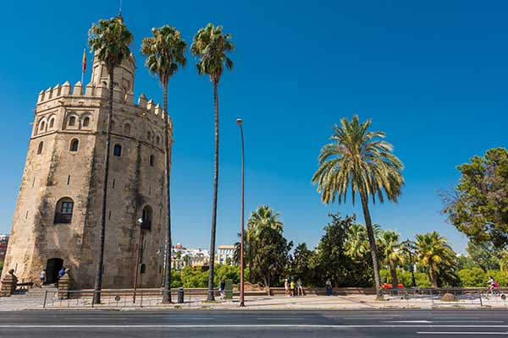
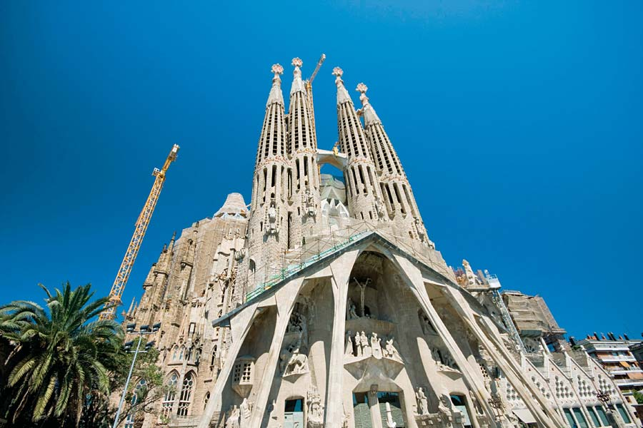
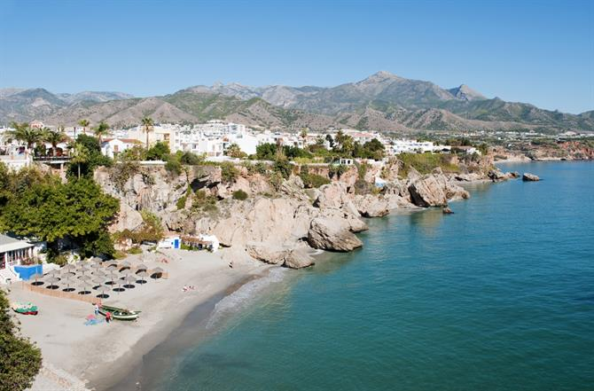
The main tourist attractions in Spain
Seville Cathedral and Alcazar -La Giralda tower, Seville Cathedral, and the Alcazar combine to form a UNESCO World Heritage Site. The tower is a minaret, a "masterpiece of Almohad architecture," according to UNESCO. The cathedral has more interior space than St. Peter's in Rome and a 37-meter main altar of carved statues completely covered in gold.
Santiago de Compostela Cathedral - he magnificent cathedral of Santiago (St. James) was built to house and honor the relics of the saint, and it has been the goal of pilgrims since the Middle Ages, the culmination of their completing the famed Camino de Santiago.
Ciudad de las Artes y las Ciencias, Valencia - Europe's largest oceanographic aquarium, L'Oceanogràfic, was built in the shape of a water lily with buildings dedicated to different aquatic environments from the tropics to the poles.
Costa del Sol Beaches
Barcelona's Sagrada Familia The Torre del Oro is the "Tower of Gold" in Seville
Costa del Sol (Nerja)

Slide 11
Geography of France
France, the second largest country in Europe, is partially covered central, north and west by a relatively flat plain that's punctuated by some time-worn low rolling hills and mountains.
Rugged cliffs front its coastline along the English Channel. There, to the northwest of Caen, the Cotentin Peninsula shields the Channel Islands, while a bit further to the west, the Brittany Peninsula juts into the Atlantic Ocean. Assorted coastal islands dot the western coastline south of Brest, where white-sandy beaches stretch along the Atlantic Ocean to the border with Spain.
A few scattered islands are found along the pebbled beaches of the Mediterranean coast. Corsica, a mountainous island and the country's largest island, is located 160 km (99 miles) southeast of Nice.
Mountains dominate eastern, south central and southern France, including the snowcapped Alps that stretch along its border with Italy, then on into Switzerland and across southern Europe. The country's highest point, and the second highest point in Europe is located here; Mont Blanc at (4,807m).
The country is drained by dozens and dozens of rivers. The longest river in France is the Loire at (1,020 km) in length. Other significant rivers include the Garonne, Lot, Rhine, Rhone Seine..

Slide 12
The main tourist attractions in France
The symbol of Paris, the Eiffel Tower is one of the world's most famous landmarks. This feat of ingenuity is a structure of 8,000 metallic parts, designed by Gustave Eiffel as a temporary exhibit for the World Fair of 1889.
In the former royal palace of French Kings, the Louvre is an incomparable museum that ranks among the top European collections of fine arts. Many of Western Civilization's most famous works are found here including the Mona Lisa by Leonardo DaVinci, the Wedding Feast at Cana by Veronese, and the 1st-century-BC Venus de Milo sculpture.
More than just a royal residence, Versailles was designed to show off the glory of the French monarchy. "Sun King" Louis XIV transformed his father's small hunting lodge into an opulent palace with a sumptuous Baroque interior. The palace became Louis XIV's symbol of absolute power and set the standard for princely courts in Europe.
The most fashionable stretch of coastline in France, the Côte d'Azur is synonymous with glamour. The Côte d'Azur translates to "Coast of Blue," named after the mesmerizing deep blue color of the Mediterranean Sea. Also known as the French Riviera, the Côte d'Azur extends from Saint-Tropez to Menton near the border with Italy.

Slide 13
The main tourist attractions in France
Rising dramatically out of the sea on the coast of Normandy, Mont Saint-Michel is one of France's most striking landmarks. This "Pyramid of the Seas" is a mystical sight, perched on a rocky islet and surrounded by walls and bastions. At high tide, Mont-Saint-Michel is an island. At low tide, it is possible to walk across the sand to the Mont. The main tourist attraction, the Abbaye de Saint-Michel was founded in 708 by the Archbishop Aubert of Avranches after the Archangel Michael appeared to him in a vision.
Loire Valley Châteaux - Traveling through the Loire Valley feels like turning the pages of a children's storybook. Throughout the enchanting countryside of woodlands and river valleys are fairy-tale castles complete with moats and turreted towers. The entire area of the Loire Valley, a lush area known as the "Garden of France," is listed as a UNESCO.
For more than eight centuries, the magnificence of Chartres Cathedral has inspired the faithful. Some say this breathtaking beauty of Chartres has restored belief in the doubtful. The UNESCO-listed cathedral exemplifies the glory of medieval Gothic architecture.
Biarritz is a fashionable beach town on the beautiful Bay of Biscay in France's Basque country. This celebrated seaside resort has an elegant and aristocratic air; it was a favorite destination of Empress Eugénie, wife of Napoleon III.

Slide 14
The main tourist attractions in France
Provence is a gorgeous landscape of olive groves, sun-drenched rolling hills, and deep purple lavender fields, with little villages nestled in the valleys and perched on rocky outcrops. The vibrant scenery has enchanted many famous artists, including Cézanne, Matisse, Chagall, and Picasso.
The awesome spectacle of Mont Blanc in the French Alps is an unforgettable sight. The highest mountain peak in Europe, Mont Blanc forms part of the French border with Italy. Beneath its heavenly peak is the traditional alpine village of Chamonix, nestled in a high-mountain valley.
Some of the prettiest villages in France are tucked away in the green, rolling hills of Alsace, where the Vosges Mountains border the Rhine River of Germany. Many of the villages have won France's "Villages Fleuris" award for their lovely floral decorations, such as Obernai, with its characteristic burghers' houses; the charming little village of Ribeauvillé; the "town of art and history" Guebwiller; and the captivating medieval village of Bergheim.
With its turreted towers and crenellated ramparts, Carcassonne seems straight out of a fairy-tale scene.
Brittany is a beautiful historic region on the northeastern coast of France. The quintessential Breton port is Saint-Malo surrounded by ancient walls. Quimper is a picture-postcard historic town with handsome half-timbered houses, pleasant squares, and an impressive Gothic cathedral. Nantes has a spectacular château

Slide 15
Geography of Monaco
As the second-smallest independent state in the world, after the Vatican City, Monaco is a very hilly, rugged and rocky country.
Monaco sits on the Mediterranean Coast, and is almost entirely urban. The highest point is Mont Agel, which rises to (140 m).

Slide 16
The main tourist attractions in Monaco
Monte-Carlo - Monte Carlo is the district with the most glamorous atmosphere, in a setting of stunning natural beauty. Monte-Carlo is intersected by two elegant boulevards, the Boulevard Princesse Charlotte in the west and the Boulevard des Moulins at its southwestern end. There are many fashionable shopping streets, such as the Avenue de la Costa with its luxury boutiques. The Opera House is also in this district.
In a unique position high above the sea on the picturesque peninsula of Le Rocher, the Palais du Prince is home to the oldest monarchy in the world.
The Musée Oceanographique lies in a spectacular location on Le Rocher, almost 90 meters above sea level.
Delight the senses with a visit to Monaco's Jardin Exotique. The garden lies in the Fontvieille area (the more modern section) of Monaco outside of the historic center.
This Roman-Byzantine-style cathedral was constructed out of striking white stones from nearby La Turbie.
Overlooking the serene blue waters of the Mediterranean Sea, Les Jardins Saint-Martin lie near the Musée Océanographique and would be an ideal complement to visiting the museum.

Slide 17
Geography of Italy
Mainland Italy extends southward into the Mediterranean Sea as a large boot-shaped peninsula. This extension of land has forced the creation of individual bodies of water, namely the Adriatic Sea, Ionian Sea, Ligurian Sea and Tyrrhenian Sea
The northern reaches of the country are dominated by varied ranges of the Alps, a massive stretch of mountains that extends from France to Austria, and then south along the Adriatic Sea. Italy's highest point near the summit of Mont Blanc (or Monte Bianco), a mountain it shares with France, rises to 4,748 m.
The beautiful and rugged Lake District of northern Italy includes many mountain lakes, with the major ones being Como, Garda and Maggiore.
Italy is renowned for its many rugged islands, most volcanic in origin. Significant ones include the large islands of Sardinia and Sicily and the smaller islands of Capri, Elba, Ischia, and the Aeolian Island group.
Much of Italy is volcanic in origin, and today a few of its many volcanoes are active, including Sicily's Mt. Etna, Stomboli in the Aeolian Islands, and volcanologists are constantly monitoring Mt. Vesuvius near Naples, as it has the potential to erupt at anytime.

Slide 18
The main tourist attractions in Italy
For travelers making their way through Italy, the Colosseum is a must see. This huge Amphitheater is the largest of its kind ever built by the Roman Empire and has remained a model for sports facilities right up to modern times.
A gondola ride through the canals of Venice is a tradition that travelers have been participating in for centuries. Venice is a city of islands and the canals have long been, in many ways, the city's streets.
Below the rumbling volcano of Mt Vesuvius stand the ruins of Pompeii, an ancient Roman city preserved in time by the eruption in A.D. 79.
The Leaning Tower of Pisa is actually just one of many attractions in the city of Pisa, but its fame, gained from its flaw, is world renown.
Lake Como is one of Italy's most scenic areas, surrounded by mountains and lined by small picturesque towns.
The Amalfi Coast, a UNESCO World Heritage Site, is a stunning stretch of coastline along the Sorrentine Peninsula.
Regarded as one of the finest cathedrals in the world, the Duomo Santa Maria del Fiore, or the Cathedral of Santa Maria del Fiore, dominates the Florence skyline.

Slide 19
The main tourist attractions in Italy
Cinque Terre, which translates as "Five Villages", is a lovely coastal region with steep oceanside cliffs and hills.
The Vatican is home to some of the world's most priceless art and art collections. Beyond the obvious sites of St Peter's Basilica and St Peter's square.
The Roman Forum may require a little imagination to understand exactly what this area once looked like.
One of the most important tourist sites in Venice is St Mark's Basilica. Most visitors wandering around Venice will find themselves in the famous square, Piazza San Marco, in front of the basilica, looking at the main west facing facade.
The Pantheon, an exceptionally well preserved remnant from Roman times, reveals the incredible architectural achievements of the Roman Empire.
In 1982, the Historic Centre of Florence was added to the list of UNESCO World Heritage Sites in Italy. Florence has also become a symbol of the Renaissance period in Italy. Cathedral of Santa Maria del Fiore and Piazza Duomo, Piazza della Signoria and the Loggia dei Lanzi, San Lorenzo and Michelangelo's Medici Tombs

Slide 20
Geography of Slovenia
Over 40% of Slovenia is mountains, as the Alps extend across the northern part of the country.
The country's highest point is Triglav, which rests in the Alps, and peaks at (2,864 m).
The Julian and Savinja ranges run along its borders with Austria and Italy.
Located within the Julian Alps are two glacial lakes (Bohinj and Bled), and major rivers include the Drava and Sava.
Moving towards the central and south, the balance of land is a mixture of high hills and valleys, covered by green forests.
Slovenia, as a matter of fact, is ranked third in Europe for being the most forested country, with over half of its land covered.

Slide 21
The main tourist attractions in Slovenia
Slovenia, with its diverse landscapes, is an attraction in itself. It is the first country in the world that has been, as a whole, declared a green tourist destination. Here, in addition to exceptional and special natural features, you can discover places that are UNESCO World Heritage protected.
One of the best places to visit in Slovenia is its capital, Ljubljana. Although Ljubljana is much smaller than most European capitals, it has a unique charm that makes it worth a visit. A major attraction in the city is Tromostovje, also known as the Triple Bridge, where three picturesque bridges span the river right next to one another.
Serving as a gateway to the Triglav National park is Lake Bled, a scenic body of water surrounded by the Julian Alps.
If you want to get outdoors and explore some of the amazing natural scenery in Slovenia, then Triglav National Park is the ideal spot to visit.
Postojna is a relatively small town in Southwest Slovenia, but it is a must-see destination for travelers drawn to unique attractions and natural scenery. Postojna is known for its extensive cave system, which boasts a staggering 20 km (13 miles) of chambers, hallways and galleries, some of which have ceilings nearly 50 meters (150 feet) high.

Slide 22
The main tourist attractions in Slovenia
On the tip of Southwestern Slovenia, and on the coast of the Adriatic Sea, is the resort hotspot called Piran. The destination is reminiscent of Italy, which makes sense since it was actually part of the Venetian Empire for more than five centuries. Piran is small in size, but it is quaint, historic and scenic.
Portorož is a Slovenian Adriatic seaside resort and spa settlement located in the Municipality of Piran in southwestern Slovenia. The Slovene name Portorož is borrowed from Italian Portorose, literally 'port of roses‘, which was recorded in the 12th century as Porto di rose.
On the banks of the Drava River is the city of Ptuj, a destination in Eastern Slovenia with an impressive collection of historic architecture. Ptuj is widely regarded as one of the oldest cities in the nation, and it has been important in the local culture since the Stone Age.
One of the oldest cities in all of Slovenia is Celje, a small city perched on the banks of the Savinja River. The biggest attraction in the city is the enormous castle, which was erected in the 14th century and now looks down over the city from its hilltop location.
Popular for winter sports enthusiasts is the destination of Kranjska Gora, located in the northwest of Slovenia. During the winter, Kranjska Gora is busy with visitors who ski and snowboard in the resort of Vitranc, taking advantage of the frequent snowfall and the steep trails.
As one of the oldest coastal towns in Slovenia, and a major port, Koper is an integral part of the country’s infrastructure.

Slide 23
Geography of Croatia
Given the size of Croatia, the landscape is considerably diverse and made up of fertile and mostly flat plains in the north, and low mountains and highlands along the coast.
The Dinaric Alps and a few smaller mountain ranges (Velebit and Velika Kapela) slice through the country, with the highest point rising to (1,831m).
Along the Dalmatian coast, as well as on most of Croatia's offshore islands, the land is hilly, rocky and steep.
Natural water sources are numerous, and the country's biggest lake, Lake Vrana, extends over 12 sq. miles (30 sq. km).
However, the Plitvice lakes are the most famous, and are composed of a group of 16 different small lakes connected by waterfalls.
Europe's second largest river, the Danube, forms the far northeastern border with Serbia.

Slide 24
The main tourist attractions in Croatia
Dubrovnik, Croatia's most glamorous tourist destination, centers on the magnificent old town, contained within sturdy medieval defensive walls and declared a UNESCO. Any first-time sightseeing tour of the city should begin with a walk around the ramparts (the complete circuit measures two kilometers), which incorporate fortresses, towers, and cannons along the way.
Split, Croatia's second biggest city after Zagreb, grew up within the ancient Roman walls of Diocletian's Palace.
Many tourists visit Croatia to explore the blissful Dalmatian islands, of which the most fashionable is Hvar. Here, trendy Hvar Town is home to some of the country's top hotels and best seafood restaurants.
Croatia's most visited inland attraction, Plitvice National Park encompasses steep forested hillsides surrounding 16 emerald-blue lakes connected by a succession of thundering waterfalls.
In the Croatian capital, Zagreb, the main sightseeing area is the medieval Gornji Grad (Upper Town). Here, attractions include the cathedral with its Neo-Gothic façade and twin steeples; the Croatian Sabor (Parliament); the Church of St. Mark…
Sailing Around Kornati National Park
Croatia's political and cultural heart, Zagreb is the country's capital and a thriving and energetic city. Long popular as a tourist destination, it hosts some of Croatia's best (and quirkiest) museums, along with a great shopping, dining, and café culture.

Slide 25
The main tourist attractions in Croatia
Zadar's car-free old town is built on a small peninsula. Its top attractions are its fine Romanesque churches, built between the 9th and 13th centuries, and filled with religious paintings and ornate golden treasures. Be sure to check out the 9th-century pre-Romanesque Church of St. Donatus; the 11th-century Church of St. Mary; and the Cathedral of Anastasia and the Church of St. Chrysogonus, both from the 12th century.
Croatia's most photographed beach has to be Zlatni Rat (Golden Horn) in Bol on the south coast of Brač.
Korčula Town, the chief settlement on the island of Korčula in South Dalmatia, sits compact on a tiny peninsula.
The western third of the island of Mljet is a national park.
In northwest Croatia, on the Istrian peninsula, the Venetian-era seaside town of Rovinj is made up of pastel-colored houses ringing a pretty fishing harbor, and presided over by a hilltop church with an elegant bell tower.
Lying off the Istrian peninsula, this archipelago of scattered pine-scented islets is a national park. The largest island, Veli Brijun, is covered with beautifully landscaped parkland and is open to visitors.

Slide 26
Geography of Albania
Albania is partly a broad and swampy coastal plain fronting the Adriatic Sea. From there, making up roughly 70% of the country, the land rises into hills and mountains.
Major ranges include the Albanian Alps, and the Korab and Pindus Mountains. The highest point is Mt. Karabit in the Korab mountains, which runs along and through the Macedonia border, at (2,764 m).
From the mountains, flowing inland toward the Adriatic Sea, significant rivers include the Drin and Vlore.
The three major lakes of Albania include Shkodra (shared with Montenegro), Ohrid and Prespa (both shared with Macedonia). Lake Ohrid is the deepest lake in the Balkans, and reaches depths of (284 m).

Slide 27
The main tourist attractions in Albania
The city of Berat is located at the river Osum in the middle of the country. In the past it was built as a castle and it is erected at a hill. At this hill there can be found the original castle, named Kalaja. The castle contains a district with numerous churches and mosques and is well worth seeing.
Albanian Riviera - In the southwest of the country there is a steep coastline, which can be compared to the Italian Riviera but is much quieter and less crowded. Beaches invite to go swimming or sunbathing. New built hotels and attractions shall allure tourists and promise a great holiday.
Next to the city of Fier in the middle of Albania one can find the ruins of an ancient town, named after the god Apollon. Apollonia was the biggest and most important city in the ancient world. The ruins are still impressing and show a little piece of the original glory.
The big city Durres at the coastline of Albania is the most important harbor city in the country. Not only from economic viewpoint but also culturally it is a capital. Cultural events and feastings take place all over the year.
Gjirokastra - The city in the south of Albania was elected UNESCO world cultural heritage. Reason for this is the unique architectural style, most of the buildings show. The style is called Balkan architecture and contains small castle-like houses made of stone.

Slide 28
Geography of Greece
Occupying the southern most part of the Balkan Peninsula, Greece and its many islands (almost 1,500) extend southward from the European continent into the Aegean, Cretan, Ionian, Mediterranean and Thracian seas.
Crete and Evia are its two largest islands and major island groups include the Argo-Saronic, Cyclades, Dodecanese, Ionian, Northeast Aegean and Sporades.
The western half of the country is dominated by the steep peaks of the Pindus mountains, a range of the Dinaric Alps that stretch south from Albania and Macedonia. Typical elevations here exceed 2,500 meters, and those mountains are punctuated by numerous lakes, rivers and wetlands.
The highest Greek mountain is Mount Olympus, rising to 2,918 meters.
Greece is home to a series of ancient volcanoes, including those on the islands of Kos, Methana, Milos, Nisyros, Poros and Santorini.
The Peloponnese Peninsula is slightly separated from the mainland by the Corinth Canal, a 4-mile long man-made canal through the Isthmus of Corinth.

Slide 29
The main tourist attractions in Greece
Considered the symbol of Athens and Greece, and indeed of Western civilisation, the Acropolis is a rocky mound rising in the heart of modern Athens and crowned by three magnificent temples dating from the 5th century BC. The so-called Archaeological Promenade is a two-and-a-half-kilometer walkway, which skirts the foot of the Acropolis and connects it to the city's other main ancient attractions - the Ancient Agora , the Roman Forum, Kerameikos, and the Temple of Olympian Zeus.
Opened in 2009, the Acropolis Museum is now one of Athens' most-visited tourist attractions. Top things to see here include the 6th-century-BC Moschophoros (statue of a young man carrying a calf on his shoulders), the Caryatids (sculptures of female figures that held up the Erechtheion) and the highly controversial Parthenon marbles.
The most dramatic of all the Greek islands, Santorini is best known for the cliff-top towns of Fira and Oia, which lie on the west coast, overlooking the deep, blue sea-filled caldera.
Greece's most glamorous island destination is Mykonos. After-dark activities center on Mykonos Town, noted for its chic boutique hotels, classy seafood restaurants, and live music venues. Other attractions include Paraportiani (a whitewashed church in Mykonos Town) and numerous sandy beaches along the island's south coast.

Slide 30
The main tourist attractions in Greece
On the Greek mainland, Delphi is a UNESCO World Heritage site, the Delphi Museum Archaeological Museum, displaying an impressive collection of finds from the site. Delphi lies 180 kilometers northwest of Athens.
One of the most unusual things to see in Greece has to be the Thessaly Plain where bizarre rocky outcrops are capped by the centuries-old monasteries of Meteora. On the UNESCO World Heritage list, six of the monasteries are open to the public.
Lying on the Aegean Sea, close to Turkey, Rhodes is the largest of the Dodecanese islands. Its capital, UNESCO-listed Rhodes Town, is one of Greece's top tourist destinations.
On the Ionian Sea, off the west coast of mainland Greece, Corfu is one of the country's most-visited island destinations. The capital, Corfu Town, is a UNESCO World Heritage site, thanks to its elegant Italianate architecture - it was ruled by the Venetians for several centuries.
On the island of Crete, the Samaria Gorge is a top attraction for lovers of the great outdoors. Measuring 16 kilometers in length and, at its narrowest point, only four meters wide, it runs from Omalos (1,250 meters) in the White Mountains down to Agia Roumeli, on the Libyan Sea.

Slide 31
The main tourist attractions in Greece
Often cited as Greece's most beautiful city, Nafplio is a popular weekend destination for wealthy Athenians. Built on a small peninsular on the east coast of the Peloponnese.
Zagorohoria & the Ancient Ruins of Kassope and Nikopolis -In the Pindus Mountains in Epirus in northwest Greece, close to Ioannina, the remote region of Zagori is known for its stunningly dramatic landscapes crisscrossed by hiking paths. Here, you'll find Zagorohoria, some 46 old stone villages, the best known of which are Papingo and Monodendri. A little further afield, archaeology buffs will enjoy a visit to the ancient city of Kassope, one of the best examples of a city built according to the grid-like pattern of a Hippodamian plan.
Overlooking the Aegean Sea in northern Greece, Thessaloniki (Salonica) is the country's second biggest city after Athens. Its main sightseeing attractions are its UNESCO-listed Byzantine churches, but there are also several Roman monuments (including the Triumphal Arch of Galerius and the 4th-century Rotunda), the 15th century White Tower on the seafront, and an excellent Byzantine Museum.

Slide 32
Geography of Malta
Surrounded by the waters of the Mediterranean Sea, Malta is a cluster of small islands composed of coralline limestone.
The only inhabited islands of this archipelago are the three largest: Malta, Gozo and Comino (which is home to the gorgeous Blue Lagoon); each of which are mostly low, rocky islands with rugged, steep coastal cliffs.
The highest point is located within the triangular plateau Ta'Zuta, and rises to (253 m).
Malta does not have any permanent natural lakes or rivers, though during periods of intense rainfall small rivers are known to form.

Slide 33
The main tourist attractions in Malta
Valletta: Malta's Elegant Capital -Tourists can easily navigate this small city that is bounded by two harbors, the Grand Harbor and Marsamxett Harbor. Begin a tour of Valletta at Saint John's Co-Cathedral. This 16th-century church was built by the different Orders of the Knights, hailing from various countries such as France, Spain, and Italy. Visitors are surprised by the awe-inspiring interior with its opulent gilded decor. Next, visit the immense Grand Master's Palace, once the residence of the Knights of Malta.
Gozo Island is the most idyllic destination of the Maltese Islands. Victoria; a bustling seaside resort, Marsalforn; and the most important archaeological site of the Maltese Islands, Ggantija Temples dating back to around 3500 BC. Gozo is also famous for the Azure Window, a striking coastal formation that stuns visitors with its beauty.
Mdina offers an escape to an enchanting fairy-tale city. This captivating medieval hilltop town is steeped in history. Tourists must pass through the dramatic Main Gate to enter the city, giving the impression of walking back in time.
Just outside the Mdina ramparts is the neighboring town of Rabat. Tourists can see both cities in the same day; Mdina and Rabat are sometimes considered to be one unified urban area.

Slide 34
The main tourist attractions in Malta
Prehistoric Tarxien Temples, Island of Malta -Stone reliefs and sculptures that were found here are represented on the site by excellent reproductions; the originals are displayed in the National Museum of Archeology in Valletta.
Blue Lagoon, Island of Comino: Nature's Perfect Swimming Pool - An amazing nature site, the Blue Lagoon is a mesmerizing scene of crystal-clear turquoise waters. It has a South Pacific quality with the waters lapping over a white-sand seabed.
The Blue Grotto is approached by a winding road on a cliff high above the Mediterranean Sea. The spectacular coastal scenery provides an exciting introduction to the nature site.
Breathtaking Views at Dingli Cliffs, Island of Malta - Those who appreciate inspiring coastal scenery should take a short drive or bus ride from the Blue Grotto in Wied iz-Zurrieq to the Dingli Cliffs. The appeal (and the drawback) of this location is its remoteness.
Golden Bay Beach, Island of Malta - With its sandy shores protected by a mountainous coastline and sloping cliffs, Golden Bay in Northwest Malta is one of the island's prettiest beaches. Golden Bay Beach is easily accessible by car or bus; the bus stop is only a five-minute walk away from the beach.

Slide 35
Thank you for your attention

