Slide 1

Role of the policy
What is the role of the policy in relation to support of minority entrepreneurship?
Who is the policy maker?
Direct and indirect policy support in minority business.
Support of minority business in the USA and the Czech Republic
.
Agenda of the lecture

Slide 2
The role of the policy
Main goal of the lecture is:
to understand the role of the policy for support of minority entrepreneurship.
to explain the policy support in general, in the EU, in the USA and in the Czech Republic.
.

Slide 3
The role of the policy
Based on the OECD report (2017), it is appropriate for economic growth to further support entrepreneurs, especially those who are considered to be disadvantaged in the labor market.

Slide 4
Policy makers
Policy makers are involved in making policies and policy decisions.
Policy makers address different problems that arise in
a country’s economy, mainly as a result of market failures.

Slide 5
Policy makers
Policy makers who are developing programs to support minority entrepreneurship, with this support to unemployment of this groups.
Policy makers who wish to support minority entrepreneurship are special group as the needs of minority communities are quite distinctive.

Slide 6
Different level of policy for support of minority entrepreneurship
European level
National level
Local level
Regional level

Slide 7
Inclusive policy
An inclusive business policy aims to give everyone the same opportunity to start a business or start a self-employed activity regardless of their social background.

Slide 8
Forms of enterprises
Incorporated and unincorporated business,
For-profit and not-for-profit businesses as well as social enterprises,
Full-time and part-time businesses.

Slide 9
The components of an inklusive enterpreneurship program
The European Union uses usually four basic instruments for inclusive entrepreneurship policy. They are:
  finance,
  training,
  coaching
  mentoring and strengthening institutions
  (OECD, 2017).

Slide 10
Policy support for minority enterpreneurship
direct support of women, youth, migrants and long-term unemployed who wish to start their own enterprises and self-employment,
indirect support through the development of social enterprises.

Slide 11
The better enterpreneurship policy tool
This instrument was jointly developed by the OECD and the European Commission; it is based on the lessons learned jointly by the OECD and the EC on Inclusive and Social Entrepreneurship.
This tool was designed for policy makers and other interested parties at local, regional and national levels.
The Better Entrepreneurship tool includes modules for supporting women, youth, migrants and the unemployed in setting up businesses.

Slide 12
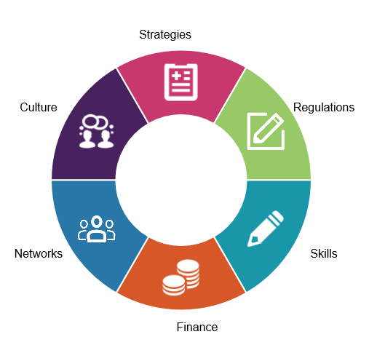
Modules

Slide 13
Policy for supporting Minority Entrepreneurs in USA
Corporations, the federal government and state agencies usually prefer to do business with minority entrepreneurs.
Certification “the Minority Business Enterprise” or “MBE”
The Minority Business Development Agency (MBDA) plays an important role in the area of minority entrepreneurship.

Slide 14
The Minority Business Development Agency
The MBDA promotes growth and competitiveness of minority owned businesses, including Hispanic, Latino American, Asian Pacific American, African American and Native American businesses.
The agency wants to help minority owned businesses by providing access to capital, contracts and market opportunities – on a local and global level.
This organization helps minority owned businesses with their advisory services.

Slide 15
Inclusive entrepreneurship policies and programs in the Czech Republic
The support can be divided into direct and indirect.
The direct support is through financing of the creation of new minority enterprises (own business, self-employment, social enterprises).
The indirect governmental support is through buying products or services from the minority enterprises.

Slide 16
Summary
The role of policy to support minority businesses is primarily to involve minority groups in the labor market. Involving minority groups in the labor market in the form of starting a business promotes economic growth and is therefore highly desirable. Policy makers have the task of preparing support programs to help minority groups start their own business. An inclusive business policy aims to give everyone the same opportunity to start a business or start a self-employed activity regardless of their social background.

