Slide 1

GROWTH, ECONOMIC DEVELOPMENT AND STRUCTURE OF THE WORLD ECONOMY
Ingrid Majerova
World Economy
EVS/XXX
LESSON III

Slide 2

Outline of the lecture
Growth of the World Economy
Economic Development of the World Economy
Structure of the World Economy
Waves of the World Economy
Trends in the World Economy

Slide 3
GROWTH AND ECONOMIC DEVELOPMENT OF THE WORLD ECONOMY
Economic growth: such a development of the productive forces of the economy, which leads to the growth of output of finished goods and services, which is subsequently reflected in the increase in real output for a certain period
Development of the productive forces: change of the scope and quality of production factors as a result of scientific and technological progress
Economic development: changing the scope and quality of the country's wealth, which occurs so that part of the newly produced goods are not consumed in a given period, but is accumulated in the economy

Slide 4
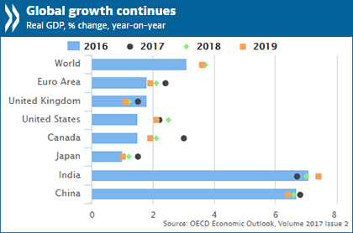
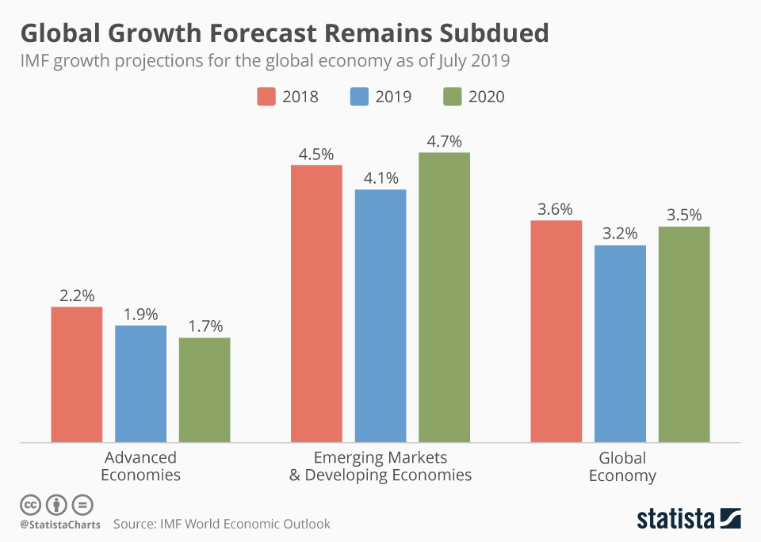
DEVELOPMENT OF THE WORLD ECONOMY

Slide 5
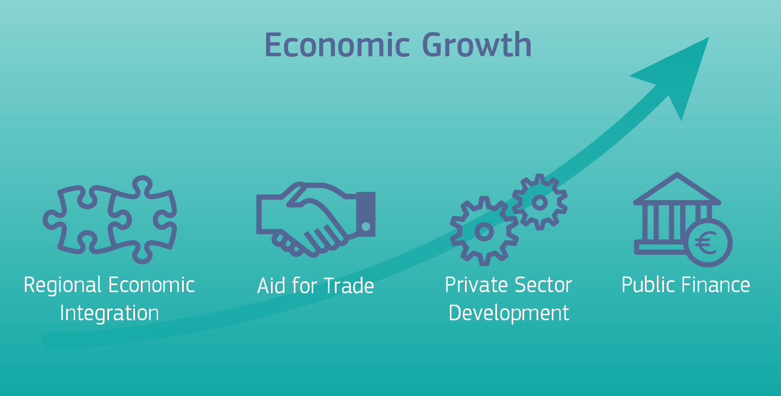
GROWTH AND ECONOMIC DEVELOPMENT OF THE WORLD ECONOMY
Lower limit of economic growth: given by the population growth
Minimal growth provides only stagnation of the economy, it is about economic growth without economic development
Upper limit economic growth: based on the possibility of exhaustion of material resources
Rather than the upper limit of growth is possible to talk about short-term barriers to growth

Slide 6
GROWTH AND ECONOMIC DEVELOPMENT OF THE WORLD ECONOMY
Barriers of economic growth: labor shortages or inadequate level of its qualifications, lack of raw materials, respectively lack of capital
Measurement of global growth: based on macroeconomic aggregates and these aggregates are then used to measure the growth rate of the world economy
The types of economic growth:
Intensive growth: linked with the growth of labor productivity based on the application of new knowledge in science and technology, set up their own regional groupings,
Extensive growth: associated with widespread deposits of labor and capital at the technical level
Development proceeds vary unevenly….
Solow neoclassical growth theory: sources of growth are increasing labor inputs and capital, together with the use of innovation and the rise of human capital.

Slide 7
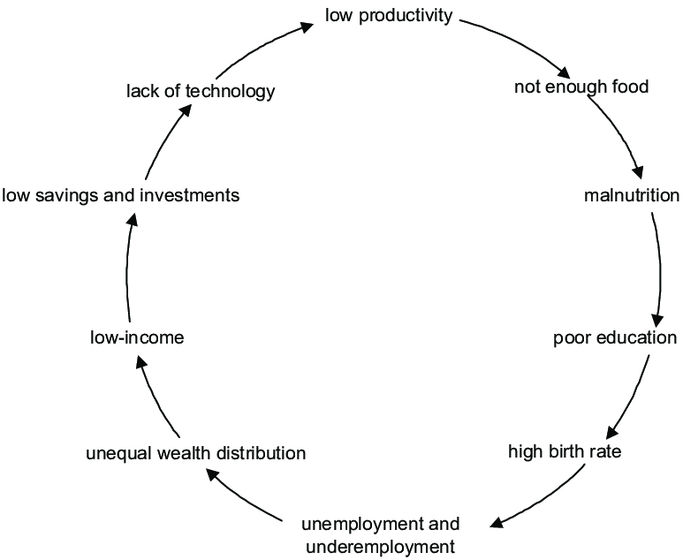
DEVELOPMENT OF THE WORLD ECONOMY
The vicious cycle of poverty

Slide 8
REGIONAL INEQUALITY GROWTH AND ITS FACTORS
Basic condition of growth: natural conditions
Climatic conditions: they can be so severe that fundamentally limit the conditions for human survival and impossible to use eg. mineral resources hidden in the ground
Geographic remoteness and difficult access settlements of people due to the nature of the terrain: hampers the exchange of information, restricts trade and leads to delayed development of such isolated civilizations
Other growth factors: a form of social organization (ownership relations), the realization of free will of members in society and the economy's ability to generate and adopt innovations
Last growth factors - market size, which is given by:
  the size of the economy
  degree of involvement of the economy into the world economy
  and the nature of integration into the world economy

Slide 9
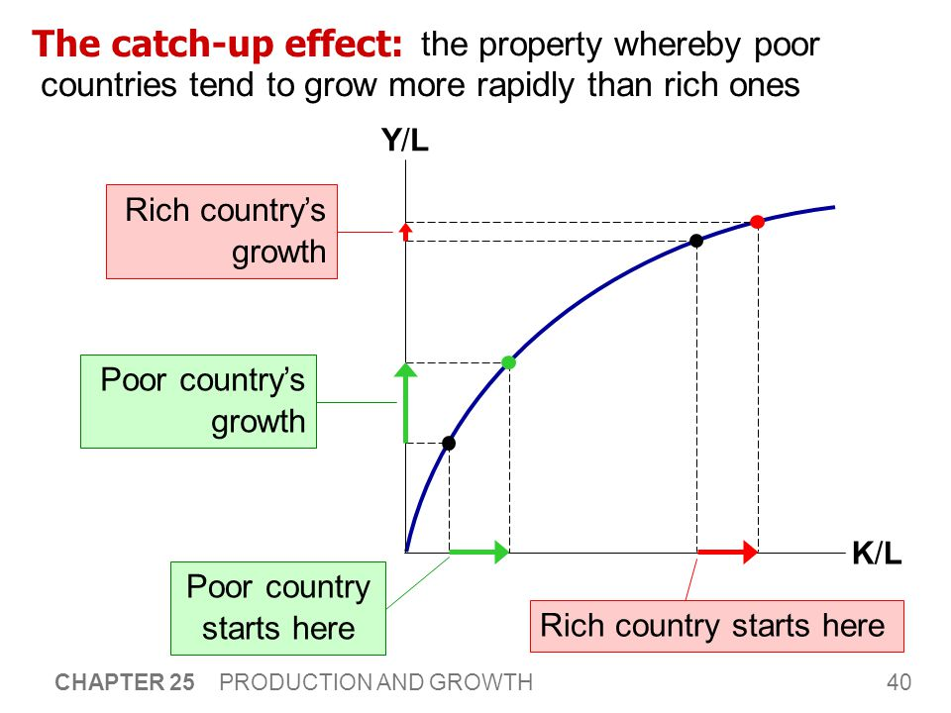
REGIONAL INEQUALITY GROWTH AND ITS FACTORS
Characteristic feature of the global economy: regional inequality of growth
Catching up effect: the country does not need to make an effort to discover once discovered innovation and technological processes

Slide 10
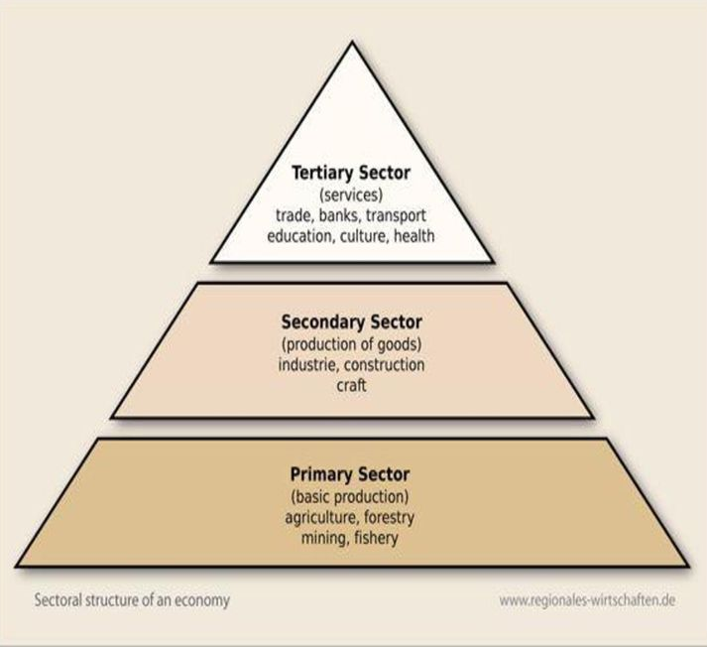
DEVELOPMENT OF THE SECTOR STRUCTURE OF THE WORLD ECONOMY
Sector: summary of the production units producing the same product
Sectoral structure of the economy: the share of individual sector in the economy - economic development of the country
Economic growth is accompanied by changes in the sectoral structure of the economy of each country
Changes in the structure of the economy: changing the share of each sector in GDP and total employment

Slide 11
DEVELOPMENT OF THE SECTOR STRUCTURE OF THE WORLD ECONOMY
Economic sectors:
  primary sector (A), which is agriculture, forestry, fishing and mining,
  secondary sector (I), which is represented by industry, construction, energy
  tertiary sector (S), which consists of transportation, communication, trade, finance, science, education etc.
Three basic types of structures:
  Traditional:
  ASI, dominated by agriculture,
  AIS, with the dominant agriculture and higher share of industry
  Industrial:
  IAS with lower industrial structure and prevailing industry
  ISA characterized by higher industrial structure,
  Modern:
  SIA with prevailing of services

Slide 12
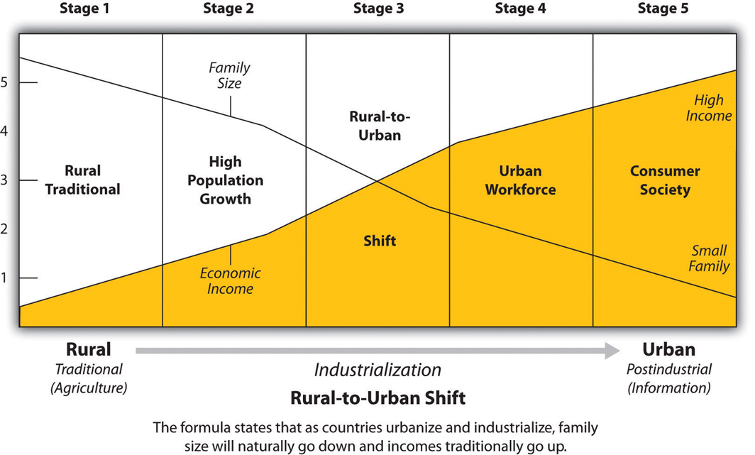
DEVELOPMENT OF THE SECTOR STRUCTURE OF THE WORLD ECONOMY
18th century 20th century

Slide 13
DEVELOPMENT OF THE SECTOR STRUCTURE OF THE WORLD ECONOMY
18th century 20th century

Slide 14
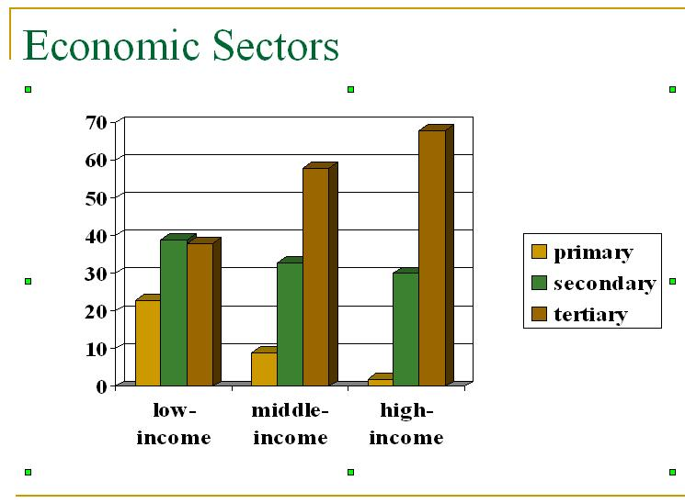
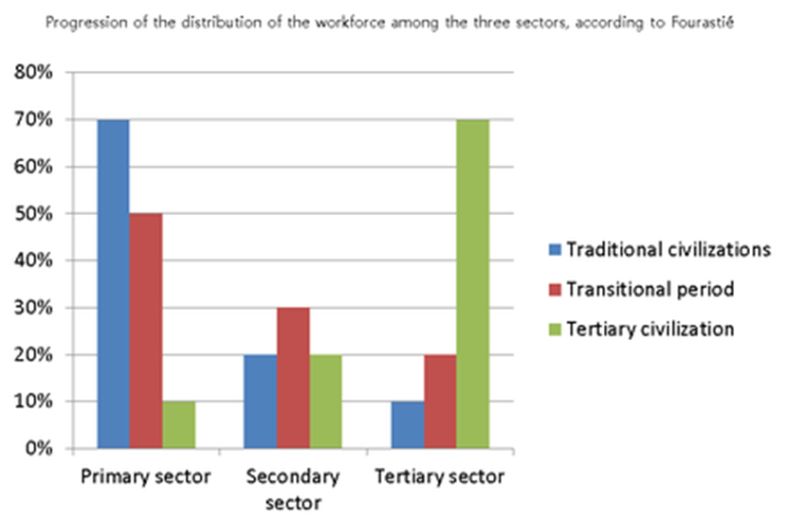
DEVELOPMENT OF THE SECTOR STRUCTURE OF THE WORLD ECONOMY

Slide 15
THE GROWTH OF THE WORLD ECONOMY AND TECHNICAL PROGRESS
Scientific and technical progress: process of continuous discovery of knowledge (inventions) and their implementation in the form of innovation in the production process of goods and services
Consequences of scientific progress:
Changes in the structure of existing production units, manifested as a change in the division of labor, specialization and cooperation between the different production units,
The emergence of new products, new industries and manufacturing and services sectors and the termination of old industries and sectors.
Specialization: condition in which the manufacturer restricts the range of production only to a narrow circle, which produces more efficiently than other manufacturers and achieves economies of scale,
Diversification of production: condition where the expansion of product range with new products satisfying the constantly new forms of consumption

Slide 16
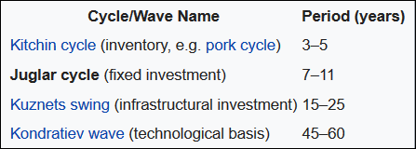
THE GROWTH OF THE WORLD ECONOMY AND TECHNICAL PROGRESS
Scientific and technological progress affects economic growth not only by the emergence of new industries and a decline of the importance of other sectors, ie. makes changes in the structure of the national economy, but affects the evenness of growth as well,
Joseph Alois Schumpeter (1883-1950) distinguished three types of cycles according to duration:
  Kondratieff economic cycle (60 years)
  Longer economic Kuznetz cycle (20 years)
  Medium-term economic Juglar cycle, or investment cycle (lasting 10 years)
  Short-term economic Kitchin cycle (duration 3-5 years), associated with cycles in renewal of stocks
Radical or also fundamental innovation give the basic rhythm of economic development

Slide 17
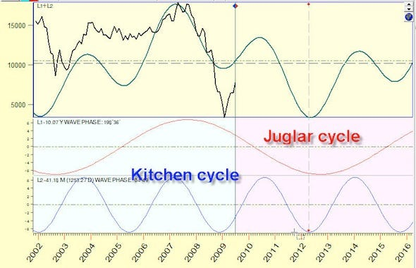
DEVELOPMENT OF THE SECTOR STRUCTURE OF THE WORLD ECONOMY

Slide 18
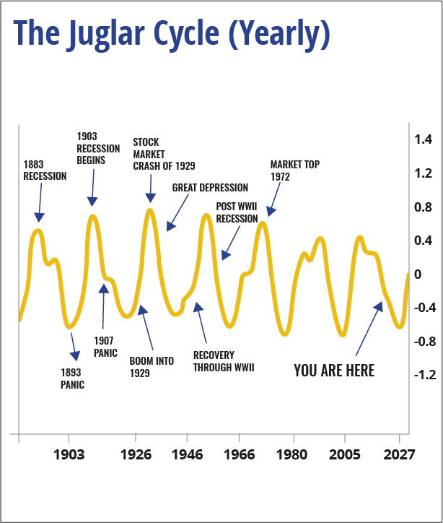
DEVELOPMENT OF THE SECTOR STRUCTURE OF THE WORLD ECONOMY

Slide 19
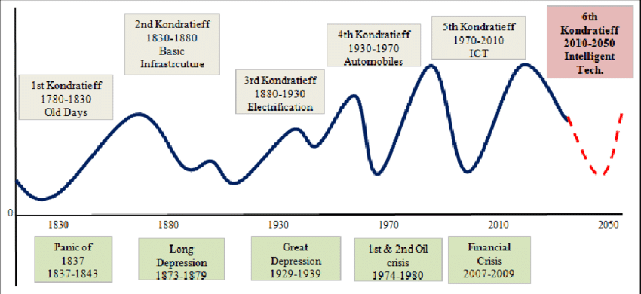
THE GROWTH OF THE WORLD ECONOMY AND TECHNICAL PROGRESS

Slide 20
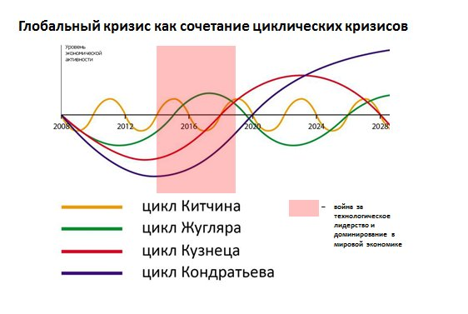
DEVELOPMENT OF THE SECTOR STRUCTURE OF THE WORLD ECONOMY

Slide 21


THE GROWTH OF THE WORLD ECONOMY AND TECHNICAL PROGRESS
Industrial cycle (first three Kondratieff cycles): technology machine mass production and mass production of uniform products in large enterprises
Post-industrial cycle (last two Kondratieff cycles): decentralized production of custom and basic technologies are becoming information and knowledge technologies

Slide 22
TRENDS IN THE WORLD ECONOMY
Internationalization of production: process in which foreign trade enters directly into the production process
Interdependence of countries: the state, when country specialization leads to interdependence between countries
Internationalization of the world economy: situation in which the decision-making in the country is significantly influenced by developments in other countries
Globalization: process in which the retraction of individual national economies deepens further into the world economy

Slide 23
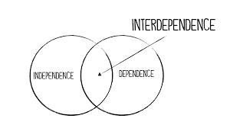
TRENDS IN THE WORLD ECONOMY
Basic characteristic of the development of the world economy is its temporal and regional inequality
Internationalization: the process of widening and deepening of international economic relations, due to economies of specialization
Interdependence: growth of countries´ dependence on imports from other countries, and this dependency is usually reversible

Slide 24
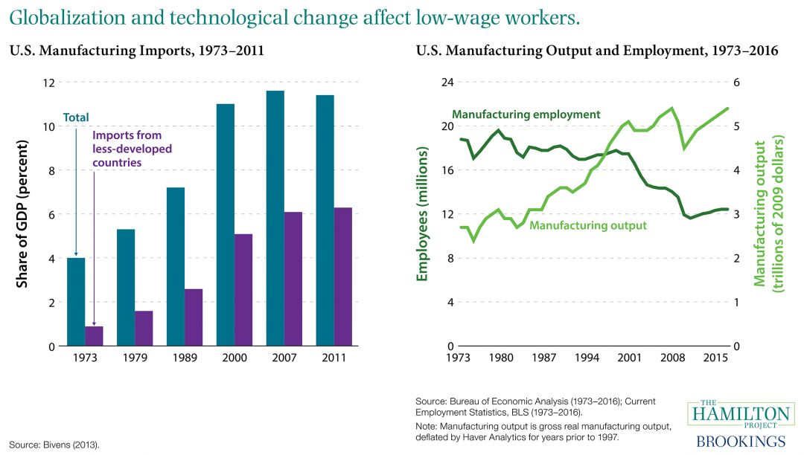
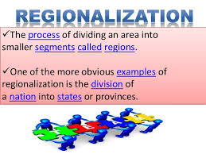
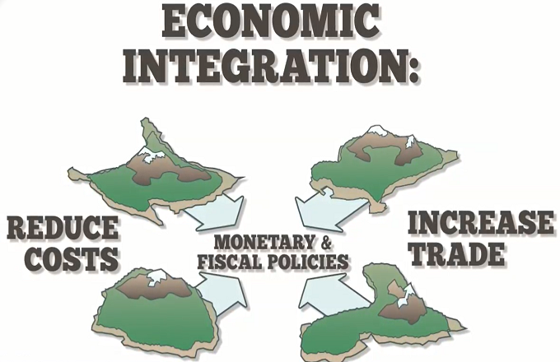
TRENDS IN THE WORLD ECONOMY
Regionalization: process that is given by the fact that in some regions of the world economy, the processes of internationalization and interdependence promote more intensively than others
Integration: completion of the above processes by the institutionalization
Globalization: it represents the intersection of the above tendencies, but brings new aspects, while it can be characterized as the internationalization of higher type

Slide 25
WORLD ECONOMY
Thank you for your Attention!

