Slide 1

INFLATION AND UNEMPLOYMENT
LESSON VIII
Dr. Ingrid Majerova
MACROECONOMICS/EVS/NAMAB

Slide 2
INFLATION AND ENEMPLOYMENT
Outline of the lecture
Inflation
Deflation and Disinflation
Measurement of Inflation
Unemployment and its Concepts
Phillips Curve

Slide 3

INFLATION AND UNEMPLOYMENT
INFLATION, DEFLATION AND DISINFLATION
Inflation is defined as the percentage increase in the average price level in a given period of time.
When we talk about inflation of a country, we indicate the increase in the general price level, not increase in the price of specific commodities.
The opposite scenario of inflation is called deflation.
  Deflation is defined as the percentage decrease in the average price level in a given period of time.
Inflation is generally considered bad if it is high, deflation is also considered bad if decrease in the price level is considerable.
If the rate of inflation falls then we call it disinflation.

Slide 4
INFLATION AND UNEMPLOYMENT
INFLATION AND ITS SOURCES
Demand-pull inflation: occurs when demand increases exceeding available supply.
Cost-push inflation: occurs when cost of production increases and as a result producers increase price.
Fiscal inflation: occurs when there is excess government spending. This may also be considered as another version of demand-pull inflation.
Monetary inflation: occurs when the government increases money supply.
Pricing power inflation: occurs when firms increase price to maximize their profit.
Protective measure: occurs when a country, for example increases tariff to protect domestic industries.

Slide 5
INFLATION AND UNEMPLOYMENT
INFLATION AND ITS EFFECTS
Negative effects:
Hurts fixed income group
Encourages hoarding
Social unrest
Menu cost
Automatic tax increase (Bracket creep)
Money illusion
Creates pressure on the exchange rate
Hurts lenders
Positive effects:
Employment increases
Beneficial for the borrowers and therefore encourages investment

Slide 6
INFLATION AND UNEMPLOYMENT
DEGREE OF INFLATION
Opinions about the acceptable degree of inflation varies.
A general thumb rule is: if the rate of inflation is below 5% it is tolerable. It is very good when around 2%. Policy makers should be cautious when the rate is more than 5% but less than 10%. Policy makers should declare war against inflation if the rate is more than 10%.
Usually an inflation rate without a time dimension indicates annual inflation.
But, if the rate is monthly or quarterly then situation gets much worse.
Hyperinflation is the extreme scenario when the rate of inflation increases abnormally, may be even on a daily basis.

Slide 7
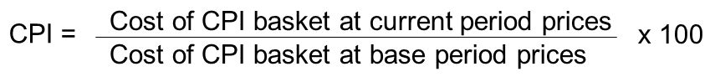
INFLATION AND UNEMPLOYMENT
MEASUREMENT OF INFLATION
Consumer Price Index (CPI): an index that depicts changes in prices of selected consumer goods.
Wholesale Price Index (WPI): This is also know as Producer Price Index (PPI). It indicates changes in the price of selected wholesale goods.
GDP Deflator = (nominal GDP / real GDP) X 100
Core price index: an index that indicates price changes of selected items (excluding items prices of which are volatile).

Slide 8
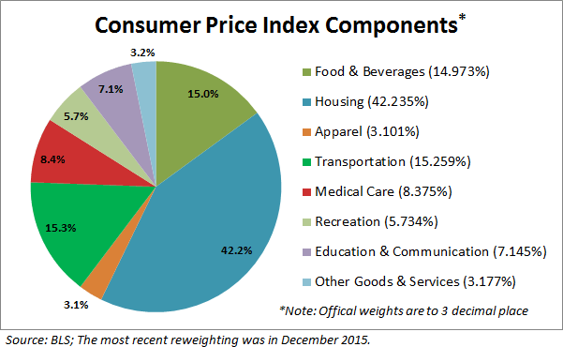
INFLATION AND UNEMPLOYMENT
MEASUREMENT OF INFLATION (CASE OF US CPI)

Slide 9
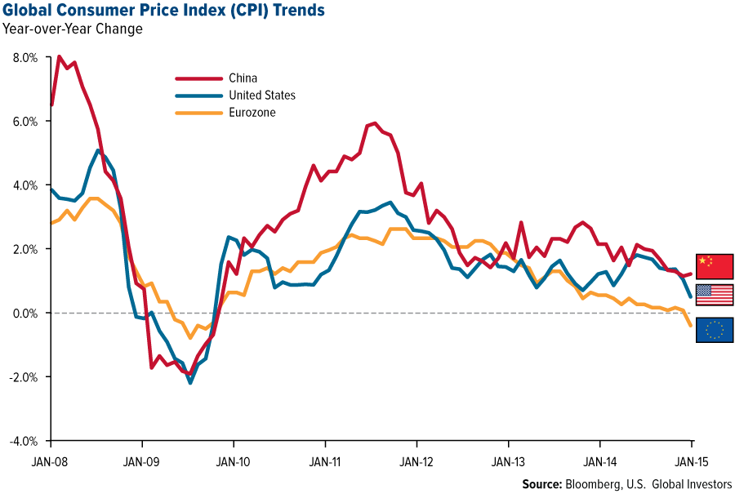
INFLATION AND UNEMPLOYMENT
DEVELOPMENT OF INFLATION (CASE OF US, CHINA AND EUROZONE)

Slide 10
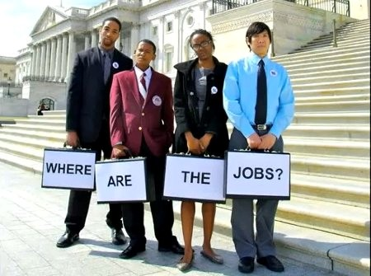
INFLATION AND UNEMPLOYMENT
UNEMPLOYMENT
Is defined by the International Labor Organization (ILO) as a situation in which people are without jobs and they have actively looked for a job for the past four weeks.
According to this definition, people who do not look for a job will not be considered unemployed.

Slide 11
INFLATION AND UNEMPLOYMENT
FORMS OF UNEMPLOYMENT
Frictional unemployment: caused by temporary job loss. For example: when workers switch jobs they might be unemployed for a short period as long as they find a suitable job.
Structural unemployment: caused by a permanent shift of events. For example: if a country shuts down its jute factories and starts readymade garments industries then workers of the jute industry may find it very difficult to find a job in the readymade garments industry as the skills set does not match.
Natural rate of unemployment: it is the level of unemployment when the economy is at the full employment level. The natural rate of unemployment is a combination of both frictional and structural unemployment.
Cyclical unemployment: it is the deviation of natural rate of unemployment form the actual employment.

Slide 12
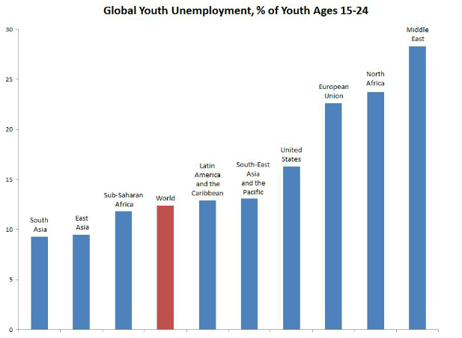
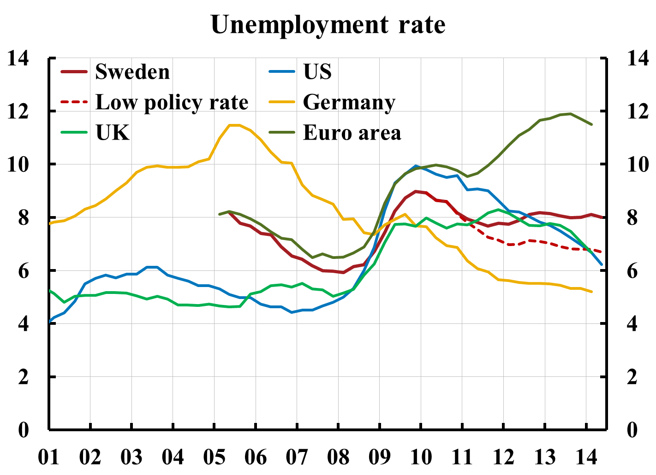
INFLATION AND UNEMPLOYMENT
DEVELOPMENT OF UNEMPLOYMENT

Slide 13
INFLATION AND UNEMPLOYMENT
RELATION OF INFLATION AND UNEMPLOYMENT
There is a common perception that inflation and unemployment are related was proposed by A. W. Phillips in 1958.
Phillips explained 97 years of British data on unemployment and nominal wage growth and found that, historically, unemployment tended to be low in years when nominal wages grew rapidly and high in years when nominal wages grew slowly.
Economists later modified Phillips’s linkage between wage growth and unemployment and plotted the relationship between unemployment and growth of price level.
This negative relationship when showed in a graph is called the Phillips Curve.

Slide 14
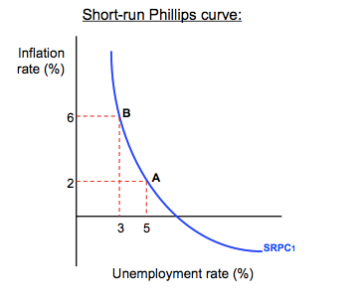
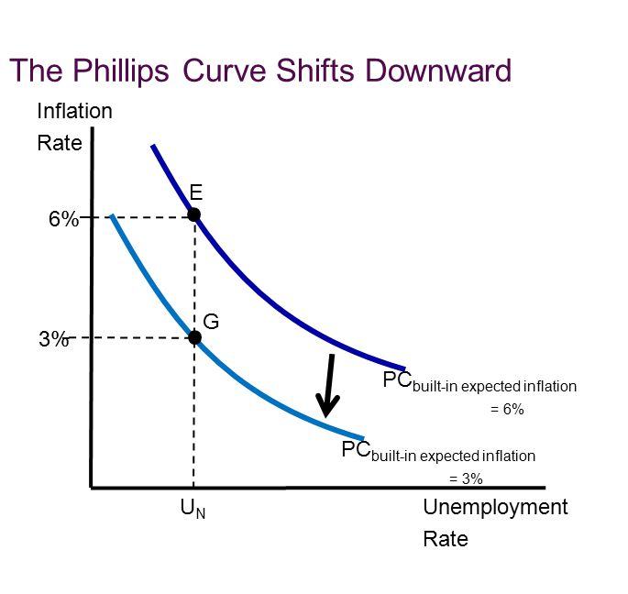
INFLATION AND UNEMPLOYMENT
PHILLIPS CURVE

Slide 15
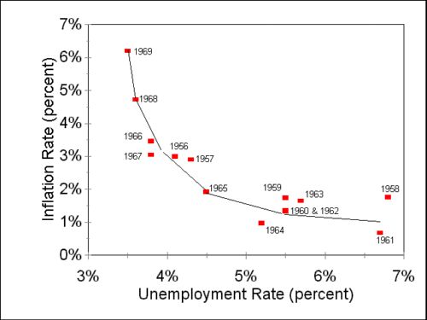
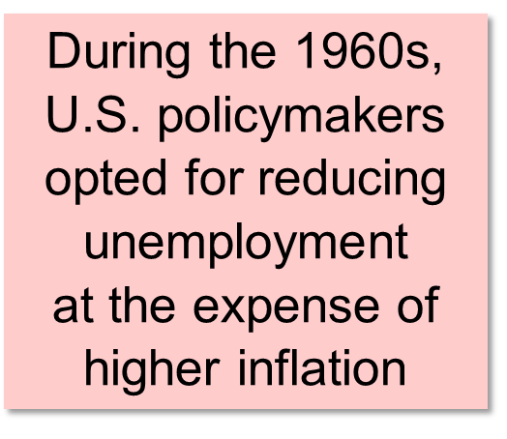
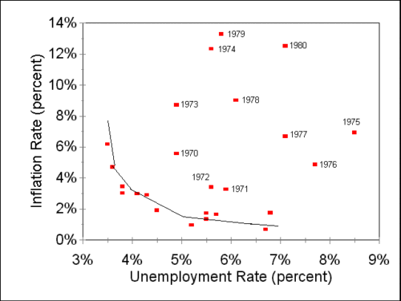
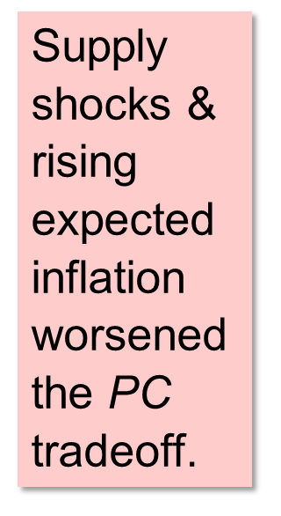
INFLATION AND UNEMPLOYMENT
US PHILLIPS CURVE, 1950s, 1960s and 1970s

Slide 16
INFLATION AND UNEMPLOYMENT
EMPIRICAL EVIDENCE OF PHILLIPS CURVE
During 1960s in the USA unemployment rate and inflation were found to be negatively related supporting the Phillips curve.
However, for the 1970-2002 period there was no clear negative relationship between inflation and unemployment
The non-existence of the negative relationship between inflation and unemployment after 1970 raised three questions:
  Why was negative relationship observed before 1970?
  Why did the relationship vanish after 1970?
  Does the Phillips Curve provide choices for the policymakers?

Slide 17


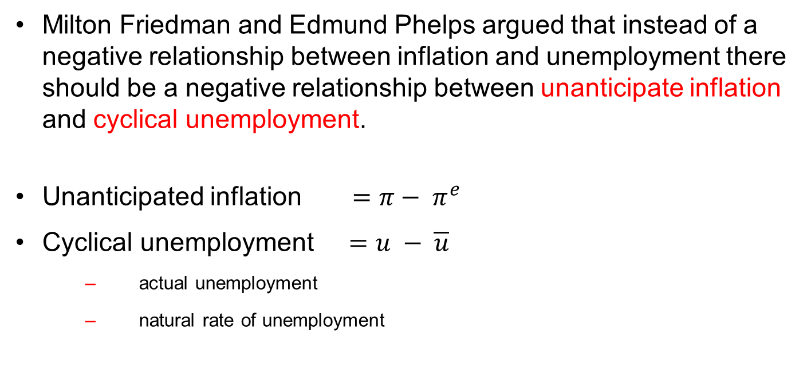
INFLATION AND UNEMPLOYMENT
THE EXPECTATION-AUGMENTED PHILLIPS CURVE
Milton Friedman and Edmund Phelps argued that instead of a negative relationship between inflation and unemployment there should be a negative relationship between unanticipate inflation and cyclical unemployment.
Unanticipated inflation $=π− π^{e}$
Cyclical unemployment $=u − \overline{u}$
  actual unemployment
  natural rate of unemployment

Slide 18
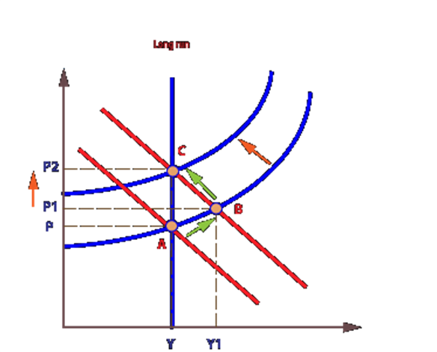
INFLATION AND UNEMPLOYMENT
THE EXPECTATION-AUGMENTED PHILLIPS CURVE
Suppose, an economy is at full-employment with steady, full anticipated inflation.
  In this economy both unanticipated inflation and cyclical employment are zero.
For some reason, aggregate demand growth increases unexpectedly and as a result unanticipated inflation increases and cyclical unemployment reduces.
  If this is the case, then it shows the negative relationship between unanticipated inflation and cyclical unemployment.

Slide 19
INFLATION AND UNEMPLOYMENT
THE EXPECTATION-AUGMENTED PHILLIPS CURVE
However, in expectations differ from reality, both unanticipated inflation and cyclical unemployment will be non-zero.
In expected inflation is less than actual one - there will be positive unanticipated inflation and negative cyclical unemployment.
On the other hand, if expected inflation is more than actual one - then there will be negative unanticipated inflation and positive cyclical unemployment.
The above relations shows that the relationship that Phillips curve states will not hold if expected inflation or natural rate of unemployment deviates from the actual inflation and unemployment rate respectively.

Slide 20
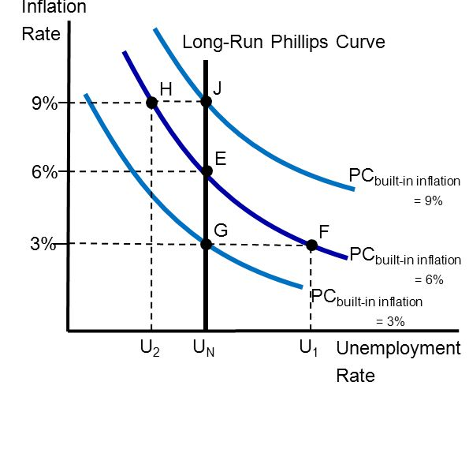
INFLATION AND UNEMPLOYMENT
LONG RUN PHILLIPS CURVE
The vertical line is the economy´s long-run PC, showing all combinations of unemployment and inflation the central bank can choose in the long run.
The curve is vertical because in the long run, the unemployment rate must equal the natural rate (NAIRU)

Slide 21
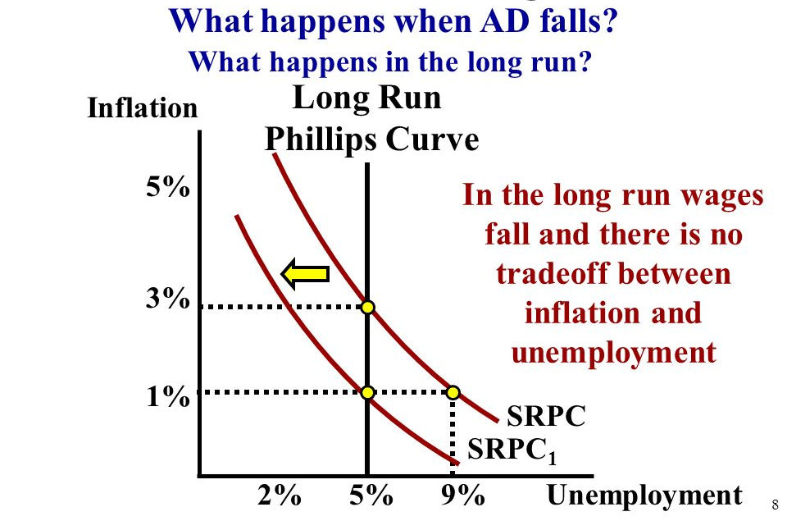
INFLATION AND UNEMPLOYMENT
LONG RUN PHILLIPS CURVE

Slide 22
INFLATION AND UNEMPLOYMENT
ANSWERING THE PREVIOUS QUESTIONS
Why was negative relationship observed between inflation and unemployment in USA before 1970?
  Because both natural rate of unemployment and expected inflation were fairly constant.
Why didn’t the relationship hold after 1970?
  There were several shocks in the economy including 1973 oil shock, 1979 oil shock, Iraqi invasion in Kuwait in 1990, east Asian currency crisis in 1997, attack on Twin Tower in 2001, USA’s preemptive strike on Iraq in 2004.
  Because of these shocks, the usual relationship stated by the Phillips curve did not hold. However, plotting unexpected inflation on the vertical axis and cyclical unemployment on the horizontal axis proves that Friedman-Phelps theory was correct- there was negative relationship between cyclical unemployment and unexpected inflation.

Slide 23
INFLATION AND UNEMPLOYMENT
ANSWERING THE PREVIOUS QUESTIONS
Does the Phillips Curve provide choices for the policymakers?
  Classical and Keynesian economists differ on this issue.
  Classical economists believe in rapid adjustment of economic variables, and therefore, suggest that temporary surprises will not have any effect. In this context, the classical economists think that Phillips curve does not represent any policy choice for the policy makers.
  On the other hand, Keynesians believe that the policy makers have choices, at least in the short run, to manipulate expected inflation to change natural rate of unemployment.
  However, both the classical and the Keynesian economists agree that such use of Phillips curve is not possible in the long run, as in the long-run everything will be adjusted to reach equilibrium.

Slide 24
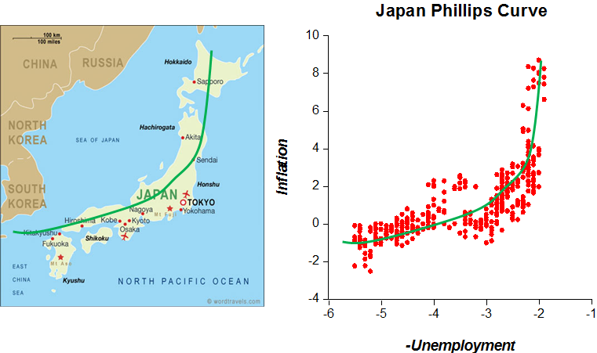
INFLATION AND UNEMPLOYMENT
JAPAN PHILLIPS CURVE

Slide 25
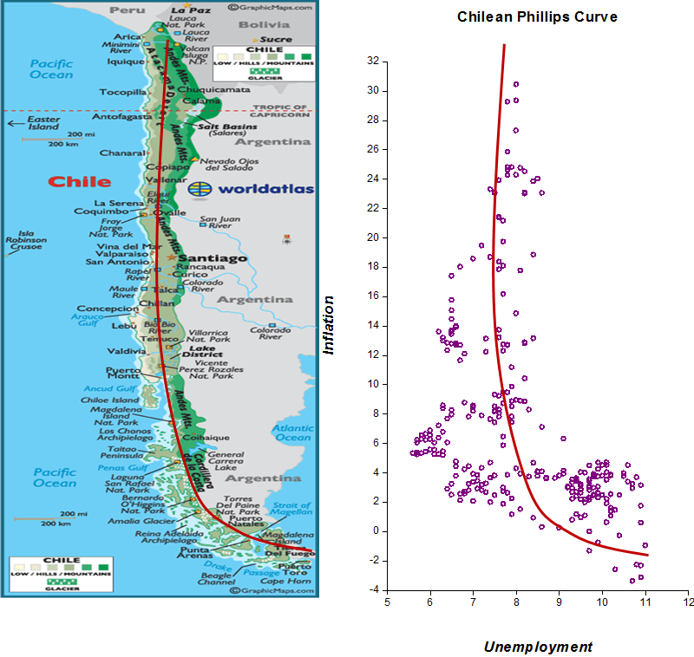
INFLATION AND UNEMPLOYMENT
CHILLEAN PHILLIPS CURVE

Slide 26
INFLATION AND UNEMPLOYMENT
THANK YOU FOR YOUR ATTENTION…

