Slide 1

BUSINESS CYCLES
LESSON X
Dr. Ingrid Majerova
MACROECONOMICS/EVS/NAMAB

Slide 2
BUSINESS CYCLES
Outline of the lecture
Long-run and short-run – determination of growth and business cycles
Characteristic of Growth
Characteristic of Business Cycles
Indicators of Business Cycles
Some Practical Cases

Slide 3


BUSINESS CYCLES
LONG- RUN AND SHORT-RUN
The four central issues of macroeconomics are growth, business cycles, unemployment, and inflation
Issues of growth are considered in a long-run framework
  Long-run growth focuses on supply (also called supply-side economics)
  Supply is so important in the long run, policies that affect production - such as incentives that promote work, capital, and technological change - are key.
Business cycles are generally considered in a short-run
framework
  The short-run fluctuation framework focuses on demand.
  Much of the policy discussion of short-run fluctuations focuses on ways to increase or decrease components of aggregate expenditures.

Slide 4
BUSINESS CYCLES
THE GROWTH
The primary measurement of growth is change in real gross domestic product (GDP)
  Global experiences with growth vary across time and among nations.
  Today's growth rates are high by historical standards.
  The range of growth rates among nations is wide.
BENEFITS COSTS
- for all subjects - environmental problems (pollution,
- governments resources exhaustion, destruction
- creating jobs of natural habitat)
The Business Cycle allows people to understand the direction the economy (GDP) is going (growing or shrinking) and plan accordingly.

Slide 5
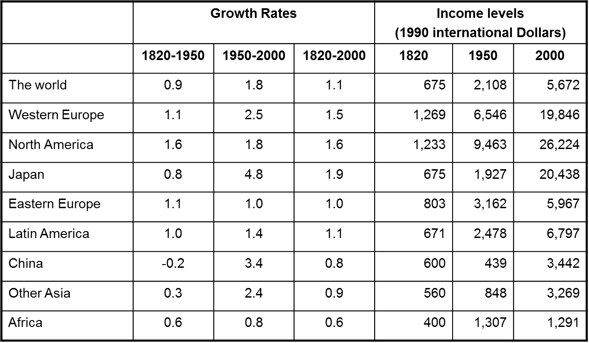
BUSINESS CYCLES
GROWTH

Slide 6
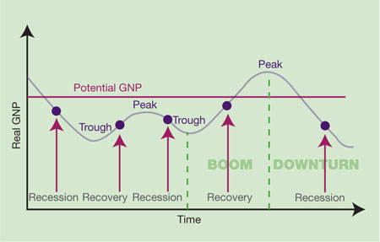
BUSINESS CYCLES
BUSINESS CYCLES
There are numerous fluctuations around the secular growth trend, called the business cycle.
The business cycle is the upward and downward movement of economic activity that occurs around the growth trend.

Slide 7
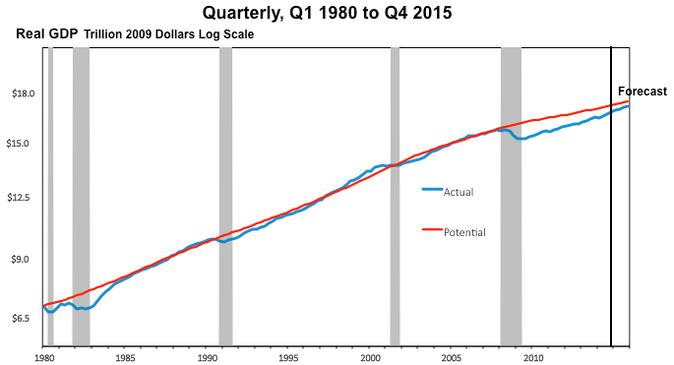
BUSINESS CYCLES
REAL AND POTENTIAL GROWTH OF U.S.

Slide 8
BUSINESS CYCLES
BUSINESS CYCLES
CANADIAN BUSINESS CYCLE
U.S. BUSINESS CYCLE

Slide 9
BUSINESS CYCLES
BUSINESS CYCLES
There are a number of theories regarding the nature and causes of business cycles
  CLASSICALS are group of economists who generally favour laissez-faire of interventionist policies
    Classical economists argue that business cycles are to be expected in a market economy
  KEYNESIANS generally favour activist policies
    Keynesian economists believe that fluctuations can and should be controlled.
  MONETARISTS focuse on low inflation rates and stable growth
    Inflation is always more damaging to any economy than unemployment. Unemployment hurts the jobless, inflation hurts everyone in the society.

Slide 10
BUSINESS CYCLES
INDICATORS OF BUSINESS CYCLES
Leading indicators anticipate the direction in which the economy is headed.
The coincident indicators provide information about the current status of the economy
  changing as the economy moves from one phase of the business cycle to the next
  telling economists that an upturn or downturn in the economy has arrived.
Lagging indicators change months after a downturn or upturn in the economy has begun and help economists predict the duration of economic downturns or upturns.

Slide 11
BUSINESS CYCLES
INDICATORS OF BUSINESS CYCLES
Based on the theory that expectations of future profits are the motivating force in the economy:
Companies may expand production of goods and services and investment in new structures and equipment, when business executives believe that their sales and profits will rise.
When they believe profits will decline, they reduce production and investment.
These actions generate the four phases of the business cycle.

Slide 12
BUSINESS CYCLES
CAUSES OF FLUCTUATIONS
Innovation
Political events
Random events
Wars
Level of consumer spending
Seasonal fluctuations
Cyclical Impacts — durable and non durable

Slide 13
BUSINESS CYCLES
CAUSES OF FLUCTUATIONS – ANOTHER VIEW
Business Investment
  When the economy is expanding, sales and profit keep rising, so companies invest in new plants and equipment, creating new jobs and more expansion. In contraction, the opposite is true
Interest Rates and Credit
  Low interest rates, companies make new investments, adding jobs. When interest rates climb, investment dries up and less job growth
Consumer Expectations
  Forecasts of an expanding economy fuels more spending, while fear of a recession decreases consumer spending
External Shocks
  External Shocks, such as disruptions of the oil supply, wars, or natural disasters greatly influence the output of the economy

Slide 14
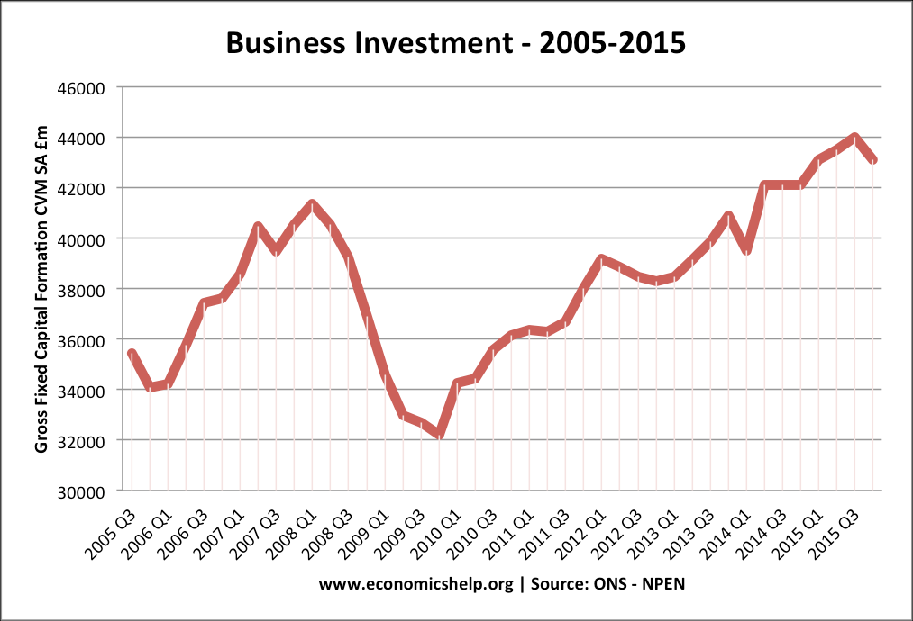
BUSINESS CYCLES
BUSINESS INVESTMENT

Slide 15
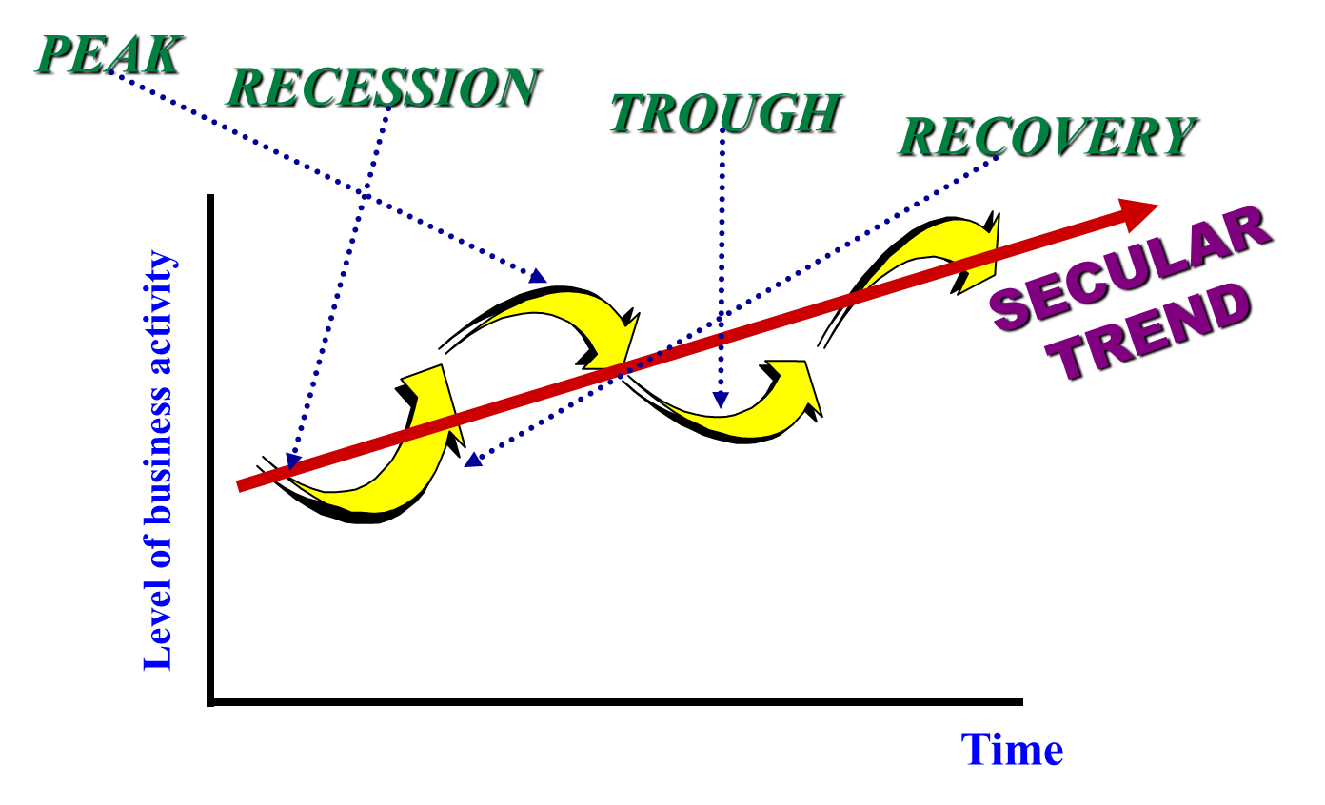
BUSINESS CYCLES
WHY DO BUSINESS CYCLES OCCUR?

Slide 16
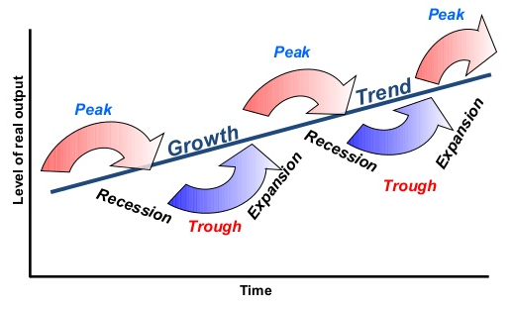
BUSINESS CYCLES
THE PHASES OF BUSINESS CYCLES
The peak is the top of the business cycle.
A boom is a very high peak, representing a big jump in output.
The downturn is the phenomenon of economic activity starting to fall from a peak.
The recession is a downturn that lasts at least two consecutive quaters of a year.
As total output starts to expand, the economy comes out of the trough into an upturn, which may turn into an expansion.
An expansion is an upturn that lasts at least two consecutive quarters of a year.

Slide 17
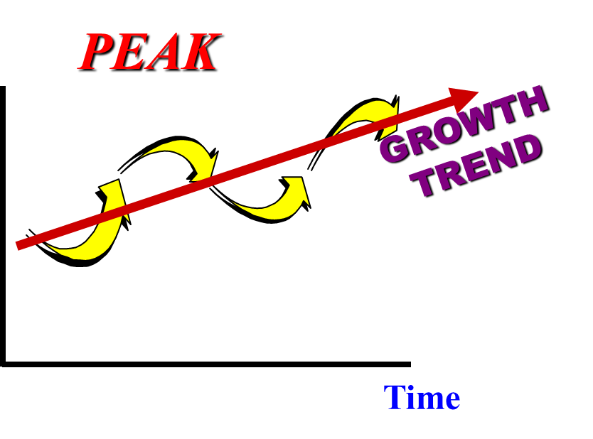
BUSINESS CYCLES
PHASES OF BUSINESS CYCLES
Peak or prosperity phase:
Real output in the economy is at a high level
Unemployment is low
Domestic output may be at its capacity
Businesses can’t produce any more or hire more people
Inflation may be high.

Slide 18
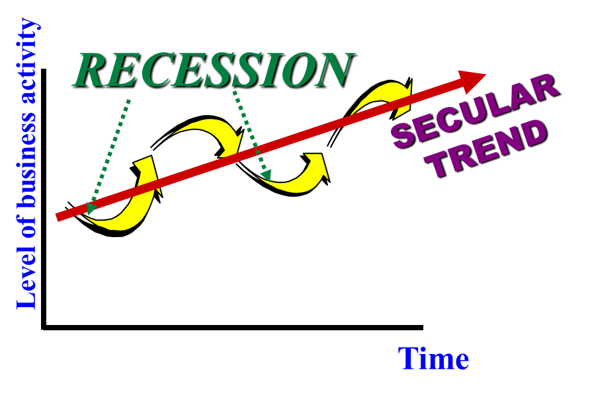
BUSINESS CYCLES
PHASES OF BUSINESS CYCLES
Contraction/recession phase (> 2 quarters of declining GDP):
Real output is decreasing
Unemployment rate is rising.
As contraction continues, inflation pressure fades.
If the recession is prolonged, price may decline (deflation)
A recession of more than one year is called a depression.

Slide 19
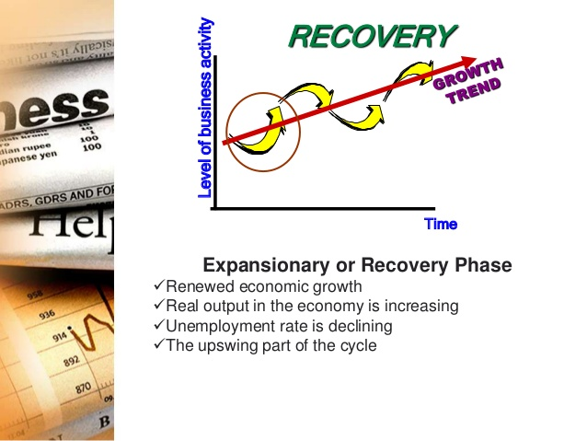
BUSINESS CYCLES
PHASES OF BUSINESS CYCLES
Expansionary (> 2 quarters of ↑ rGDP):
Real output in the economy is increasing
Unemployment rate is declining
People are optimistic and spending money
High demand for goods
Businesses start
Easy to get a bank loan
Businesses make profits and stock prices increase

Slide 20
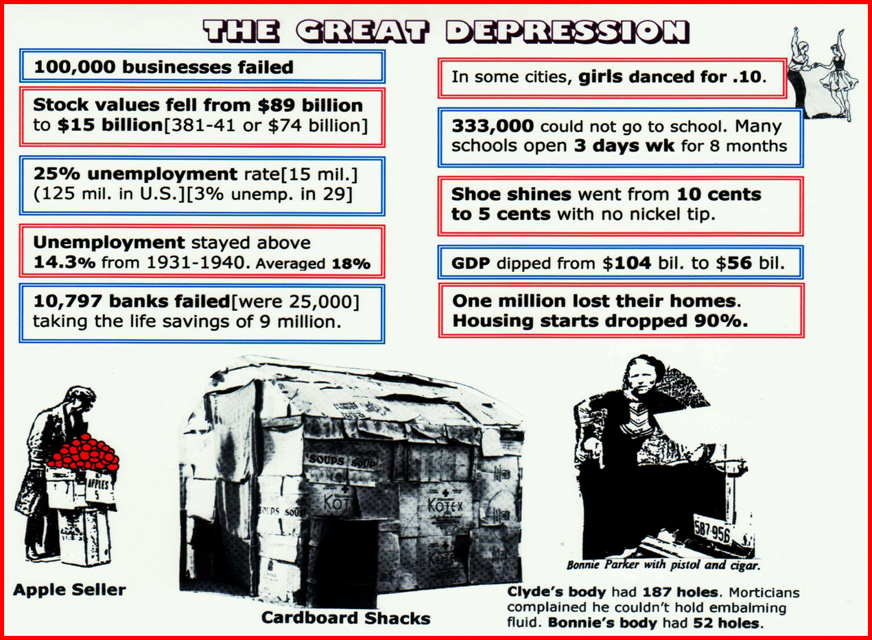
BUSINESS CYCLES
BUSINESS CYCLE IN 30´

Slide 21
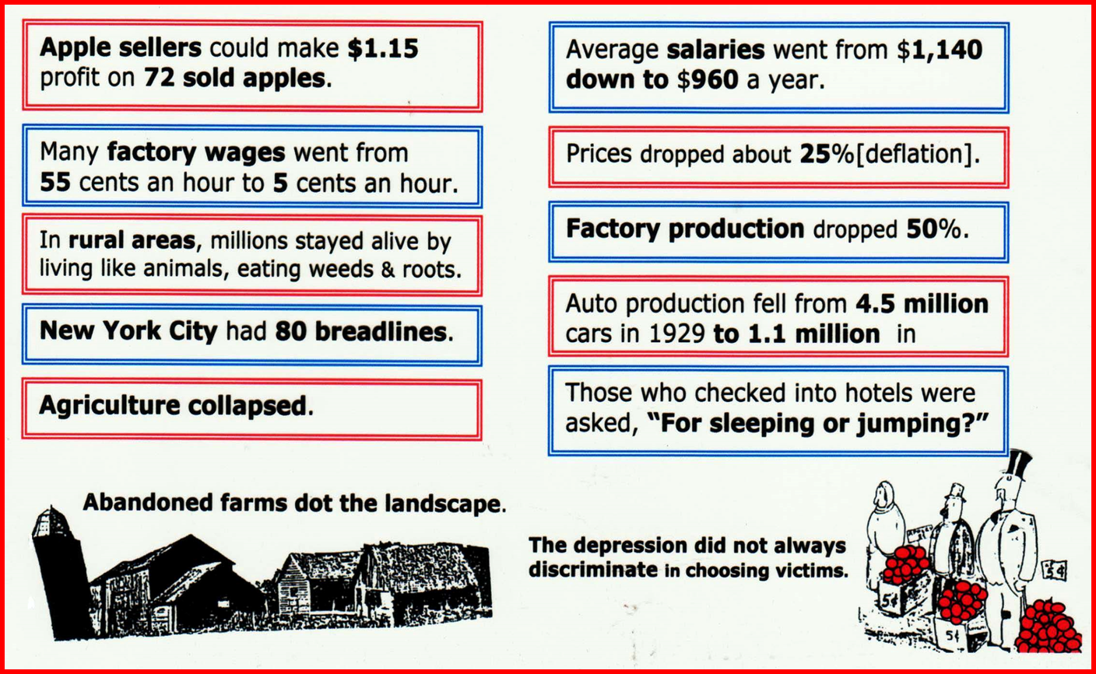
BUSINESS CYCLES
BUSINESS CYCLE IN 30´

Slide 22
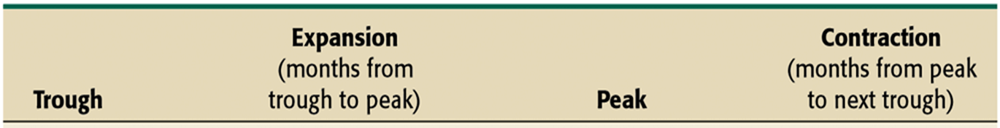
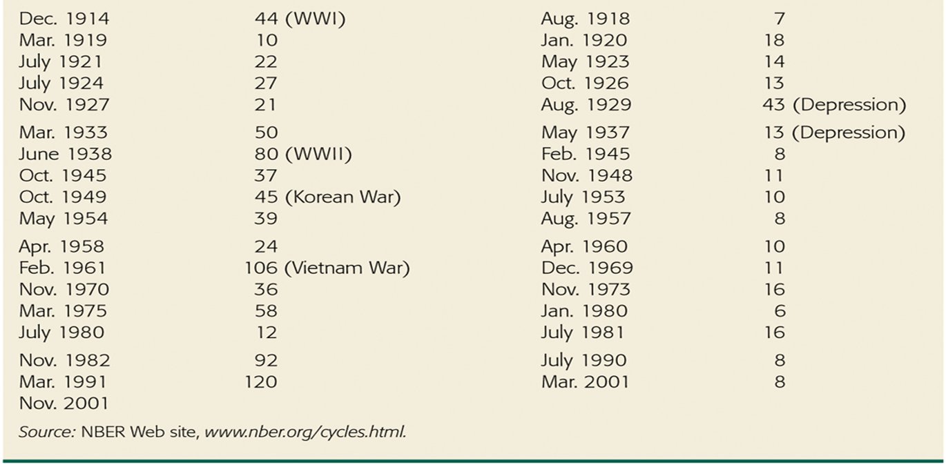
BUSINESS CYCLES
BUSINESS CYCLES IN USA

Slide 23
BUSINESS CYCLES
INTERNATIONAL ASPECTS OF BUSINESS CYCLES
International aspects of the business cycle
  The cyclical behavior of key economic variables in other countries is similar
  Major industrial countries frequently have recessions and expansions at about the same time
  Fig. illustrates common cycles for Japan, Canada, the United States, France, Germany, and the United Kingdom
  In addition, each economy faces small fluctuations that aren't shared with other countries

Slide 24
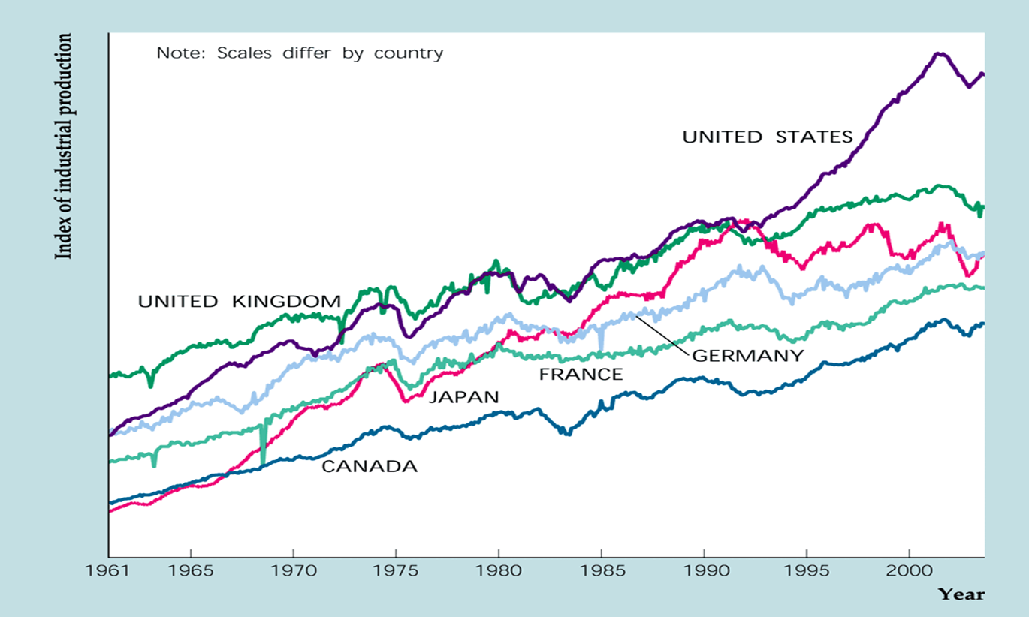
BUSINESS CYCLES
INTERNATIONAL ASPECTS OF BUSINESS CYCLES

Slide 25
BUSINESS CYCLES
THANK YOU FOR YOUR ATTENTION…

