Slide 1

Principles and Methods of Operational Analysis
Ing. Radomír Perzina, Ph.D.
Operational Analysis for Economists
INMBAOAE

Slide 2
Outline of the lecture
History
Phases of problem solving by methods of operational analysis
Mathematical modelling
Disciplines of operational analysis

Slide 3
History
Origin: World War II
Military problems: Deployment of radars. Management of convoy, bombing, antisubmarine and mining operations.
The result was called Military Operations Research
After World War II spreading to civil sector
From 50s of 20th century – taught at economical and technical universities
Operational Research = Operational Analysis

Slide 4
History
The roots of OR can be traced back many decades, when early attempts were made to use a scientific approach in the management of organizations.
However, the beginning of the activity called operations research has generally been attributed to the military services early in World War II.
Because of the war effort, there was an urgent need to allocate scarce resources to the various military operations and to the activities within each operation in an effective manner.
Therefore, the British and then the U.S. military management called upon a large number of scientists to apply a scientific approach to dealing with this and other strategic and tactical problems.

Slide 5
History
In effect, they were asked to do research on (military) operations. These teams of scientists were the first OR teams.
By developing effective methods of using the new tool of radar, these teams were instrumental in winning the Air Battle of Britain.
Through their research on how to better manage convoy and antisubmarine operations, they also played a major role in winning the Battle of the North Atlantic.
Similar efforts assisted the Island Campaign in the Pacific.
A key person in the post-war development of OR was George B Dantzig. In 1947, he developed linear programming and its solution method known as simplex method.

Slide 6
History
Besides linear programming, many other tools of OR such as statistical control, dynamic programming queuing theory and inventory theory were well developed before the end of the 1950s.
O.R. as a formal subject is about fifty five years old, origins may be traced to the latter half of World War II. The impetus for its origin was the development of radar defense systems for the Royal Air Force, and the first recorded use of the term Operations Research is attributed to a British Air Ministry official named A. P. Rowe who constituted teams to do “operational researches” on the communication system and the control room at a British radar station.

Slide 7
History
The studies had to do with improving the operational efficiency of systems (an objective which is still one of the cornerstones of modern O.R.). This new approach of picking an “operational’’ system and conducting “research” on how to make it run more efficiently soon started to expand into other arenas of the war.
Perhaps the most famous of the groups involved in this effort was the one led by a physicist named P. M. S. Blackett which included physiologists, mathematicians, astrophysicists, and even a surveyor. This multifunctional team focus of an operations research project group is one carried forward to this day. Blackett’s biggest contribution was in convincing the authorities of the need for a scientific approach to manage complex operations, and indeed he is regarded in many circles as the original operations research analyst.

Slide 8
Definitions
The science that applies mathematical and computer science tools to support decision making.
Operation Analysis is concerned with scientifically deciding how to best design and operate man-machine systems usually requiring the allocating of scarce resources. -Operations Research Society, America
Operation Analysis is the art of winning wars without actually fighting. -Arthur Clarke
Operation Analysis is a scientific method of providing executive departments with a quantitative basis for decision regarding the operations under their control. -Morse and Kimbal
Operation Analysis is the art of giving bad answers to problems where otherwise worse answers are given. -T.L. Satty

Slide 9
Operational Analysis Foundations
Team solving of a complex problem
OA = a set of disciplines for solving various decision-making problems. Exact definition of OA is not possible.
System methods for solving problems.

Slide 10
System approach
The essence of systems approach is to find all significant and indirect effects on all parts of a system and to evaluate each action in terms of the effects for the system as a whole. e.g., a new strategy of marketing department can effect all the other departments of the organisation and so in evaluating the strategy, not only its effects on the marketing department should be considered but also the effects of the proposal on other departments as well.

Slide 11
Inter-disciplinary team approach
OR is interdisciplinary in nature and needs a team approach solving economic, physical, psychological, biological, sociological and engineering aspects of any problem by the assistance of mathematicians statisticians, engineers, economists, management and computer experts, this team for a given problem tries to analyse the cause and effect relationship between various parameters and evaluates the outcome of various alternative strategies.

Slide 12
OR increases creative ability of the decision maker
OR is a powerful tool in increasing the effectiveness of managerial decision. OR techniques help the decision maker to improve his creative and judicious capabilities, analyse and understand the problem situation leading to better control, co-ordination, system finally better decisions.

Slide 13
Scientific approach
OR gives scientific methods for the purpose of solving problems, and there is no place of whims a guesswork in it. It is a formulized process of reasoning and consists of the following steps:
(i) Defining: The problem to be analyzed clearly and defining the conditions for observations.
(ii) Observing: Observations are made under different conditions to determine the behaviour of the system.
(iii) Formulating: A hypothesis describing how the various factors involved are believed to interact and the best solution to the problem is formulated on the basis of above observations.
(iv) Testing: Finally the result of experiment is design and executed, observations are made and measurements are recorded.
(v) Analysing: Finally the result of experiment are analysis and check weather hypothesis is accepted or not. Of the hypothesis is accepted it means the solution obtained is optimum.

Slide 14
Objectivistic approach
OR attempts to find out the strategic or optimal solution to the problem under consideration. For this purpose, it is required that a measure of effectiveness be defined which is based on the objectives of the organization. This measure is then used as the basis to compare the alternative courses of action.
Use of digital computer has become an integral part of the operations research approach to decision-making. The computer may be required due to the complexity of the model, volume of data required or the computations to be made. Many quantitative techniques are available in the form of ‘canned’ programmes.

Slide 15
Quantitative solution
Operation research assists the management with a quantitative basis for decision making. OR attempts to provide a systematic and scientific rational approach for quantitative solutions to the various managerial problems.
OR is a continuing process. It continues with the emergence of new problems, finding and implementing solutions and interpreting the results of such implementation. Problems continue to arise in the modern dynamic environment. As such OR becomes a continuing process.
OR ties to optimize total return by maximizing the profit and minimizing the cost or loss.
In deriving quantitative solution, sometimes human factors, play significant role, in the problems, are ignored. So, study of the OR is incomplete without a study of human factors.

Slide 16
Why Operational Analysis
You may ask, “Why must we learn the Operations Research techniques?” Here are a few motivating reasons:
Organizations are becoming more complex, Huge numbers of choices and relentless time pressures and margin pressures make the decisions you face more daunting and more difficult.
Environments are changing so rapidly that past practices are no longer adequate. Meanwhile, new enterprise applications and software are generating massive amounts of data – and it can see like an overwhelming task to turn that data into insight and answers.
The costs of making bad decisions have increased.

Slide 17
Operation Analysis Helps
Deciding where to invest capital in order to grow
Getting more value out of ERP (Enterprise Resource Planning), CRM (Customer Relationship Management), and other software systems
Figuring out the best way to run a call center
Locating a warehouse or depot to deliver material s over shorter distances at reduced cost
Forecasting sales for a new kind of product that has never marketed before
Solving complex scheduling problems

Slide 18
Operation Analysis Helps
Planning for a potential terrorist attack
Deciding when to discount, and how much
Getting more cycles out of manufacturing equipment
Optimizing a portfolio of investments, whether it contains financial securities or pharmaceutical product inventory
Deciding how large a budget to devote to Internet vs. traditional sales
Planting crops in the face of uncertainty about weather and consumer demand

Slide 19
Optimization problems
The aim of OA: To set intensity of operations or their relationship, in order to optimize behavior of the whole system
Criteria for evaluation of the system
Restricted sources
Optimization problem = Finding values of variable parameters to gain the maximal efficiency of the system.

Slide 20
Mathematical modelling
The main instrument of OA together with computers
Model = Abstract simplification of an object
Advantages:
  Analysis of the system behavior in relatively short time
  Easy manipulation of the system
  Specification of all possible states of the system
  Neglectable costs
Disadvantages:
  Simplification of the real object
  Limited accuracy of the results

Slide 21
Phases of OA Application
Problem definition
Economical model
(“verbal description“)
Mathematical model
Solving the model
Interpretation and verification
Implementation

Slide 22
Formulation of the Economical Model
Verbal description of the main elements of the real system and relations between the elements from the point of view of the solved problem
Elements of the economical model:
  Target of analysis
  Descriptions of processes in the system
  Description of factors that restrict the intensity of the processes
  Description of relations of processes, factors and target of analysis

Slide 23
Formulation of the Mathematical Model
Formalization of the verbal economical model
The mathematical model must contain the same elements as the economical model, but they must be expressed by mathematical apparatus
The target of the analysis: The function of n variables
Processes → variables
Intensity of processes → values of variables
Factors → nonchangable parameters,
Relations between processes, factors and target of analysis → equations and inequalities

Slide 24
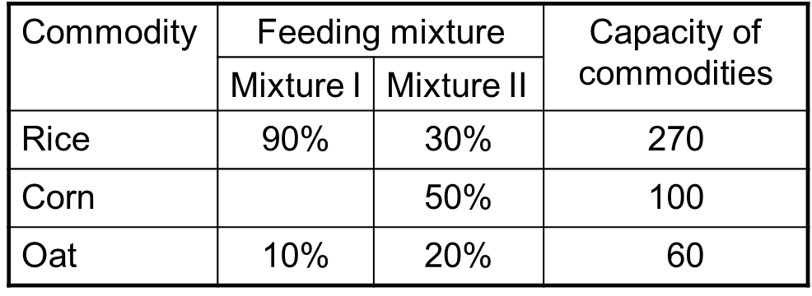
Example
The firm plan production of two kinds of feeding mixtures. The capacity of rice is 270 tons, corn 100 tons and oat 60 tons. It is necessary to abide the ratio of the compounds according to the following table:
The profit from selling 1 ton of mixture I is 2000 Euro and for the mixture II the profit is 3000 Euro/t. How much of each mixture should the firm produce to maximize the profit?

Slide 25
Disciplines of Operational Analysis
Mathematical Programming
Linear Programming
Optimization Problems on Graphs
Theory of Inventory
Queue Theory
Simulation
Theory of Games
....

Slide 26
Management Applications
Production Management
Marketing Management
Financial Management
Personal Management

Slide 27
Thank you for your attention

