Slide 1

Linear Programming I
Ing. Radomír Perzina, Ph.D.
Operational Analysis for Economists
INMBAOAE

Slide 2
Outline of the lecture
Transform the economical model to the mathematical model
Compounds of mathematical model
Basic terms concerning the Linear Programming (LP)
Graphically depict the set of feasible solutions of the LP problem with two variables
Solving the LP problem

Slide 3
Introduction to Linear Programming
A Linear Programming model seeks to maximize or minimize a linear function, subject to a set of linear constraints.
The linear model consists of the following
components:
  A set of decision variables.
  An objective function.
  A set of constraints.
The Importance of Linear Programming
  Many real world problems lend themselves to linear programming modeling.
  Many real world problems can be approximated by linear models.

Slide 4
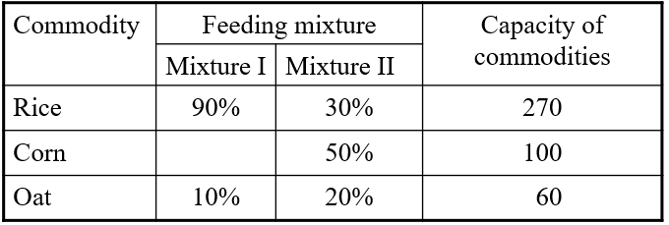
Example
The firm plan production of two kinds of feeding mixtures. The capacity of rice is 270 tons, corn 100 tons and oat 60 tons. It is necessary to abide the ratio of the compounds according to the following table:
The profit from selling 1 ton of mixture I is 2000 Euro and for the mixture II the profit is 3000 Euro/t. How much of each mixture should the firm produce to maximize the profit?

Slide 5
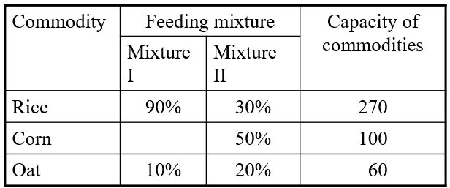
Transformation to the Mathematical Model
2 processes:
1. Production of the mixture I of quantity x₁ ≥ 0
2. Production of the mixture II of quantity x₂ ≥ 0
3 sources (factors): Rice, Corn, Oat

Slide 6
Effectiveness of processes
1 t of the mixture I gains profit 2000 Euro
1 t of the mixture II gains profit 3000 Euro
z = 2000x₁ + 3000x₂ – total profit
- x₁ t of the mixture I
- x₂ t of the mixture II

Slide 7
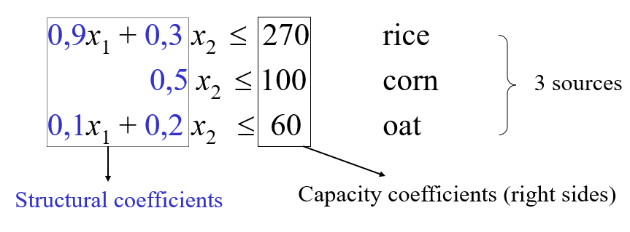
Constraints
Main constraints:
Conditions of non-negativity: x₁ ≥ 0, x₂ ≥ 0

Slide 8
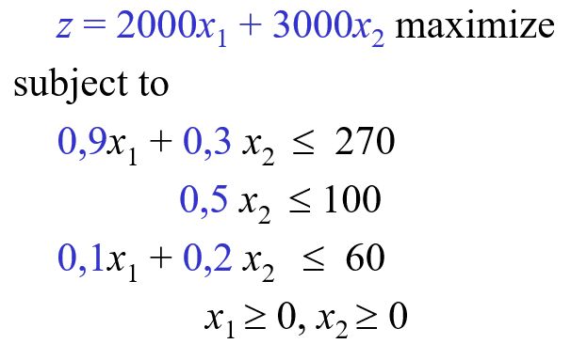
Mathematical Model of LP
2 processes, 3 sources (factors)

Slide 9
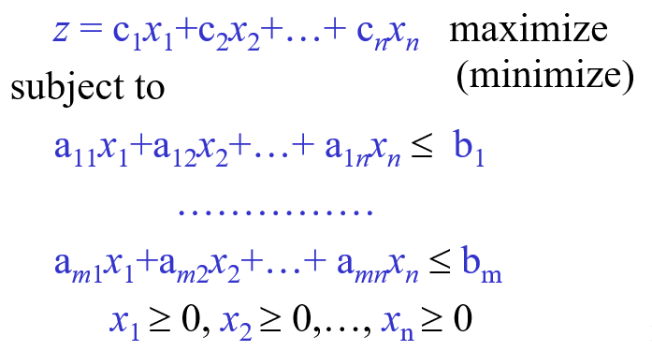
General Mathematical Model LP
n processes, m sources (factors)

Slide 10
Equivalent Forms
Maximization of the function: z = f(x)
Minimization of the function : w = - f(x)
Example:
Max z = 2x + 3y Min w = -2x - 3y

Slide 11
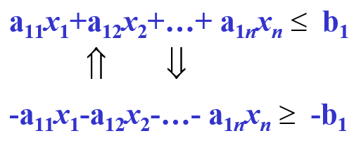

Equivalent Forms
Example:

Slide 12
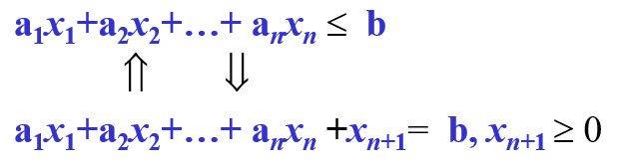
Equivalent Forms
Example:

Slide 13
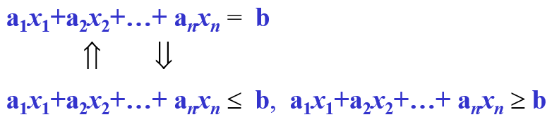

Equivalent Forms
Example:

Slide 14
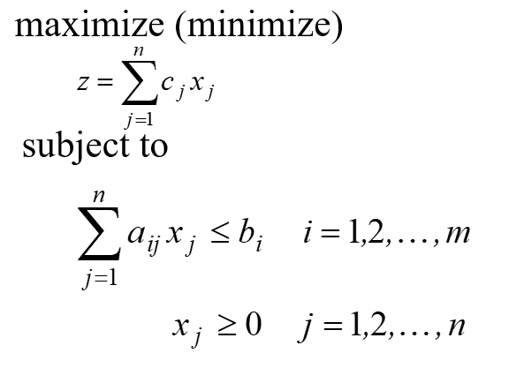
Alternative Formulation LP
Sum notation

Slide 15
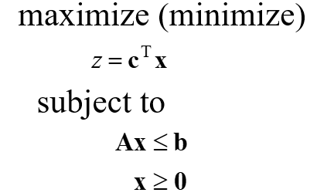
Alternative Formulation LP
Vector notation

Slide 16
Graphical Interpretation of Basic Elements of LP
Feasible solution: Solution, i.e. the vector that satisfy all constraints. Every other solution is called the infeasible solution.
Optimal solution: The feasible solution with maximal (minimal) value of the objective function

Slide 17
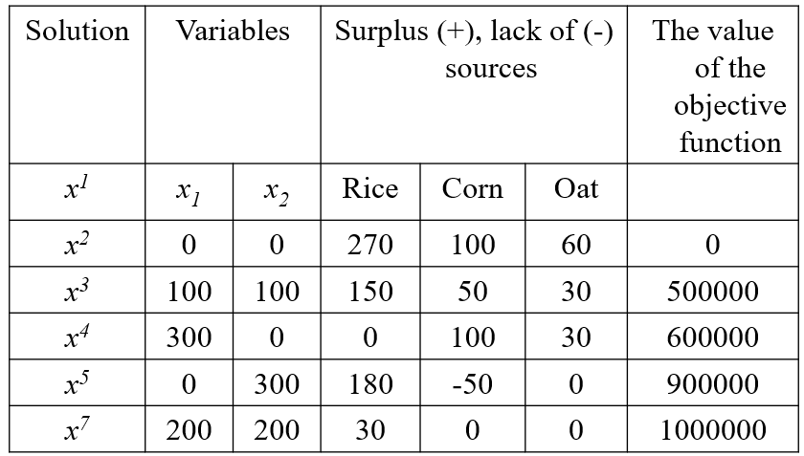
Some Feasible and Infeasible Solutions of the LP Problem

Slide 18
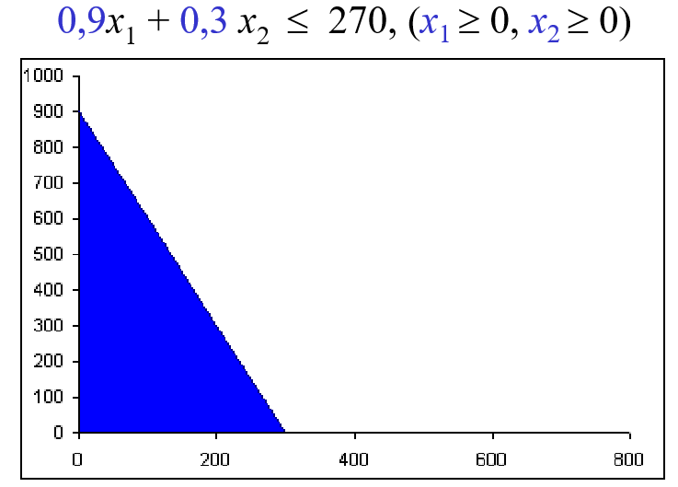
Graphical Depiction of the Constraint

Slide 19
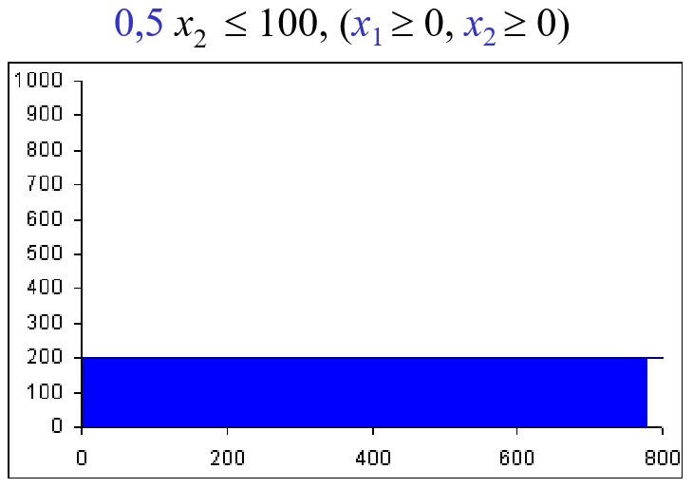
Graphical Depiction of the Constraint

Slide 20
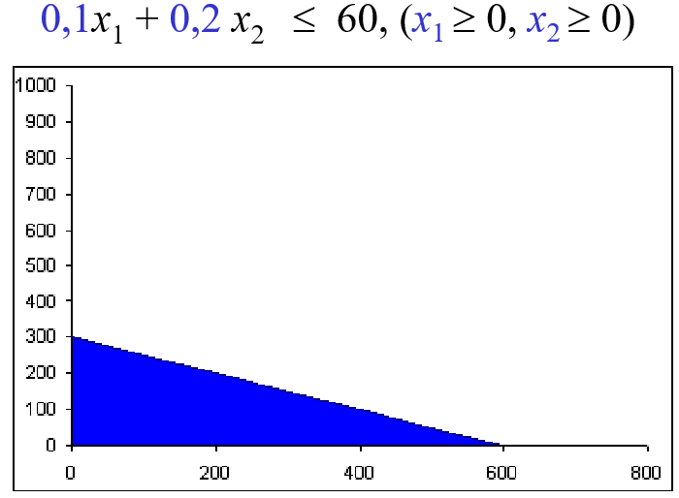
Graphical Depiction of the Constraint

Slide 21
Graphical Depiction of the Set of All Feasible Solutions

Slide 22
Graphical Solution of the LP Problem

Slide 23
Points to Remember
Objective Function
Profit Coefficients
Constraints
Structural Coefficients
Feasible Solution
Optimal Solution

Slide 24
Questions
What is linear programming?
What is the difference between feasible and optimal solution?
What is objective function?
Is the condition of non-negativity obligatory?
Describe structural coefficients

Slide 25
Thank you for your attention

