Slide 1

Integer Linear Programming
Ing. Radomír Perzina, Ph.D.
Operational Analysis for Economists
INMBAOAE

Slide 2
Outline of the lecture
Integer linear programming classifications
Solving methods
Applications
Assignment problem

Slide 3
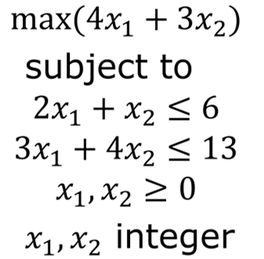
Example
Solve with and without condition of integer variables
x_{LP} = (2.2, 1.6) x_{ILP} = (3, 0)

Slide 4
Integer programming models
Total Integer Model: All decision variables required to have integer solution values.
0-1 Integer Model: All decision variables required to have integer values of zero or one.
Mixed Integer Model: Some of the decision variables (but not all) required to have integer values.

Slide 5
Methods for solving integer linear programming problems
1. Rounding–Off A non–integer solution
2. Cutting–Plane Method
  (developed by: Ralph E. Gomory)
3. Branch–and–Bound Method
  (Developed By: A.H. Land and A. G. Doing)
4. The Additive algorithm for Zero–One integer programming problems
  (Developed By: E. Balas)

Slide 6
The cutting plane algorithm
An Algorithm for solving Pure integer and mixed integer programming problems has been developed by Ralph E. Gomory
Relax the integer requirements.
Solve the resulting LP problem using Simplex Method.
If all the basic variables have integer values, Optimality of the Integer programming problem is reached. So go step 7; otherwise go to step 4.
Examine the constraints corresponding to the current optimal solution. For each Basic Variable with non-integer solution in the current optimal table, find the fractional part ,f_{i} , Therefore, b_{i} = [b_{i}] + f_{i}, where [b_{i}] is the integer part of b_{i}, and f_{i} is the fractional part of b_{i}.

Slide 7
The cutting plane algorithm
Choose the largest fraction among various f_{i} ; i.e. Max (f_{i}). Treat the constraint corresponding to the maximum fraction as the source row (equation). Based on the source equation, develop an additional constraint (Gomory’s constraint / fractional cut) as shown:
–f_{i} = S_{i} – Summation ((f_{i})(Non–Basic Variable))
Add the fractional cut as the last row in the latest optimal table and proceed further using dual simplex method, and find the new optimum solution. If the new optimum solution is integer, then go to step 7; otherwise go to step 4.
Print the integer solution [X’s and Z – Values]

Slide 8
Branch and bound method
Creates and solves a sequence of sub-problems to the original problem that are increasingly more restrictive until an optimal solution is found
BRANCHING:
  Selection of an integer value of a decision variable to examine for a possible integer solution to a problem
  “If the solution to the linear programming problem contains non-integer values for some or all decision variables, then the solution space is reduced by introducing constraints with respect to any one of those decision variables. If the value of the decision variable “X₁” is 2.5, then two more problems will be created by using each of the following constraints. X₁ ≤ 2 and X₁ ≥ 3.

Slide 9
Branch and bound method
BOUND:
An upper or lower limit on the value of the objective function at a given stage of the analysis of an integer programming problem.
LOWER BOUND: The lower bound at a node is the value of the objective function corresponding to the truncated values (integer parts) of the decision variables of the problem in that node.
UPPER BOUND: The upper bound at a node is the value of the objective function corresponding to the linear programming solution in that node. Assign jobs to machines.

Slide 10
Branch and bound method
FATHOMED SUBPROBLEM / NODE: A problem is said to be fathomed if any one of the following three conditions is true:
  The values of the decision variables of the problem are integer.
  The upper bound of the problem which has non–integer values for its decision variables is not greater than the current best lower bound.
  The problem has infeasible solution. This means that further branching from this type of fathomed nodes is not necessary.
CURRENT BEST LOWER BOUND: This is the best lower bound (highest in the case of maximization problem and lowest in the case of minimization problem) among the lower bounds of all the fathomed nodes. Initially, it is assumed as infinity for the root node.

Slide 11
Branch and bound algorithm
Solve the given linear programming problem graphically or using iterative method. Set, the current best lower bound ZB as ∞.
Check, Whether the problem has integer solution. If yes, print the current solution as the optimal solution and stop; Otherwise go to Step–3.
Identify the variable X_{k} which has the maximum fractional part as the branching variable. (In case of tie, select the variable which has the highest objective function coefficient.)
Create two more problems by including each of the following constraints to the current problem and solve them.
a. X_{k} ≤ Integer part of X_{k}
b. X_{k} ≥ Next Integer of X_{k}

Slide 12
Branch and bound algorithm
If any one of the new sub-problems has infeasible solution or fully integer values for the decision variables, the corresponding node is fathomed. If a new node has integer values for the decision variables, update the current best lower bound as the lower bound of that node if its lower bound is greater than the previous current best lower bound.
Are all terminal nodes fathomed? If answer is yes, go to step–7; otherwise, identify the node with the highest lower bound and go to step–3.
Select the solution of the problem with respect to the fathomed node whose lower bound is equal to the current best lower bound as the optimal solution.

Slide 13
The Additive algorithm for Zero–One integer programming problems
Convert the problem into the minimization form with all “≥” type constraints & all the coefficients of the objective function must be in positive form.
Define a new variable Y_{j} such that Y_{j} = X_{j} “if C_{j} ≥ 0 in the minimization problem” Y_{j} = 1–X_{j} “if C_{j} ≤ 0 in the minimization problem” Where Y_{j} is the binary variable in objective function as well as constraints. Slack variables S_{i} can be now added to constraints to put them into equality form.
A Branch & Bound procedure is used to solve the 0–1 programming problem.
SOLUTION VECTOR (S): A set of binary variables picked for the solution to be fixed (i.e.: either (“+” or “1”) or (“–” or “0”). Initially it always be a NULL set.

Slide 14
The Additive algorithm for Zero–One integer programming problems
VIOLATED CONSTRAINT VECTOR (V): All those constraints which are not feasible at particular solution.
SET of HELPFUL VARIABLE (H): A variable is helpful if it doesn’t figure in solution vector (S) either in “+” or “–” form and has positive coefficient in at least one violated constraint.”
BACK TRACK (FATHOMED SOLUTION): Backtrack occurs if any one of the following condition occurs.
  If Violated Constraint Vector (V) or Set of Helpful Variable (H) appear to be a NULL set.
  If feasible solution found; When “V” is Null Set.
  If we did not have the helpful variable from the at least one of the violated constraints.
  If Solution is infeasible.
TERMINATION CONDITION: When backtracking is not possible “means shifting from Zero (0) to One(1) is not possible.”

Slide 15
Assignment problem
It involves assignment of people to projects, jobs to machines, workers to jobs and teachers to classes etc., while maximizing the total assignment utility.
One of the important characteristics of assignment problem is that only one job (or worker) is assigned to one machine (or project).
An assignment problem is a special type of linear programming problem where the objective is to maximize the utility of completing a number of jobs by a number of persons.

Slide 16
Assignment problem applications
Assign jobs to machines.
Assign personnel to tasks.
Assign students to writing seminars.
Assign machines to factory orders.
Assign sales/marketing people to sales territories.
Assign contracts to bidders by systematic bid-evaluation.
Assign teachers to classes.
Assign accountants to accounts of the clients.

Slide 17
Example
A couch prepares children to dance competition. He has to match four girls and four boys to create pairs.
Quality of different pairs is different – expected levels of pairs are given in table. Match girls to boys such that they perform in competition at the best possible level.

Slide 18
Mathematical model
Denote:
c_{i,j} …Quality of the pair girl A_{i} – boy B_{j}, c_{i,j} the higher the better quality
x_{i,j}. …assignment of A_{i} and B_{i}
x_{i,j} = 1… A_{i} is assigned to B_{i}
x_{i,j} = 0 …not assigned elements

Slide 19
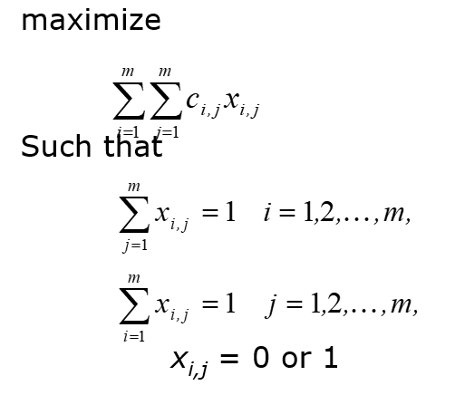
Mathematical model

Slide 20
Solution

Slide 21
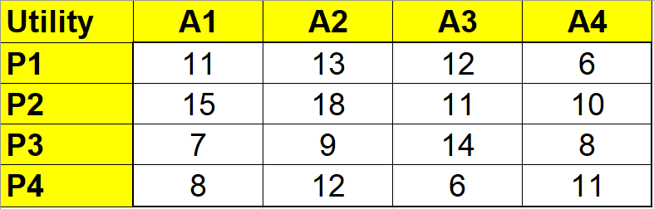
Example 2
A project manager needs to build a team for a new project. The project consists of 4 activities and there are 4 people available.
Quality of different assignments is different – expected levels of assignments are given in table. Match activities to people such that they complete the project at the best possible level.

Slide 22
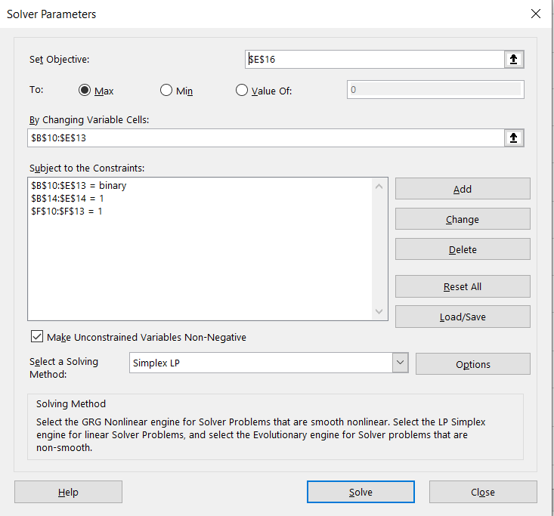
Solver parameters

Slide 23
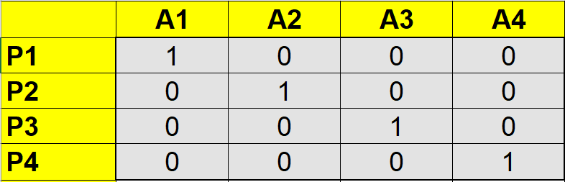
Solution
Optimal total utility: 54

Slide 24
Points to remember
Integer variable
Binary variable
Cutting plane method
Assignment problem
Applications

Slide 25
Thank you for your attention

