Slide 1

Introduction to Graph Theory
Ing. Radomír Perzina, Ph.D.
Operational Analysis for Economists
INMBAOAE

Slide 2
Outline of the lecture
Basics of the graph theory
Minimal spanning tree
Shortest path
Maximal flow

Slide 3
Definition
In mathematics, and more specifically in graph theory, a graph is a structure amounting to a set of objects in which some pairs of the objects are in some sense "related".
The objects correspond to mathematical abstractions called vertices (also called nodes or points) and each of the related pairs of vertices is called an edge (also called link or line).
Typically, a graph is depicted in diagrammatic form as a set of dots or circles for the vertices, joined by lines or curves for the edges. Graphs are one of the objects of study in discrete mathematics.

Slide 4
History
The paper written by Leonhard Euler on the Seven Bridges of Königsberg and published in 1736 is regarded as the first paper in the history of graph theory. This paper, as well as the one written by Vandermonde on the knight problem, carried on with the analysis situs initiated by Leibniz. Euler's formula relating the number of edges, vertices, and faces of a convex polyhedron was studied and generalized by Cauchy and L'Huilier, and represents the beginning of the branch of mathematics known as topology.
The term "graph" was introduced by Sylvester in a paper published in 1878 in Nature, where he draws an analogy between "quantic invariants" and "co-variants" of algebra and molecular diagrams.

Slide 5
Basics of the Graph Theory
Graph: an object composed from vertices (nodes) and edges. Denote V ..... set of vertices, E ..... set of edges
then G = (V,E)
The edge connects two vertices or the vertex with itself (loop)
Undirected edge is symmetrical connection of two vertices
Directed edge: we distinguish direction given by the start and end vertex
Undirected graph: all edges are undirected
Directed graph: at least one edge is directed
Parallel (multiple) edges connect two vertex several times
Multigraph contains parallel edges or loops

Slide 6
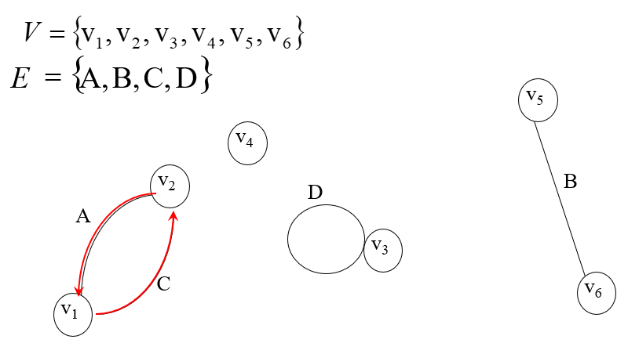
Basics of the Graph Theory

Slide 7
Basics of the Graph Theory
Subgraph: deleting some vertices or edges
Edge valuated graph
Vertex valuated graph
Complete graph: each vertex is connected with each other
Plane graph: can be drawn on a piece of paper such that no edge intersects any other.

Slide 8
Basics of the Graph Theory
v₂
13
7
5
v₁
v₄
8
6
v₃

Slide 9
Basics of the Graph Theory
Path - sequence of directed edges, where one edge ends and the second begins
Chain - path regardless direction
Cycle - path that begins and ends in the same vertex
Connected graph - between each pair of vertices exist at least one chain
Spanning tree - acyclic subgraph
Minimal spanning tree – spanning tree with minimal value of sum of edges

Slide 10
Minimum Spanning Tree
A minimum spanning tree or minimum weight spanning tree is a subset of the edges of a connected, edge-weighted undirected graph that connects all the vertices together, without any cycles and with the minimum possible total edge weight. That is, it is a spanning tree whose sum of edge weights is as small as possible. More generally, any edge-weighted undirected graph (not necessarily connected) has a minimum spanning forest, which is a union of the minimum spanning trees for its connected components.
There are quite a few use cases for minimum spanning trees. One example would be a telecommunications company trying to lay cable in a new neighborhood.

Slide 11
Minimum Spanning Tree Algorithm
Step 1. Select the edge with the minimal value of k_{ij}
Step 2. From remaining edges select next edge with the minimal vale such that it doesn’t make a cycle with already selected edges
Step 3. According step 2 continue until (n –1) edges are selected.

Slide 12
Minimum Spanning Tree - Example
Newly built houses need to be connected with the computer network. Suggest the cheapest connection such that from each house it is possible to access each other by the network.
v₂
5
14
20
7
10
v₃
v₁
17
6
4
19
v₄
v₅
11

Slide 13
Minimum Spanning Tree – Example Solving
1. Sort edges by their distances:
1. k34 : 4 4. k24 : 7 7. k12 : 14 9. k15 : 19
2. k23 : 5 5. k13 : 10 8. k35 : 17 10. k25 : 20
3. k14 : 6 6. k45 : 11
2. According the algorithm we select these edges:
k34 : 4, k23 : 5, k14 : 6.
The edge k24 : 7 with next shortest distance will not be select because it makes a cycle with previously selected edges. The last selected edge will be k45 : 11.

Slide 14
Minimum Spanning Tree – Example Solving
v₂
5
7
14
20
10
v₃
v₁
17
6
4
19
v₄
v₅
11

Slide 15
Shortest Path Problem
The shortest path problem is the problem of finding a path between two vertices in a graph such that the sum of the weights of its constituent edges is minimized.
Path length – sum of all edges on the path
Shortest path – a path between entrance point and exit point with shortest length

Slide 16
Shortest Path Algorithm
1. To vertex 1 is assigned the value v₁ = 0.
2. For m ≠ 0 we assign to vertex m value v_{m} according the formula v_{m} = min{v_{i} + k_{ij}}.
The minimum is searched for each i, for which v_{i} is already assigned and for all j, for which v_{j} is not still assigned.
3. The value v_{m} assigned to vertex m represent the length of the shortest path from vertex 1 to vertex m and for their edges (i,j), holds the formula
v_{j} = v_{i} + k_{ij}

Slide 17
Example: Find the shortest path between vertices 1 and 9
21
18
7
1
8
19
11
17
11
10
16
6
2
16
24
7
18
5
12
9
9
14
4
3
12
28

Slide 18
Example - Solving
1 | 2 | 3 | 4 | 5 | 6 | 7 | 8 | 9
5(10) 6(19) 7(18) | 3(9) 4(18) 6(16) 7(17) 8(11) 9(24) | 2(9) 4(28) 9(12) | 2(18) 3(28) 5(14) 6(12) | 1(10) 4(14) 6(7) | 1(19) 2(16) 4(12) 5(7) 7(11) | 1(18) 2(17) 6(11) 8(21) | 2(11) 7(21) 9(16) | 2(24) 3(12) 8(16)
0
33
42
24
10
17
18
39
54
The shortest path is composed by edges with vertices in sequence: 1, 5, 6, 2, 3 and 9. The length of the path is 54.

Slide 19
Maximal Flow Problem
In optimization theory, maximum flow problems involve finding a feasible flow through a flow network that is maximum.
The maximum flow problem can be seen as a special case of more complex network flow problems, such as the circulation problem. The maximum value of an s-t flow (i.e., flow from source s to sink t) is equal to the minimum capacity of an s-t cut (i.e., cut severing s from t) in the network, as stated in the max-flow min-cut theorem.
The maximum flow problem was first formulated in 1954 by T. E. Harris and F. S. Ross as a simplified model of Soviet railway traffic flow.
In 1955, Lester R. Ford, Jr. and Delbert R. Fulkerson created the first known algorithm, the Ford–Fulkerson algorithm.

Slide 20
Maximal Flow Problem
Network flow - a function that to each edge e_{ij} assigns the nonnegative number x_{ij}
Valuation k_{ij} of edge e_{ij} represents edge flow capacity
Simple network - Plane network

Slide 21
Maximal Flow Algorithm in the Simple Network
The Most-North Path Algorithm:
Step 1. Select the most north path in the network from vertex “1” (entrance) to vertex “n” (exit) – denote C1.
Step 2. On this path (C1) find edge(-s) with the least capacity k_{rs}. Denote k(C1) = k_{rs}.
Step 3. Remove this edge(-s) and the capacity of the remaining edges of the path C1 decrease by the value of k(C1).
Step 4. Repeat steps 1 to 3 until there is any path between vertices 1 and n.
Step 5. Maximal network flow is
Tmax = k(C1) + k(C2) +…

Slide 22
Maximal Flow Algorithm in the Simple Network
2
1
5
4
6
1
3
1
1
3
5
6
2
k(C1) = 1
k(C4) = 5
4
k(C2) = 4
k(C3) = 2
Tmax = 1 + 4 + 2 + 5 = 12

Slide 23
Points to remember
Graph
Edge
Node
Spanning tree
Path
Network flow

Slide 24
Questions
Define undirected graph.
Draw a complete graph with 3 nodes.
Does a multigraph have parallel edges?
What is a plane graph?
How many nodes does have a spanning tree with 4 nodes?

Slide 25
Thank you for your attention

