Slide 1
Project Management I
Critical Path Method - CPM
Ing. Radomír Perzina, Ph.D.
Operational Analysis for Economists
INMBAOAE

Slide 2
Outline of the lecture
To construct project graph
To calculate length of the project using CPM
To interpret obtained results: calculate slacks, determine critical activities, show critical path, determine activities’ timetable

Slide 3
Project
The word project comes from the Latin word projectum from the Latin verb proicere, "before an action" which in turn comes from pro-, which denotes precedence, something that comes before something else in time (paralleling the Greek πρό) and iacere, "to do". The word "project" thus originally meant "before an action".
A project consists of a concrete and organized effort motivated by a perceived opportunity when facing a problem, a need, a desire or a source of discomfort (e.g., lack of proper ventilation in a building). It seeks the realization of a unique and innovative deliverable, such as a product, a service, a process, or in some cases, a scientific research.
Each project has a beginning and an end

Slide 4
Critical Path Method History
The critical path method was developed at the DuPont Company in 1957 by a pair of mathematicians who were looking at ways to avoid the costs of plant shutdowns and restarts caused by inefficient scheduling. Their research showed that money could be saved by focusing efforts on performing the right tasks at the right times, rather than flooding the problem with labor to stay on schedule. This saved DuPont 25 percent on shutdowns, and James Kelley and Morgan Walker published the first paper on their findings in 1959. Ironically, DuPont then dropped the CPM system when the management team responsible for it changed.

Slide 5
Time analysis of Projects
Project: several timely or technologically dependent activities – “black box”
Realization of the project: successfully finished all activities of the project.
Activities – characteristics - time, price, mandatory predecessors - order of activities is not random.

Slide 6
Project Graph Properties
1. Acyclic.
2. No Multigraph: use “dummy activities”
3. One input, one output.
4. Arrows from vertex with smaller evaluation to higher evaluation.

Slide 7
Terminology
Activity: An activity carries the arrow symbol. This represent a task or subproject that uses time or resources
Event: A node (an event), denoted by a circle, marks the start and completion of an activity, which contain a number that helps to identify its location.
Dummy Activity: An activity, which is used to maintain the pre-defined precedence relationship only during the construction of the project network, is called a dummy activity. Dummy activity is represented by a dotted arrow and does not consume any time and resource
Parallel activity: There are two activity which being at same event and end at same event. This activities are called parallel activity. NOT ALLOWED!

Slide 8
Dummy activities
2
A
A
1
2
C
3
1
X
B
B
3
C
4
incorrect
correct

Slide 9
Construction of a project graph – an example
Introduction of a special new product covers twelve activities A-L. In the next table, there are activities with their lengths and all predecessors. Construct a graph of this project.

Slide 10
Construction of a project graph – an example
5
5
D
D
2
E
E
2
6
6
E
A
2
E
2
5
A
2
E
D
X
A
5
A
A
D
H
8
D
X
J
X
K
X
H
6
B
B
K
9
B
H
6
8
1
3
I
H
5
7
1
4
1
4
I
B
B
K
C
1
4
I
J
1
4
9
C
I
J
L
F
C
L
8
10
C
F
F
G
7
9
4
C
7
F
G
6
G
3
F
7
3
7
G
G
3
3
8

Slide 11
Time analysis of project
Two approaches:
deterministic: - CPM (Critical Path Method)
stochastic: method PERT (Program Evaluation and Review Technique)

Slide 12
Critical path method (CPM)
The critical path method (CPM) is an algorithm scheduling a set of project activities. It is an important tool for effective project management.
The essential technique for using CPMis to construct a model of the project that includes
A list of all activities required to complete the project
The time (duration) that each activity will take to completion, and
The dependencies between the activities.
CPM calculates the longest path of planned activities to the end of the project, and the earliest and latest that each activity can start and finish without making the project longer.

Slide 13
Critical path
This process determines which activities are "critical“ and which have "total float" (i.e., can be delayed without making the project longer).
A critical path determines the shortest time possible to complete the project. Any delay of an activity on the critical path directly impacts the planned project completion date
A project can have several, parallel, near critical paths.
An additional parallel path through the network with the total durations shorter than the critical path is called a sub-critical or non-critical path.
Slacks are 0

Slide 14
CPM
Four stages of calculation:
Ist. stage: Earliest start and finish.
IInd. stage: Latest start and finish.
IIIrd. stage: Slacks
IVth. stage: Interpretation.

Slide 15
CPM
(i,j) activity which begins in the node i and ends in the node j
y_{ij} activity (i,j) time
t_{i}(0) earliest start
t_{i}(0) + y_{ij} earliest finish
t_{j}(1) latest finish
t_{j}(1) - y_{ij} latest start
T_{p} project completion time

Slide 16
CPM
Stage I– „From the beginning to the end“ – calculation of earliest start and earliest finish of all activities
Stage II: „From the end to the beginning“
Stage III: Slacks (=LS-ES)

Slide 17
CPM - Example
Activity | Predecessors | Time
A | ------ | 5
B | ----- | 10
C | ----- | 6
D | A | 6
E | A | 1
F | C | 2
G | C | 5
H | E, B, F | 8
I | E, B, F | 7
J | D, H | 9
K | D, H | 7
L | G, I, J | 12

Slide 18
CPM - example
D
2
5
K
E
A
H
J
7
B
1
4
I
L
C
F
3
G
6

Slide 19
CPM - example
0
5
4
9
4
0
6
2
8
2
0
10
0
10
0
5
6
9
10
4
5
11
12
18
7
6
8
8
10
2
6
11
22
27
16
10
18
10
18
0
10
17
20
27
10
18
27
18
27
0
18
25
32
39
14
27
39
27
39
0

Slide 20
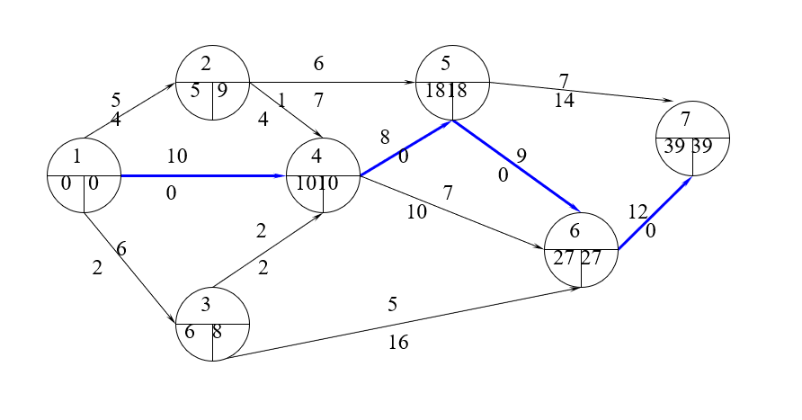
CPM - example

Slide 21
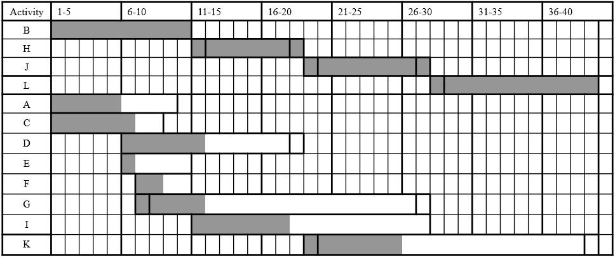
CPM - example

Slide 22
Benefits of CPM
Useful at many stages of project management
Mathematically simple
Give critical path and float time
Provide project documentation
Useful in monitoring costs
Visual representation

Slide 23
Limitations to CPM
Specified precedence relationship
Activity time estimates are subjective and depend on judgment
Can be more difficult understand than Gantt charts
The time needed for tasks is not as clear as with Gantt charts

Slide 24
Points to remember
Critical path
Activity
Project
Dummy activity
Slack
Gantt chart

Slide 25
Thank you for your attention

