Slide 1

Mathematics in Economics
Lecture 1
Jiří Mazurek, Ph.D.
Mathematics in Economics/PMAT

Slide 2
Lecture 1
General information
  Mathematics in Economics: 5 credits, 13 lectures and seminars.
  Seminars are mandatory.
  Materials can be found at Public files and Elearning.
  Teachers: Radmila Krkošková
  Exam: written, two parts (30+70 points).
  Evaluation: A (100-91 points), B (90-81), C (80-71), D (70-66), E (65-60), F (59-0).

Slide 3
Syllabus (short version)
Lecture 1
1. Real function of one real variable
2. Introduction to differential calculus of one real variable
3. Course of a function of one real variable
4. Real function of two real variables
5. Local and bounded extremes of a function of two variables
6. Indefinite integral of one real variable
7. Special substitutions in the indefinite integral
8. Definite integral of one real variable
9. Applications of the definite integral
10. Infinite number series
11. Infinite function series
12. Introduction into ordinary differential equations
13. Linear differential equations

Slide 4
Literature
Lecture 1
Basic:
CHIANG, C.C. Fundamental Methods of Mathematical Economics. New York: McGraw-Hill, Inc., 2000. ISBN 0-12-417890-1.
Recommended:
KLEIN, M. Mathematical Methods for Economics. Edinburgh: Pearson Education Limited, 2014.
ASANO, A. An Introduction to Mathematics for Economics. Tokyo: Sophia University, 2012.

Slide 5
Youtube math courses
Lecture 1
Bhagwan Singh Vishwakarma:
https://www.youtube.com/channel/UCBmdoqkBaIUh128ffq8XATw
Nancy Pi:
https://www.youtube.com/channel/UCRGXV1QlxZ8aucmE45tRx8w

Slide 6
A real function of one real variable
Lecture 1
A function is a relation f between two sets X and Y such that each x from X is related to exactly one y from Y.
We write y = f(x).
Examples:
The set X is called a domain, the set Y is called a range or a co-domain.
In economics the domain usually consists of non-negative real numbers.

Slide 7
A graph of a function
Lecture 1
A graph of a function is the collection of all ordered pairs (x,y) displayed in a two-dimensial plane.
In a two dimensional plane it as a curve.
Examples:
Linear function: a line,
Quadratic function: a parabola,
Reciprocal function: a hyperbola.
Other functions are represented by more complex curves.

Slide 8
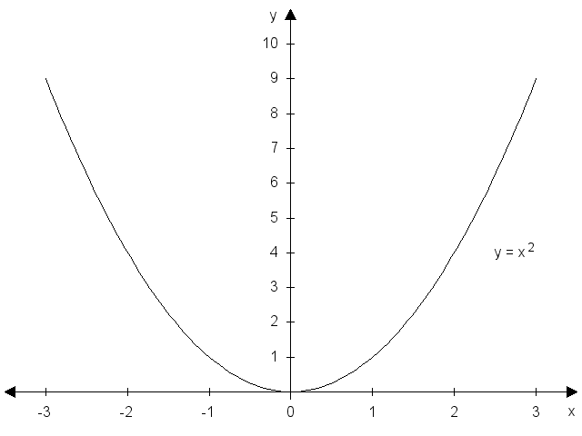
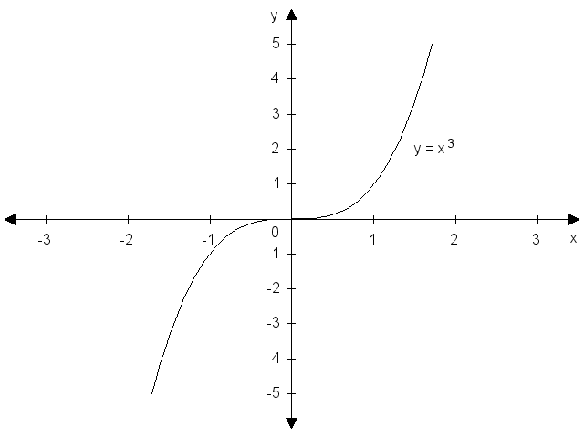
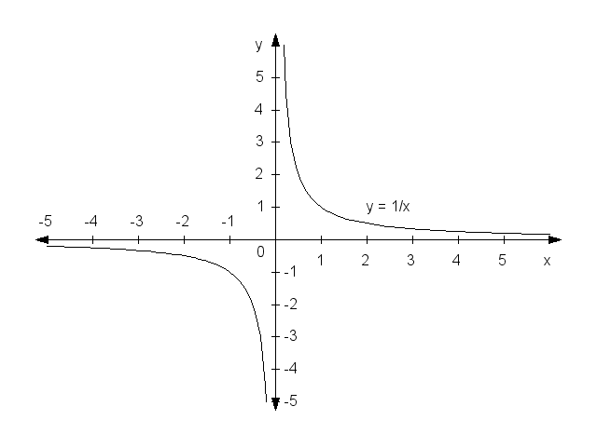
A graph of a function: examples
Lecture 1

Slide 9
Elementary function properties
Lecture 1
Domain and range,
Monotonicity (increasing, decreasing, non-increasing, non-decreasing, constant)
Extremes (local or global maximum or minimum),
Concavity and convexity,
Inflection points,
Bounded vs unbounded function,
Even functions and odd functions,
Peridiocity.

Slide 10
Elementary functions
Lecture 1
Linear function: y = ax + b,
Quadratic function:
Polynomial function:
Linear reciprocal function:
Logarithmic function:
In the logarithmic function, a is the so called a base. The decadic logarithm: a = 10, the natural logarithm: a = e = 2.718… For a larger than 1, the function is increasing, and for a smaller than 1 it is decreasing.

Slide 11
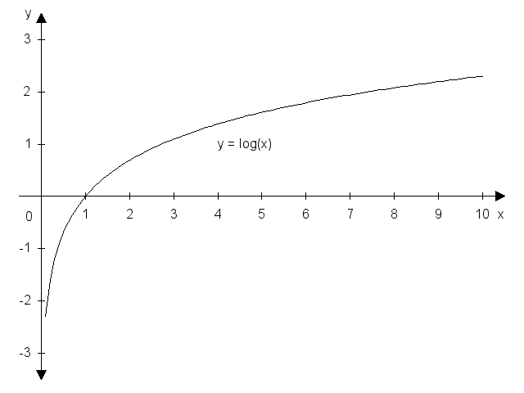
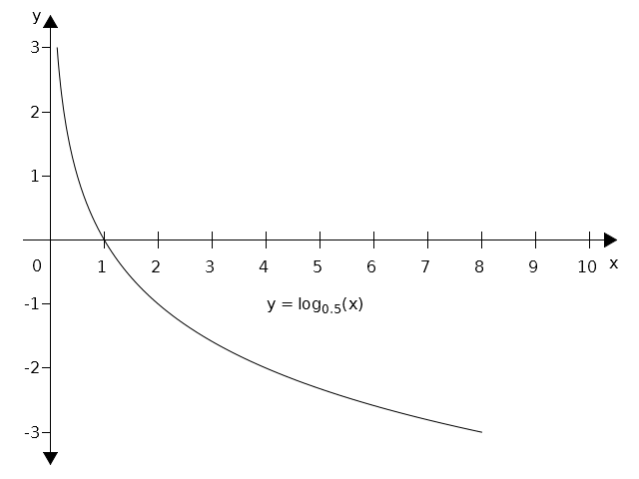
Graphs of logarithmic functions
Lecture 1

Slide 12
Elementary functions - continued
Lecture 1
Exponential function:
Goniometric functions: y = sinx, y = cosx, y = tgx,
y = cotgx.
Cyclometric functions: y = arcsinx, y = arccosx,
y = arctgx, y = arccotgx.
Notes: exponential and logarithmic functions are inverse to each other. The same applies to goniometric and cyclometric functions.

Slide 13
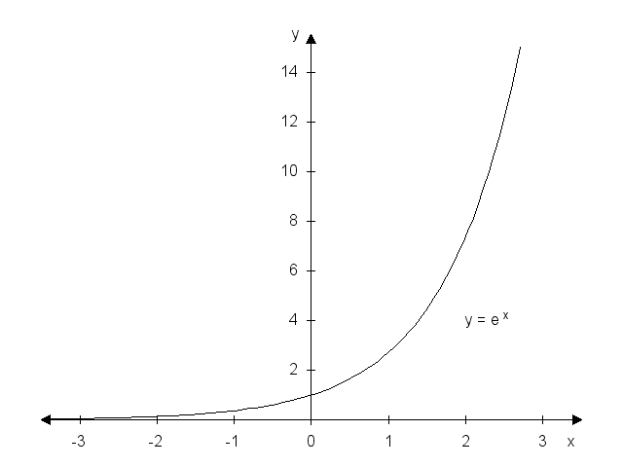
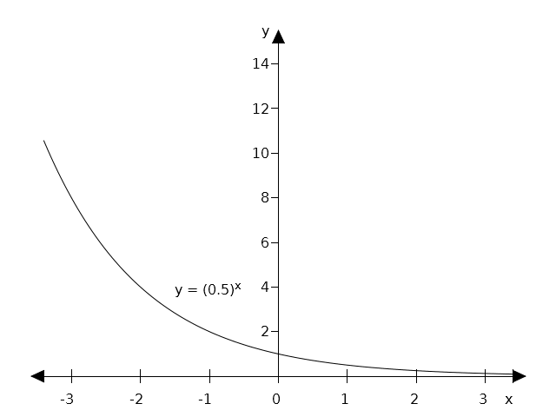
Graphs of exponential functions
Lecture 1
For a >1, the exponential function is increasing, for a < 1 is
decreasing.

Slide 14
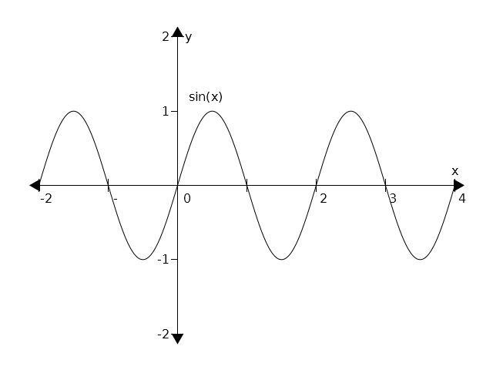
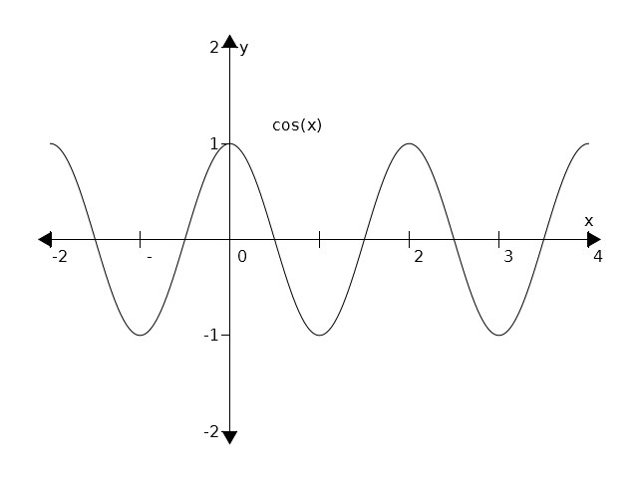
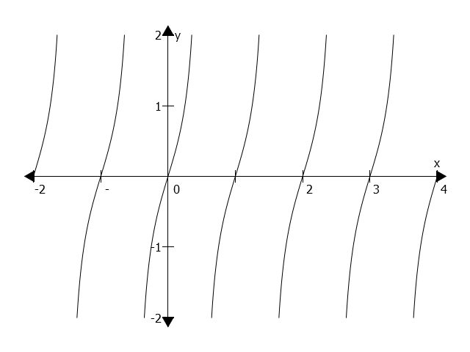
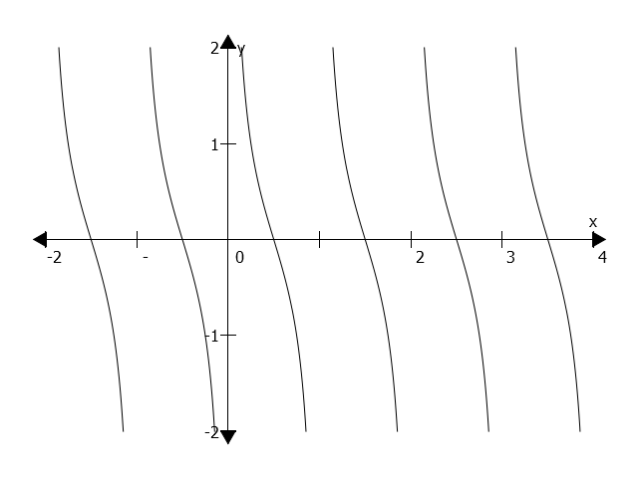
Graphs of goniometric functions
Lecture 1

Slide 15
Polynomials
Lecture 1
In economics, various functions, such as demand or supply, are expressed by polynomials. Two main tasks when dealing with polynomials are transformation of a polyonomial into a product, and to find roots of a polynomial.
Let denote a polynomial of a degree n.
Polynomial roots are such values of x that .
The equation above can be solved via known formulas or identities such as .

Slide 16
Demand and supply function, equilibrium
Lecture 1
The demand function expresses relationship between a price of a good (P) and a demanded quantity (Q) by customers. Usually, the demand function is denoted as Q= D(P) or QD , and it is assumed this function is decreasing.
The supply function expresses relationship between a price of a good (P) and a supplied quantity (Q) by sellers. Usually, the supply function is denoted as Q= S(P) or Qs , and it is assumed this function is increasing.
A point where demand is equal to supply, ant a market is cleared, is called an equilibrium.

Slide 17
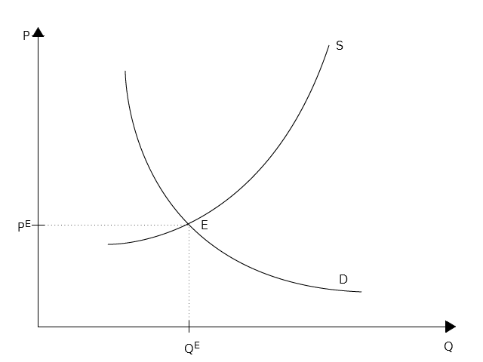
Demand and supply function, equilibrium – cont.
Lecture 1

Slide 18
Solved problem 1
Lecture 1
Find the domain of the function f: .
Solution: the expression under the square root sign must be non-negative, therefore we obtain:
Hence, the domain is .

Slide 19
Solved problem 2
Lecture 1
Find the domain of the function f: .
Solution: the expression in the logarithm must be positive, therefore we obtain:
We expand the term on the left hand side:
From the last inequality it follows that -5 and 5 are the roots that divide the x line into three intervals. By checking the sign in each interval we obtain the final solution:

Slide 20
Solved problem 3
Lecture 1
Find the domain of the function f: .
Solution: the expression in the arcsin is bounded by -1 from below and by 1 from above. Therefore, we obtain:
By dividing this inequality into two simple linear inequalities we obtain:
and
Hence, we obtain the solution:

Slide 21
Solved problem 4
Lecture 1
Let us asssume that the demand and the supply functions are given as follows: , .
Find the equilibrium.
Solution: in the equilibrium both functions are equal:
Therefore, we obtain: PE = 6, and QE = 4. Draw both function!
How will the situation change if there is a price floor P = 8?

Slide 22
Solved problem 5
Lecture 1
Let us asssume that the demand and the supply functions are given as follows: , .
Find the equilibrium.
Solution: in the equilibrium both functions are equal:
Therefore, we obtain: PE = 3, and QE = 18. Draw both function!

Slide 23
Problems to solve
Lecture 1
1. Find the domain of the following functions:

Slide 24
Problems to solve – cont.
Lecture 1
2. Draw a graph of the following functions:

Slide 25
Problems to solve – cont.
Lecture 1
3. For the given functions of demand and supply find the equilibrium both geometrically and algebraically:

Slide 26
Lecture 1
Thank you for your attention!

