Slide 1

logistics
-
Introduction to the issue
The aim of this lecture is to get acquainted with the history of logistics and define it in the current concept in the economic sphere
.
Šárka Čemerková
guarantor and lecturer

Slide 2
Logistics
-
Introduction to the issue
Historical roots of logistics content
Origin of the word logistics
Essence of logistics
Definition of logistics
Economic logistics – definition and development
.
Structure of the lecture

Slide 3
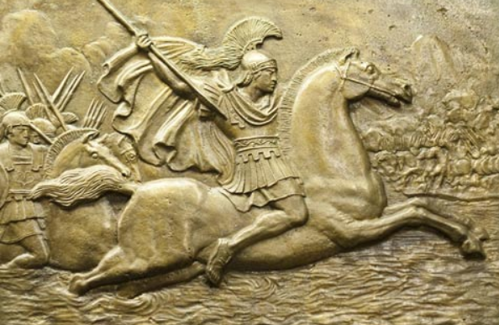
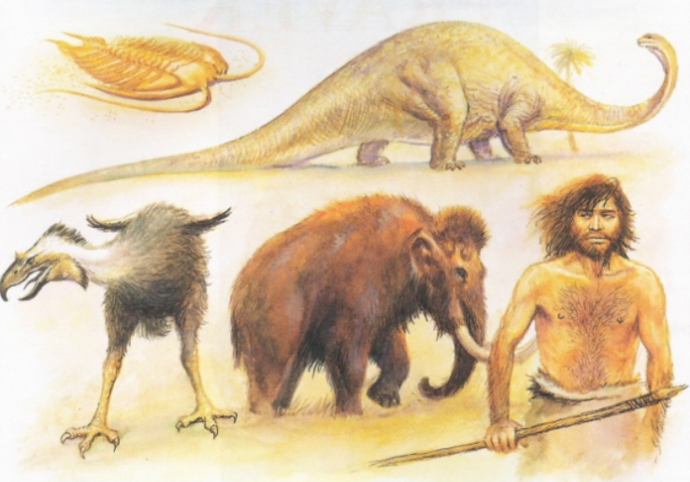
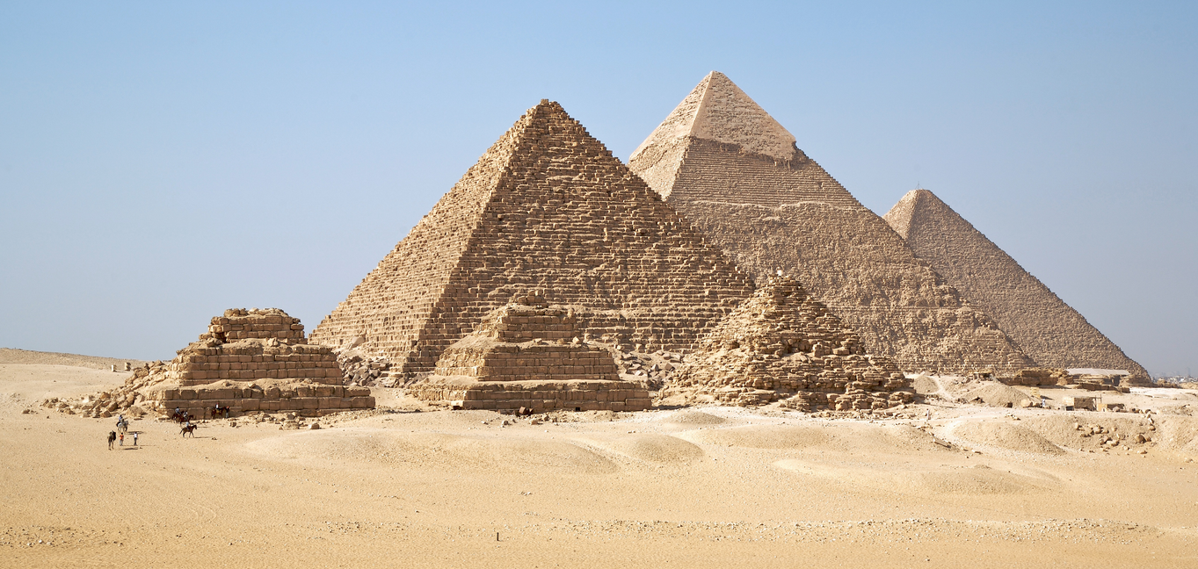
Historical roots
as a kind of activities thousands years old
origin associated with:
  the earliest forms of organized trade
  warfare
Notes:
An initial example: hunting, cutting, moving and storing of mammoth

Slide 4
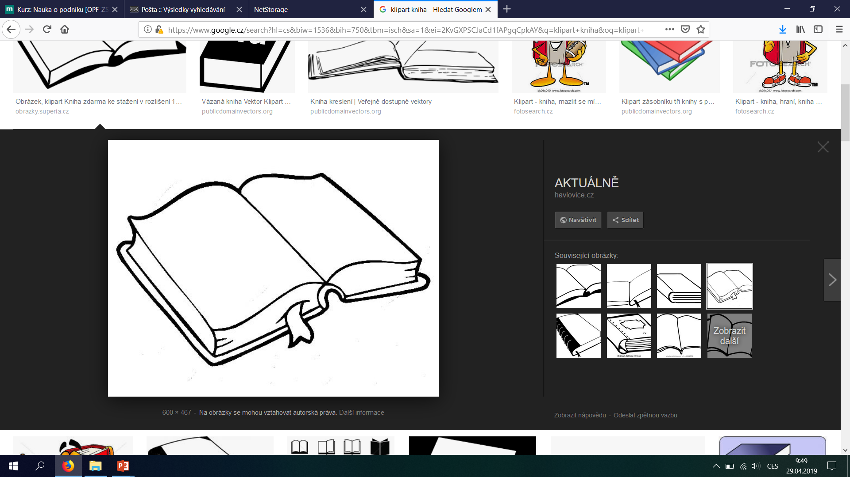
subject of investigation at the beginning of the 20th century
more attention was paid to logistics after the World War II and in the 1990s
1960s – the first comprehensive texts about logistics
logistics

Slide 5
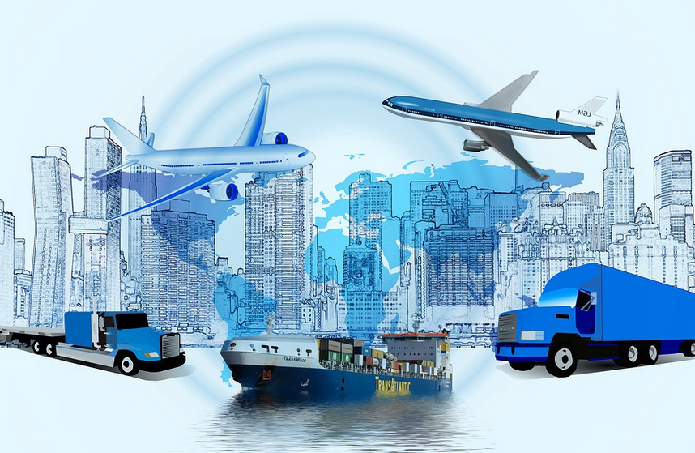
Peter Drucker:
Logistics is one of the last chances and opportunities to increase efficiency of companies

Slide 6
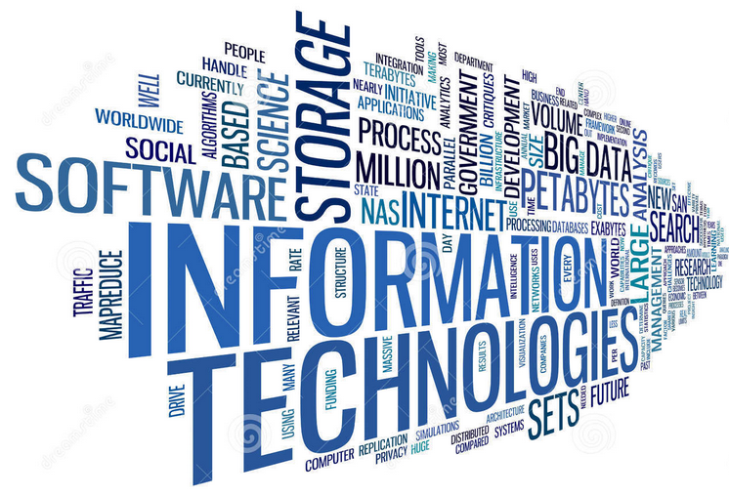
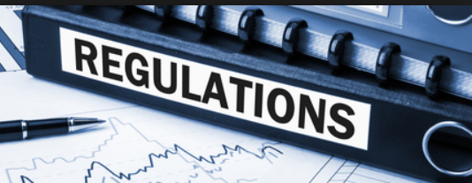
1970s and 1980s – deregulation of transport in the USA
1970s:
  impact of globalisation
  information technology boom
  positive impact on profit – logistics costs

Slide 7
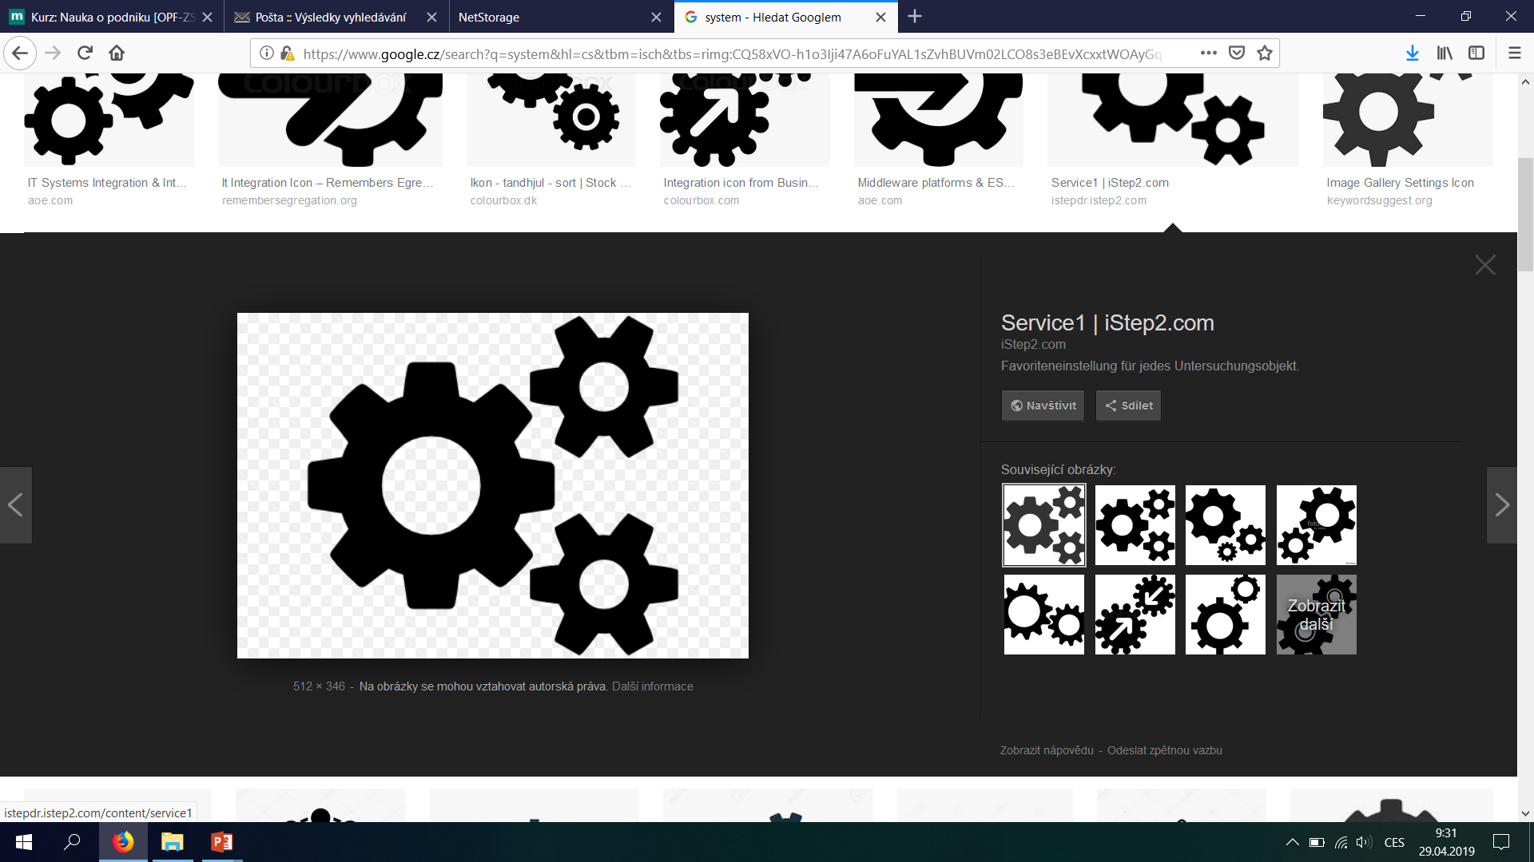
end of the 1980s – penetration of logistics into the Eastern bloc countries
today logistics is considered a scientific discipline characterized by a system approach

Slide 8
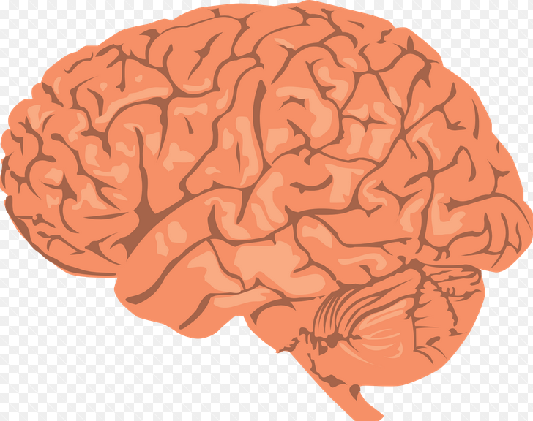
Origin of the word logistics
Origin in Greek:
logos – word, reason, speech, counting
logistikon – ingenuity, invention, reason
logistikos - counting, numerical art
N = vQ + F
Min N = c₁x + c₂y

Slide 9
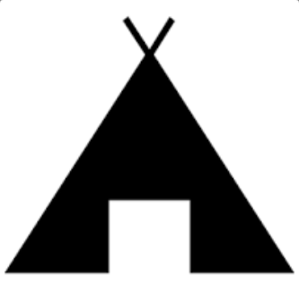
later these words were modified in Latin:
logicus - logical, scientific
logica - logical interpretation, theory
in Romance languages it means:
logis – apartment, temporary accommodation
loger – live, house someone

Slide 10
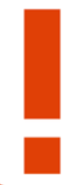
Contemporary concept of logistics
logistics is a science dealing with material flows and related information and financial flows

Slide 11
logistics vs. other fields
Mathematics:
  Formerly as practical counting with numbers
  Today the concept of logistics function
Military:
  Science of movement, supply and accommodation of troops
Economy:
  Science of movement, supply and storage of goods

Slide 12
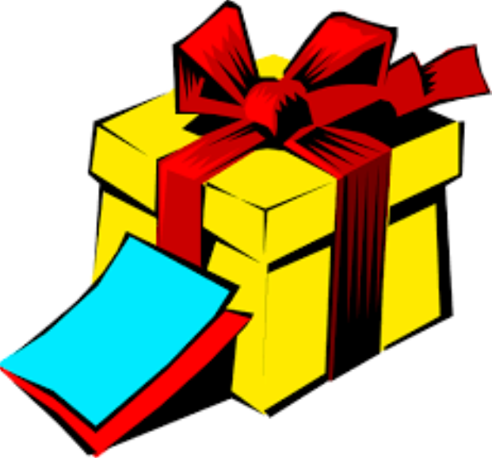

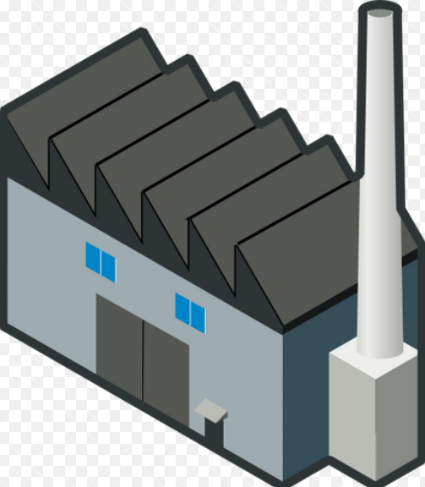
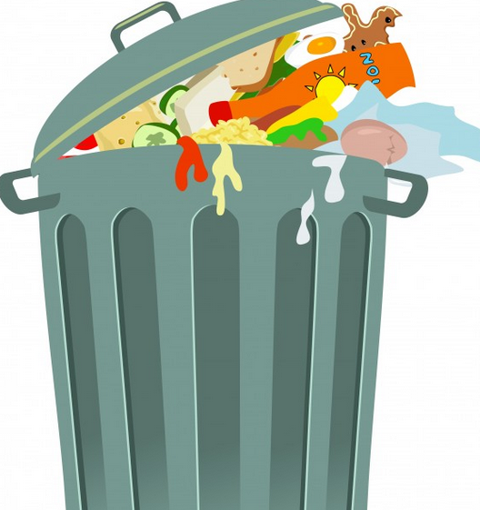
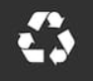
economic logistics
result of the integration of technical, economic and social sciences
deals with the flow of goods from place of origin to the place of consumption, respectively also back to the place of disposal

Slide 13
Definition of economic logistics from 1988 by H. C. Phol:
  Logistics should ensure, that the place of receipt is supplied according to its requirements from the place of delivery with the right product, in the right quantity and condition, at the right time and at the same time, at minimal costs.

Slide 14
another definition of economic logistics
  Olšovský:
Economic logistics deals with all movement and storage that allow the flow of the product from the location of the raw materials to the place of final consumption, as well as information flows that set the product in motion so as to provide adequate customer service at reasonable costs. By product we mean both goods and services.

Slide 15
  Schulte:
Logistics is integrated planning, formation, implementation and monitoring of tangible and related information flows from supplier to enterprise, within the enterprise and from enterprise to customer.
  Rupper:
Logistics is a set of complex tasks and measures derived from them to optimally ensure the flow of material, information and values in the company´s transformation process.

Slide 16
  Kortschak:
Logistics is the science of coordination of the active and passive elements of an enterprise, aiming at the lowest cost over time, improving the flexibility and adaptability of the business to changing general economic conditions and changing market.
  Kirch:
logistics is a summary of all technical and organizational activities by which material flow operations are planned. It includes not only the flow of material but also the flow of information between all objects and spans various industrial and business processes over time.

Slide 17
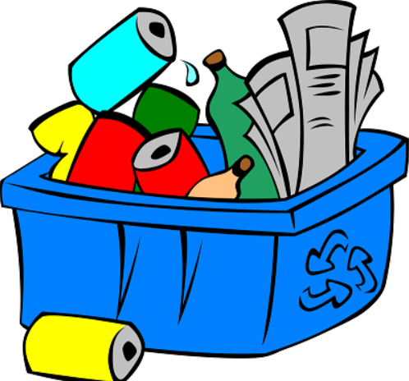
Objects of economic logistics:
  all kinds of materials and goods (production materials, auxiliary and operating materials, subcontracting and spare parts, commercial goods, as well as semi-finished and finished products) – the boundary to other procured factors (equipment, labor and capital) is clearly defined

Slide 18
logistically thinking and acting = involves looking for time savings, cost savings, striving for effective interconnection of supply, production and trade activities, applying flexible organizational structure to generally reduce the tying of current assets, increasing the flow of production and meeting the needs of customers

Slide 19
Logistics service function – attempt to secure the following three essential facts:
  The existence of an exchange of goods
  The existence of a serious supply of goods
  The existence of a flexible and economical offer

Slide 20
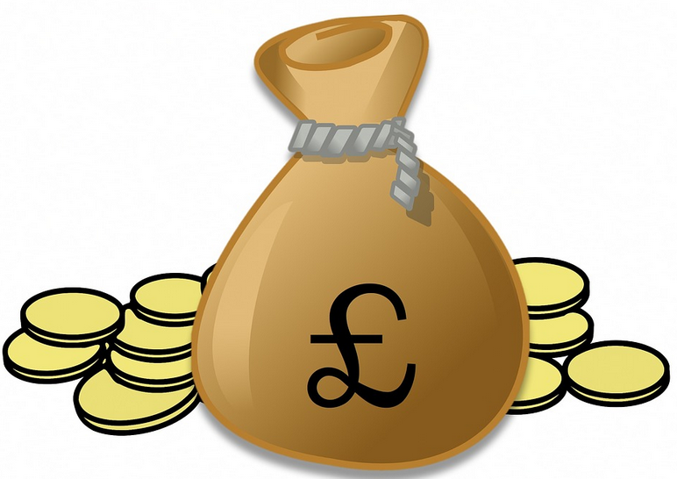
at the enterprise level it covers:
pre – production stages
production stages
distribution stages
cooperates with marketing
to achieve the ultimate
synergic effect
in performance
and cost

Slide 21
it has a huge impact on customer satisfaction - the necessary activity in the realization of sales of any kind of goods or services
participates in the creation of added value:
  product (transformation process of production of goods or creation of services)
  ownership (the fact, that the customer can gain real ownership of the product or service)
  time (item is available when customer needs it)
  place (item is available where customer needs it)
  Place + time = customer satisfaction base

Slide 22
Basic features:
  complexity and system approach
  concept of object dynamics, resp. its transformation
  access to temporal, spatial and economic discrepancies and relation to market environment
  relation to management practice

Slide 23
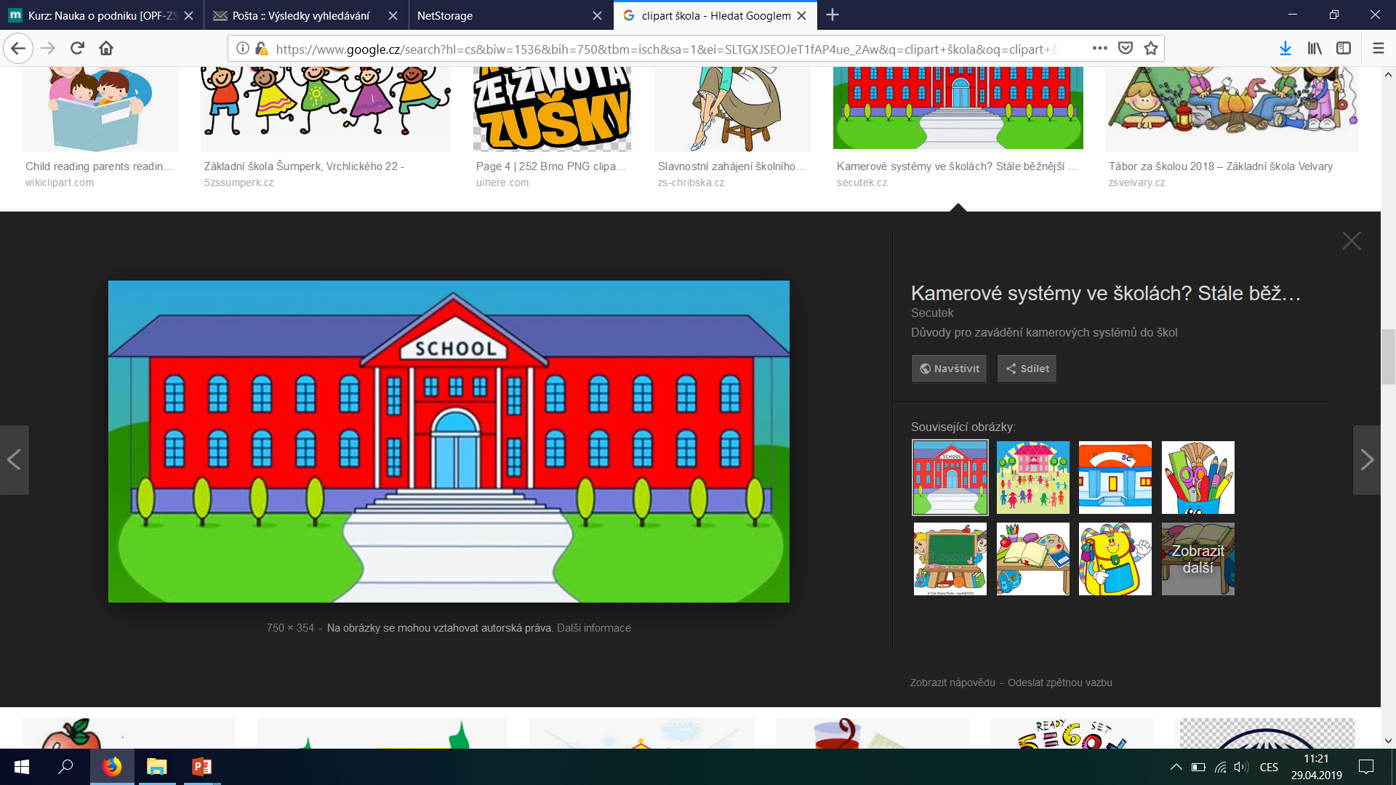
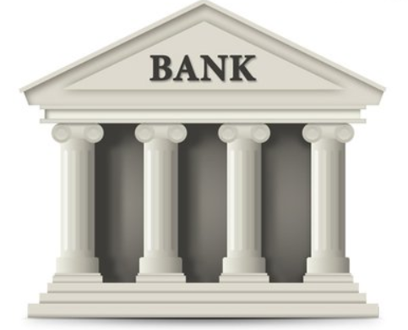
It applies to all types of organizations:
  production sphere
  government
  hospitals
  schools
  organizations providing business,
  banking or financial services
SCHOOL
BANK

Slide 24
HISTORICal development of
logistics in the economic sector
Period to 1950 - the period of “logistics sleep“:
  gradual emergence of theoretical concepts and practical activities in interaction with sales activities and emerging marketing concepts
  application of partial elements of logistics without interconnection
  identification of the nature of physical distribution - physical movement of materials and final products from the place of origin to the place of use, which should ensure the fulfillment of customer and business requirements and bring profit

Slide 25
  development of logistics management practice overtakes the development of logistics theory
  at the end of the period, due to the overall economic recovery, the rapid development of logistics networks (distribution and supply)
  substantial growth of logistics infrastructure (vehicles and equipment, warehouses, transshipment points and communication networks)

Slide 26
1950 to1970 = „the preparation period for the start of logistics theory and practice“
  Distribution is still a problematic element of marketing mix
  Harvard University (1956):
    role of air transport in physical distribution
    possibility of substitution of one type of costs for another and principle of the importance of total, not partial costs
    decisive for the creation of the so-called Total Costs concept - the basic principle of logistics
CN = f(N₁, N₂, …,N_{m})
CN = f(N₁, N₂, …,N_{m})
CN = f(N₁, N₂, …,N_{m})

Slide 27
  significant structural changes in consumer demand with an emphasis on the differentiation of offers
  change in the structure of production and distribution with a direct impact on the efficiency of these processes
  system concept of logistics - recognition of an alternative approach to solving logistic problems and recognition of the fact that if a problem is signaled within a certain subsystem, its solution must be complex and often outside its own subsystem, which signaled the problem
  formed logistic theory and its application in practice

Slide 28
3. Period after 1970 - the "logistics success period":
  expanding logistics in the US and Western Europe
  development of flexible manufacturing systems: Just In Time (JIT) and Total Quality Management (TQM) systems, which have their roots in Japan, the USA and the UK.
  in the 1990s in Western European countries there was a tendency to market saturation ⇒ increasing the importance of marketing
  Eastern bloc – ideological condemnation, something used, but not called

Slide 29
  in the former GDR, the concept of so-called TUL processes (Transport, Umschlag, Lagerung) – focusing on material chains in physical distribution (transport, circulation and storage of materials and products) in order to streamline supply structures and processes by optimizing their technical component
  concept of integrated material management

Slide 30
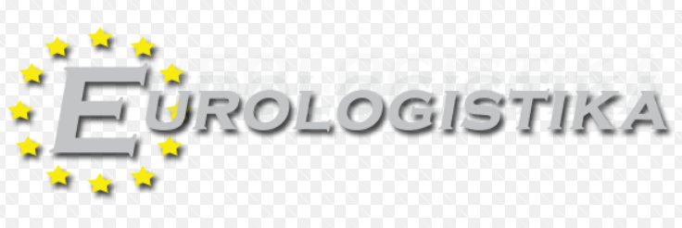
  at present, along with a qualitative leap in transport, the rapid development of information systems and public communication networks for the remote transmission of information for production, trade and transport
  Euro logistics was established in Europe

Slide 31
Summary of the lecture
You can:
Explain the historical roots of logistics
Describe the origin of the word logistics
Clarify the essence of logistics
Define general and economic logistics
Define important historical milestones of general logistics as well as economic logistics

