Slide 1

Logistics
-
Logistics activities and costs of their implementation
The aim of this lecture is to get acquainted with individual logistics activities and costs of their implementation
.
Šárka Čemerková
Lecturer

Slide 2
Logistics
-
Logistics activities and costs of their implementation
Logistics activities
Transport - Transportation
Logistics costs
.
Structure of the lecture

Slide 3
Logistics activities
1. Customer Service
it connects and manages all the components of the connection to the customer within the specified costs / service ratio
logistics system output
it must be measured by specific measures - customer service level indicators
3 phases: pre-sales, sales and after-sales

Slide 4
2. Demand Forecasting
How much to order from suppliers and how many products should be prepared or available?
series of realized sales are starting point:
  sales at some times are lower than actual demand
  estimate of total market capacity is not usually included

Slide 5
3. Stock Management
Goal: To maintain stock levels to achieve the required level of customer service while achieving minimum storage and stock maintenance costs
the most sophisticated part of logistics theory
in companies often quite badly managed

Slide 6
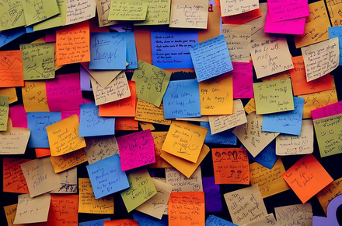
4. Logistics Communication
key to efficient operation of any system
the level of communication within the system can be the basis of the company's competitive advantage
trends: rapid increase in complexity,
automation and speed

Slide 7
relations:
  enterprise and its suppliers and customers
  main business units (logistics, technical departments, accounting, marketing and production)
  different logistics activities with each other
  various logistics activities within yourself
  enterprise and logistics service provider

Slide 8
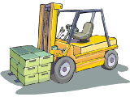
5. Material Handling
all aspects of the movement or transfer of raw materials, production stocks and finished products within the plant or warehouse of the enterprise
always generates costs, but does not add value to the item
It is necessary to eliminate as much as possible!

Slide 9
6. Order Processing
key contact point of the customer and the company, i.e. it can have a great influence on the level of quality of services and thus also on customer satisfaction
very wide and highly automated area (EDI, EFT)
summary indication of all activities that are needed between shipping the order and receiving the delivery with the recipient

Slide 10
time between order submission and delivery, including its payment, is known as the order cycle, i.e. the sum of the duration of the following activities:
  signal path of need
  determination of ordered quantity
  supplier selection and negotiation
  execution and delivery of the order, or conclusion of the contract
  supplier's delivery time
  transport to the store (this time may already be included in the delivery time)
  acceptance of delivery
  storage of the delivery and recording of receipt or delivery

Slide 11
  evenness vs. speed
  space for shortening - internal and external part
  consequences of errors
1. customer places an order
6. customer receives the goods
5. order is transported to the customer
2. order accepted by a supplier
3. order is being processed
4. order is completed and packed

Slide 12
Size of orders
influenced by a number of internal and external factors:
  size needed
  available funds
  store layout
  situation on the suppliers market
  capacity of transport equipment
minimum size vs. smaller quantities at extra costs

Slide 13
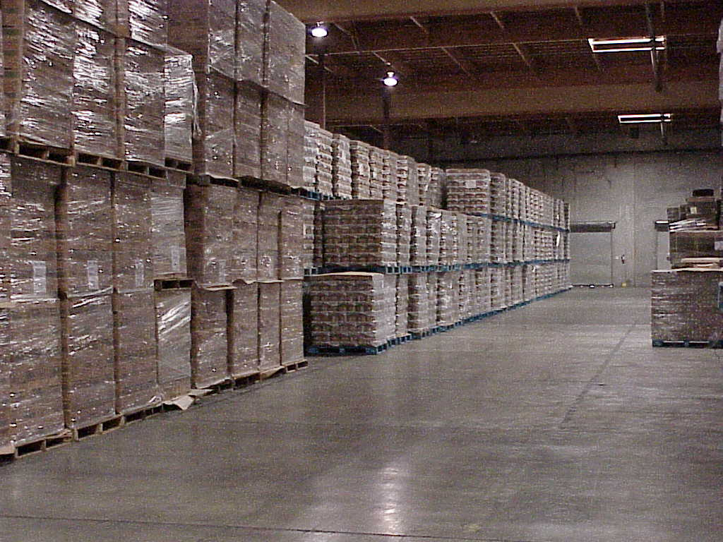
7. Packaging
marketing vs. logistics meaning of packaging
in logistics 2 key functions:
  protective
  rational handling, transport and storage unit
bearer of logistics information
boxes, bags, pallets and containers

Slide 14
8. Service Support and Spare Parts
logistics is also responsible for providing after-sales service:
  supply of spare parts
  storage of spare parts
  picking up defective or malfunctioning products
  quick response to repairs

Slide 15
9. Determination of Production and Storage Location
strategic decisions
it will affect the cost of transport of raw materials to the enterprise and finished products to customers, as well as the level of customer service and response speed
localization factors:
  location of customers and suppliers
  availability of transport services
  availability of qualified workers with acceptable pay levels
  possibilities of cooperation with authorities etc.

Slide 16
10. Procurement / Purchase
providing input from external organizations
for most industries, 40-60% of revenue is used to procure materials and services that come from outside sources
purchase activities:
  selection of suppliers
  price negotiations
  negotiations on delivery terms and quantities
  purchase itself
  evaluation of supplier quality

Slide 17
11. Handling of Returned Goods
for various reasons:
  problem with product operation
  customer changes his mind
complicated process:
  mostly handling of a small quantity back from the customer
  company is used to handling of large volumes towards the customer
many logistics systems have a problem handling this type of goods movement

Slide 18
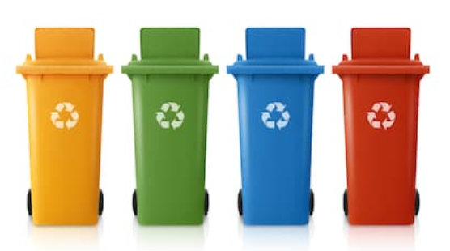
12. Reverse Logistics
removal and, where appropriate, disposal of waste material arising from the production, distribution and packaging of goods
includes:
  temporary storage of materials
  subsequent transport to the place of disposal, treatment, re-use or recycling
there is a growing interest in recycling
and reuse of materials
legislative restrictions

Slide 19
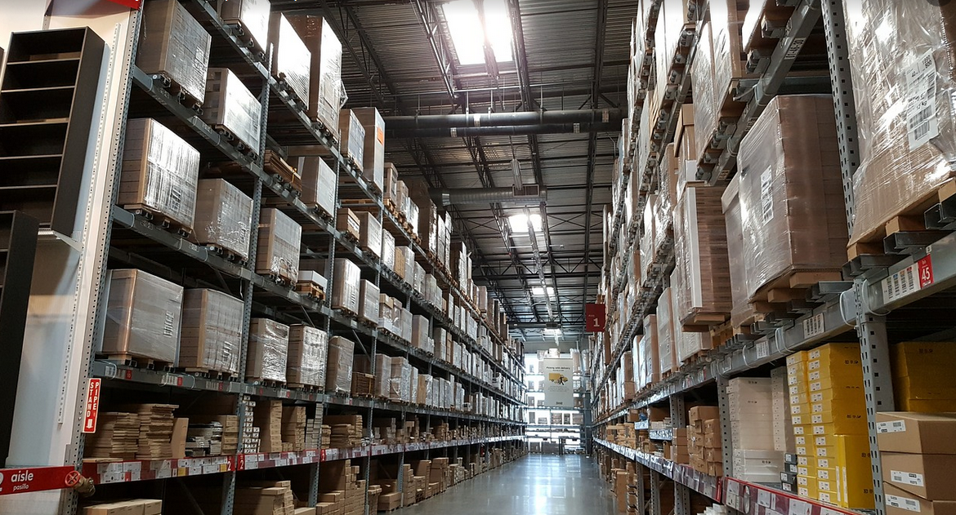
13. Storage
significantly contributes to the creation of the utility value of time and place: it enables the goods to be manufactured and retained for later consumption
storage activities concern:
  design and layout of store
  deciding on ownership of store
  automation
  staff training and many other areas

Slide 20
14. Transport and transportation
key logistics activity
often the largest single cost item
ensuring transportation includes:
  choice of mode of transport
  selection of a transport route
  ensuring that the regulations of the country of transport are not exceeded
  selection of a carrier

Slide 21
Carrier
transport operator
realizes its own movement in space and time by means of transport
producer and implementer of transport services on the market, i.e. sells transport services

Slide 22
Transporter
carrier customer - manufacturer, trader, exporter, importer
often the owner of tangible goods
it may be itself a carrier if he owns a fleet (own or leased) and operates a transport for his own use
if the fleet is not owned by the transporter, the entities providing the transportation are usually entered into the relationship - shippers, intermediaries, associations of transporters, etc.

Slide 23
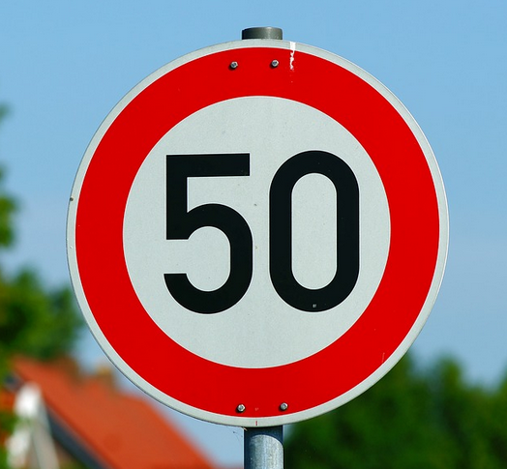
Speed of transport
the speed of the vehicle in a particular section of the route
maximum speed vs. average speed

Slide 24
Speed of transportation
in freight transport, the total time it takes to transportation of goods (consignments) from place to destination, including the time required for transshipment
in passenger transport, the time elapsed between the start of the journey and its end, including transfers and the time spent waiting for connections

Slide 25
Logistics costs
caused by logistics activities
total cost concept - it is not possible to focus on individual isolated logistics activities, but to reduce the total costs of logistics activities
the conflicting nature of logistics costs - reducing costs in one area can result in costs in other areas

Slide 26
Costs related to customer service
Customer service
Service support and spare parts
Handling of returned goods
Stock maitenance costs
Stock management
Packaging
Reverse logistics
Transportation costs
Transport and Transportation
Quantity costs
Material handling
Procurement/Purchase
Storage costs
Storage
Selection of production and storage location
Costs of order processing and IS
Logistics communication
Order processing
Demand forecasting

Slide 27
Costs Related to Customer Service
customer service support:
  costs associated with processing orders
  costs of securing spare parts
  costs of servicing
  costs of returning the goods
insufficient level of customer service - costs associated with the loss of sales opportunity
determining the level of customer service based on the identification of customer needs

Slide 28
Transportation Costs
caused by the transportation of goods
they can be analyzed from a variety of aspects (according to customers, products, channel type,…)
varies greatly depending on:
  delivery volume
  delivery weight
  transportation distance
  place of origin
  destination
  type of means of transport

Slide 29
Storage Costs
arise in the process of storing goods
affected by the choice of location of production capacities and storages of the company
include all costs incurred in changing the number or location of storages

Slide 30
Costs of Order Processing and IS
costs associated with :
  orders processing
  logistics communication
  demand forecasting
order processing system and IS mean an extensive investment - they significantly contribute to the level of customer service and cost management

Slide 31
Quantity Costs
originate in a change in quantity
include the following:
  preparatory costs
  loss of capacity due to outages when replacing a line or switching to another supplier
  material handling, planning and shipping
  price differences due to the purchase of different quantities
  order costs associated with placing and tracking orders

Slide 32
Stock Maintenance Costs
some of the most problematic - they very often evoke additional costs
high costs of maintaining stocks usually indicate other problems
arise as a result of log. activities:
  stock management
  packaging
  reverse logistics (disposal of waste material, packaging,…)

Slide 33
four main categories of stock maintenance costs:
  capital costs
  costs related to services (insurance, taxation)
  stock storage costs (costs of changing storage area depending on stock levels)
  costs of risk (obsolescence of goods, theft, damage during movement)

Slide 34
Summary of the lecture
You can:
List and briefly characterize all 13 logistics activities
Explain the difference between transport and transportation
Define logistics costs and assign activities that result from them

