Slide 1

Logistics
-
Customer servise part 1
The aim of this lecture is to define customer service, its components and starting points in developing its strategy
.
Šárka Čemerková
Lecturer

Slide 2
Logistics
-
Customer Service
Part 1
Logistics activities
Customer Service Definition Customer Service Components
Starting points of customer service strategy
.
Structure of the lecture

Slide 3
Customer service (cS)
process that takes place between the buyer, seller and possibly third party (logistics companies)
result of this process is the added value (short and long term) that increases the value of the product or service being exchanged
cost effectiveness
https://www.youtube.com/watch?v=bL_D-qyva0c
https://www.youtube.com/watch?v=tYUXK2Rb-PY

Slide 4
How can be CS understood?
Activity to be managed
Performance in certain parameters
Business philosophy

Slide 5
  CS Components
Pre-sales phase
Sales phase
After-sales phase

Slide 6
1. Pre-sales components
mostly relate to the organization's policy or strategy
have a major impact on how customers perceive the organization and what their level of satisfaction is
do not always have to be directly related to logistics
formulated and available before an enterprise starts implementing and performing customer service activities

Slide 7
are provided independently and outside the normal order cycle
relatively stable, long-term nature
provide some assurance in terms of customer expectations

Slide 8
I. Written declaration of customer service policy
definition of service standards in response to customer requirements
it includes measures to monitor and evaluate service performance, including how often results are reported

Slide 9
II. Handing over customer service declarations to customers
enterprise makes the customer aware of what he can expect to avoid exaggerating expectations
in this form the customer should learn how to proceed in cases where the expected level of service is not met by the enterprise

Slide 10
III. Organization structure
ensures that customer service goals are achieved
there are no universal rules
it must allow both internal and external communication policy, performance and, where appropriate, corrective actions
customers should have easy access to people who are directly involved in meeting their needs and can answer their questions

Slide 11
IV. System flexibility
plans for a random or unforeseen event that would allow the organization to respond flexibly when such exceptional situations occur

Slide 12
V. Management services
assistance in advertising sales
assistance in stock management
assistance with ordering
provided in the form of various manuals, seminars, or personal consultations
free or paid

Slide 13
Sales components
services that are usually associated with the term customer service
Stock depletion level
measures the availability of a particular product
stock depletion level should be monitored by product and by customer
maintains customer confidence when stocks are exhausted (replacement product, delivery from another source)

Slide 14
II. Order status information
information about the status of ordered goods in stock
order status information
information about the expected or actual delivery date
information about the status of pending orders
customers pay increased attention to any delivery problems or variations in delivery

Slide 15
III. System accuracy
order cycle uniformity
special delivery solutions
movements of goods
ease of ordering
product substitutability

Slide 16
IV. Order cycle evenness
customers attach more importance to maintaining order cycle evenness than absolute cycle length
need to monitor actual performance achieved in supply evenness and if necessary taking corrective measures

Slide 17
V. Special delivery solutions
delivery that cannot be delivered within the usual distribution system
costs of these deliveries significantly exceed the costs of standard deliveries
necessity determines which types of customers or situations are eligible for this special treatment and which are not

Slide 18
VI. Goods redistribution
moving goods between different distribution points
aim is to prevent the depletion of stocks
where there are several distribution points, the rules for such transfers should be laid down

Slide 19
VII. Ease of ordering
How easy is it for the customer to order?
user friendly preference
ordering problems need to be monitored

Slide 20
VIII. Product substitutability
if the goods ordered by the customer are not in stock but can be replaced:
  different size/packaging of the same product
  another product that has similar or better user properties

Slide 21
3. After-sales components
provide product or service support after the customer has received it
are the most neglected

Slide 22
I. Installation, warranty, modifications, repairs, spare parts
important consideration in virtually any purchase, but especially in the purchase of investment products
they must be given the same attention and investigation as the sales parts

Slide 23
II. Product tracking
form of registration - which products were sold to which customers
this information can be extremely important (e.g. need to inform customers about a potential problem)

Slide 24
III. Handling complaints, returned goods
importance of online IS
reverse logistics
setting clear rules

Slide 25
IV. Temporary product replacement
for some products it is necessary to keep in stock backup products that can be offered to the customer during the service of the product (cars, mobile phones,…)
minimizing customer trouble and the ability to significantly increase customer loyalty

Slide 26
CS Strategy
market and business analyzes mainly in the following areas:
  determination of the level of CS following customer response in the event of depleted stock at retail level
  interdependencies between costs and revenues
  ABC analysis
  customer service audit

Slide 27
Determination of the level of service following customer response in the event of depleted stock
is difficult for the manufacturer to determine the impact of stock depletion on end-users
depletion of stocks at the producer level does not necessarily mean that stocks at the retail level are depleted
when goods are not available, the customer can:
  buy another size / packaking of the same brand
  buy another brand
  go to another store

Slide 28
proper understanding of the behavior of subjects at different levels of the distribution channel is critical for the right strategy formulation (e.g. infant food)
the starting point for customizing the order cycle, order fulfillment reliability, transport options and other elements of the logistics system

Slide 29
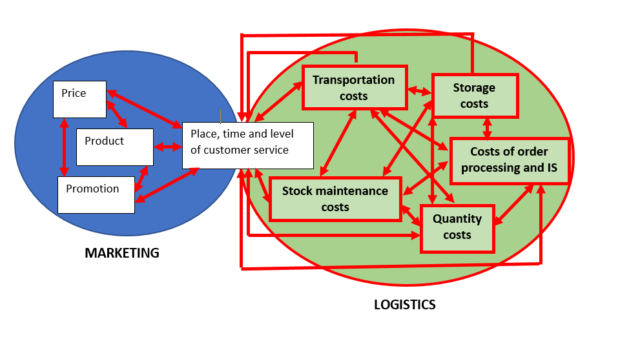
Cost links in the logistics system

Slide 30
ABC analysis
some customers (products) benefit the enterprise more than other customers (products):
  A: the most important (85%)
  B: less important (15%)
  C: the least important (5%)

Slide 31
Example: different service levels
Customer | Stock availability standard (%) | Order cycle time standard (hr.) | Standard for completeness of supply (%)
A | 100 | 48 | 99
B | 95 | 72 | 97
C | 90 | 96 | 95

Slide 32
Summary of the lecture
You can:
Define customer service
Describe the individual components of customer service
Define the bases of customer service strategy
Clarify customer´s response in case of stock depletion
Use ABC analysis to create a customer service strategy

