Slide 1

Logistics
-
stock and their management
The aim of the lecture is to clarify importance of stock and the essence of their management
.
Šárka Čemerková
lecturer

Slide 2
Logistics
-
Stock and their management
Stock and their types
Stock creation factors
Stock management factors
Stock management phases
Stock management level indicators
Approaches to stock management
.
Structure of the lecture

Slide 3
  stock
current or short-term assets of the company
their characteristic feature is that they are consumed or produced by the enterprise (as a result of the purchasing or production process)

Slide 4
main stock categories:
  material:
    raw materials and basic material
    auxiliary and operating substances
    fuel
    spare parts
    packaging and small assets

Slide 5
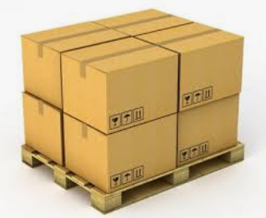

  stock of own production:
    work in progress
    semi-finished products
    finished products
  goods

Slide 6
signaling levels of stock:
  minimum stock
  maximum stock
functional components of stock:
  current stock
  safety stock
  technical and technological stock
  seasonal stock
  speculative stock
  emergency stock

Slide 7
Reasons for stock creation:
differences between resources (supply) and needs (demand) in terms of time, place and amount of their origin and use
continuous and flexible production process
differences between forecasted (planned) needs and actual consumption
proper process or completion of the technological process

Slide 8
  discount when purchasing in larger delivery quantities
  purchase of raw materials at a time when there is enough on the market
  trying to avoid the problems caused by the lack of raw materials on the market
  delay sales in periods of low demand and allowing speculative profits from sales in later periods of high demand
  creation of optimal production or transport batch

Slide 9
stock of raw materials
stock in production
stock of finished products in the production plant
supplier´s stock
stock of finished products at distribution points
stock in retail
consumer stock
reworking or repacking the product
waste and by-products
waste disposal

Slide 10
  Stock management
stock level regulation
goal:
  to maintain stock in a size and structure that meets the needs of the business while respecting the economic efficiency criteria
logistics stock regulation focuses on 2 conflict areas:
  performance that is closely related to delivery readiness
  economy, thus reducing the cost of stock

Slide 11
basic groups of factors influencing stock management:
  external factors (factors of the surroundings of the enterprise) - in market and mixed economies are considered primary
  internal factors (business microenvironment factors)
    the most important external regulator - the state of supply and demand in the relevant stock market
    basic factor of internal regulation - costs of maintaining and securing stock

Slide 12
Internal Stock Management Factors:
how the storage of stock works - we have one or more products; stock is drawn periodically or non-periodically
how the storage is replenished - immediately, randomly, gradually, there are delays or not
how goods are taken from the storage - randomly or deterministically
there are some losses in the storage
restrictions - storage size, financing

Slide 13
Stock management levels
strategic stock management - a set of decisions on the amount of financial resources that the company can allocate from the total available resources to cover stock in a given amount and structure
operative stock management
  keeping of specific types of stock at the level and structure as appropriate to in-house cost needs
  based on the classification of stock according to functional components

Slide 14
phases of stock management in a broader sense:
  stock record:
    basic and indispensable source of information on the state and movement of stock
    captures phenomena signaling a material or value change in stock
  stock analysis:
    tool for identification and evaluation of structural, quantitative, qualitative, material and value changes in stock
    monitors factors that affect the state and movement of stock

Slide 15
  stock inspection:
    allows us to identify the levels of stock management
    degree of adherence to certain rules and guidelines of the supervisory authorities for the control and use of stock
    inspection of the method of disposal of unnecessary, redundant, event. unusable stock
    quality control of stock record and analysis

Slide 16
  self regulation:
    stock management in a narrower sense
    continuous monitoring and evaluation of the state and movement of stock on the basis of adopted rules
    flexible provision of feedback in case of deviations from the desired state and development

Slide 17
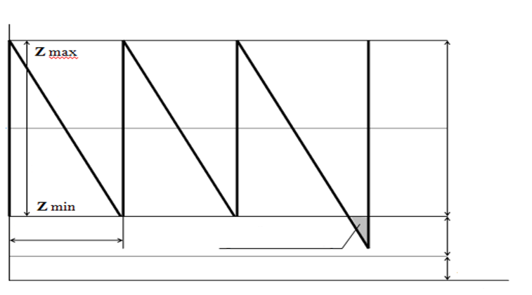
Development of stock in time
Size of the stock
Consumption
Consumption
Consumption
  Current stock
Supply
Supply
Supply
Supply
Delivery cycle
Delay in delivery
  Safety stock
  Technological stock
Time

Slide 18
  Stock management level indicators
bearer of a specific amount of stock in an enterprise is a realized supply, the amount of which is converted into stock during the storage process
average current stock
in conditions of continuous even consumption
where
D … supply

Slide 19
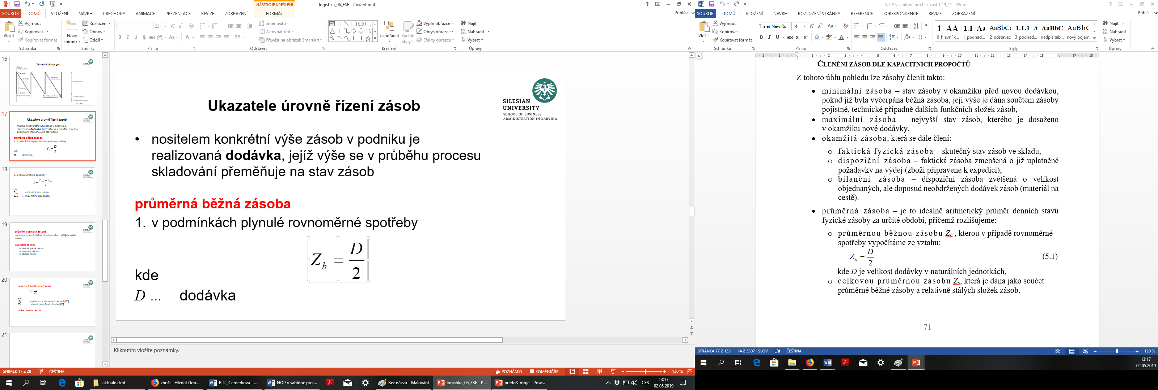
2. in conditions of uneven consumption
where
Z_{min} … minimal level of stock
Z_{max} … maximal level of stock

Slide 20
total average stock Z_{C}
sum of the average current stock and all fixed components of stock
immediate stock
  actual physical stock
  available stock
  balance stock

Slide 21

turnover (turnover rate) of stock
where
S_{o} … consumption for the period under review [CZK]
Z_{c} … total average stock [CZK]
stock turnover time

Slide 22
In stock management, we always need to know the answers to basic questions:
What and when to order?
How much to order?
What's in stock?
How to ensure the accuracy of stock data?

Slide 23
Stock management methods and techniques
Optimization methods
they follow the theory of stock management + principle of cost optimization
finding a minimum total costs
in the area of purchasing, this principle is used, for example, to calculate the optimum size of supply

Slide 24
Total cost of ordering and storage
where
c₁ … unit storage costs per year
c₂ … costs of one delivery
D … size of one delivery
P … annual demand (annual amount of supplies)
D/2 … average stock
P/D … number of delivery cycles

Slide 25
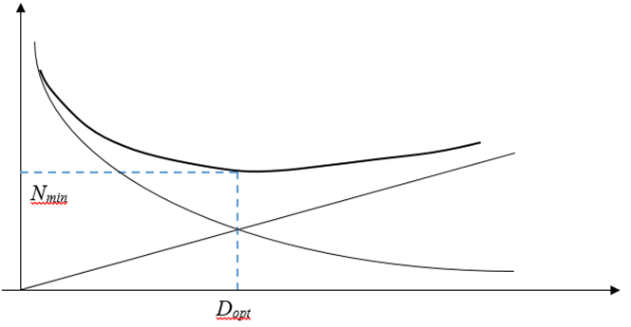
Costs
Total costs
Storage costs
Ordering costs
Order size

Slide 26
optimum supply size
optimal (minimal) costs

Slide 27
Pull Systems
proactive system triggered by the power of customer demand
Just-In-Time (JIT) + Kanban
originally the automotive industry – Toyota
today global logistics technology

Slide 28
Push Systems
characterized by the creation of stock - the amount and structure determined on the basis of forecast demand
traditional supply systems Just-in-Case (JIC)
traditional in European countries and America
possibility of elimination of the risks of timely non-delivery at the expense of increased storage and maintenance costs
existence of safety stock

Slide 29
Differentiated stock management system
where stock arises and what are the causes of its formation
selection of the items to achieve the lowest stock levels
application of selected methods of stock management
building of selected contractual supplier-customer relations
creating logistics chains
for risk items there is a need to maintain safety stock (even if using the JIT concept)

Slide 30
basic method for analysis and reduction of maintained stock - ABC analysis:
  to sort all delivered items based on delivered volume (number of pieces) and prices of individual items into 3 groups A, B, C:
    group A: items with a low delivery volume and high value
    group C: items with a high volume of supply and low value
    to achieve the lowest stock for the most expensive items and for items difficult to store

Slide 31
Effect of stock turnover on stock maintenance costs
Example: the relationship between average stock level for different number of turnovers, maintenance costs, and savings
Turnover | Average stock [CZK] | Stock maintenance costs [CZK] | Cost saving [CZK]
1 | 750000 | 300000 | -
2 | 375000 | 150000 | 150000
3 | 250000 | 100000 | 50000
4 | 187500 | 75000 | 25000
5 | 150000 | 60000 | 15000
6 | 125000 | 50000 | 10000
7 | 107142.86 | 42857.14 | 7142.86
8 | 93750 | 37500 | 5357.14
9 | 83333.33 | 33333.33 | 4166.67
10 | 75000 | 30000 | 3333.33
11 | 68181.82 | 27272.73 | 2727.27
12 | 62500 | 25000 | 2272.73
13 | 57692.31 | 23076.92 | 1923.08
14 | 53571.43 | 21428.57 | 1648.35
15 | 50000 | 20000 | 1428.57

Slide 32
Number of turnovers

Slide 33
Summary of the lecture
You can:
Explain the importance of stock creation
Describe the types of stock
Clarify the nature of stock management
List stock management indicators
Characterize individual approaches to stock management

