Slide 1

Logistics
-
transport
The aim of this lecture is to introduce you to transport facilities and individual modes of transport
.
Šárka Čemerková
Lecturer

Slide 2
Logistics
-
Transport
Transport facilities
Transport classification
Characteristics of transport by transport routes
.
Structure of the lecture

Slide 3
Transport
interconnects individual parts of the logistics process
ensures the physical movement of products from the place where they are produced to the place where they are needed - the benefits of the place
is a time-benefit factor - it determines how quickly and how reliably a product is moved from one location to another location

Slide 4
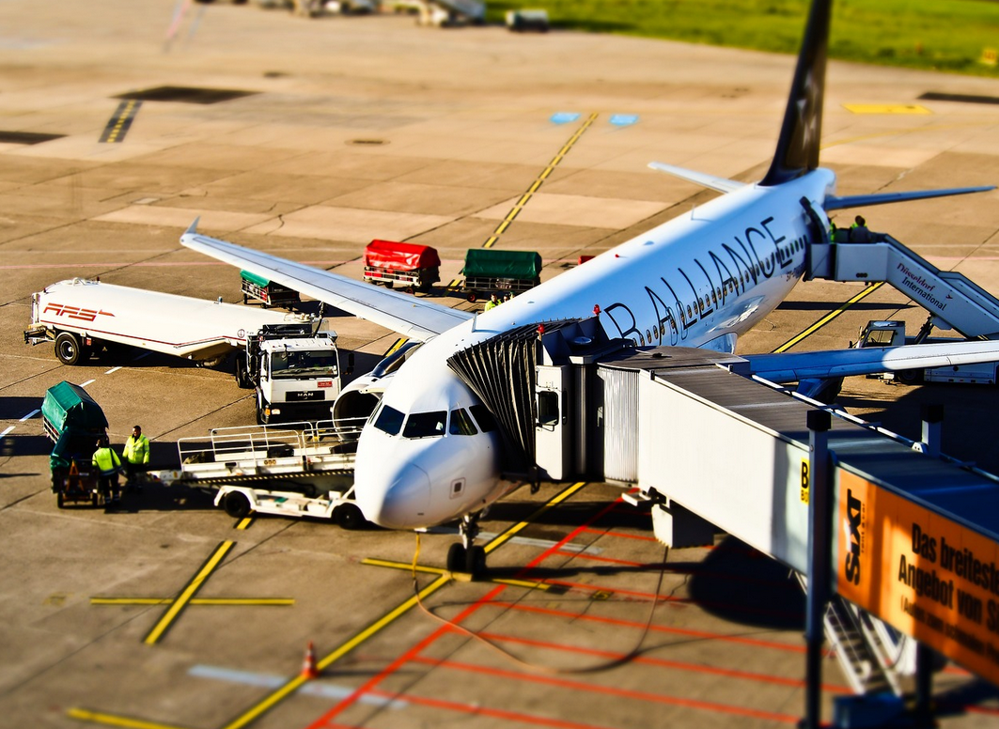
logistics management in transport = integrated use of technical, organizational and management methods to ensure the transfer of the required items at the right time at the right place with the required quality of services and relevant information

Slide 5
ensures the transfer of products to geographically separated markets
when products arrive on time in the market, undamaged and in the required quantities, transport provides added value to customers
planning of transport systems:
  customer requirements for time and hence for transport costs
  choice of transport facilities and other loading aids
  choice of means of transport

Slide 6
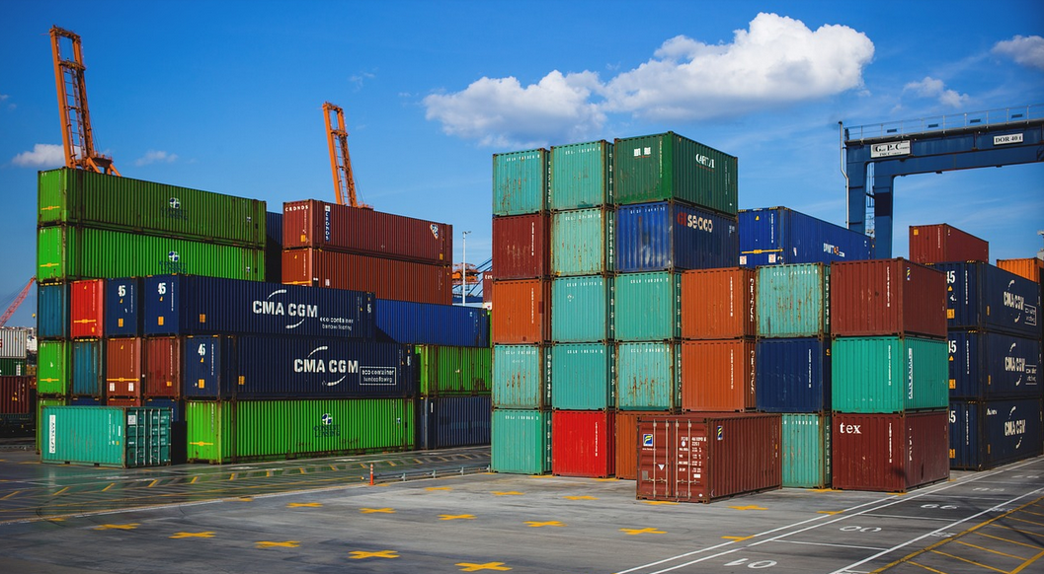

Transport facilities
types of transport facilities:
  pallets
  containers
  dimensionally unstable containers

Slide 7
function of transport facilities:
  acceptance and unification of transported materials
  protection of transported goods against damage, theft, etc.
  manipulability
  storability
  information carriers

Slide 8
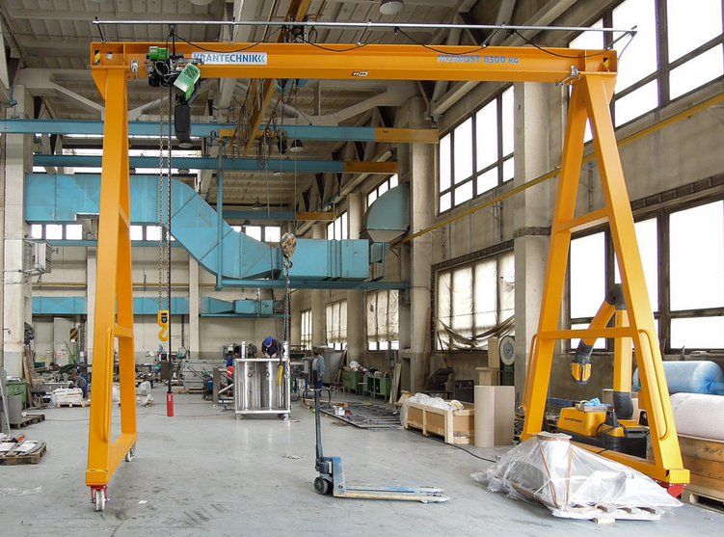
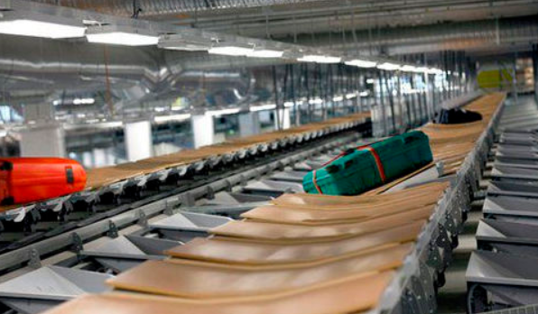
Transport classification
  by supplier and customer:
  outside the company
  inside the company:
    continuous means of transport
    non-continuous means of transport

Slide 9
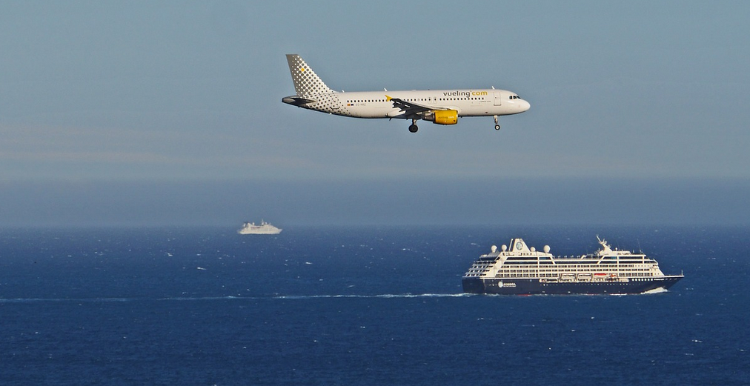
by transported object:
    passenger
    freight
  by transport route:
  road
  rail
  water:
    inland (river and lake)
    sea
  air
  pipeline
  combined transport: rail-road, road-ship, road-air or rail-ship

Slide 10
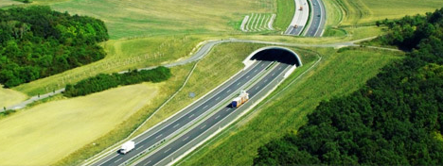
Road transport
positives vs. negatives
full truck shipment
collection service
extra-large (oversized) transport

Slide 11
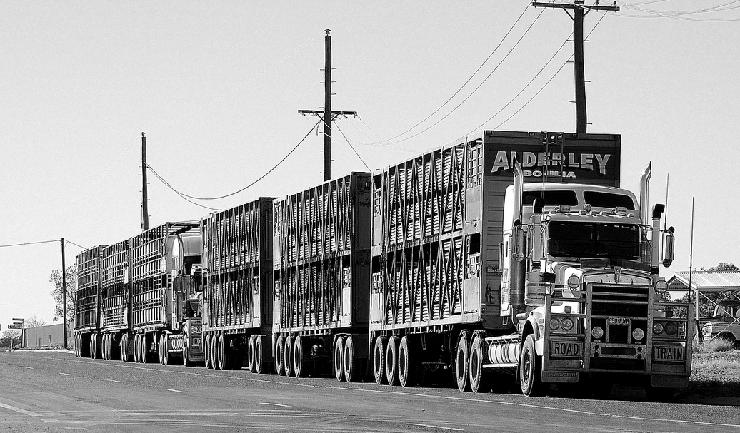
Road train (XXL, LCV, gigaliner, Eurocombi, Megatruck)
road set in the Czech Republic 22 m (up to 153 pallets), with the exception of more,
in the world about 50 m
up to 4 different
temperature modes

Slide 12
conditions of use in the Czech Republic:
  Subject to approval of the Ministry of Transport of the Czech Republic, which approves the transport route (for 3 months)
  Weight max 48 t, on D1 near Prague 40 t (bridge capacity)
  Only on separate motorways and expressways, except for max. 10 km for loading / unloading
  It can not cross the railway
  Special designation
  E.g. Schenker - piece shipments Prague-Brno

Slide 13
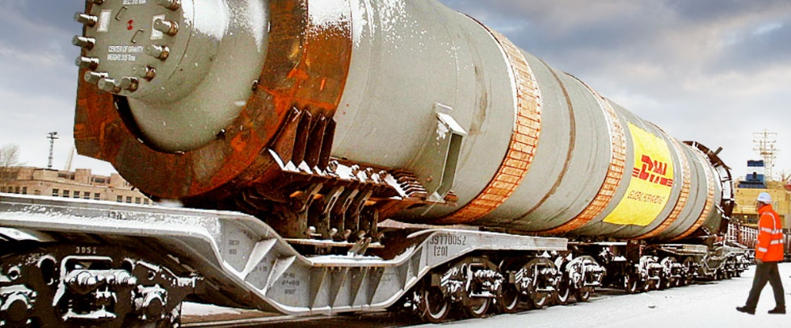
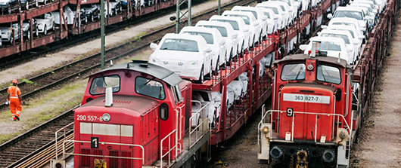
Rail transport
positives vs. negatives
individual wagon consignments
express parcels
complete train
individual consignments

Slide 14
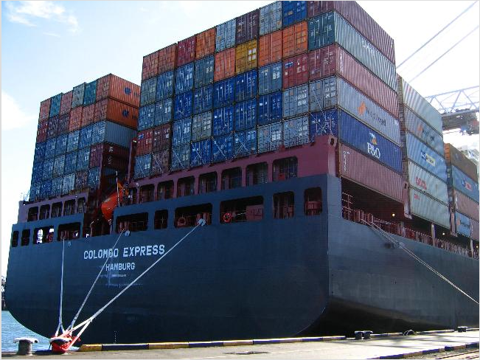
Water transport
positives vs. negatives
rivers, lakes and artificial water channels
sea:
  coastal (cabotage)
  transoceanic
liner
charter

Slide 15
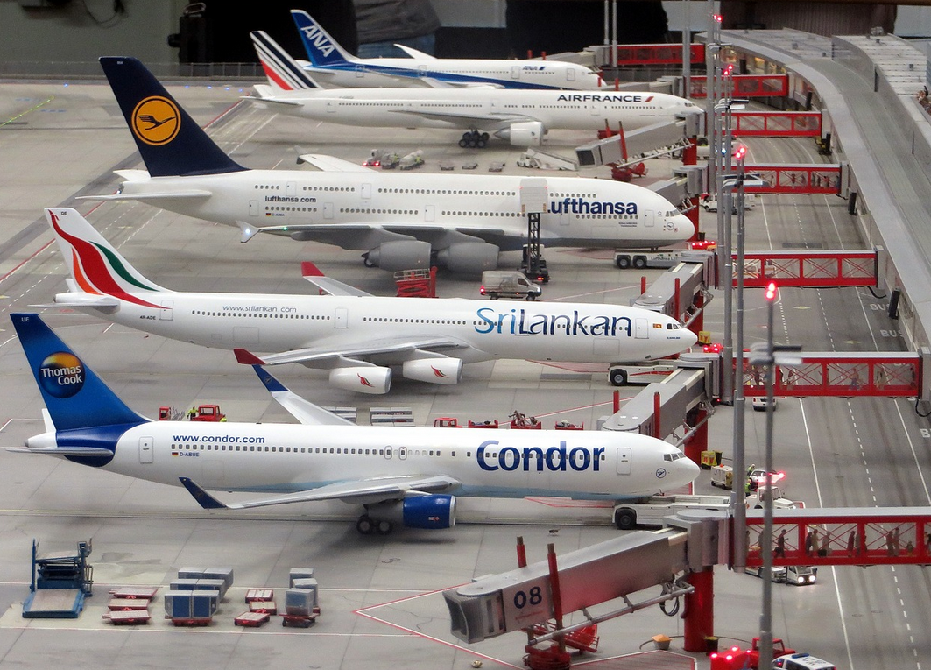
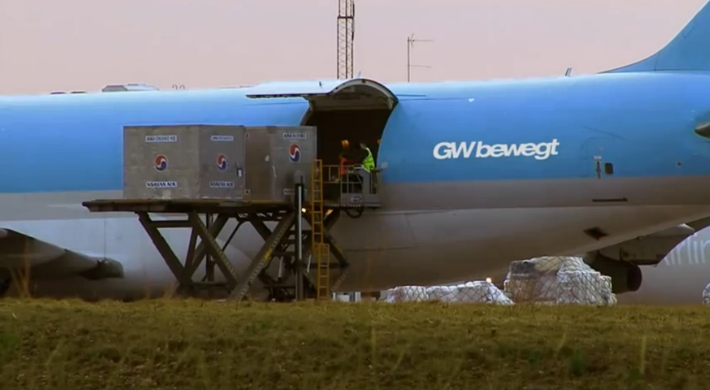
Air transport
positives vs. negatives
regular line
charter

Slide 16
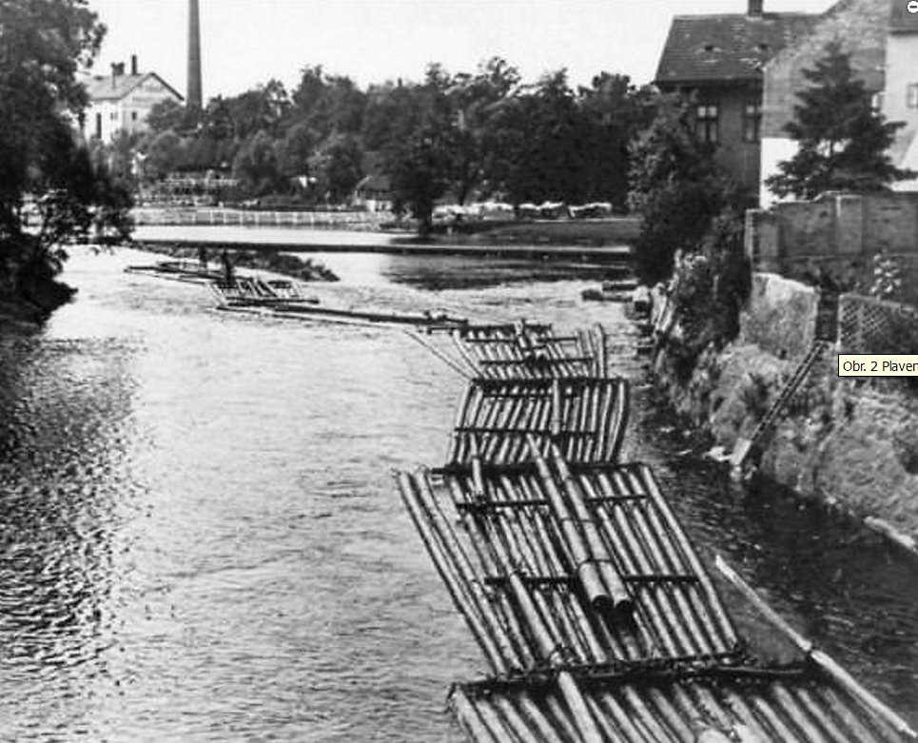
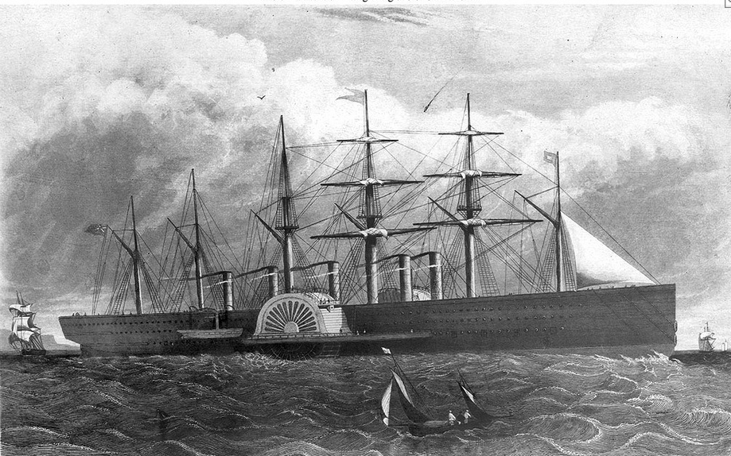
Notes:
British merchant ship from the 19th century
wooden rafts

Slide 17
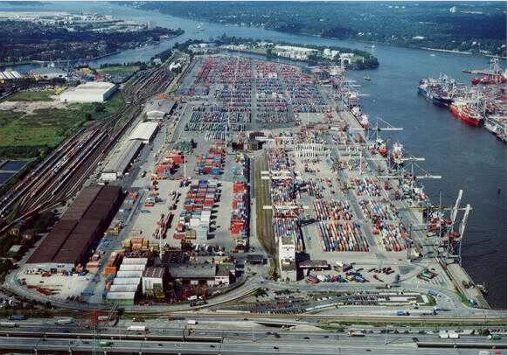
Port of Bremenhaven

Slide 18
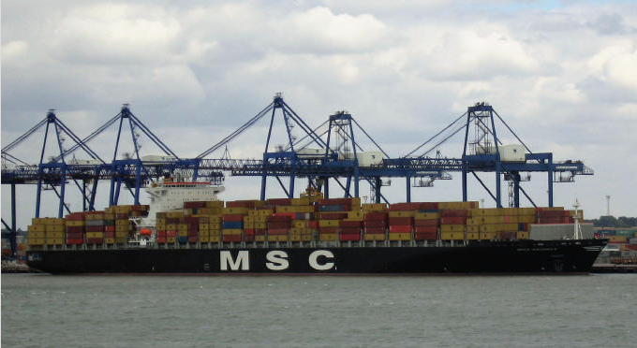
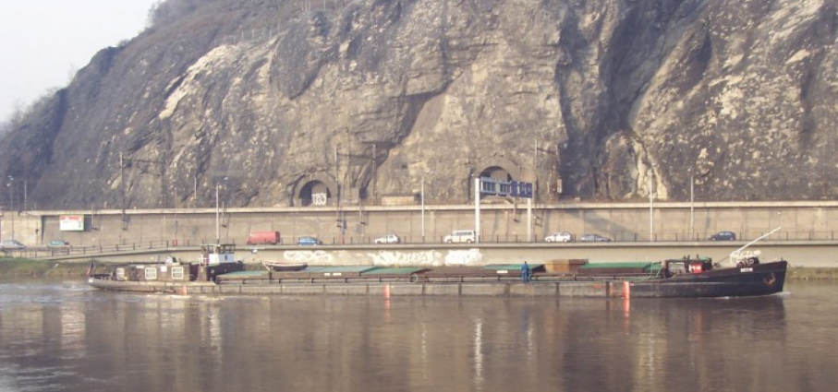
River transport

Slide 19
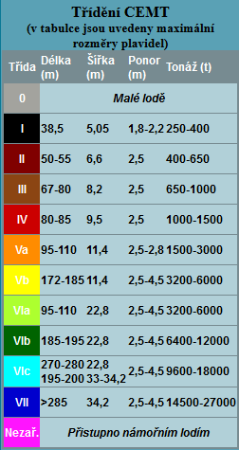
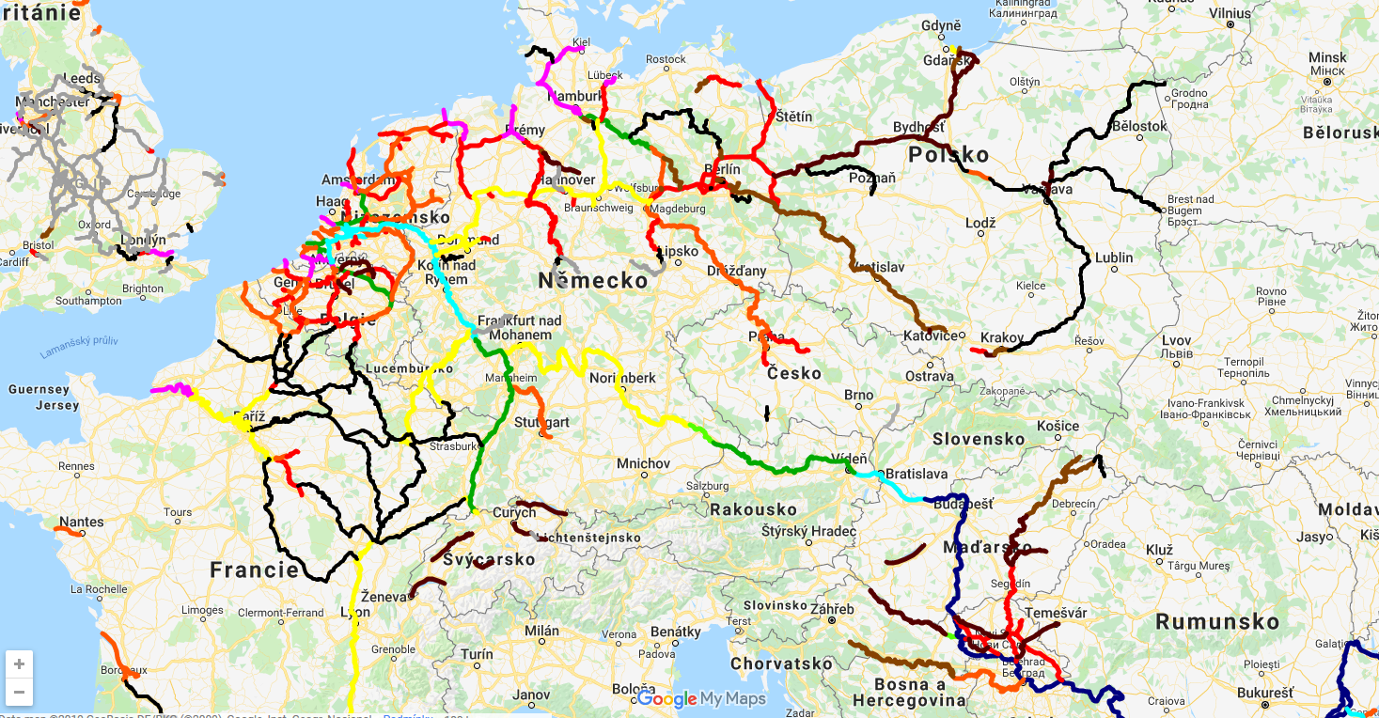
European riverways

Slide 20
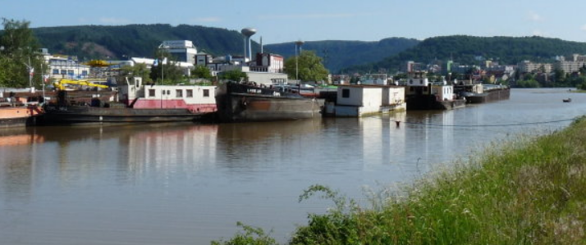

Cruise liner in Prague

Slide 21
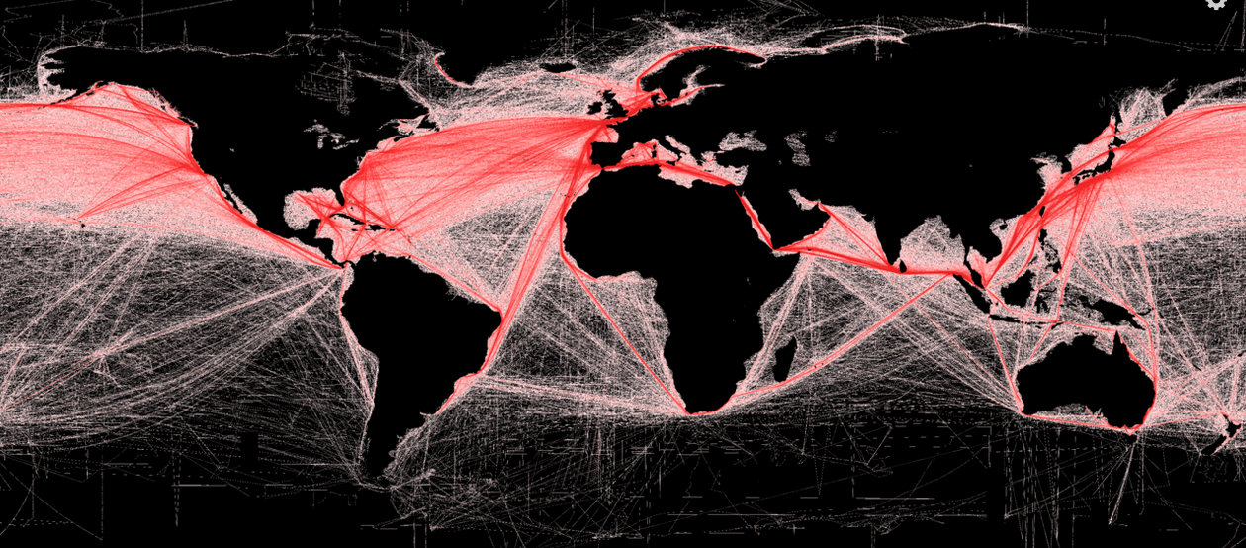
Shipping density map

Slide 22
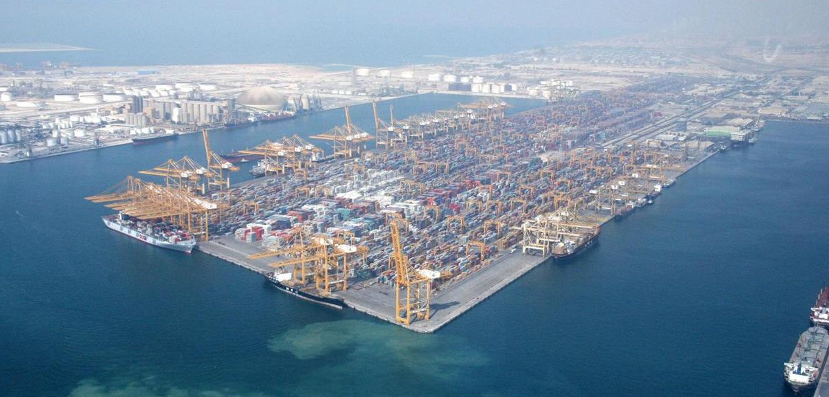
World's largest container shipping ports (2017)
Shanghai (China; 40.23 mil. containers-TEU)
Singapur (Singapur; 33.66 mil. TEU)
Shenzhen (China; 25.20 mil. TEU)
Ning-po-Zhoushan (China)
Hongkong (Hongkong )
Pusan (South Korea)
Kanton (China)
Qingdao (China)
Dubai (SAE)
Tianjin (China)
Rotterdam (Holland; 13.73 mil. TEU)
Note: TEU = Twenty-foot Equivalent Unit, where 1 TEU is equivalent to one 20-foot container.

Slide 23
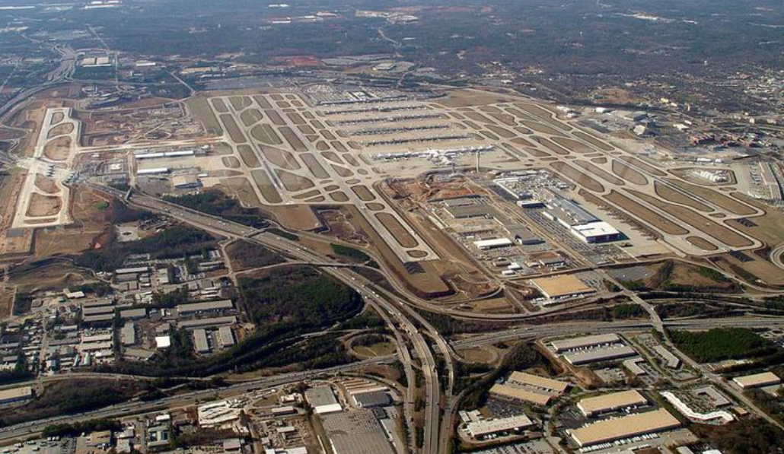
World's largest airports (number of passengers in millions in 2017)
Atlanta (USA) | 104
Bei jing (China) | 96
Dubai (SAE) | 88
Tokyo Haneda (Japan) | 85
Los Angeles (USA) | 84.6
Chicago (USA) | 80
London Heathrow (GB) | 78
Hongkong (China) | 73
Shanghai (China) | 70
Paris (France) | 69
Amsterdam (Holland) | 68.5
Source: airflight.blog.cz

Slide 24
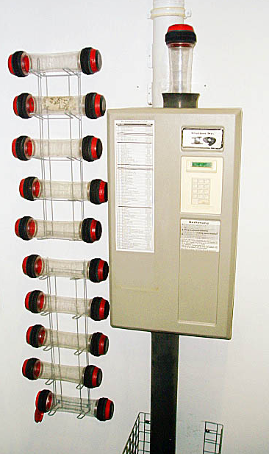
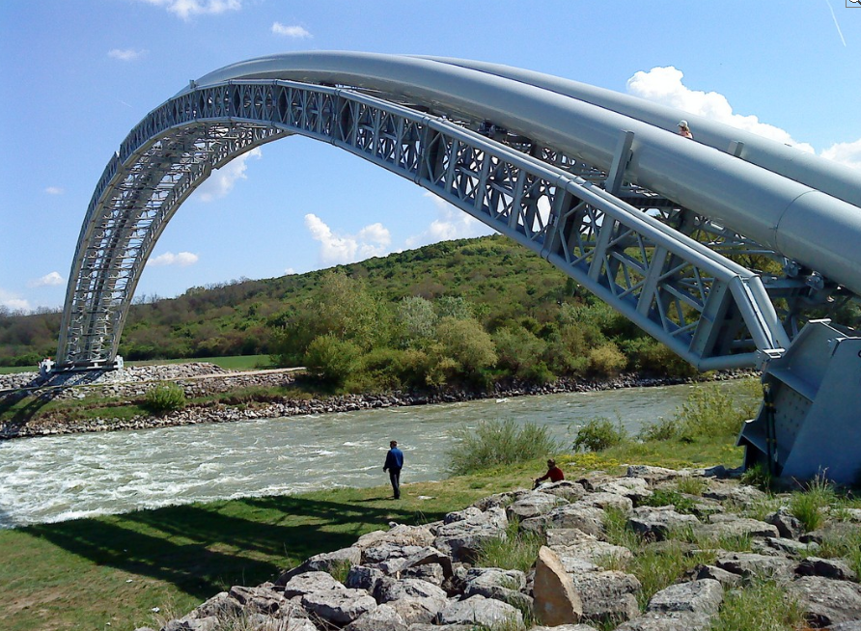
Pipeline transport
positives vs. negatives
product pipelines
Source: vitejtenazemi.cz

Slide 25
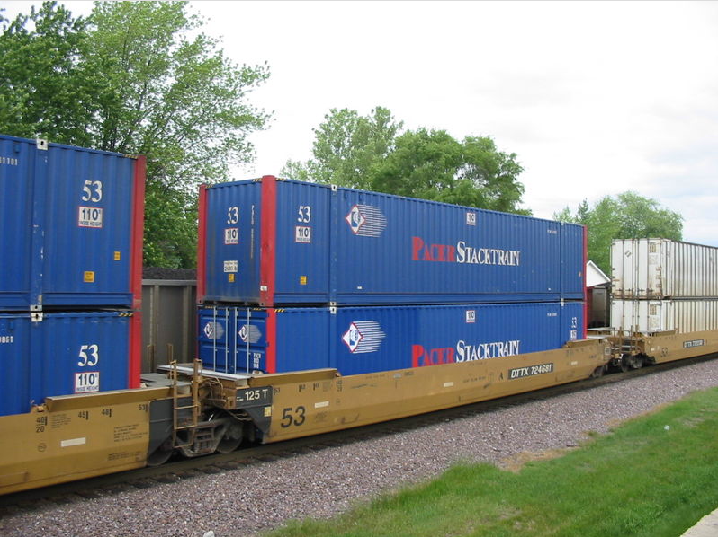
Combined transport
part of the route passes by rail, inland waterway or sea and the other carriage is covered by road transport
road transport is used to pick up the shipment from the sender and to deliver the shipment to the recipient

Slide 26
selected characteristics of combined transport:
  Reduction of material handling costs
  High security of transported goods
  Minimizing the amount of heavy handwork
  Unified technique of mechanization, automation, loading and unloading
  Insufficient legislative support of the state
  Insufficient harmonization of conditions for the operation of individual modes of freight transport

Slide 27
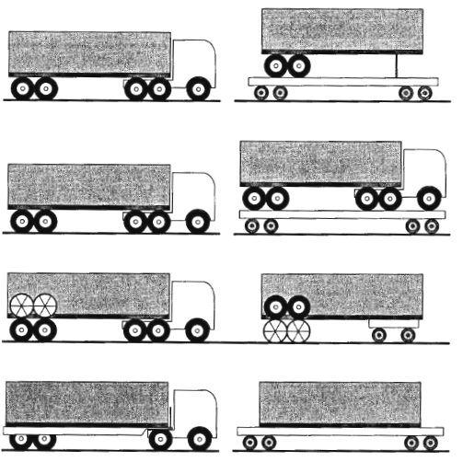
TOFC = trailer-on-flatcar
tractor with trailer on the flatcar
roadrailer
COFC = container-on-flatcar

Slide 28
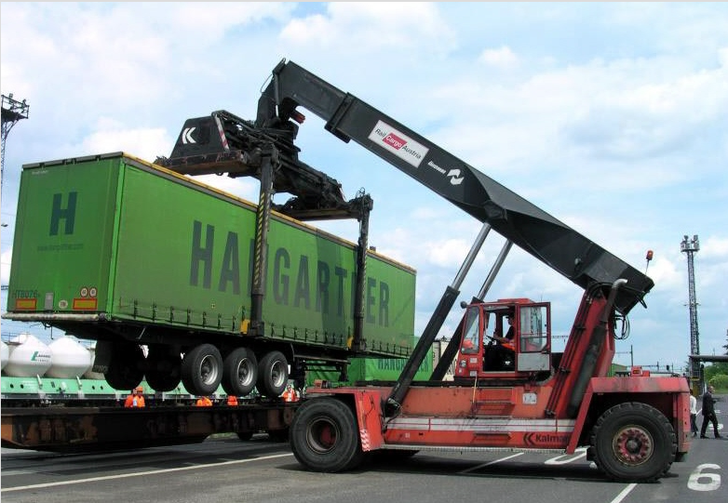
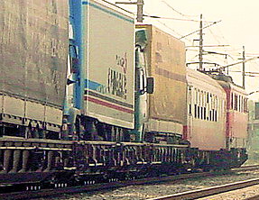

Slide 29
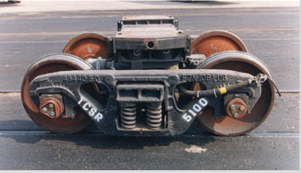
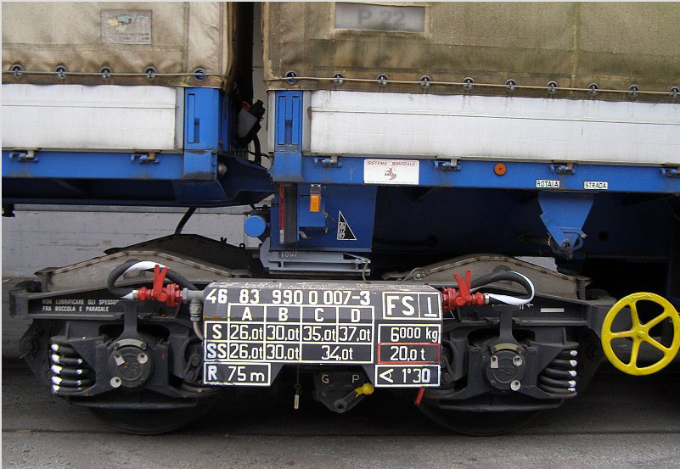

Slide 30
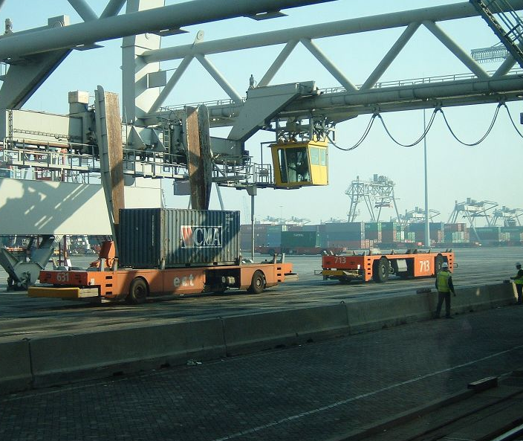
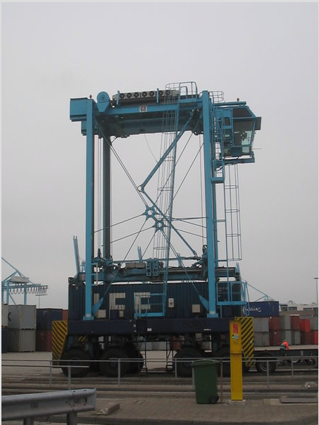

Slide 31
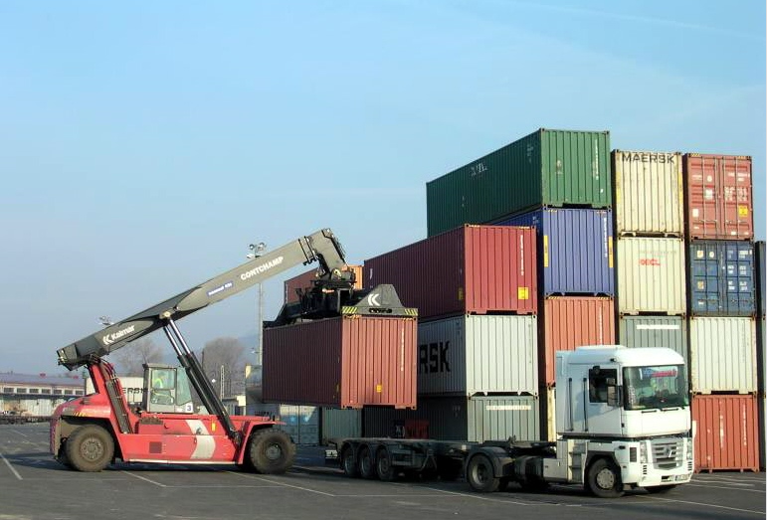
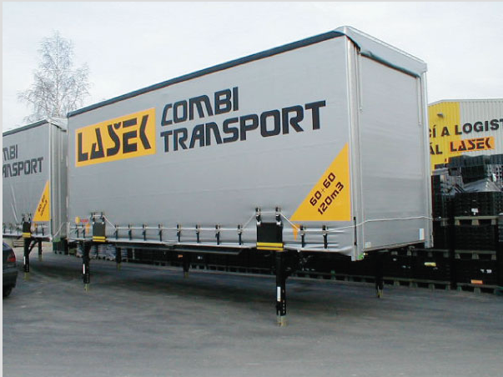

Slide 32
Summary of the lecture
You can:
Explain benefits of transport
Define transport facilities
Classify transport from different points of view
Characterize modes of transport according to transport routes

