Slide 1
Logistics
-
Transport
Part 2
The aim of the lecture is to discuss various factors affecting the development of the transport sector
.
Šárka Čemerková
lecturer

Slide 2
Logistics
-
Transport
Part 2
Factors affecting the development of the transport sector Globalization of transport EU transport strategy Regulation in transport Tariff systems Transport management in the company
.
Structure of the lecture

Slide 3
Globalization of transport
air and ship transport are the most important in international transport
internally, road and rail transport dominate
significant differences between countries

Slide 4
in Europe, there is state ownership of railways or rail subsidies by the state
in Japan and Europe, shipping is much more used than in the US and Canada
costs of international transport represent a much higher share of the value of the product than in domestic transport

Slide 5
Intermodal transport:
type of combined transport
transport process carried out using at least two different modes of transport while maintaining one integrated handling unit on the entire transport route, organized by only one operator
overall result is cost savings and higher level of CS

Slide 6
Factors that influence the future development of the transport sector
Political aspects
Economic aspects
Technical aspects
Social aspects
Ecological aspects

Slide 7
Migration
Urban development
Problems of intercity transport
Problems of transport in cities
Transport investment financing
Planning

Slide 8
EU Transport Strategy 2050 (White Paper on Transport)
Efforts to create a competitive transport system within the EU that will improve mobility and also will remove major barriers in key areas (reducing Europe's dependence on oil, reducing transport carbon emissions by 60% by 2050)
10 strategic goals:
Goal 1: to halve the use of 'conventionally driven' cars in urban transport by 2030; discard them by 2050; by 2030 public transport without CO².

Slide 9
Goal 3: by 2030 to transfer 30% of road freight transport over 300 km to other modes (rail, shipping), by 2050 more than 50%.
Goal 4: Complete the European high-speed rail network by 2050. Triple the length of existing high-speed rail networks by 2030 and maintain a dense rail network in all Member States. By 2050, most of the medium-haul passenger volume should be by rail.

Slide 10
Transport regulations
Forms of transport regulation:
multilateral agreements
international bilateral agreements
national standards, legislation

Slide 11
Road transport
CMR:
convention on the contract of carriage in international road transport
standard consignment note
TIR:
agreement establishing a system of security in a number of European countries and Japan to cover possible duties and other charges on goods transported in Europe and in international trade
Source: https://www.trucksamolepky.eu

Slide 12
ADR:
European agreement on the international carriage of hazardous substances travelling by road
diamond-shaped symbol on the back of a trailer
is designed to clearly show when a truck is carrying anything that is flammable, poisonous, corrosive, radioactive or otherwise harmful
regulates under what conditions goods can be transported, safety standards, etc.
Source: http://www.bakugls.com/transporting-chemicals-by-road-a-guide-to-adr/

Slide 13
ATP:
agreement on the international carriage of perishable foodstuffs and the specialized means for such carriage
sets standards for international road and rail transport
means of transport: I - isothermal R - refrigerated F - cooling and freezing C - heating
Source: http://www.testek.sk/files/stitky_349-2009.pdf

Slide 14
AETR:
European agreement on the work of vehicle crews in international road transport
determines the conditions applicable to professional road users (age and professional requirements for drivers, determines the maximum driving time, breaks and exceptions to these rules)

Slide 15
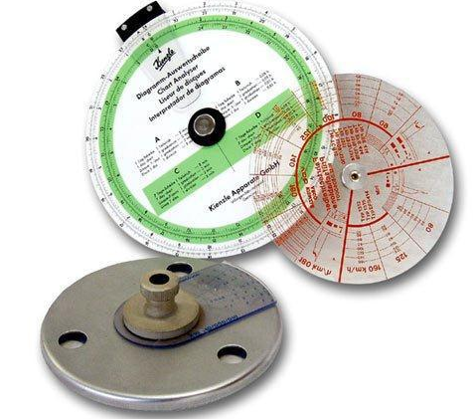
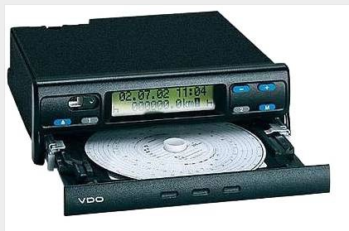
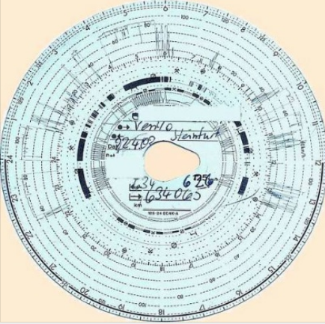
Notes:
analogue and digital tachograph

Slide 16
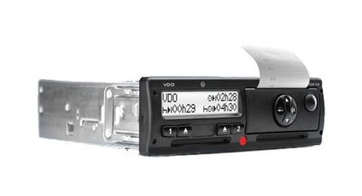
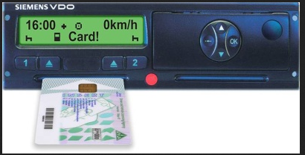

Slide 17
Toll systems
charging for the use of roads by means of electronic monitoring of the movement of vehicles
need to equip the vehicles under review with an on-board unit - independent for each country
payment for kilometers actually traveled - differentiated according to the season and ecological load of vehicles

Slide 18
two basic types of systems
microwave system – toll gates monitoring with microwave sensors and vehicle motion detection cameras
satellite system – enables full-area tracking of vehicles not only on specially equipped roads, but throughout the terrain
microwave systems dominate Europe

Slide 19
Austria introduced the first full - area microwave system in 2004, the Czech Republic in 2007
since 2009 a traffic management system has been in operation in the Czech Republic, which enables online collection of traffic flow data using sensors and informing drivers of the current situation by means of information tables on the motorway
since 2012, a system that can detect a car traveling in the opposite direction (CZ)

Slide 20
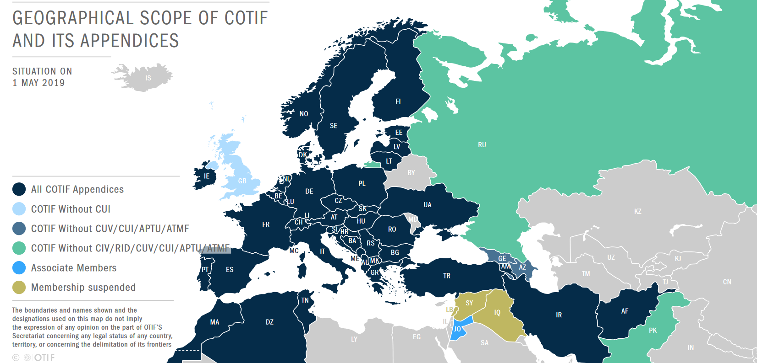
Rail transport
ATP
COTIF (Convention on International Carriage by Rail)
Source: https://otif.org/en/?page_id=53

Slide 21
Appendicies
Source: https://otif.org/en/?page_id=53

Slide 22
Air transport
Convention on the Unification of Certain Rules for International Carriage by Air (called the Montreal Convention):
for international transport only, either between two contracting states or to a return journey to and from the territory of a contracting state through the territory of any other state
EU has made it mandatory for all EU air carriers to carry passengers and luggage

Slide 23
River transport
European Agreement on Main Inland Waterways of International Importance (AGN Agreement)
European Agreement concerning the International Carriage of Dangerous Goods by Inland Waterways (ADN)
Budapest Convention on the Contract for the Carriage of Goods by Inland Waterways (CMNI)

Slide 24
Sea transport
International Convention for the Unification of Certain Bill of Lading Rules (The Hague Rules)
United Nations Convention on the Carriage of Goods by Sea (Hamburg Convention on the Carriage of Goods by Sea) – the maritime carrier liability concept for damage
many countries have their own rules (e.g. USA, China)

Slide 25
Price and delivery conditions of carriers
factors affecting shipping prices:
factors related to the nature of the product:
density - weight to volume ratio
product shelf life
ease / difficulty of handling
financial value and liability

Slide 26
factors related to the market character:
level of competition
market placement
nature and extent of government regulatory measures
balance or imbalance of transport to and from a certain market
seasonality of product movements
whether the product is transported only nationally or internationally

Slide 27
tariff systems:
In-kind (cost) tariff
Value tariff
Distance (kilometer) tariff
Time tariff
Performance tariff
Spatial tariff
Weight tariff
Combined tariff
Source: www.dpp.cz

Slide 28
Traffic management in the enterprise
external (out-plant) transport
internal (in-house) transport:
between objects
between operations
in operations

Slide 29
objectives of traffic management in the enterprise:
optimal use
higher level of service
flexibility
transparency

Slide 30
Summary of the lecture
You can:
Describe the factors influencing the development of the transport sector
Describe the selected objectives of the White Paper on Transport
Explain the importance and types of regulation in transport
Characterize tariff systems
Briefly describe traffic management in the enterprise

