Slide 1

Managerial skills
Ing. Žaneta Rylková, Ph.D.
Silesian Univerzity in Opava, School of Business Administration in Karvina
Czech Republic
Department of Business Economics and Management
rylkova@opf.slu.cz

Slide 2

Outline of the lecture
Behaviour
Managerial skills

Slide 3
Organizational behaviour
Organisational behaviour is the study of human behaviour in organisational contexts with a focus on both individual and group processes and actions.
Hence, it involves an exploration of organisational and managerial processes in the dynamic context of the organisation and is primarily concerned with the human implications of such activity.

Slide 4
Organizational behaviour
Human behaviour in organisations is complex as it is affected by, and in turn influences, an array of factors, including managerial action, changing competitive circumstances and new technologies.
People in organisations interact with their environment, with stakeholders and with others in the organisation.
There are significant differences in personality between individuals, many people behave differently in groups than when working alone and most are influenced by the norms and values of the organisation and of the society in which they live and work.

Slide 5
Why study organizational behaviour?
A knowledge of OB should enable you to explain and even predict human behaviour in organisations and potentially to manage and control it if appropriate.
As a result of studying this subject, you may possibly alter your „management philosophy“ including, perhaps, long-harboured beliefs. You may also obtain the answers to outstanding questions about issues such as:
  how people are motivated or led,
  how groups or teams function,
  why the structure of an organisation influences the behaviour of people who work in it,
  and how both the culture and power relationships in organisations affect human behaviour at work.

Slide 6

Personality
Is the starting point for an examination of individual behaviour in the organisation
There is a large number of personality theories, each taking a different perspective.
There is a similarly wide range of definitions of personality which can make the concept more complex.

Slide 7
Personality
For our purposes, we will define personality as: specific characteristics of individuals which may be open or hidden and which may determine either commonality or differences in behaviour in an organisation.

Slide 8
Personality
This definition suggests that personality not only affects other people in an organisation through interaction but also that it affects how individuals see themselves and thus the extent to which individuals are a positive or a negative force in the organisation.
For example, personality differences can lead to hostility between individuals, which could hinder the development of effective teams, although the mix of different personalities can lead to the formation of efficinet teams.
Attitudes and motivation are influenced by personality in terms of how individuals respond to motivational stimuli or, more negatively, how a negative concept of self can lead to attitudes which might hamper attempts to motivate individuals at an organisational level.

Slide 9
Personality
Furthermore, personality may have a major bearing on the way people behave in an organisation. An issue often debated is the extent of this interaction, as it is argued that behaviour is determined by a number of innate factors, based around personal attributes, and also by a number of environmental factors outside the control of the individual.
Some of these factors can be seen in Table.

Slide 10
Personality
Variables affecting individual behaviour
Innate factors | Environmental factors
Personality | Organisation/work factors
Perception | Family
Values | Peer-group pressures
Abilities | Personal life experiences

Slide 11
Personality
People have certain inherent traits which determine their personality and thus their behaviour.
Five main personality traits are the most significant for determining behaviour. These, or a subset of these, form the basis of many personality tests often used in organisational settings for recruitment and development purposes. Each of these five characteristics provides a continuum along which supposedly we all can be located.

Slide 12
Personality
These key traits are (Big five factors – FFM):
  Agreebleness – an individual can be seen as very agreeable or very uncooperative
  Openess to experience – the range is from very open-minded to closed and narrow-minded
  Extrovert or introvert – the range is from very sociable and outgoing to more reserved and cautious
  Conscientiousness – the range is from responsible to irresponsible, and
  Emotionally stable – the range is from an ability to control emotions to a more unstable emotional pattern

Slide 13
Testing indiviudals and groups in organisations – personality type
Extrovert | Introvert
outgoing | quiet
Publicly expressive | Reserved
Interacting | Concentrating
Speaks, then thinks | Thinks, then speaks
Gregarious | Reflective
Perception
Sensing | Intuitive
Practical | General
Specific | Abstract
Feet on the ground | Head in the clouds
Details | Possibilites
Concrete | Theoretical

Slide 14
Testing indiviudals and groups in organisations – personality type
Judgement
Thinking | Feeling
Analytical | Subjective
Clarity | Harmony
Head | Heart
Justice | Mercy
Rules | Circumstances
Relating to environment
Judging | Perceiving
Structured | Flexible
Time-oriented | Open-ended
Decisive | Exploring
Organised | Spontaneous

Slide 15
Variables Influencing Individual Behavior
The Person: Skills and abilities, personality, perceptions, attitudes, values, ethics
The Environment: organization, working group, job, personal life
The Behavior: B = f(P,E)

Slide 16
Identifying your personality type
Analytical
Driver
Amiable
Expressive

Slide 17
Quick Quiz to Identify Your Personality Type
In the following lists, check those words (or phrases) that describe you best in a business or study life situation. Your score will be tallied for each group of words.

Slide 18
Group A
Reserved
Uncommunicative
Cool
Cautious
Guarded
Seems difficult to get to know
Demanding of self
Disciplined attitudes
Formal speech
Rational decision-making
Strict
Impersonal
Businesslike
Disciplined about time
Uses facts
Formal dress
Measured actions
Total „A“

Slide 19
Group B
Take-charge attitude
Directive
Tends to use power
Fast actions
Risk-taker
Competitive
Agressive
Strong opinions
Excitable
Takes social initiative
Makes statements
Loud voice
Quick pace
Expressive voice
Firm handshake
Clear idea of needs
Initiator
Total „B“

Slide 20
Group C
Communicative
Open
Warm
Approachable
Friendly
Fluid attitudes
Informal speech
Undisciplined about time
Easy-going with self
Impulsive
Informal dress
Dramatic opinions
Uses opinions
Permissive
Emotional decision-making
Seems easy to get to know
Personal
Total „C“

Slide 21
Group D
Slow pace
Flat voice
Soft-spoken
Helper
Unclear about what is needed
Moderate opinions
Calm
Asks questions
Tends to avoid use of power
Indifferent handshake
Deliberate actions
Lets others take social initiative
Risk-avoider
Quiet
Go-along attitude
Supportive
Cooperative
Total „D“

Slide 22
Quick Quiz to Identify Your Personality Type
Test has 4 parts: A, B, C, D.
In each group you have to choose right words which characterize your personality. The number of words = score in each section.
Score „A“ ………
Score „B“ ………
Score „C“ ………
Score „D“ ………

Slide 23
Quick Quiz to Identify Your Personality Type
Than we have to fill in the Grid:
Score „A“ versus score „C“:
  Which group dominate? ……
  How many points more than second group? …..
Score „B“ versus score „D“:
  Which group dominate? ……
  How many points more than second group? …..

Slide 24
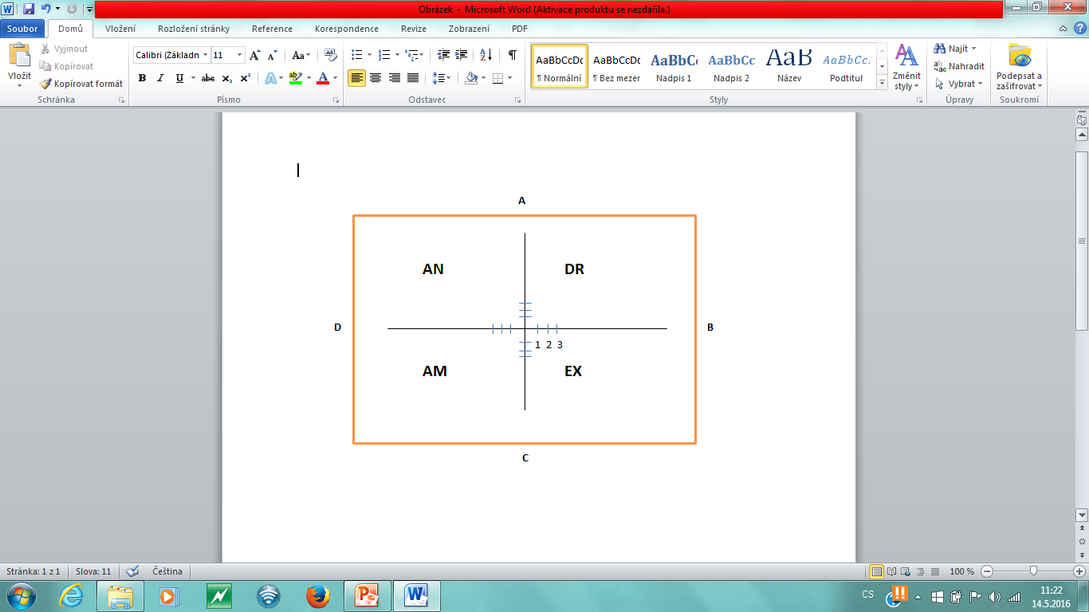
Quick Quiz to Identify Your Personality Type

Slide 25
Analytical
Person is focused on precision and perfection. Other strenghts include persistence, diligence, systematic approach.
Weaknesses involve being boring, quiet, reclusive.
The analytical needs to be right, and won´t openly discuss ideas until confident in a decision.
Loyal, precise, serious, systematic, prudent

Slide 26
Driver
The individual is extroverted, strong-willed, direct, practical, organized, forceful, decisive. The driver is task- rather than relationship-oriented and wants immediate results.
The driver can be stubborn, domineering, impatient, insensitive and shorttempered.
His or her pain is loss of respect.
Efficient, independent, candid, decisive, pragmatic

Slide 27
Amiable
He or she is a team player, cooperative, trustful, sensitive and a good listener.
Weaknesses include indecision and an inability to take risks. Amiables are often too focused on others, conforming, quiet, and passive.
His or her pain is change and chaos.
Loyal, cooperative, supportive, diplomatic, patient

Slide 28
Expressive
He or she loves to be one of the gang, and is always ready for something new and exciting, especially if the gang is ready to participate. Additional strengths include enthusiasm, diplomatic skills, and the ability to inspire others.
Weaknesses involve impatience, a tendency to generalize, sometimes irrational behavior. The expressive can be manipulative, undisciplined, unorganized.
His or her main need is to be appreciated and accepted.
Enthusiastic, outgoing, persuasive, fun-loving, spontaneous

Slide 29
Your learning style

Slide 30
Your Learning Style
Watching and Feeling – these people like to view situations from various perspectives. They like to collect and review data carefully before coming to a conclusion. Like to have time to prepare.
Watching and Thinking – these people want to understand the theory behind the action. Tend to be perfectionists. Prefers to reason logically and design models, theories, and projects.

Slide 31
Your Learning Style
Doing and Thinking – these people are eager to try new things. They need to see how to put their learning into practice. Prefers solving problems, feedback, dicision-making. Want to put ideas into action.
Doing and Feeling – these people are enthusiastic, tend to act first and think later, and learn by doing. Prefers the challenges of new experiences, working with teams, assimilation, and role-playing.

Slide 32
Implications
Individuals need to develop self-awareness of their behaviour and attitudes while attempting to identify their leadership and management credentials.
Individuals need to appreciate when leadership qualities, such as developing and disseminating a sense of vision, are appropriate and, alternatively, when managerial skills, such as negotiation and transaction, are required.
Individuals need to recognise that the frame in which they operate influences their understanding, attitudes and behaviour, recognition of this fact is a prerequisite for personal development and growth.

Slide 33
Managerial skills
Management skills are important for many reasons. They position you to act as an effective manager and leader and problem-solver in so many situations. Work on honing these skills and watch how they can impact your job performance and opportunities.

Slide 34
Managerial skills – Robert Katz
Technical skills
  Specialized knowledge but practical
  Related to mechanical technology and IT
Interpersonal skills
  Important to be able to get along with customers, co-workers, managers
  Related to communication and interaction with others
Conceptual skills
  See the processes of organization, know how all parts of organization work together in order to achieve the organizational goals
  Related to creativity, patterns, big pictures, ability to analyze

Slide 35
Managerial skills
In the area of:
  Communication (listening, keeping messaging simple,feedback)
  Problem solving (conflict resolution, delegation)
  Motivation
  Professionalism (decision making, positive attitude)
  Project management (technical, innovation)
  Collaboration

