Slide 1

Value proposition
Marketing of services

Slide 2
What we already know?
Marketing, value, need, wish, demand, goods and services, marketing mix.
What are services and its attributes.

Slide 3
OUTCOME CONSUMPTION
MARKETING
PRODUCTION
CONSUMPTION
PROCESS CONSUMPTION
PRODUCTION
MARKETING?
CONSUMPTION

Slide 4
From Business model to Marketing and vice versa

Slide 5
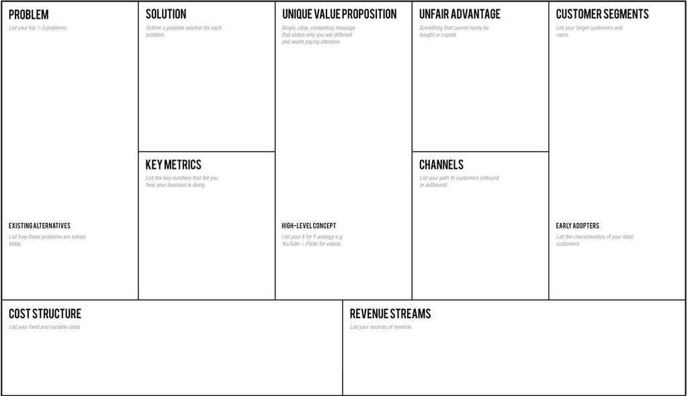
Lean Canvas

Slide 6
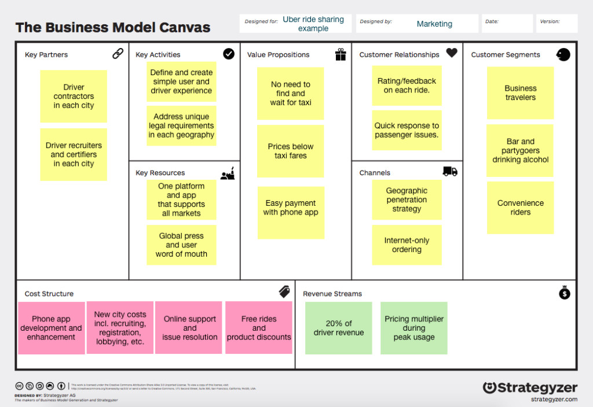

Slide 7
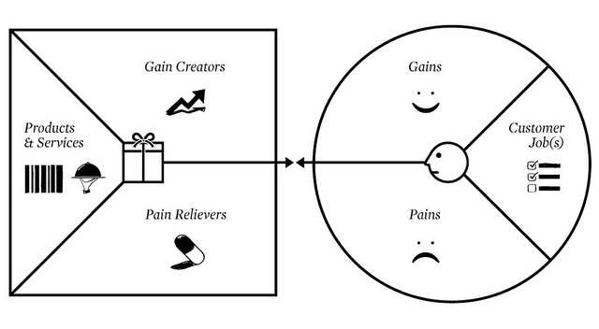
Value Proposition Canvas

Slide 8
Completing your canvas in 9 easy steps
Choose your segment
Identify consumer jobs
Identify pains
Identify gains
Prioritize
Write down the list of products
Describe pain relievers
Describe gain creators
Prioritize

Slide 9
1) Choose your segment
Choose segment which you want to serve
Segment has to be representative
  Large enough
There is internal homogenity and external heterogenity

Slide 10

2) Identify consumer jobs
Ask yourself a question: What are my customers trying to accomplish?
Map all their tasks – each of them is one postit

Slide 11
3) Identify pains
What limitations and problems are your customers facing?
Include risks as well

Slide 12
4) Identify gains
What gains your customers want to get?
What would make their lives easier?

Slide 13
5) Prioritize
Put the jobs, pains and gains in order:
JOBS: Important -> Inessential
PAINS: Extreme -> Slight
GAINS: Necessary -> Nice to have

Slide 14
6) Write down the list of products
All existing goods and services
7) Describe pain relievers
How you solve your customers problem

Slide 15
8) Describe gain creators
What benefits do you deliver now
9) Prioritize
Put the products, pain relievers and gain creators in order from most important to inessential

