Slide 1


Název prezentace
Název projektu | Rozvoj vzdělávání na Slezské univerzitě v Opavě
Registrační číslo projektu | CZ.02.2.69/0.0./0.0/16_015/0002400
Prezentace předmětu:
Marketing of Sevices
Vyučující:
Ing. Michal Stoklasa, Ph.D.
Ing. Martin Klepek, Ph.D.

Slide 2

MARKETING MIX: PROCESSES
The aim of the lecture is to explain and overview processes which deliver value to the customer in a service business
.
Michal Stoklasa
Garant předmětu
Martin Klepek
Přednášející

Slide 3
MARKETING MIX: processes
Why is process essential in services
Internal and external marketing
Customer experiences
Perception of services
.
Lecture content

Slide 4
Introduction
The most important difference between services and goods, is the fact that a service is like beauty, more in the eye of the beholder.
It is primarily an experience for the customer and those around them – and this means that it must be seen as a performance by those who are providing the service.
Notes:
Ruskin-Brown (2005)

Slide 5
Introduction
As it is performed rather than ‘produced’, the service marketer must ensure it is well managed.
This management is addressed in that element of the service marketing mix referred to as ‘PROCESS’.
Notes:
Ruskin-Brown (2005)

Slide 6
Introduction
Process in services refers to the actual procedures, mechanisms, and flow of activities by which the service is delivered the service delivery and operating systems.
In a service organisation, the system by which customer receives delivery of the service constitutes the process. In fast food outlets the process comprises buying the coupons at one counter and picking up the food against that at another counter.
Notes:
Urbánek (2014)

Slide 7
Introduction
The process of a delivery function which can be compared with that of operations management implies the conversion of input into the finished product. But, in a service organisation, there is no clear cut input or output.
Rather, it is the process of adding value or utility to system inputs to create outputs which are useful for the customers.
Notes:
Urbánek (2014)

Slide 8
Introduction
It is said that this aspect of the marketing of any service is a major contributor to building customer loyalty, i.e. turning customers into ‘friends and advocates’ and as such is so important that it should be allocated a minimum of 50% of the marketer’s time effort and budget.
Notes:
Ruskin-Brown (2005)

Slide 9
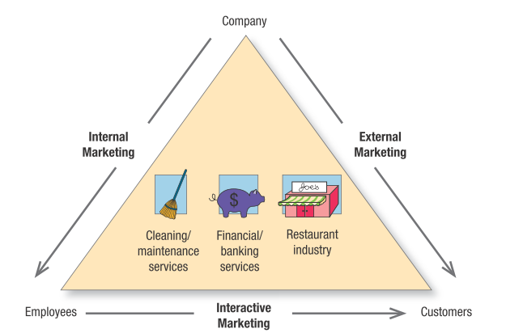
Types of „marketing“ in services
Source: Kolter & Keller (2016)

Slide 10
Internal Marketing
Internal marketing is a term commonly used to describe the programmes necessary to instill and maintain a strong service mentality throughout the organisation. For every service, employees remain the primary ingredient of success.

Slide 11
Internal Marketing
Internal marketing is a management strategy that focuses on how to develop customer conscious employees. Employees must be skilled, have customer orientation and be service minded so that they can influence customer perceptions positively in interactions during production, delivery, client handling, technical service, and other related activities.

Slide 12
External Marketing
The objective of external marketing is to attract every customer to participate in the service process.
Service companies should design an effective promotional campaign to inform, educate, persuade, train, and encourage buying and experiencing the service offered.

Slide 13
External Marketing
Developments of promotional mix strategies are vital to the success of external marketing.
The most powerful media in services is word of mouth communication.
Service organisation should be careful of negative word-of-mouth. In the absence of relevant and effective communication, consumers may have doubts and suspicions about the service offering.

Slide 14
Interactive Marketing
Interactive marketing describes the employees’ skill in serving the client.
Clients judge service not only by its technical quality (Was the surgery successful?), but also by its functional quality (Did the surgeon show concern and inspire confidence?).
In interactive marketing, teamwork is often key.

Slide 15
Interactive Marketing
Delegating authority to frontline employees can allow for greater service flexibility and adaptability because it promotes better problem solving, closer employee cooperation, and more efficient knowledge transfer.
Top service companies are “customer obsessed.”
They have a clear sense of their target customers and their needs and have developed a distinctive strategy for satisfying them.

Slide 16
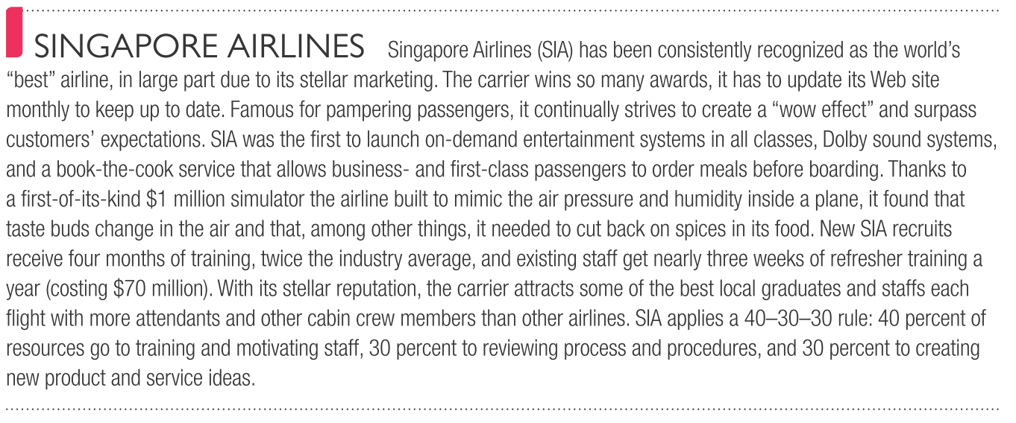
Case study
Source: Kolter & Keller (2016)
Notes:
Ruskin-Brown (2005)

Slide 17
Focus on the experience
Marketers of goods (e.g. motor vehicles) have very little control over how a customer experiences the use of their product, try as they might to inﬂuence this via badging, branding and advertising of the aspirational lifestyle of the stereotypical customer for that model.
The marketer’s inﬂuence is always at several removes from the actuality of the product’s use.
Notes:
Ruskin-Brown (2005)

Slide 18
Focus on the experience
The customer of a good is almost invariably out of direct contact with the ﬁrm producing and/or supplying that good when it is used. Whereas:
  A service product IS the experience that a customer has when the service is being delivered to them.
  A service is no more, and no less than this experience.
  A customer’s perception of this experience is THE MOST CRITICAL aspect of its marketing.
Notes:
Ruskin-Brown (2005)

Slide 19
Focus on the experience
The customer’s favorable experience of the delivery of that service, conﬁrms that they made the right choice of supplier, and promotes the possibility that they will return to this supplier when next they are in the market.
Notes:
Ruskin-Brown (2005)

Slide 20
Focus on the experience
Favorable perceptions will create and build relationships, unfavourable ones will destroy them.
So important is this ‘experiential’ aspect of a service that it has been rightly named ‘The Moment of Truth’.
During this ‘Moment of Truth’ all the effort taken to deliver the service either comes to fruition, or is wasted.
Notes:
Ruskin-Brown (2005)

Slide 21
Perception of services
The customer’s perception will be formed from their perspective, not ours.
All marketers must strive to manage the perceptions of their customers and prospects.
However, for the service marketer this issue is vital to the extent that a major part of the service marketer’s job has been described (by Tom Peters) as ‘the strategic management of perception’.
Notes:
Ruskin-Brown (2005)

Slide 22
Perception of services
The process by which services are created and delivered to the customer is a major factor within the services marketing mix, as services customers will often perceive the service delivery system as part of the service itself.
Thus, decisions on operations management are of great importance to the success of the marketing of the service.
Notes:
Urbánek (2014)

Slide 23
Perception of services
It is the perceptions of the ‘prospects’ and ‘customers’, not our perception, that will drive their behavior!
Notes:
Ruskin-Brown (2005)

Slide 24
Perception of services
The wise service marketers will therefore devote at least half of their energy, attention and budget to ensuring that the performance of their service delivers the optimum experience to the customer and turn as many of them as possible into ‘friends’ and ‘advocates’ and thus grow their business.
The element of the services marketing mix that covers this aspect, the performance, is process.
Notes:
Ruskin-Brown (2005)

Slide 25
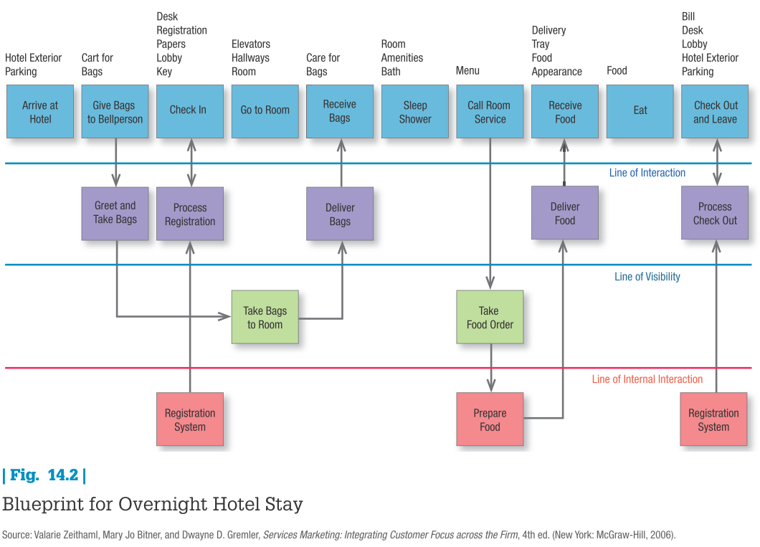
Service process form customer perspective
Notes:
Kolter & Keller (2016)

Slide 26
What a customer may want from a service
Reliability, the service is consistent, dependable and perhaps backed by guarantees.
Accessibility, provided at convenient times and locations with little waiting.
Notes:
Ruskin-Brown (2005)

Slide 27
What a customer may want from a service
Credibility, the ﬁrm and its staff are seen to be trustworthy in terms of delivering what they promise, and with a respectable track-record in their business.
Notes:
Ruskin-Brown (2005)

Slide 28
What a customer may want from a service
Prestige, the source/supplier is well respected by the customer’s peers, and at least there will be no disrepute to the customer’s image, at best this will confer status by association.
Notes:
Ruskin-Brown (2005)

Slide 29
What a customer may want from a service
Security, there will be no ﬁnancial or other risk to the customer.
Privacy, the customer’s confidentiality, and/or person will be respected.
Notes:
Ruskin-Brown (2005)

Slide 30
What a customer may want from a service
Responsiveness, the speed and attention given to the customer’s needs, requests, questions and/or problems.
Competence, the service deliverers’ level of relevant skills, know-how, expertise.
Notes:
Ruskin-Brown (2005)

Slide 31
What a customer may want from a service
Communication, how well do the service deliverers interface with the customer, how accurately and clearly is the service described?
How well do they feel that the service deliverer(s) listened to them?
Notes:
Ruskin-Brown (2005)

Slide 32
What a customer may want from a service
Courtesy, the pleasantness/friendliness of the service deliverers toward the customer.
Stress free, i.e. freedom from physical and/or mental stress, the customer feels welcome, feels ‘at home’ when dealing with the service provider.
Notes:
Ruskin-Brown (2005)

Slide 33
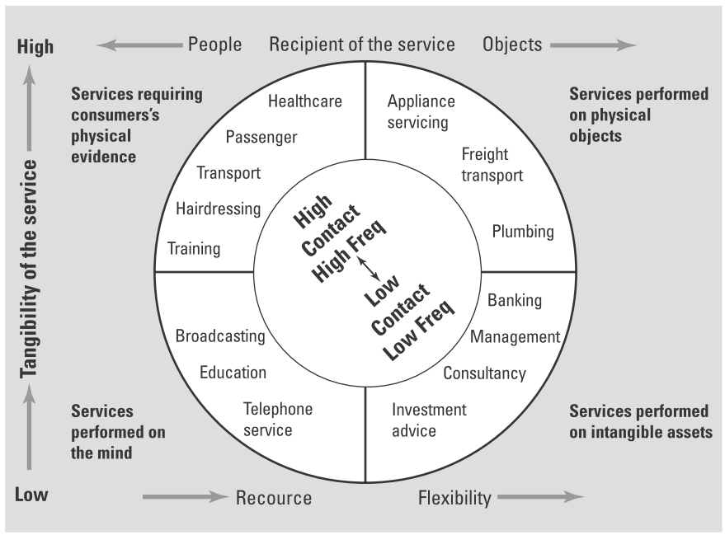
Classification of service encounter types
Source: Ruskin-Brown (2005)
Notes:
Ruskin-Brown (2005)

Slide 34
Conclusion
The process by which services are created and delivered to the customer is a major factor within the services marketing mix, as services customers will often perceive the service delivery system as part of the service itself.
Thus, decisions on operations management are of great importance to the success of the marketing of the service. In fact, continuous coordination between marketing and operations is essential to success in most services businesses. Identification of process management as a separate activity is a prerequisite of service quality improvement.
The importance of this element is especially highlighted in service businesses where inventories cannot be stored.

