Slide 1
Název prezentace
Název projektu | Rozvoj vzdělávání na Slezské univerzitě v Opavě
Registrační číslo projektu | CZ.02.2.69/0.0./0.0/16_015/0002400
Prezentace předmětu:
Marketing of services
Vyučující:
Ing. Martin Klepek, Ph.D.
Ing. Sarath T. Mallika M.B.A.

Slide 2
MARKETING MIX 1
The aim of this presentation is to describe the nature of marketing mix in services with special focus on product
.
Martin Klepek
Garant předmětu
Michal Stoklasa
Přednášející

Slide 3
Marketing mix 1
What is marketing mix
Product
Product layers
Product lifecycle
.
Lecture structure

Slide 4
Introduction
Marketing mix is the set of important internal elements that make up an organisation’s marketing programme.
The marketing mix concept is a well established tool used as a structure by marketers.
It can be defined as the elements an organisation controls that can be used to satisfy or communicate with customers.

Slide 5
Introduction
The phrase ‘marketing mix’ was first used by Neil H. Borden.
The concept had its genesis in the classic work of James Culliton on the management of marketing costs.
Borden suggested twelve marketing mix variables in the context of manufacturers.

Slide 6
Introduction
Borden’s concept of marketing mix was given due recognition in marketing theory and the concept of marketing mix was accepted as the set of marketing tools that a firm uses to pursue its marketing objectives in the target market, influenced by specific environmental variables.

Slide 7
Introduction
It was McCarthy who summed up the twelve elements of Borden’s marketing mix into 4Ps - product, price, place (i.e. distribution), and promotion.
He even clarified that the customer is not a part of the marketing mix, rather, he should be the target of all marketing efforts.

Slide 8
Introduction
The activities in service marketing are different , and often do not fall in the conventional marketing mix (4Ps) classification, though many marketing concepts and tools used by goods marketers hold good in services with some change in focus and importance.

Slide 9
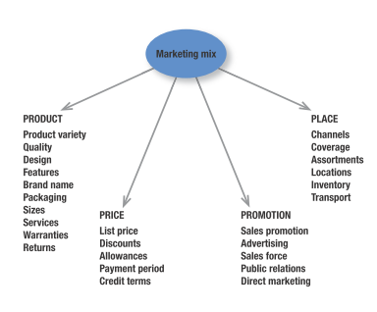
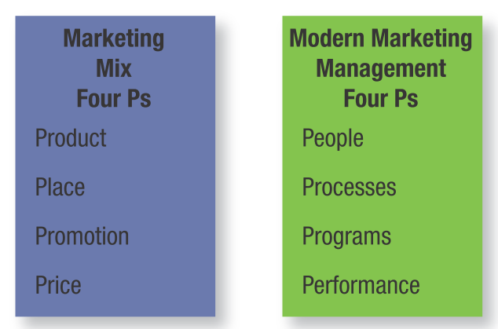
Introduction
Source: Kotler & Keller (2016)
Source: Kotler & Keller (2016)

Slide 10
Introduction
The traditional marketing mix became inadequate for service industries because of the following reasons:
The concept of marketing mix as such was developed for manufacturing industries and was more oriented to deal with goods marketing situations.
Marketing practitioners in service sector found that it did not address their needs.
Due to differences in characteristics of physical products and services, marketing models and concepts had to be developed in direction of the service sector.

Slide 11
Introduction
Keeping in view the inadequacy of conventional marketing mix to address the service situations, it needs to be modified and broadened.
A seven Ps framework for services has been proposed.
These elements of marketing mix for services are product, price, place, promotion, people, physical evidence and process.

Slide 12
Introduction
It is important to elaborate these Ps in order to have an understanding of a specific combination of these elements to arrive at the marketing strategy for service firms.
A detailed account of each of these elements of marketing mix is as follows.

Slide 13
Product
A product is an overall concept of objects or processes which provide some value to customer; goods and services are subcategories which describe two types of product.
Thus, the term product is frequently used in a broad sense to denote either a manufactured good or a service.
In fact, customers are not buying goods or services - they are really buying specific benefits and value from the total offering.

Slide 14
Product
So, the most important issue in service product is what benefits and satisfaction the consumer is seeking from the service.
From the point of view of a restaurant’s manager, the restaurant simply provides food.
But, the customers coming to the restaurant may be seeking an ‘outing’ - an atmosphere different from home, relaxation, entertainment or even status.

Slide 15
Product
The marketing of services can be a success only if there is a match between the service product from the customer’s view point and the supplier’s view point.
To find this match it is desirable to analyse the service at the following levels

Slide 16
Product
A
B
Installation
Warranty
Design
Package
Spare
parts
Deliveries
Principal function
Brand name
Repair and maintenance
Financial services
Quality
Styling
Instructions
C

Slide 17
Product
Generic product: fulfils the basic function of the product (Bank Account: the basic function)
Expected product: minimal requirements expected by customer (BA: credit card, internet banking)
Augmented product: offers more than usually expected by customer (BA: international banking free, ATM free, loan, discount card)
Potential product: everything that can make the product perfect and ultimately increase the utility (BA: everything that is on the market and everything that is possible to offer)

Slide 18
Product lifecycle
SALES
PROFIT
Maturnity
Saturation
Growth
Decline
Introduction
Sales
Profit
TIME

Slide 19
Product lifecycle
RECYCLE/STYLE
WAVY CYCLE
FASHION HIT
FASHION

Slide 20
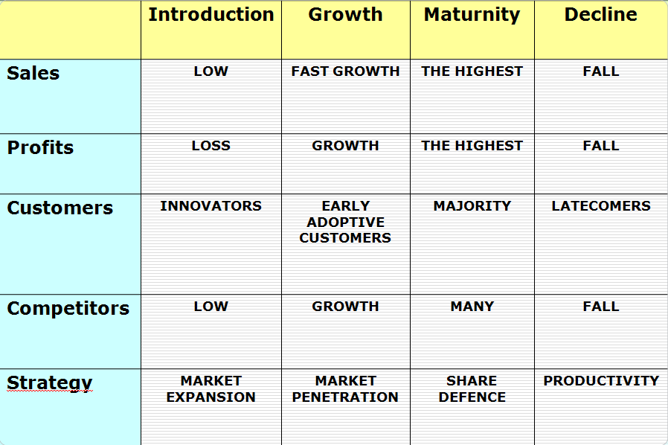
Product lifecycle

Slide 21
Product
Customer benefit concept:
The service product which is offered in the market must have its origin in the benefits which the customers are seeking.
But, the problem is that customers themselves may not have a clear idea of what they are seeking, or they may find it difficult to express or it may be a combination of several benefits and not a single one.

Slide 22
Product
Customer benefit concept:
Over a period of time, the benefits sought may also change.
This change in customer may come about by a satisfactory or unhappy experience in utilising the service, through increased sophistication in service use and consumption, and changing expectations.
All these make the issue of marketing a service product more complex.

Slide 23
Product
Service concept:
Using the customer benefits as starting point, the service concept defines the specific benefits which the service offers.
At the generic level, the service concept refers to the basic service which is being offered.
A centre for performing arts may offer entertainment and recreation.

Slide 24
Product
Service offer:
After defining the business in which we are operating, the next step is to give a specific shape and form to the basic service concept. In the case of centre for the performing arts, the service concept is to provide entertainment.
The service offer is concerned with the specific elements that will be used to provide entertainment; drama, music, mime, dance.

Slide 25
Product
Service offer:
In the category of musical concerts the choice may be vocal or instrumental, with vocal whether light or classical, Hindustani, Carnatic or Western. While these represent the intangible items of the service offer, the physical infrastructure of the centre, in terms of its seating capacity, seating comfort, quality and acoustics, provision for air-conditioning, snack bar and toilets are the tangible items.

Slide 26
Product
Service forms:
In what form should the services be made avail able to the customers is another area of decision making. Should all the shows of the centre be available in a package deal against an annual membership fee or seasonal ticket?

Slide 27
Product
Service forms:
Should there be daily tickets with the consumer having the freedom to watch any one or more performances being staged on that particular day?
Should each performance have a separate entrance ticket, with a higher priced ticket for a well-known performer?
Service form refers to the various options relating to each service element. The manner in which they are combined gives shape to the service form.

Slide 28
Product
Service delivery system:
When we go to bank to withdraw money, we either use a cheque or a withdrawal slip in which we fill all the particulars and hand it over to the dealing assistant, who after verifying the details, gives us money.
The cheque or with-drawal slip and the dealing assistant constitute the delivery system.

Slide 29
Product
Service delivery system:
In case of airlines, the aeroplane, pilot, crew members, airport, etc. are the elements of delivery system.
The two main elements in a delivery system are the people and the physical evidence.

Slide 30
Product
Service delivery system:
The competence and public relations ability of a lawyer represents the ‘people’ component, while his office building, office door, letter head, etc., are all elements of the ‘physical evidence’ component.

Slide 31
Product
Service delivery system:
The physical evidence components have also been called facilitating goods or support goods.
These are the tangible elements of the service and they exert an important influence on the quality of the service as perceived by the consumers.
Delivering an intangible at a level consistently is a complex issue. The experience in two flights of the same airline is not the same.

Slide 32
Product
Service delivery system:
The visit to a bank on two occasions brings different experiences. The consumer’s service experience is, as such, a result of provider-customer interaction, atmosphere, emotional stress, anxieties, surprises, etc.
It is because of these delivery factors (varying at different points of time) that no two customer experiences are identical. This variability of experience is attributable to the inability of the service firms to deliver the intangible uniformly

Slide 33
Product
Service delivery system:
Service firms must learn to manage intangibles. They need to go beyond the technical skills of employees or the tangible output.
Service levels should be set in accordance with the desired customer satisfaction.
The answer to ‘what customer expects’ should be sought. And it is not an easy answer because the subjective nature of the customer expectations often vitiates the whole exercise.

Slide 34
Summary
We have learned in this presentatipn, that Marketing mix is a et of tools with the help of which marketing exercise is undertaken and is comprised of 4 Ps namely Product, Price, Place and Promotion. In case of services, three more Ps can be added – People, Process and Physical evidence.
We focused on the first P of marketing mix which is Product. We introduced its variations and differend angles of how this element could be understood and utilised in marketing of services.

