Slide 1


Název prezentace
Název projektu | Rozvoj vzdělávání na Slezské univerzitě v Opavě
Registrační číslo projektu | CZ.02.2.69/0.0./0.0/16_015/0002400
Prezentace předmětu:
Marketing of services
Vyučující:
Ing. Michal Stoklasa, Ph.D.
Ing. Martin Klepek, Ph.D.

Slide 2

MARKETING MIX 3
The aim of this presentation is to describe the nature of marketing mix in services with focus on place and promotion
.
Martin Klepek
Garant předmětu
Michal Stoklasa
Přednášející

Slide 3
Marketing mix 3
Place
Promotion
Communication mix
.
Lecture structure

Slide 4
Place
In order to bring the products to the customer, the marketer has to work with distribution channels that are the interdependent set of organisations involved in the process of making the goods or services available. Service marketers, like goods marketers, also have to handle distribution channel problems. They too, have to make their services available to target customers without which marketing cannot take place. Because of intangibility of services, they cannot be stored, transported and inventoried.

Slide 5
Place
Similarly, because of inseparability, that is, in case of services production cannot be separated from selling, services must be created and sold at the same time. These characteristics of services make distribution strategy more complex and difficult.

Slide 6
Place
There are three critical issues that must be sorted out while evolving the distribution channels for a service

Slide 7
Location of the service
Location is concerned with the decisions a firm makes about where its operations and staff are situated.
The importance of location for a service depends upon the type and degree of interaction involved.
When the customer has to go to the service provider, location becomes very important.

Slide 8
Location of the service
For a service business such as a restaurant, location may be one of the main reasons for patronage. In this type of interaction, service providers seeking growth can consider offering their services at more than one location. Where the service provider can go to the customer, site location becomes much less important provided it is sufficiently close to the customers for good quality service to be received. In some circumstances, the service provider has no discretion in going to customer as certain services must be provided at the customer’s premises.

Slide 9
Location of the service
This is the case with a wide range of maintenance services such as, lift repair, cleaning services etc.
However, when the customer and service organisation transact at arm’s length location may be largely irrelevant.
Customers are not concerned with where the physical locations are of suppliers of services such as electricity, telephone or insurance.

Slide 10
Location of the service
There are three important questions that would help service provider in deciding where to locate service:
How important is the location of the service to the customers?
Is the service, technology - based or people-based?
How important are complementary services to the location decision?

Slide 11
Channels through which services are provided
The second decision variable in the distribution strategy is whether to sell directly to the customers or through intermediaries.
Traditionally it has been argued that direct sales are the most appropriate form of distribution for services.

Slide 12
Channels through which services are provided
Whilst this form of distribution is common in some service sectors, e.g., professional services, companies in other areas of the service sector are increasingly seeking other channels to achieve improved growth and to fill unused capacity.

Slide 13
Channels through which services are provided
Many services are now being delivered by intermediaries and these can take a variety of forms.
The broad channel options for services are direct sales, agent or broker, sellers’ and buyers’ agents, franchises or contracted service deliverers.

Slide 14
How to provide service to maximum number of customers
The third decision variable in the distribution strategy is how to provide the service to a maximum number of customers in the most cost-effective manner.
  Rental or leasing-leasing or rental offers an easy solution for companies which want to expand and diversify but do not have the necessary resources to buy the required plant and machinery.

Slide 15
How to provide service to maximum number of customers
The third decision variable in the distribution strategy is how to provide the service to a maximum number of customers in the most cost-effective manner.
  Franchising-franchising is the granting of rights to another person or institution to exploit a trade name, trade mark or product in return for a lump-sum payment or a royalty.

Slide 16
How to provide service to maximum number of customers
The third decision variable in the distribution strategy is how to provide the service to a maximum number of customers in the most cost-effective manner.
  Service integration - recent times have also witnessed the growth of an integrated service system. Hotels offer local tours and airlines offer holiday resort services. Travel agencies offer ‘package tours’ in which they take care of all formalities such as visa, foreign exchange, reservations, local travel, etc.

Slide 17
Promotion
The promotion element of the services marketing mix forms a vital role in communicating the positioning of the service to customers.
Promotion adds significance to services; it can also add tangibility and help the customer make a better evaluation of the service offer.
The fundamental difference which must be kept in mind while designing the promotion strategy is that the customer relies more on subjective impressions rather than concrete evidence.

Slide 18
Promotion
This is because of the inherent nature of services.
Secondly, the customer is likely to judge the quality of service on the basis of the performer rather than the actual service.
Thirdly, since it is difficult to sample the service before paying for it, the customers find it difficult to evaluate its quality and value.
Thus, buying a service is a riskier proposition than buying a product. So, the service marketers must design a promotion strategy which helps the customers overcome these constraints.

Slide 19
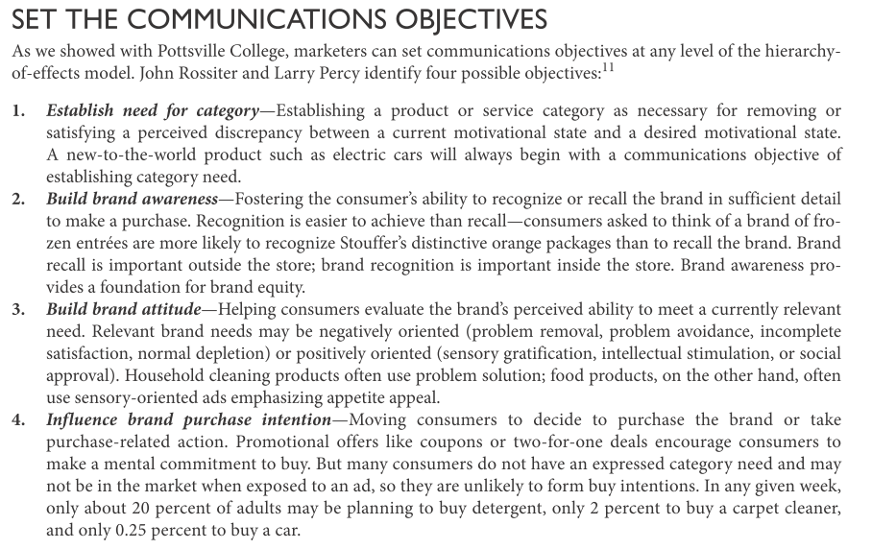
Promotion
Source: Kotler & Keller (2016)

Slide 20
Promotion
George and Berry have identified six guidelines for services advertising which really are applicable to most elements of the communication mix. These apply to a wide range of service industries, but not to all of them, because of the heterogeneous nature of services.
Provide tangible clues, make the service understood, communication continuity, promising what is possible, capitalising on word o mouth, direct communications to employees.

Slide 21
Promotion
Provide tangible clues - A service is intangible in the sense that a performance rather than an object is purchased. Tangible elements within the product surround can be used to provide tangible clues, e.g. seating comfort in aircraft.
Make the service understood - Services may be difficult to grasp mentally because of their intangibility. Tangible attributes of the service can be used to help better understand the service offered, e.g. credit cards.

Slide 22
Promotion
Communication continuity - This is important to help achieve differentiation and present a unifying and consistent theme over time. McDonalds and Disney logo provide good examples of such continuity.
Promising what is possible - Service firms need to deliver on their promises. If a promise such as fast delivery cannot be consistently met, it should not be made at all, e.g. Domino’s Pizza.

Slide 23
Promotion
Capitalising on word of mouth - The variability inherent in services contributes to the importance of word of mouth. Word of mouth is a vitally important communication’s vehicle in services, as evidenced by the way we seek personal recommendations for lawyers, accountants, doctors, bankers, etc.
Direct communications to employees - In high contact services communication should be directed at employees to build their motivation, e.g. cabin crew of airlines.

Slide 24
Advertising
It is any kind of paid, non-personal method of promotion by an identified organisation or individual. The role of advertising in services marketing is to build awareness of the service, to add to customer’s knowledge of the service, to help persuade the customer to buy, and to differentiate the service from the other service offerings.

Slide 25
Advertising
Relevant and consistent advertising is therefore, of great importance to the success of the marketing of the service.
Advertising has a major role in helping deliver the desired positioning for the service.
Since the core product is intangible it is difficult to promote, and therefore, service marketers frequently choose tangible elements within the product for promotion.

Slide 26
Personall selling
Personal selling has a vital role in services, because of the large number of service businesses which involve personal interaction between the service provider and the customer, and service being provided by a person, not a machine.
The problem with using personal selling to promote services is that in certain types of services, the service cannot be separated from the performer.

Slide 27
Personall selling
Moreover, it is not a homogeneous service in which exact standards of performance can be specified. In such situations, personal selling implies using an actual professional rather than a salesman to sell the service.
A firm of management consultants may send one of its consultants for soliciting new business. This kind of personal selling is certainly effective but also very expensive.

Slide 28
Personall selling
Personal contact - Three customer contact functions have been identified; selling, servicing and monitoring. These personal contacts should be managed to ensure that the customer’s satisfaction is increased or maintained at a high level.
Relationship enhancement - The frequent and sometimes intimate contact in many service businesses provides a great opportunity to enhance the relationship between the seller/service provider and the customer.

Slide 29
Personall selling
Cross selling - The close contact frequently provides the opportunity for cross-selling other services. The sales persons are also in a good position to communicate details of other services which they may offered to customers.

Slide 30
Sales promotion
In the case of services, the sales promotion techniques which are used are varied and various in number.
Traditionally, sales promotion has been used mainly in the fast moving consumer goods market.
However, in the recent past we have seen a trend for many service firms to use sales promotion

Slide 31
Sales promotion
Sales promotion tools are aimed at these audiences:
Customers - Free offers, samples, demonstrations, coupons, cash refunds, prizes, contests and warrantees.
Intermediaries - Discounts, advertising allowances, cooperative advertising, distribution contests and awards.
Sales force - Bonuses, awards, contests and prizes for best performer.

Slide 32
Publicity
It is unpaid for exposure which is derived by getting coverage as a news or editorial item. It is possible to get publicity when the service which one is offering is unique and, therefore, newsworthy, by holding a press conference in which offered ser-vices can be associated with some issues of greater social relevance or by involving the interest of the newspaper or its staff in covering the service.

Slide 33
Word of mouth
One of the most distinctive features of promotion in service businesses is the word of mouth communications. This highlights the importance of the people factor in services promotion. Customers are often closely involved in the delivery of a service and then talk to other potential customers about their experiences.

Slide 34
Summary
We have learned there are three critical issues that must be sorted out while evolving the distribution channels for a service.
Many services are now being delivered by intermediaries and these can take a variety of forms.
We also learned how to approcah marketing communications differently in services by dew tips. Provide tangible clues, make the service understood, communication continuity, promising what is possible, capitalising on word o mouth, direct communications to employees.

