Slide 1
HUMAN RESOURCE MANAGEMENT
Lesson 4
Leadership. Multigenerational leadership.
Ing. Helena Marková, Ph.D.

Slide 2
Content
PERSONALISTIKA PEM SU OPF
leadership
leadership x management
personality of leader
multigenerational leadership
diversity management

Slide 3
Corporate culture and leadership
HRM PEM SU OPF
corporate culture is closely connected with the style of leadership within an organization. A company's culture can be defined as the shared values, beliefs, behaviors, and practices that shape the organization's identity and guide the behavior of its employees.
Do you remember: symbols, values, rituals… and HEROS.
The style of leadership in an organization plays a crucial role in shaping its culture.
Styles: transparency, collaboration, and inclusivity X competition, hierarchy, and individualism

Slide 4
What is leadership?
HRM PEM SU OPF
refers to the ability to inspire, motivate, and influence people to achieve a common goal.
Leaders are often visionary and have a strong sense of purpose.
They inspire others to follow them by setting an example, sharing their vision, and empowering others to achieve their full potential.
Leaders often challenge the status quo and seek to bring about positive change (Can they bring negative change?).

Slide 5
Is a leadership style important?
HRM PEM SU OPF
The leadership style also determines the level of employee engagement, motivation, and job satisfaction.
Leaders who promote a positive and supportive culture tend to have a more engaged and motivated workforce, while leaders who promote a negative or toxic culture tend to have a disengaged and unhappy workforce.
Appreciated leaders from history:
widely regarded as effective and inspirational include Nelson Mandela, Mahatma Gandhi, Martin Luther King Jr., Mother Teresa, and Winston Churchill…
Why? exceptional qualities such as vision, courage, empathy, and the ability to inspire and unite people towards a common goal.

Slide 6
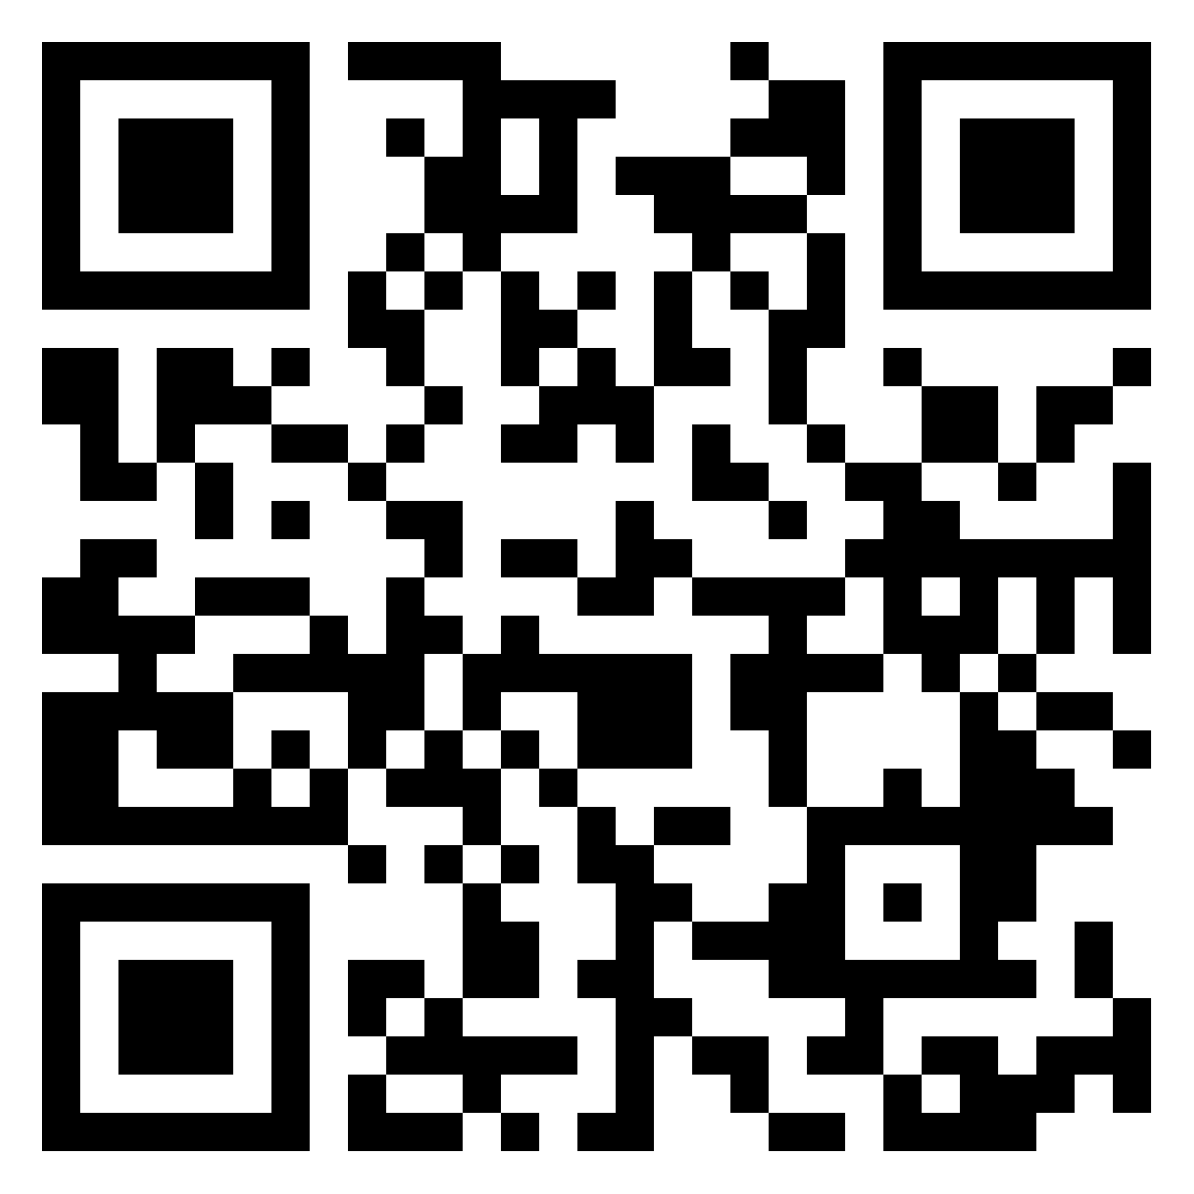
TASK 1 - Leaders
HRM PEM SU OPF
Find the top leader:
in your country or in the world (characterise them – where are they from, who they work for or why are they appreciated)
https://padlet.com/markova17/human-resource-management-vrgwh5tmnxynw3d9
what are their common features?

Slide 7
Who is the leader - features
HRM PEM SU OPF
effective leadership requires a combination of skills, traits, and behaviors that allow leaders to inspire and motivate their team to achieve their best.
Visionary: Effective leaders have a clear vision for the future of their organization and can articulate this vision to their team in a way that inspires and motivates them.
Communicative: Effective leaders are skilled communicators who can convey their ideas and thoughts clearly and persuasively to their team.
Empathetic: Effective leaders are empathetic and understand the needs and concerns of their team members. They listen actively to their team's feedback and ideas, and seek to understand their perspectives.

Slide 8
Who is the leader - features
HRM PEM SU OPF
Decisive: Effective leaders are decisive and able to make sound decisions based on available information and data. They can weigh the pros and cons of different options and choose the best course of action.
Collaborative: Effective leaders recognize the importance of collaboration and seek input from their team members when making decisions. They encourage open communication and create an environment that fosters teamwork and mutual respect.
Adaptable: Effective leaders are adaptable and able to pivot quickly in response to changing circumstances or unexpected challenges. They are open to new ideas and approaches and can adjust their strategy as needed.
Inspirational: Effective leaders inspire their team members to work towards a common goal and achieve their full potential. They lead by example and set a high standard of excellence for themselves and their team.

Slide 9
Identifying personality of leader
HRM PEM SU OPF
the personality of a leader can be done by observing their behavior, communication style, decision-making approach, and overall leadership style.
Some ways to identify a leader's personality include:
Look at how the leader interacts with their team and others.
Do they seem calm, assertive, or outgoing?
Do they inspire others, or do they come across as distant or authoritarian?

Slide 10
Identifying personality of leader
HRM PEM SU OPF
How does the leader communicate with others?
Do they speak clearly and effectively, or are they vague and unresponsive?
Do they listen actively and empathetically, or do they dominate conversations and interrupt others?
How does the leader make decisions?
What is the leader's overall approach to leadership?
Do they lead by example and inspire others, or do they rely on rules and authority to maintain control?

Slide 11
Methods of selection
HRM PEM SU OPF
There are many tests and assessments available to help identify and evaluate leadership skills and potential. Some of the most widely used tests for leaders include:
Myers-Briggs Type Indicator (MBTI):four key areas of personality: extraversion vs. introversion, sensing vs. intuition, thinking vs. feeling, and judging vs. perceiving
StrengthsFinder: This test identifies an individual's top strengths and talents, 34 different strengths, such as strategic thinking, empathy, and positivity
360-Degree Feedback: This assessment involves gathering feedback from multiple sources, including peers, managers, direct reports
Assesment centre!

Slide 12
What must leaders know?
HRM PEM SU OPF
The organization's vision, mission, and values: Leaders must have a clear understanding of the organization's goals and values, and be able to communicate these to their team in a way that inspires and motivates them.
The strengths and weaknesses of their team: Leaders must be aware of the skills and abilities of their team members, as well as their areas for improvement.
The needs of their stakeholders: Leaders must know the needs and expectations of their stakeholders, including customers, employees, shareholders, and community members – better decision-making.

Slide 13
What must leaders know?
HRM PEM SU OPF
How to communicate effectively: clearly, both verbally and in writing, be good listeners and able to provide feedback.
How to manage conflict: in their team and between stakeholders. This involves: listen to different perspectives, find common ground, and facilitate problem-solving.
How to lead through change: to adapt to changing circumstances, flexible, responsive, and able to communicate a clear vision for the future.

Slide 14
Leadership methods
HRM PEM SU OPF
1. Transformational leadership: involves inspiring and motivating followers to achieve their best, encouraging creativity and innovation, and developing their skills and abilities. Transformational leaders often have a clear vision, communicate effectively, and lead by example.
2. Situational leadership: they are able to adapt their style the situation. Leaders assess the readiness and ability of their followers and adjust their approach accordingly.
3. Servant leadership: Servant leaders focus on empowering their followers to achieve their full potential.

Slide 15
Leadership methods
HRM PEM SU OPF
4. Authentic leadership: This leadership method involves being true to oneself, promoting honesty and transparency, and building strong relationships with followers. Authentic leaders often have a strong moral compass and demonstrate integrity in their decision-making.
5. Laissez-faire leadership: This leadership method involves giving followers a great deal of autonomy, with minimal guidance or direction from the leader. This approach can be effective in situations where followers have a high level of expertise and experience.

Slide 16
Is there a difference between leadership and management?
HRM PEM SU OPF
Leadership
Management
Refers to the ability to inspire, motivate, and influence people to achieve a common goal.
Leaders are often visionary and have a strong sense of purpose. They inspire others to follow them by setting an example, sharing their vision, and empowering others to achieve their full potential.
Leaders often challenge the status quo and seek to bring about positive change.
Refers to the process of planning, organizing, directing, and controlling resources (e.g., people, finances, materials) to achieve organizational goals. Managers are responsible for efficiently and effectively completed processes.
They focus on maintaining order and stability within an organization, and often work within established procedures and guidelines.

Slide 17
TASK 2 – a case study that could help explain the difference between a leader and a manager
HRM PEM SU OPF
How would you define the role of a leader, and the role of a manager?
How do the president and the operations manager differ in their approach to leadership and management?
What are the strengths and weaknesses of each approach?
How might the differences between the president and the operations manager impact the organization's success?
How could the organization benefit from a balance of both leadership and management approaches?

Slide 18
Multigenerational leadership
HRM PEM SU OPF
Multigenerational leadership refers to the ability to effectively lead and manage teams that include members from different generations, such as Baby Boomers, Gen X, Millennials, and Gen Z.
Each generation has its own unique characteristics, values, and communication styles, and effective multigenerational leaders are able to understand and navigate these differences in order to create a cohesive and productive team.

Slide 19
Skills to be a multigenerational leader
HRM PEM SU OPF
Strong communication skills: to communicate effectively with team members from different generations, to adapt communication style to meet the needs and preferences of each individual.
Cultural competence: to understand the cultural values and beliefs of each generation, and how those values may impact their work style and priorities.
Flexibility: to be flexible and adaptable, and able to adjust their leadership style to meet the needs of each individual and the team as a whole.
Empathy: to be able to put themselves in the shoes of team members from different generations, and understand their perspectives and challenges.
Collaboration: to be able to build bridges between team members from different generations, and foster a sense of collaboration and shared purpose.

Slide 20
Generations and their characteristics
HRM PEM SU OPF
1. Baby Boomers (born 1946-1964): Baby Boomers are often characterized as hardworking, competitive, and goal-oriented. They tend to value stability and security, and may be motivated by opportunities for advancement and recognition.
2. Generation X (born 1965-1980): Gen Xers are often described as independent, self-reliant, and adaptable. They value work-life balance and may be motivated by flexibility and opportunities to learn and grow.
3. Millennials (born 1981-1996): Millennials are often characterized as tech-savvy, socially conscious, and collaborative. They value work that is meaningful and aligned with their values, and may be motivated by opportunities to make a positive impact.
4. Generation Z (born after 1996): Gen Zers are just entering the workforce and are often described as entrepreneurial, creative, and diverse. They tend to value autonomy and opportunities to learn and grow, and may be motivated by the chance to make a tangible impact.

Slide 21
Pros and cons of multigen approach
HRM PEM SU OPF
Pros
Cons/challenges
Diverse perspectives
Improved decision-making
Enhanced learning opportunities
Increased adaptability
Communication challenges
Differing work styles
Conflict resolution challenges
Ageism

Slide 22
Companies with positive multigen approach
HRM PEM SU OPF
IBM has been recognized for its efforts to create an inclusive workplace for employees of all ages. The company offers training programs, mentorship opportunities, and flexible work arrangements to support employees at all stages of their careers.
PwC has implemented a "reverse mentoring" program, where younger employees mentor older employees on new technologies and trends.
BMW has a diversity and inclusion program and encourages cross-generational mentorship and collaboration.
Marriott International has implemented a "Learn from Everyone" program, which encourages employees to learn from colleagues of all ages.

Slide 23
TASK 3 – multigen challenge
HRM PEM SU OPF
Divide students into 4 groups/4 generations.
Create the features of the approach to each group of employees:
Work-life Integration
Technology
Continuous Learning
Feedback and Recognition
Team Interaction (Collaboration)

Slide 24
Diversity management
HRM PEM SU OPF
Diversity management refers to the proactive steps an organization takes to create and maintain a diverse and inclusive workplace.
The goal of diversity management is to ensure that all employees are valued and respected for their unique backgrounds, experiences, and perspectives, and that they are given equal opportunities to succeed.
It is more innovative, productive, and successful approach. By embracing diversity and inclusion, organizations can attract and retain top talent, improve customer satisfaction, and build stronger relationships with the communities they serve.

Slide 25
Diversity management
HRM PEM SU OPF
Significant role of leaders: Finally, effective diversity management requires strong leadership and accountability at all levels of the organization.
Leaders must support inclusive workplace culture and diverse and respectful workplace.
DM is projected into all processes: recruitment and hiring, training and developement programs esp.

Slide 26
Advantages of diversity management
HRM PEM SU OPF
Increased Innovation
Better Decision-Making
Improved Employee Engagement
Enhanced Reputation
Increased Creativity
Expanded Market Reach

Slide 27
Disadvantages / challenges of diversity management
HRM PEM SU OPF
Resistance to Change
Communication Challenges
Potential for Conflict
Misunderstandings
Increased Complexity (Managing a diverse workforce can be more complex and require more resources than managing a homogenous workforce. This can lead to increased administrative costs and logistical challenges.)

Slide 28
Next lesson content
HRM PEM SU OPF
Talent management
Branding
Role of social network

Slide 29
PERSONALISTIKA PEM SU OPF
Thank you
for your attention.
Děkuji vám za pozornost, přeji příjemný den.

