Slide 1

HUMAN RESOURCE MANAGEMENT
Lesson 5
Diversity management. Talent management. Branding. Social media.
Ing. Helena Marková, Ph.D.

Slide 2
Content
PERSONALISTIKA PEM SU OPF
Diversity management.
Branding.
Role of social network.

Slide 3
Diversity management
HRM PEM SU OPF
Diversity management refers to the proactive steps an organization takes to create and maintain a diverse and inclusive workplace.
The goal of diversity management is to ensure that all employees are valued and respected for their unique backgrounds, experiences, and perspectives, and that they are given equal opportunities to succeed.
It is more innovative, productive, and successful approach. By embracing diversity and inclusion, organizations can attract and retain top talent, improve customer satisfaction, and build stronger relationships with the communities they serve.

Slide 4
Diversity management
HRM PEM SU OPF
Different approaches – from liberal to radical.
Government level of measures – quotes for employing women in managerial post, anti-discrimination legal.
Cultural background of inequal conditions, lack of effort to change habits.
Concept of inclusion is spreading in all areas of public life.
Connection between strategic HRM and diversity management – SHRM is more oriented on business goals, DM more on employees, but today diversity approach becomes one of strategic goal of companies.

Slide 5
Diversity management
HRM PEM SU OPF
Significant role of leaders: Finally, effective diversity management requires strong leadership and accountability at all levels of the organization.
Leaders must support inclusive workplace culture and diverse and respectful workplace.
DM is projected into all processes: recruitment and hiring, training and developement programs esp.

Slide 6
Diversity management
HRM PEM SU OPF
Significant role of leaders: Finally, effective diversity management requires strong leadership and accountability at all levels of the organization.
Leaders must support inclusive workplace culture and diverse and respectful workplace.
DM is projected into all processes: recruitment and hiring, training and developement programs esp.

Slide 7
Advantages of diversity management
HRM PEM SU OPF
Increased Innovation
Better Decision-Making
Improved Employee Engagement
Enhanced Reputation
Increased Creativity
Expanded Market Reach

Slide 8
Disadvantages / challenges of diversity management
HRM PEM SU OPF
Resistance to Change
Communication Challenges
Potential for Conflict
Misunderstandings
Increased Complexity (Managing a diverse workforce can be more complex and require more resources than managing a homogenous workforce. This can lead to increased administrative costs and logistical challenges.)

Slide 9
Methods of diversity management
HRM PEM SU OPF
Diversity management is the practice of creating and maintaining a workplace that respects and values individual differences. There are several methods of diversity management that can be employed in an organization, including:
Diversity training: This involves educating employees about the benefits of diversity and how to recognize and avoid bias.
Recruitment and hiring practices: Organizations can adopt policies that ensure diverse candidate pools for open positions and use diverse selection committees.

Slide 10
Methods of diversity management
HRM PEM SU OPF
Mentoring and networking: Creating formal and informal mentoring programs that connect employees from different backgrounds can help foster a more inclusive workplace.
Affinity groups: These are employee-led groups that come together based on shared characteristics, such as race, gender, or sexual orientation. These groups can provide support and advocacy for underrepresented employees.
Flexible work arrangements: Offering flexible schedules or remote work options can accommodate diverse needs and help create a more inclusive workplace.

Slide 11
Methods of diversity management
HRM PEM SU OPF
Performance management: Organizations can ensure that their performance evaluations are free of bias and that all employees are given equal opportunities for advancement.
Diversity councils: These are cross-functional teams that can help create and implement diversity initiatives and policies.
Employee resource groups: These are groups of employees who come together to address specific workplace issues, such as disability accommodations or LGBTQ+ rights.

Slide 12
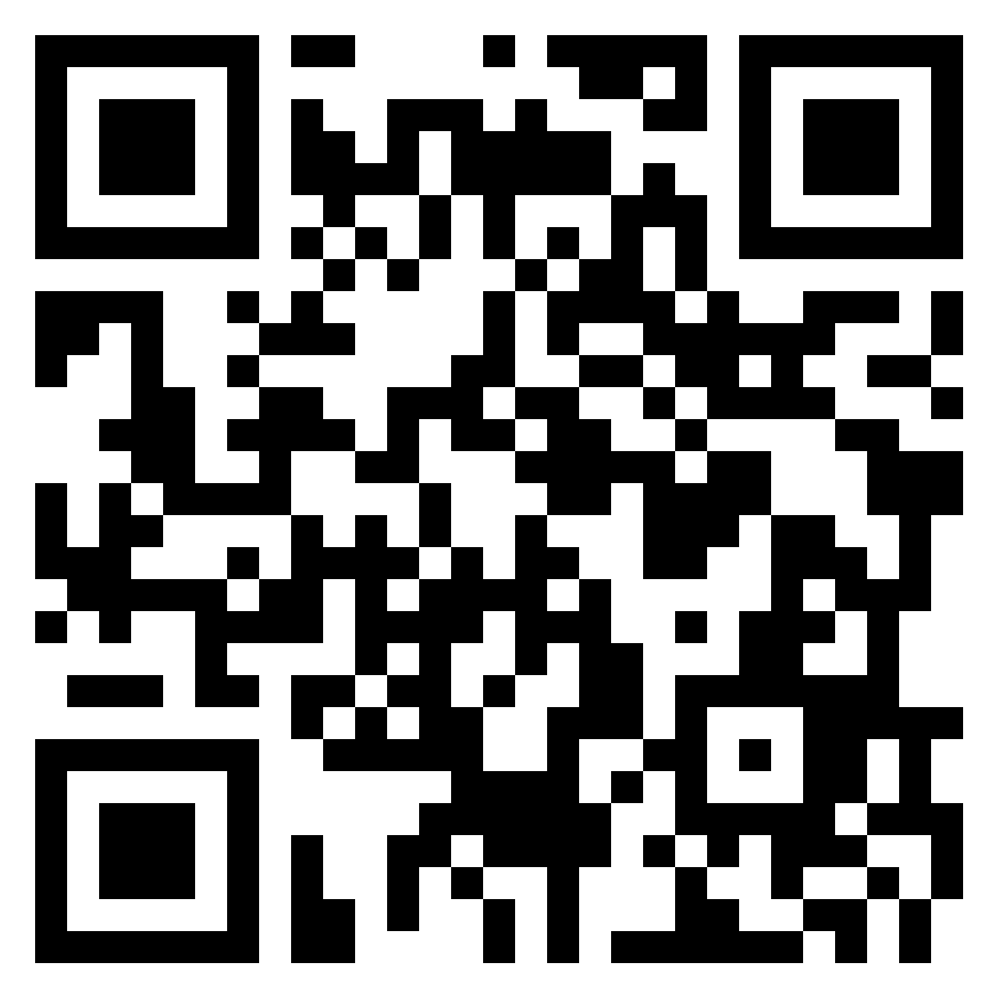
Discussion
HRM PEM SU OPF
Design issues to include employees:
single parents (or parents as well)
employees with disabilities
religious people
https://padlet.com/markova17/human-resource-management-kavssxzcvtorrsoa

Slide 13
Talent management
HRM PEM SU OPF
What is it?
Talent management is a company's internal system that deals with the recruitment, retention and development of talent in the organization. It is a long-term strategy whereby the company "trains" and retains quality employees, or handles succession to individual positions.

Slide 14
Talent management
HRM PEM SU OPF
Talent management enables organizations to attract and retain talent in the long term.
It encompasses development opportunities and strategies that motivate teams to be at their best performance.
Why is it important?
The cost of hiring a new employee can range from one-half to two times the employee’s annual salary (by Gallup Institute).

Slide 15
Talent management x Talent aquisition
HRM PEM SU OPF
Talent management and talent acquisition seem interchangeable, but there are some key differences.
While talent management’s aim is to build and retain talent after hiring,
talent acquisition is mainly focused on attracting and recruiting individuals to join your company.

Slide 16
Key Principles of Talent Management
HRM PEM SU OPF
Alignment With Strategy (if corporate strategy changes …adapt your talent approach)
Internal Consistency (regular feedback, evaluation…consistent in all company, competitive and similar compensation in all positions)
Management Involvement (career development programs, job rotations and new assignments. Professional development is the best way to improve company culture.)
Cultural Embeddedness (hiring candidates with the same values, training programmes of comp.culture)
Employer Branding Through Differentiation (employers must differentiate themselves from competitors and increase brand awareness in local communities…launching campaigns in universities that emphasize unique long-term opportunities, benefits and promotions)
Balancing Global and Local Needs (In international companies managers and HR teams may need to adjust their processes based on the cultural and behavioral norms in a particular country.)

Slide 17
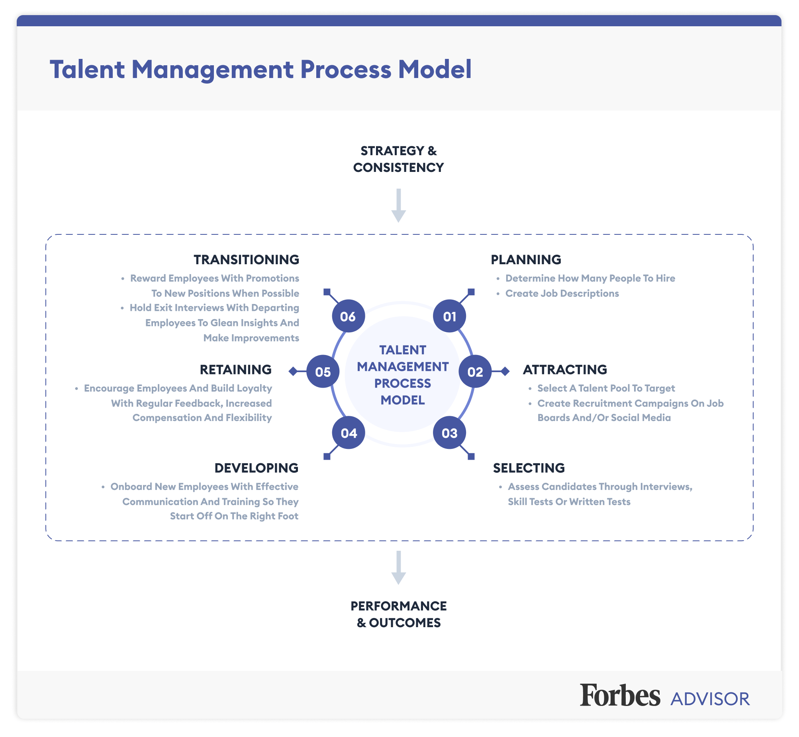
Talent management process
HRM PEM SU OPF

Slide 18
Branding
HRM PEM SU OPF
What is it and is it important?
A strong employer brand can help an organization to attract and retain top talent by creating a positive image of the organization as a desirable place to work.

Slide 19
Branding
HRM PEM SU OPF
How to get an employer brand?
Developing a clear employer brand message / marketing
Building a strong online presence / marketing, PR
Offering competitive compensation and benefits / management, HRM - performance
Providing opportunities for career growth and development / HMR-developement and education
Creating a positive candidate experience / HRM – recruitment and hiring

Slide 20
Some examples of companies with a strong brand in HR
HRM PEM SU OPF
1. Google - Known for its unique culture and employee perks, Google has built a strong brand in human resource management that emphasizes employee satisfaction, innovation, and collaboration.
2. LinkedIn - As a leading professional networking platform, LinkedIn has built a strong brand in human resource management that emphasizes career development, networking, and talent acquisition.
3. Marriott International - Known for its commitment to employee development and training, Marriott International has built a strong brand in human resource management that emphasizes career growth, diversity and inclusion, and community engagement.

Slide 21
Some examples of companies with a strong brand in HR
HRM PEM SU OPF
4. Southwest Airlines - With its fun and friendly culture, Southwest Airlines has built a strong brand in human resource management that emphasizes employee engagement, empowerment, and customer service.
5. Patagonia - As a company that is committed to environmental sustainability and social responsibility, Patagonia has built a strong brand in human resource management that emphasizes employee activism, work-life balance, and purpose-driven work.

Slide 22
Branding
HRM PEM SU OPF
Overall, these companies have built strong brands in human resource management by prioritizing employee satisfaction, career development, diversity and inclusion, and social responsibility. By creating a positive and supportive workplace culture, these companies have been able to attract and retain top talent, which has helped to drive their business success.

Slide 23
Is branding useful?
HRM PEM SU OPF
A study by the Harvard Business Review
strong employer brand can increase a company's ability to attract and retain top talent by up to 50%
receive a higher number of job applications
lower employee turnover rates.
a survey by LinkedIn
72% of recruiting leaders worldwide believe that employer branding has a significant impact on hiring
a study by Universum
strong employer brands are more likely to attract and retain top talent, as well as to have more engaged and productive employees.

Slide 24
Social media and HRM
HRM PEM SU OPF
Where is the place of social media in HRM?
Social media has increasingly become an important tool for human resource management (HRM). Here are some of the ways in which social media can play a role in HRM:
1. Recruitment and Hiring: Social media platforms such as LinkedIn, Facebook, and Twitter can be used by HR professionals to search for and attract job candidates. Companies can also use social media to post job openings and reach a wider audience.
2. Employer Branding: Social media can be used to showcase an organization's culture and values, as well as to highlight its achievements and awards. This can help attract potential candidates and improve the company's reputation.

Slide 25
Social media and HRM
HRM PEM SU OPF
3. Employee Engagement: Social media can be used to engage with employees and build a sense of community. Companies can create private groups for employees to share ideas and collaborate on projects, as well as to communicate important company news and updates.
4. Training and Development: Social media can be used as a platform for training and development programs, such as online courses or webinars. This can be particularly useful for remote or distributed teams.
5. Performance Management: Social media can be used to monitor and evaluate employee performance, as well as to provide feedback and recognition. For example, companies can use social media to track employee contributions to online discussions or to recognize outstanding work.

Slide 26
Examples of use social media platforms
HRM PEM SU OPF
1. LinkedIn: LinkedIn is a professional networking platform that is widely used for recruitment and hiring. HR professionals can use LinkedIn to search for job candidates, post job openings, and build their organization's brand.
2. Facebook: Although primarily known as a social networking platform, Facebook is increasingly being used for recruitment and employer branding. Companies can use Facebook to post job openings and engage with potential candidates through targeted advertising and messaging.
3. Twitter: Twitter is a microblogging platform that can be used for real-time communication and engagement. HR professionals can use Twitter to share job openings, communicate with candidates, and showcase their organization's culture and values.
4. Instagram: Instagram is a visual social media platform that can be used for employer branding and employee engagement. Companies can use Instagram to showcase their culture, highlight employee achievements, and promote job openings.
5. Glassdoor: Glassdoor is a platform that allows employees to share anonymous reviews and feedback about their company. HR professionals can use Glassdoor to monitor their organization's reputation and address any concerns or issues raised by current or former employees.

Slide 27
Risks associated with social media
HRM PEM SU OPF
Discrimination and Bias: information about an employee's race, ethnicity, religion, age, and other personal details that are legally protected. Using this information in HRM decisions could result in discrimination and bias, which is illegal.
Inaccurate information: Information is not always accurate and can be misleading. Making HRM decisions based on inaccurate information can lead to errors and can negatively impact employee morale and motivation.
Privacy concerns: Social media platforms may contain personal information about employees that they do not want their employers to see. Accessing such information could result in a breach of privacy and could lead to legal implications.

Slide 28
Risks associated with social media
HRM PEM SU OPF
Unfair treatment: Social media platforms may provide information about an employee's personal life that could be used to make unfair judgments about their work performance, leading to an unfair treatment of employees.
Legal risks: Employers must comply with various laws and regulations when using social media platforms for HRM purposes. Failing to comply with these laws and regulations could result in legal risks and financial penalties.
Negative impact on company reputation:, which could affect the business's profitability and growth.

Slide 29
Interesting ideas
HRM PEM SU OPF
A report from discussion panel of experts about using social media by HR managers
https://www.forbes.com/sites/forbeshumanresourcescouncil/2022/01/05/12-ways-hr-managers-can-utilize-social-media-to-woo-top-talent/?sh=4886ca9fe9fc

Slide 30
Discussion – a practise
HRM PEM SU OPF
Discuss: As a personalist, would you check candidates´profiles? What do you think about this practise? What is your attitude to social media on the professional level?
Write your opinion on e-mail markova@opf.slu.cz

Slide 31

PERSONALISTIKA PEM SU OPF
Thank you
for your attention.
Děkuji vám za pozornost, přeji příjemný den.

