Slide 1
Název prezentace
Název projektu | Rozvoj vzdělávání na Slezské univerzitě v Opavě
Registrační číslo projektu | CZ.02.2.69/0.0./0.0/16_015/0002400
Course Presentation:
MINORITY ENTREPRENEURSHIP
Lecturers:
Mgr. Lubomír Nenička, Ph.D.
Ing. Vojtěch Beck

Slide 2
DEFINITION OF MINORITY ENTREPRENEURSHIP
What is a Minority group?
What is the difference between entrepreneurship and minority entrepreneurship?
.
Agenda of the lecture

Slide 3
DEFINITION OF MINORITY ENTREPRENEURSHIP – part I
Main goal of the lecture is:
understand a definition of an entrepreneurship and an entrepreneur.
explain differences between minority entrepreneurship and entrepreneurship in general.
.

Slide 4
Entrepreneurship
Globally said, you could hear about entrepreneurs. Just open a newspaper or magazine or some web sites, you will find at least one story about successful entrepreneur.
Entrepreneurs have existed throughout the history. At various times, individuals spotted an opportunity and set up a structure to exploit it.
They mobilised resources and traded or manufactured something for a profit (Rwigema, 2008). However, what is exactly entrepreneurship and how it relates to minority entrepreneurship?

Slide 5
Definition of Entrepreneurship I
The word “entrepreneur” came to business world and literature from French verb “entreprendre”, which means “to undertake” (also to start, to begin or to initiate some activity).
Entrepreneurship could be described as a process, whereby an individual or a group of individuals uses organized effort to pursue opportunities to create value and it grows by fulfilling needs through uniqueness of products or services.
Entrepreneurship is based on observing business environment trends and changes that no one else has seen or paid attention to and finding the gap on the market.

Slide 6
Definition of Entrepreneurship II
Hisrich and Peters (2002) define entrepreneurship as: “…process of creating something new, with value, by devoting the necessary time and effort, assuming the accompanying financial, psychic, and social risks, and receiving the resulting rewards of monetary and personal satisfaction and independence.”

Slide 7
Four characteristics
Entrepreneurship involves the creative process; creating a new value. The creation must have value to the entrepreneur, and it is valuable also to the audience like customers for which it was developed.
Entrepreneurship requires necessary time and effort to create something new and make it happened.
Entrepreneurship relates to the risk. These risks concentrate on financial, psychological and social areas.
Entrepreneurship brings rewards of being an entrepreneur. The most important of this advantage is independence, personal satisfaction and monetary rewards.

Slide 8
Intrapreneurship
Intrapreneurship describes innovative processes within the context of existing organizations; it would be private or public.
The definition of intrapreneurship is like entrepreneurship in general, in exception that intrapreneurship takes place within an organization.
The major value is to create or develop the entrepreneurial spirit within corporate boundaries, supporting an atmosphere of innovation to prosper.

Slide 9
Extrapreneurship
It is a venturing process where employees of a company spin-off from their former employing company or place of work to establish a supplementary business.
The business is often in the same line as business from the former place of work, since that individual has already acquired some experience in this line of business from the former place of work.

Slide 10
Entrepreneur
Filion (2011) interrogates the origin and development of the term ‘entrepreneur’, revealing its meaning to the 17th century, when Richard Cantillon being the first who offer a clear conception of the entrepreneurial function and its relation to innovation.

Slide 11
Definition of an Entrepreneur
An entrepreneur is an actor who innovates by recognizing opportunities; he or she makes moderately risky decisions that lead into actions requiring the efficient use of resources and contributing a benefit.

Slide 12
Entrepreneurial Types
Stokes and Wilson (2010) explained how different groups of scientists could define an entrepreneur:
Economists define an entrepreneur as one who brings resources, labour, raw material and other assets into combinations that increase their value.
Psychologists define an entrepreneur as a person, who is driven by some forces, which create a desire to obtain or attain something.
Sociologists define ‘entrepreneur’ as a person whose actions would determine his social status and who contributes to the development of society.
Management experts define ‘entrepreneur’ as a person who has a vision and generates an action plan to achieve it.

Slide 13
Entrepreneurial categories
Gupta and Khanka (2010) work with other categories, which are based on innovations and enthusiasm. According that, they described also four entrepreneurial categories:
Innovating Entrepreneurs, who present new goods and services, develops new methods of production, make experiments with new processes and they are look for a new market and restructure the enterprise. Those entrepreneurs can work only in innovation-friendly business environment and they work with people who look forward for change.
Imitative Entrepreneurs, who are characterized by their readiness to adopt successful innovations worldwide. They use existing innovations to imitate techniques and technology presented previously by others.

Slide 14
Entrepreneurial categories II
Gupta and Khanka (2010) work with other categories, which are based on innovations and enthusiasm. According that, they described also four entrepreneurial categories:
Fabian Entrepreneurs are who doesn’t care to adopt new methods and innovations. They prefer only to imitate in several cases, when they are sure that this product and process is successful, and the investment isn’t risky.
Drone Entrepreneurs, who refused any opportunity to adopt changes and innovations. They don’t plan any growth in their business. They prefer conventional way of business.

Slide 15
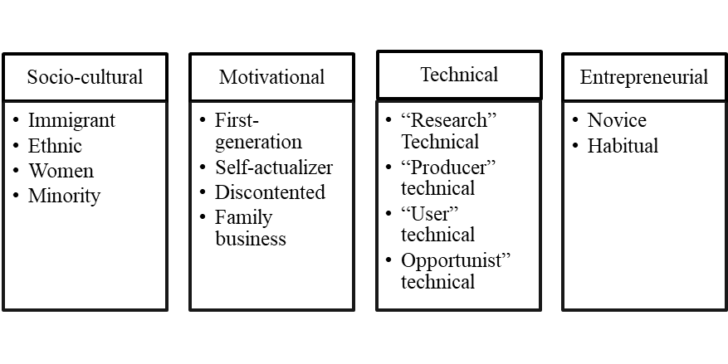
Entrepreneurial Typology
Source: Naidu and Rao (2008)

Slide 16
1 Socio Cultural Classification
Those entrepreneurs can be divided into four categories.
Immigrant Entrepreneur is an individual who has a recent arrival in a country and starts a business as a way of living in the “host” country.
Ethnic entrepreneurs have a set of common connections and regular patterns of interaction among people sharing common national backgrounds or migration experiences.
Minority entrepreneurs are the ones who don’t belong to majority population.
Women Entrepreneurs.

Slide 17
2 Motivational Classification
Motivational Classification focus on motivation to start a new business venture, such as:
First-generation entrepreneur is the one who starts a new business, without any family business roots.
Self-actualized entrepreneurs, when the main motivation is self-actualization, people want to they achieve something what they are capable of, to feel independence and autonomy.
Discontented entrepreneurs are those, who are unhappy with the current organization and they decide to start a new venture.
Family business entrepreneurs are those, who are involved in their family business.

Slide 18
3 Entrepreneurial Experience Classification
Entrepreneurial Experience Classification deals with previous entrepreneurial experience:
Novice entrepreneurs are people who don’t have any business experience in the past but now they own their own business.
Habitual Entrepreneurs are entrepreneurs, who have the experience at least two or more different companies, one at a time (Serial Entrepreneurs) or simultaneously (Portfolio entrepreneur).

Slide 19
4 Technical experience Classification
Technical experience Classification is based on the founder experience of technology-based business.
“Research” entrepreneur has a prior experience of technological research before start own technical business.
“Producer” entrepreneur, is the one who has a commercial production prior to starting his own venture
“User” technical entrepreneur is the one who had been involved as an end user of the specific product/technology.
“Opportunist” technical entrepreneur, who has identified and visualized a technology-based opportunity and grabbed it to set up his technology-based venture.

Slide 20
Task
Try to find out an example of companies who comply previous definitions. Give a one example for each category. Do not forget that some companies could meet more than one criterion. Your examples will be discussed on the lecture or by on-line conversation with the lecturer.

Slide 21
Example
 | Criteria/company name | Bata shoe company | Arcelor Mittal | Kaufland
sociocultural | Immigrant | √
 | Ethnic
 | Women
 | Minority
motivation | First-generation
 | Self-actualizer | √
 | Discontented |  |  | √
 | Family business | √ | √
experience | Novice
 | Habitual | √ | √ | √
technical | “Research” | √
 | “Producer” |  | √
 | “User”
 | Opportunist” | √ | √

Slide 22
Summary
Minority Entrepreneurship is for all and the required personal qualities and conditions for it are fulfilled by different people and it involves supporting entrepreneurs from all background who would like to take complex decisions, to manage risks, find innovative solution, collaborate with others in order to survive in their daily lives. It implies understanding barriers faced by different people in different places, helping them to use their creative potential to overcome barriers and create a sustainable future for them and all.

