Slide 1

INTRODUCTION INTO THE WORLD ECONOMY
LESSON I
Ingrid Majerova
World Economy
EVS/XXX

Slide 2

First….
Name: Ingrid Majerova
Office: A 203
E-mail: majerova@opf.slu.cz
Consultation hours: …….
Info: Moodle
IS SU

Slide 3
Outline of the lecture
World Economy as a Science
Definition of the World Economy
Classification of Countries
GDP and GDP per capita in the World
Development of the World Economy

Slide 4
DEFINITION OF THE WORLD ECONOMY
In domestic and foreign literature there are various approaches to definition of the concept “world economy”. The most important of them are:
  Set of the national farms connected with each other by system of the international division of labor. Such definition is based on idea of the world economy as to the sum of national economies;
  World system of the production and financial relations. The main components of the world economy – the sphere of real production and the sphere of the address found reflection in such approach;
  Set of the national and state and non-state structures, and also their interactions on the basis of the international division of labor and political contacts. In this treatment the world economy represents a common economic space (mega-economy) in which act as subjects of the economic relations: national economies of the countries of the world; subjects of world business – multinational corporations and their alliances; institutes of the world economy – the international economic organizations.

Slide 5
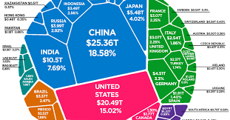
DEFINITION OF THE WORLD ECONOMY
World economy - a single social organism in which national economies are in different degrees integrated through an international division of labor and international economic relations.
Cornerstones of the WE - individual, of various sizes and various advanced national economies.
Transnational corporations play a significant role.

Slide 6

DEFINITION OF THE WORLD ECONOMY
Elements of the WE:
  national economies
  regional economic groupings
  transnational companies
  and international economic institutions
International economic relations:
  international trade
  international capital movements
  international monetary relations
  international labor migration
  and the international flow of scientific and technical information

Slide 7
CLASSIFICATION OF COUNTRIES
Individual countries: the basic elements of the world economy:
  basic division: advanced countries x developing countries
  to 90´s: plus group of countries with centrally planned economies
  division of the former centrally planned economies: countries with economies in transition x countries with central control of foreign trade

Slide 8
CLASSIFICATION OF COUNTRIES
Narrower concept (UN): the criterion of political independence and the nature of economic relations.
Wider concept (WB, OECD): terms of economic level measured by GDP or GNP per capita, the character of the sectoral structure of the economy and the status and level of infrastructure.
New classification of UNCTAD:
  advanced economies
  former European countries with centrally planned economies and the Commonwealth of Independent States (ECONOMIES IN TRANSITION)
  and developing economies.

Slide 9
CLASSIFICATION OF COUNTRIES

Slide 10
CLASSIFICATION OF COUNTRIES
Subgroups of developing countries in UNCTAD division:
Major oil exporters
Landlocked Developing Countries (LLDC´s) - developing countries not having access to the sea (ocean)
Small Island Developing Countries (SIDC´s)
Least Developed Countries (LDC´s) - world's poorest countries
Heavily indebted poor countries (36 post-completition point + 3 pre-decision point countries)

Slide 11
CLASSIFICATION OF COUNTRIES

Slide 12
CLASSIFICATION OF COUNTRIES

Slide 13
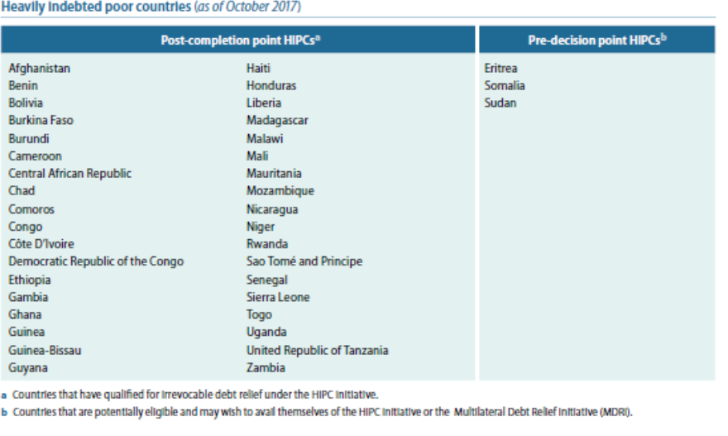
CLASSIFICATION OF COUNTRIES

Slide 14
CLASSIFICATION OF COUNTRIES
According to OECD:
OECD countries
and non-OECD countries that are further divided into:
Africa and the Middle East
developing countries of Asia
Latin America
the countries of Central and Eastern Europe
emerging markets - countries that are the targets of investment flows and represent promising markets for products from advanced countries, on the other hand, are able to establish production cooperation with them.

Slide 15
CLASSIFICATION OF COUNTRIES
World Bank clasifies countries by the GNI per capita and ranks them into the performance groups (in 2019):
countries producing more than 12,376 USD per capita (high income)
countries with an output from 3,996 to 12,375 USD (upper middle income)
countries with an output from 1,026 to 4,995 USD (lower middle income)
countries with less than 1,025 USD/capita (low income)

Slide 16
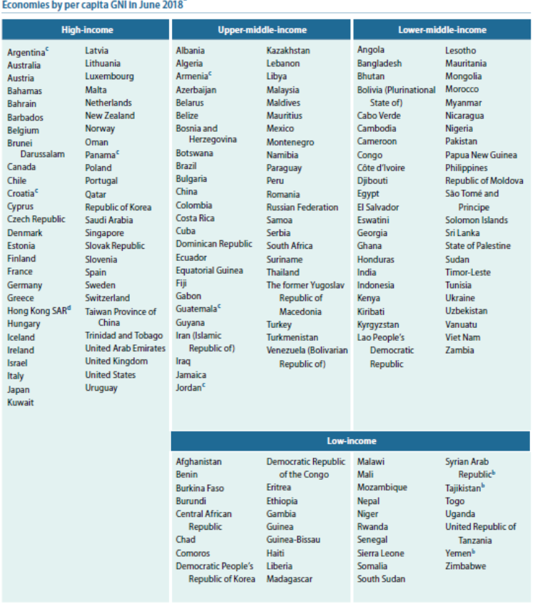
CLASSIFICATION OF COUNTRIES

Slide 17
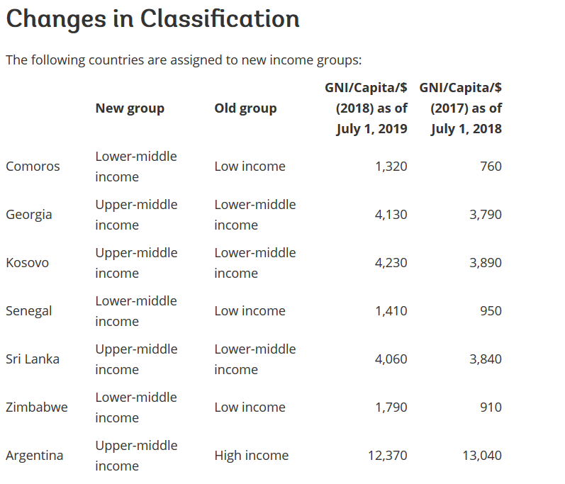
CLASSIFICATION OF COUNTRIES

Slide 18
CLASSIFICATION OF COUNTRIES
Division by innovations:
Center of the world economy: GDP over 10.000 USD per capita, this group is a source of innovation and scientific and technical progress
Close peripherals: GDP from 3000 to $ 10,000 per capita, and the ability to apply and accept innovations produced elsewhere
Distant peripherals: rest of the world with low levels of participation in the international division of labor with low skills even if only to accept innovations

Slide 19
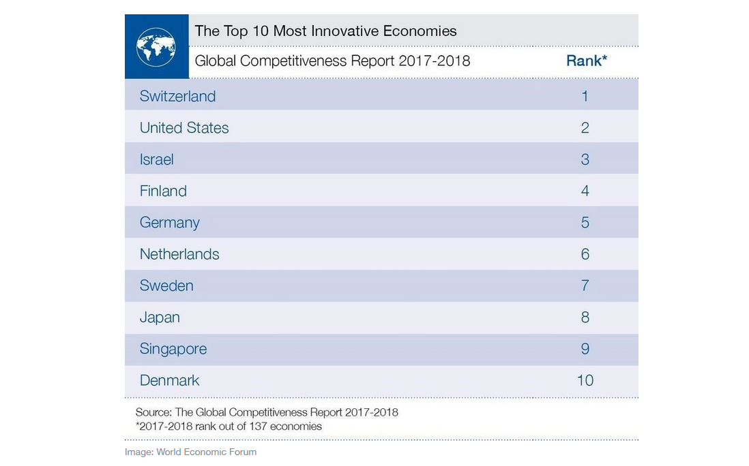
CLASSIFICATION OF COUNTRIES

Slide 20

CLASSIFICATION OF COUNTRIES
Division of countries according to the size of the economy:
Small economies: to 20 million inhabitants
Medium-sized economies: from 20 to 100 million inhabitants
Large economies: over 100 million inhabitants

Slide 21
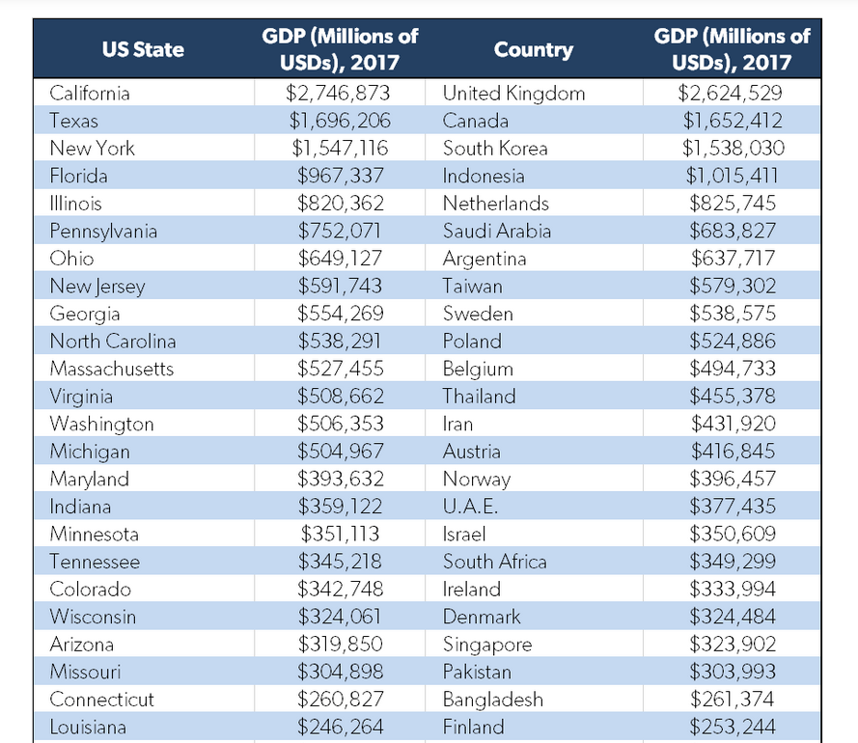
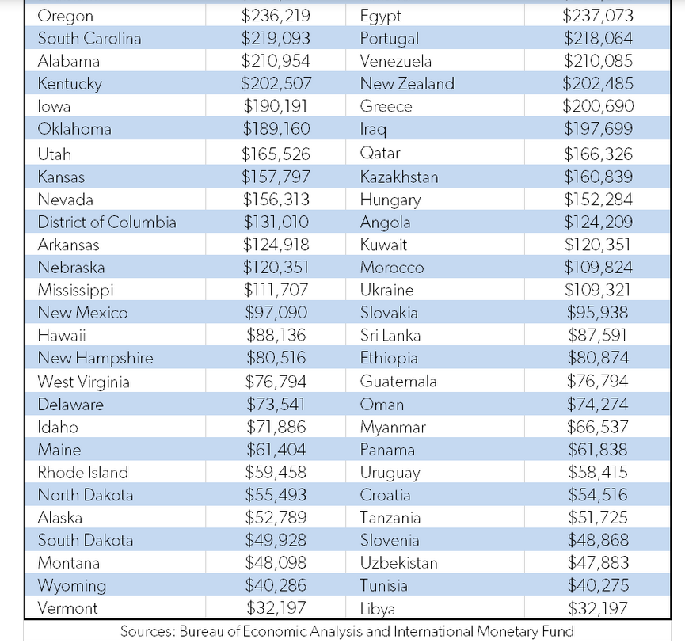
CLASSIFICATION OF COUNTRIES

Slide 22
GROWTH OF THE WORLD ECONOMY
Growth of World Trade and World GDP (Source: UN/DESA)

Slide 23
GROWTH OF THE WORLD ECONOMY
Contribution to Global Merchandise EXPORT Volume Growth by Region in 2011-2018
(Source: UN/DESA)
Contribution to Global Merchandise IMPORT Volum Growth by Region in 2011-2018 (Source: UN/DESA)

Slide 24
GROWTH OF THE WORLD ECONOMY

Slide 25
GROWTH OF THE WORLD ECONOMY

Slide 26
GROWTH OF THE WORLD ECONOMY

Slide 27
GROWTH OF THE WORLD ECONOMY

Slide 28
WORLD ECONOMY
Thank you for your Attention!

