Slide 1

Pure Theory of Trade
Lesson I
Ingrid Majerova
International Economics
NAMEE

Slide 2

Outline of the lecture
Characteristic of International Trade
Development of the Theory to 18th Century
Pure Theory of International Trade

Slide 3
CHARACTERISTIC OF INTERNATIONAL TRADE
International economics uses basic methods of economic analysis as well as other fields of economics, because motives and behaviour of economic subjects are the same, whether they are domestic or foreign transaction.
International economics can be divided into two sub-areas: the area of international trade and area of international flow of money
Analysis of international trade deals with transactions of international economics such as movements of goods or allocations of economic resources.
Analysis of flow of international flow of money deals with the monetary side of international economics and these are financial transactions.

Slide 4
CHARACTERISTIC OF INTERNATIONAL TRADE
The aim of the investigation of international economics is revenues from trade, trade restrictions, foreign exchange markets, balance of payments and its adjustment and international capital markets.
The balance of payments measures total payments and receipts of the resident of the country in their transactions with the rest of the world
International capital market is developing together with the development of international trade by combining the individual capital markets of national economies.
The first two objectives of the exploration of the international economics, the pure trade of international trade and theory of trade policy, are the microeconomic aspect of international economics, because they discuss about individual national economies as separate entities as well as the relative prices of commodities..
Macroeconomic aspect of international economics are represented by the follow-named objectives – the foreign exchange markets, the issue of balance of payments and its adjustments, since they discuss about the total flows and affect the national income.

Slide 5
CHARACTERISTIC OF INTERNATIONAL TRADE
International trade, representing the exchange of goods of one country with other countries, expands consumer potential of economies and there are several reasons, which despite all above-mentioned negatives contribute to the ongoing development:
  The diversity of production conditions and technology between economies – south will specialize in the development of coastal tourism and the cultivation of citrus, north in salmon farming and development of ski resorts
  The increasing returns to scale – or economies of scale, when average cost of production decreases with the increase in production
  Differences in consumer tastes and therefore in demand – e.g. in Sweden and Norway is the production of reindeer meat and salmon the same, Swedes love to eat meat and Norwegians love to eat fishes – the reciprocal export of meat and fish would be beneficial to both countries and would increase the wealth
  The existence of government economic policy – tax and subsidy measures may change the price of goods and services that can create advantages while producing
  And conflict between production and consumption – based on the fact that no country in the role of producer of goods and services is able to satisfy all requirements of its consumers.

Slide 6
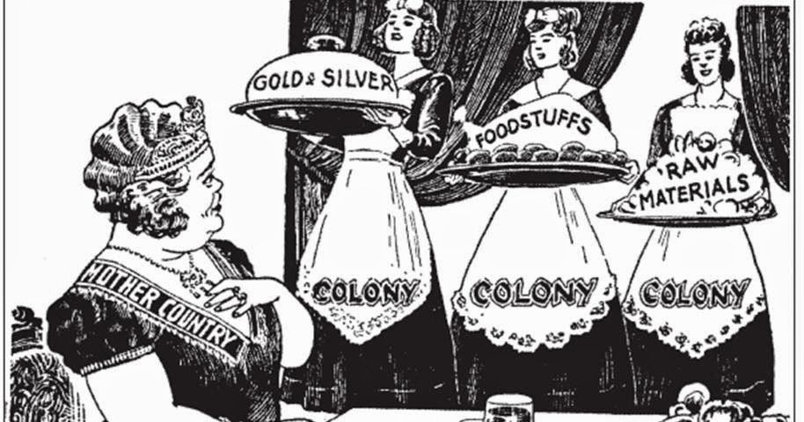
THE DEVELOPMENT OF THE THEORY OF INTERNATIONAL TRADE
Mercantilism
mid 14th to mid 18th century
The expression of the nation’s wealth was the amount of gold and silver and other means of payment at that time.
Increasing wealth could occur in three ways:
  (1) domestic extraction of precious metals,
  (2) in case of their lack by the use of the resources of colonies or
  (3) active trade balance (more exports than exports)
Mercantilism itself is divided into two development phases – early mercantilism, also known as bullionism (mid 14th – mid 16th century)2 and developed mercantilism (mid 16th –mid 18th century).

Slide 7
THE DEVELOPMENT OF THE THEORY OF INTERNATIONAL TRADE
Mercantilism
The both phases show some common features:
  Restriction of imports, especially of luxury consumer goods
  The prevention of exports and import promotion of raw materials
  The favouring and export promotion of industrial consumer goods and agricultural products
  A support the development of domestic industry
  And reduction of consumption (weakening incentives to import and the chance to export more)
International trade was at that time considered to be disadvantageous when each country participating to foreign trade earns and automatically the other lose, and therefore it was always more beneficial to export than import (a thus have active trade balance).
The first, who used a term balance of foreign trade, was mercantilist Edward Misselden.
  He argued that the state should rather focus on the monitoring of trade, i.e. monitoring the trade balance, than focusing on the application of restrictions.

Slide 8
THE DEVELOPMENT OF THE THEORY OF INTERNATIONAL TRADE
Mercantilism
The most known mercantilist was Gerard de Malynes, which recommended the state regulatory measures in foreign trade.
Criticism - Thomas Mun
  the British East India Company precious metals exported from the country - Mun’s argument that for these exported precious metals can be imported goods, which are further processed and exported, that ultimately the precious metals flowing back into the economy.
  the passive trade balance of Company with India - Mun argued that there is no need to have an active balance with each country, but it is enough to have active only overall trade balance, which enriches the state.
He also knew that the active trade balance increases the amount of money (precious metals) in the economy and this leads to an increase in the price level and reducing the price competitiveness of domestic producers (due to rising prices of goods).
  That is the principle of price compensatory mechanism of balance of payments, which is based on the quantity theory of money.

Slide 9
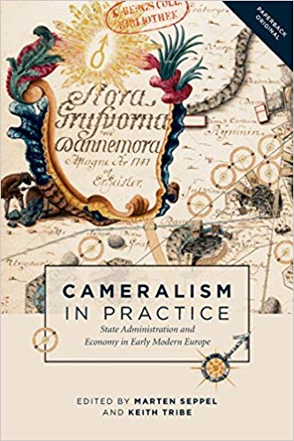
THE DEVELOPMENT OF THE THEORY OF INTERNATIONAL TRADE
Cameralism
At the turn of the 18th and 19th century the central European mercantilism (German and Austrian) so-called cameralism (name derived from the Latin word camera) is formed.
focused on matters related to the administration (finance, accounting, administrative law etc.) and they place more emphasis on population growth. In addition, they not consider precious metals for the country’s wealth (manufacturing and agriculture)
the active trade balance as a means of increasing employment in the economy
explained that export increases domestic demand for goods and thus the labour demand and that import of foreign goods displaces domestic goods and reduces the labour demand and employment
thoughts meet mercantilism:
  They forbid export of precious metals and raw materials
  They negatively perceive import of luxury goods and consumer goods that could compete with domestic producers
  they promote stagnation of consumption

Slide 10
THE DEVELOPMENT OF THE THEORY OF INTERNATIONAL TRADE
Formative Economics
David Hume is the most prominent representative of this approach, which became the basis of classical economics.
He was a strong critic of mercantilism, particularly in the determination of the country’s wealth, which is according him determinate by the amount of labour in the country.
He refused active trade balance through the mentioned quantity theory of money, whose main essence was formulated by Thomas Mun. According Hume, the achieving of an active trade balance does not make a sense, since it accumulated the amount of precious metals increases the price level and reduces the international competitiveness of the economy.
  The result of this is lower export of country and higher import. Trade balances are again equalized or get into deficit. To avoid the increasing price level in the economy caused by the increasing amount of precious metals is necessary to increase production in the economy.
Hume also argues that country that prevents foreign trade mainly harms itself. He also understood the significance of the international division of labour and indirectly formulated the theory of absolute advantages, for whose author is considered Adam Smith.

Slide 11
PURE THEORY OF INTERNATIONAL TRADE
Classical Economics Approach
The basis for trading in the pure theory of international trade (whether classic or neoclassic which is analysed in next chapter) is technological differences between countries in terms of cost and productivity.
two different ways how to describe these differences:
  the first way is absolute advantage described by Adam Smith
  and the second method is comparative advantage whose author is considered David Ricardo.
The pure theory of international trade tried to uncover the causes of trade seen in the benefits deriving form it and to determine the nature of these benefits.
In practical testing was found that only applies to the interdisciplinary area and that means for trade with non-substitutes.

Slide 12
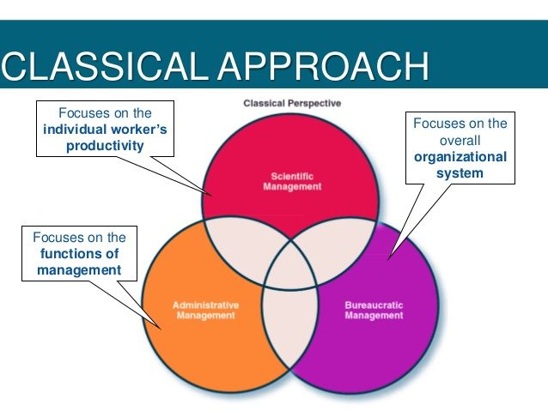
PURE THEORY OF INTERNATIONAL TRADE
Classical Economics Approach
The classical approach is based on an analysis of the supply side and the following assumptions:
  Economic subjects are behave rationally and make decisions based on real relative prices
  The market is perfectly competitive and thus there are no trade barriers, externalities, transaction costs and information is perfect
  There are only two economies, two goods and two factors of production
  Factors of production are limited, fully utilized and there is a mobility between sectors, but not between individual economies
  Production technologies exhibit constant returns to scale (PPF is a straight line)
  A workforce determines the cost and productivity
  Consumer preferences are the same, as well as their indifference curves
  And balanced foreign trade balance.

Slide 13
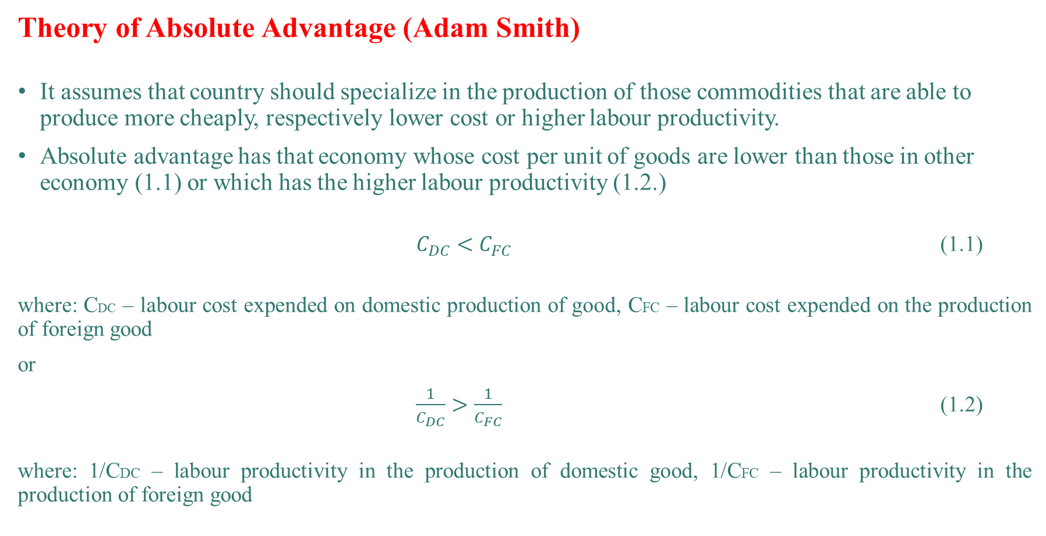
PURE THEORY OF INTERNATIONAL TRADE
Theory of Absolute Advantage (Adam Smith)
It assumes that country should specialize in the production of those commodities that are able to produce more cheaply, respectively lower cost or higher labour productivity.
Absolute advantage has that economy whose cost per unit of goods are lower than those in other economy (1.1) or which has the higher labour productivity (1.2.)
$C_{DC}<C_{FC}$ (1.1)
where: CDC – labour cost expended on domestic production of good, CFC – labour cost expended on the production of foreign good
or
$\frac{1}{C_{DC}}>\frac{1}{C_{FC}}$ (1.2)
where: 1/CDC – labour productivity in the production of domestic good, 1/CFC – labour productivity in the production of foreign good

Slide 14
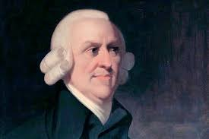
PURE THEORY OF INTERNATIONAL TRADE
Theory of Absolute Advantage (Adam Smith)
The theory of absolute advantages says that the international trade is a source of growth in wealth, since it allows more efficient use of factors of production on a global scale and thus allows the growth of production, which is a source of growing wealth.
However, the theory of absolute advanages do explain only a small part of the principles of world trade such as international trade between developed and developing countries.
The majority of current global trade (especially between developed countries) is ongoing on the principle of comparative advantages.

Slide 15
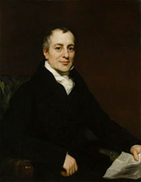
PURE THEORY OF INTERNATIONAL TRADE
Theory of Comparative Advantage (David Ricardo)
The theory of comparative advantages, also known as a single-factor model, is the most important concept of the theory of international trade. The first, who described the principle of this theory, was Robert Torrens (in 1815), who uses the example of trade between England and Poland with wheat and denied the correctness of the theory of absolute advantages.
Two years later, David Ricardo formalized the principle of the theory of comparative advantage while using mathematical apparatus and he was recognized as its author.
  He showed that not only countries that have an absolute advantage could enter the international markets.
This theory is based on the premise of mutual trade between the countries while comparing the opportunity cost (an opportunity cost theory itself was developed by G. Haberler), furthermore the labour productivity or benefits derived from mutual convertibility.

Slide 16

PURE THEORY OF INTERNATIONAL TRADE
Theory of Comparative Advantage (David Ricardo)
How to set up the opportunity cost?
The opportunity costs are generally defined as the value of the second earliest opportunity.
  For example, the economy Alpha has the ability to produce beer and cheese.
  If economy Alpha would like to produce more cheese, the labour would have to be – due to their rarity and take full advantage – move from beer production into cheese production.
  The loss in production of beer means for the economy the opportunity cost.
The opportunity cost is expressed by the amount of beer production that the economy must give up to produce one kilogram of cheese.

Slide 17

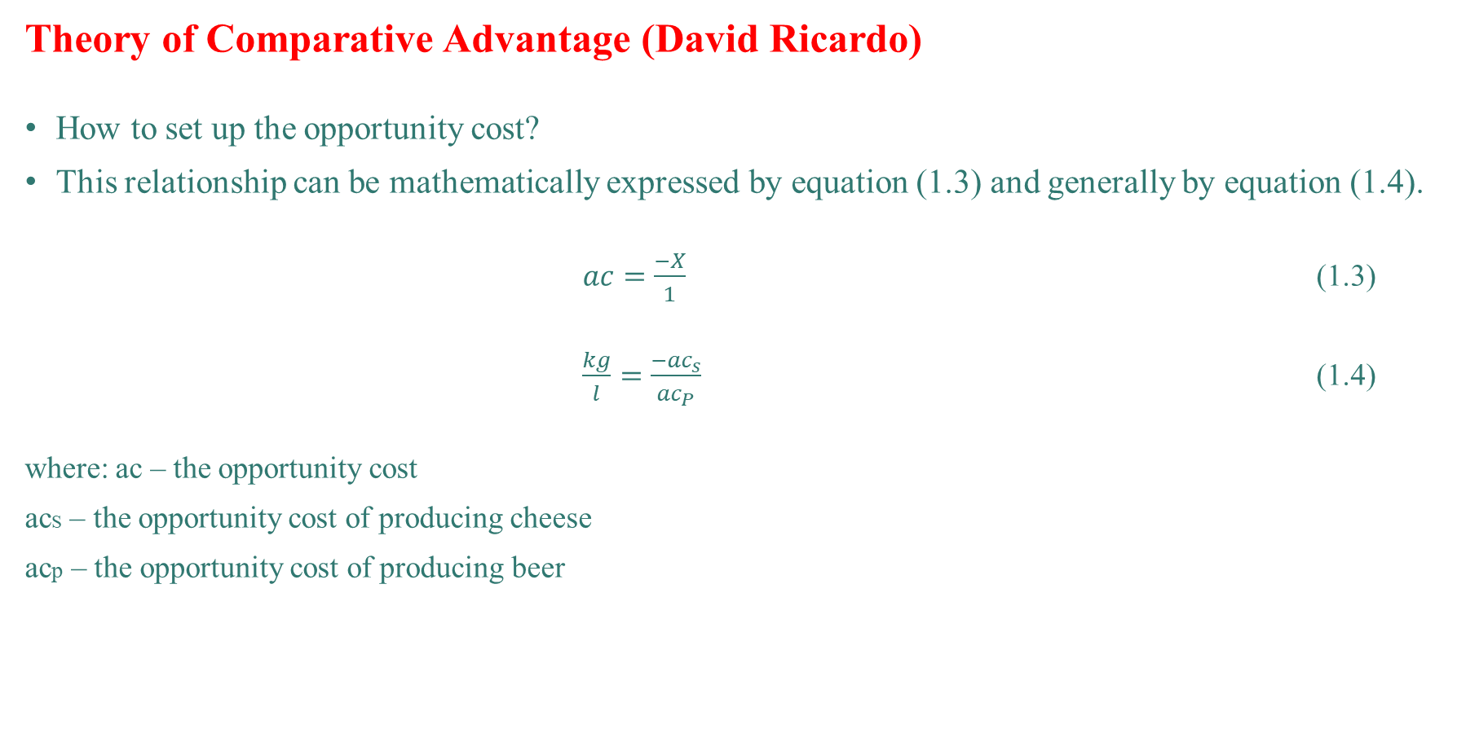
PURE THEORY OF INTERNATIONAL TRADE
Theory of Comparative Advantage (David Ricardo)
How to set up the opportunity cost?
This relationship can be mathematically expressed by equation (1.3) and generally by equation (1.4).
$ac=\frac{−X}{1}$ (1.3)
$\frac{kg}{l}=\frac{{−ac}_{s}}{{ac}_{P}}$ (1.4)
where: ac – the opportunity cost
acS – the opportunity cost of producing cheese
acp – the opportunity cost of producing beer

Slide 18
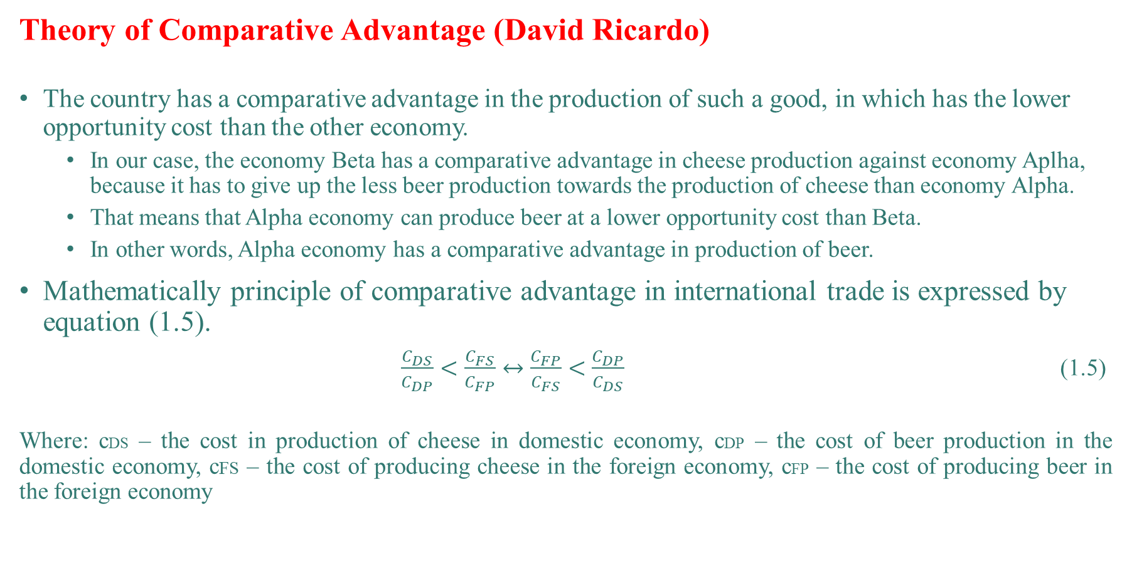
PURE THEORY OF INTERNATIONAL TRADE
Theory of Comparative Advantage (David Ricardo)
The country has a comparative advantage in the production of such a good, in which has the lower opportunity cost than the other economy.
  In our case, the economy Beta has a comparative advantage in cheese production against economy Aplha, because it has to give up the less beer production towards the production of cheese than economy Alpha.
  That means that Alpha economy can produce beer at a lower opportunity cost than Beta.
  In other words, Alpha economy has a comparative advantage in production of beer.
Mathematically principle of comparative advantage in international trade is expressed by equation (1.5).
$\frac{C_{DS}}{C_{DP}}<\frac{C_{FS}}{C_{FP}}↔\frac{C_{FP}}{C_{FS}}<\frac{C_{DP}}{C_{DS}}$ (1.5)
Where: cDS – the cost in production of cheese in domestic economy, cDP – the cost of beer production in the domestic economy, cFS – the cost of producing cheese in the foreign economy, cFP – the cost of producing beer in the foreign economy

Slide 19
PURE THEORY OF INTERNATIONAL TRADE
Theory of Comparative Advantage (David Ricardo)
The country has a comparative advantage in production of such a good in which it has the greatest absolute advantage (economy Alpha in beer production) or the smallest absolute disadvantage (economy Beta in production of cheese).
We could also say that if the more developed country having the largest absolute advantage in production of certain good will specialise in this good and the other one leave to the less developed trade partner, it can reached the larger world production of other commodity, even though its production is shifted to less favourable conditions.
In practice, this theory has shown as disadvantageous for developing countries in a long-term perspective, since it can bring only short-term effect.
Specialisation in manufacture and export of “comparative advantageous” goods does not allow developing of such industrial branches, which are necessary for the development of economy a thus deepen their economic backwardness.

Slide 20
PURE THEORY OF INTERNATIONAL TRADE
The Theory of Reciprocal Demand (John Stuard Mill)
The last representative of the English classical school was John Stuart Mill, whose father was a close friend and supporter of economic D. Ricardo.
While Ricardo settled for determining mutual benefits of international trade, Mill led his theory further and dealt with the issue of determining the exchange ratio between countries (i.e. setting the world price) and then how to share the benefits of international trade.
He created the theory of international value, or the theory of reciprocal demand.
Mill found out that international value of goods is moving within the boundaries of national labour costs and specific numeric value of goods is determined by the two countries‚ mutual demand for the offered goods.
He indirectly defined the international value of the goods, which is determined by the costs (supply) and by demand.
  This value is expressed in international exchange ratio and borders are the national exchange ratios. However, the question arises, where exactly in this interval will be the international exchange ratio.
  The answer is the law of reciprocal demand, which says that the international exchange ratio is fixed at a level at which the supply and demand for both products will be balanced.

Slide 21
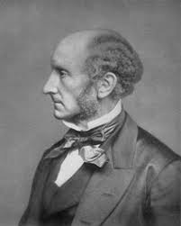
PURE THEORY OF INTERNATIONAL TRADE
The Theory of Reciprocal Demand (John Stuard Mill)
Based on the above findings, we can describe the overall benefits of international trade, which derives from Mill's theory of reciprocal demand:
  The economy gaining a larger share of international trade, if the international exchange ratio is approaching the national exchange ratio of its trade partner
  And if there are two countries trading with each other – one large (meaning economically) and the other small, the small one always appropriates a larger share of the benefits from international trade.
  In economical terminology: if the economy Alpha has a large demand for goods of economy Beta and Beta has a little demand for goods of economy Alpha, the international exchange ratio approaching the national ratio of economy Alpha.

Slide 22
THANK YOU FOR YOUR ATTENTION!

