Slide 1

Neo-Classical and Standard Theory of Trade
Lesson II
Ingrid Majerova
International Economics
NAMEE

Slide 2

Outline of the lecture
Neoclassical Theories of Trade – The Theory of Opportunity Costs
The Factor-Propotions Theory
The Theory of Factor Price Equalization
The Standard Theory of Trade

Slide 3

NEOCLASSICAL THEORIES OF INTERNATIONAL TRADE
Neoclassical economists, except that they focused on the demand side, differs from its predecessors mainly in the refusing of the theory of labour value as the essence of the price of goods.
The fundamental argument is a fact that goods are not produced only while using labour but also by other factors of production such as capital or land.
Hence the name multifactor model.

Slide 4
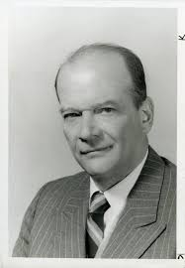
THE THEORY OF OPPORTUNITY COST
The price of good in the neoclassical approach is given by the opportunity cost.
The author of the theory of opportunity cost is Gottfried Haberler.
  introduced a graphical representation of this theory while using curves of the production possibility frontier (PPF)
In terms of international economics and our example of the opportunity cost of beer represent the amount of cheese that economy Alpha has to give up to produce additional liters of beer.

Slide 5
THE THEORY OF OPPORTUNITY COST
Now we are going to analyse these curves in different situations - at constant or increasing costs, particularly in individual economies and then while engaging in the international trade.
If we stay with our example and in the economy Alpha will produce six litres of beer with the same cost (P) and 8 kg of cheese (S), and in the economy Beta 2 litres of beer and 4 kg of cheese (see Figure 1).
Figure 1: PPF at the constant costs

Slide 6
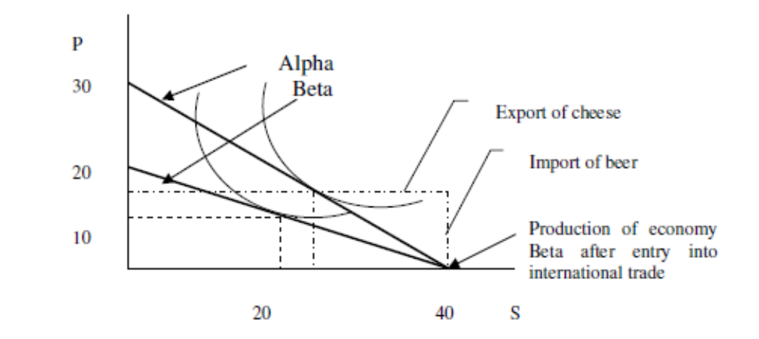
THE THEORY OF OPPORTUNITY COST
What happens when those two countries engaged in international trade?
  We construct a PPF in one graph on a larger scale with the involving of indifference curves. These indifference curves are in our case social indifferent curves expressing consumer preferences and demands of the population of the economy that are analogous to individual indifferent curves.
  In economy Alpha will be for 40 kg of cheese bartering 30 l of beer and in the economy Beta for 40 kg of cheese 20 l of beer. In case that Beta will be autarkic economy, its production and consumption possibilities would reach 20 kg of cheese and 10 l of beer (E).
In the case of participation in international trade and specialization, according to the theory of comparative advantage, its production and consumption possibilities grew to E' (due to the production of 40 kg of cheese), and thus the economy Beta would export larger quantities of cheese and import larger quantities of beer, which is shown in Figure 2.

Slide 7
THE THEORY OF OPPORTUNITY COST
The case of a closed economy is shown by the curve on Figure 3. E represents
equilibrium in an economy that is in a situation of maximum efficiency, since the slope of the
tangent of the international exchange ratio, the marginal rate of transformation of product
(PPF) and the marginal rate of substitution (IC) are equal.
Figure 3: PPF curve in case of increasing costs

Slide 8
THE THEORY OF OPPORTUNITY COST
If the economy enters into international trade, due to the situation which it occurs, the new equilibrium would be as follows:
If a country has entered into international trade, shifts the equilibrium to F (see Figure 4).
How big will be this shift depends primarily on the terms of trade, whose balance shows a dashed line. With this trade, the economy consumes such a quantity of goods corresponding to G.
Figure 4: PPF curve and participation of countries
in international trade
G
F

Slide 9
THE THEORY OF OPPORTUNITY COST
The above figure graphically shows the effects and implications of the participation of economies in international trade, which are:
  An increase of consumption possibilities of the given economy
  The reallocation of factors of production in the given economy
  New markets
  An expansion of production
  The increase the standard of living economies entering into international trade
  And last but not least, the dynamic changes such as increasing productivity, increasing economies of scale and market power.

Slide 10
THE FACTOR-PROPORTIONS THEORY
The most significant contribution to the definition of two-factor model of the theory of international trade was the factor-proportions theory created by economists Eli Heckscher and Bertil Ohlin.
Following assumptions:
  The existence of perfect competition, free trade and the same consumer preferences, the absence of transaction costs and factor mobility between economies
  The existence of two economies with two goods and two factors of production (labour and capital)
  Economies have different resource endowments of factors of production, in our case it means that economy Alpha has a relatively capital-intensive and Beta is labour intensive (K/LA>K/LB)
  Productions are differently intensive on factor-proportion and the use of factors of production, in our case, beer is more difficult to capital and cheese to work
  The both economies use the same production technologies, and thus factors of production can not be replaced (e.g. replace labour to capital or vice versa)
  The existence of decreasing returns to scale.

Slide 11
THE FACTOR-PROPORTIONS THEORY
Heckscher and Ohlin came out from the presumption that the price of factor of production depends on the relative supply, i.e. on the relative sufficiency and insufficiency. If enough is its price is low and vice versa.
This means that the country will specialize in the production and export of such a good that use relatively intensively its relatively plentiful factor of production and import will be focused on goods that use relatively intensively the factor of production that the given country has a less.
This is the essence of Heckscher-Ohlin theorem.
  In other words, the classical theory of international trade see the causes of trade in the existence of comparative advantages and costs, while the neoclassical theory extending comparative advantage of differences of countries in the endowments of factors of production.
Graphic form - see Figure 5.

Slide 12
THE FACTOR-PROPORTIONS THEORY
Figure 5: PPF Heckscher-Ohlin Theorem

Slide 13
THE FACTOR-PROPORTIONS THEORY
On the left side of the graph we can see autarchic economies and on the right side we can see economies involved in international trade. ICs are equal by assuming the same preferences.
These IC intersect PPF at A and A', what means that just as many will be produced and consumed in each country for the relative price given by the tangents of individual PPFs.
the economy Alpha will have a comparative advantage in the production of beer (production is a capital-intensive) and the economy Beta in the production of cheese (production is labour-intensive). If both economies enter into mutual trade, the situation is changing.
The economy Alpha producing at B due to exchange of beer for cheese reaches E as well as Beta, which produces at B' and by the exchange of cheese for a beer will gain a consumer equilibrium at E'.
Both economies therefore benefit from international trade, since they consume at a higher level of indifferent curve.

Slide 14
THE FACTOR-PROPORTIONS THEORY
Criticism
Traditional assumption of perfect competition, free trade and the absence of transaction costs.
the assumption of lack of mobility of factors of production (especially capital)
  unrealistic, because the economy where is the fewer of capital there is no problem to bring into the economy and focus on the capital-intensive production despite the fact that the country is better endowed with labour.
the impossibility of replacing the factors of production
  it is possible that a certain good can be produced in the country that is relatively better endowed with capital of in larger quantities, while in the country endowed with labour not, which means that the same product can be capital-intensive in the first country, while in the second country can be labour-intensive
dependence of the price of the factor of on relative supply
  if the supply of labour is high in the given economy, it does not automatically mean that this factor of production is cheap.

Slide 15
THE FACTOR-PROPORTIONS THEORY
Criticism
English economist Tadeusz Rybczynski,
his conclusions are summarized in the Rybczynski theorem
  in the economy may occur the situation where the above-mentioned rule does not apply and there will be a change, for example, due to an epidemy or, conversely, the population explosion or inflow of capital into the economy.
Increase in the economy's endowment of capital (where the labour endowment stay at the same level), it will be reflected in a shift of the PPF, but disproportionately from higher degree of capital-intensive (rotation curves)
  the production should increase in both of goods – in beer and in cheese as well
The opposite is true, while in beer production there is a large increase, in the production of cheese is on decline corresponding E' (see Figure 6).

Slide 16
THE FACTOR-PROPORTIONS THEORY
The conclusion of this theorem states that if there is a rise in the endowment of one factor, production of good that uses relatively intensively this factor of production increases, but at the same time the production of good that uses relatively intensively the factor of production, whose endowment stay the same, will decrease.
Figure 6: International trade and Rybczynski theorem

Slide 17
THE THEORY OF FACTOR PRICE EQUALIZATION
Stolper-Samuelson Theorem
The assumption of the change of price of factor of production and then the change of a (world) price of a good while involving of the economy in international trade.
If the economy is well endowed with capital, labour is scarce and therefore there is a low price of capital r and high price of labour w.
If the countries are involved in international trade, expand the production (and export) of beer, and since the beer is capital-intensive, the demand for capital will increase as well as profits. Conversely, cheeses (as labour-intensive products) will begin to import, the demand for labour decrease as well as nominal wages.
The involvement of the economy in international trade leads to an increase of the price of that factor of production on which its production is relatively intensive and reduces the price of the factor of production on which the production is less intensive.

Slide 18
THE THEORY OF FACTOR PRICE EQUALIZATION
Stolper-Samuelson Theorem
After opening the economy, the price and profitability of the good with a comparative advantage (production intensive on abundant factor of production, the cheap one) increase and the price of good intensive on a less abundant factor of production – scarce source – decreases.
This leads to a reduction (balancing) the differences in prices of factors of production between countries with different endowment of these factors.
The increase of the world price of the good leads to an increase of the price of that factor on which its production is relatively intensive and reduces the price of the factors on which the production is less intensive.
Other two conclusion derive from this theorem:
  Not all economic entities benefit from international trade. Taking into account our example, these entities that own capital will be in profit, while the owners of the labour will be worse off. Economically speaking, the entry of economy into the international economy implies a change in the structure of the national income distribution.
  After opening the economy, the price and profitability of a good with a comparative advantage (with production intensive on abundant factor – the cheap one) increases and the price of good intensive on less abundant-factor – the precious resource – decreases. This leads to a reduction of differences in prices of factors between countries with their different endowment.

Slide 19

THE STANDARD THEORY OF INTERNATIONAL TRADE
Economist Paul Krugman performed the generalization of all hitherto existing theories of international trade.
He did that in terms of the analysis of the supply and demand curves, which we refer to as the standard theory of international trade.
This theory analyses the model of two economies that produce two goods, and based on the following key relationships:
  there is a correlation between the PPF and relative supply curve (RS)
  there is a correlation between relative prices and relative demand (RD)
  a world equilibrium is determined by means of RS and RD,
  the impact of terms of trade (TT) on nation’s welfare.

Slide 20
THE STANDARD THEORY OF INTERNATIONAL TRADE
If we analyse the first relationship, with regard to our example, we can say that RS of beer increases if the relative price of beer (and its relative quantity) is increasing.
Production possibility frontier is the same as the term of terms of trade (TT) and tangents represent the relative prices of PP/PS, whose slope depends on the preferences of consumers.
Graphically speaking, if relative prices are rising (dashed tangent PPF), the volume of beer will increase from Q1 to Q2, while reducing supply and price of cheese (see Figure 7).
Figure 7 The relative supply and PPF curve
Q1
Q2

Slide 21
THE STANDARD THEORY OF INTERNATIONAL TRADE
If we analyse the second assumption, we can build on what we already know from the previous chapter. In Figure 8, the preferences of consumers are graphically expressed through indifference curves. Initially, the economy Alpha produces at Q1 and demand is at D1.
In case that the relative price of beer increases in this economy (e.g., because of the entry into the international trade), produced quantity is shifted to Q2 and the demand from D1 to D2.
The effect of an increase in the relative price is such that it increases the well being of the economy, but if there will be a decline, the economic welfare would also decline.
Figure 8 The effect of an increase in the relative price in relation to the relative demand

Slide 22
THE STANDARD THEORY OF INTERNATIONAL TRADE
To derive the third assumption and its analysis, the second economy Beta must enter “into the game„; this economy exports cheese, while the economy Alpha is dedicated to export of beer.
Figure 9 shows the situation before and after the entry of economies into international trade.
  On the left side of the chart is shown the derivation of the relative supply and demand curves of Alpha autarkic economy. PR and QR represent relative prices and relative quantities of beer.
  RS is increasing since the higher relative prices of beer leads to an increase in the production of beer in relation to cheese, RD is declining due to increasing relative demand in case of an increase of the relative price of beer.
Figure 9 Relative demand and supply curves

Slide 23
THE STANDARD THEORY OF INTERNATIONAL TRADE
RD remains the same due to identically consumer preferences, but only the supply differs. Why?
Economies have different technologies and different endowment of production factors.
  While the economy Alpha is well-endowed with capital and is "poor" with labour, the economy Beta is doing the opposite.
  Relative supply of Alpha is on the right side of the relative supply of Beta (her PR of beer is lower). When these two countries enter into international trade, brewing and cheese production is the sum of these productions in individual countries, and therefore the world's RS is between RS of individual countries (as well as the world PR).
This means that international trade increases the prices of beer in the economy Alpha and reduces in the economy Beta - it improves the terms of trade in the economy Alpha and worsens in the economy Beta.
This improvement or deterioration has an impact on the well-being of individual economies. Whereas the wellbeing in the economy Alpha is increased, the economy Beta records a decline.

Slide 24
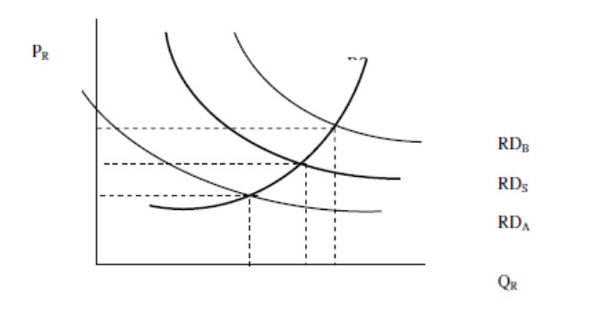
THE STANDARD THEORY OF INTERNATIONAL TRADE
When does the RD change?
In case of changes in consumer preferences in individual economies: Imagine that consumers in the economy Alpha begin to prefer greater consumption of cheese and consumers of economy Beta begin to prefer greater consumption of beer.
This is reflected in the relative demand shifts, as is shown in Figure 10.
While the relative supply remains the same, the national relative prices differ.
  Different preferences lead to different demand for goods of the other economy, which means that the given countries benefit from participation in international trade, since the prices of the exported goods are increasing (for the economy Alpha the terms of trade of beer and economy Beta has an improving terms of trade of cheese).
Figure 10 Shifts in the relative demand curves

Slide 25
THANK YOU FOR YOUR ATTENTION!

