Slide 1

Alternative and Integrative Theories of Trade
Lesson III
Ingrid Majerova
International Economics
NAMEE

Slide 2

Outline of the lecture
The Alternative Theories of International Trade
  The Theory of the Infant Industry
  The Theory of International Value
  The Theory of the Second Best
  The Dependency Theory
  The Theory of Immiserizing Growth
Integrative Theories
  Custums Union
  Optimum Currency Area

Slide 3
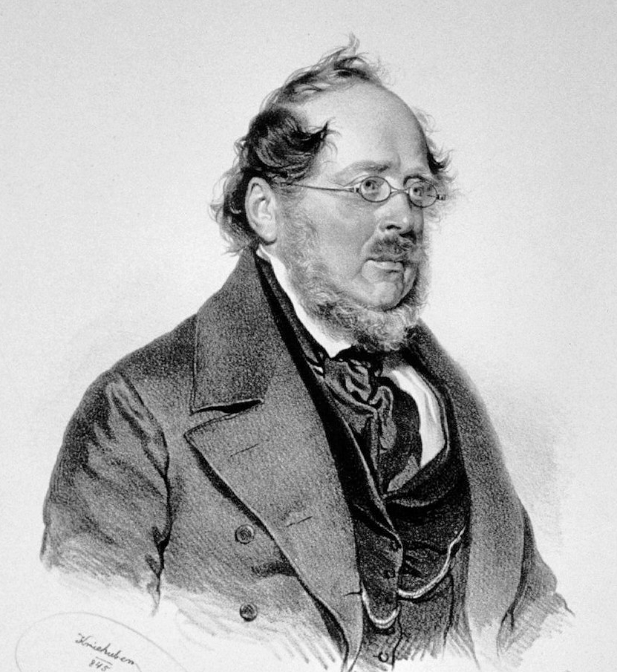
THE ALTERNATIVE THEORIES OF INTERNATIONAL TRADE
THE THEORY OF THE INFANT INDUSTRY
One of the oldest alternative theories
Friedrich List (founder of German historical school)
Idea that an economy whose production is in its initial (infant) stage, cannot operate on the basis of free trade with countries that are already mature, because of the absence of competitiveness of their products.
Despite the constant efforts to liberalize international trade, the protectionist arguments of the theory of the infant industry are still relevant, since with the new arrangement of postwar world economy and the emergence of a group of developing economies, raised the problem of whether they are able to be involved in liberalized trade.

Slide 4
THE ALTERNATIVE THEORIES OF INTERNATIONAL TRADE
THE THEORY OF THE INFANT INDUSTRY
This theory not assume that the protectionist measures could be limited.
On the other hand, domestic firms, protected by e.g. import tariffs, would be able to cover the increased costs of production and began to profit from higher prices of products and, over time, because of the experience and knowledge reduce costs of production and the degree of protectionism then could be continuously reduced.
Each country based on the comparative advantages should specialize in the production, which has a lower costs and other less productive and less effective production leave to the others.
  The problem is hidden in the resolution of static and dynamic comparative advantages.

Slide 5

THE ALTERNATIVE THEORIES OF INTERNATIONAL TRADE
THE THEORY OF THE INFANT INDUSTRY
While pure theory of international trade is based on static comparative advantages (the most efficient allocation at one point in time), the theory of infant industry is based on dynamic comparative advantages (the most efficient allocation in the long term).
The positive effect in the long term (dynamic model) eliminates the negative effects of short-term (static model), and therefore the application of the theory of infant industry for emerging industries is (in our case the beer production in the economy Beta) justified.

Slide 6
THE ALTERNATIVE THEORIES OF INTERNATIONAL TRADE
THE THEORY OF THE INFANT INDUSTRY
Criticism with arguments against the introduction of the theory of infant industry:
  A possible emergence of externalities, when in this case is this theory only the second-best choice and there is other, more efficient, method, and that is production subsidy, which does not cause the shift of supply curve, therefore no losses of consumer and surplus of producer – the cost of introduction of subsidies are thus smaller than in the theory of infant industry (which moreover causes the loss of consumer), which means that even though it is beneficial for the economy, it does not necessarily be the best.
  The problem of providing protectionist measures that may be counterproductive in the long term (bring more costs than profit from protectionism and bring even to inefficient firms profits)
  A removal of impulses to the development of firms themselves
  A lack of awareness in the implementation of protectionist measures – the government have to know the potential of each sector, as these sectors (and their support) will affect the others, etc.
  A complicated estimate of the correct settings of the above measures for the right sector and for the right time.

Slide 7
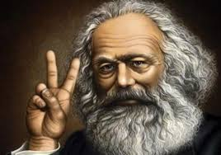
THE ALTERNATIVE THEORIES OF INTERNATIONAL TRADE
THE THEORY OF INTERNATIONAL VALUE
by Karl Marx and based on the lebour theory of value
to prove the erroneousness of the theory of reciprocal demand
Reciprocal demand cannot affect the international exchange ratios (relative price changes), but the change of demand in one economy for the products of second economy (price increase) will cause a change in supply of demanded product (and return to the original value of production)
International exchange ratios are not determined by relative prices, but by the value of the international exchange
The international value was determined on the basis of the international division of labour by social relation between producers of different countries, which was shown by exchanging their products.

Slide 8
THE ALTERNATIVE THEORIES OF INTERNATIONAL TRADE
THE THEORY OF INTERNATIONAL VALUE
The size of this international value was determined by the socially necessary labour or labour expended by the largest suppliers of products on international market.
  International trade is not a mere exchange of use value of goods for goods, but also by the exchange of national labour, which is included in this goods.
There is a fundamental contradiction in this theory:
If the products are exchanged in international trade, it means as mentioned above that there is exchanged the same amount of socially necessary labour, but since in individual economies, there are different initial conditions and thus different costs of production, the amount of national work is differ.

Slide 9
THE ALTERNATIVE THEORIES OF INTERNATIONAL TRADE
THE THEORY OF INTERNATIONAL VALUE
Firms in less developed countries produce their products at higher national costs (on labour) and if they are not the largest suppliers, then they trade on international markets at lower price than their national ones and vice versa (the developer economies have lower costs and sell at higher value than is their national one).
Thus, international trade expresses the economic inequality and its removal at the international level is not possible in most cases due to limiting factors such as less skilled labour force or less access to modern technologies.
Marx recommend international trade, since on the base of comparative advantages the less developed economy obtains more use value than if would produce the product by itself.
  The imported product would expend more national labour then before.

Slide 10
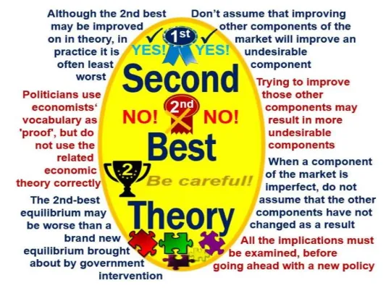
THE ALTERNATIVE THEORIES OF INTERNATIONAL TRADE
THE THEORY OF THE SECOND BEST
Richard G. Lipsey and Kelvin J. Lancaster
It is focused on exploring what happens in the economic model, if the optimum conditions are not meet.
A perfectly competitive market includes:
  Prices of firms’ output are equal to marginal cost
  The ratio of the prices of two products are equal to the ratio of substitution
  of these two products
  In the long run, the economic profit of firms is equal to zero
  The supply of products are equal to demand for them.

Slide 11
THE ALTERNATIVE THEORIES OF INTERNATIONAL TRADE
THE THEORY OF THE SECOND BEST
But what happens if one of the above-mentioned conditions is not met for any reason?
What happens if the market does not reach equilibrium and demand will not match the supply?
Will firms set prices based on marginal rates and consumers their optimum comparing prices and marginal rates of substitution or will market operate on different principles?
If one of the conditions of equilibrium will not be met, it will change the other conditions (i.e. firms will not set their prices based on marginal costs and consumers will set their optimum based on above mentioned ratio).

Slide 12
THE ALTERNATIVE THEORIES OF INTERNATIONAL TRADE
THE THEORY OF THE SECOND BEST
How we can apply this theory to international trade?
If an open economy is in equilibrium, it follows from the fact that the optimal government policy is a free trade policy and each protectionist intervention reduces economic efficiency and national wealth.
  In this case, we can name the free trade policy as the first best choice and such a situation when economic efficiency cannot increase, we call economic nirvana.
  However, the real economy does not reach this situation, there are plenty of distortions and imperfections (externalities, government intervention, firms are price makers, imperfect information, etc.).
  If there are these imperfections, it reduces economic efficiency and national wealth. We can call the optimum achieved in such a situation as the second-best optimum.
  The trade policy through action (protectionist measures) will lead the economy to the second best optimum, and this optimum, which is at a lower level than the best optimum, is called the second best option.

Slide 13
THE ALTERNATIVE THEORIES OF INTERNATIONAL TRADE
THE DEPENDENCY THEORY
Raúl Prebisch and Hans W. Singer
Conclusions known as the Singer-Prebisch thesis (also known as Prebisch-Singer thesis or Prebisch-Singer hypothesis)
Economic activity in the developed countries, which they called "centres" (they were OECD member countries) often caused economic problems of poorer countries, called "periphery" (they considered for them countries of Latin America, Africa and Asia, and countries with a low GNP per residents and single-commodity export specialization)
Based on the fact that "primary production is located in the periphery and the other degrees of sophistication and spending in centres" and they exchange this production between each other.
All incomes from international trade flowed into the centre, since they processed industrial products from primary commodities and sold them back to peripherals, which creates value added.
  An obstacle to the development of peripheral economies, which was recommended to remove by focusing on industrialization through the form of import substitution

Slide 14
THE ALTERNATIVE THEORIES OF INTERNATIONAL TRADE
THE DEPENDENCY THEORY
The conclusion: over the time, the terms of trade worsen between primary products and manufactured goods, which mean that peripherals are able to import still smaller quantities of industrial products at the same – unchanging volume of foreign trade.
  One of the reasons for this deterioration - the income elasticity of demand for industrial goods is greater than the income elasticity of demand for primary products
  As income grows, so the demand for industrial goods is growing faster than the demand for primary commodities
  Over time, the technology is also improving, which means that wages are increasing and profits of firms and centre are able to accumulate savings, but in the peripheral economies, where is not so noticeable technological progress is not achieved high profits and wages and savings are "dissolved" in lower prices

Slide 15
THE ALTERNATIVE THEORIES OF INTERNATIONAL TRADE
THE DEPENDENCY THEORY
Several contentious issues:
The distinction of the concept of backwardness and underdevelopment – while the backwardness reflects the use of available resources in a peripheral economy, but in favour of centres, underdevelopment means unused resources
Peripheral economies in terms of historical context are not poor because they lagged behind the scientific or enlightened development of centres, but because of they were relegated by these centres to the role of supplier of cheap agricultural products, raw materials and cheap labour force and thus were deprived of the opportunity to trade their resources to compete with centres.
The definition of term national interest, which is identified with meeting the needs of the poor people from peripheries and is neglect of meeting the needs of companies or government needs.
A misuse of resources over time, which is maintained not only through the power of dominant states (centre), but also through the power of elites in the dependent states (peripheries), whose interests are the same, since these elites were educated in the centres.

Slide 16

THE ALTERNATIVE THEORIES OF INTERNATIONAL TRADE
THE THEORY OF IMMISERIZING GROWTH
Jagdish Bhagwati
Economic growth might lead to a decline in economic welfare. Although he did not define that these economies may be developing countries, this theory was accepted by many advocates of protectionism, especially in less developed economies, "in whose exports dominate simple primary products"
Based on the analysis of the impact of deteriorating terms of trade.
However, the possibility that immiserizing growth occurs is conditioned by the inelastic demand of the rest of the world (in our model, i.e. the second economy) and growth reducing the domestic production of the exported goods.
Other conditions of immiserizing growth include low ratio of export to domestic production (GDP) and low elasticity of demand for exported goods, due to their changing prices.

Slide 17
THE ALTERNATIVE THEORIES OF INTERNATIONAL TRADE
OVERLAPPING DEMAND THEORY
H. M. S. Burenstam Linder
Hypothesis later called Linder hypothesis
  based on demand unlike the theory factor proportion theory that are focused on the supply side
  economies with the similar demand will develop a similar industry
  economies will trade with each other with a similar, but differentiated product
The main determinant of trade flows between the two economies is the structure of preferences and the effect of the domestic market in the selection of exported products.
  the economy should export those goods for which they have a large domestic market
With increasing distance, the trade between economies is increasing, while it cannot be understood only as the geographic remoteness, but rather as the economic distance
  plus institutions and language understanding

Slide 18
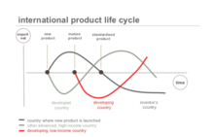
THE ALTERNATIVE THEORIES OF INTERNATIONAL TRADE
THE TECHNOLOGICAL GAP THEORY
M. V. Posner
Assumes that trade can be caused by technological changes and development that affect certain sectors and not the others
Based on these changes, which are actually innovations, arise comparative advantages accompanied by increased exports of these goods (and increased income).
Over time this advantage is losing, since the rest of the world begins to imitate innovation.
In this situation, the original innovator economy try to "come into the market" with another innovation that should lead and then repeats the above-described mechanism.
If follows that innovations cause the constant time-limited technological gaps of innovator and imitators

Slide 19
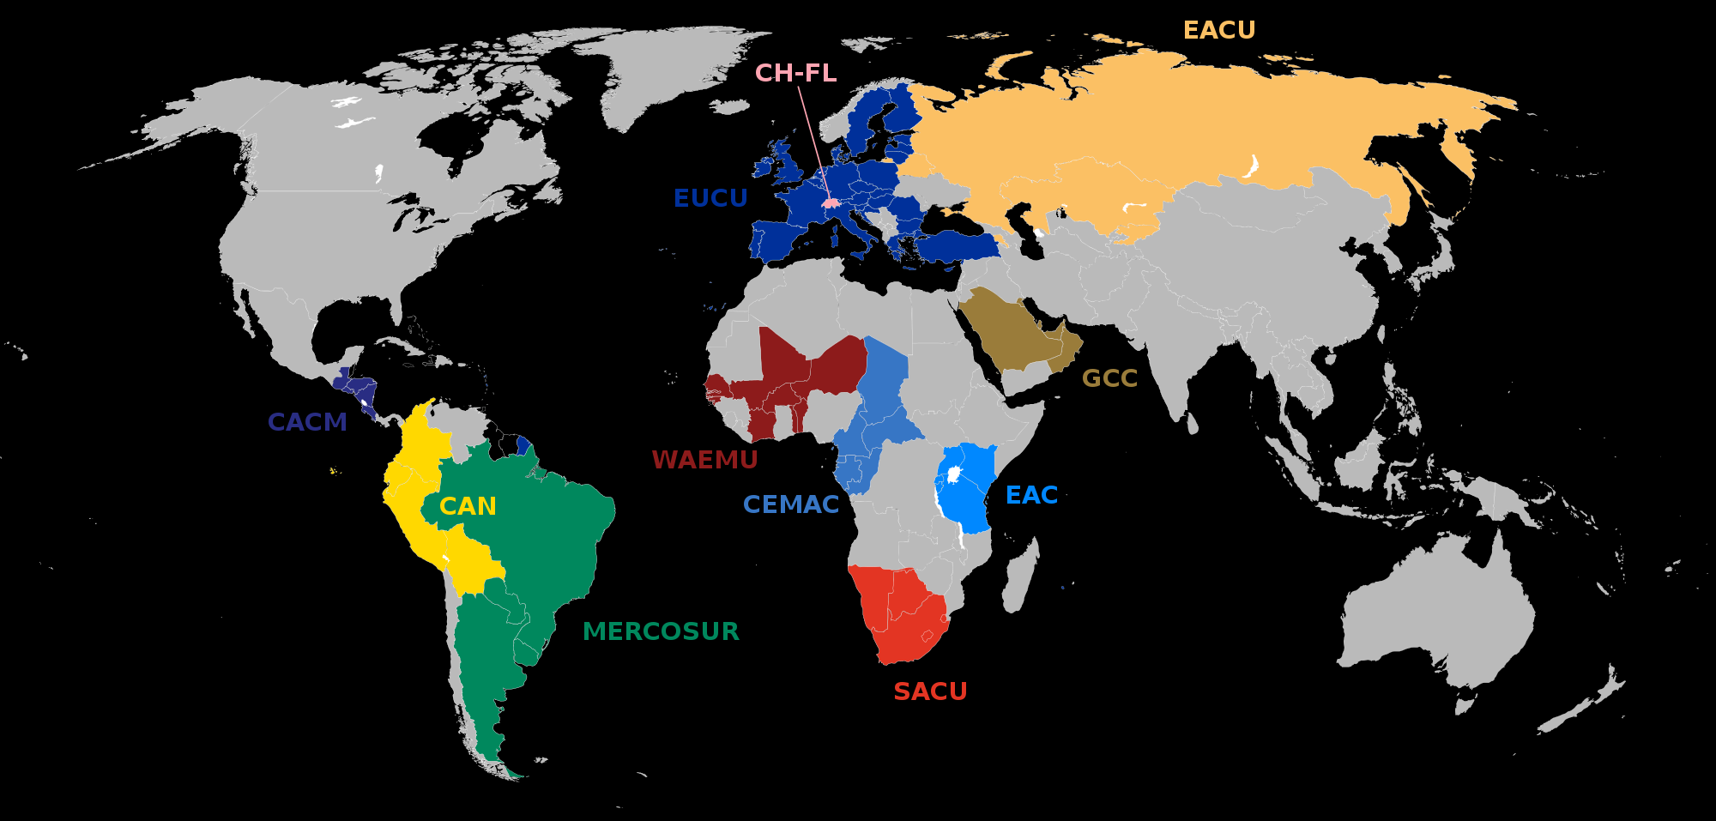
INTEGRATIVE THEORIES OF INTERNATIONAL TRADE
THE THEORY OF CUSTOMS UNION
Jacob Viner
The static and dynamic effects of the lower forms of integration along with its effects on international trade, which he called the creation, transfer and deflection of trade
Trade creation is the process by which the result of the establishment of the custom union the international trade increases.
The reason for such a growth is:
  A consumption effect, which is reflected in a decline in domestic prices of the imported product, when consumers increase purchases of goods
  A production effect, which does not have such a positive effect on domestic economy, because the elimination of tariffs can cause that foreign production crowd out the domestic production.

Slide 20
INTEGRATIVE THEORIES OF INTERNATIONAL TRADE
THE THEORY OF CUSTOMS UNION
Transfer of trade will occur when imports from third countries are substitute of import of another member state of the union on the basis of the abolition of tariff barriers.
To the reduction of the trade occurs when they are imposed higher duties on imports from nonmember countries than were before the creation of the customs union, which leads to a reduction in imported products.
Our analysis will be further developed in two directions – we will try to summarize the short-term reactions (static effects) and long-term reactions (dynamic effects) on the establishment of a customs union.

Slide 21
INTEGRATIVE THEORIES OF INTERNATIONAL TRADE
THE THEORY OF CUSTOMS UNION
Introduction of the customs union has a static positive effect in the short term.
The long-term dynamic perspective - an optimal impact of the customs union because of the economies reach the maximum volume of consumption with minimal cost (increasing economies of scale).
It can also occur the situation, which we call sub-optimal impact.
  when firms in the economy Beta will not adjust to the new conditions and products from economy Alpha flow (through lower prices) into the economy Beta.
  This causes a further decline in demand for goods from economy Beta, which are ultimately crowded out and the consumed amount will reduce.
To avoid that those not very optimal conditions are not met, the state interventions through appropriate economic policy are necessary.

Slide 22

INTEGRATIVE THEORIES OF INTERNATIONAL TRADE
THE THEORY OF CUSTOMS UNION
There are obstacles that prevent the unlimited mobility – these include physical, fiscal and technical barriers:
  Physical barriers in the form of physical checks at national borders (for example EC quotas on Japanese products, which were broken down between the Member States, the license check against international transport or subsidies under the common agricultural policy, when he had to control the movement of agricultural commodities).
  Fiscal barriers through various indirect and direct taxes (value added tax, consumption tax).
  Technological barriers in the form of non-uniform technical, sanitary and environmental standards that are the most difficult to remove from these three types of barriers and there are the subject of lawsuits.

Slide 23

INTEGRATIVE THEORIES OF INTERNATIONAL TRADE
THE THEORY OF OPTIMUM CURRENCY AREA
Robert Mundell
OCA - the geographical area with internal mobility and external factor immobility, where should maximize its economic efficiency based on the single currency.
Describes the optimum conditions for the unification of currencies, or to create a new currency, and often is used for affirmative or disapproving justification, whether one or other economy is ready to enter into the higher forms of integration.
Meeting these conditions guarantees a good balance between the costs and benefits of monetary union, and if these conditions are not met, they lead to the opposite situation.

Slide 24
INTEGRATIVE THEORIES OF INTERNATIONAL TRADE
THE THEORY OF OPTIMUM CURRENCY AREA
These conditions include:
  The sufficient level of labour mobility between different parts of the monetary union
  The lowest possible degree of wage and price fixation within the individual economies
  Similar endowments of natural resources
  The synchronization of the business cycle
  The high degree of diversification of foreign trade and homogeneous structure of production
  A symmetry of positive and negative external shocks
  The existence of an adequate mechanism of fiscal compensation.
The exchange rate of the national economy is considered as an important tool for economic policy to adapt to an asymmetric shock
  A situation, which affects only a particular national economy and causes in various economies differentiated impacts, especially on economic growth and employment

Slide 25
INTEGRATIVE THEORIES OF INTERNATIONAL TRADE
THE THEORY OF OPTIMUM CURRENCY AREA
M. Friedman has already formulated the assumption, based on the fact that if there is an external factor immobility, prices and wages are fixed and if there are supply or demand shocks (asymmetric shocks) is better when the economy has a floating exchange rate.
  Thanks to this exchange regime, the economy can adjust these shocks.
  If economy fixe an exchange rate, it results in negative changes in the price level and unemployment.
Benefits of monetary efficiency belong to the positive effects and there are expressed:
  Elimination of transaction costs in the form of e.g. the abolition of bank charges for foreign transactions (it is estimated that banks in the EU have lost half their income)
  For small open economies, reducing the impact of changes of exchange rate on the price level and real growth.

Slide 26
INTEGRATIVE THEORIES OF INTERNATIONAL TRADE
THE THEORY OF OPTIMUM CURRENCY AREA
The benefits of OCA in international trade include a reduction in the uncertainty of financial investment by increasing the stability of the exchange rate and reduction of the risk of currency crises and especially by the expansion of foreign trade and increase of mobility of capital between member states of monetary union (due to lower transaction costs and risks).
It also has its negatives or cost. This negative can be the loss of economic stability that arises from the inability to use exchange rates and monetary policy to stabilize output and employment.
There are also some unclear impacts and these can be the impact of the fiscal policy of nation-states, since the centralization of the policy can eliminate the asymmetric shocks and on the other hand, leads to higher costs of it, and further it is a loss of so-called seigniorage (revenue that government obtained by financing the budget deficit by changing the monetary base) and its distribution among the participating economies.

Slide 27
THANK YOU FOR YOUR ATTENTION!

