Slide 1

Modern Theories of Trade
Lesson IV
Ingrid Majerova
International Economics
NAMEE

Slide 2

Outline of the Lecture
Modern Theories of International Trade
  Models of Economies of Scale
  Model of Internal Economies
  Model of External Economies
Movement of Production Factor
  International Labour Movement
  International Capital Movement
  Role of Multinational Companies

Slide 3

MODERN THEORIES OF INTERNATIONAL TRADE
The substantial part of international trade is among advanced economies that have similar technologies, similar factors endowment and just a little different preferences
According above-mentioned models (classical single factor model or neoclassical Heckscher-Ohlin one) these economies would not have many reasons to trade with each other.
Mutual trade is made on the basis of other then perfect competition´s conditions.

Slide 4
MODERN THEORIES OF INTERNATIONAL TRADE
MODELS OF ECONOMIES OF SCALE
The different conditions include economies of scale or otherwise increasing returns to scale
Economies of scale mean that with a lower cost can be achieved a higher production output
  If production shows such a characteristic, then specialization and mutual trade can lead to an improvement in global production and to increase the welfare of all participating economies
To analyse the effect of international trade between the two economies Alpha and Beta, we used the PPF curve and a map of indifference curves.
  PPF curve has a convex shape, since there are increasing returns to scale and economies trading with each other in two different commodities – beer and cheese, when this type of trade is called an interdisciplinary trade.

Slide 5
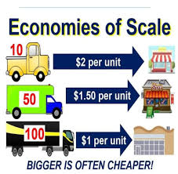
MODERN THEORIES OF INTERNATIONAL TRADE
MODELS OF ECONOMIES OF SCALE
However, generally the trade of interdisciplinary product (in this case, beer and cheese) does not match the current international trade, on which the theory of comparative advantage can be applied.
In recent decades dominate the trade with diversified products, so-called intra-industry trade, which cannot be explained by using classical and neoclassical apparatus.
Many countries export and import similar products. For example, the Czech Republic imports and export almost in identical ratio of transport equipment, manufactured goods and raw materials.

Slide 6
MODERN THEORIES OF INTERNATIONAL TRADE
MODELS OF ECONOMIES OF SCALE – The Case of the Czech Republic
IMPORTS | EXPORTS
industrial machinery - machines, engines, pumps (17.6%) | industrial machinery (19.35%)
electrical machinery (16.4%) | motor vehicles and vehicle parts (19.02%)
vehicles - motor vehicles and parts (9.21%) | electrical machinery (16.73%)
oil and mineral fuels (8.05%) | iron and steel products (4.06%)
plastics (5.61%) | plastics (3.67%)
iron and steel (3.79%) | oil and mineral fuels (2.65%)
pharmaceuticals (2.95%) iron and steel products (2.9%) | furniture (2.50%) iron and steel (2.39%)

Slide 7
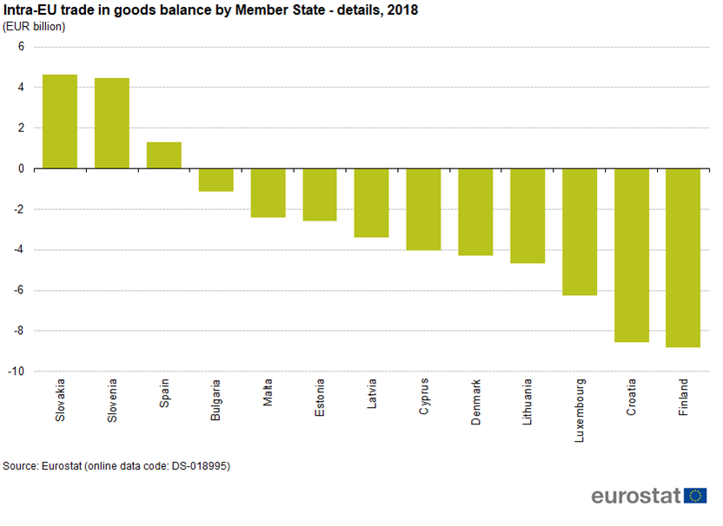
MODERN THEORIES OF INTERNATIONAL TRADE
MODELS OF ECONOMIES OF SCALE
A country that uses intra-industry trade, benefits from a larger market by reducing the number of manufactured goods in favour of their diversity, and that is based on demand and also on efforts to satisfy domestic consumers.
From a mathematical point of view, the degree of intra-union trade shows Grubel-Lloyd index (Grubel and Lloyd, 1975) - equation (4.1) or (4.2).

Slide 8
MODERN THEORIES OF INTERNATIONAL TRADE
MODELS OF ECONOMIES OF SCALE
The pure and standard theories of international trade analyse interdisciplinary trade (on the basis of comparative advantages) in perfect competition where there are no economies of scale and firms are price takers.
However, in the real world, this assumption is almost impossible to meet, because firms that are mainly engaged in international trade, profit from increasing economies and they are price makers.
  It is clear that they operate in conditions of imperfect competition.
  On the basis of this type of competition was created a model of internal economies.
In addition to this model, we will further analyse the model of external economies and model of dumping.

Slide 9
MODERN THEORIES OF INTERNATIONAL TRADE
MODEL OF INTERNAL ECONOMIES – THE MODEL OF MONOPOLISTIC COMPETITION
Monopolistic competition - based on the following assumptions:
  Existence of many companies in the industry (corresponding the assumption of perfect competition)
  Each firm produces a differentiated product (i.e. the product of a different nature)
  Differentiated products are imperfect substitutes in consumption, which means that if a price increase, consumers will move to the consumption of another product – a function of demand has a declining shape, but its slope will depend on the type and price of the substituted product (corresponding the assumption of monopoly)
  The possibility of free entry and exit of firms to and from the sector – economic profit attracts new firms to the industry and a large number of firms will lead in the long term to zero economic profit (corresponding to the assumption of perfect competition)
  The existence of internal economies of scale, which are expressed by decreasing average cost curve (assumption correspond to monopoly).

Slide 10
MODERN THEORIES OF INTERNATIONAL TRADE
MODEL OF INTERNAL ECONOMIES – THE MODEL OF MONOPOLISTIC COMPETITION
It can be explained by intra-industry trade, even though in individual economies are no differences in resources or in technologies
We explain this on the graphical model. We stay in our example – in the economy Alpha there is a plenty of firms producing an excellent beer (differentiated products). Firms are price makers (the effort to maximize profits MR=MC) and there are economies of scale (internal economies), see Figure 4-1.
The profit that is created by production is not large (the field shown by the little arrow), and given the deadweight loss it could increase (by increasing production), which is not possible because of low demand. The only way to do that is to expand into foreign markets.

Slide 11
MODERN THEORIES OF INTERNATIONAL TRADE
MODEL OF INTERNAL ECONOMIES – THE MODEL OF MONOPOLISTIC COMPETITION

Slide 12
MODERN THEORIES OF INTERNATIONAL TRADE
MODEL OF INTERNAL ECONOMIES – THE MODEL OF MONOPOLISTIC COMPETITION
Due to political negotiations with the economy Beta, the restrictive measures were successfully cancelled.
Since the beer production in the economy Beta is not able to compete with the production of beer in economy Alpha, demand for beer of economy Alpha shifts to a higher position, what results in a shift in the marginal revenue (MR) and increase in profit (the field with the larger arrows).
The volume of beer production in the economy Alpha can theoretically go up to level 730, but only under the assumption of perfect competition, in this situation, it is preferable to produce at 400 and "collect" the highest possible profit.

Slide 13
MODERN THEORIES OF INTERNATIONAL TRADE
MODEL OF INTERNAL ECONOMIES – THE MODEL OF MONOPOLISTIC COMPETITION
On the one hand, the expansion of trade brings an increase in living standards and on the other hand, it raises enormous pressure on the competitiveness of individual producers.
Fight for consumers will result in the need to constantly offer new and better products, what leads to their differentiation.
That means limiting the substitutability resulting in gaining more market power and manipulation with consumer preferences.
Success can be provided in many sectors only by access to international markets.

Slide 14
MODERN THEORIES OF INTERNATIONAL TRADE
MODEL OF INTERNAL ECONOMIES – THE MODEL OF MONOPOLISTIC COMPETITION
The´expansion of trade should also lead to an increase in their standard of living.
This growth is based on three main determinants:
  An increase of diversity of demanded products, which is caused by product differentiation within a certain group
  A reduction of the price of each differentiated product through a shift in AC curve and increase in supply of products to other markets and reduction of their prices due to the transfer of free resources from existing production.On the one hand, the expansion of trade brings an increase in living standards and on the other hand, it raises enormous pressure on the competitiveness of individual producers.

Slide 15
MODERN THEORIES OF INTERNATIONAL TRADE
MODEL OF INTERNAL ECONOMIES – THE MODEL OF MONOPOLISTIC COMPETITION
Two negative impacts of international trade – those are the potential costs of adapting production and the risk associated with the increasing diversity of products and that the increasing transaction costs:
  The growth of output is accompanied by growth in productivity of factors of production – that each firm would be forced to reduce the use of factors of production and in the long term it could lead to the firm closure.
  This closure is associated with the alternative cost of closed production, with the costs associated with the growth of unemployment, the costs associated with searching for a new job, further with moving costs, etc.
  assuming the preference of the extension of product diversity preferred by consumers, we must take into account the associated costs – the demand for beer - consumers have to find information about the content of hops, alcohol, etc.

Slide 16
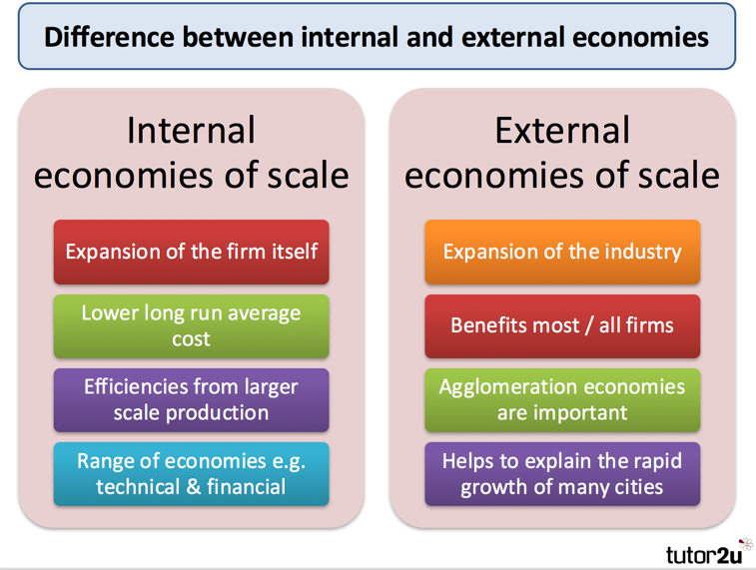
MODERN THEORIES OF INTERNATIONAL TRADE
MODEL OF EXTERNAL ECONOMIES
External (industrial) economies are such economies, which we analyse on the level of sector, not on the level of individual firms.
They mainly occur due to the geographical concentration of production of one sector that is on the local market either because of the provision of specialized services supporting this production or because of the larger flexibility of specialized workforce (a typical example is the Silicon Valley).
What is a difference between those two models – model of internal economies and model of external economies?
Are not their impacts on involved economies the same?

Slide 17
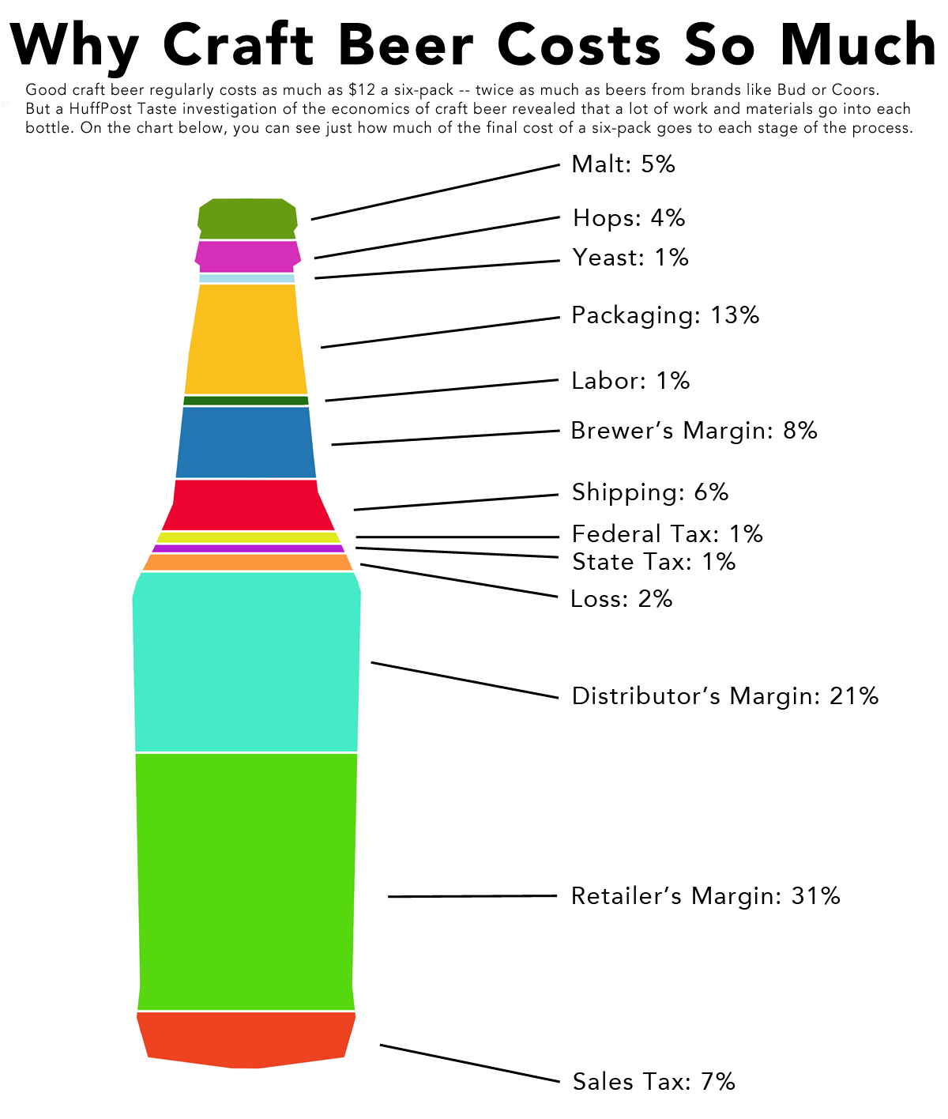
MODERN THEORIES OF INTERNATIONAL TRADE
MODEL OF EXTERNAL ECONOMIES
Consider our classic example – the economy Alpha and economy Beta - Alpha specializes in beer production and Beta in production of cheese, since they are traditional producers of these goods and they have some comparative advantages.
What happens, if the economy Beta also wants to export beer, for example, because the price of inputs is lower and therefore Beta is able to produce at lower average costs?
Could we conclude that the global price of beer of the economy Beta will be lower and so the demand for the beer will be bigger?

Slide 18
MODERN THEORIES OF INTERNATIONAL TRADE
MODEL OF EXTERNAL ECONOMIES
The conclusion:
Countries that started out as large producers of goods in certain sectors, probably still remain their major producers, even if some other country can potentially produce the same goods more cheaply.
External economies of scale play an important role in international trade, but their effect is different from those internal ones:
  External economies does not have to lead (in the existence of many small firms in the industry) to imperfect competition.
  International trade in their existence does not bring benefits to all participating countries.

Slide 19

THE INTERNATIONAL FACTOR MOVEMENTS
The real economic processes in the areas of specialization, concentration, spatial distribution of production capacities and flows of goods and services between each other cannot be interpreted without the exploring of flows of capital and labour.
The international movement of production results (goods and services) is not the only form of international trade. The another form is an international factor movements, which is further divided into:
  international labour movement
  and international capital movement

Slide 20

THE INTERNATIONAL FACTOR MOVEMENTS
Although the international movement of labour is less mobile and less frequent than the international movement of capital.
The analysis of both are based on the following assumptions:
  The world economy consists of two countries Alpha and Beta
  The both economies use factors of production – labour (L) and capital (K), which are free to "spill over" from one economy to another
  The economy Alpha is technologically advanced, that there is a better valuation of the work (higher wage rate w) and capital (higher profits r)
  The marginal products of labour and capital in both economies have decreasing trend.

Slide 21
THE INTERNATIONAL FACTOR MOVEMENTS
INTERNATIONAL LABOUR MOVEMENT
Except that the labour force (L) is generally considered as the less mobile factor than the capital, another difference is that the only one who “moves” makes the movement of labour unlike capital.
We analyse a model that is a static model and therefore, it does not reflectpopulation changes or technological advances and differences in labour productivity (having a relationship with the price of the work).
This international labour movement has both economic and non-economic motives.
  The economic motives were the finding new experiences and possibility of livelihood and currently it is the prospect of higher wages and pensions.
  Among the non-economic motives are political, racial, national and religious repression or military and political situation in emigration economy.

Slide 22
THE INTERNATIONAL FACTOR MOVEMENTS
INTERNATIONAL LABOUR MOVEMENT
The economic aspects of the movement of labour force – economy Alpha and Beta (Figure 4-2).

Slide 23

THE INTERNATIONAL FACTOR MOVEMENTS
INTERNATIONAL LABOUR MOVEMENT
As a result of the international labour movement there is the equalization of wage level in both economies, when the total production of the economy Beta decrease from 0ADL1 at 0AEL2 and the economy Alpha increase from 0BCL1 at 0BEL2.
This will lead to a net increase in world output, which is shown by the area ECD.
Except that it causes the damage of some group of population in the emigration economy (owners of capital and land are disadvantaged by the smaller supply of labour) and in immigration economy to the pressure on real wages.

Slide 24

THE INTERNATIONAL FACTOR MOVEMENTS
INTERNATIONAL LABOUR MOVEMENT - Impact
Decisions of economic entities regarding the migration of the labour are based on the same stimulus as every other investment decisions and bring both relative costs and benefits – in other words both positive and negative economic and non-economic impact.
The positive effects of international labour mobility are:
  An increasing of economic efficiency in global scale
  A reduction of the level of unemployment in less developed countries
  An increasing of incomes of immigrants
  A higher possibility of education and job opportunity
  An increasing of income from trade in the recipient country
  And inflow of highly qualified labour force (brain-gain).

Slide 25

THE INTERNATIONAL FACTOR MOVEMENTS
INTERNATIONAL LABOUR MOVEMENT - Impact
The negative effects (costs) of international labour movement are:
  „Immigration" costs in the host country (administrative costs)
  The issue of adaptation in a new country (separation, culture, language, racial and criminal problems)
  Costs associated with the relocation and temporary loss of employment
  The increasing of the level of unemployment in the recipient country
  A loss of labour productivity in the emigration policy due to loss of workforce
  A brain drain from less developed economies (brain-drain)

Slide 26
THE INTERNATIONAL FACTOR MOVEMENTS
INTERNATIONAL CAPITAL MOVEMENT
Capital is both the financial instruments (securities, loans, business loans) and non-financial assets (stocks of grain, machinery and equipment) and last but not least, there are intangible assets (patents, copyrights).
The international movement of capital does not involve the physical movement of machinery and equipment, but "only" their movements through the financial flows (purchases and sales of securities and loans).
Several perspectives:
  The viewpoint of stakeholders (capital transactions of central banks, governments, commercial banks and other entities).
  The aspect of ownership (private capital, public capital or capital of international institutions), in terms of time (short, medium and long-term capital) and the viewpoint of its function.

Slide 27
THE INTERNATIONAL FACTOR MOVEMENTS
INTERNATIONAL CAPITAL MOVEMENT
Division of capital:
  Foreign direct investment (FDI) - transactions between direct investors and companies in which investments flows to acquire a significant share of the management company, where the major holders are mainly multinational companies (this includes a stock capital, reinvested incomes and other capital) and they are the most important item of capital flows to all regions of the world (see Table 4-2)
  Portfolio investments - transactions in shares and bonds, etc.
  Other investments - business loans (the largest part), loans, deposits, loans from the International Monetary Fund, etc.
  Reserves or foreign assets of the central bank (monetary gold, special drawing rights, assets in foreign currency)
  Capital transfers - transactions without countervalue and a specific type of international capital movements (forgiveness of debt, investment grants, capital transfers related to migration, forgiveness of private debts, transfers of copyrights and patents, etc.).

Slide 28
THE INTERNATIONAL FACTOR MOVEMENTS
INTERNATIONAL CAPITAL MOVEMENT
Division of capital:
  Foreign direct investment (FDI) - transactions between direct investors and companies in which investments flows to acquire a significant share of the management company, where the major holders are mainly multinational companies (this includes a stock capital, reinvested incomes and other capital) and they are the most important item of capital flows to all regions of the world.
  Portfolio investments, which are transactions in shares and bonds, etc.
  Other investments - business loans (the largest part), loans, deposits, loans from the International Monetary Fund, etc.
  Reserves or foreign assets of the central bank (monetary gold, special drawing rights, assets in foreign currency)
  Capital transfers, i.e. transactions without countervalue and a specific type of international capital movements (forgiveness of debt, investment grants, capital transfers related to migration, forgiveness of private debts, transfers of copyrights and patents, etc.).

Slide 29
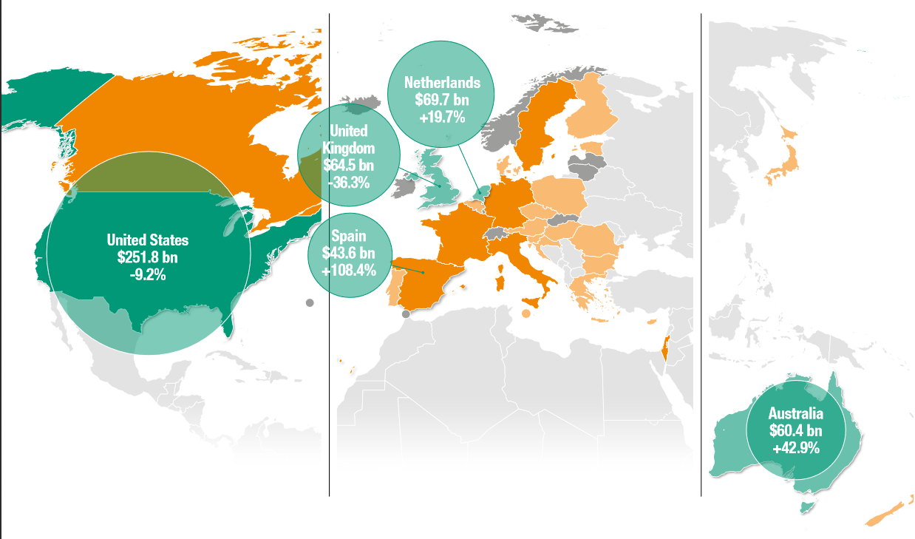
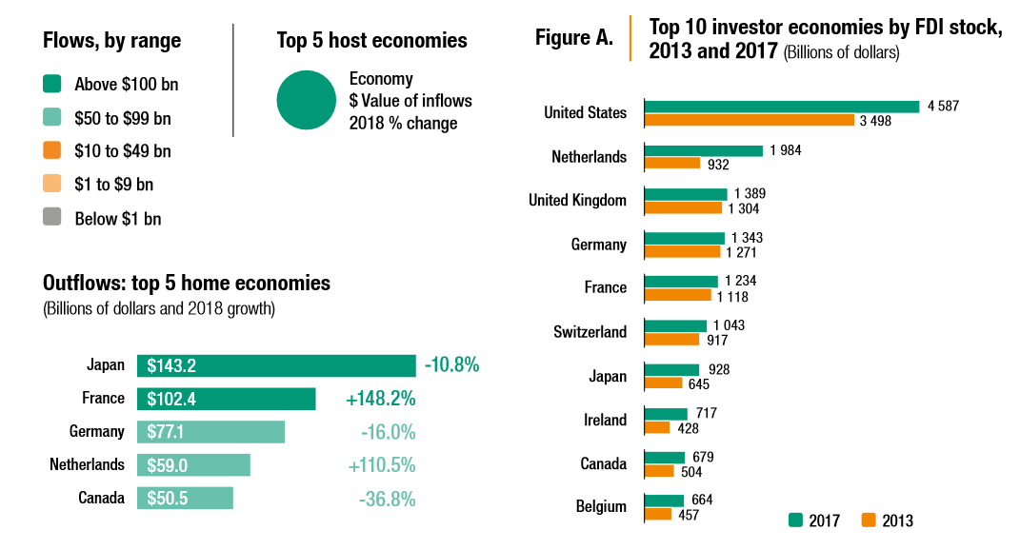
THE INTERNATIONAL FACTOR MOVEMENTS
INTERNATIONAL CAPITAL MOVEMENT – FDI in 2017-2018

Slide 30
THE INTERNATIONAL FACTOR MOVEMENTS
INTERNATIONAL CAPITAL MOVEMENT
Motives of the international capital movement:
  The main motive is to achieve higher profits.
  Another motive is the distribution of portfolio and diversification of risk in the case of portfolio investment.
  In the case of FDI it is a searching of sales markets, favourable economic conditions (lower taxes, lower wage costs, higher qualification, infrastructure, fiscal policy, market size, inflation rate, the possibility of spillover profit, etc.), or overcoming barriers to international trade (protectionist barriers) or the use of preferential position of the developing countries (some have lower, respectively. no customs).
The economic analysis of the impact of international capital movement is similar to international labour movement and it is shown in Figure 4-3.

Slide 31
THE INTERNATIONAL FACTOR MOVEMENTS
INTERNATIONAL CAPITAL MOVEMENT

Slide 32
THE INTERNATIONAL FACTOR MOVEMENTS
INTERNATIONAL CAPITAL MOVEMENT
The above-described movement caused a net increase in world output at CDE, where CEF is for the economy Alpha and EDF for the economy Beta. Moreover, in case of the economy Alpha earnings from the international capital movement will distribute among the economy Alpha (area CEF) and the economy Beta (area K2EFK1).
Although there has been a growth of the production in the individual economies, the effects on the distribution of income will be different in both economies:
  In the economy Beta, there will be an increase in returns of capital of owners of capital (from 0RBDK1 at 0VBFK1) and then the incomes of owners of factors of production will decrease (from RBAD at VBAE).
  And vice versa, in the economy Alpha, there will be a decrease in profits of owners of capital and increase in incomes of other factors of productions.

Slide 33

THE INTERNATIONAL FACTOR MOVEMENTS
INTERNATIONAL CAPITAL MOVEMENT
The international capital movement leads to the increase of the total volume of production, but also to income redistribution and then to the pressures on the (un)employment.
Whereas in the investing economy (Beta) the foreign investments reduce incomes of owner of other factors of productions and increase unemployment, in the host economy (Alpha) it is opposite – foreign investments increase employment.

Slide 34
THE INTERNATIONAL FACTOR MOVEMENTS
INTERNATIONAL CAPITAL MOVEMENT
Another economic impacts are:
  An equalization of returns of capital
  An increasing of the efficient allocation of resources
  An impact on the balance of payments (short term), when the investing country has a deterioration in the balance of payments by higher foreign expenditures (imports) and the receiving country contrary shows the improvement
  Impacts on tax revenues when firms investing abroad do not pay in most of the countries double taxes and state will loses tax revenue (for example, if a firm from the economy Alpha invest into the economy Beta, where taxes are lower and where exist agreements on avoidance of double-taxation between states, the economy Alpha will pay to Beta e.g. 20 % tax and in the economy Alpha will pay the rest – let say 8 %, what means the state Alpha “lost” 20 percent of taxes)
  The impact on terms of trade, technological progress and independent economic policy.

Slide 35
THE INTERNATIONAL FACTOR MOVEMENTS
THE ROLE OF THE MULTINATIONAL COMPANIES
The holders of the international movement of factors of production (especially the capital).
Multinational company is a company, which has its headquarters in one country and develops a permanent activity under its supervision at least in two other countries, where has at least ten percent of its turnover.
There are two types of multinational companies.
  The first is multinational corporation, which was formed as a result of the merger of two or more firms from different countries and
  The other type is transnational corporation that arises by the allocation of a company's capital into the other countries. These companies with their incomes and number of employees dominate in international trade and they indicate the growth rate of not only their home economies.

Slide 36
THE INTERNATIONAL FACTOR MOVEMENTS
THE ROLE OF THE MULTINATIONAL COMPANIES
The national firm may become a multinational company by several ways:
  Merger is the situation when two companies will merge in one company, where the first company (acquiring) absorbs another company that after this merger ceases to exist.
  An acquisition means that one company join to another one (taking over all or at least a majority of the stocks) without their cessation.
  A consolidation occurs when two companies combines together to form a new company, which assumes the rights and obligations of consolidated companies.
  A joint venture is an association of two or more companies that carry out the single business with the participation of domestic and foreign capital in various fields of economic activity.
The main reason of the existence of multinational firms is a competitive advantage of the globalization of production and distribution.

Slide 37
THE INTERNATIONAL FACTOR MOVEMENTS
THE ROLE OF THE MULTINATIONAL COMPANIES
The advantages of multinational companies:
  The advantage of ownership, when multinational firms own special kind of capital called “knowledge capital” (in the Czech Republic it is intangible property), consisting of human capital, patents, know-how, trademarks, etc. whose shifts between branch offices of company are almost cost-free
  The location advantage, which means that the appropriate location of production of multinational company saves transport costs and company pay less for certain factors of production and also bypasses tariff barriers (i.e. so-called tariff-jump argument).
  The internalisation advantage related to the technologies, patents, etc. They are based on two assumptions. If there is an absence of multinational companies that “wrap-up” these technologies and try to avoid a leakage and dispersion of important knowledge and also if one company produces products for the other one and both of them are monopoly it may lead to price conflicts, which are eliminated due to the existence of multinational companies.

Slide 38

THE INTERNATIONAL FACTOR MOVEMENTS
THE ROLE OF THE MULTINATIONAL COMPANIES - IMPACTS
The the case of the parent country:
  increasing unemployment (less qualified workforce)
  worsening of balance of payment
  reduce tax revenues and distort the tax base
  bypass monetary policy and thus hinder the control of government over the economy
  + create modern values through the development of advanced technologies based on research and development
The case of the host country:
  the control of the most of the capital in the country
  foreign loans, which bypass the credit terms set by the host country
  the "attack" on national habits through massive advertising
  the technological dependence of the host economy on multinational companies
  + new technologies, modern organization and management, reduce unemployment and have at least partly effect on the economic growth of the given country

Slide 39
THANK YOU FOR YOUR ATTENTION!

