Slide 1

The Theory of Foreign Trade Policy
Lesson V
Ingrid Majerova
International Economics
NAMEE

Slide 2

Outline of the Lecture
Foreign Trade Policy and its Instruments
Characteristitcs of Autonomous Instruments
The Effect of Customs Duties
The Effect of Quantitative Restriction

Slide 3
FOREIGN TRADE POLICY AND ITS INSTRUMENTS
Foreign trade policy of the state represents the behaviour of the state against foreign trade.
  Set of objectives and instruments, which the government uses in order to directly or indirectly regulate the scope and structure of foreign trade
Foreign trade policy is a part of economic policy as well as its foreign policy.
The long-term objective of trade policy is to increase the well-being of the country and therefore the effective participation into the international division of labour.
The short-term objectives are usually attempts to remove undesirable developments of balance of payments or the balance of trade, or the protection of the weak domestic producers against foreign competition.

Slide 4
FOREIGN TRADE POLICY AND ITS INSTRUMENTS
To promote the mentioned objectives - instruments of trade policy.
  the complex of principles, including the principle of reciprocity, the principle of national equality and the principle of equality of provided benefits
Trade policy instruments can be divided into two groups:
  contractual instruments – country can apply by agreement with another country (or group of countries)
  autonomous instruments – country can apply in its sole discretion, if it is not bound by commitments from multilateral agreements such as GATT.
Autonomous instruments of foreign trade policy are different measures of the government unilaterally applied in order to regulate the import or export.
They consist of tariff instruments (application of customs) and non-tariff instruments.

Slide 5

CHARACTERISTICS OF AUTONOMOUS INSTRUMENTS
The autonomous instruments are measures of government, which government use in order to influence export from the country or the import into the country, their size and structure to meet the established economic and political goals.
Mostly defensive in nature and designed to prevent unfair foreign competition and protect domestic consumers X protection of domestic less-competitive producers
May be used only by this country that is not a signatory to the multilateral trade agreements.
  WTO members can use them for short periods and only with the consent of the WTO

Slide 6

CHARACTERISTICS OF AUTONOMOUS INSTRUMENTS
Tariff instruments are customs duties, which are fees charged for goods when crossing the customs border
  Customs duties have a relatively long history and they have evolved from various trade and transport charges levied for the use of roads, bridges, ports and markets but also to protect buyers. Customs duty as a single dose charged only when crossing the borders of the country began to collect in the United Kingdom in the mid-17th century, in France after the revolution in 1790.
  The first single tariffs were introduced in Germany in Prussia (1818) and in 1834 were enforced by the founding of the German Customs Union (1834).
  In the USA were introduced in 1789.

Slide 7

CHARACTERISTICS OF AUTONOMOUS INSTRUMENTS
Aspects:
According to the direction of transport:
  Export duties, their purpose is to prevent undesirable export of certain commodities (usually for political reasons)
  Import duties, their purpose is to regulate the import of goods into the country, there are imposed on imported goods, their purpose is protectionist.
  Transit duties, their purpose is fiscal and the other purpose is to charge the transit countries, nowadays is replace by other forms of transit charges

Slide 8

CHARACTERISTICS OF AUTONOMOUS INSTRUMENTS
According to the calculation:
  Ad valorem duties, which are determined as a percentage of the invoiced valued of goods (the customs value)
  Specific duties are determined from the unit quantity of goods (weight, volume, pieces) and is taken as the basis for the gross weight of goods (gross)
  Compound duties are determined as a combination of specific and ad valorem duty (e.g. 10 % of the customs value, but not less than 1 USD per 100 kg)
  Differential duties are determined on the basis of graded tariff rates depending on the height of the prices of goods
  Sliding-scale duties are determined in relation to the prices of the commodity in the domestic market

Slide 9
CHARACTERISTICS OF AUTONOMOUS INSTRUMENTS
According to the purpose of the duty:
  Revenue duties, i.e. whose main purpose is to obtain customs revenue, when these duties are used primarily in developing countries
  Protective duties represents a classical instrument of protectionist policy and they can be divided into
    Educational duties which serves as the protection of young emerging industries against advanced foreign competition
    Negotiation duties are set to provide the opportunity to achieve concessions in trade negotiations
    Differential duties represents the implementation of a variety of duties for the given commodity depending on the direction or type of transportation, the objective is to prefer some ways of transportation or means of transport of some countries
    Contingent duties should eliminate the disadvantages of domestic producer caused by the subsidization of production in the country of importer

Slide 10
CHARACTERISTICS OF AUTONOMOUS INSTRUMENTS
  Protective duties (cont.)
    Anti-dumping duties are introduced in the case of proven dumping, they should not be higher than the so-called dumping margin
    Compensating tariffs should eliminate the disadvantages of domestic goods given by the higher taxation than is the customs duty for the same, but imported goods, it is so-called import duty
    Retaliation duties are levied as a reprisal for an increase of tariffs by any country, what can lead to the phenomena referred to as the tariff war
    Customs-contingent duties are levied for the customs contingents down in trade agreements, the importing country sets differentiated tariffs by the imported quantities – the minimum is sets at an agreed quantity, while imports over this amount of customs tariff increases
    Prohibitive duties are used to the complete prevent of import of a certain commodity
    Preferential duties are customs duties, which are provided on the basis of an international agreement on preferential trade such as the Customs Union. There are also customs duties provided to the developing countries based on Generalized System of Preferences (GSP)

Slide 11
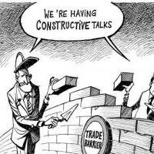
CHARACTERISTICS OF AUTONOMOUS INSTRUMENTS
Non-tariff instruments:
Paratariff barriers are duties related to customs procedures. They are applied primarily in developing countries, which procure by that way funds to cover the costs of customs procedures. These are especially duties for customs procedure:
  Fiscal tax levied in addition to the custom duties (for selected commodities)
  Statistical duties (1 % of the payment of customs for customs statistics)
  Charges for stamps
  A tax on imports (transaction fee)
  Transport and port duties (e.g., $ 5 per truck)
  A tax on the development of foreign trade
  Fees for consular formalities.
Quantitative restrictions of export or import are determined by the quantity of product that can be exported or imported in a certain period (e.g. in a given year)

Slide 12
CHARACTERISTICS OF AUTONOMOUS INSTRUMENTS
Non-tariff instruments:
Technical Barriers of Trade include a variety of measures that try to set technical and other characteristics of imported goods and the obligation of their proof (examination).
  On the one hand, these should protect domestic consumers, but on the other hand they can significantly hamper imports.
  Natural technical barriers that are given by the different historical and cultural level of consumption (e.g. steering wheel on the right, voltage, etc.)
  Artificial technical barriers given by domestic technical, sanitary, veterinary and other regulations.
Technical barriers and their application are governed by the Agreement on Technical Barriers to Trade (1979), which was updated in 1994.
  Guiding principle of the agreement is to ensure that technical regulations and standards do not become obstacles to international trade.
  For this reason, member states should be based on the existing international standards while developing standards. If there are not exist and countries develop their own standards, the must to provide an explanation to the standard if is requested by another member state.

Slide 13

CHARACTERISTICS OF AUTONOMOUS INSTRUMENTS
Non-tariff instruments:
Technical Barriers of Trade
Each member state shall ensure that its normalization body proceeded in its activity in accordance with the Code of Good Practice for the Preparation, Adoption and Application of Standards, which are annexed to the Agreement
If product meets the international standard and regulation is required, the member states grant to the foreign products the same conditions.
Each member state shall ensure the establishment of an information centre that will answer answers of other member countries, provide a documentation of all received or preparing regulations and technical standards for the conformity assessment.

Slide 14
CHARACTERISTICS OF AUTONOMOUS INSTRUMENTS
Other non-tariff instruments:
An import charge – the amount levied on imports of goods and set as a percentage of the customs value
An import deposit – the amount paid in interest-free import of a specified amount for a specified period, after its expiration is returned
The monitoring of imports or exports – keeping the volume of trade if there are available information about the possibility of damage of the given industry and therefore it is necessary to monitor the situation on the market, or if it is required by the international agreement
A minimum price – a measure which determines the lower limit of exported product the to foreign exporter, in the case of non-compliance can be imposed sanctions in the form of additional duties or quantitative restrictions.
Support instruments of export are the base of pro-export policy that can be characterized as the objectives that should be reached by the export and set of instruments and measures to their ensuring

Slide 15

THE EFFECT OF CUSTOMS DUTIES ON SMALL AND LARGE ECONOMIES
The significant part of the theory of international trade considers customs duty for the basic barrier to international trade and tries to prove their versatility harmfulness.
On the other hand, there is also the theory of optimal duty that shows also advantages that the customs duties may bring to the economy.
The effects of customs duties are multifaceted and interrelated.
  They have an significant impact on a small open economy where the price at which it sells production on its markets is affected by foreign importers.
  A small economy is in this case in the position of price taker.

Slide 16
THE EFFECT OF CUSTOMS DUTIES ON SMALL AND LARGE ECONOMIES
The effects of tariffs on the economy are as follows:
  Protectionist – the economy as a whole loses, because it expend more social costs (factors) on the production that could be used somewhere else
  An effect on consumption – there is the increase in prices for consumer and reduction of consumption
  An effect on the state budget – tariffs represents customs revenues
  A redistributive effect – the imposition of duty leads to the transfer of consumer surplus (through increase of price) in favour of the protected producers
  An effect on competition – eliminates foreign competition, thus creating a domestic producer of greenhouse conditions that lead to long-term decline in the efficiency of the national economy, and therefore it is possible to proceed with this step only if it is for the protection of the young industries that need protection for the period before they will be able to produce under conditions comparable with global competitors.

Slide 17
THE EFFECT OF CUSTOMS DUTIES ON SMALL ECONOMIES
The case of the economy Beta that produces cheese (see Figure 5-1).
The price of production in a closed economy is to at equilibrium level PD and domestic producers provide all demand for production. After opening the economy to foreign production, the price of goods stabilizes at PW.
At this price, they sell only the production of Q1, but domestic consumers are willing to buy the amount of Q4. The gap between the supplied and demanded quantity is filled by import (supply SW).
This development has a negative impact on domestic producers and they are lobbying for their own benefit and the government to protect them, imposes a duty on imports of production.
The price of cheese rises to the level of PT, where domestic producers are able to offer quantity Q2, but buyers are at this price able to buy only the quantity Q3 and the supply of foreign manufacturers fall to SW+T.

Slide 18
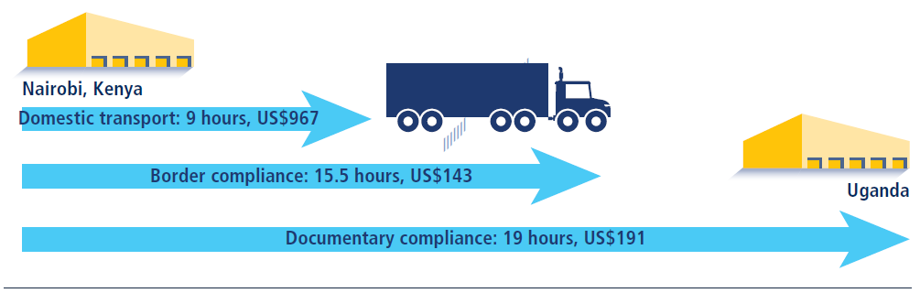
THE EFFECT OF CUSTOMS DUTIES ON SMALL ECONOMIES
The customs duties are the following effects:
  There will be a decrease of consumption, which is shown be the decrease from Q1Q4 at Q2Q3, the area d expresses the limit of consumer possibilities due to the limitation of supply possibilities Q3Q4
  The area b express the inefficiency associated with shifting of resources into the supported production, it is the loss of other sectors
  The area a represents additional income of supported producers at the expense of consumer surplus
  The area c represents the customs revenues into the state budget
  The area c represents the revenue to the state budget associated with a change of terms of trade due to the imposition of customs duty.

Slide 19

THE EFFECT OF CUSTOMS DUTIES ON SMALL ECONOMIES
Customs duties may have other effects since they can be used to influence the macroeconomic aggregates:
  Income and inflation – the imposition of customs duty decrease the supply for foreign goods, thus there is a saving of resources that can be used for the mobilization of available factors of production at home, which will lead to the growth of income and inflation and vice versa
  A balance of payments – a limitation of expenditures abroad currently means decline in imports, which in the case of passive trade balance that may lead and thus to the improvement and thus to improvement of the balance of payments.
  Terms of trade – customs duty increases the price of imported goods and relatively reduces the cost of domestic production, which can be simultaneously exported what results in relative improvement of terms of trade.

Slide 20
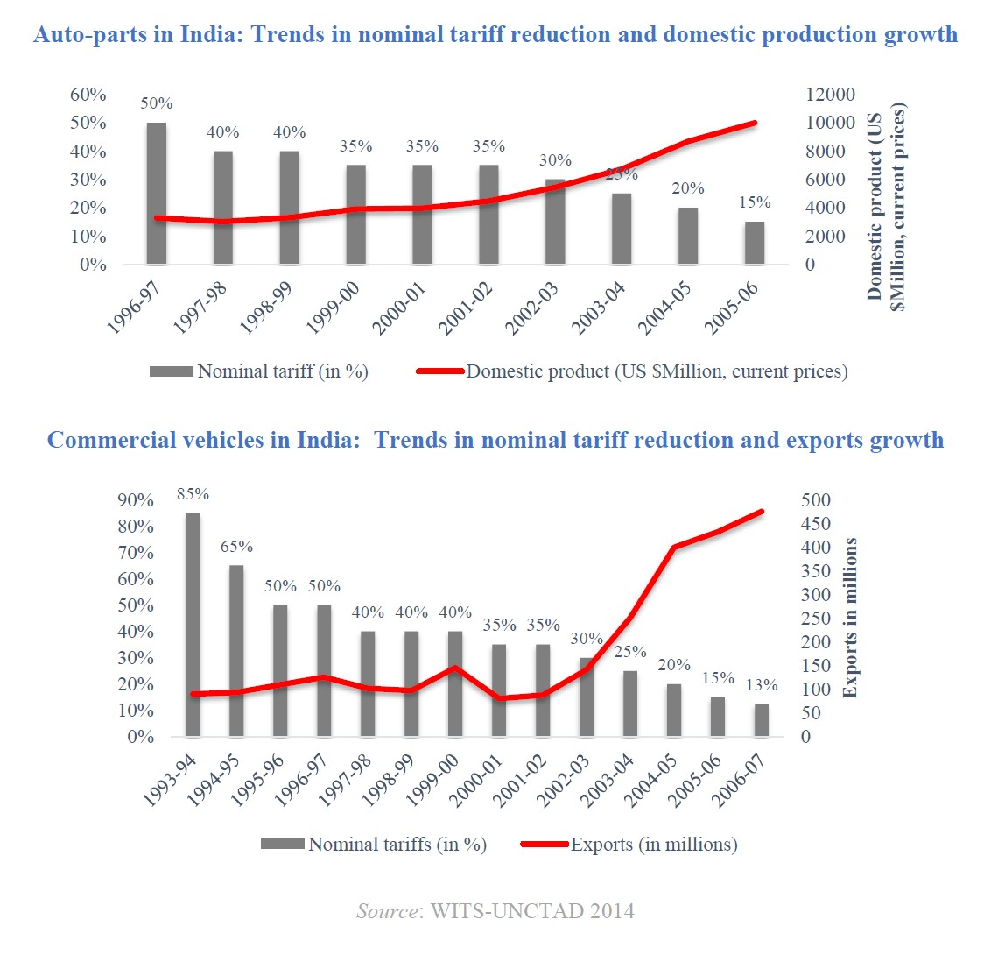
THE EFFECT OF CUSTOMS DUTIES ON LARGE ECONOMIES
What are the effects of introduction of customs duties if they will be imposed in a large economy, i.e. the economy, where the consumption of the given commodity is globally very important?
Such an economy can acquire so-called the market power, when introducing of customs duties may get the economy into the position of worldwide oligopoly, respectively oligopsony, and it becomes a price maker.
Country may affect the terms of trade through tariffs
to its advantage.
This is illustrated in the following Figure 5-2.

Slide 21
THE EFFECT OF CUSTOMS DUTIES ON SMALL AND LARGE ECONOMIES
The demand for the given commodity in a large economy is given by the line D, initial supply of world exporters by line S line and it is buying the Q0 units at a price P0.
The introduction of duties means a shift in the global supply position at S1. In this situation, the price would rise to PX and demanded quantity would fall at QX. This would mean serious problems for manufacturers in the world (unutilized capacity), and therefore the price drops to a level P2. Taking into account the duty, the final selling price is P1. At this price, the demanded quantity falls at Q1.
Rectangles ca and cb represent the total amount of customs revenue of the state budget and on the other hand, they show that domestic consumers do not pay duties, but importers on whose goods the duty was imposed as well as it was enforced the price reduction pay.
Triangle d expresses the loss of consumers in the large economy and triangle f expresses the loss of manufacturers because of the unutilized capacity. As is evident, the large economy obtains a net income.

Slide 22
THE EFFECT OF CUSTOMS DUTIES ON LARGE ECONOMIES
Other problems with the imposition of duties in a large economy according to Stolper-Samuelson theorem:
Suppose that a country is abundant in capital-intensive goods, it specialized in their production and import the labour-intensive goods.
The imposition of duties on imported goods, which are labour-intensive, changing conditions on the domestic market. The increasing price of the production is a stimulus to produce it in the inland. There is a pressure on increasing of wages and it reduces the price of capital. The opposite process occurs in the rest of the world.
Stolper-Samuelson theorem demonstrates the fundamentally anti-market nature of the duties. This can significantly affect the distribution of income and economic activity related to the factors of production.

Slide 23
IMPACTS OF CUSTOMS DUTIES - GENERAL EQUILIBRIUM
We also have to distinguish the impact on small and large economies.
Economy Beta will be considered as the small economy (therefore it can not influence its terms of trade), it will export cheese and import beer.
The impacts of the duty are shown in Figure 5-3.
before the introduction of tariffs, the economy "operates" on the level of production Q1 and consumption D1. Within the application of protectionist policy, the production of beer increased, but the level of exported production decreased to Q2 and also consumption decreased to a lower IC at D2.

Slide 24
THE EFFECT OF CUSTOMS DUTIES ON SMALL AND LARGE ECONOMIES
What happens if the economy, which has the ability to influence world prices and is a large economy?
The large economy exports beer and import cheeses (see Figure 5-4).
This is very similar to the previous one, except that there is an improvement of the economic situation after the imposition of duties because of the improvement in their terms of trade and deterioration of trade of trade of the rest of the world. The country raised its beer production from Q1 at Q3 and consumption from D1 at D3.

Slide 25
THE EFFECT OF QUANTITATIVE RESTRICTION ON THE ECONOMY
To protect the economy can be used also a quantitative restrictions that mean the limits of the quantity of production by setting of quotas, which happens at the concluding annual trade agreements. On the given quota is granted an import licence and import over this licence is prohibited.
The impact has much more harder impact on the economy that negative effects of the imposition of customs duties (see Figure 5-7).
By the introducing of quotas the economy looses the state budget revenue and eventual production of public goods, while this loss increases the net monopoly rent, that accrue to foreign importers and domestic producers.
The consumer loses as in the case of the custom duty.

Slide 26
THE EFFECT OF QUANTITATIVE RESTRICTION ON THE ECONOMY
PD represents the equilibrium price in a situation with the production of cheese and the economy is closed.
The price dropped at PW when the economy has opened to foreign production.
Domestic producers are calling for protection and thus a quota on imports of the given commodity is established while its price rose up from the level PW at PK and total supply changes from level to level SW at SD+K (SW'). Supply curve has a cranked shape because the demand, in its horizontal part, is hedged by imports and its growing part is hedged by domestic production.
Imports fall from Q1Q4 at Q2Q3 and the sum of the areas a+b+c+d expresses the loss of consumer surplus (due to increasing of prices).
The area c will not accrue to the state budget, as is the case of the imposition of custom duty, but to the domestic importers or foreign companies that received the import license.
  This area is referred to as a pure monopoly rent.

Slide 27
THANK YOU FOR YOUR ATTENTION!

