Slide 1

Macroeconomics of Open Economy –
Part I
Lesson VII
Ingrid Majerova
International Economics
NAMEE

Slide 2

Outline of the Lecture
PART I:
The Theory of Balance of Payments
The Structure of the Balance of Payments
PART II:
Macroeconomics of Open Economy
  A Blance Payment Curve
  Mundell-Fleming Model
  J-Curve

Slide 3
THE THEORY OF BALANCE OF PAYMENTS
The classical theory of trade proved the advantageousness of international trade for all countries involved, but with no matter of different level of their development.
In less developed countries, which could not export their goods, arose fears of difficulties with their balance of payments, if they open up their markets to cheaper foreign goods.
There was a threat that money (gold) flow out of the economy and the debt rises up as well as the external economic imbalances of country.
The answer to this question was the classical theory of the balance of payments, which proved that there are mechanisms, which eliminate the imbalances in the balance of payments. This theory was later developed by both the Keynesian and monetary economics.

Slide 4

THE THEORY OF BALANCE OF PAYMENTS
The theory of balance of payments defines mechanisms that in the absence of trade barriers should lead to the elimination of external economic imbalances, which are caused by different flows of money due to the specific form of integration of country into the global economy.
Three approaches:
  The classical theory of balance of payments and the price-specie flow mechanism
  The Keynesian model and the income adjustment mechanism
  The monetarist approach and monetary mechanism of adjustment.

Slide 5
THE THEORY OF BALANCE OF PAYMENTS
The Classical Theory of Balance of Payment
David Hume formulated the classical theory of balance of payments (in the work Political Discourses, 1752).
The assumptions on which David Hume built up were a quantitative theory of money, the existing gold-coin standard and thus fixed exchange rates that prevailed in international monetary relations.
Another important moment was the fact that the demand for foreign currencies resulted primarily as a result of foreign trade and international capital movements played only a minor role.
Therefore, it was possible to identify the balance of payments with the balance of trade.

Slide 6
THE THEORY OF BALANCE OF PAYMENTS
The Classical Theory of Balance of Payment
The exchange rate was given by the gold parity and money used for cash payments were fully fledged.
The resulting imbalances did not have an affect on the movement of Exchange rates, which remained stable. However, there were international movements of gold.
The quantity theory of money showed that the growth of money in circulation in the country (for example, due to growing exports) reduces the purchasing power of money (there is an internal devaluation), thus increasing the price level in the country.
The decrease of money in circulation has the opposite effect.

Slide 7
THE THEORY OF BALANCE OF PAYMENTS
The Classical Theory of Balance of Payment
On this basis, D. Hume clarified the price–specie flow mechanism:
  In a country, which has a negative balance of trade, gold would flow out of the country to decrease the amount of money in circulation (central banks can issue only paper money with regard to the amount of held gold). It caused a decline in the prince level, which resulted in the growth of competitiveness of goods (cost of goods compared to foreign goods decreased). Foreign demand increased and hence there was a rise in exports and decline in imports (foreign goods become more expensive), and this process continued until the balance of payments will be balanced.
  And conversely, in a country, which has a positive balance of trade, due to the export of gold, the amount of money in circulation increased as well as the price level, the competitiveness of goods decreased (domestic goods versus foreign goods were more expensive) and foreign demand also decreased. Export decreased and vice versa import began increasing until the balance of payments adjusted it.

Slide 8

THE THEORY OF BALANCE OF PAYMENTS
The Classical Theory of Balance of Payment
This theory proved that the external balance of the economy is automatically restored. However, there is a condition – a general application of the policy of free trade.
Over time, individual countries have begun to adopt a floating exchange rate policy and the abovementioned mechanism underwent modification. The imbalance of balance of payment was adjusted by a change in the exchange rate.
This modification is sometimes referred to the exchange rate adjustment mechanism. It is a variant of neoclassical price adjustment mechanism.

Slide 9

THE THEORY OF BALANCE OF PAYMENTS
The Classical Theory of Balance of Payments
This mechanism works as follows:
  In a country with a passive balance of payment leads to excess of supply of the domestic currency over demand (payments abroad). It leads to a currency depreciation of the domestic currency’s exchange. It also cheaper domestic goods and imports are more expensive, which leads to an adjustment of balance of payment.
  And in a country with an active balance of payments it is opposite and it leads to excess of demand for the domestic currency over its supply (exporters sell foreign currency and buy the domestic currency to pay to domestic subcontractors). There is a currency appreciation of the domestic currency’s exchange, which in turn leads to higher prices of production exported and cheaper imported production, which leads to equalization of balance of payments.

Slide 10
THE THEORY OF BALANCE OF PAYMENTS
The Classical Theory of Balance of Payments
The question is – how large the changes of exchange rates have to be to ensure the restoration of balance of payments equilibrium?
Solved by A. Marshall - a term price elasticity of imports and exports.
  It shows a change in demand for products of the country in response to a change in price by 1%. Price elasticity of imports and exports show the sensitivity of exports and imports to price changes.
  The imbalance of balance of payments does not induce changes in internal prices of the economy, but changes of exchange rates and through them, the changes in the prices of goods in foreign currency. The price elasticity expresses e.g. the volume change of the English exports to the U.S. in decline (rise) of exchange rate GBP/USD. The price elasticity of imports and exports depend on substitution of one good to other one. The easier the goods are substitutable, the price elasticity of imports and exports increased.

Slide 11
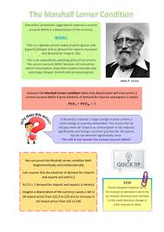
THE THEORY OF BALANCE OF PAYMENTS
The Classical Theory of Balance of Payments
To remove the deficit of balance of payments through the currency depreciation so-called Marshall-Lerner condition must be fulfilled.
This is defined by equation (7.1):
where: eM – elasticity of import
eX – elasticity of export

Slide 12
THE THEORY OF BALANCE OF PAYMENTS
The Classical Theory of Balance of Payments
Marshall-Lerner condition says:
  If the sum of the elasticity of demand for export and elasticity of demand for import is greater than 1, then the devaluation improves net export.
  If the sum of these elasticities is equal to 1, then devaluation has no effect on the current account.
  And if the sum is less than 1, the devaluation worsens the current account.
However, these theories did not take into account the possibility of thesauration of money in the country with the inflow of gold and in the existence of available factors of production, the ability to invest idle funds into the next production, which would prevent the rises in prices.
The connection between foreign trade and GDP growth was devoted to the Keynesian macroeconomics.

Slide 13

THE THEORY OF BALANCE OF PAYMENTS
The Keynesian Theory of Balance of Payments
For understanding the relationship between foreign trade and the product of the economy is necessary to remind the basic Keynes’ idea that the size of the product is determined by the level of purchase effective demand, i.e. the amount of cash expenditures in the country.
In a closed economy, the purchase effective demand consists of spending on consumption, investment and government spending. The left side indicates the right side, what means that the size of expenditure determines the amount of product and there is relation.
C+I+G = Y (7.2)

Slide 14
THE THEORY OF BALANCE OF PAYMENTS
The Keynesian Theory of Balance of Payments
In an open economy, there are additional expenditures accruing to above-mentioned expenditures, and that are the expenditures of foreign entities spent on goods of the given country, which are the value of exports of the given country.
At the same time, the part of the expenditures of the domestic population is spent on foreign products, whose value is the value of imports of the country. This value is not involved in product formation of the given country, but in the product formation of other countries, and therefore it must be deducted from the expenditure.
(C-M)+I+G+X = Y (7.3)

Slide 15
THE THEORY OF BALANCE OF PAYMENTS
The Keynesian Theory of Balance of Payments
In an open economy, there are additional expenditures accruing to above-mentioned expenditures, and that are the expenditures of foreign entities spent on goods of the given country, which are the value of exports of the given country.
At the same time, the part of the expenditures of the domestic population is spent on foreign products, whose value is the value of imports of the country. This value is not involved in product formation of the given country, but in the product formation of other countries, and therefore it must be deducted from the expenditure.
(C-M)+I+G+X = Y (7.3)
C+I+G+(X- M) = Y (7.4)

Slide 16
THE THEORY OF BALANCE OF PAYMENTS
The Keynesian Theory of Balance of Payments
Expression (X-M) is also known as a net export (NX). Previous equation (7.4) can be written as:
From the above it follows that export increases product and import reduces it, or trade surplus increases product and deficit of the balance of payment reduces it. From the abovementioned relationship can be derived the condition for the equilibrium of open economy. If there is a balance of closed economy expressed by the relationship I=S and simultaneously G=T.
C+I+G+NX = Y (7.5)
I+G = S+T (7.6)

Slide 17
THE THEORY OF BALANCE OF PAYMENTS
The Keynesian Theory of Balance of Payments
Then the equilibrium condition for an open economy can be expressed by following expression (7.7):
X+I+G = S+T+M (7.7)
X-M = (S-I)+(T-G) (7.8)
The economy is in equilibrium if is reached the internal and inner equilibrium and if there is the internal equilibrium then there is also external equilibrium.
However, this also means that if they are saving less than investment, then there is a deficit of the current account (assuming that government expenditures and taxes are equal and the state budget is balanced).

Slide 18
THE THEORY OF BALANCE OF PAYMENTS
The Keynesian Theory of Balance of Payments
Another feature of Keynesian theory is the definition of the function import. It is based on the Keynesian consumption function, which says that consumption is an increasing function of the product and is conditioned by the marginal propensity to consume of the population.
Since consumption expenditure includes also expenditure on imported consumer goods, it can similarly formulate the imports. It says that imports are increasing function of the product.
The marginal propensity to import show the increase in imports caused by a one-unit increase in Y. Marginal propensity to import is a necessary variable for determining the multiplicative effect of foreign trade on the product.
M = mpi * Y (7.9)

Slide 19
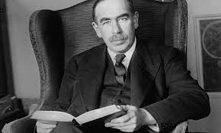
THE THEORY OF BALANCE OF PAYMENTS
The Keynesian Theory of Balance of Payments
As well as investments having multiplicative effect on Y (there is a much greater increase in income than the increase of investment) has a multiplicative effect of exports (X).
The size increment of the product due to increase exports can be determined using the export multiplier which indicates how many times the product is increased if there will be one-unit unit increase in export.

Slide 20
THE THEORY OF BALANCE OF PAYMENTS
The Keynesian Theory of Balance of Payments
An open economy multiplier is the greater, the smaller the marginal propensity to save and marginal propensity to import.
The multiplier effect of exports lies in the fact that the export produces primary exports of exporters.
They are transformed into savings and consumer expenditures. Expenditure on consumer goods in this country is creating additional income for producers of consumer goods, etc. The multiplier operates in the opposite direction.
Export creates an increase in income and it leads to an increase in savings and imports. It follows that rising exports raises import. The same goes for investment. It should be borne in mind that everything is based on the assumption that all imports consist of imports of consumer goods. If capital goods are imported, those relations have only limited validity.

Slide 21
THE THEORY OF BALANCE OF PAYMENTS
The Keynesian Theory of Balance of Payments
The above-defined relations between exports and product became the essence of the Keynesian approach to the adjustment of the balance of payments.
They are based on the fact that the system of fixed exchange rates is transmitted by impulses from the external economy in the form of income effects. Income effect means the increase in the product in the domestic economy through net exports and it is transferred to the foreign economy and vice versa.
The degree of mutual transfer depends on the marginal propensity to import in domestic and foreign economies.
  Export growth leads to an increase in aggregate demand, product and employment.
  Growth in import means that the demand is shifted to abroad, on the contrary, it leads to a decrease in product and employment.

Slide 22
THE THEORY OF BALANCE OF PAYMENTS
The Keynesian Theory of Balance of Payments
This so-called income adjustment mechanism then operates as follows:
  A country with passive balance of payments records a decline in aggregate spending, which leads to a decline in real output, which leads to a decline in imports while maintaining the current level of exports what should lead to the adjustment of balance of payments
  A country with active balance of payments records the growth of aggregate expenditures, and therefore the growth of real output resulting in import growth while maintaining the current level of exports what should lead to the adjustment of balance of payments.

Slide 23

THE THEORY OF BALANCE OF PAYMENTS
The Monetary Theory of Balance of Payments
At the end of the 60s of the 20th century, economists R. Mundell and H. G. Johnson elaborated the alternative to the above-mentioned approach.
The monetary mechanism of adjustment is based on the fact, that excess demand for goods, services and capital (current account deficit) reflects the excess supply of money that flows to abroad. Balance of payments surplus arises on the contrary by the excess demand for money.
  If this demand is not met by growth in the domestic money supply, it is met by the inflow of money from abroad through surplus balance of payments (e.g. the allows explaining the balance of payments surpluses in rapidly growing economies).

Slide 24
THE THEORY OF BALANCE OF PAYMENTS
The Monetary Theory of Balance of Payments
It works as follows: the balance of payments surplus leads to pressure on the appreciation of the currency, the central bank in its effort to keep the exchange intervenes by selling the currency. Consequently, the money supply increases.
This leads to both the direct growth of import and the increase in the price level (inflation) and thus to the growth of import and finally to the growth of real output growth is again to the growth of import. As a result of these pressures on growth of import there is an increase in import and the equilibrium of balance of payments is restored.
As is evident, the monetary mechanism of adjustment contains elements of both the price–specie flow mechanism and income adjustment mechanism.
It is also focused on the overall balance of payments of the country, not only on the balance of trade, which has great influence on the issue of relations between external and internal balance.

Slide 25
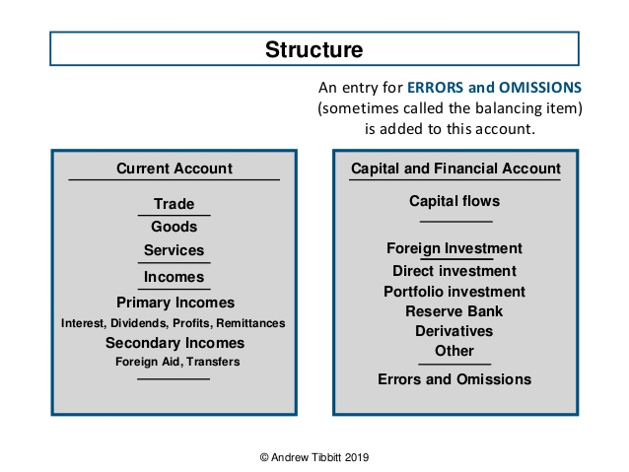
THE STRUCTURE OF BALANCE OF PAYMENTS

Slide 26
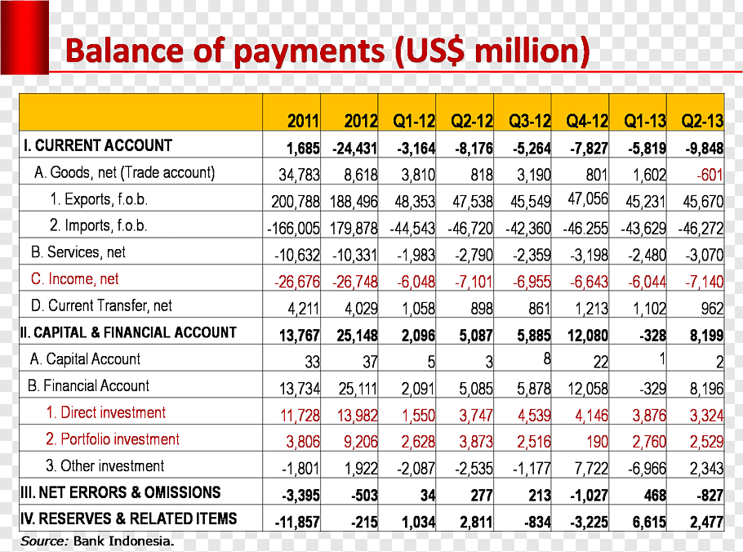
THE STRUCTURE OF BALANCE OF PAYMENTS
A BoP surplus (or deficit) is accompanied by an accumulation (or decumulation) of foreign exchange reserves by the central bank.

Slide 27
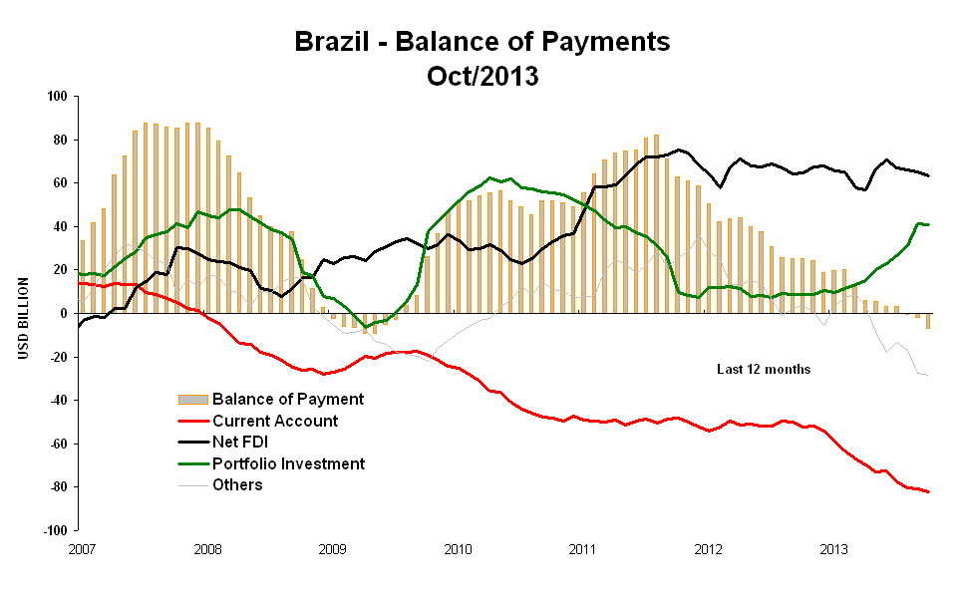
THE STRUCTURE OF BALANCE OF PAYMENTS

Slide 28
THANK YOU FOR YOUR ATTENTION!

