Slide 1

Macroeconomics of Open Economy –
Part II
Lesson VIII
Ingrid Majerova
International Economics
NAMEE

Slide 2

Outline of the Lecture
PART I:
The Theory of Balance of Payments
The Structure of the Balance of Payments
PART II:
Macroeconomics of Open Economy
  A Blance Payment Curve
  Mundell-Fleming Model
  J-Curve

Slide 3

MACROECONOMICS OF OPEN POLICY
Macroeconomics mainly works with models of the national economy and that in both a closed economy and an open economy.
An open economy is associated with foreign economies through two basic channels and those are international trade and international financial markets.
These two channels can be found in models of open economy in the form of balance of payments.
In this lecture, the basic framework of open economy macroeconomics, which is the model IS-LM-BP, will be introduced.

Slide 4
MACROECONOMICS OF OPEN POLICY
An essential feature of open economy macroeconomics is the distinction between internal and external balance.
  Internal balance means achieving a level of real income, which corresponds to the natural rate of unemployment and price stability.
  External balance means a situation when the balance of payments is in equilibrium. In this case, the external economic balance occurs when the central bank does not lose or accumulate foreign exchange reserves.
Internal and external balances are mostly achieved through automatically acting market mechanism.
  However, this often does not respond quickly enough and therefore, there remains scope for regulatory role of the state and its policies.

Slide 5
A BALANCE OF PAYMENT CURVE
According the Keynesian theory, changes of the balance of payments are caused by two factors, namely by the growth of economy (leading to growth in imports and therefore to the balance of payments deficit) and changes in interest rates, which affect the import or export of capital.
The balance of payments curve reflects these relationships and it is valid at a given exchange rate.
The curve reflects all combinations of interest rates and income, in which the balance of payments is in equilibrium.
  The balance of payments curve is therefore referred to as a balance of payments in equilibrium.

Slide 6

A BALANCE OF PAYMENT CURVE
Points above the BoP curve represent the balance of payments surplus while points under the curve represent its deficit (see Figure 7-1).
BoP curve is increasing because the increasing income worsens the BoP and is necessary to attract more foreign capital to the restore the balance, which is possible only through the increasing interest rates.
Conversely, if there is the BoP surplus, it must be offset by capital exports, which must contribute to the decline in interest rates.

Slide 7
A BALANCE OF PAYMENT CURVE

Slide 8
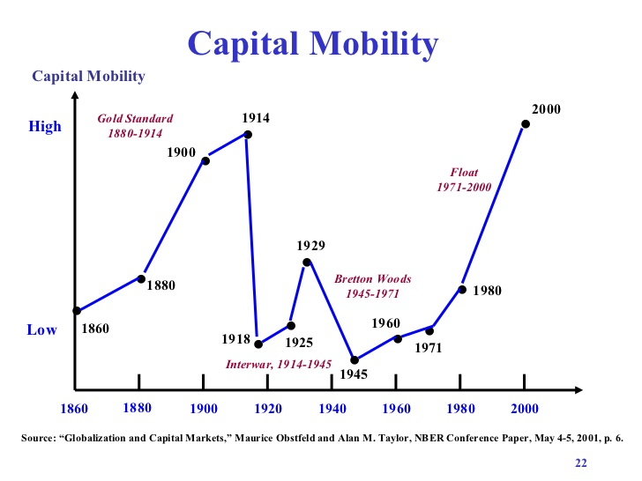
A BALANCE OF PAYMENT CURVE
The slope of the curve is affected by the mobility of international capital.
If the capital is more mobile, then the curve is approaching the horizontal.
The mobility means the sensitivity/elasticity to changes in interest rates between countries.
Conversely, the capital is less mobile (barriers to the movement of capital), the balance of payment curve is steeper.

Slide 9
A BALANCE OF PAYMENT CURVE
BoP curve has three basic shapes that reflect the three different situations:
  BP curve is horizontal (perfectly elastic) – there is a perfect capital mobility, which means that domestic and foreign financial assets are perfect substitutes and capital flows react quickly to changes in the interest rate differential (the difference in domestic and foreign interest rates):
    if is the interest rate differential positive, there will be an unrestricted inflow of capital and a surplus of the balance of payments, regardless of the status of BoP, the situation in the balance of payments situation will be determined by financial account and interest rates (a situation typical for economically developed countries

Slide 10
A BALANCE OF PAYMENT CURVE
BoP curve has three basic shapes that reflect the three different situations:
  BP curve is vertical (perfectly inelastic) – the mobility of capital is null and capital flows to changes in interest rate differentials do not react (a situation typical of many developing countries with undeveloped monetary systems and non-convertible currency), this BoP is completely determined by the development of the current account and that affect it
  BP curve is increasing (elastic) – this is a limited respectively ultimate mobility of capital, the impact on the BoP has both the current account and the financial account.

Slide 11
MODEL IS-LM-BP
Model IS-LM-BP is the basic model of an open economy that allows exploring the possibilities of stabilization policy, thus maintaining internal and external balance of the economy.
It was created by the extending IS-LM model, which expresses the balance in goods and services market (IS curve) and the money market (LM curve) in a closed economy.
This model has been extended to external relations, as expressed through the curve BP. This model is referred as its authors – the Mundell-Fleming model.
Since the book of macroeconomics deals with this model, we outline only the necessary context.

Slide 12
MODEL IS-LM-BP
The Mundell-Fleming model is based on following assumptions:
  A fixed price level and therefore no inflation
  A real product is lower than the potential
  An economy is open
  A central bank controls the money supply
  An equilibrium is formed in goods markets and financial markets
  A supply is adjusting to demand
  Savings and tax increases are direct proportionally to income, the marginal propensity to save and income tax rate are constant
  Economic entities do not expect changes in exchange rates
  Countries taking world prices
  A perfect capital mobility
  A validity of Marshall-Lerner condition.

Slide 13
MODEL IS-LM-BP
The model is based on the above assumptions and it is shown in Figure 7-2.
The model demonstrates that the equilibrium product (Y) is reached if there is equilibrium in goods and services market, while domestic and foreign financial assets are perfect substitutes and capital flows react quickly to changes in the interest rate differential.
As was already mentioned, this model is used to study the impact of fiscal and monetary policy on a balance of the economy in an open economy.
External relations enter into the model as foreign demand for domestic goods and services and supply of foreign goods in the domestic market as well as the movement of capital into and out of the economy, which is all reflected in the movement of the exchange rate of the national currency.

Slide 14
MODEL IS-LM-BP

Slide 15
MODEL IS-LM-BP
In a system of floating exchange rates, a central bank does not have to intervene in favour of the exchange rate of the national currency.
  Monetary policy is more effective than fiscal policy.
  When monetary expansion (LM curve moves to the right) and floating Exchange rate the net export (NX) increases.
In a system of fixed exchange rates, the central bank must intervene and therefore fiscal policy is more effective.
  When fiscal expansion (IS curve moves to the right) and in a fixed exchange rate, the NX is decreasing.
These conclusions could be applied only on to the above-mentioned assumption for in the short run.

Slide 16
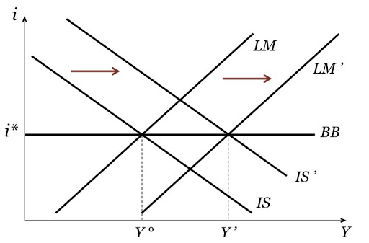
MODEL IS-LM-BP

Slide 17
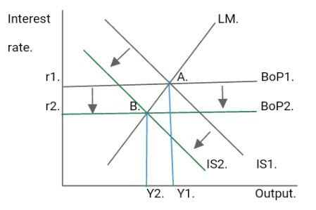
MODEL IS-LM-BP

Slide 18
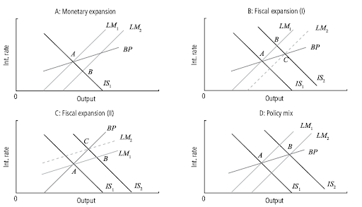
MODEL IS-LM-BP

Slide 19
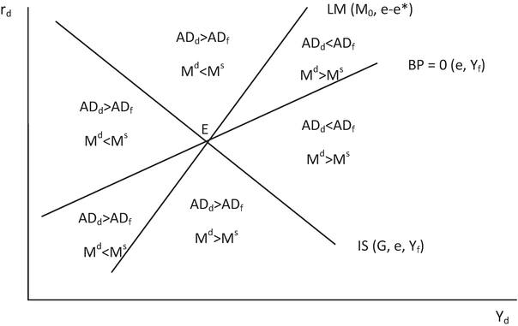
A BALANCE OF PAYMENT CURVE

Slide 20
J-CURVE
If there are fluctuations in exchange rates, this results in displacement from equilibrium of the BoP.
It is caused by reaction of the current account balance of BoP. For example, if there is a depreciation of the currency, the current account immediately records a deterioration of its balance.
This reaction can be represented graphically by using the J-curve (see Figure 7-3).

Slide 21
J-CURVE

Slide 22
J-CURVE
The current account of the BoP (measured through domestic output) may be deteriorated after the real depreciation of the currency.
This is recorded by the movement from point A to B in the figure above and this situation arises because that most of the import and export transactions were agreed several months in advance.
In the following months after the depreciation, exports and imports may reflect a buying decision based on "old" exchange rate, and therefore the primary effect of depreciation increases the value of imports, while export value has not changed (and thus causing deterioration of the current account).

Slide 23
J-CURVE
After a certain period of time, the domestic production will be cheaper abroad (export) and imported goods in the domestic economy will be more expensive, what improves the current account balance and this process is shown by the shift between points B and C. At point C, the level of the current account balance achieves original values and in the long run, the depreciation causes its surplus.
This is caused by substitution of foreign products by domestic products.
Based on empirical studies, estimated duration of the J-curve is between six months and one year and depends on many factors, such as the possibility of substitution of foreign production, sales markets, technological capabilities of domestic production, etc.

Slide 24
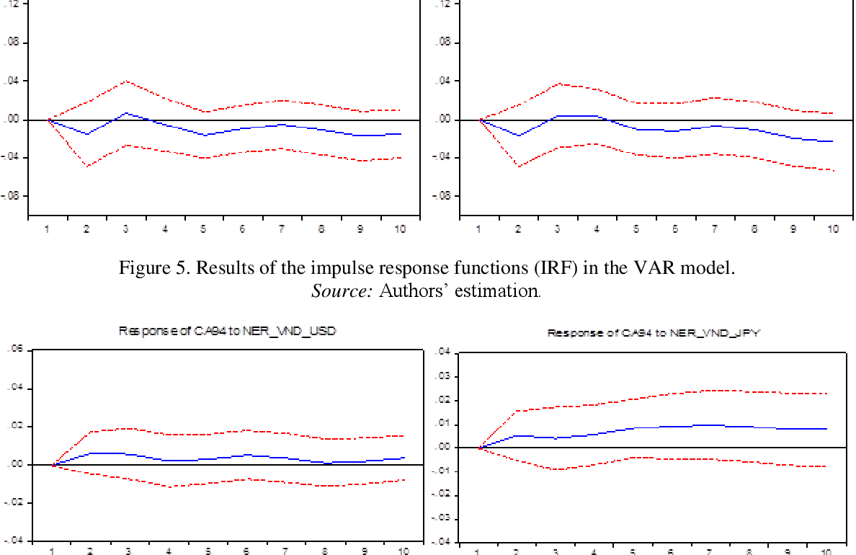
J-CURVE – THE EMPIRICAL TEST
The Impact of Exchange Rate Movements on Trade Balance between Vietnam and Japan: J Curve Effect Test

Slide 25
THANK YOU FOR YOUR ATTENTION!

