Slide 1
Statistics
Lecture 11
ANOVA:
Analysis of Variance
(for a single factor)
David Bartl
Statistics
INM/BASTA

Slide 2
Analysis of Variance (ANOVA) for a single factor
Bartlett’s test

Slide 3
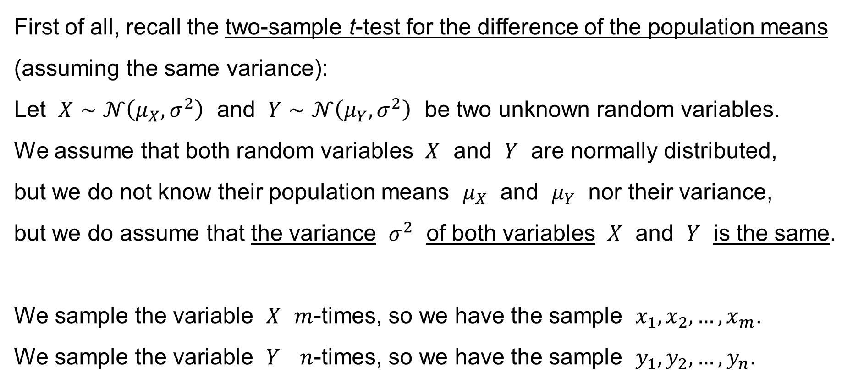
Two-sample t-test for the diff. of the pop. means // σ_{X}=σ_{Y}
First of all, recall the two-sample t-test for the difference of the population means (assuming the same variance):
Let $X∼𝒩\left(μ_{X},σ^{2}\right)$ and $Y∼𝒩\left(μ_{Y},σ^{2}\right)$ be two unknown random variables.
We assume that both random variables $X$ and $Y$ are normally distributed,
but we do not know their population means $μ_{X}$ and $μ_{Y}$ nor their variance,
but we do assume that the variance $σ^{2}$ of both variables $X$ and $Y$ is the same.
We sample the variable $X$ $m$-times, so we have the sample $x_{1},x_{2},…,x_{m}$.
We sample the variable $Y$ $n$-times, so we have the sample $y_{1},y_{2},…,y_{n}$.

Slide 4
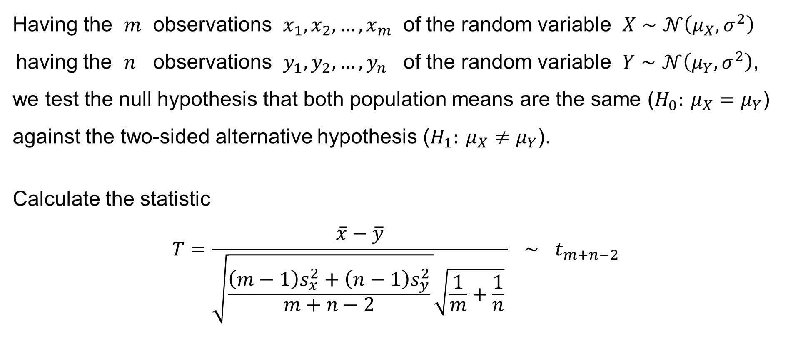
Two-sample t-test for the diff. of the pop. means // σ_{X}=σ_{Y}
Having the $m$ observations $x_{1},x_{2},…,x_{m}$ of the random variable $X∼𝒩\left(μ_{X},σ^{2}\right)$
having the $n$ observations $y_{1},y_{2},…,y_{n}$ of the random variable $Y∼𝒩\left(μ_{Y},σ^{2}\right)$,
we test the null hypothesis that both population means are the same ($H_{0}: μ_{X}=μ_{Y}$) against the two-sided alternative hypothesis ($H_{1}: μ_{X}≠μ_{Y}$).
Calculate the statistic
$$T=\frac{\left.\overline{x}−\overline{y}\right.}{\sqrt{\frac{\left(m−1\right)s_{x}^{2}+\left(n−1\right)s_{y}^{2}}{m+n−2} }\sqrt{\frac{1}{m}+\frac{1}{n}} } ∼ t_{m+n−2}$$
and

Slide 5
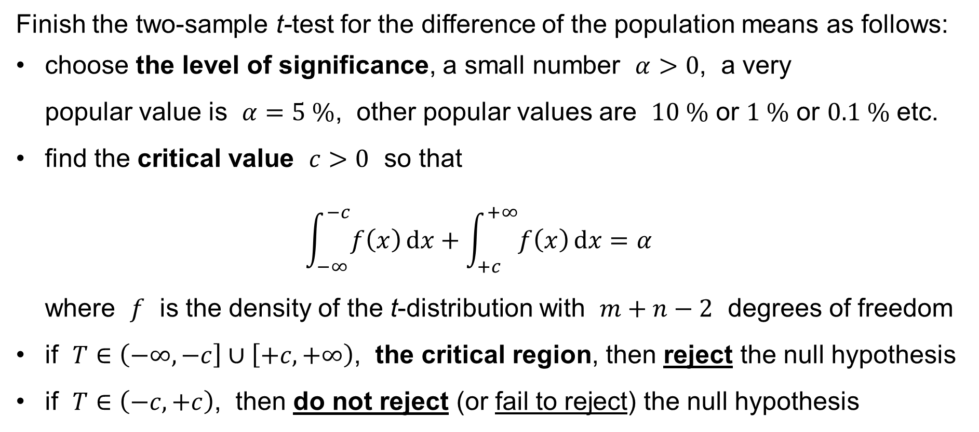
Two-sample t-test for the diff. of the pop. means // σ_{X}=σ_{Y}
Finish the two-sample t-test for the difference of the population means as follows:
choose the level of significance, a small number $α>0$, a very
popular value is $α=5 \%$, other popular values are $10 \%$ or $1 \%$ or $0.1 \%$ etc.
find the critical value $c>0$ so that
$\int_{−∞}^{−c}{f\left(x\right) dx}+\int_{+c}^{+∞}{f\left(x\right) dx}=α$
where $f$ is the density of the t-distribution with $m+n−2$ degrees of freedom
if $T∈\left(−∞,−c\right]∪\left[+c,+∞\right)$, the critical region, then reject the null hypothesis
if $T∈\left(−c,+c\right)$, then do not reject (or fail to reject) the null hypothesis

Slide 6
One-Way ANOVA

Slide 7
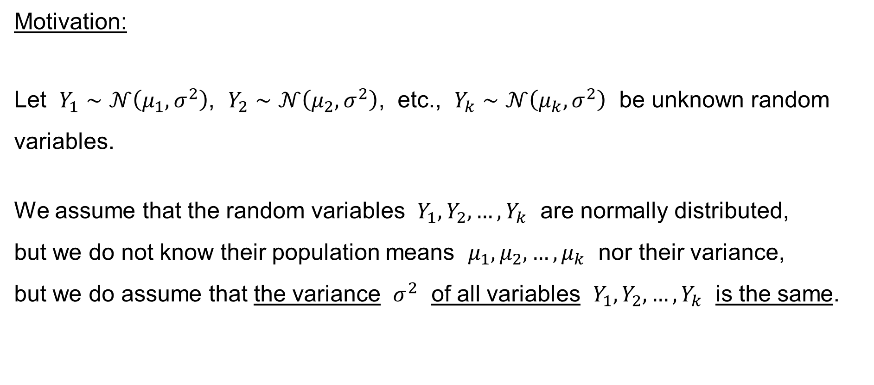
One-way ANOVA
Motivation:
Let $Y_{1}∼𝒩\left(μ_{1},σ^{2}\right)$, $Y_{2}∼𝒩\left(μ_{2},σ^{2}\right)$, etc., $Y_{k}∼𝒩\left(μ_{k},σ^{2}\right)$ be unknown random variables.
We assume that the random variables $Y_{1},Y_{2},…,Y_{k}$ are normally distributed,
but we do not know their population means $μ_{1},μ_{2},…,μ_{k}$ nor their variance,
but we do assume that the variance $σ^{2}$ of all variables $Y_{1},Y_{2},…,Y_{k}$ is the same.

Slide 8
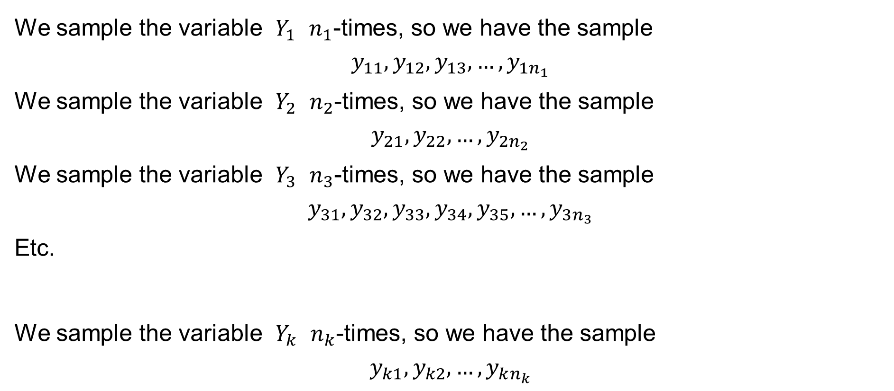
One-way ANOVA
We sample the variable $Y_{1}$ $n_{1}$-times, so we have the sample
$$y_{11},y_{12},y_{13},…,y_{1n_{1}}$$
We sample the variable $Y_{2}$ $n_{2}$-times, so we have the sample
$$y_{21},y_{22},…,y_{2n_{2}}$$
We sample the variable $Y_{3}$ $n_{3}$-times, so we have the sample
$$y_{31},y_{32},y_{33},y_{34},y_{35},…,y_{3n_{3}}$$
Etc.
We sample the variable $Y_{k}$ $n_{k}$-times, so we have the sample
$$y_{k1},y_{k2},…,y_{kn_{k}}$$

Slide 9
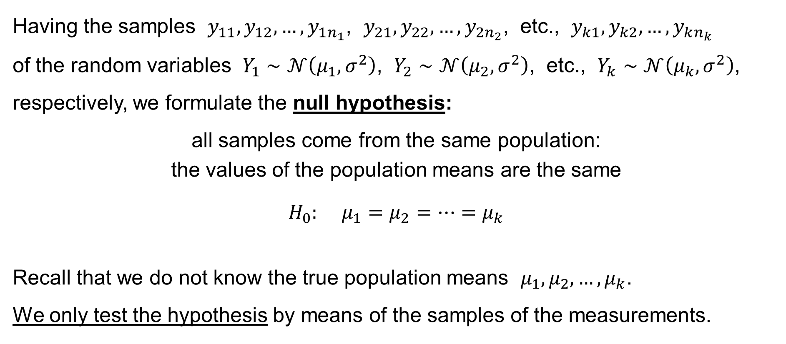
One-way ANOVA
Having the samples $y_{11},y_{12},…,y_{1n_{1}}$, $y_{21},y_{22},…,y_{2n_{2}}$, etc., $y_{k1},y_{k2},…,y_{kn_{k}}$
of the random variables $Y_{1}∼𝒩\left(μ_{1},σ^{2}\right)$, $Y_{2}∼𝒩\left(μ_{2},σ^{2}\right)$, etc., $Y_{k}∼𝒩\left(μ_{k},σ^{2}\right)$, respectively, we formulate the null hypothesis:
all samples come from the same population:
the values of the population means are the same
$$H_{0}: μ_{1}=μ_{2}=⋯=μ_{k}$$
Recall that we do not know the true population means $μ_{1},μ_{2},…,μ_{k}$.
We only test the hypothesis by means of the samples of the measurements.

Slide 10
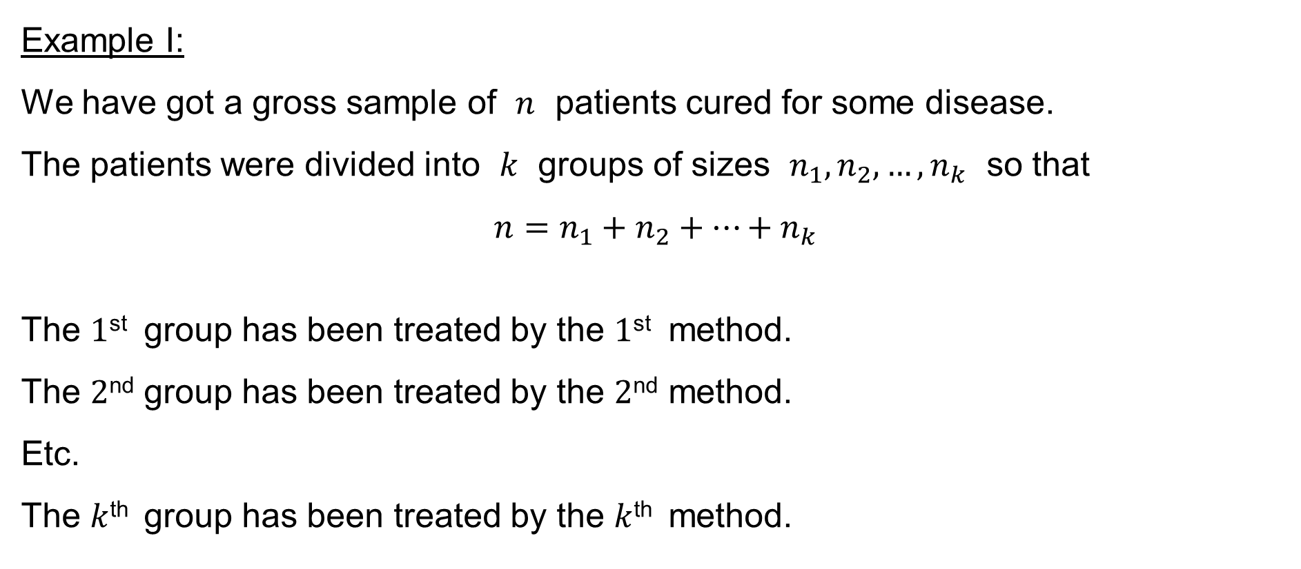
One-way ANOVA
Example I:
We have got a gross sample of $n$ patients cured for some disease.
The patients were divided into $k$ groups of sizes $n_{1},n_{2},…,n_{k}$ so that
$$n=n_{1}+n_{2}+⋯+n_{k}$$
The $1$^{st} group has been treated by the $1$^{st} method.
The $2$^{nd} group has been treated by the $2$^{nd} method.
Etc.
The $k$^{th} group has been treated by the $k$^{th} method.

Slide 11
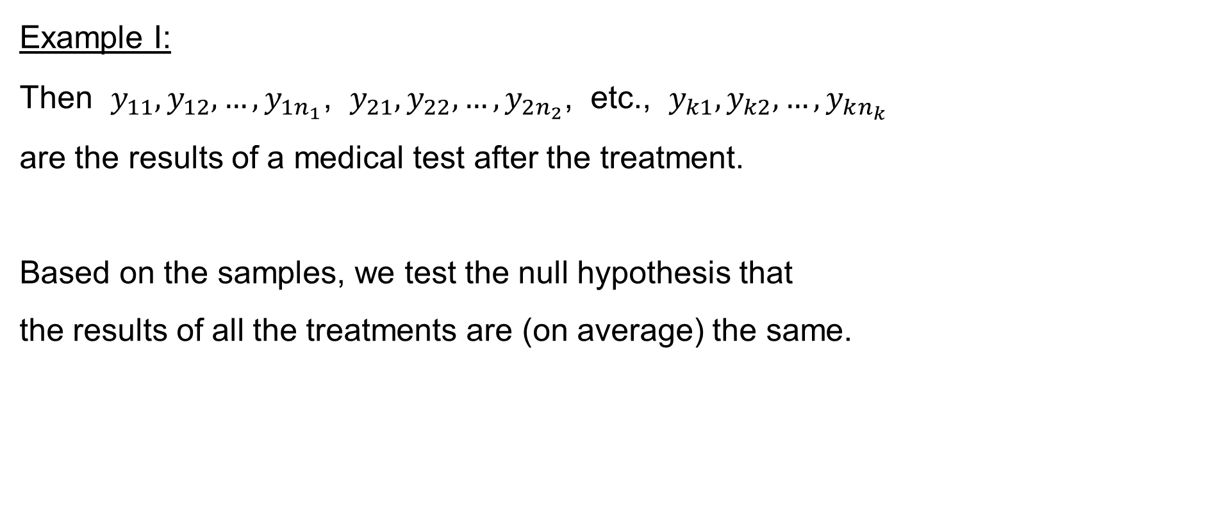
One-way ANOVA
Example I:
Then $y_{11},y_{12},…,y_{1n_{1}}$, $y_{21},y_{22},…,y_{2n_{2}}$, etc., $y_{k1},y_{k2},…,y_{kn_{k}}$
are the results of a medical test after the treatment.
Based on the samples, we test the null hypothesis that
the results of all the treatments are (on average) the same.

Slide 12
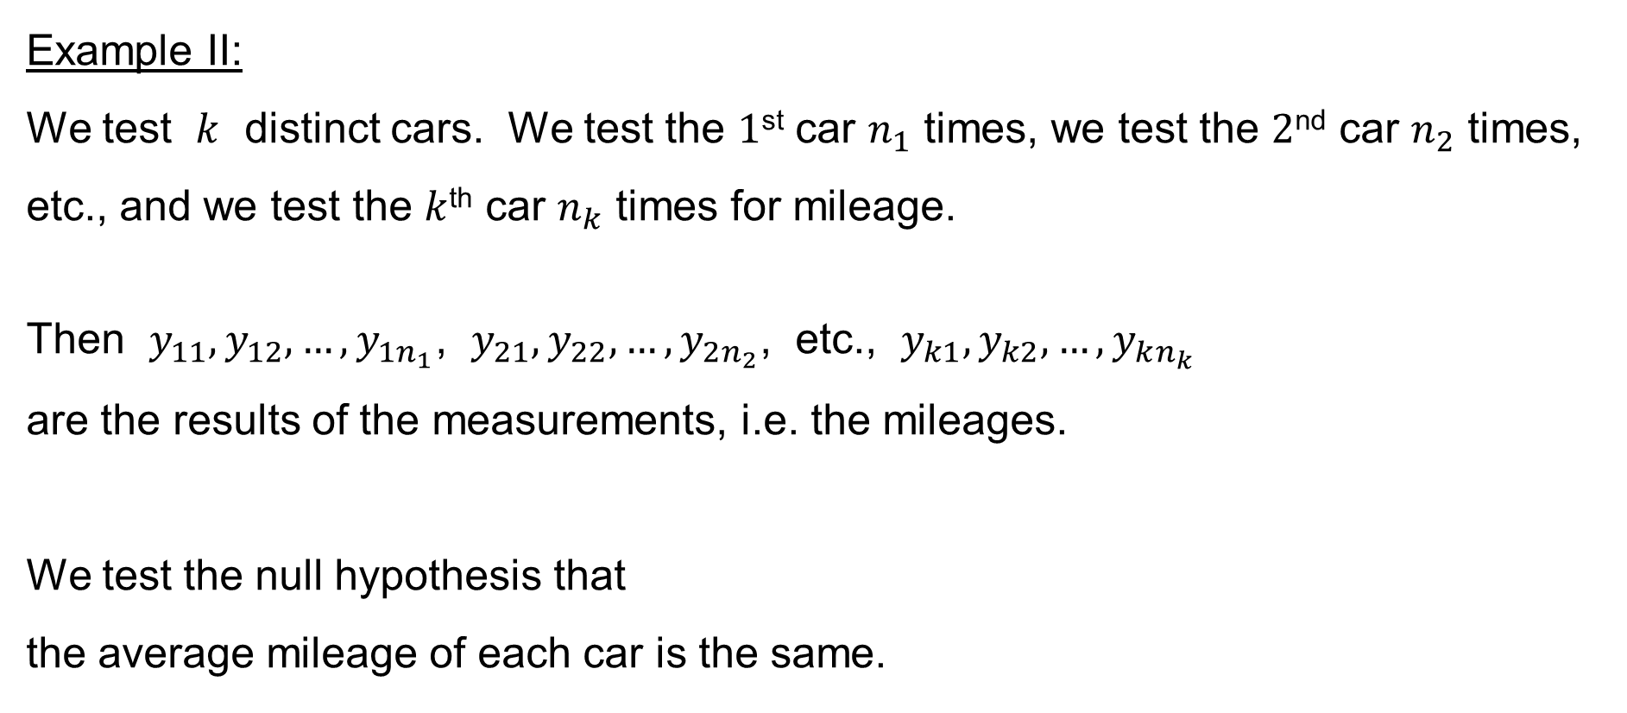
One-way ANOVA
Example II:
We test $k$ distinct cars. We test the $1$^{st} car $n_{1}$ times, we test the $2$^{nd} car $n_{2}$ times, etc., and we test the $k$^{th} car $n_{k}$ times for mileage.
Then $y_{11},y_{12},…,y_{1n_{1}}$, $y_{21},y_{22},…,y_{2n_{2}}$, etc., $y_{k1},y_{k2},…,y_{kn_{k}}$
are the results of the measurements, i.e. the mileages.
We test the null hypothesis that
the average mileage of each car is the same.

Slide 13
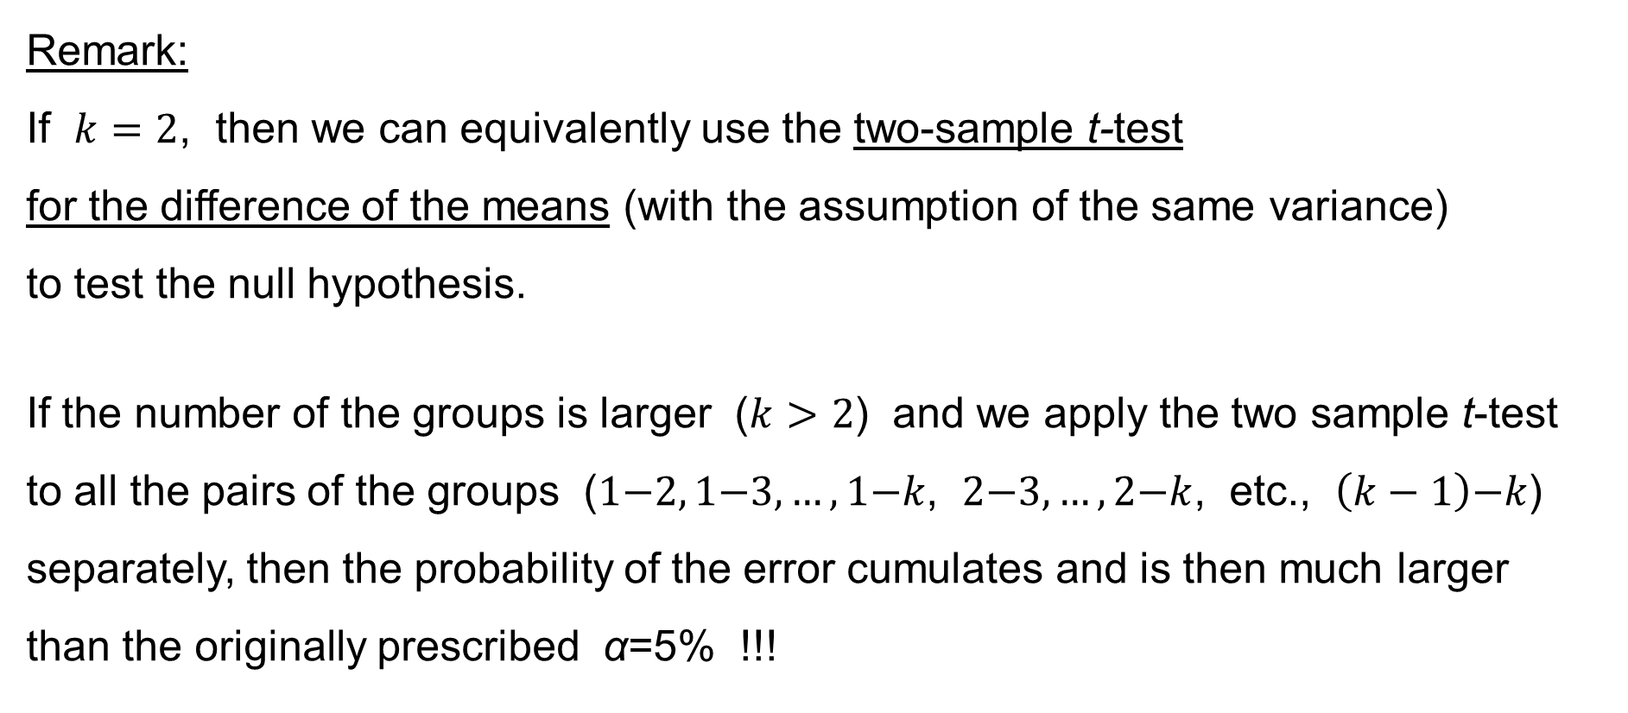
One-way ANOVA
Remark:
If $k=2$, then we can equivalently use the two-sample t-test
for the difference of the means (with the assumption of the same variance)
to test the null hypothesis.
If the number of the groups is larger ($k>2$) and we apply the two sample t-test
to all the pairs of the groups ($1\text{−}2, 1\text{−}3,…,1\text{−}k$, $2\text{−}3,…,2\text{−}k$, etc., $\left(k−1\right)\text{−}k$) separately, then the probability of the error cumulates and is then much larger
than the originally prescribed α=5% !!!

Slide 14
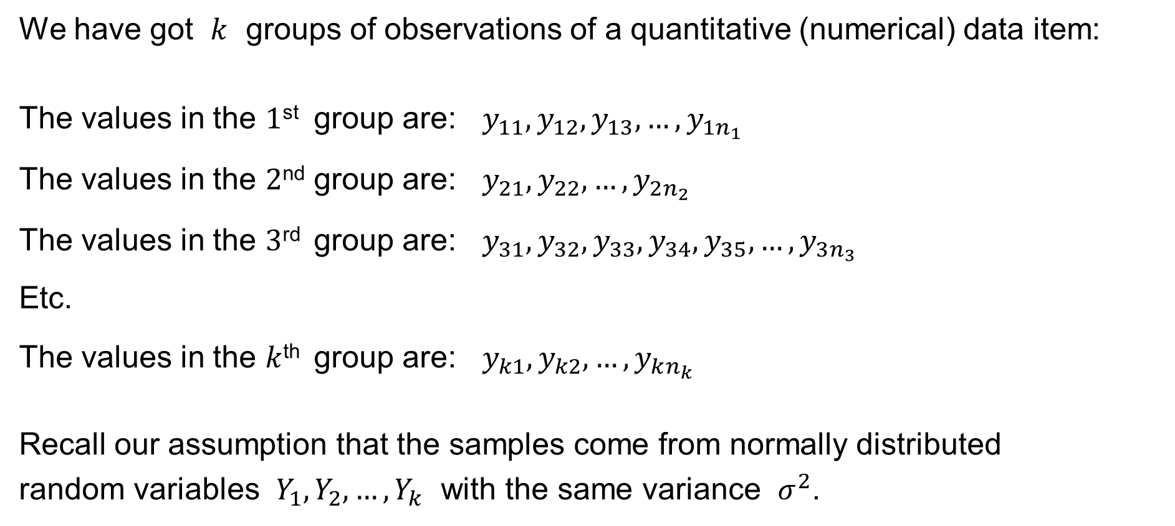
One-way ANOVA
We have got $k$ groups of observations of a quantitative (numerical) data item:
The values in the $1$^{st} group are: $y_{11},y_{12},y_{13},…,y_{1n_{1}}$
The values in the $2$^{nd} group are: $y_{21},y_{22},…,y_{2n_{2}}$
The values in the $3$^{rd} group are: $y_{31},y_{32},y_{33},y_{34},y_{35},…,y_{3n_{3}}$
Etc.
The values in the $k$^{th} group are: $y_{k1},y_{k2},…,y_{kn_{k}}$
Recall our assumption that the samples come from normally distributed
random variables $Y_{1},Y_{2},…,Y_{k}$ with the same variance $σ^{2}$.

Slide 15
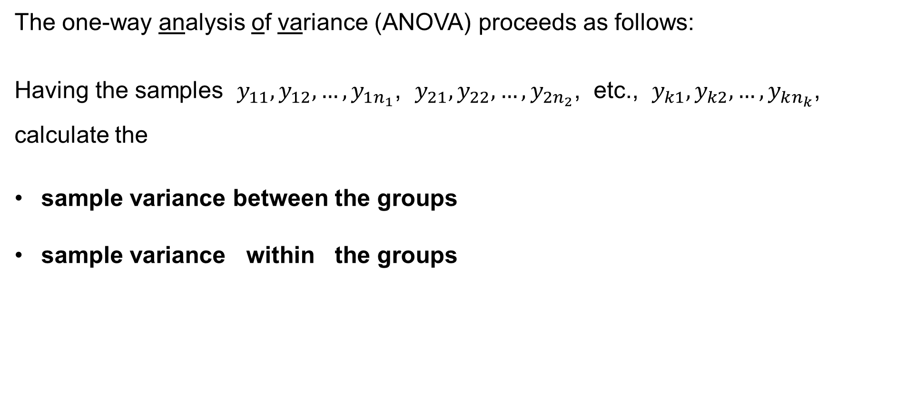
One-way ANOVA
The one-way analysis of variance (ANOVA) proceeds as follows:
Having the samples $y_{11},y_{12},…,y_{1n_{1}}$, $y_{21},y_{22},…,y_{2n_{2}}$, etc., $y_{k1},y_{k2},…,y_{kn_{k}}$,
calculate the
sample variance between the groups
sample variance within the groups

Slide 16
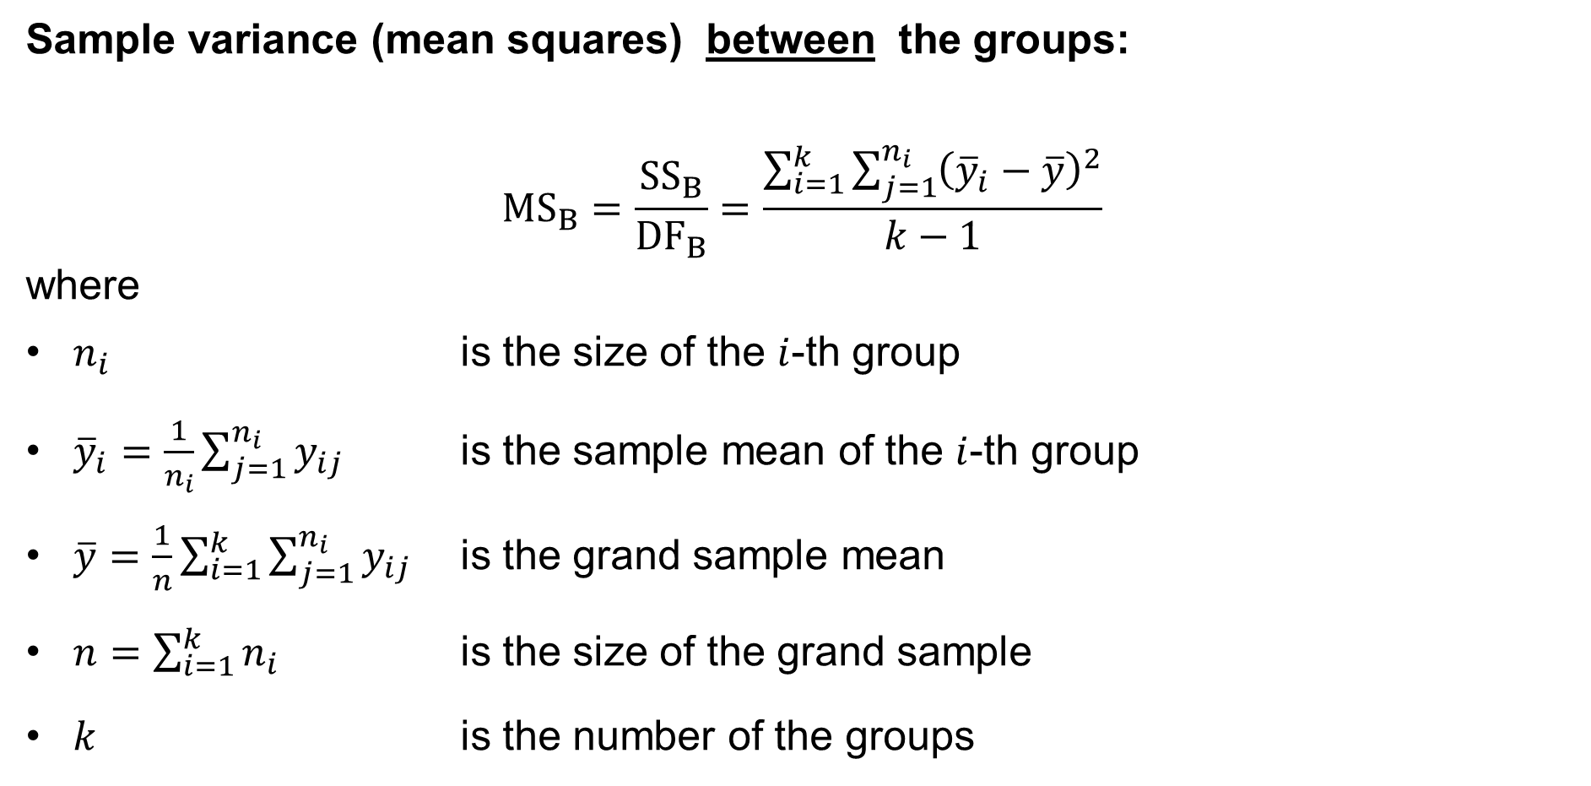
One-way ANOVA
Sample variance (mean squares) between the groups:
$${MS}_{B}=\frac{{SS}_{B}}{{DF}_{B}}=\frac{\sum_{i=1}^{k}{\sum_{j=1}^{n_{i}}{{\left({\overline{y}}_{i}−\overline{y}\right)}^{2}}}}{k−1}$$
where
$n_{i}$ is the size of the $i$-th group
${\overline{y}}_{i}=\frac{1}{n_{i}}\sum_{j=1}^{n_{i}}{y_{ij}}$ is the sample mean of the $i$-th group
$\overline{y}=\frac{1}{n}\sum_{i=1}^{k}{\sum_{j=1}^{n_{i}}{y_{ij}}}$ is the grand sample mean
$n=\sum_{i=1}^{k}{n_{i}}$ is the size of the grand sample
$k$ is the number of the groups
sum of squares (between)
mean squares (between)
degrees of freedom (between)

Slide 17
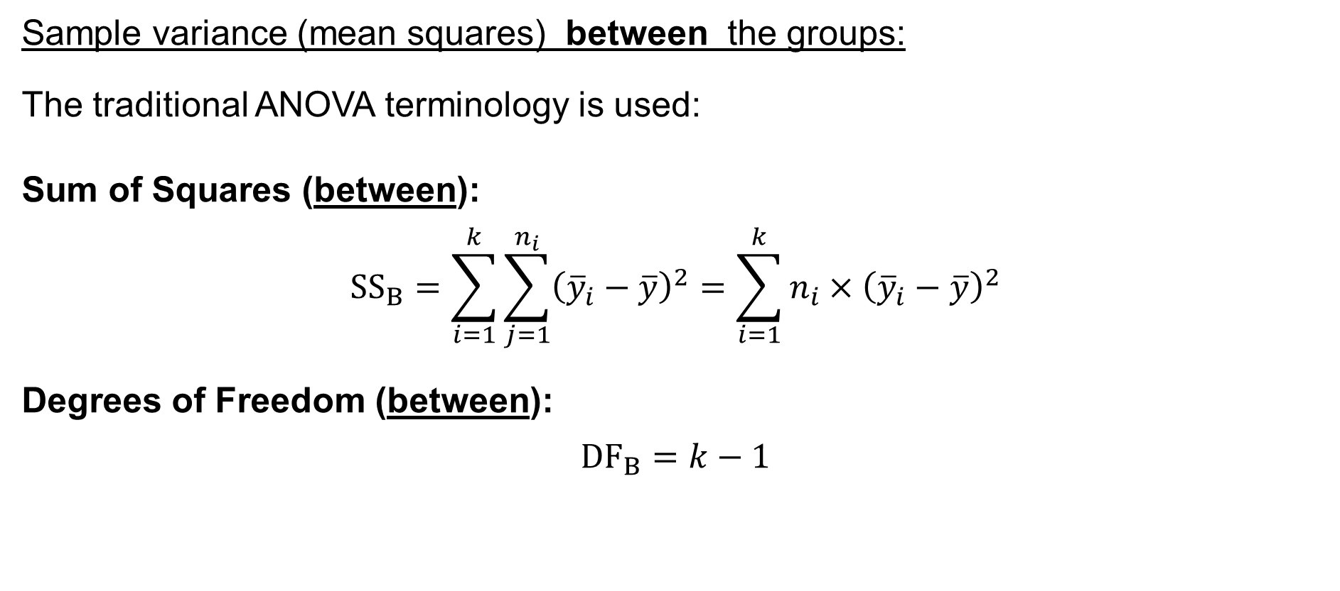
One-way ANOVA
Sample variance (mean squares) between the groups:
The traditional ANOVA terminology is used:
Sum of Squares (between):
$${SS}_{B}=\sum_{i=1}^{k}{\sum_{j=1}^{n_{i}}{{\left({\overline{y}}_{i}−\overline{y}\right)}^{2}}}=\sum_{i=1}^{k}{{n_{i}×\left({\overline{y}}_{i}−\overline{y}\right)}^{2}}$$
Degrees of Freedom (between):
$${DF}_{B}=k−1$$

Slide 18
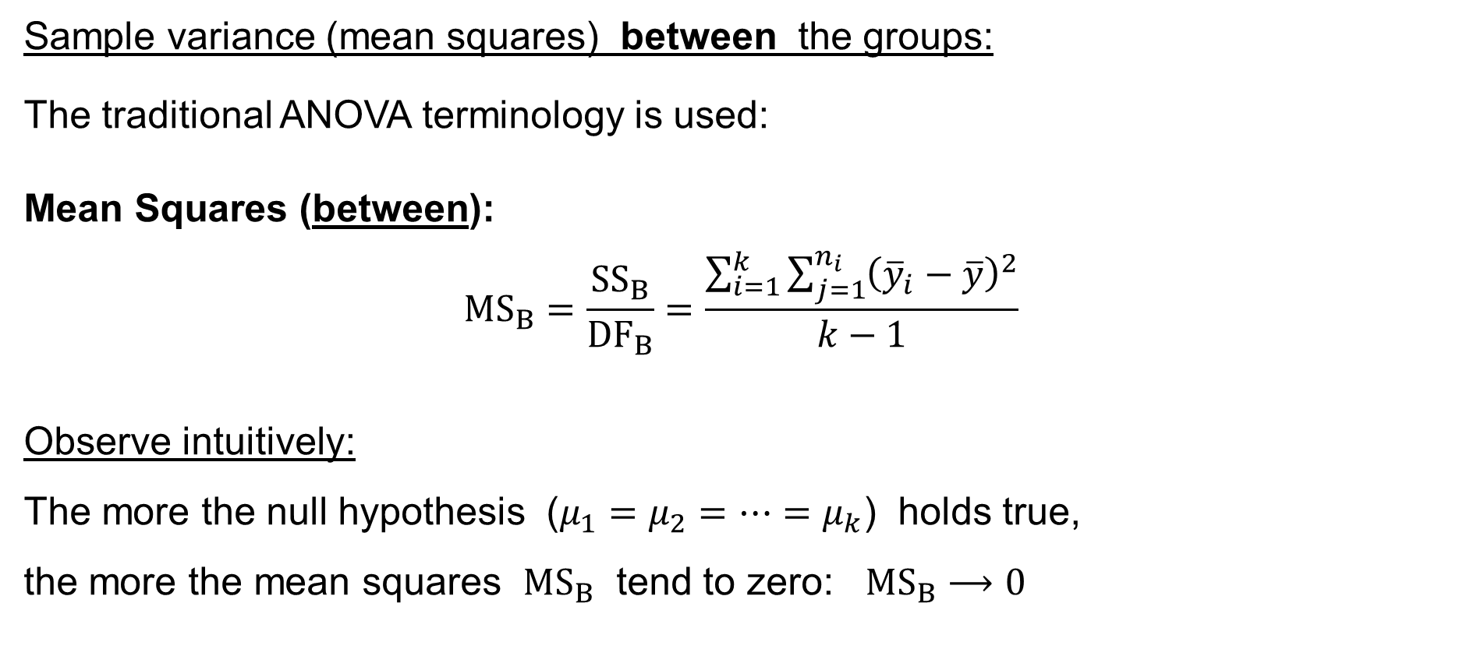
One-way ANOVA
Sample variance (mean squares) between the groups:
The traditional ANOVA terminology is used:
Mean Squares (between):
$${MS}_{B}=\frac{{SS}_{B}}{{DF}_{B}}=\frac{\sum_{i=1}^{k}{\sum_{j=1}^{n_{i}}{{\left({\overline{y}}_{i}−\overline{y}\right)}^{2}}}}{k−1}$$
Observe intuitively:
The more the null hypothesis ($μ_{1}=μ_{2}=⋯=μ_{k}$) holds true,
the more the mean squares ${MS}_{B}$ tend to zero: ${MS}_{B}⟶0$

Slide 19
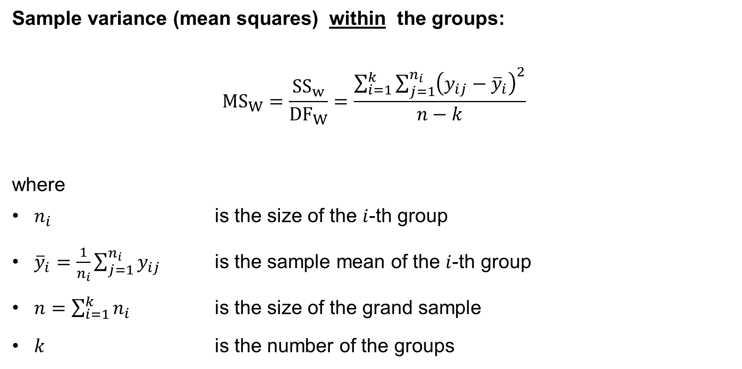
One-way ANOVA
Sample variance (mean squares) within the groups:
$${MS}_{W}=\frac{{SS}_{w}}{{DF}_{W}}=\frac{\sum_{i=1}^{k}{\sum_{j=1}^{n_{i}}{{\left(y_{ij}−{\overline{y}}_{i}\right)}^{2}}}}{n−k}$$
where
$n_{i}$ is the size of the $i$-th group
${\overline{y}}_{i}=\frac{1}{n_{i}}\sum_{j=1}^{n_{i}}{y_{ij}}$ is the sample mean of the $i$-th group
$n=\sum_{i=1}^{k}{n_{i}}$ is the size of the grand sample
$k$ is the number of the groups
sum of squares (within)
mean squares (within)
degrees of freedom (within)

Slide 20
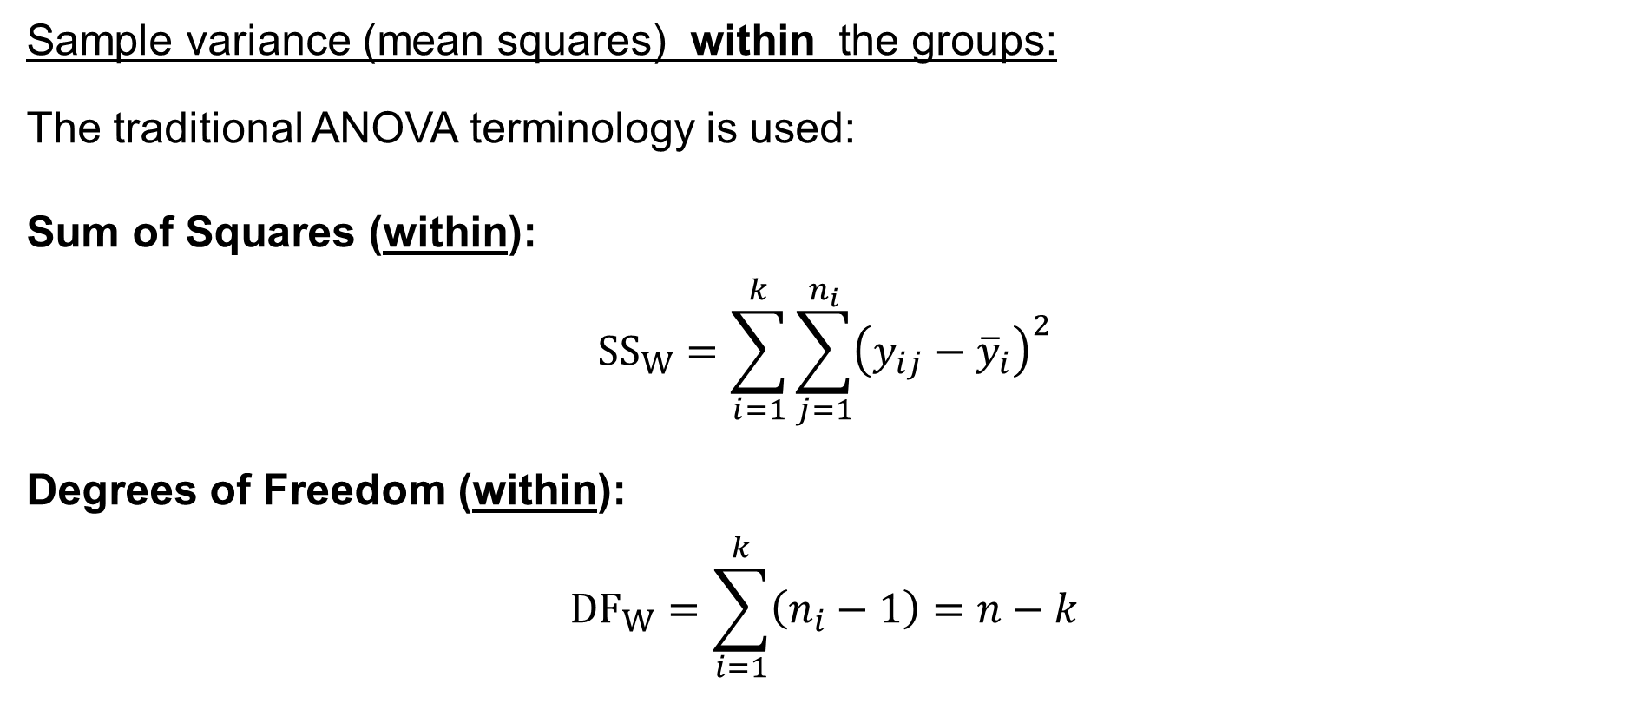
One-way ANOVA
Sample variance (mean squares) within the groups:
The traditional ANOVA terminology is used:
Sum of Squares (within):
$${SS}_{W}=\sum_{i=1}^{k}{\sum_{j=1}^{n_{i}}{{\left(y_{ij}−{\overline{y}}_{i}\right)}^{2}}}$$
Degrees of Freedom (within):
$${DF}_{W}=\sum_{i=1}^{k}{\left(n_{i}−1\right)}=n−k$$

Slide 21
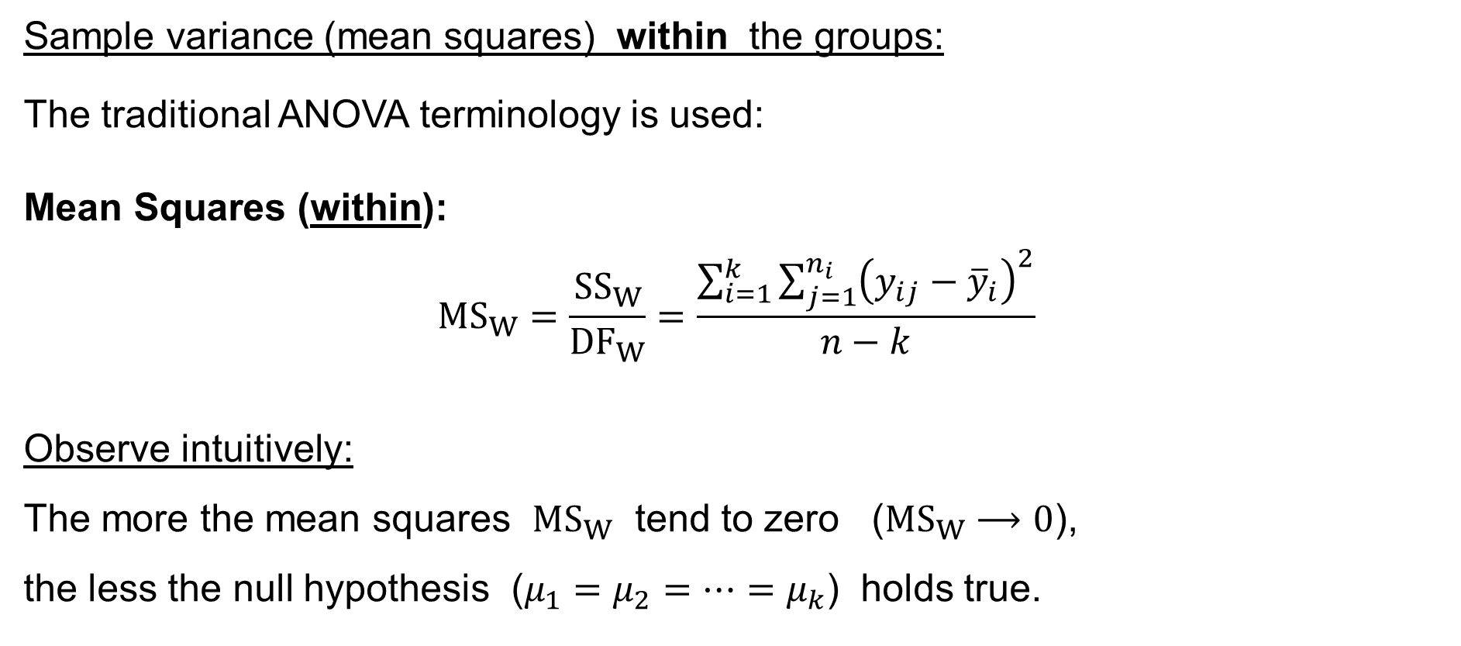
One-way ANOVA
Sample variance (mean squares) within the groups:
The traditional ANOVA terminology is used:
Mean Squares (within):
$${MS}_{W}=\frac{{SS}_{W}}{{DF}_{W}}=\frac{\sum_{i=1}^{k}{\sum_{j=1}^{n_{i}}{{\left(y_{ij}−{\overline{y}}_{i}\right)}^{2}}}}{n−k}$$
Observe intuitively:
The more the mean squares ${MS}_{W}$ tend to zero (${MS}_{W}⟶0$),
the less the null hypothesis ($μ_{1}=μ_{2}=⋯=μ_{k}$) holds true.

Slide 22
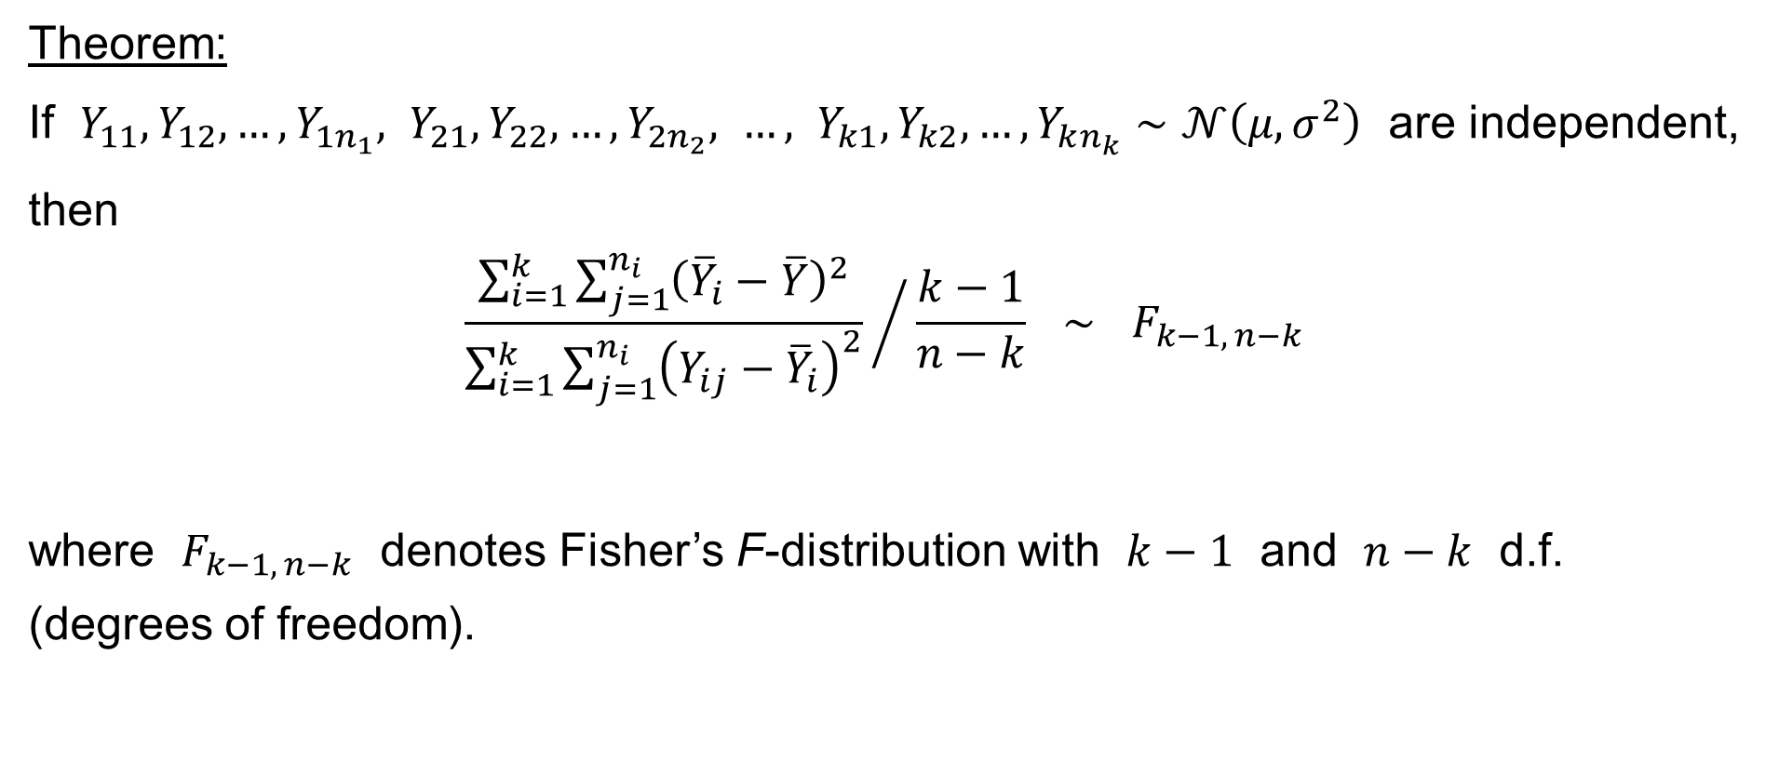
One-way ANOVA
Theorem:
If $Y_{11},Y_{12},…,Y_{1n_{1}}, Y_{21},Y_{22},…,Y_{2n_{2}}, …, Y_{k1},Y_{k2},…,Y_{kn_{k}}∼𝒩\left(μ,σ^{2}\right)$ are independent, then
$${\frac{\sum_{i=1}^{k}{\sum_{j=1}^{n_{i}}{{\left({\overline{Y}}_{i}−\overline{Y}\right)}^{2}}}}{\sum_{i=1}^{k}{\sum_{j=1}^{n_{i}}{{\left(Y_{ij}−{\overline{Y}}_{i}\right)}^{2}}}} }/{ \frac{k−1}{n−k}} ∼ F_{k−1, n−k}$$
where $F_{k−1, n−k}$ denotes Fisher’s F-distribution with $k−1$ and $n−k$ d.f.
(degrees of freedom).

Slide 23
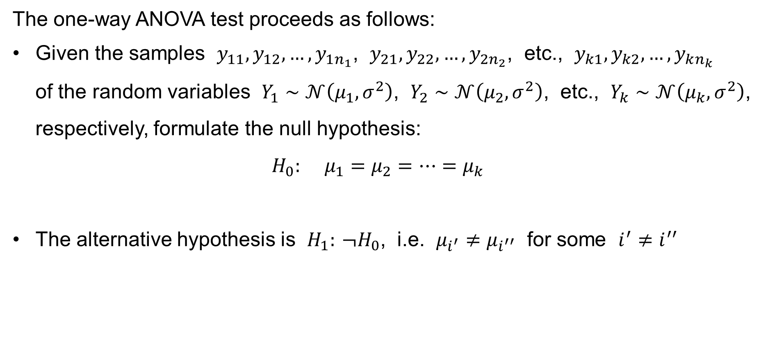
One-way ANOVA: the test
The one-way ANOVA test proceeds as follows:
Given the samples $y_{11},y_{12},…,y_{1n_{1}}$, $y_{21},y_{22},…,y_{2n_{2}}$, etc., $y_{k1},y_{k2},…,y_{kn_{k}}$
of the random variables $Y_{1}∼𝒩\left(μ_{1},σ^{2}\right)$, $Y_{2}∼𝒩\left(μ_{2},σ^{2}\right)$, etc., $Y_{k}∼𝒩\left(μ_{k},σ^{2}\right)$, respectively, formulate the null hypothesis:
$H_{0}: μ_{1}=μ_{2}=⋯=μ_{k}$
The alternative hypothesis is $H_{1}: ¬H_{0}$, i.e. $μ_{i^{′}}≠μ_{i^{′′}}$ for some $i^{′}≠i^{′′}$

Slide 24
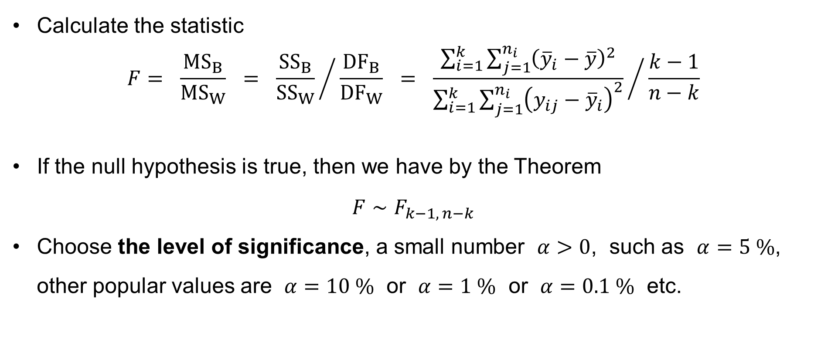
One-way ANOVA: the test
Calculate the statistic
$$F= \frac{{MS}_{B}}{{MS}_{W}} = {\frac{{SS}_{B}}{{SS}_{W}} }/{ \frac{{DF}_{B}}{{DF}_{W}}} = {\frac{\sum_{i=1}^{k}{\sum_{j=1}^{n_{i}}{{\left({\overline{y}}_{i}−\overline{y}\right)}^{2}}}}{\sum_{i=1}^{k}{\sum_{j=1}^{n_{i}}{{\left(y_{ij}−{\overline{y}}_{i}\right)}^{2}}}} }/{ \frac{k−1}{n−k}}$$
If the null hypothesis is true, then we have by the Theorem
$F∼F_{k−1, n−k}$
Choose the level of significance, a small number $α>0$, such as $α=5 \%$, other popular values are $α=10 \%$ or $α=1 \%$ or $α=0.1 \%$ etc.

Slide 25
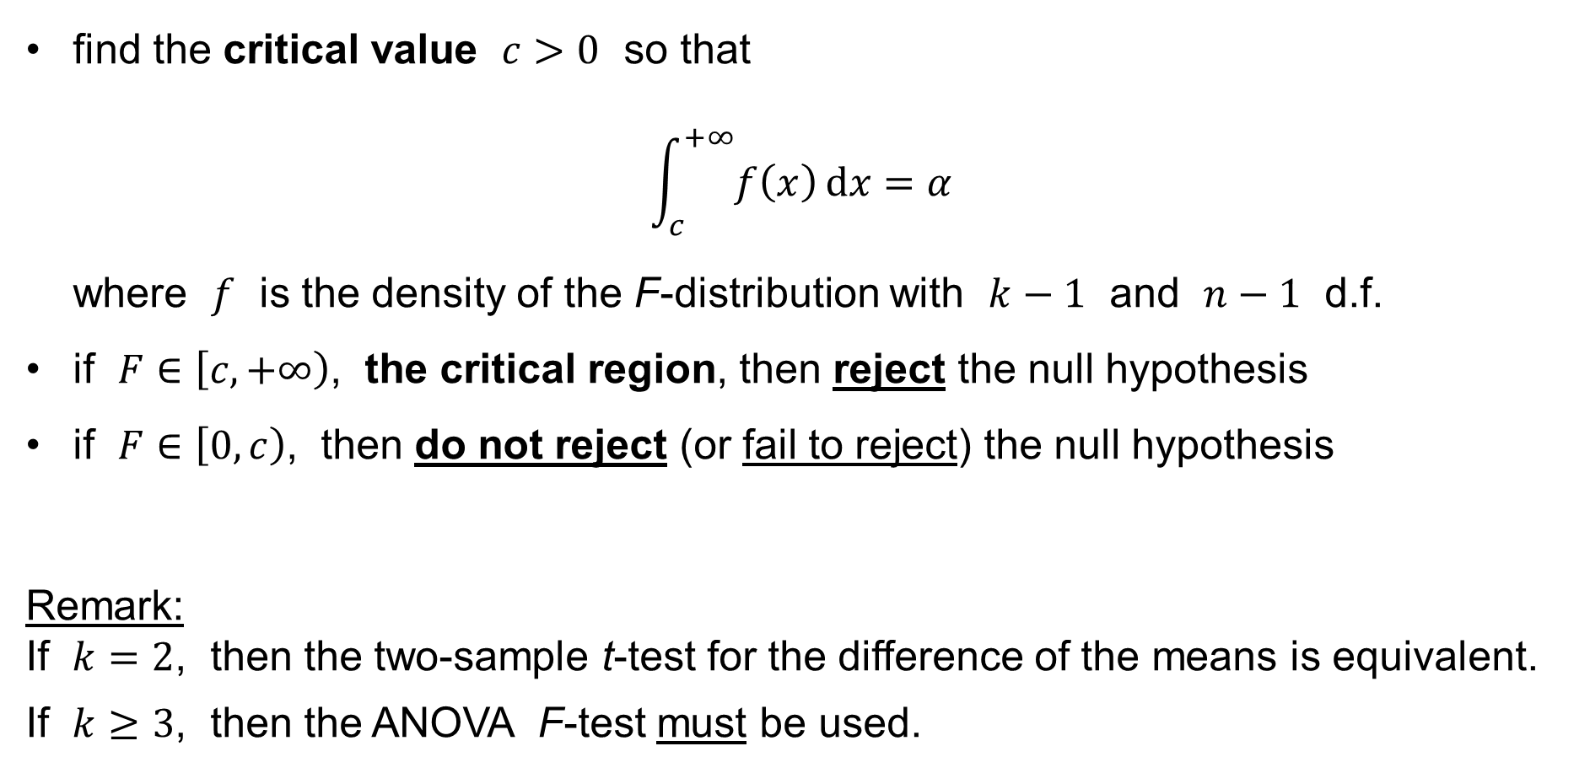
One-way ANOVA: the test
find the critical value $c>0$ so that
$\int_{c}^{+∞}{f\left(x\right) dx}=α$
where $f$ is the density of the F-distribution with $k−1$ and $n−1$ d.f.
if $F∈\left[c,+∞\right)$, the critical region, then reject the null hypothesis
if $F∈\left[0,c\right)$, then do not reject (or fail to reject) the null hypothesis
Remark:
If $k=2$, then the two-sample t-test for the difference of the means is equivalent.
If $k≥3$, then the ANOVA F-test must be used.

Slide 26
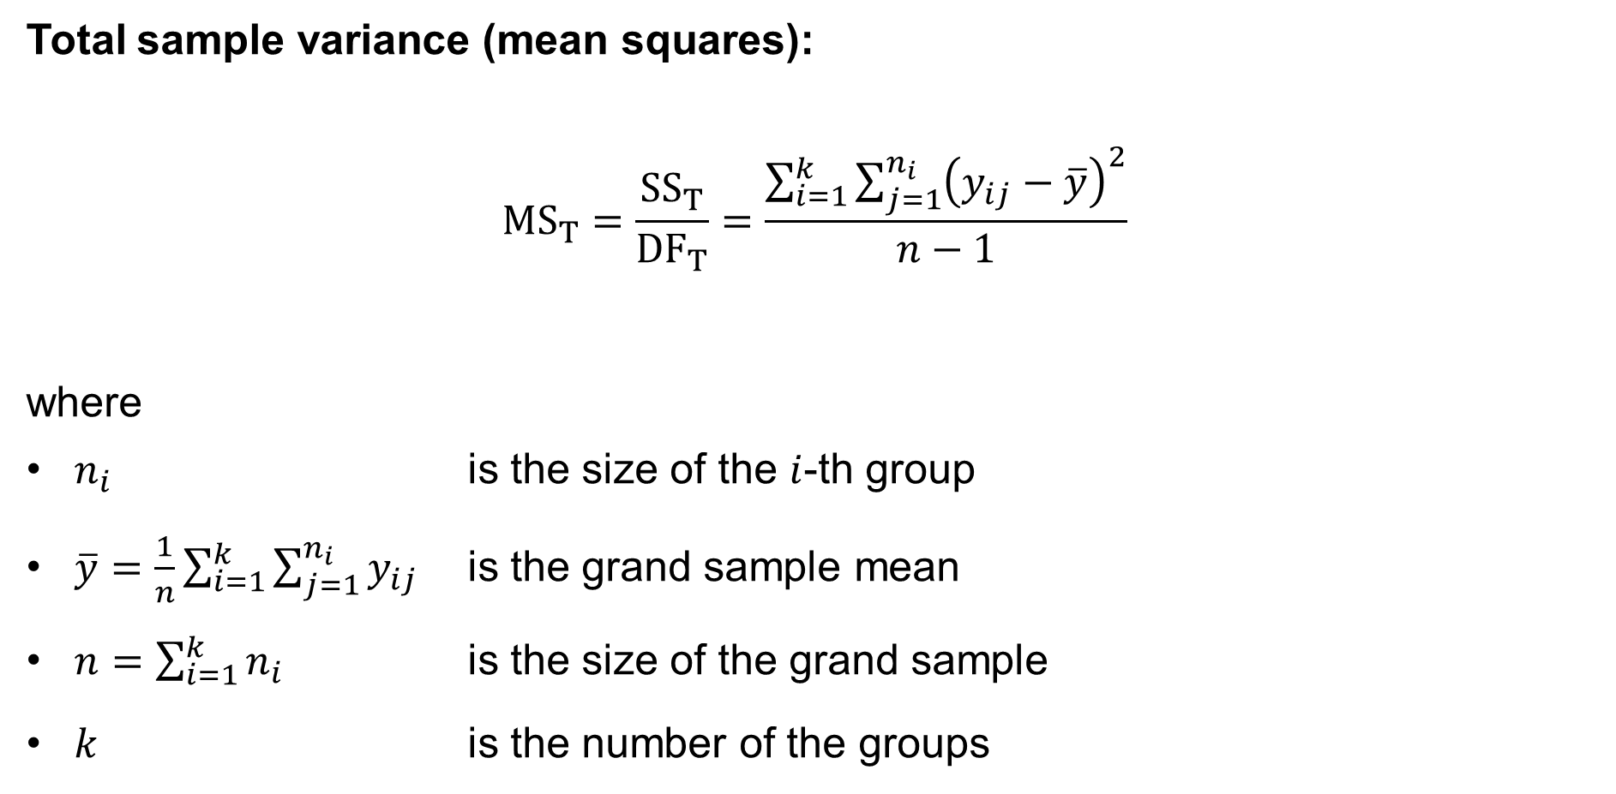
One-way ANOVA: total variation
Total sample variance (mean squares):
$${MS}_{T}=\frac{{SS}_{T}}{{DF}_{T}}=\frac{\sum_{i=1}^{k}{\sum_{j=1}^{n_{i}}{{\left(y_{ij}−\overline{y}\right)}^{2}}}}{n−1}$$
where
$n_{i}$ is the size of the $i$-th group
$\overline{y}=\frac{1}{n}\sum_{i=1}^{k}{\sum_{j=1}^{n_{i}}{y_{ij}}}$ is the grand sample mean
$n=\sum_{i=1}^{k}{n_{i}}$ is the size of the grand sample
$k$ is the number of the groups
sum of squares (total)
mean squares (total)
degrees of freedom (total)

Slide 27
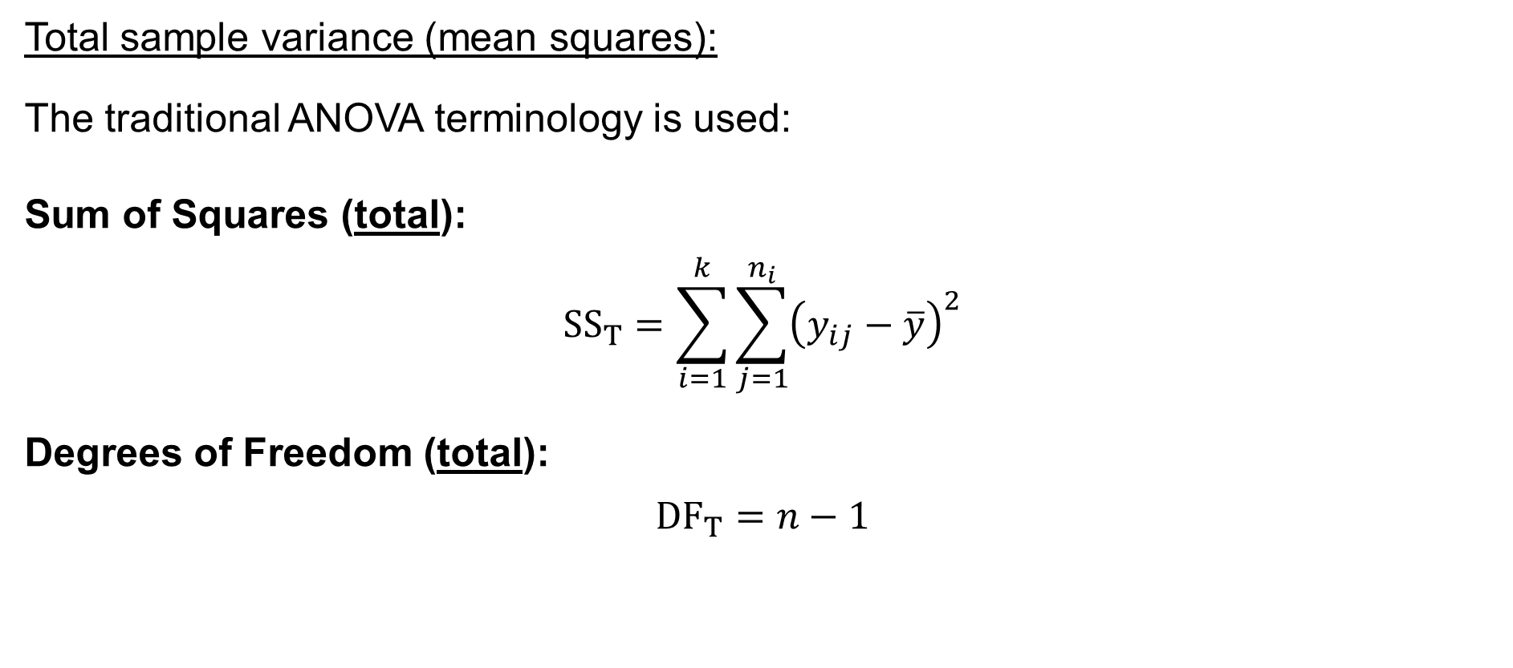
One-way ANOVA: total variation
Total sample variance (mean squares):
The traditional ANOVA terminology is used:
Sum of Squares (total):
$${SS}_{T}=\sum_{i=1}^{k}{\sum_{j=1}^{n_{i}}{{\left(y_{ij}−\overline{y}\right)}^{2}}}$$
Degrees of Freedom (total):
$${DF}_{T}=n−1$$

Slide 28

One-way ANOVA: total variation
Total sample variance (mean squares):
The traditional ANOVA terminology is used:
Mean Squares (total):
$${MS}_{T}=\frac{{SS}_{T}}{{DF}_{T}}=\frac{\sum_{i=1}^{k}{\sum_{j=1}^{n_{i}}{{\left(y_{ij}−\overline{y}\right)}^{2}}}}{n−1}$$

Slide 29

One-way ANOVA: total variation
Notice that it holds:
$${SS}_{T}={SS}_{W}+{SS}_{B}$$
or
$$\sum_{i=1}^{k}{\sum_{j=1}^{n_{i}}{{\left(y_{ij}−\overline{y}\right)}^{2}}}=\sum_{i=1}^{k}{\sum_{j=1}^{n_{i}}{{\left(y_{ij}−{\overline{y}}_{i}\right)}^{2}}}+\sum_{i=1}^{k}{\sum_{j=1}^{n_{i}}{{\left({\overline{y}}_{i}−\overline{y}\right)}^{2}}}$$

Slide 30

One-way ANOVA: total variation
Notice first:
$$\sum_{j=1}^{n_{i}}{\left(y_{ij}−{\overline{y}}_{i}\right)}=\sum_{j=1}^{n_{i}}{y_{ij}}−\sum_{j=1}^{n_{i}}{{\overline{y}}_{i}}=\sum_{j=1}^{n_{i}}{y_{ij}}−n_{i}×{\overline{y}}_{i}= \\ =\sum_{j=1}^{n_{i}}{y_{ij}}−n_{i}\frac{\sum_{j=1}^{n_{i}}{y_{ij}}}{n_{i}}= \\ =\sum_{j=1}^{n_{i}}{y_{ij}}−\sum_{j=1}^{n_{i}}{y_{ij}}=0$$

Slide 31
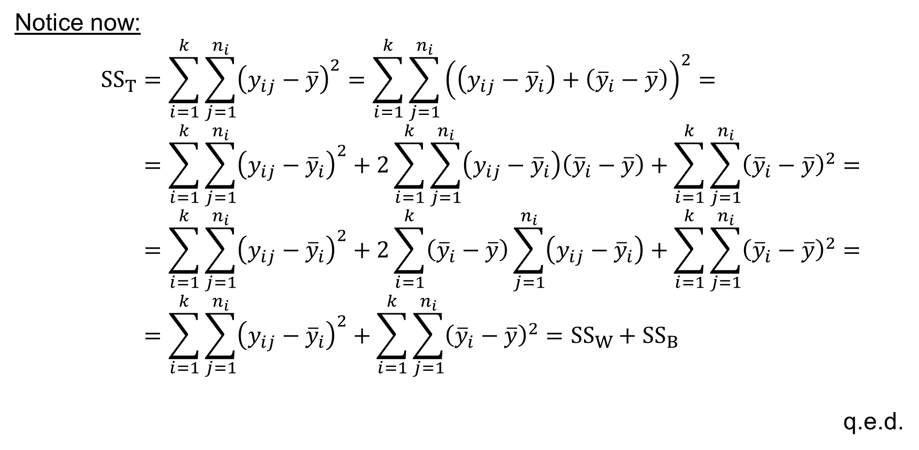
One-way ANOVA: total variation
Notice now:
$${SS}_{T}=\sum_{i=1}^{k}{\sum_{j=1}^{n_{i}}{{\left(y_{ij}−\overline{y}\right)}^{2}}}=\sum_{i=1}^{k}{\sum_{j=1}^{n_{i}}{{\left(\left(y_{ij}−{\overline{y}}_{i}\right)+\left({\overline{y}}_{i}−\overline{y}\right)\right)}^{2}}}= \\ =\sum_{i=1}^{k}{\sum_{j=1}^{n_{i}}{{\left(y_{ij}−{\overline{y}}_{i}\right)}^{2}}}+2\sum_{i=1}^{k}{\sum_{j=1}^{n_{i}}{\left(y_{ij}−{\overline{y}}_{i}\right)\left({\overline{y}}_{i}−\overline{y}\right)}}+\sum_{i=1}^{k}{\sum_{j=1}^{n_{i}}{{\left({\overline{y}}_{i}−\overline{y}\right)}^{2}}}= \\ =\sum_{i=1}^{k}{\sum_{j=1}^{n_{i}}{{\left(y_{ij}−{\overline{y}}_{i}\right)}^{2}}}+2\sum_{i=1}^{k}{\left({\overline{y}}_{i}−\overline{y}\right)\sum_{j=1}^{n_{i}}{\left(y_{ij}−{\overline{y}}_{i}\right)}}+\sum_{i=1}^{k}{\sum_{j=1}^{n_{i}}{{\left({\overline{y}}_{i}−\overline{y}\right)}^{2}}}= \\ =\sum_{i=1}^{k}{\sum_{j=1}^{n_{i}}{{\left(y_{ij}−{\overline{y}}_{i}\right)}^{2}}}+\sum_{i=1}^{k}{\sum_{j=1}^{n_{i}}{{\left({\overline{y}}_{i}−\overline{y}\right)}^{2}}}={SS}_{W}+{SS}_{B}$$
q.e.d.

Slide 32
Bartlett’s test

Slide 33
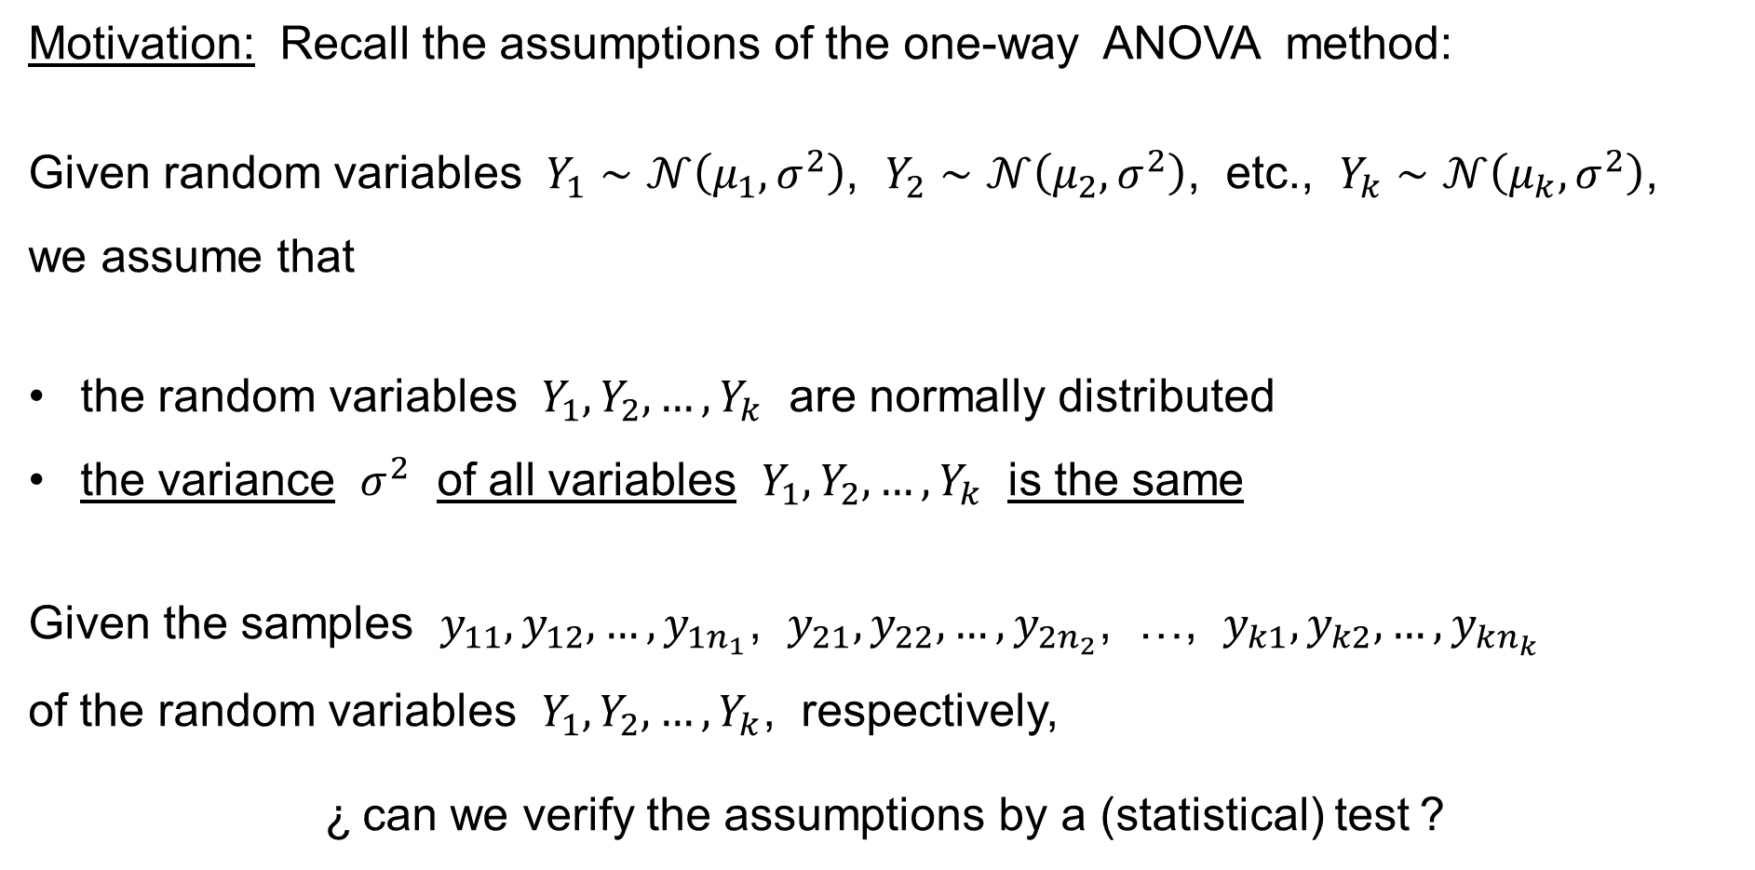
Bartlett’s test
Motivation: Recall the assumptions of the one-way ANOVA method:
Given random variables $Y_{1}∼𝒩\left(μ_{1},σ^{2}\right)$, $Y_{2}∼𝒩\left(μ_{2},σ^{2}\right)$, etc., $Y_{k}∼𝒩\left(μ_{k},σ^{2}\right)$,
we assume that
the random variables $Y_{1},Y_{2},…,Y_{k}$ are normally distributed
the variance $σ^{2}$ of all variables $Y_{1},Y_{2},…,Y_{k}$ is the same
Given the samples $y_{11},y_{12},…,y_{1n_{1}}$, $y_{21},y_{22},…,y_{2n_{2}}$, …, $y_{k1},y_{k2},…,y_{kn_{k}}$
of the random variables $Y_{1},Y_{2},…,Y_{k}$, respectively,
¿ can we verify the assumptions by a (statistical) test ?

Slide 34
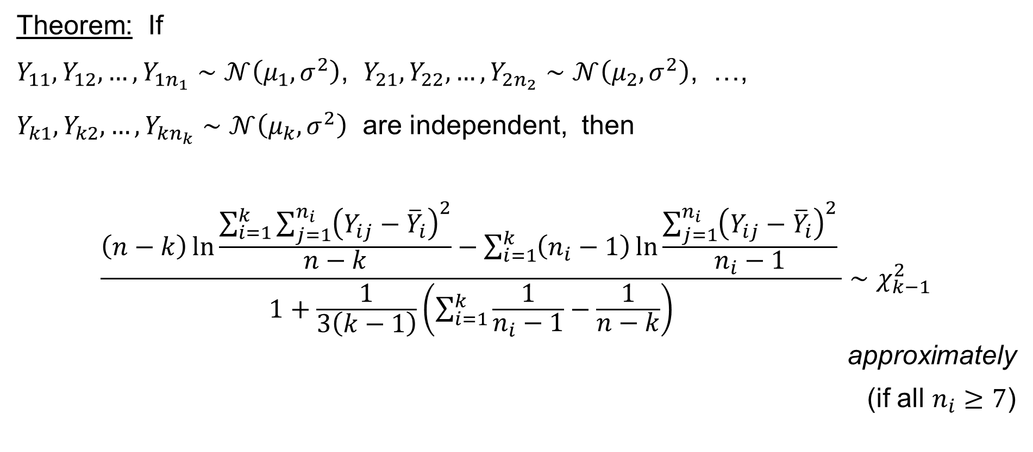
Bartlett’s test
Theorem: If
$Y_{11},Y_{12},…,Y_{1n_{1}}∼𝒩\left(μ_{1},σ^{2}\right)$, $Y_{21},Y_{22},…,Y_{2n_{2}}∼𝒩\left(μ_{2},σ^{2}\right)$, …,
$Y_{k1},Y_{k2},…,Y_{kn_{k}}∼𝒩\left(μ_{k},σ^{2}\right)$ are independent, then
$$\frac{\left(n−k\right)\ln{\frac{\sum_{i=1}^{k}{\sum_{j=1}^{n_{i}}{{\left(Y_{ij}−{\overline{Y}}_{i}\right)}^{2}}}}{n−k}}−\sum_{i=1}^{k}{\left(n_{i}−1\right)\ln{\frac{\sum_{j=1}^{n_{i}}{{\left(Y_{ij}−{\overline{Y}}_{i}\right)}^{2}}}{n_{i}−1}}} }{1+\frac{1}{3\left(k−1\right)}\left(\sum_{i=1}^{k}{\frac{1}{n_{i}−1}}−\frac{1}{n−k}\right)}∼χ_{k−1}^{2}$$
approximately
(if all $n_{i}≥7$)

Slide 35
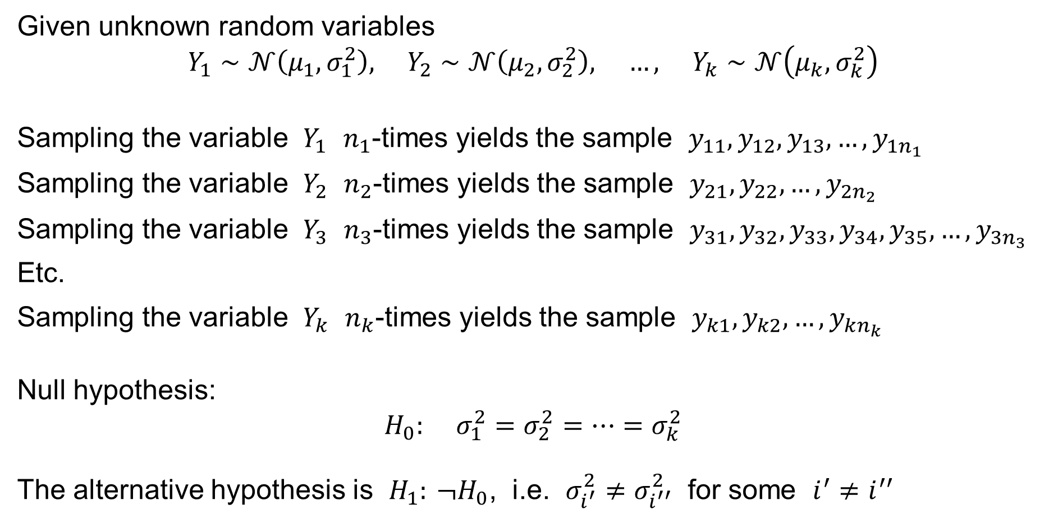
Bartlett’s test
Given unknown random variables
$$Y_{1}∼𝒩\left(μ_{1},σ_{1}^{2}\right), Y_{2}∼𝒩\left(μ_{2},σ_{2}^{2}\right), …, Y_{k}∼𝒩\left(μ_{k},σ_{k}^{2}\right)$$
Sampling the variable $Y_{1}$ $n_{1}$-times yields the sample $y_{11},y_{12},y_{13},…,y_{1n_{1}}$
Sampling the variable $Y_{2}$ $n_{2}$-times yields the sample $y_{21},y_{22},…,y_{2n_{2}}$
Sampling the variable $Y_{3}$ $n_{3}$-times yields the sample $y_{31},y_{32},y_{33},y_{34},y_{35},…,y_{3n_{3}}$
Etc.
Sampling the variable $Y_{k}$ $n_{k}$-times yields the sample $y_{k1},y_{k2},…,y_{kn_{k}}$
Null hypothesis:
$$H_{0}: σ_{1}^{2}=σ_{2}^{2}=⋯=σ_{k}^{2}$$
The alternative hypothesis is $H_{1}: ¬H_{0}$, i.e. $σ_{i^{′}}^{2}≠σ_{i^{′′}}^{2}$ for some $i^{′}≠i^{′′}$

Slide 36
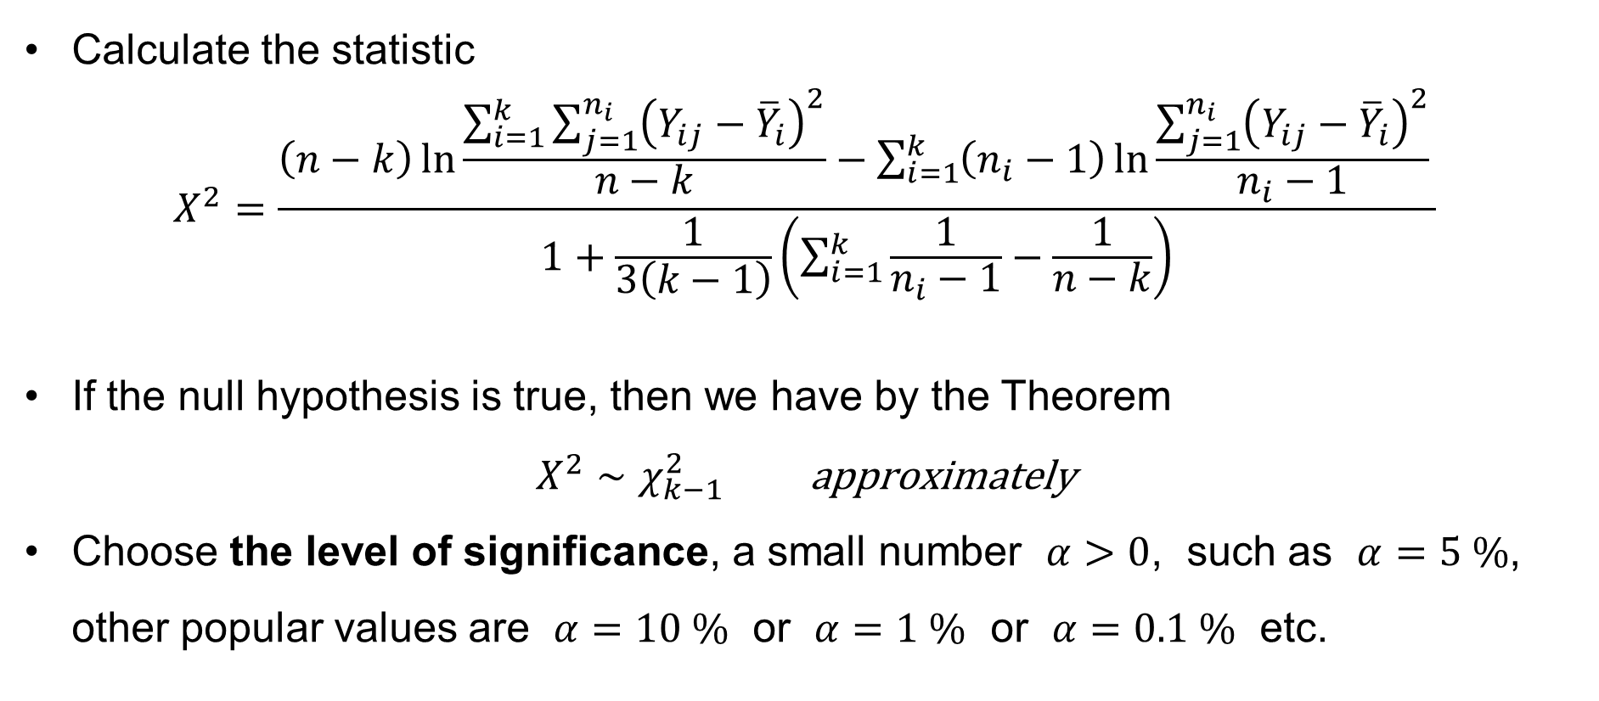
Bartlett’s test
Calculate the statistic
$$X^{2}=\frac{\left(n−k\right)\ln{\frac{\sum_{i=1}^{k}{\sum_{j=1}^{n_{i}}{{\left(Y_{ij}−{\overline{Y}}_{i}\right)}^{2}}}}{n−k}}−\sum_{i=1}^{k}{\left(n_{i}−1\right)\ln{\frac{\sum_{j=1}^{n_{i}}{{\left(Y_{ij}−{\overline{Y}}_{i}\right)}^{2}}}{n_{i}−1}}} }{1+\frac{1}{3\left(k−1\right)}\left(\sum_{i=1}^{k}{\frac{1}{n_{i}−1}}−\frac{1}{n−k}\right)}$$
If the null hypothesis is true, then we have by the Theorem
$X^{2}∼χ_{k−1}^{2} \text{approximately}$
Choose the level of significance, a small number $α>0$, such as $α=5 \%$, other popular values are $α=10 \%$ or $α=1 \%$ or $α=0.1 \%$ etc.

Slide 37
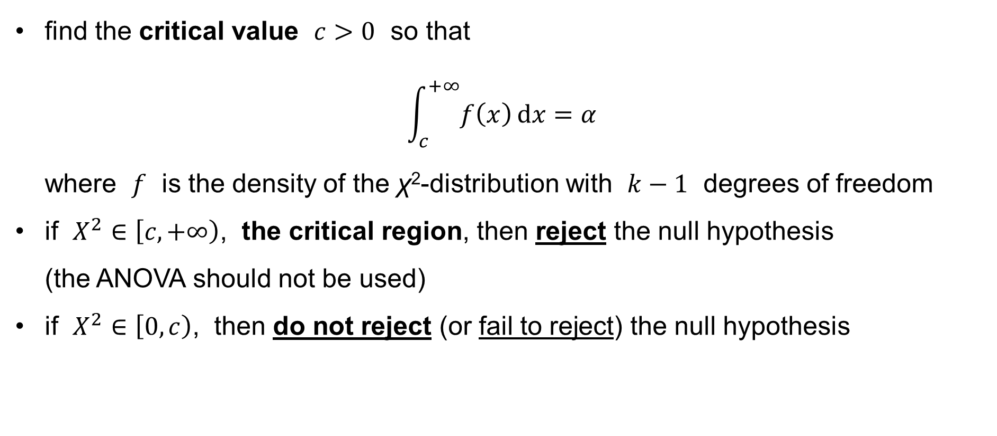
Bartlett’s test
find the critical value $c>0$ so that
$\int_{c}^{+∞}{f\left(x\right) dx}=α$
where $f$ is the density of the χ²-distribution with $k−1$ degrees of freedom
if $X^{2}∈\left[c,+∞\right)$, the critical region, then reject the null hypothesis
(the ANOVA should not be used)
if $X^{2}∈\left[0,c\right)$, then do not reject (or fail to reject) the null hypothesis

