Slide 1
Statistics
Lecture 12
Simple Linear Regression
David Bartl
Statistics
INM/BASTA

Slide 2
Introduction
Least Squares Method
An application: the trend of a time series
Summary & Background
The Classical Assumptions
The Coefficient of Determination (R²)
Further Theorems, Tests of Hypotheses and Confidence Intervals
Two-sample t-test for the difference of the population means // σ_{X}=σ_{Y}
Simple linear regression without the intercept term

Slide 3
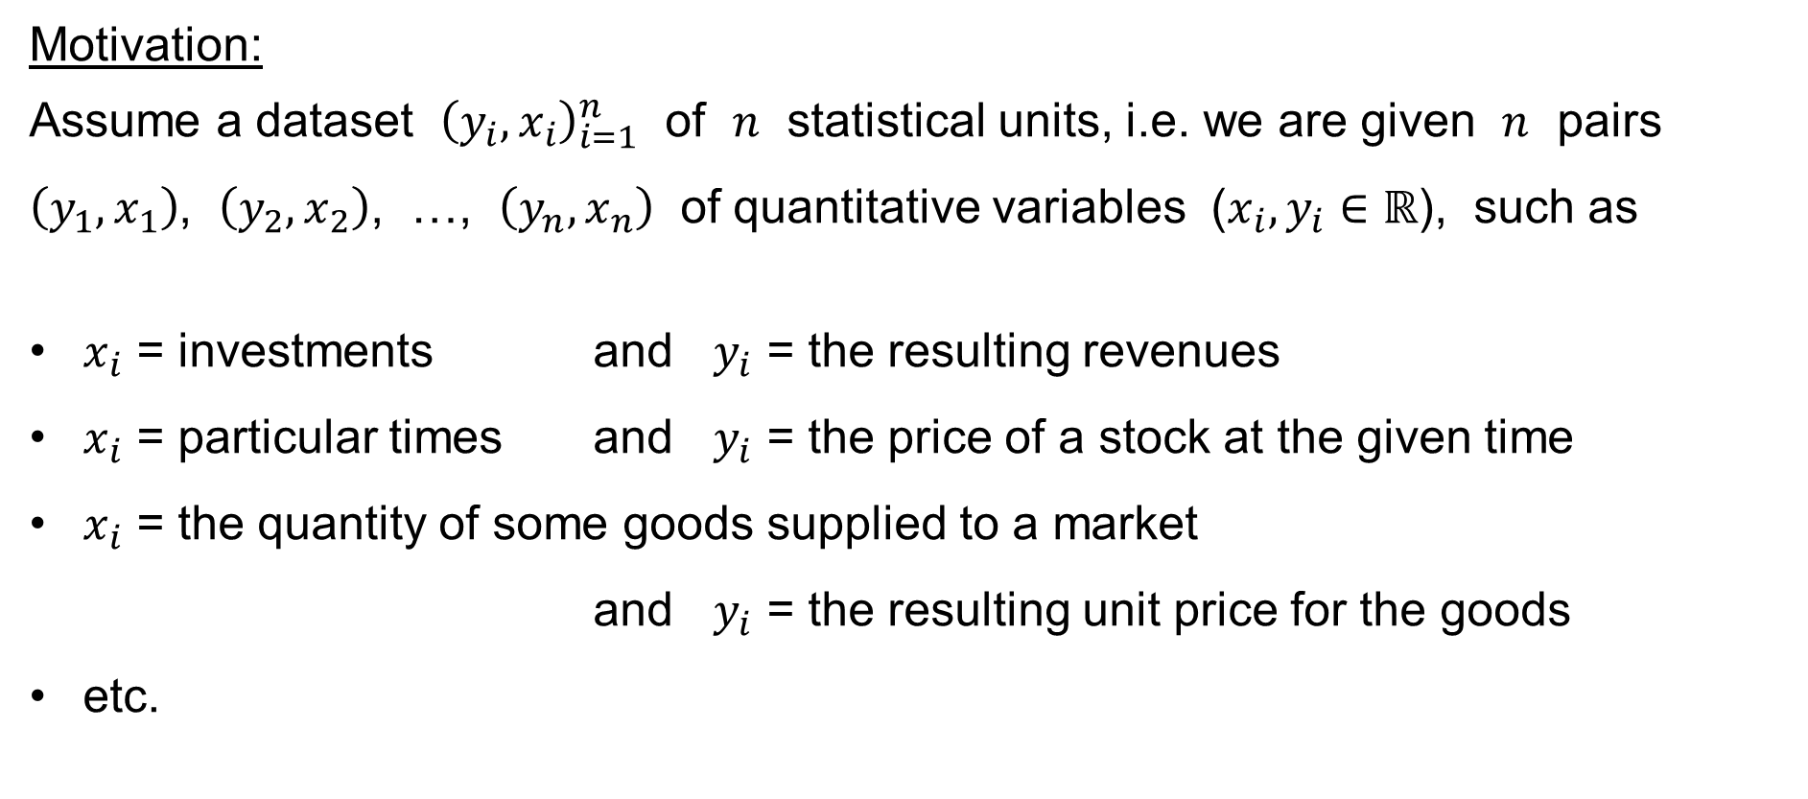
Simple Linear Regression: Motivation
Motivation:
Assume a dataset ${\left(y_{i},x_{i}\right)}_{i=1}^{n}$ of $n$ statistical units, i.e. we are given $n$ pairs
$\left(y_{1},x_{1}\right)$, $\left(y_{2},x_{2}\right)$, …, $\left(y_{n},x_{n}\right)$ of quantitative variables ($x_{i},y_{i}∈ℝ$), such as
$x_{i}$ = investments and $y_{i}$ = the resulting revenues
$x_{i}$ = particular times and $y_{i}$ = the price of a stock at the given time
$x_{i}$ = the quantity of some goods supplied to a market
and $y_{i}$ = the resulting unit price for the goods
etc.

Slide 4
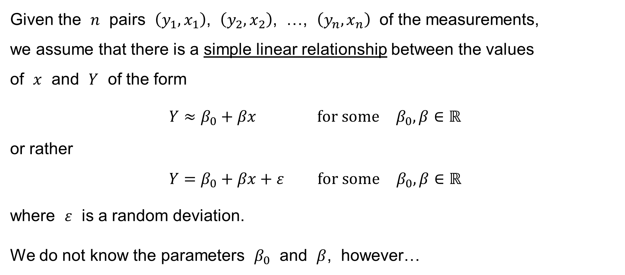
Simple Linear Regression: Motivation
Given the $n$ pairs $\left(y_{1},x_{1}\right)$, $\left(y_{2},x_{2}\right)$, …, $\left(y_{n},x_{n}\right)$ of the measurements,
we assume that there is a simple linear relationship between the values
of $x$ and $Y$ of the form
$$Y≈β_{0}+βx \text{for} \text{some} β_{0},β∈ℝ$$
or rather
$$Y=β_{0}+βx+ε \text{for} \text{some} β_{0},β∈ℝ$$
where $ε$ is a random deviation.
We do not know the parameters $β_{0}$ and $β$, however…

Slide 5
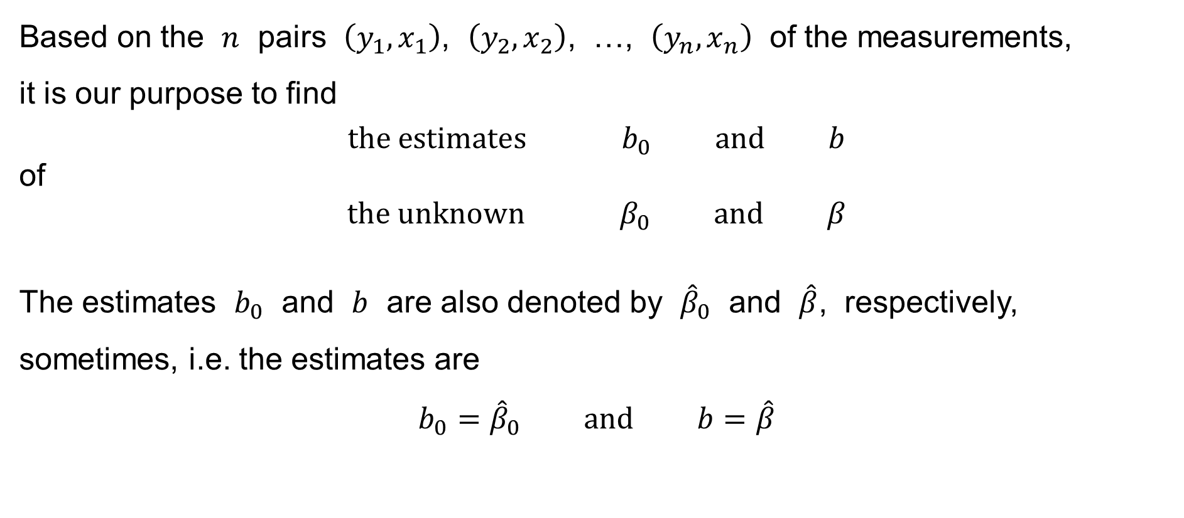
Simple Linear Regression: Motivation
Based on the $n$ pairs $\left(y_{1},x_{1}\right)$, $\left(y_{2},x_{2}\right)$, …, $\left(y_{n},x_{n}\right)$ of the measurements,
it is our purpose to find
$$\text{the} \text{estimates} b_{0} \text{and} b$$
of
$$\text{the} \text{unknown} β_{0} \text{and} β$$
The estimates $b_{0}$ and $b$ are also denoted by ${\hat{β}}_{0}$ and $\hat{β}$, respectively, sometimes, i.e. the estimates are
$$b_{0}={\hat{β}}_{0} \text{and} b=\hat{β}$$

Slide 6
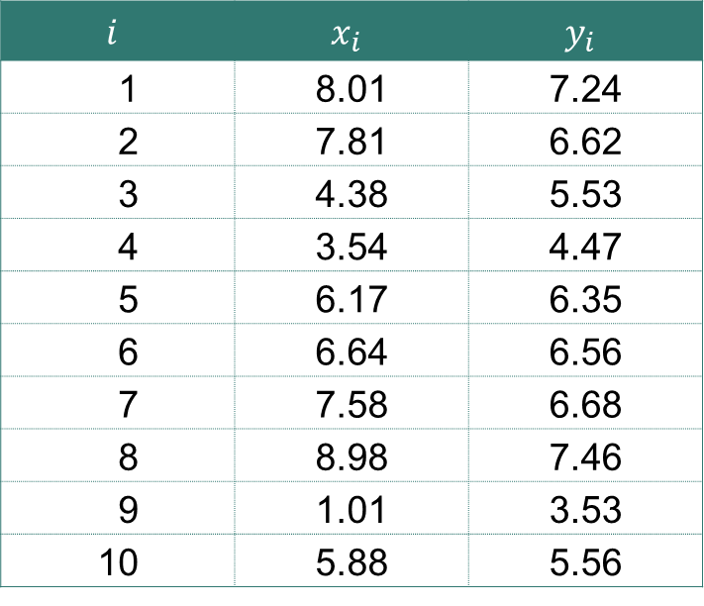

Simple Linear Regression: Example
We have got a sample of $n=10$ observations:
E.g.: $x_{i}$ = temperature & $y_{i}$ = the length of a metal rod
$$i$$ | $$x_{i}$$ | $$y_{i}$$
1 | 8.01 | 7.24
2 | 7.81 | 6.62
3 | 4.38 | 5.53
4 | 3.54 | 4.47
5 | 6.17 | 6.35
6 | 6.64 | 6.56
7 | 7.58 | 6.68
8 | 8.98 | 7.46
9 | 1.01 | 3.53
10 | 5.88 | 5.56

Slide 7



Simple Linear Regression: Example
$$y$$
10
9
8
$$y=3+\frac{1}{2}x$$
7
6
5
4
3
2
1
0
$$x$$
1
2
3
4
5
6
7
8
9
10

Slide 8
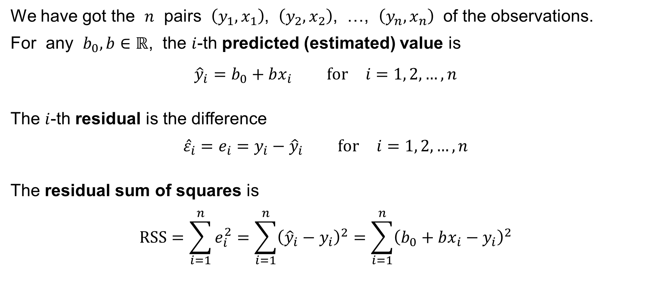
Simple Linear Regression: Least Squares Method
We have got the $n$ pairs $\left(y_{1},x_{1}\right)$, $\left(y_{2},x_{2}\right)$, …, $\left(y_{n},x_{n}\right)$ of the observations.
For any $b_{0},b∈ℝ$, the $i$-th predicted (estimated) value is
$${\hat{y}}_{i}=b_{0}+bx_{i} \text{for} i=1, 2,…,n$$
The $i$-th residual is the difference
$${\hat{ε}}_{i}=e_{i}=y_{i}−{\hat{y}}_{i} \text{for} i=1, 2,…,n$$
The residual sum of squares is
$$RSS=\sum_{i=1}^{n}{e_{i}^{2}}=\sum_{i=1}^{n}{{\left({\hat{y}}_{i}−y_{i}\right)}^{2}}=\sum_{i=1}^{n}{{\left(b_{0}+bx_{i}−y_{i}\right)}^{2}}$$

Slide 9
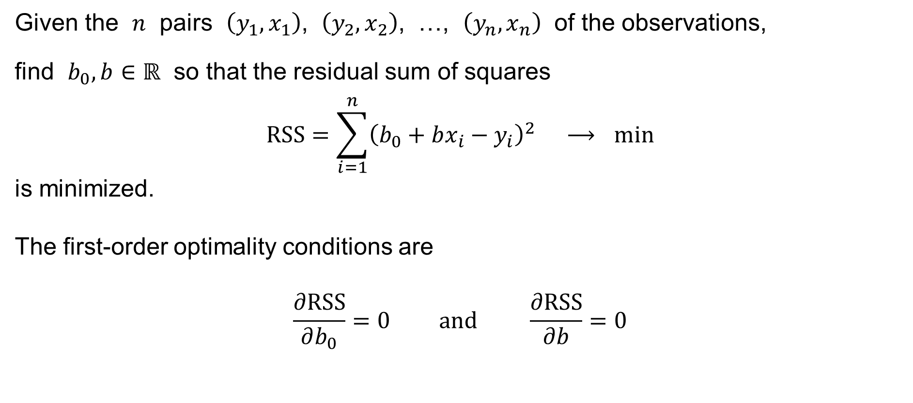
Simple Linear Regression: Least Squares Method
Given the $n$ pairs $\left(y_{1},x_{1}\right)$, $\left(y_{2},x_{2}\right)$, …, $\left(y_{n},x_{n}\right)$ of the observations,
find $b_{0},b∈ℝ$ so that the residual sum of squares
$$RSS=\sum_{i=1}^{n}{{\left(b_{0}+bx_{i}−y_{i}\right)}^{2}} ⟶ min$$
is minimized.
The first-order optimality conditions are
$$\frac{∂RSS}{∂b_{0}}=0 \text{and} \frac{∂RSS}{∂b}=0$$

Slide 10
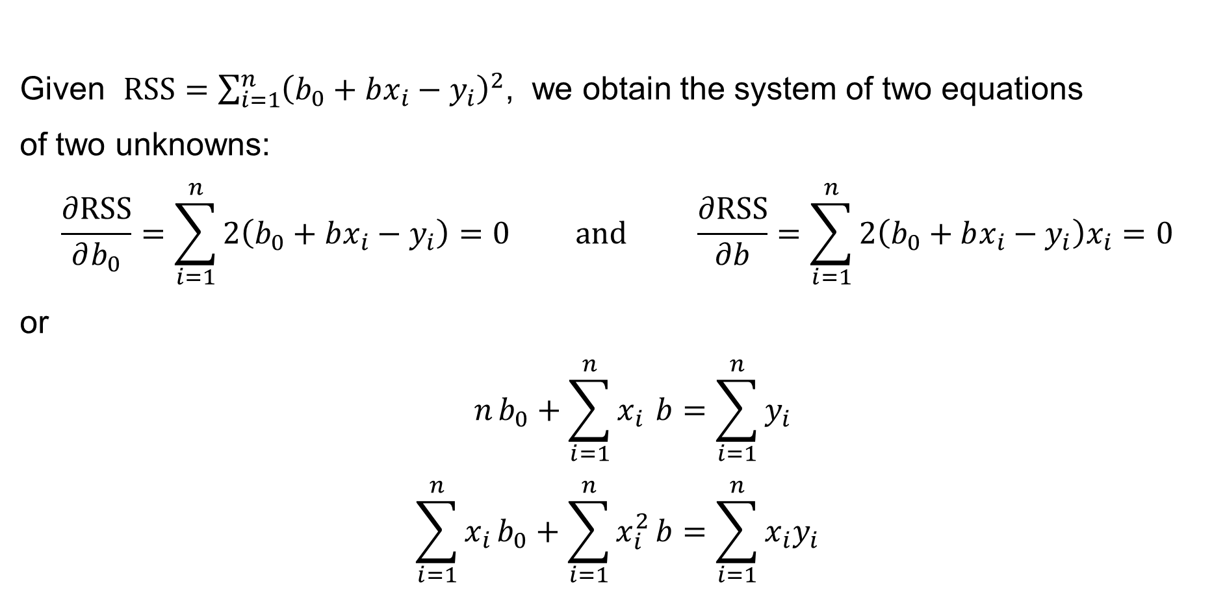
Simple Linear Regression: Least Squares Method
Given $RSS=\sum_{i=1}^{n}{{\left(b_{0}+bx_{i}−y_{i}\right)}^{2}}$, we obtain the system of two equations
of two unknowns:
$$\frac{∂RSS}{∂b_{0}}=\sum_{i=1}^{n}{2\left(b_{0}+bx_{i}−y_{i}\right)}=0 \text{and} \frac{∂RSS}{∂b}=\sum_{i=1}^{n}{2\left(b_{0}+bx_{i}−y_{i}\right)x_{i}}=0$$
or
$$n b_{0}+\sum_{i=1}^{n}{x_{i}} b=\sum_{i=1}^{n}{y_{i}} \\ \sum_{i=1}^{n}{x_{i}}b_{0}+\sum_{i=1}^{n}{x_{i}^{2}}b=\sum_{i=1}^{n}{x_{i}y_{i}}$$
the normal equation

Slide 11
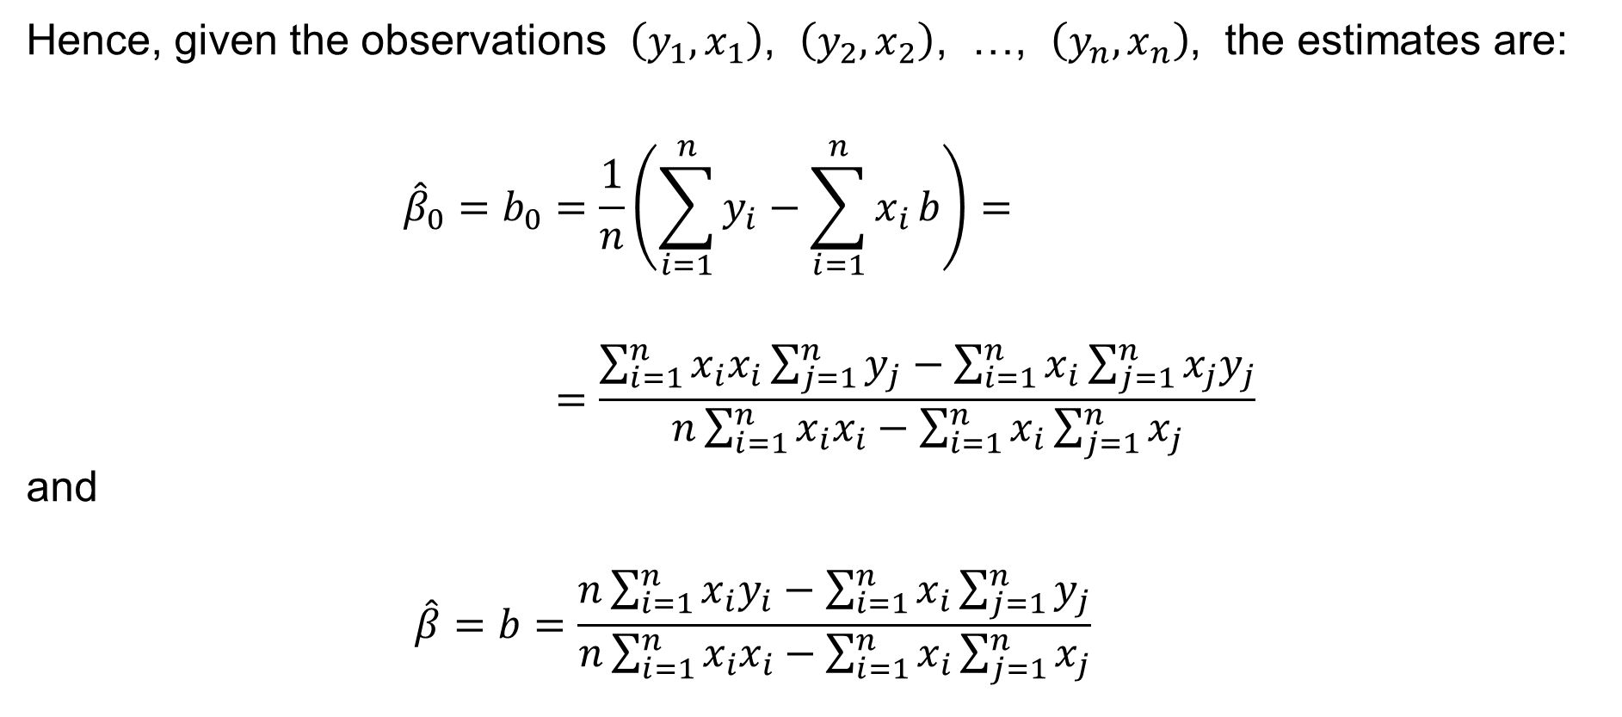
Simple Linear Regression: Least Squares Method
Hence, given the observations $\left(y_{1},x_{1}\right)$, $\left(y_{2},x_{2}\right)$, …, $\left(y_{n},x_{n}\right)$, the estimates are:
$${\hat{β}}_{0}=b_{0}=\frac{1}{n}\left(\sum_{i=1}^{n}{y_{i}}−\sum_{i=1}^{n}{x_{i}}b\right)= \\ =\frac{\sum_{i=1}^{n}{x_{i}x_{i}}\sum_{j=1}^{n}{y_{j}}−\sum_{i=1}^{n}{x_{i}}\sum_{j=1}^{n}{x_{j}y_{j}}}{n\sum_{i=1}^{n}{x_{i}x_{i}}−\sum_{i=1}^{n}{x_{i}}\sum_{j=1}^{n}{x_{j}}}$$
and
$$\hat{β}=b=\frac{n\sum_{i=1}^{n}{x_{i}y_{i}}−\sum_{i=1}^{n}{x_{i}}\sum_{j=1}^{n}{y_{j}}}{n\sum_{i=1}^{n}{x_{i}x_{i}}−\sum_{i=1}^{n}{x_{i}}\sum_{j=1}^{n}{x_{j}}}$$

Slide 12
An application: the trend of a time series

Slide 13
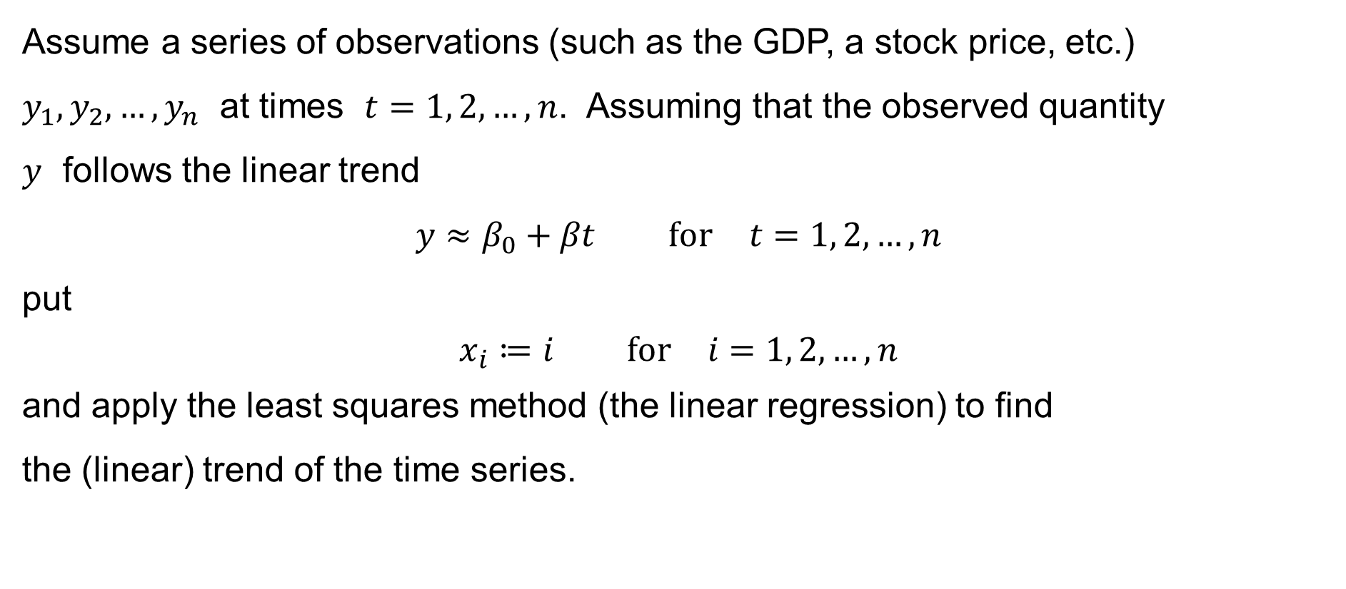
The trend of a time series
Assume a series of observations (such as the GDP, a stock price, etc.)
$y_{1},y_{2},…,y_{n}$ at times $t=1, 2,…,n$. Assuming that the observed quantity
$y$ follows the linear trend
$$y≈β_{0}+βt \text{for} t=1, 2,…,n$$
put
$$x_{i}≔i \text{for} i=1, 2,…,n$$
and apply the least squares method (the linear regression) to find
the (linear) trend of the time series.

Slide 14
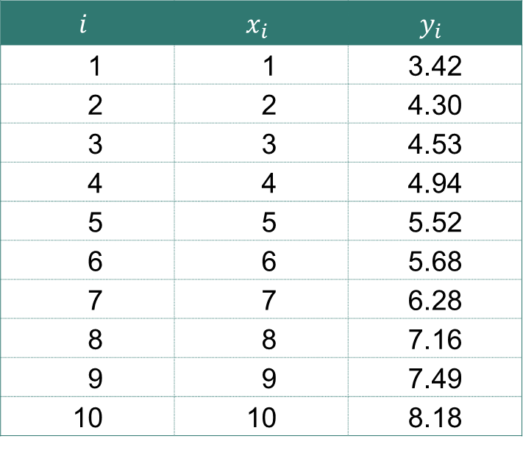

The trend of a time series: Example
We have got a sample of $n=10$ observations:
Here, e.g.: $x_{i}$ = year & $y_{i}$ = the wealth
$$i$$ | $$x_{i}$$ | $$y_{i}$$
1 | 1 | 3.42
2 | 2 | 4.30
3 | 3 | 4.53
4 | 4 | 4.94
5 | 5 | 5.52
6 | 6 | 5.68
7 | 7 | 6.28
8 | 8 | 7.16
9 | 9 | 7.49
10 | 10 | 8.18

Slide 15

The trend of a time series: Example
$$y$$
10
9
8
$$y=3+\frac{1}{2}x$$
7
6
5
4
3
2
1
0
$$x$$
1
2
3
4
5
6
7
8
9
10

Slide 16
Summary & Background

Slide 17
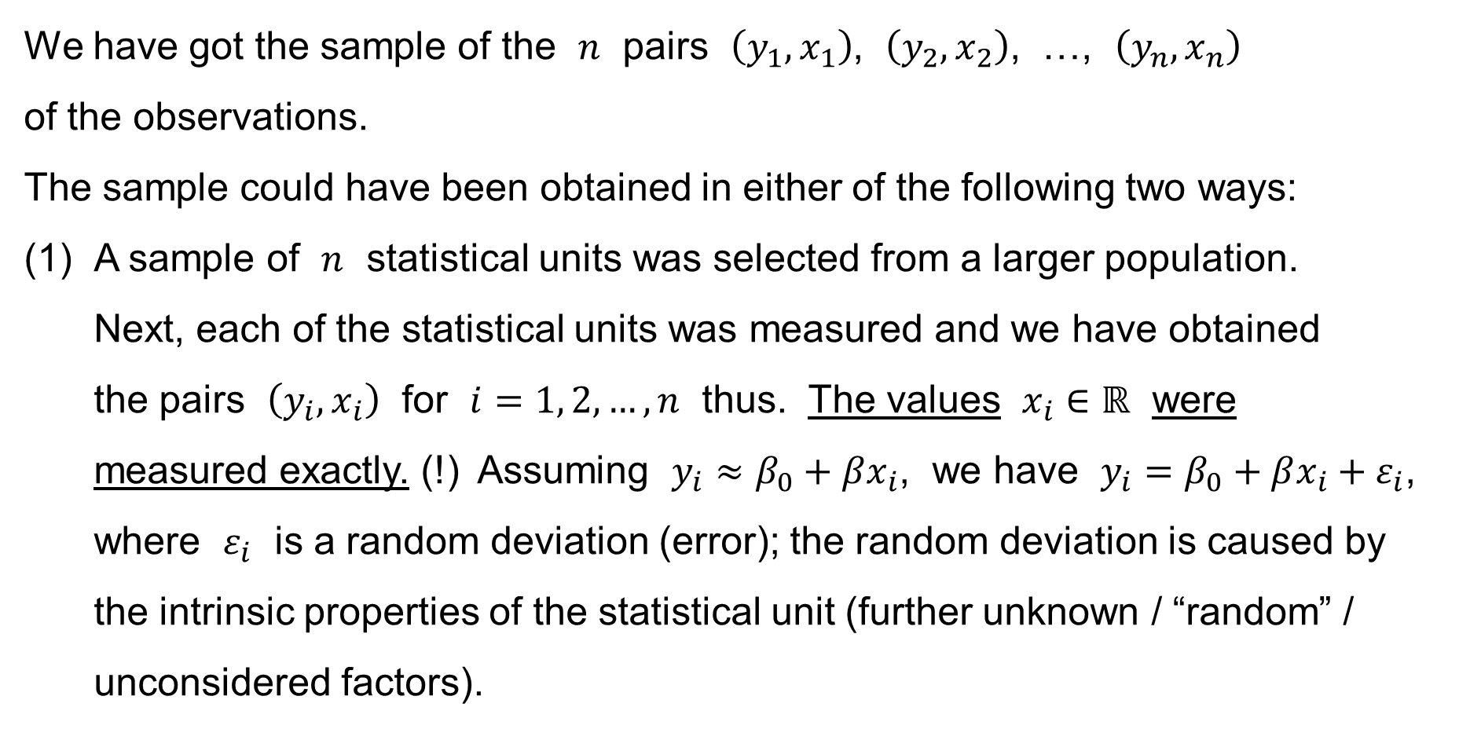
Simple Linear Regression: Summary & Background
We have got the sample of the $n$ pairs $\left(y_{1},x_{1}\right)$, $\left(y_{2},x_{2}\right)$, …, $\left(y_{n},x_{n}\right)$
of the observations.
The sample could have been obtained in either of the following two ways:
(1) A sample of $n$ statistical units was selected from a larger population.
Next, each of the statistical units was measured and we have obtained
the pairs $\left(y_{i},x_{i}\right)$ for $i=1, 2,…,n$ thus. The values $x_{i}∈ℝ$ were
measured exactly. (!) Assuming $y_{i}≈β_{0}+βx_{i}$, we have $y_{i}=β_{0}+βx_{i}+ε_{i}$, where $ε_{i}$ is a random deviation (error); the random deviation is caused by
the intrinsic properties of the statistical unit (further unknown / “random” / unconsidered factors).

Slide 18
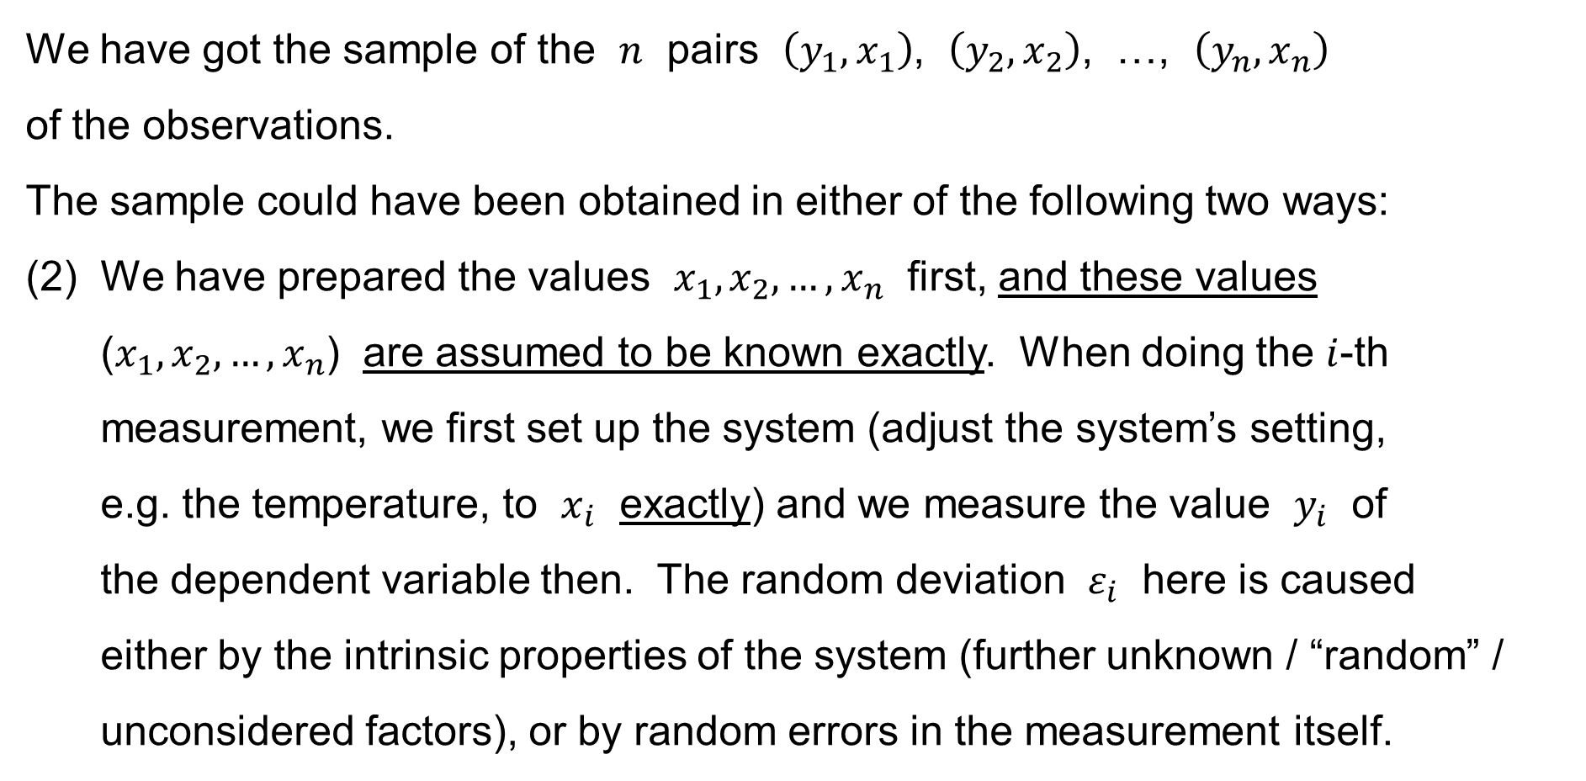
Simple Linear Regression: Summary & Background
We have got the sample of the $n$ pairs $\left(y_{1},x_{1}\right)$, $\left(y_{2},x_{2}\right)$, …, $\left(y_{n},x_{n}\right)$
of the observations.
The sample could have been obtained in either of the following two ways:
(2) We have prepared the values $x_{1},x_{2},…,x_{n}$ first, and these values ($x_{1},x_{2},…,x_{n}$) are assumed to be known exactly. When doing the $i$-th measurement, we first set up the system (adjust the system’s setting,
e.g. the temperature, to $x_{i}$ exactly) and we measure the value $y_{i}$ of
the dependent variable then. The random deviation $ε_{i}$ here is caused
either by the intrinsic properties of the system (further unknown / “random” / unconsidered factors), or by random errors in the measurement itself.

Slide 19
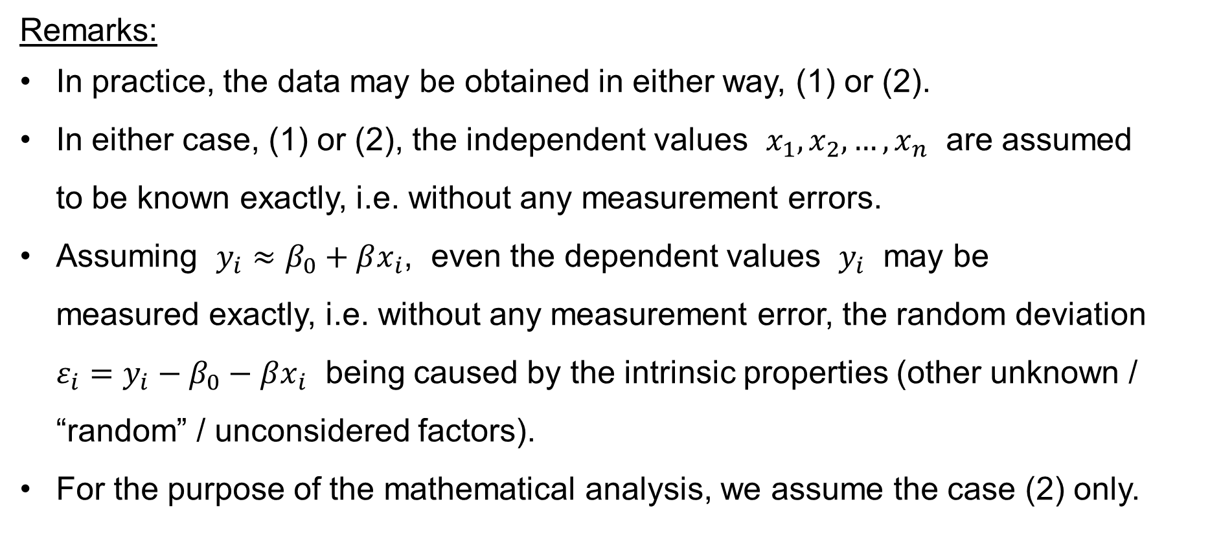
Simple Linear Regression: Summary & Background
Remarks:
In practice, the data may be obtained in either way, (1) or (2).
In either case, (1) or (2), the independent values $x_{1},x_{2},…,x_{n}$ are assumed
to be known exactly, i.e. without any measurement errors.
Assuming $y_{i}≈β_{0}+βx_{i}$, even the dependent values $y_{i}$ may be
measured exactly, i.e. without any measurement error, the random deviation $ε_{i}=y_{i}−β_{0}−βx_{i}$ being caused by the intrinsic properties (other unknown / “random” / unconsidered factors).
For the purpose of the mathematical analysis, we assume the case (2) only.

Slide 20

Simple Linear Regression: Summary & Background
The intercept term
Parameters
Regression coefficients
Terminology:
$$Y=β_{0}+βx+ε$$
Regressand
Predicand
Explained variable
Dependent variable
Endogenous variable
Controlled variable
Response
Outcome
Predicted variable
Measured variable
Regressor
Predictor
Explanatory variable
Independent variable
Exogenous variable
Control variable
Stimulus
Covariate
Deviation
Error term
Disturbance
Noise

Slide 21
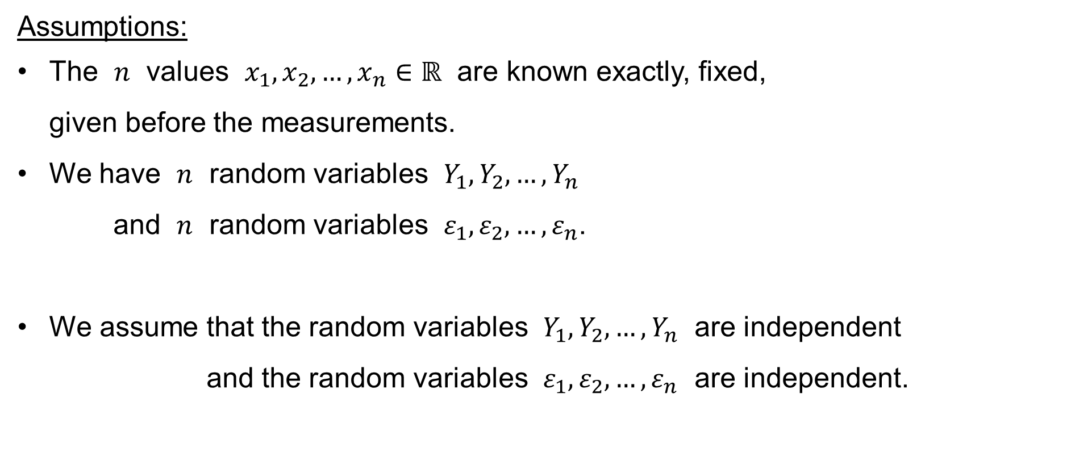
Simple Linear Regression: Summary & Background
Assumptions:
The $n$ values $x_{1},x_{2},…,x_{n}∈ℝ$ are known exactly, fixed,
given before the measurements.
We have $n$ random variables $Y_{1},Y_{2},…,Y_{n}$
and $n$ random variables $ε_{1},ε_{2},…,ε_{n}$.
We assume that the random variables $Y_{1},Y_{2},…,Y_{n}$ are independent
and the random variables $ε_{1},ε_{2},…,ε_{n}$ are independent.

Slide 22
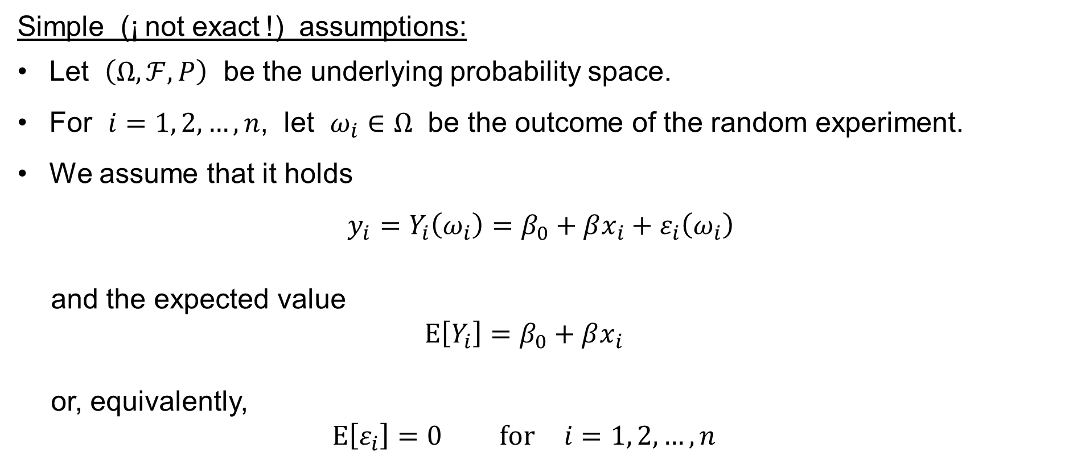
Simple Linear Regression: Summary & Background
Simple (¡ not exact !) assumptions:
Let $\left(Ω,ℱ,P\right)$ be the underlying probability space.
For $i=1, 2,…,n$, let $ω_{i}∈Ω$ be the outcome of the random experiment.
We assume that it holds
$y_{i}=Y_{i}\left(ω_{i}\right)=β_{0}+βx_{i}+ε_{i}\left(ω_{i}\right)$
and the expected value
$$E\left[Y_{i}\right]=β_{0}+βx_{i}$$
or, equivalently,
$$E\left[ε_{i}\right]=0 \text{for} i=1, 2,…,n$$

Slide 23
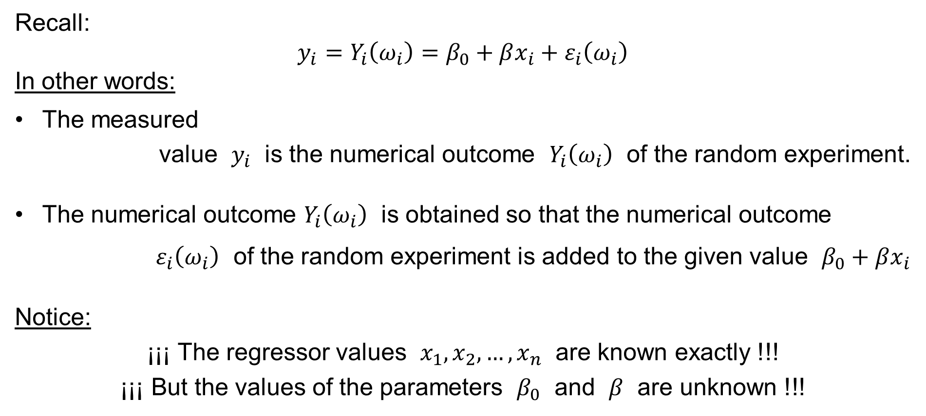
Simple Linear Regression: Summary & Background
Recall:
$$y_{i}=Y_{i}\left(ω_{i}\right)=β_{0}+βx_{i}+ε_{i}\left(ω_{i}\right)$$
In other words:
The measured
value $y_{i}$ is the numerical outcome $Y_{i}\left(ω_{i}\right)$ of the random experiment.
The numerical outcome $Y_{i}\left(ω_{i}\right)$ is obtained so that the numerical outcome
$ε_{i}\left(ω_{i}\right)$ of the random experiment is added to the given value $β_{0}+βx_{i}$
Notice:
¡¡¡ The regressor values $x_{1},x_{2},…,x_{n}$ are known exactly !!!
¡¡¡ But the values of the parameters $β_{0}$ and $β$ are unknown !!!

Slide 24
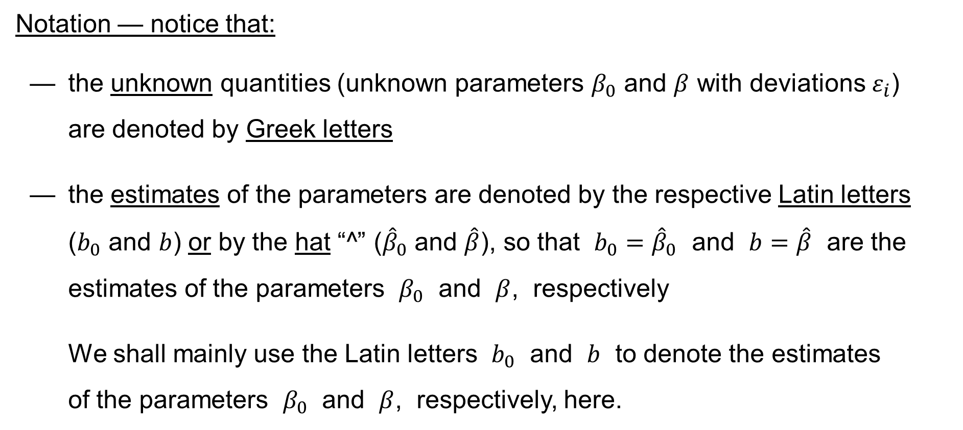
Simple Linear Regression: Summary & Background
Notation — notice that:
— the unknown quantities (unknown parameters $β_{0}$ and $β$ with deviations $ε_{i}$)
are denoted by Greek letters
— the estimates of the parameters are denoted by the respective Latin letters
($b_{0}$ and $b$) or by the hat “^” (${\hat{β}}_{0}$ and $\hat{β}$), so that $b_{0}={\hat{β}}_{0}$ and $b=\hat{β}$ are the estimates of the parameters $β_{0}$ and $β$, respectively
We shall mainly use the Latin letters $b_{0}$ and $b$ to denote the estimates
of the parameters $β_{0}$ and $β$, respectively, here.

Slide 25
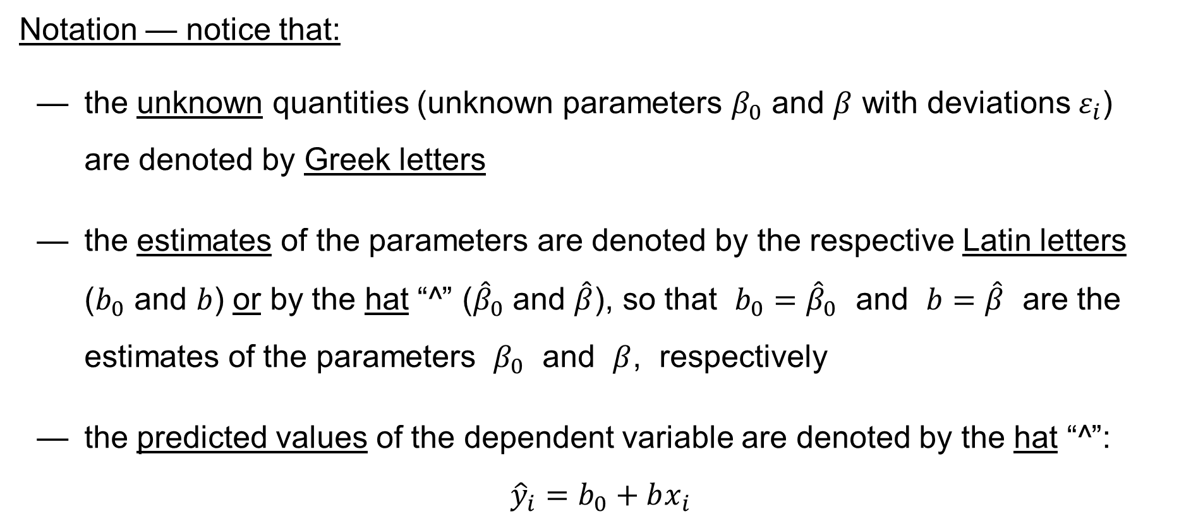
Simple Linear Regression: Summary & Background
Notation — notice that:
— the unknown quantities (unknown parameters $β_{0}$ and $β$ with deviations $ε_{i}$)
are denoted by Greek letters
— the estimates of the parameters are denoted by the respective Latin letters
($b_{0}$ and $b$) or by the hat “^” (${\hat{β}}_{0}$ and $\hat{β}$), so that $b_{0}={\hat{β}}_{0}$ and $b=\hat{β}$ are the estimates of the parameters $β_{0}$ and $β$, respectively
— the predicted values of the dependent variable are denoted by the hat “^”:
$${\hat{y}}_{i}=b_{0}+bx_{i}$$

Slide 26
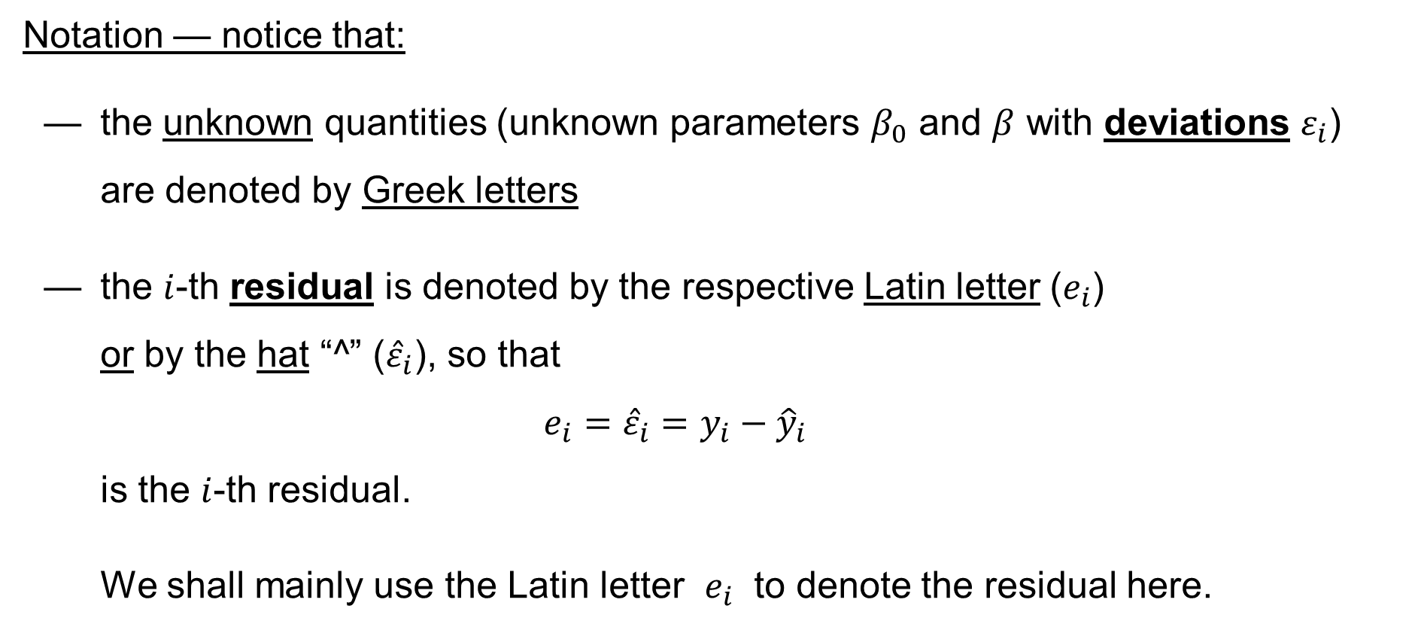
Simple Linear Regression: Summary & Background
Notation — notice that:
— the unknown quantities (unknown parameters $β_{0}$ and $β$ with deviations $ε_{i}$)
are denoted by Greek letters
— the $i$-th residual is denoted by the respective Latin letter ($e_{i}$)
or by the hat “^” (${\hat{ε}}_{i}$), so that
$$e_{i}={\hat{ε}}_{i}=y_{i}−{\hat{y}}_{i}$$
is the $i$-th residual.
We shall mainly use the Latin letter $e_{i}$ to denote the residual here.

Slide 27
The Classical Assumptions

Slide 28
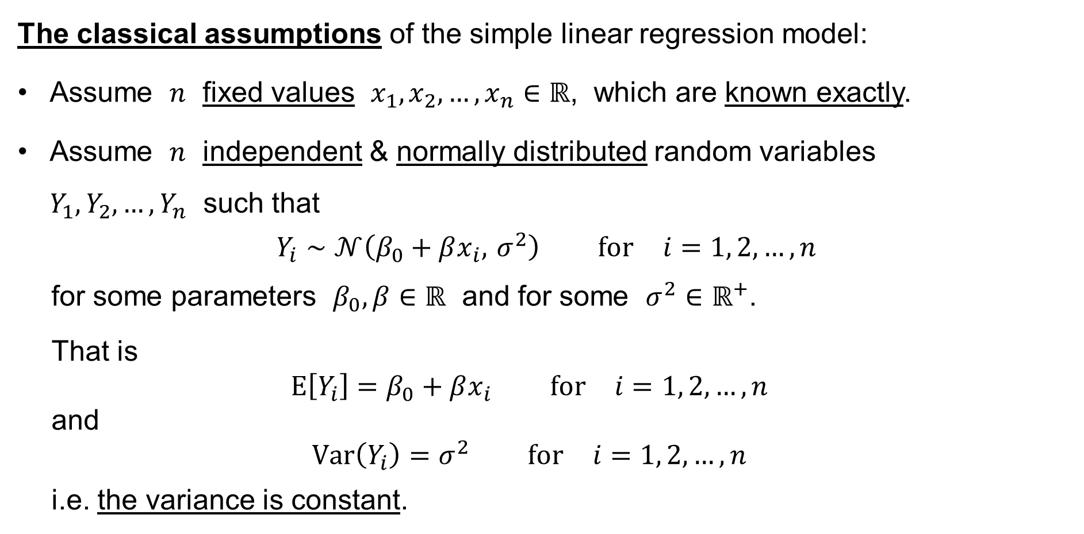
Simple Linear Regression: Assumptions
The classical assumptions of the simple linear regression model:
Assume $n$ fixed values $x_{1},x_{2},…,x_{n}∈ℝ$, which are known exactly.
Assume $n$ independent & normally distributed random variables
$Y_{1},Y_{2},…,Y_{n}$ such that
$$Y_{i}∼𝒩\left(β_{0}+βx_{i}, σ^{2}\right) \text{for} i=1, 2,…,n$$
for some parameters $β_{0},β∈ℝ$ and for some $σ^{2}∈ℝ^{+}$.
That is
$$E\left[Y_{i}\right]=β_{0}+βx_{i} \text{for} i=1, 2,…,n$$
and
$$Var\left(Y_{i}\right)=σ^{2} \text{for} i=1, 2,…,n$$
i.e. the variance is constant.
linearity
homoskedasticity

Slide 29
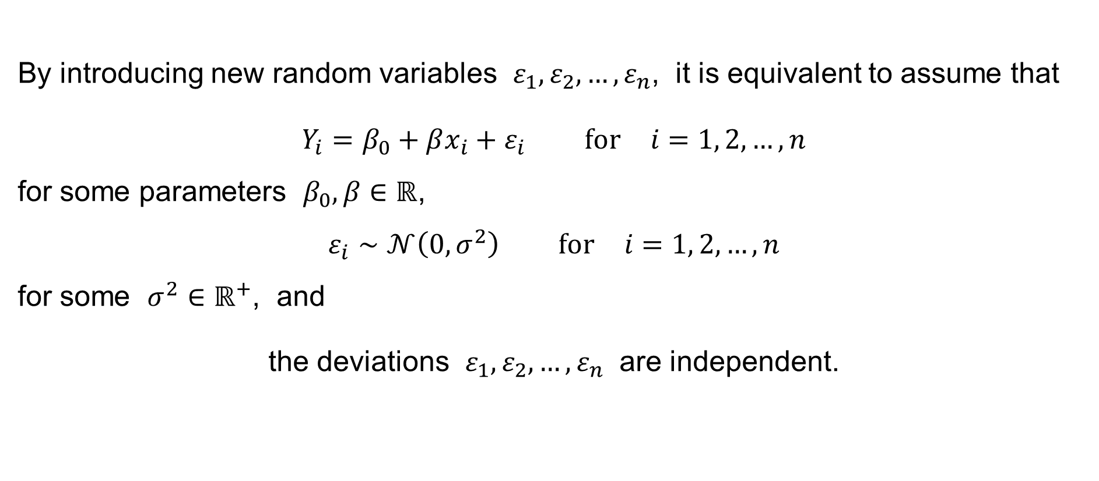
Simple Linear Regression: Assumptions
By introducing new random variables $ε_{1},ε_{2},…,ε_{n}$, it is equivalent to assume that
$$Y_{i}=β_{0}+βx_{i}+ε_{i} \text{for} i=1, 2,…,n$$
for some parameters $β_{0},β∈ℝ$,
$$ε_{i}∼𝒩\left(0,σ^{2}\right) \text{for} i=1, 2,…,n$$
for some $σ^{2}∈ℝ^{+}$, and
the deviations $ε_{1},ε_{2},…,ε_{n}$ are independent.

Slide 30
Further Theorems,
Tests of Hypotheses and
Confidence Intervals

Slide 31
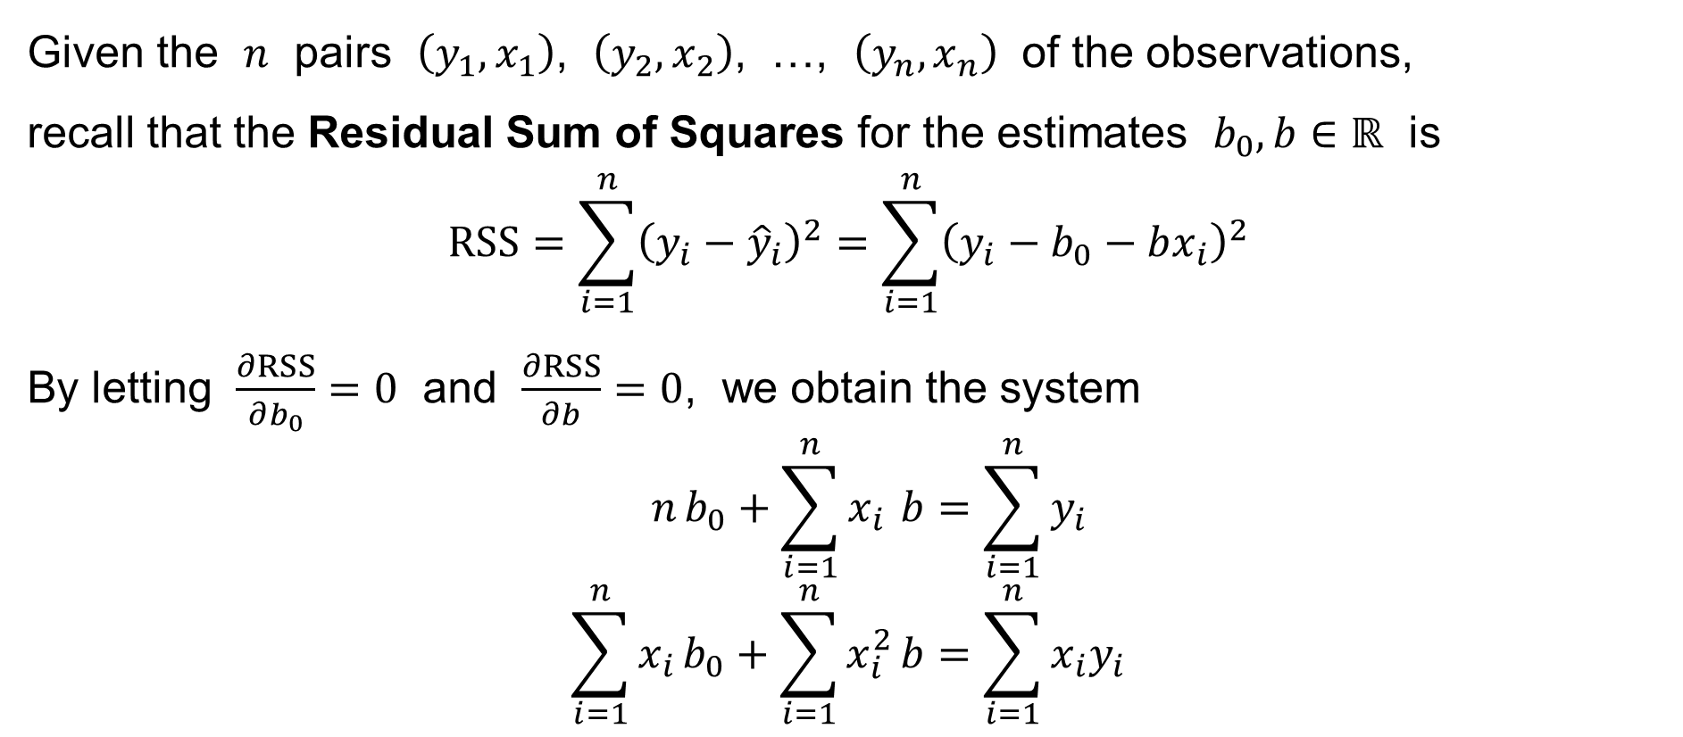
Simple Linear Regression: The Normal Equation
Given the $n$ pairs $\left(y_{1},x_{1}\right)$, $\left(y_{2},x_{2}\right)$, …, $\left(y_{n},x_{n}\right)$ of the observations,
recall that the Residual Sum of Squares for the estimates $b_{0},b∈ℝ$ is
$$RSS=\sum_{i=1}^{n}{{\left(y_{i}−{\hat{y}}_{i}\right)}^{2}}=\sum_{i=1}^{n}{{\left(y_{i}−b_{0}−bx_{i}\right)}^{2}}$$
By letting $\frac{∂RSS}{∂b_{0}}=0$ and $\frac{∂RSS}{∂b}=0$, we obtain the system
$$n b_{0}+\sum_{i=1}^{n}{x_{i}} b=\sum_{i=1}^{n}{y_{i}} \\ \sum_{i=1}^{n}{x_{i}}b_{0}+\sum_{i=1}^{n}{x_{i}^{2}}b=\sum_{i=1}^{n}{x_{i}y_{i}}$$
the normal equation

Slide 32
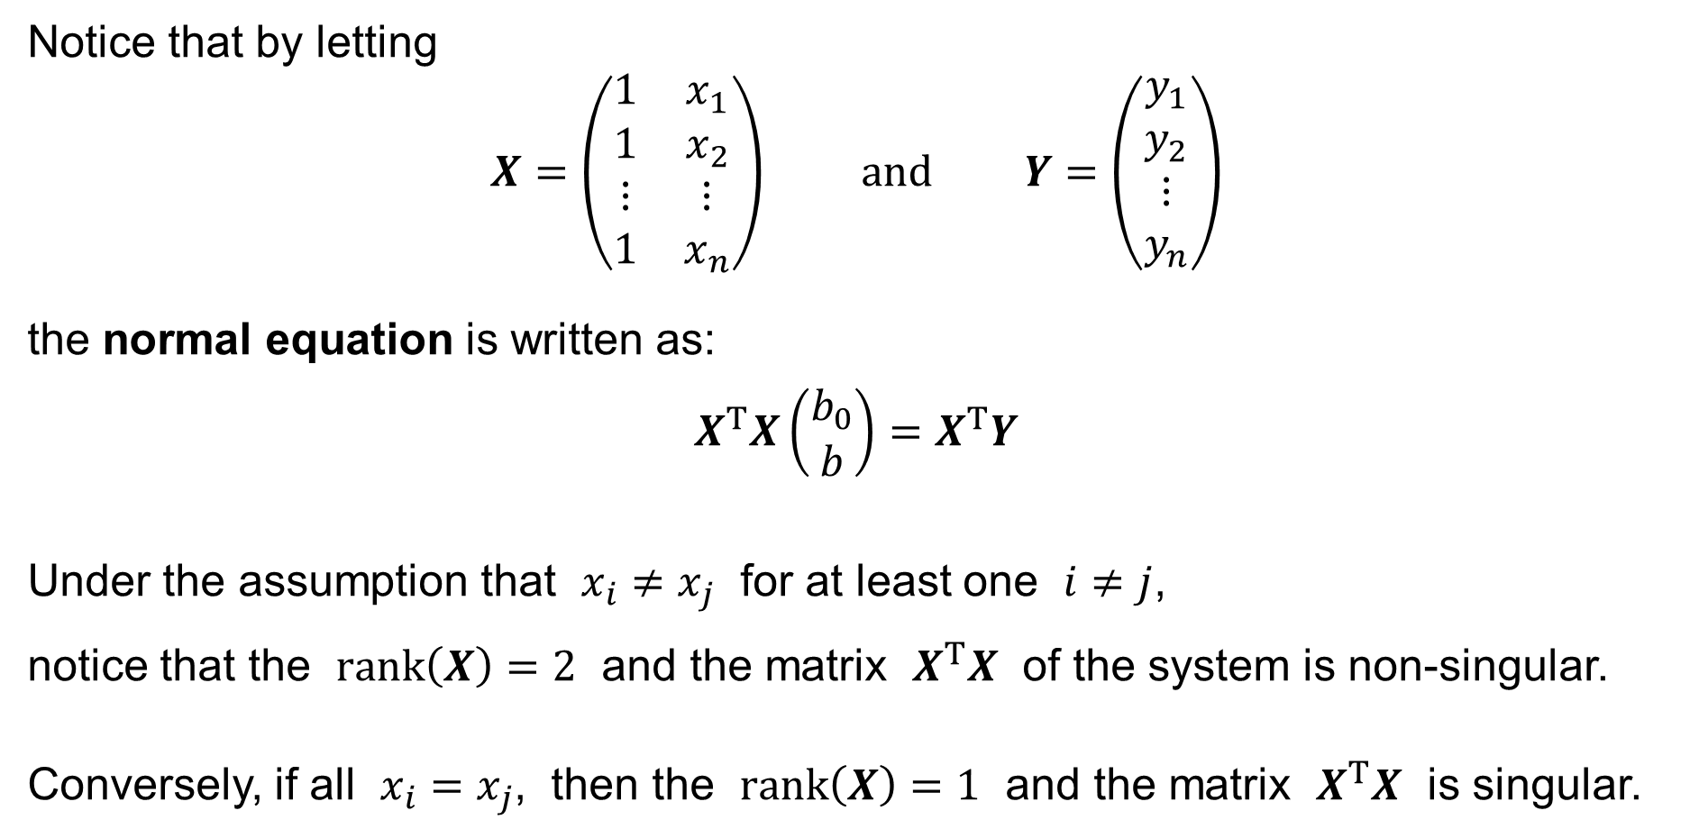
Simple Linear Regression: The Normal Equation
Notice that by letting
$$X=\left(\begin{matrix}1 & x_{1} \\ 1 & x_{2} \\ ⋮ & ⋮ \\ 1 & x_{n}\end{matrix}\right) \text{and} Y=\left(\begin{matrix}y_{1} \\ y_{2} \\ ⋮ \\ y_{n}\end{matrix}\right)$$
the normal equation is written as:
$$X^{T}X\left(\begin{matrix}b_{0} \\ b\end{matrix}\right)=X^{T}Y$$
Under the assumption that $x_{i}≠x_{j}$ for at least one $i≠j$,
notice that the $rank\left(X\right)=2$ and the matrix $X^{T}X$ of the system is non-singular.
Conversely, if all $x_{i}=x_{j}$, then the $rank\left(X\right)=1$ and the matrix $X^{T}X$ is singular.
the normal equation

Slide 33
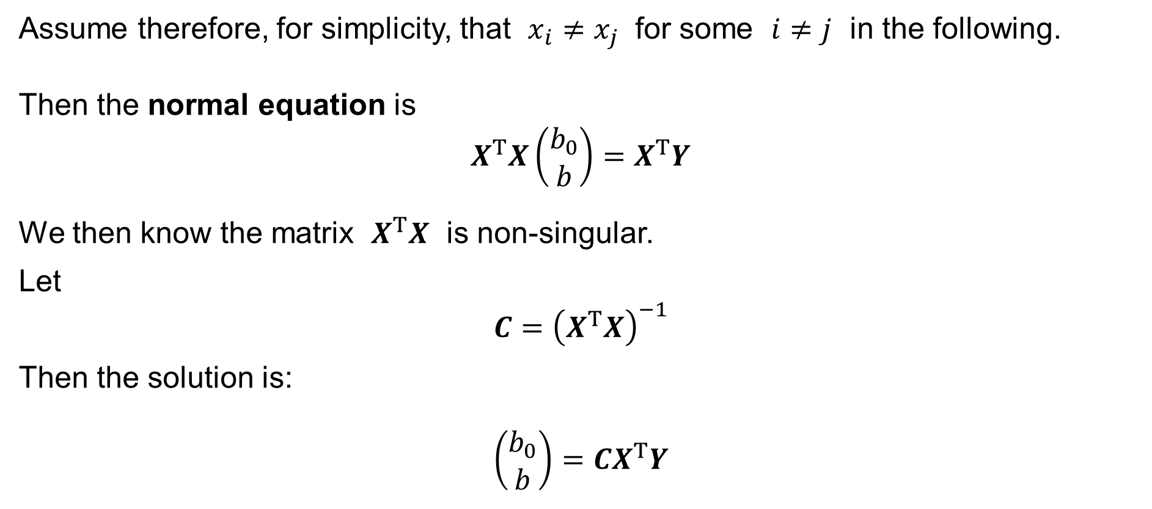
Simple Linear Regression: The Normal Equation
Assume therefore, for simplicity, that $x_{i}≠x_{j}$ for some $i≠j$ in the following.
Then the normal equation is
$$X^{T}X\left(\begin{matrix}b_{0} \\ b\end{matrix}\right)=X^{T}Y$$
We then know the matrix $X^{T}X$ is non-singular.
Let
$$C={\left(X^{T}X\right)}^{−1}$$
Then the solution is:
$$\left(\begin{matrix}b_{0} \\ b\end{matrix}\right)=CX^{T}Y$$

Slide 34
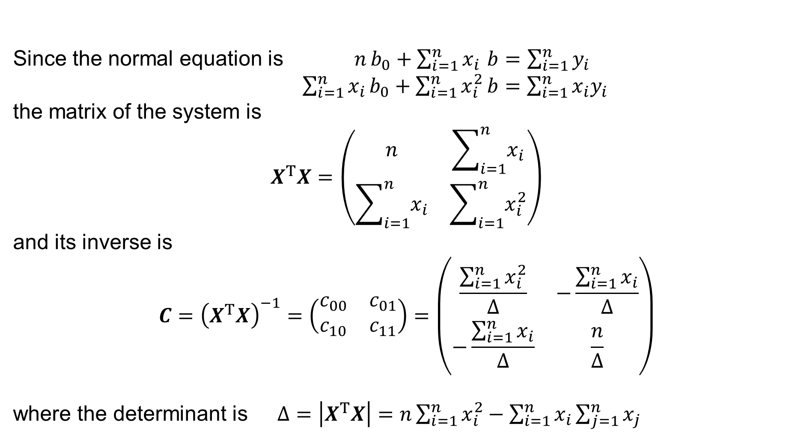
Simple Linear Regression: The Normal Equation
Since the normal equation is $n b_{0}+\sum_{i=1}^{n}{x_{i}} b=\sum_{i=1}^{n}{y_{i}}$
$\sum_{i=1}^{n}{x_{i}}b_{0}+\sum_{i=1}^{n}{x_{i}^{2}}b=\sum_{i=1}^{n}{x_{i}y_{i}}$
the matrix of the system is
$$X^{T}X=\left(\begin{matrix}n & \sum_{i=1}^{n}{x_{i}} \\ \sum_{i=1}^{n}{x_{i}} & \sum_{i=1}^{n}{x_{i}^{2}}\end{matrix}\right)$$
and its inverse is
$$C={\left(X^{T}X\right)}^{−1}=\left(\begin{matrix}c_{00} & c_{01} \\ c_{10} & c_{11}\end{matrix}\right)=\left(\begin{matrix}\frac{\sum_{i=1}^{n}{x_{i}^{2}}}{Δ} & −\frac{\sum_{i=1}^{n}{x_{i}}}{Δ} \\ −\frac{\sum_{i=1}^{n}{x_{i}}}{Δ} & \frac{n}{Δ}\end{matrix}\right)$$
where the determinant is $Δ=\left|X^{T}X\right|=n\sum_{i=1}^{n}{x_{i}^{2}}−\sum_{i=1}^{n}{x_{i}}\sum_{j=1}^{n}{x_{j}}$

Slide 35
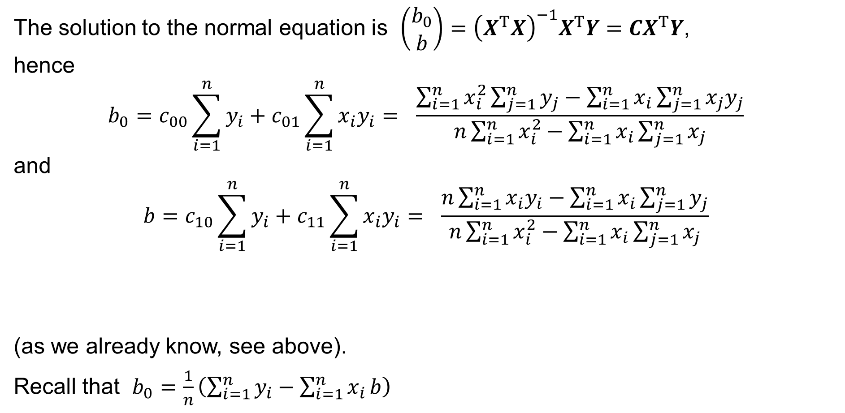
Simple Linear Regression: The Normal Equation
The solution to the normal equation is $\left(\begin{matrix}b_{0} \\ b\end{matrix}\right)={\left(X^{T}X\right)}^{−1}X^{T}Y=CX^{T}Y$,
hence
$$b_{0}=c_{00}\sum_{i=1}^{n}{y_{i}}+c_{01}\sum_{i=1}^{n}{x_{i}y_{i}}= \frac{\sum_{i=1}^{n}{x_{i}^{2}}\sum_{j=1}^{n}{y_{j}}−\sum_{i=1}^{n}{x_{i}}\sum_{j=1}^{n}{x_{j}y_{j}}}{n\sum_{i=1}^{n}{x_{i}^{2}}−\sum_{i=1}^{n}{x_{i}}\sum_{j=1}^{n}{x_{j}}}$$
and
$$b=c_{10}\sum_{i=1}^{n}{y_{i}}+c_{11}\sum_{i=1}^{n}{x_{i}y_{i}}= \frac{n\sum_{i=1}^{n}{x_{i}y_{i}}−\sum_{i=1}^{n}{x_{i}}\sum_{j=1}^{n}{y_{j}}}{n\sum_{i=1}^{n}{x_{i}^{2}}−\sum_{i=1}^{n}{x_{i}}\sum_{j=1}^{n}{x_{j}}}$$
(as we already know, see above).
Recall that $b_{0}=\frac{1}{n}\left(\sum_{i=1}^{n}{y_{i}}−\sum_{i=1}^{n}{x_{i}}b\right)$

Slide 36
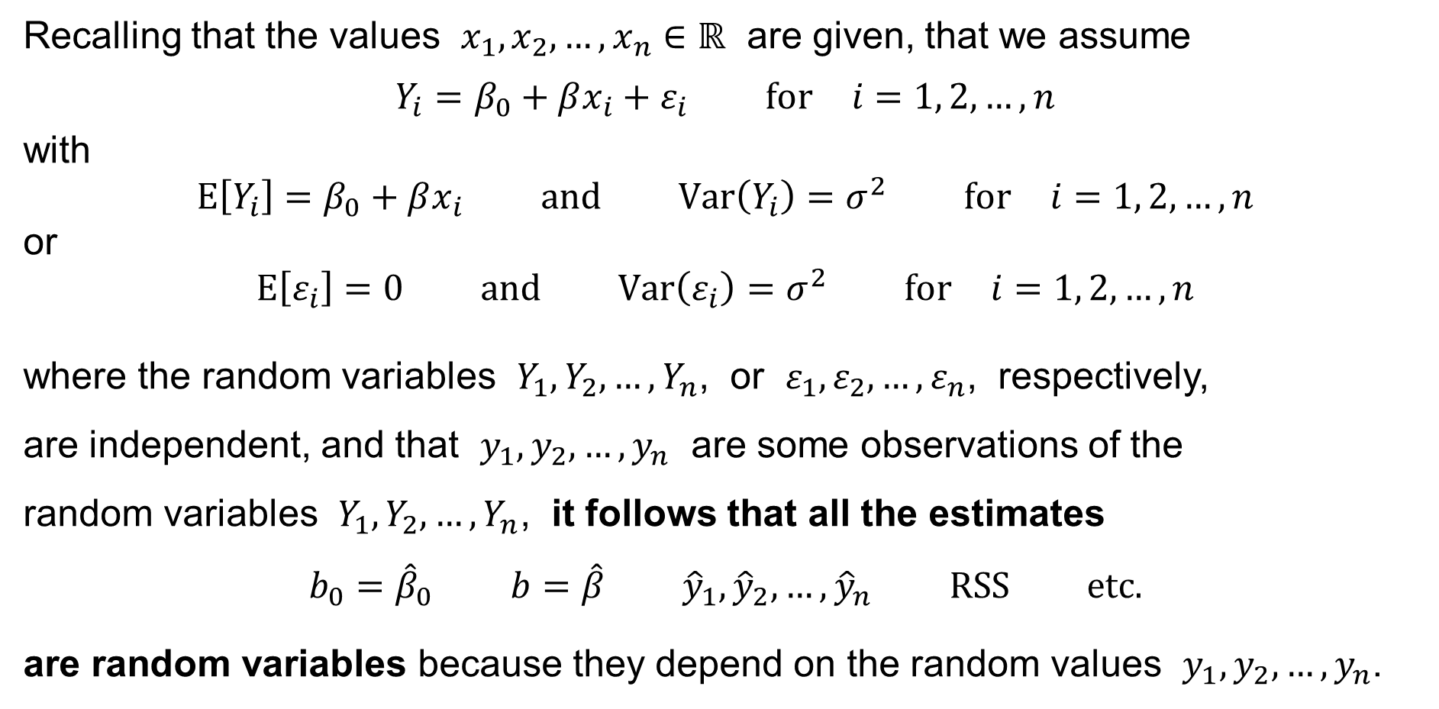
Simple Linear Regression
Recalling that the values $x_{1},x_{2},…,x_{n}∈ℝ$ are given, that we assume
$$Y_{i}=β_{0}+βx_{i}+ε_{i} \text{for} i=1, 2,…,n$$
with
$$E\left[Y_{i}\right]=β_{0}+βx_{i} \text{and} Var\left(Y_{i}\right)=σ^{2} \text{for} i=1, 2,…,n$$
or
$$E\left[ε_{i}\right]=0 \text{and} Var\left(ε_{i}\right)=σ^{2} \text{for} i=1, 2,…,n$$
where the random variables $Y_{1},Y_{2},…,Y_{n}$, or $ε_{1},ε_{2},…,ε_{n}$, respectively,
are independent, and that $y_{1},y_{2},…,y_{n}$ are some observations of the
random variables $Y_{1},Y_{2},…,Y_{n}$, it follows that all the estimates
$$b_{0}={\hat{β}}_{0} b=\hat{β} {\hat{y}}_{1},{\hat{y}}_{2},…,{\hat{y}}_{n} RSS \text{etc}\text{.}$$
are random variables because they depend on the random values $y_{1},y_{2},…,y_{n}$.

Slide 37
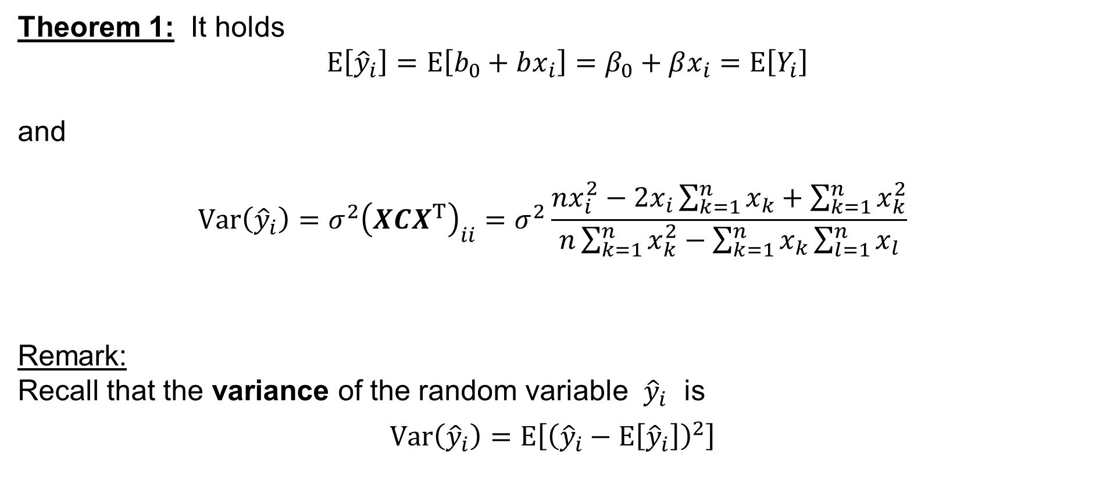
Simple Linear Regression: Theorem 1
Theorem 1: It holds
$$E\left[{\hat{y}}_{i}\right]=E\left[b_{0}+bx_{i}\right]=β_{0}+βx_{i}=E\left[Y_{i}\right]$$
and
$$Var\left({\hat{y}}_{i}\right)=σ^{2}{\left(XCX^{T}\right)}_{ii}=σ^{2}\frac{nx_{i}^{2}−2x_{i}\sum_{k=1}^{n}{x_{k}}+\sum_{k=1}^{n}{x_{k}^{2}}}{n\sum_{k=1}^{n}{x_{k}^{2}}−\sum_{k=1}^{n}{x_{k}}\sum_{l=1}^{n}{x_{l}}}$$
Remark:
Recall that the variance of the random variable ${\hat{y}}_{i}$ is
$$Var\left({\hat{y}}_{i}\right)=E\left[{\left({\hat{y}}_{i}−E\left[{\hat{y}}_{i}\right]\right)}^{2}\right]$$

Slide 38
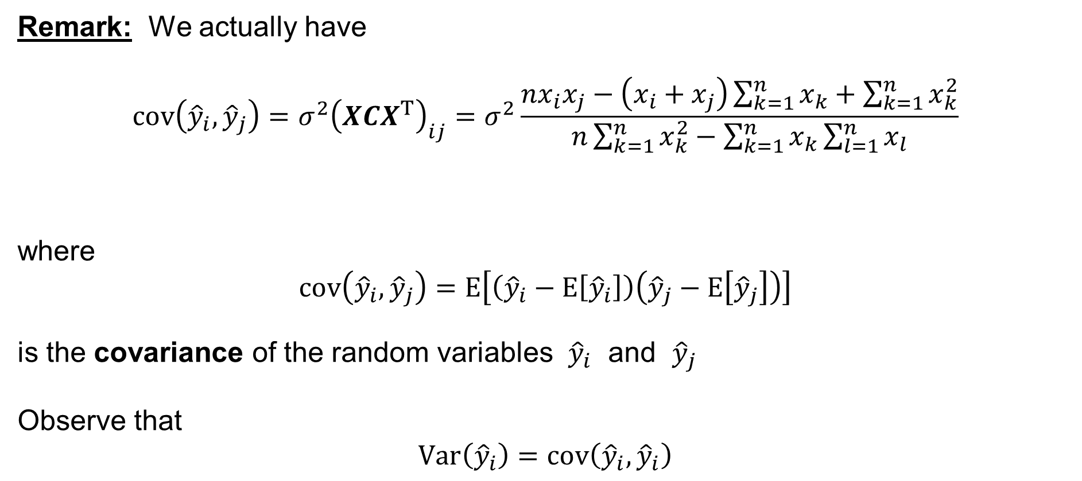
Simple Linear Regression
Remark: We actually have
$$cov\left({\hat{y}}_{i},{\hat{y}}_{j}\right)=σ^{2}{\left(XCX^{T}\right)}_{ij}=σ^{2}\frac{nx_{i}x_{j}−\left(x_{i}+x_{j}\right)\sum_{k=1}^{n}{x_{k}}+\sum_{k=1}^{n}{x_{k}^{2}}}{n\sum_{k=1}^{n}{x_{k}^{2}}−\sum_{k=1}^{n}{x_{k}}\sum_{l=1}^{n}{x_{l}}}$$
where
$$cov\left({\hat{y}}_{i},{\hat{y}}_{j}\right)=E\left[\left({\hat{y}}_{i}−E\left[{\hat{y}}_{i}\right]\right)\left({\hat{y}}_{j}−E\left[{\hat{y}}_{j}\right]\right)\right]$$
is the covariance of the random variables ${\hat{y}}_{i}$ and ${\hat{y}}_{j}$
Observe that
$$Var\left({\hat{y}}_{i}\right)=cov\left({\hat{y}}_{i},{\hat{y}}_{i}\right)$$

Slide 39
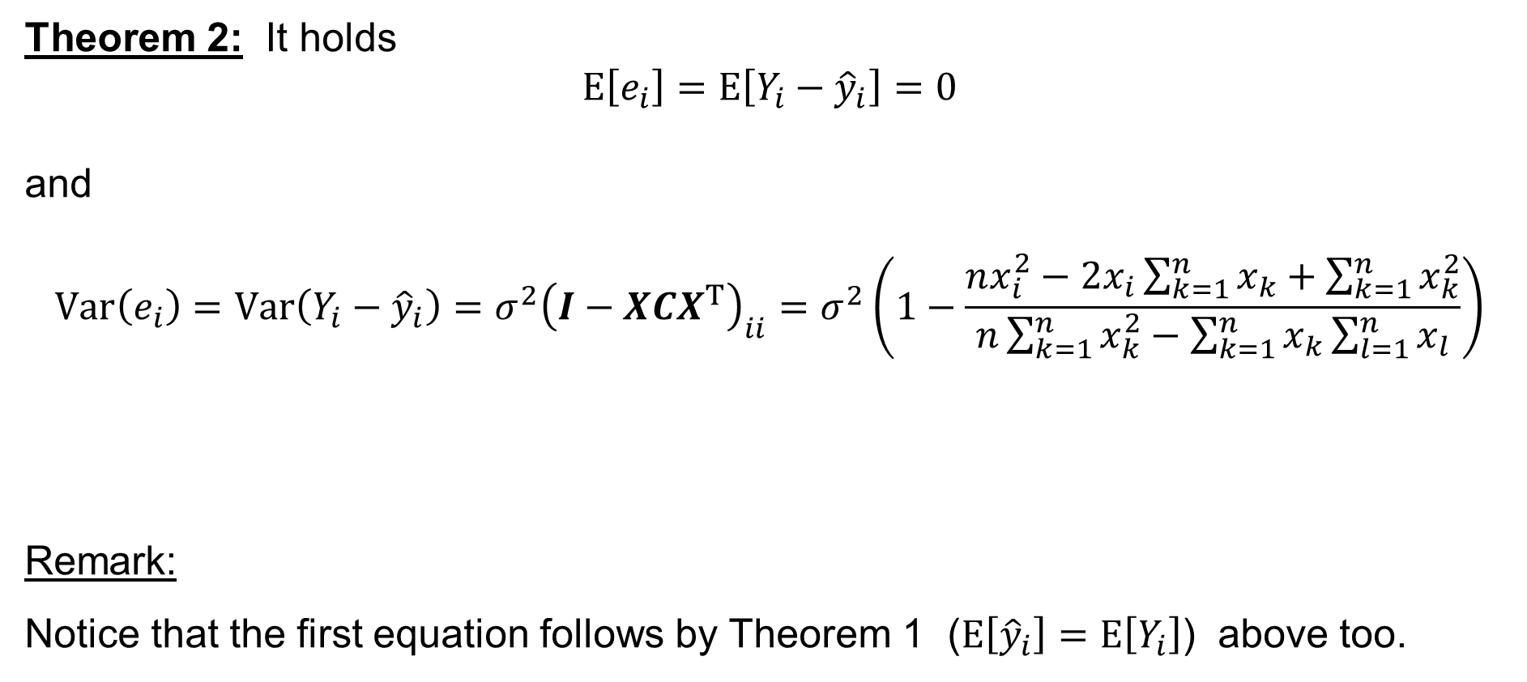
Simple Linear Regression: Theorem 2
Theorem 2: It holds
$$E\left[e_{i}\right]=E\left[Y_{i}−{\hat{y}}_{i}\right]=0$$
and
$$Var\left(e_{i}\right)=Var\left(Y_{i}−{\hat{y}}_{i}\right)=σ^{2}{\left(I−XCX^{T}\right)}_{ii}=σ^{2}\left(1−\frac{nx_{i}^{2}−2x_{i}\sum_{k=1}^{n}{x_{k}}+\sum_{k=1}^{n}{x_{k}^{2}}}{n\sum_{k=1}^{n}{x_{k}^{2}}−\sum_{k=1}^{n}{x_{k}}\sum_{l=1}^{n}{x_{l}}}\right)$$
Remark:
Notice that the first equation follows by Theorem 1 ($E\left[{\hat{y}}_{i}\right]=E\left[Y_{i}\right]$) above too.

Slide 40

Simple Linear Regression
Remark: For $i≠j$, we actually have
$$cov\left(e_{i},e_{j}\right)=cov\left(Y_{i}−{\hat{y}}_{i}, Y_{j}−{\hat{y}}_{j}\right)=σ^{2}{\left(I−XCX^{T}\right)}_{ij}= \\ =−σ^{2}\frac{nx_{i}x_{j}−\left(x_{i}+x_{j}\right)\sum_{k=1}^{n}{x_{k}}+\sum_{k=1}^{n}{x_{k}^{2}}}{n\sum_{k=1}^{n}{x_{k}^{2}}−\sum_{k=1}^{n}{x_{k}}\sum_{l=1}^{n}{x_{l}}}= \\ =−cov\left({\hat{y}}_{i},{\hat{y}}_{j}\right) \text{if} i≠j$$

Slide 41
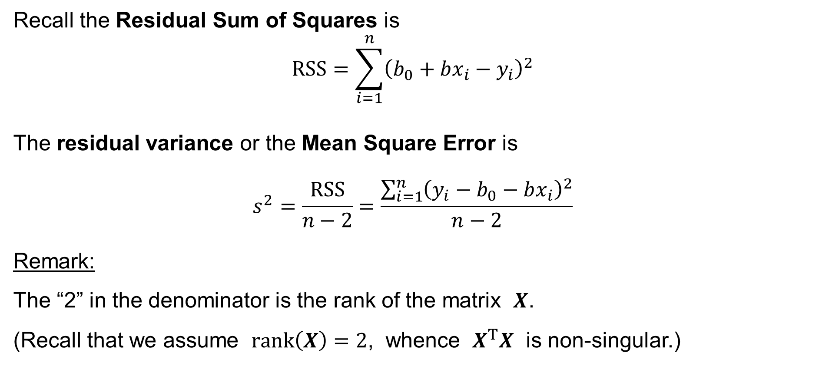
Simple Linear Regression
Recall the Residual Sum of Squares is
$$RSS=\sum_{i=1}^{n}{{\left(b_{0}+bx_{i}−y_{i}\right)}^{2}}$$
The residual variance or the Mean Square Error is
$$s^{2}=\frac{RSS}{n−2}=\frac{\sum_{i=1}^{n}{{\left(y_{i}−b_{0}−bx_{i}\right)}^{2}}}{n−2}$$
Remark:
The “2” in the denominator is the rank of the matrix $X$.
(Recall that we assume $rank\left(X\right)=2$, whence $X^{T}X$ is non-singular.)

Slide 42
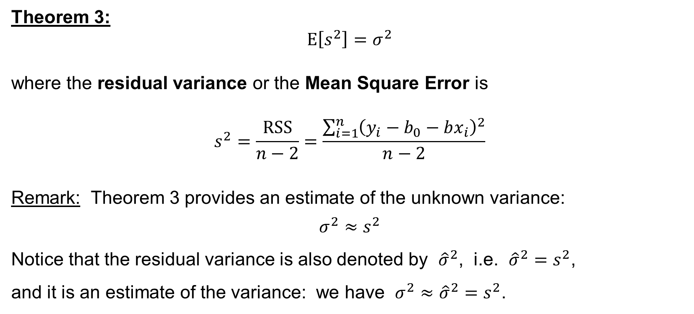
Simple Linear Regression: Theorem 3
Theorem 3:
$$E\left[s^{2}\right]=σ^{2}$$
where the residual variance or the Mean Square Error is
$$s^{2}=\frac{RSS}{n−2}=\frac{\sum_{i=1}^{n}{{\left(y_{i}−b_{0}−bx_{i}\right)}^{2}}}{n−2}$$
Remark: Theorem 3 provides an estimate of the unknown variance:
$$σ^{2}≈s^{2}$$
Notice that the residual variance is also denoted by ${\hat{σ}}^{2}$, i.e. ${\hat{σ}}^{2}=s^{2}$,
and it is an estimate of the variance: we have $σ^{2}≈{\hat{σ}}^{2}=s^{2}$.

Slide 43

Simple Linear Regression: Theorem 4
Theorem 4: It holds
$$E\left[b_{0}\right]=β_{0} \text{and} E\left[b\right]=β$$
with
$$Var\left(b_{0}\right)=σ^{2}c_{00}=σ^{2}\left.\frac{\sum_{i=1}^{n}{x_{i}^{2}}}{n\sum_{i=1}^{n}{x_{i}^{2}}−\sum_{i=1}^{n}{x_{i}}\sum_{j=1}^{n}{x_{j}}}\right.$$
and
$$Var\left(b\right)=σ^{2}c_{11}=σ^{2}\left.\frac{n}{n\sum_{i=1}^{n}{x_{i}^{2}}−\sum_{i=1}^{n}{x_{i}}\sum_{j=1}^{n}{x_{j}}}\right.$$

Slide 44

Simple Linear Regression
Remark: We also have
$$cov\left(b_{0},b\right)=σ^{2}c_{01}=−σ^{2}\left.\frac{\sum_{i=1}^{n}{x_{i}}}{n\sum_{i=1}^{n}{x_{i}^{2}}−\sum_{i=1}^{n}{x_{i}}\sum_{j=1}^{n}{x_{j}}}\right.$$

Slide 45
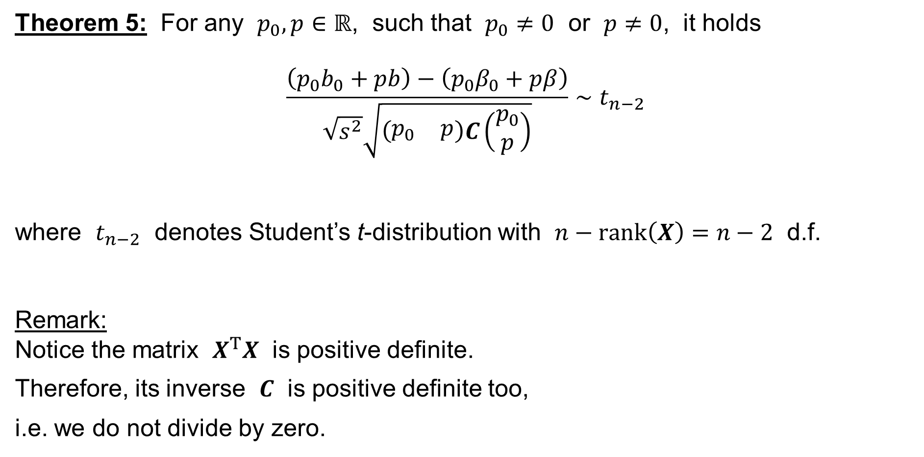
Simple Linear Regression: Theorem 5
Theorem 5: For any $p_{0},p∈ℝ$, such that $p_{0}≠0$ or $p≠0$, it holds
$$\frac{\left(p_{0}b_{0}+pb\right)−\left(p_{0}β_{0}+pβ\right)}{\sqrt{s^{2}}\sqrt{\left(\begin{matrix}p_{0} & p\end{matrix}\right)C\left(\begin{matrix}p_{0} \\ p\end{matrix}\right)}}∼t_{n−2}$$
where $t_{n−2}$ denotes Student’s t-distribution with $n−rank\left(X\right)=n−2$ d.f.
Remark:
Notice the matrix $X^{T}X$ is positive definite.
Therefore, its inverse $C$ is positive definite too,
i.e. we do not divide by zero.

Slide 46
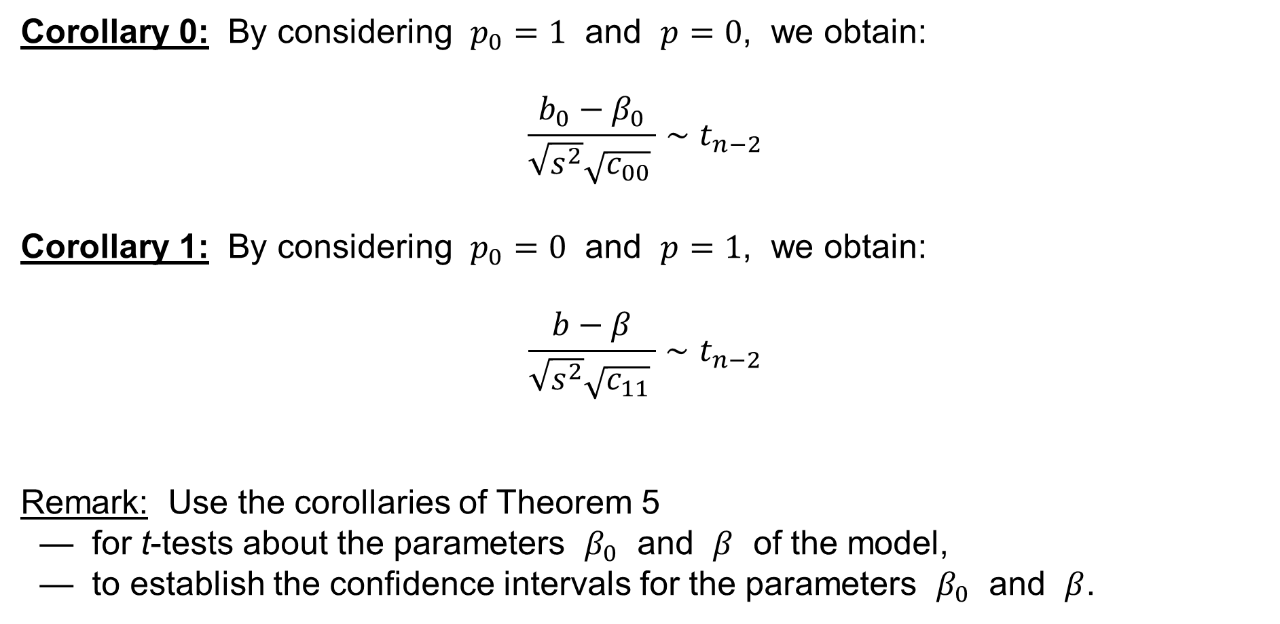
Simple Linear Regression: Corollaries
Corollary 0: By considering $p_{0}=1$ and $p=0$, we obtain:
$$\frac{b_{0}−β_{0}}{\sqrt{s^{2}}\sqrt{c_{00}} }∼t_{n−2}$$
Corollary 1: By considering $p_{0}=0$ and $p=1$, we obtain:
$$\frac{b−β}{\sqrt{s^{2}}\sqrt{c_{11}} }∼t_{n−2}$$
Remark: Use the corollaries of Theorem 5
— for t-tests about the parameters $β_{0}$ and $β$ of the model,
— to establish the confidence intervals for the parameters $β_{0}$ and $β$.

Slide 47
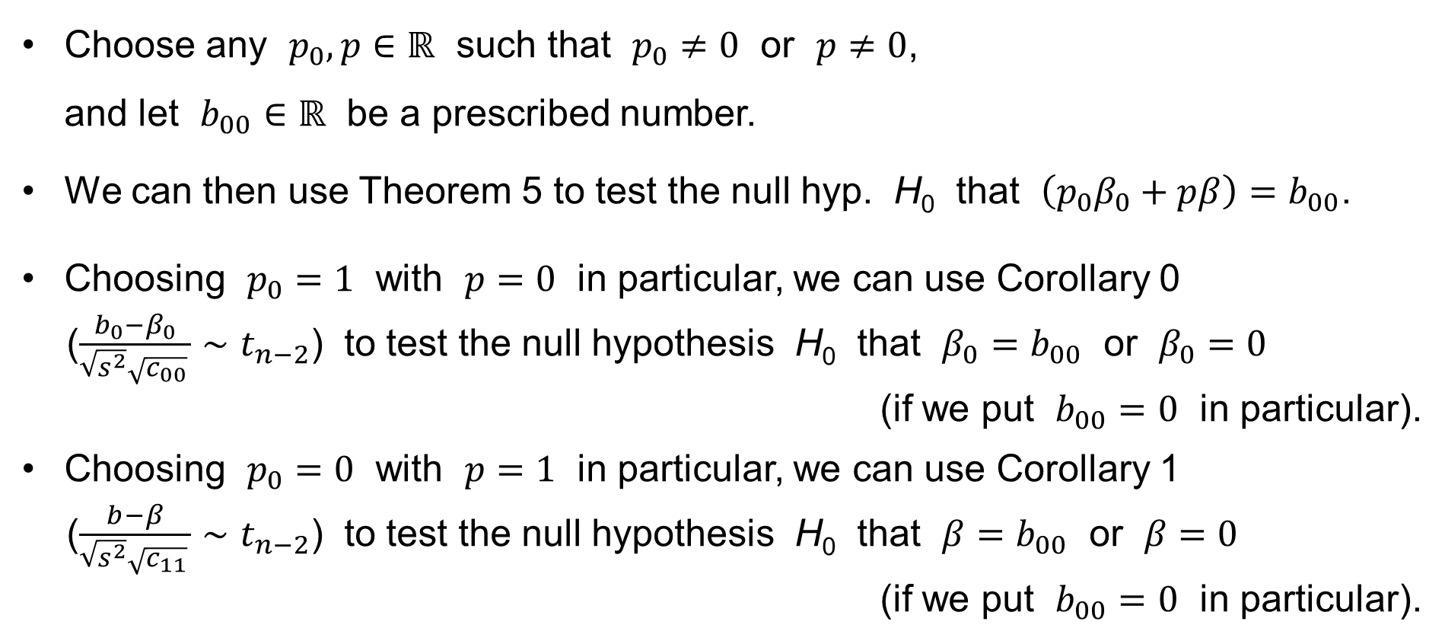
Tests of hypotheses about the parameters β₀ and β
Choose any $p_{0},p∈ℝ$ such that $p_{0}≠0$ or $p≠0$,
and let $b_{00}∈ℝ$ be a prescribed number.
We can then use Theorem 5 to test the null hyp. H₀ that $\left(p_{0}β_{0}+pβ\right)=b_{00}$.
Choosing $p_{0}=1$ with $p=0$ in particular, we can use Corollary 0
($\frac{b_{0}−β_{0}}{\sqrt{s^{2}}\sqrt{c_{00}} }∼t_{n−2}$) to test the null hypothesis H₀ that $β_{0}=b_{00}$ or $β_{0}=0$
(if we put $b_{00}=0$ in particular).
Choosing $p_{0}=0$ with $p=1$ in particular, we can use Corollary 1
($\frac{b−β}{\sqrt{s^{2}}\sqrt{c_{11}} }∼t_{n−2}$) to test the null hypothesis H₀ that $β=b_{00}$ or $β=0$
(if we put $b_{00}=0$ in particular).

Slide 48
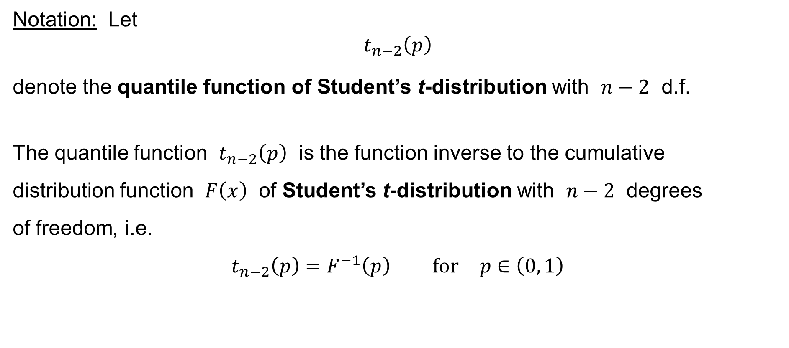
t-test for the parameter β₀ or β
Notation: Let
$$t_{n−2}\left(p\right)$$
denote the quantile function of Student’s t-distribution with $n−2$ d.f.
The quantile function $t_{n−2}\left(p\right)$ is the function inverse to the cumulative
distribution function $F\left(x\right)$ of Student’s t-distribution with $n−2$ degrees
of freedom, i.e.
$$t_{n−2}\left(p\right)=F^{−1}\left(p\right) \text{for} p∈\left(0, 1\right)$$

Slide 49
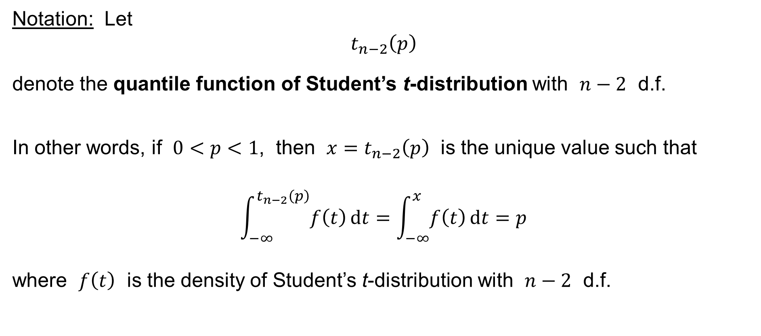
t-test for the parameter β₀ or β
Notation: Let
$$t_{n−2}\left(p\right)$$
denote the quantile function of Student’s t-distribution with $n−2$ d.f.
In other words, if $0<p<1$, then $x=t_{n−2}\left(p\right)$ is the unique value such that
$$\int_{−∞}^{t_{n−2}\left(p\right)}{f\left(t\right) dt}=\int_{−∞}^{x}{f\left(t\right) dt}=p$$
where $f\left(t\right)$ is the density of Student’s t-distribution with $n−2$ d.f.

Slide 50
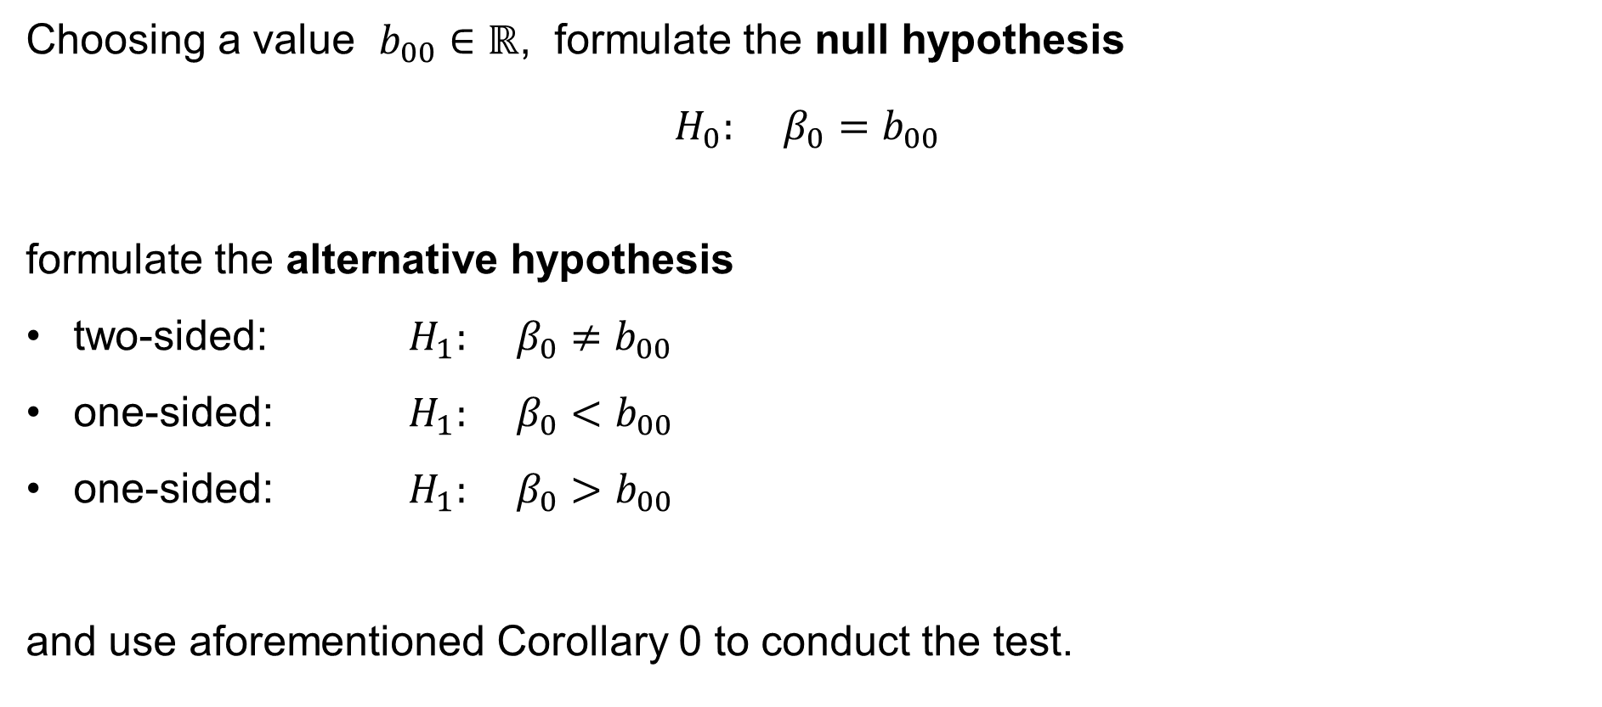
t-test for the parameter β₀
Choosing a value $b_{00}∈ℝ$, formulate the null hypothesis
$$H_{0}: β_{0}=b_{00}$$
formulate the alternative hypothesis
two-sided: $H_{1}: β_{0}≠b_{00}$
one-sided: $H_{1}: β_{0}<b_{00}$
one-sided: $H_{1}: β_{0}>b_{00}$
and use aforementioned Corollary 0 to conduct the test.

Slide 51
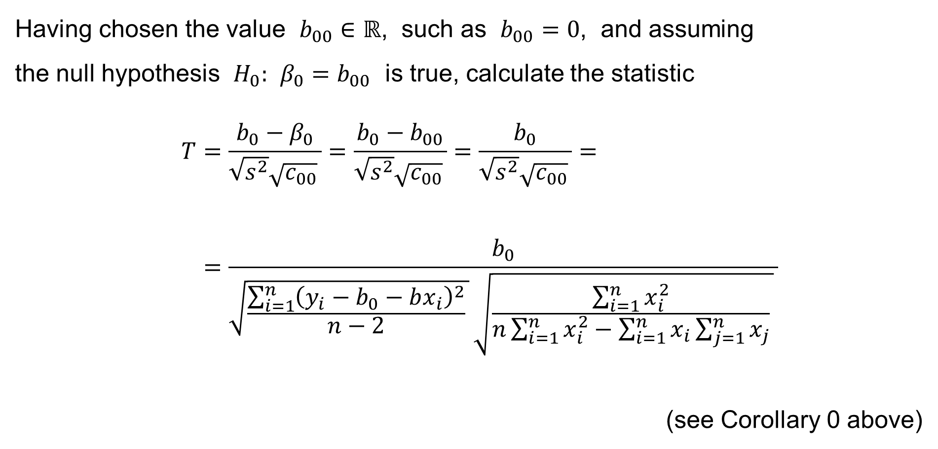
t-test for the parameter β₀
Having chosen the value $b_{00}∈ℝ$, such as $b_{00}=0$, and assuming
the null hypothesis $H_{0}: β_{0}=b_{00}$ is true, calculate the statistic
$$T=\frac{b_{0}−β_{0}}{\sqrt{s^{2}}\sqrt{c_{00}} }=\frac{b_{0}−b_{00}}{\sqrt{s^{2}}\sqrt{c_{00}} }=\frac{b_{0}}{\sqrt{s^{2}}\sqrt{c_{00}} }= \\ =\frac{b_{0}}{\sqrt{\frac{\sum_{i=1}^{n}{{\left(y_{i}−b_{0}−bx_{i}\right)}^{2}}}{n−2} } \sqrt{\frac{\sum_{i=1}^{n}{x_{i}^{2}}}{n\sum_{i=1}^{n}{x_{i}^{2}}−\sum_{i=1}^{n}{x_{i}}\sum_{j=1}^{n}{x_{j}}} } }$$
(see Corollary 0 above)

Slide 52
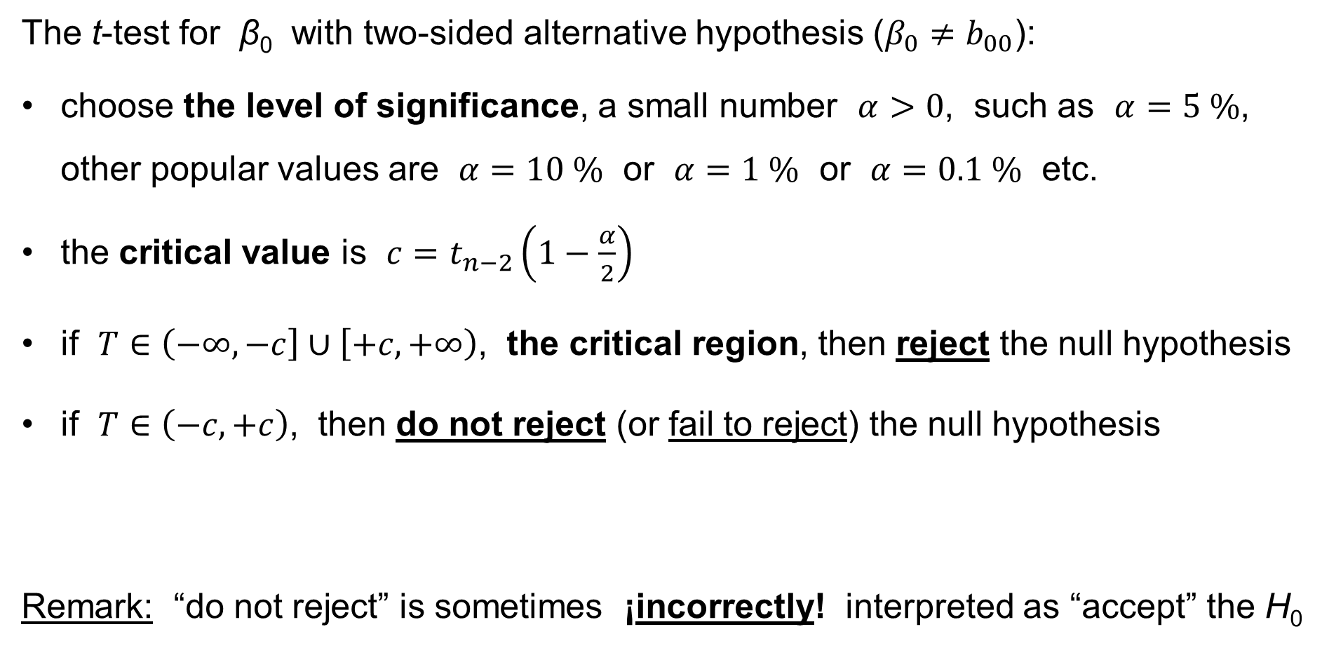
t-test for the parameter β₀
The t-test for β₀ with two-sided alternative hypothesis ($β_{0}≠b_{00}$):
choose the level of significance, a small number $α>0$, such as $α=5 \%$, other popular values are $α=10 \%$ or $α=1 \%$ or $α=0.1 \%$ etc.
the critical value is $c=t_{n−2}\left(1−\frac{α}{2}\right)$
if $T∈\left(−∞,−c\right]∪\left[+c,+∞\right)$, the critical region, then reject the null hypothesis
if $T∈\left(−c,+c\right)$, then do not reject (or fail to reject) the null hypothesis
Remark: “do not reject” is sometimes ¡incorrectly! interpreted as “accept” the H₀

Slide 53
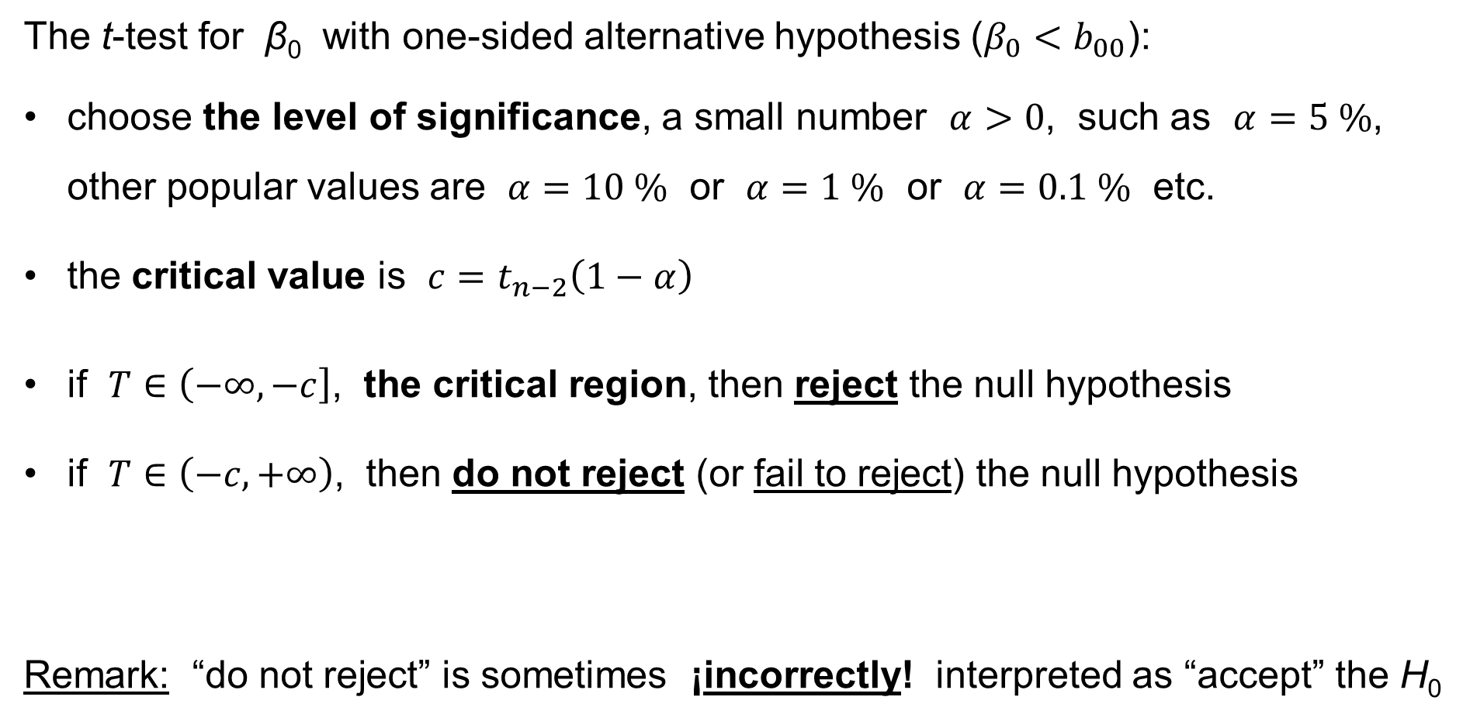
t-test for the parameter β₀
The t-test for β₀ with one-sided alternative hypothesis ($β_{0}<b_{00}$):
choose the level of significance, a small number $α>0$, such as $α=5 \%$, other popular values are $α=10 \%$ or $α=1 \%$ or $α=0.1 \%$ etc.
the critical value is $c=t_{n−2}\left(1−α\right)$
if $T∈\left(−∞,−c\right]$, the critical region, then reject the null hypothesis
if $T∈\left(−c,+∞\right)$, then do not reject (or fail to reject) the null hypothesis
Remark: “do not reject” is sometimes ¡incorrectly! interpreted as “accept” the H₀

Slide 54
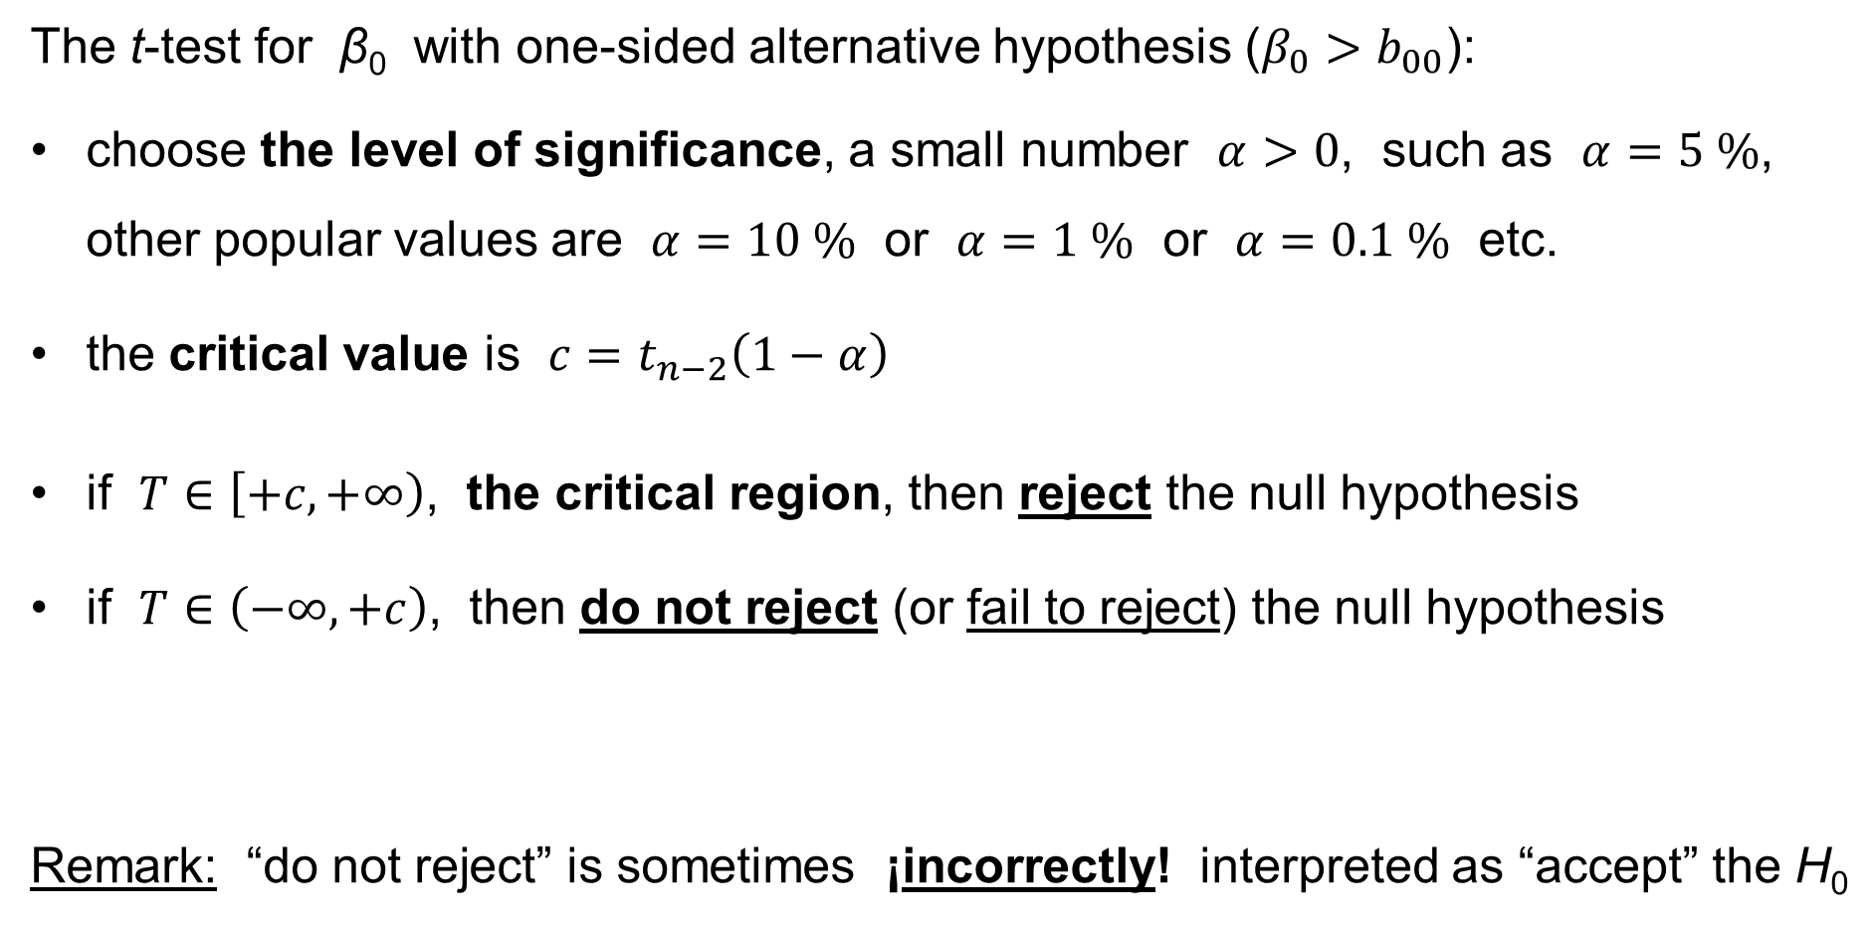
t-test for the parameter β₀
The t-test for β₀ with one-sided alternative hypothesis ($β_{0}>b_{00}$):
choose the level of significance, a small number $α>0$, such as $α=5 \%$, other popular values are $α=10 \%$ or $α=1 \%$ or $α=0.1 \%$ etc.
the critical value is $c=t_{n−2}\left(1−α\right)$
if $T∈\left[+c,+∞\right)$, the critical region, then reject the null hypothesis
if $T∈\left(−∞,+c\right)$, then do not reject (or fail to reject) the null hypothesis
Remark: “do not reject” is sometimes ¡incorrectly! interpreted as “accept” the H₀

Slide 55
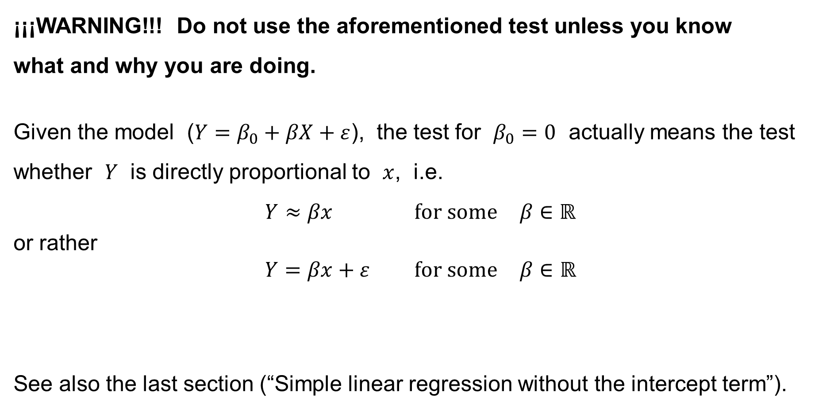
t-test for the parameter β₀
¡¡¡WARNING!!! Do not use the aforementioned test unless you know
what and why you are doing.
Given the model ($Y=β_{0}+βX+ε$), the test for $β_{0}=0$ actually means the test whether $Y$ is directly proportional to $x$, i.e.
$$Y≈βx \text{for} \text{some} β∈ℝ$$
or rather
$$Y=βx+ε \text{for} \text{some} β∈ℝ$$
See also the last section (“Simple linear regression without the intercept term”).

Slide 56
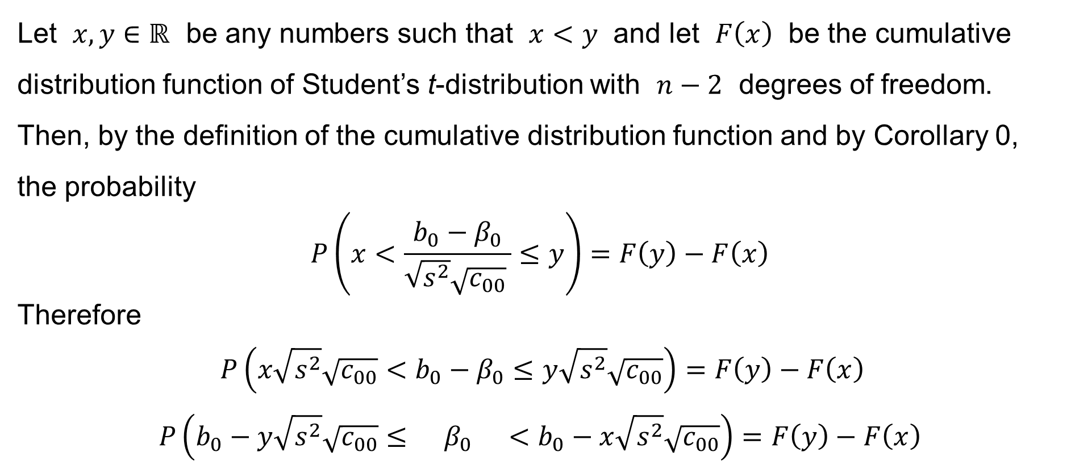
Confidence interval for the parameter β₀
Let $x,y∈ℝ$ be any numbers such that $x<y$ and let $F\left(x\right)$ be the cumulative distribution function of Student’s t-distribution with $n−2$ degrees of freedom. Then, by the definition of the cumulative distribution function and by Corollary 0, the probability
$$P\left(x<\frac{b_{0}−β_{0}}{\sqrt{s^{2}}\sqrt{c_{00}} }≤y\right)=F\left(y\right)−F\left(x\right)$$
Therefore
$$P\left(x\sqrt{s^{2}}\sqrt{c_{00}}<b_{0}−β_{0}≤y\sqrt{s^{2}}\sqrt{c_{00}}\right)=F\left(y\right)−F\left(x\right) \\ P\left(b_{0}−y\sqrt{s^{2}}\sqrt{c_{00}}≤ β_{0} <b_{0}−x\sqrt{s^{2}}\sqrt{c_{00}}\right)=F\left(y\right)−F\left(x\right)$$

Slide 57

Confidence interval for the parameter β₀
We have:
$$P\left(b_{0}−y\sqrt{s^{2}}\sqrt{c_{00}}≤β_{0}<b_{0}−x\sqrt{s^{2}}\sqrt{c_{00}}\right)=F\left(y\right)−F\left(x\right)$$
Choose the level of significance, a small number $α>0$, such as $α=5 \%$.
Let $y=t_{n−2}\left(1−\frac{α}{2}\right)$ and let $x=−y=−t_{n−2}\left(1−\frac{α}{2}\right)=t_{n−2}\left(\frac{α}{2}\right)$.
Recall that $t_{n−2}\left(p\right)=F^{−1}\left(p\right)$.
Then, by the continuity of the cumulative distribution function, the probability that
$$\text{the} \text{unknown} β_{0}∈\left[b_{0}−t_{n−2}\left(1−\frac{α}{2}\right)\sqrt{s^{2}}\sqrt{c_{00}}, b_{0}+t_{n−2}\left(1−\frac{α}{2}\right)\sqrt{s^{2}}\sqrt{c_{00}}\right]$$
is about 1−α = 95 %.

Slide 58

Confidence interval for the parameter β₀
We have:
$$P\left(b_{0}−y\sqrt{s^{2}}\sqrt{c_{00}}≤β_{0}<b_{0}−x\sqrt{s^{2}}\sqrt{c_{00}}\right)=F\left(y\right)−F\left(x\right)$$
Choose the level of significance, a small number $α>0$, such as $α=5 \%$.
Let $y=t_{n−2}\left(1−α\right)$ and let $x=−∞$. Recall that $t_{n−2}\left(p\right)=F^{−1}\left(p\right)$.
Then, by the continuity of the cumulative distribution function, the probability that
$$\text{the} \text{unknown} β_{0}∈\left[b_{0}−t_{n−2}\left(1−α\right)\sqrt{s^{2}}\sqrt{c_{00}}, +∞\right)$$
is about 1−α = 95 %.

Slide 59

Confidence interval for the parameter β₀
We have:
$$P\left(b_{0}−y\sqrt{s^{2}}\sqrt{c_{00}}≤β_{0}<b_{0}−x\sqrt{s^{2}}\sqrt{c_{00}}\right)=F\left(y\right)−F\left(x\right)$$
Choose the level of significance, a small number $α>0$, such as $α=5 \%$.
Let $y=+∞$ and let $x=t_{n−2}\left(α\right)$. Recall that $t_{n−2}\left(p\right)=F^{−1}\left(p\right)$.
Then, by the continuity of the cumulative distribution function, the probability that
$$\text{the} \text{unknown} β_{0}∈\left(−∞, b_{0}+t_{n−2}\left(1−α\right)\sqrt{s^{2}}\sqrt{c_{00}}\right]$$
is about 1−α = 95 %.

Slide 60

t-test for the parameter β
Choosing a value $b_{00}∈ℝ$, formulate the null hypothesis
$$H_{0}: β=b_{00}$$
formulate the alternative hypothesis
two-sided: $H_{1}: β≠b_{00}$
one-sided: $H_{1}: β<b_{00}$
one-sided: $H_{1}: β>b_{00}$
and use aforementioned Corollary 1 to conduct the test.

Slide 61

t-test for the parameter β
Having chosen the value $b_{00}∈ℝ$, such as $b_{00}=0$, and assuming
the null hypothesis $H_{0}: β=b_{00}$ is true, calculate the statistic
$$T=\frac{b−β}{\sqrt{s^{2}}\sqrt{c_{11}} }=\frac{b−b_{00}}{\sqrt{s^{2}}\sqrt{c_{11}} }=\frac{b}{\sqrt{s^{2}}\sqrt{c_{11}} }= \\ =\frac{b}{\sqrt{\frac{\sum_{i=1}^{n}{{\left(y_{i}−b_{0}−bx_{i}\right)}^{2}}}{n−2} } \sqrt{\frac{n}{n\sum_{i=1}^{n}{x_{i}^{2}}−\sum_{i=1}^{n}{x_{i}}\sum_{j=1}^{n}{x_{j}}} } }$$
(see Corollary 1 above)

Slide 62

t-test for the parameter β
The t-test for β with two-sided alternative hypothesis ($β≠b_{00}$):
choose the level of significance, a small number $α>0$, such as $α=5 \%$, other popular values are $α=10 \%$ or $α=1 \%$ or $α=0.1 \%$ etc.
the critical value is $c=t_{n−2}\left(1−\frac{α}{2}\right)$
if $T∈\left(−∞,−c\right]∪\left[+c,+∞\right)$, the critical region, then reject the null hypothesis
if $T∈\left(−c,+c\right)$, then do not reject (or fail to reject) the null hypothesis
Remark: “do not reject” is sometimes ¡incorrectly! interpreted as “accept” the H₀

Slide 63

t-test for the parameter β
The t-test for β with one-sided alternative hypothesis ($β<b_{00}$):
choose the level of significance, a small number $α>0$, such as $α=5 \%$, other popular values are $α=10 \%$ or $α=1 \%$ or $α=0.1 \%$ etc.
the critical value is $c=t_{n−2}\left(1−α\right)$
if $T∈\left(−∞,−c\right]$, the critical region, then reject the null hypothesis
if $T∈\left(−c,+∞\right)$, then do not reject (or fail to reject) the null hypothesis
Remark: “do not reject” is sometimes ¡incorrectly! interpreted as “accept” the H₀

Slide 64

t-test for the parameter β
The t-test for β with one-sided alternative hypothesis ($β>b_{00}$):
choose the level of significance, a small number $α>0$, such as $α=5 \%$, other popular values are $α=10 \%$ or $α=1 \%$ or $α=0.1 \%$ etc.
the critical value is $c=t_{n−2}\left(1−α\right)$
if $T∈\left[+c,+∞\right)$, the critical region, then reject the null hypothesis
if $T∈\left(−∞,+c\right)$, then do not reject (or fail to reject) the null hypothesis
Remark: “do not reject” is sometimes ¡incorrectly! interpreted as “accept” the H₀

Slide 65

t-test for the parameter β
¡¡¡REMARK!!!
Given the model ($Y=β_{0}+βX+ε$), the test for $β=0$ actually means the test whether $Y$ is completely random and independent of $x$, i.e.
$$Y≈β_{0} \text{for} \text{some} β_{0}∈ℝ$$
or rather
$$Y=β_{0}+ε \text{for} \text{some} β_{0}∈ℝ$$
i.e.
$$Y∼𝒩\left(β_{0},σ^{2}\right) \text{for} \text{some} β_{0}∈ℝ \text{and} σ^{2}∈ℝ_{0}^{+}$$
consequently, whether there is no correlation between the variables $x$ and $Y$.

Slide 66

Confidence interval for the parameter β
Let $x,y∈ℝ$ be any numbers such that $x<y$ and let $F\left(x\right)$ be the cumulative distribution function of Student’s t-distribution with $n−2$ degrees of freedom. Then, by the definition of the cumulative distribution function and by Corollary 1, the probability
$$P\left(x<\frac{b−β}{\sqrt{s^{2}}\sqrt{c_{11}} }≤y\right)=F\left(y\right)−F\left(x\right)$$
Therefore
$$P\left(x\sqrt{s^{2}}\sqrt{c_{11}}<b−β≤y\sqrt{s^{2}}\sqrt{c_{11}}\right)=F\left(y\right)−F\left(x\right) \\ P\left(b−y\sqrt{s^{2}}\sqrt{c_{11}}≤ β <b−x\sqrt{s^{2}}\sqrt{c_{11}}\right)=F\left(y\right)−F\left(x\right)$$

Slide 67

Confidence interval for the parameter β
We have:
$$P\left(b−y\sqrt{s^{2}}\sqrt{c_{11}}≤β<b−x\sqrt{s^{2}}\sqrt{c_{11}}\right)=F\left(y\right)−F\left(x\right)$$
Choose the level of significance, a small number $α>0$, such as $α=5 \%$.
Let $y=t_{n−2}\left(1−\frac{α}{2}\right)$ and let $x=−y=−t_{n−2}\left(1−\frac{α}{2}\right)=t_{n−2}\left(\frac{α}{2}\right)$.
Recall that $t_{n−2}\left(p\right)=F^{−1}\left(p\right)$.
Then, by the continuity of the cumulative distribution function, the probability that
$$\text{the} \text{unknown} β∈\left[b−t_{n−2}\left(1−\frac{α}{2}\right)\sqrt{s^{2}}\sqrt{c_{11}}, b+t_{n−2}\left(1−\frac{α}{2}\right)\sqrt{s^{2}}\sqrt{c_{11}}\right]$$
is about 1−α = 95 %.

Slide 68

Confidence interval for the parameter β
We have:
$$P\left(b−y\sqrt{s^{2}}\sqrt{c_{11}}≤β<b−x\sqrt{s^{2}}\sqrt{c_{11}}\right)=F\left(y\right)−F\left(x\right)$$
Choose the level of significance, a small number $α>0$, such as $α=5 \%$.
Let $y=t_{n−2}\left(1−α\right)$ and let $x=−∞$. Recall that $t_{n−2}\left(p\right)=F^{−1}\left(p\right)$.
Then, by the continuity of the cumulative distribution function, the probability that
$$\text{the} \text{unknown} β∈\left[b−t_{n−2}\left(1−α\right)\sqrt{s^{2}}\sqrt{c_{11}}, +∞\right)$$
is about 1−α = 95 %.

Slide 69

Confidence interval for the parameter β
We have:
$$P\left(b−y\sqrt{s^{2}}\sqrt{c_{11}}≤β<b−x\sqrt{s^{2}}\sqrt{c_{11}}\right)=F\left(y\right)−F\left(x\right)$$
Choose the level of significance, a small number $α>0$, such as $α=5 \%$.
Let $y=+∞$ and let $x=t_{n−2}\left(α\right)$. Recall that $t_{n−2}\left(p\right)=F^{−1}\left(p\right)$.
Then, by the continuity of the cumulative distribution function, the probability that
$$\text{the} \text{unknown} β∈\left(−∞, b+t_{n−2}\left(1−α\right)\sqrt{s^{2}}\sqrt{c_{11}}\right]$$
is about 1−α = 95 %.

Slide 70

Simple Linear Regression: Theorem 6
Theorem 6: The random vectors
$${\left({\hat{y}}_{i}\right)}_{i=1}^{n}={\left(b_{0}+bx_{i}\right)}_{i=1}^{n}$$
and
$${\left(e_{i}\right)}_{i=1}^{n}={\left(y_{i}−{\hat{y}}_{i}\right)}_{i=1}^{n}$$
are independent.

Slide 71

Simple Linear Regression: Theorem 7
Theorem 7:
$$\frac{RSS}{σ^{2}}=\frac{\sum_{i=1}^{n}{{\left(y_{i}−{\hat{y}}_{i}\right)}^{2}}}{σ^{2}}∼χ_{n−2}^{2}$$
where $χ_{n−2}^{2}$ denotes Pearson’s χ²-distribution with $n−2$ degrees of freedom
where we subtract the $2=rank\left(X\right)$.

Slide 72

Test of hypothesis about the variance σ²
Remark:
Theorem 7 (${RSS}/{σ^{2}}∼χ_{n−2}^{2}$) can be used to conduct the χ²-test for the variance.
Let $σ_{0}^{2}∈ℝ_{0}^{+}$ be a prescribed number.
Formulate the null hypothesis:
$H_{0}: σ^{2}=σ_{0}^{2}$
Formulate the alternative hypothesis
— two-sided: $H_{1}: σ^{2}≠σ_{0}^{2}$
— one-sided: $H_{1}: σ^{2}<σ_{0}^{2}$
— one-sided: $H_{1}: σ^{2}>σ_{0}^{2}$

Slide 73

χ²-test for the variance σ²
Notation: Let
$$χ_{n−2}^{2}\left(p\right)$$
denote the quantile function of Pearson’s χ²-distribution with $n−2$ d.f.
The quantile function $χ_{n−2}^{2}\left(p\right)$ is the function inverse to the cumulative
distribution function $F\left(x\right)$ of Pearson’s χ²-distribution with $n−2$ degrees
of freedom, i.e.
$$χ_{n−2}^{2}\left(p\right)=F^{−1}\left(p\right) \text{for} p∈\left(0, 1\right)$$

Slide 74

χ²-test for the variance σ²
Notation: Let
$$χ_{n−2}^{2}\left(p\right)$$
denote the quantile function of Pearson’s χ²-distribution with $n−2$ d.f.
In other words, if $0<p<1$, then $x=χ_{n−2}^{2}\left(p\right)$ is the unique value such that
$$\int_{−∞}^{χ_{n−2}^{2}\left(p\right)}{f\left(t\right) dt}=\int_{−∞}^{x}{f\left(t\right) dt}=p$$
where $f\left(t\right)$ is the density of Pearson’s χ²-distribution with $n−2$ d.f.

Slide 75

χ²-test for the variance σ²
Having chosen the value $σ_{0}^{2}∈ℝ_{0}^{+}$ and assuming the null hypothesis $H_{0}: σ^{2}=σ_{0}^{2}$ is true, calculate the statistic
$$X^{2}=\frac{RSS}{σ^{2}}=\frac{RSS}{σ_{0}^{2}}=\frac{\sum_{i=1}^{n}{{\left(y_{i}−{\hat{y}}_{i}\right)}^{2}}}{σ_{0}^{2}}$$

Slide 76

χ²-test for the variance σ²
The χ²-test for σ² with two-sided alternative hypothesis ($σ^{2}≠σ_{0}^{2}$):
choose the level of significance, a small number $α>0$, such as $α=5 \%$, other popular values are $α=10 \%$ or $α=1 \%$ or $α=0.1 \%$ etc.
the critical values are $c=χ_{n−2}^{2}\left(\frac{α}{2}\right)$ and $d=χ_{n−2}^{2}\left(1−\frac{α}{2}\right)$
if $X^{2}∈\left[0,c\right]∪\left[d,+∞\right)$, the critical region, then reject the null hypothesis
if $X^{2}∈\left(c,d\right)$, then do not reject (or fail to reject) the null hypothesis
Remark: “do not reject” is sometimes ¡incorrectly! interpreted as “accept” the H₀

Slide 77

χ²-test for the variance σ²
The χ²-test for σ² with one-sided alternative hypothesis ($σ^{2}<σ_{0}^{2}$):
choose the level of significance, a small number $α>0$, such as $α=5 \%$, other popular values are $α=10 \%$ or $α=1 \%$ or $α=0.1 \%$ etc.
the critical value is $c=χ_{n−2}^{2}\left(α\right)$
if $X^{2}∈\left[0,c\right]$, the critical region, then reject the null hypothesis
if $X^{2}∈\left(c,+∞\right)$, then do not reject (or fail to reject) the null hypothesis
Remark: “do not reject” is sometimes ¡incorrectly! interpreted as “accept” the H₀

Slide 78

χ²-test for the variance σ²
The χ²-test for σ² with one-sided alternative hypothesis ($σ^{2}>σ_{0}^{2}$):
choose the level of significance, a small number $α>0$, such as $α=5 \%$, other popular values are $α=10 \%$ or $α=1 \%$ or $α=0.1 \%$ etc.
the critical value is $d=χ_{n−2}^{2}\left(1−α\right)$
if $X^{2}∈\left[d,+∞\right)$, the critical region, then reject the null hypothesis
if $X^{2}∈\left[0,d\right)$, then do not reject (or fail to reject) the null hypothesis
Remark: “do not reject” is sometimes ¡incorrectly! interpreted as “accept” the H₀

Slide 79

Confidence interval for the variance σ²
Let $x,y∈ℝ^{+}$ be any numbers such that $x<y$ and let $F\left(x\right)$ be the cumulative distribution function of Pearson’s χ²-distribution with $n−2$ degrees of freedom. Then, by the definition of the cumulative distribution function and by Theorem 7, the probability
$$P\left(x<\frac{RSS}{σ^{2}}≤y\right)=F\left(y\right)−F\left(x\right)$$
Therefore
$$P\left(\frac{RSS}{y}≤σ^{2}<\frac{RSS}{x}\right)=F\left(y\right)−F\left(x\right)$$

Slide 80

Confidence interval for the variance σ²
We have:
$$P\left(\frac{RSS}{y}≤σ^{2}<\frac{RSS}{x}\right)=F\left(y\right)−F\left(x\right)$$
Choose the level of significance, a small number $α>0$, such as $α=5 \%$.
Let $y=χ_{n−2}^{2}\left(1−\frac{α}{2}\right)$ and let $x=χ_{n−2}^{2}\left(\frac{α}{2}\right)$. Recall that $χ_{n−2}^{2}\left(p\right)=F^{−1}\left(p\right)$.
Then, by the continuity of the cumulative distribution function, the probability that
$$\text{the} \text{unknown} σ^{2} ∈ \left[ \frac{RSS}{χ_{n−2}^{2}\left(1−\frac{α}{2}\right)}, \frac{RSS}{χ_{n−2}^{2}\left(\frac{α}{2}\right)} \right]$$
is about 1−α = 95 %.

Slide 81

Confidence interval for the variance σ²
We have:
$$P\left(\frac{RSS}{y}≤σ^{2}<\frac{RSS}{x}\right)=F\left(y\right)−F\left(x\right)$$
Choose the level of significance, a small number $α>0$, such as $α=5 \%$.
Let $y=χ_{n−2}^{2}\left(1−α\right)$ and let $x↘0$. Recall that $χ_{n−2}^{2}\left(p\right)=F^{−1}\left(p\right)$.
Then, by the continuity of the cumulative distribution function, the probability that
$$\text{the} \text{unknown} σ^{2} ∈ \left[ \frac{RSS}{χ_{n−2}^{2}\left(1−α\right)}, +∞\right)$$
is about 1−α = 95 %.

Slide 82

Confidence interval for the variance σ²
We have:
$$P\left(\frac{RSS}{y}≤σ^{2}<\frac{RSS}{x}\right)=F\left(y\right)−F\left(x\right)$$
Choose the level of significance, a small number $α>0$, such as $α=5 \%$.
Let $y=+∞$ and let $x=χ_{n−2}^{2}\left(α\right)$. Recall that $χ_{n−2}^{2}\left(p\right)=F^{−1}\left(p\right)$.
Then, by the continuity of the cumulative distribution function, the probability that
$$\text{the} \text{unknown} σ^{2} ∈ \left[ 0, \frac{RSS}{χ_{n−2}^{2}\left(α\right)} \right]$$
is about 1−α = 95 %.

Slide 83

Simple Linear Regression: Theorem 8
Theorem 8:
$${\frac{\left(\begin{matrix}b_{0}−β_{0} & b−β\end{matrix}\right)X^{T}X\left(\begin{matrix}b_{0}−β_{0} \\ b−β\end{matrix}\right)}{RSS}}/{\frac{2}{n−2}} ∼ F_{2, n−2}$$
where $F_{2, n−2}$ denotes Fisher’s F-distribution with $2$ and $n−2$ d.f.

Slide 84

Hypotheses about all the parameters
Remark: The theorem can be used to test the null hypothesis that
$$H_{0}: β_{0}={\overline{β}}_{0} \text{and} β=\overline{β}$$
where ${\overline{β}}_{0},\overline{β}∈ℝ$ are some prescribed values, such as ${\overline{β}}_{0}=\overline{β}=0$, i.e.
$$H_{0}: β_{0}=β=0$$
Be cautious because this test actually means the test whether $Y$ is just
a random error, i.e. $Y=ε$, i.e. $Y∼𝒩\left(0,σ^{2}\right)$ for some $σ^{2}∈ℝ_{0}^{+}$ (see above).
To conduct the test, find the critical value $c>0$ so that $\int_{c}^{+∞}{f\left(x\right) dx}=α$,
where $f\left(x\right)$ is the density of Fisher’s F-distribution with $2$ and $n−2$ d.f. The
critical region is $\left[c,+∞\right)$, i.e. reject the hypothesis if the statistic $F∈\left[c,+∞\right)$.

Slide 85
The Coefficient of Determination (R²)

Slide 86

The Coefficient of Determination (R²)
Theorem:
$$\sum_{i=1}^{n}{y_{i}}=\sum_{i=1}^{n}{{\hat{y}}_{i}}$$
Proof — to see that:
$$\sum_{i=1}^{n}{{\hat{y}}_{i}}=\sum_{i=1}^{n}{\left(b_{0}+bx_{i}\right)}=nb_{0}+\sum_{i=1}^{n}{bx_{i}}= \\ =n\frac{1}{n}\left(\sum_{i=1}^{n}{y_{i}}−\sum_{i=1}^{n}{x_{i}}b\right)+\sum_{i=1}^{n}{bx_{i}}=\sum_{i=1}^{n}{y_{i}}−\sum_{i=1}^{n}{bx_{i}}+\sum_{i=1}^{n}{bx_{i}}=\sum_{i=1}^{n}{y_{i}}$$
q.e.d.

Slide 87

The Coefficient of Determination (R²)
Recall the Residual Sum of Squares:
$$RSS=\sum_{i=1}^{n}{{\left(y_{i}−{\hat{y}}_{i}\right)}^{2}}$$
Introduce the Regression Sum of Squares:
$$RegSS=\sum_{i=1}^{n}{{\left({\hat{y}}_{i}−\overline{y}\right)}^{2}}$$
Introduce the Total Sum of Squares:
$$TSS=\sum_{i=1}^{n}{{\left(y_{i}−\overline{y}\right)}^{2}}$$
where $\overline{y}={\sum_{i=1}^{n}{y_{i}}}/n$ is the sample mean

Slide 88

The Coefficient of Determination (R²)
Theorem:
$$TSS=RSS+RegSS$$
or
$$\sum_{i=1}^{n}{{\left(y_{i}−\overline{y}\right)}^{2}}=\sum_{i=1}^{n}{{\left(y_{i}−{\hat{y}}_{i}\right)}^{2}}+\sum_{i=1}^{n}{{\left({\hat{y}}_{i}−\overline{y}\right)}^{2}}$$

Slide 89

The Coefficient of Determination (R²)
Notice first:
$${\hat{y}}_{i}=b_{0}+bx_{i} \\ \sum_{i=1}^{n}{y_{i}}=\sum_{i=1}^{n}{{\hat{y}}_{i}}=nb_{0}+b\sum_{i=1}^{n}{x_{i}} \\ \frac{\sum_{i=1}^{n}{y_{i}}}{n}=b_{0}+b\frac{\sum_{i=1}^{n}{x_{i}}}{n} \\ \overline{y}=b_{0}+b\overline{x}$$
Therefore:
$${\hat{y}}_{i}−\overline{y}=bx_{i}−b\hat{x}$$

Slide 90

The Coefficient of Determination (R²)
Notice second:
$$\hat{β}=b=\frac{n\sum_{i=1}^{n}{x_{i}y_{i}}−\sum_{i=1}^{n}{x_{i}}\sum_{j=1}^{n}{y_{j}}}{n\sum_{i=1}^{n}{x_{i}x_{i}}−\sum_{i=1}^{n}{x_{i}}\sum_{j=1}^{n}{x_{j}}}= \\ =\frac{n\sum_{i=1}^{n}{x_{i}y_{i}}−\sum_{i=1}^{n}{x_{i}}\sum_{j=1}^{n}{y_{j}}−\sum_{i=1}^{n}{x_{i}}\sum_{j=1}^{n}{y_{j}}+\sum_{i=1}^{n}{x_{i}}\sum_{j=1}^{n}{y_{j}}}{n\sum_{i=1}^{n}{x_{i}^{2}}−2\sum_{i=1}^{n}{x_{i}}\sum_{j=1}^{n}{x_{j}}+\sum_{i=1}^{n}{x_{i}}\sum_{j=1}^{n}{x_{j}}}==\frac{n\sum_{i=1}^{n}{\left(x_{i}y_{i}−x_{i}\frac{\sum_{j=1}^{n}{y_{j}}}{n}−\frac{\sum_{j=1}^{n}{x_{j}}}{n}y_{i}+\frac{\sum_{j=1}^{n}{x_{j}}}{n}\frac{\sum_{j=1}^{n}{y_{j}}}{n}\right)}}{n\sum_{i=1}^{n}{\left(x_{i}^{2}−2x_{i}\frac{\sum_{j=1}^{n}{x_{j}}}{n}+\frac{\sum_{j=1}^{n}{x_{j}}}{n}\frac{\sum_{j=1}^{n}{x_{j}}}{n}\right)}}=\frac{\sum_{i=1}^{n}{\left(x_{i}−\overline{x}\right)\left(y_{i}−\overline{y}\right)}}{\sum_{i=1}^{n}{{\left(x_{i}−\overline{x}\right)}^{2}}}$$

Slide 91

The Coefficient of Determination (R²)
Notice third:
$$\sum_{i=1}^{n}{\left(y_{i}−{\hat{y}}_{i}\right)\left({\hat{y}}_{i}−\overline{y}\right)}=\sum_{i=1}^{n}{\left(y_{i}−\overline{y}+\overline{y}−{\hat{y}}_{i}\right)\left({\hat{y}}_{i}−\overline{y}\right)}= \\ =\sum_{i=1}^{n}{\left(y_{i}−\overline{y}+b\overline{x}−bx_{i}\right)\left(bx_{i}−b\overline{x}\right)}=\sum_{i=1}^{n}{\left(y_{i}−\overline{y}\right)b\left(x_{i}−\overline{x}\right)−b^{2}{\left(\overline{x}−x_{i}\right)}^{2}}= \\ =b\sum_{i=1}^{n}{\left(y_{i}−\overline{y}\right)\left(x_{i}−\overline{x}\right)}−b\frac{\sum_{i=1}^{n}{\left(x_{i}−\overline{x}\right)\left(y_{i}−\overline{y}\right)}}{\sum_{i=1}^{n}{{\left(x_{i}−\overline{x}\right)}^{2}}}\sum_{i=1}^{n}{{\left(\overline{x}−x_{i}\right)}^{2}} =0$$

Slide 92

The Coefficient of Determination (R²)
Notice now:
$$TSS=\sum_{i=1}^{n}{{\left(y_{i}−\overline{y}\right)}^{2}}=\sum_{i=1}^{n}{{\left(\left(y_{i}−{\hat{y}}_{i}\right)+\left({\hat{y}}_{i}−\overline{y}\right)\right)}^{2}}= \\ =\sum_{i=1}^{n}{{\left(y_{i}−{\hat{y}}_{i}\right)}^{2}}+2\sum_{i=1}^{n}{\left(y_{i}−{\hat{y}}_{i}\right)\left({\hat{y}}_{i}−\overline{y}\right) }+\sum_{i=1}^{n}{{\left({\hat{y}}_{i}−\overline{y}\right)}^{2}}= \\ =\sum_{i=1}^{n}{{\left(y_{i}−{\hat{y}}_{i}\right)}^{2}}+\sum_{i=1}^{n}{{\left({\hat{y}}_{i}−\overline{y}\right)}^{2}}=RSS+RegSS$$
q.e.d.

Slide 93

The Coefficient of Determination (R²)
Recall:
Residual Sum of Squares: $RSS=\sum_{i=1}^{n}{{\left(y_{i}−{\hat{y}}_{i}\right)}^{2}}$
Regression Sum of Squares: $RegSS=\sum_{i=1}^{n}{{\left({\hat{y}}_{i}−\overline{y}\right)}^{2}}$
Total Sum of Squares: $TSS=\sum_{i=1}^{n}{{\left(y_{i}−\overline{y}\right)}^{2}}$
and
$$RSS+RegSS=TSS$$
Then the Coefficient of Determination is
$$R^{2}=1−\frac{RSS}{TSS}=\frac{RegSS}{TSS}$$

Slide 94

The Coefficient of Determination (R²)
The coefficient of determination
$$R^{2}=1−\frac{RSS}{TSS}=1−\frac{\sum_{i=1}^{n}{{\left(y_{i}−{\hat{y}}_{i}\right)}^{2}}}{\sum_{i=1}^{n}{{\left(y_{i}−\overline{y}\right)}^{2}}}=\frac{RegSS}{TSS}=\frac{\sum_{i=1}^{n}{{\left({\hat{y}}_{i}−\overline{y}\right)}^{2}}}{\sum_{i=1}^{n}{{\left(y_{i}−\overline{y}\right)}^{2}}}$$
is a measure how well the regression line $y=b_{0}+bx$ fits the observed data
$\left(x_{1},y_{1}\right)$, $\left(x_{2},y_{2}\right)$, …, $\left(x_{n},y_{n}\right)$.
It holds
$$0≤R^{2}≤1$$
If $R^{2}↗1$, the fit is good.
If $R^{2}↘0$, the fit is poor.

Slide 95


The Coefficient of Determination (R²)
$$R^{2}=0.00001$$
$$R^{2}=1$$

Slide 96

The Coefficient of Determination (R²): Theorem 9
Theorem 9: Under the hypothesis
$$H_{0}: β=0$$
it holds
$${\frac{RegSS}{RSS}}/{\frac{1}{n−2}} = \frac{R^{2}}{1−R^{2}}\left(n−2\right) ∼ F_{1, n−2}$$
where $F_{1, n−2}$ denotes Fisher’s F-distribution with $1$ and $n−2$ degrees of freedom.
Remark: Since, except the intercept term $β_{0}$, we have only one
regression coefficient $β$, this F-test is equivalent with the t-test
for the coefficient $β$ (see Corollary 1 above).

Slide 97

F-test for the null hypothesis H₀: β=0
Choose the level of significance, a small number $α>0$, such as $α=5 \%$.
Find the critical value $c>0$ so that $\int_{c}^{+∞}{f\left(x\right) dx}=α$, where $f$ is the density of the F-distribution with $1$ and $n−2$ degrees of freedom.
Calculate the statistic
$$F=\frac{R^{2}}{1−R^{2}}\left(n−2\right)={\frac{RegSS}{RSS}}/{\frac{1}{n−2}} = \frac{\sum_{i=1}^{n}{{\left({\hat{y}}_{i}−\overline{y}\right)}^{2}}}{\sum_{i=1}^{n}{{\left({\hat{y}}_{i}−y_{i}\right)}^{2}}}$$
If $F∈\left[c,+∞\right)$, the critical region, then reject the null hypothesis.
If $F∈\left[0,c\right)$, then do not reject (or fail to reject) the null hypothesis.
Remark: “do not reject” is sometimes ¡incorrectly! interpreted as “accept” the H₀

Slide 98
Two-sample t-test for the difference of the population means // σ_{X}=σ_{Y}

Slide 99

Two-sample t-test for the diff. of the pop. means // σ_{X}=σ_{Y}
Motivation:
We have two unknown random variables $Y^{′}$ and $Y^{′′}$. We ask (test the hypothesis) whether the population means of both random variables are the same.
We assume that both random variables are normal, i.e. $Y^{′}∼𝒩\left(μ^{′},σ^{′2}\right)$ and
$Y^{′′}∼𝒩\left(μ^{′′},σ^{′′2}\right)$, for some $μ^{′},μ^{′′}∈ℝ$ and for some $σ^{′2},σ^{′′2}∈ℝ_{0}^{+}$.
Although we do not know the means $μ^{′},μ^{′′}$ nor the variances $σ^{′2},σ^{′′2}$,
we assume that
$$\text{¡}\text{¡¡} \text{¡¡¡} \text{¡¡}\text{¡} σ^{′2}=σ^{′′2} \text{‼! !!! !!!}$$
In the following, let $σ^{2}=σ^{′2}=σ^{′′2}$ denote the common variance.

Slide 100

Two-sample t-test for the diff. of the pop. means // σ_{X}=σ_{Y}
Having the $m$ observations $y_{1}^{′},y_{2}^{′},…,y_{m}^{′}$ of the random variable $Y^{′}∼𝒩\left(μ^{′},σ^{2}\right)$
having the $n$ observations $y_{1}^{′′},y_{2}^{′′},…,y_{n}^{′′}$ of the random variable $Y^{′′}∼𝒩\left(μ^{′′},σ^{2}\right)$,
we formulate the null hypothesis:
both samples come from the same population:
the values of the population means are the same
$$H_{0}: μ^{′}=μ^{′′}$$
Recall that we do not know the true population means $μ^{′}$ and $μ^{′′}$. We only
test the hypothesis by means of two samples of $m$ and $n$ measurements
with the same variance.
and

Slide 101

Two-sample t-test for the diff. of the pop. means // σ_{X}=σ_{Y}
Now, transform the problem into the problem of linear regression: Put
$$N=m+n$$
and
$$x_{i}=0 \text{and} y_{i}=y_{i}^{′} \text{for} i=1, 2,…,m$$
with
$$x_{j}=1 \text{and} y_{j}=y_{j−m}^{′′} \text{for} j=m+1, m+2, …, m+n$$
Consider now the model
$$Y_{ℓ}=μ^{′}+\left(μ^{′′}−μ^{′}\right)x_{ℓ}+ε_{ℓ} \text{for} ℓ=1, 2,…,N$$
i.e. the model with $β_{0}=μ^{′}$ and $β=μ^{′′}−μ^{′}$.
Finally, conduct the t-test that $β=0$ (see above).

Slide 102
Simple linear regression without the intercept term

Slide 103

Simple linear regression without the intercept term
Let $n$ pairs $\left(y_{1},x_{1}\right)$, $\left(y_{2},x_{2}\right)$, …, $\left(y_{n},x_{n}\right)$ of some observations be given.
We sometimes know that the dependent variable $Y$ should be directly proportional to the independent variable $x$, i.e. the relationship between the values
of $x$ and $Y$ is of the form
$$Y≈βx \text{for} \text{some} β∈ℝ$$
or rather
$$Y=βx+ε \text{for} \text{some} β∈ℝ$$
where $ε$ is a random deviation.
Notice there is no intercept term $β_{0}$ now.

Slide 104

Simple linear regression without the intercept term
We then proceed as before. Having got the $n$ pairs $\left(y_{1},x_{1}\right)$, $\left(y_{2},x_{2}\right)$, …, $\left(y_{n},x_{n}\right)$
of the observations, and given an estimate $b∈ℝ$, the $i$-th predicted value is
$${\hat{y}}_{i}=bx_{i} \text{for} i=1, 2,…,n$$
the $i$-th residual is
$$e_{i}=y_{i}−{\hat{y}}_{i} \text{for} i=1, 2,…,n$$
and the residual sum of squares is
$$RSS=\sum_{i=1}^{n}{e_{i}^{2}}=\sum_{i=1}^{n}{{\left({\hat{y}}_{i}−y_{i}\right)}^{2}}=\sum_{i=1}^{n}{{\left(bx_{i}−y_{i}\right)}^{2}}$$

Slide 105

Simple linear regression without the intercept term
Given the $n$ pairs $\left(y_{1},x_{1}\right)$, $\left(y_{2},x_{2}\right)$, …, $\left(y_{n},x_{n}\right)$ of the observations,
find $b∈ℝ$ so that the residual sum of squares
$$RSS=\sum_{i=1}^{n}{{\left(bx_{i}−y_{i}\right)}^{2}} ⟶ min$$
is minimized.
The first-order optimality condition is
$$\frac{∂RSS}{∂b}=\sum_{i=1}^{n}{2\left(bx_{i}−y_{i}\right)x_{i}}=0$$

Slide 106

Simple linear regression without the intercept term
We have hence the equation
$$b\sum_{i=1}^{n}{x_{i}}=\sum_{i=1}^{n}{x_{i}y_{i}}$$
and its solution is
$$\hat{β}=b=\frac{\sum_{i=1}^{n}{x_{i}y_{i}}}{\sum_{i=1}^{n}{x_{i}}}$$
the normal equation

