Slide 1
Statistics
Lecture 9
Hypothesis testing:
Parametric tests
David Bartl
Statistics
INM/BASTA

Slide 2
z-tests for the means
— type I and type II error
— significance level α
— power of the test 1 − β
t-tests for the means
χ²-test for the variance
z-test for the population proportion
p-value of the test

Slide 3
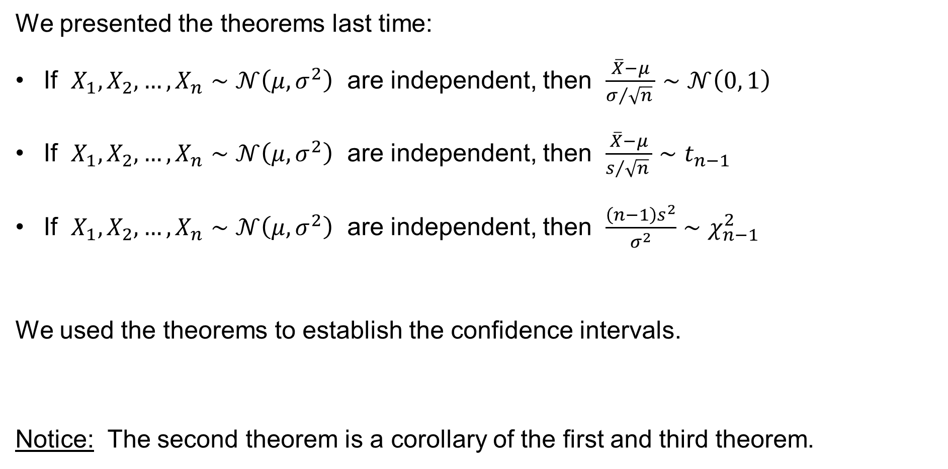
Theorems & Confidence intervals
We presented the theorems last time:
If $X_{1},X_{2},…,X_{n}∼𝒩\left(μ,σ^{2}\right)$ are independent, then $\frac{\overline{X}−μ}{σ/{\sqrt{n}} }∼𝒩\left(0, 1\right)$
If $X_{1},X_{2},…,X_{n}∼𝒩\left(μ,σ^{2}\right)$ are independent, then $\frac{\overline{X}−μ}{s/{\sqrt{n}} }∼t_{n−1}$
If $X_{1},X_{2},…,X_{n}∼𝒩\left(μ,σ^{2}\right)$ are independent, then $\frac{\left(n−1\right)s^{2}}{σ^{2}}∼χ_{n−1}^{2}$
We used the theorems to establish the confidence intervals.
Notice: The second theorem is a corollary of the first and third theorem.

Slide 4
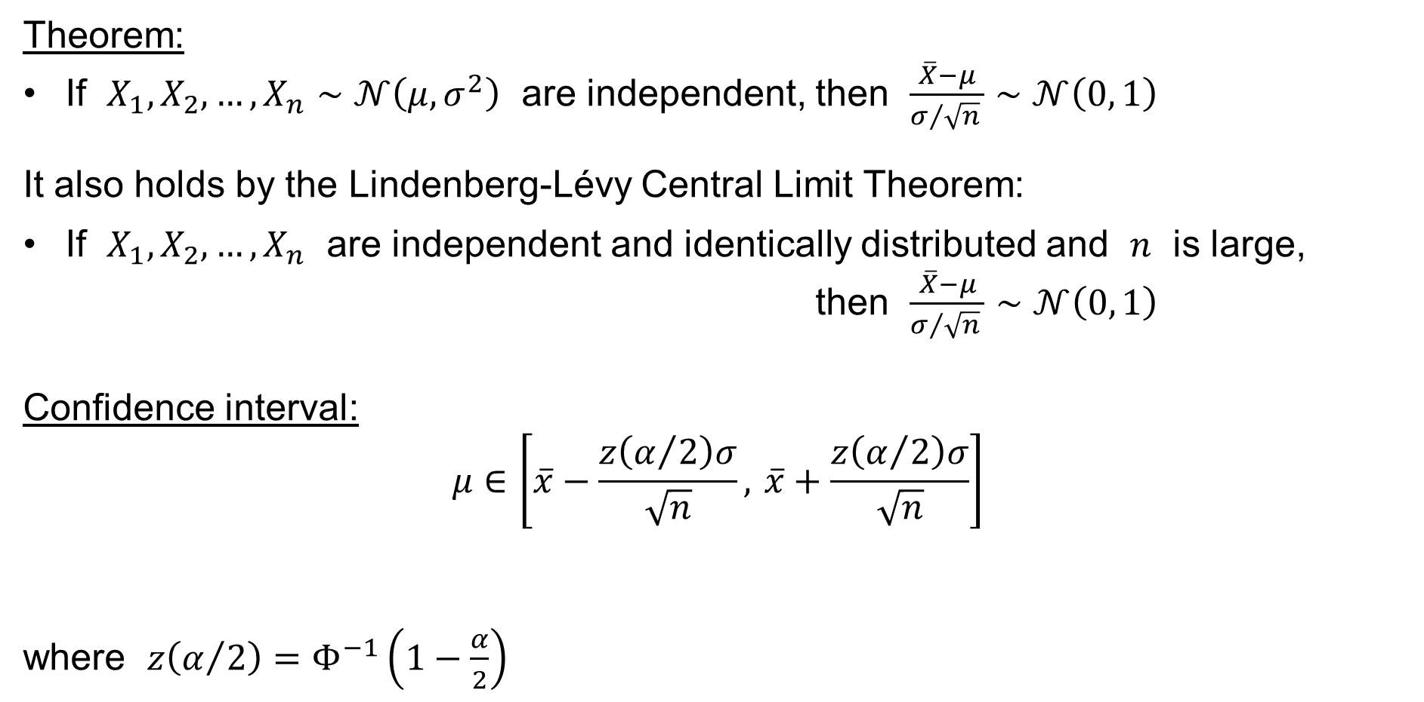
Theorems & Confidence intervals
Theorem:
If $X_{1},X_{2},…,X_{n}∼𝒩\left(μ,σ^{2}\right)$ are independent, then $\frac{\overline{X}−μ}{σ/{\sqrt{n}} }∼𝒩\left(0, 1\right)$
It also holds by the Lindenberg-Lévy Central Limit Theorem:
If $X_{1},X_{2},…,X_{n}$ are independent and identically distributed and $n$ is large,
then $\frac{\overline{X}−μ}{σ/{\sqrt{n}} }∼𝒩\left(0, 1\right)$
Confidence interval:
$$μ∈\left[\overline{x}−\frac{z\left(α/2\right)σ}{\sqrt{n}}, \overline{x}+\frac{z\left(α/2\right)σ}{\sqrt{n}}\right]$$
where $z\left(α/2\right)=Φ^{−1}\left(1−\frac{α}{2}\right)$

Slide 5
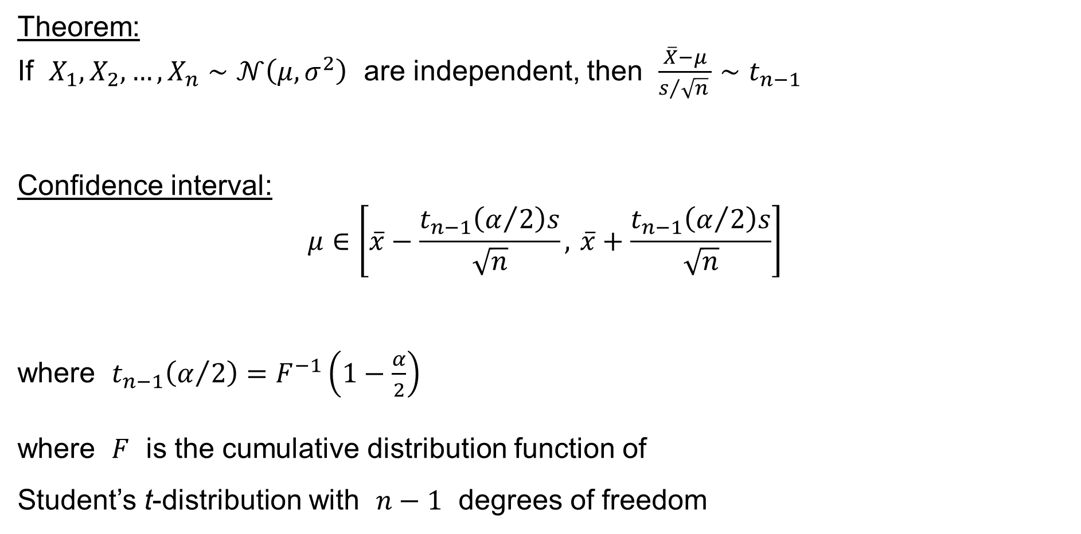
Theorems & Confidence intervals
Theorem:
If $X_{1},X_{2},…,X_{n}∼𝒩\left(μ,σ^{2}\right)$ are independent, then $\frac{\overline{X}−μ}{s/{\sqrt{n}} }∼t_{n−1}$
Confidence interval:
$$μ∈\left[\overline{x}−\frac{t_{n−1}\left(α/2\right)s}{\sqrt{n}}, \overline{x}+\frac{t_{n−1}\left(α/2\right)s}{\sqrt{n}}\right]$$
where $t_{n−1}\left(α/2\right)=F^{−1}\left(1−\frac{α}{2}\right)$
where $F$ is the cumulative distribution function of
Student’s t-distribution with $n−1$ degrees of freedom

Slide 6
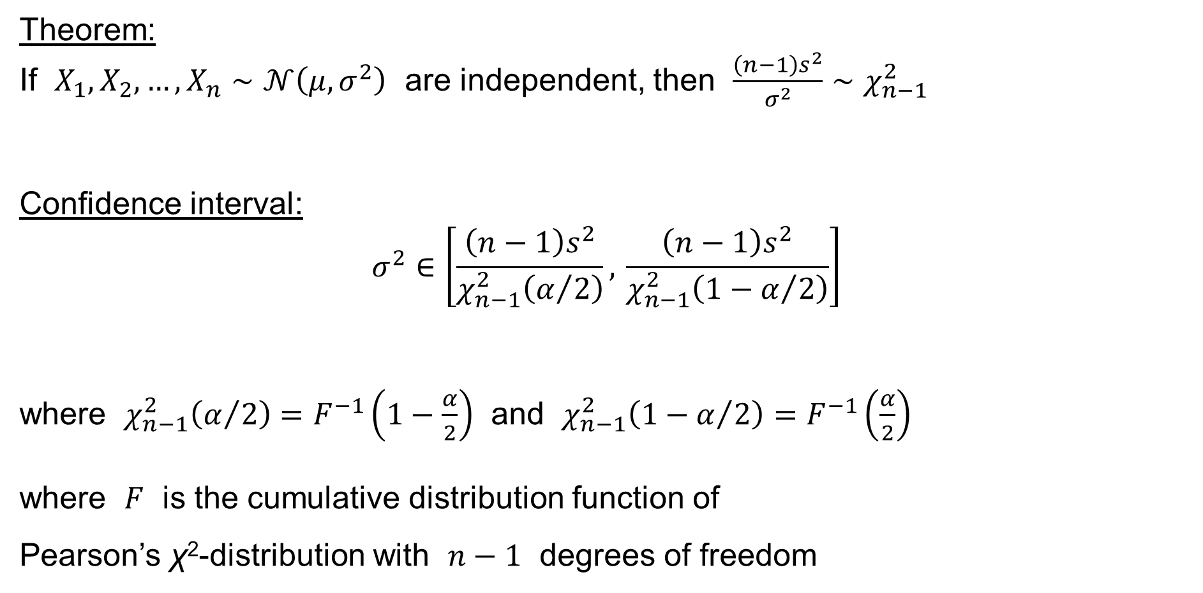
Theorems & Confidence intervals
Theorem:
If $X_{1},X_{2},…,X_{n}∼𝒩\left(μ,σ^{2}\right)$ are independent, then $\frac{\left(n−1\right)s^{2}}{σ^{2}}∼χ_{n−1}^{2}$
Confidence interval:
$$σ^{2}∈\left[\frac{\left(n−1\right)s^{2}}{χ_{n−1}^{2}\left(α/2\right)}, \frac{\left(n−1\right)s^{2}}{χ_{n−1}^{2}\left(1−α/2\right)}\right]$$
where $χ_{n−1}^{2}\left(α/2\right)=F^{−1}\left(1−\frac{α}{2}\right)$ and $χ_{n−1}^{2}\left(1−α/2\right)=F^{−1}\left(\frac{α}{2}\right)$
where $F$ is the cumulative distribution function of
Pearson’s χ²-distribution with $n−1$ degrees of freedom

Slide 7
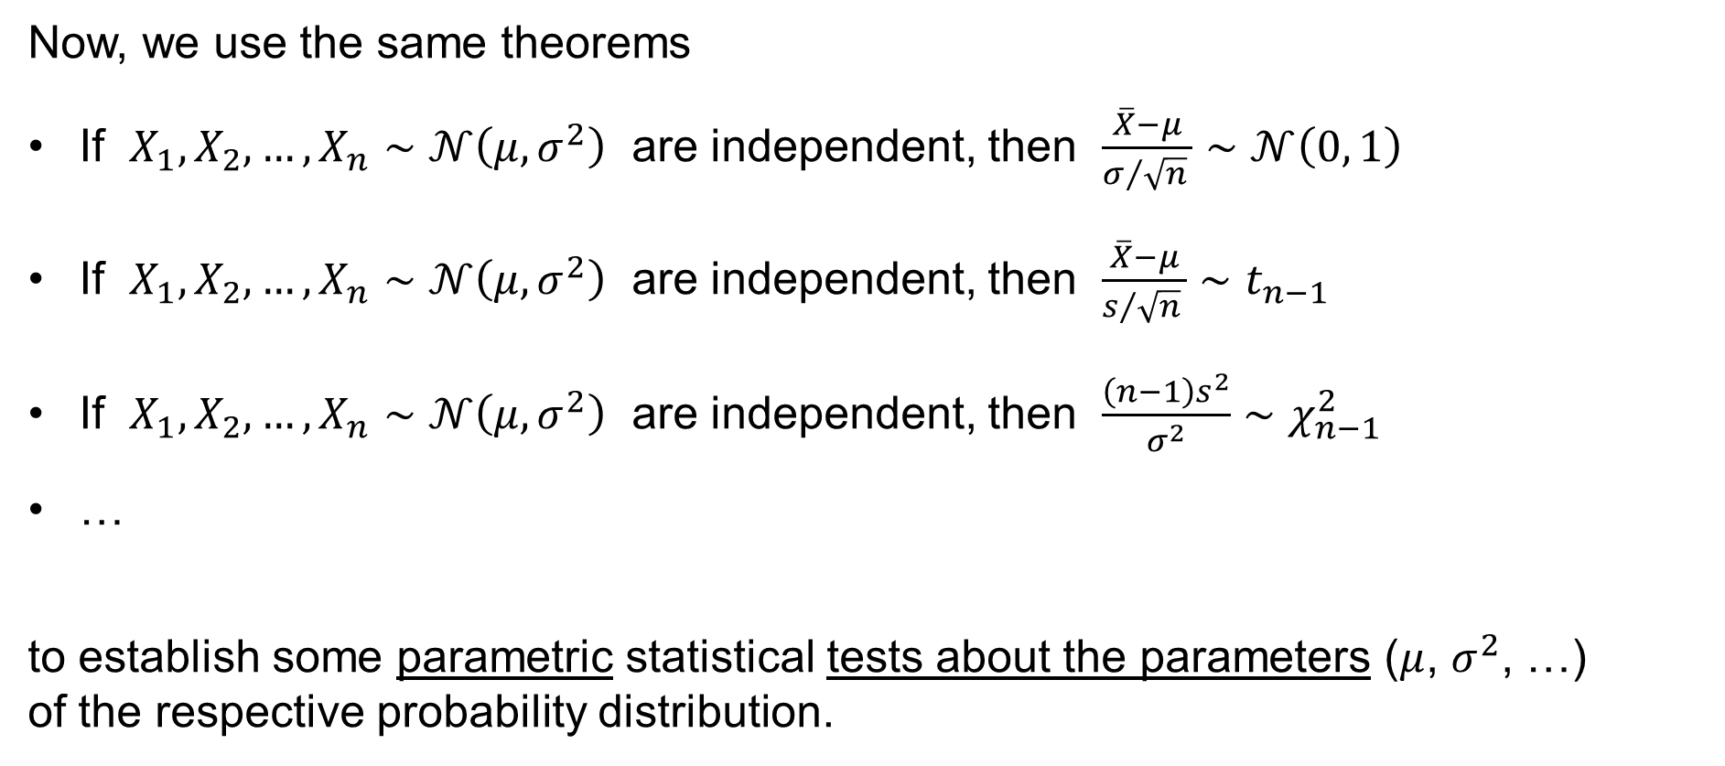
Theorems & Confidence intervals
Now, we use the same theorems
If $X_{1},X_{2},…,X_{n}∼𝒩\left(μ,σ^{2}\right)$ are independent, then $\frac{\overline{X}−μ}{σ/{\sqrt{n}} }∼𝒩\left(0, 1\right)$
If $X_{1},X_{2},…,X_{n}∼𝒩\left(μ,σ^{2}\right)$ are independent, then $\frac{\overline{X}−μ}{s/{\sqrt{n}} }∼t_{n−1}$
If $X_{1},X_{2},…,X_{n}∼𝒩\left(μ,σ^{2}\right)$ are independent, then $\frac{\left(n−1\right)s^{2}}{σ^{2}}∼χ_{n−1}^{2}$
…
to establish some parametric statistical tests about the parameters ($μ$, $σ^{2}$, …)
of the respective probability distribution.

Slide 8
z-tests for the means
One-sample z-test for
the population mean
Paired-sample z-test for
the difference of the population means
Two-sample z-test for
the difference of the population means

Slide 9
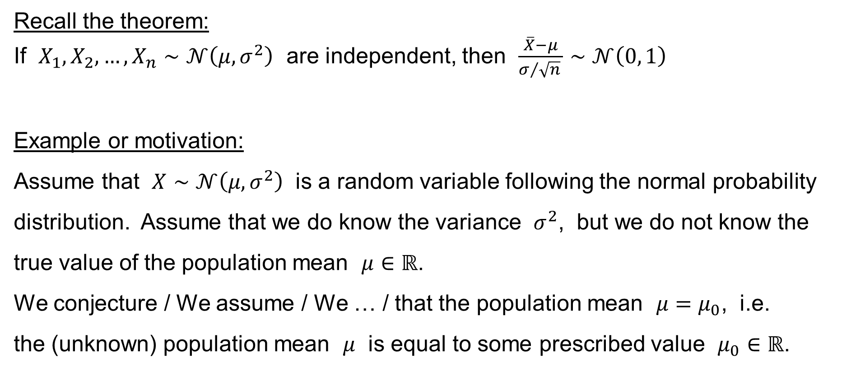
One-sample z-test for the population mean
Recall the theorem:
If $X_{1},X_{2},…,X_{n}∼𝒩\left(μ,σ^{2}\right)$ are independent, then $\frac{\overline{X}−μ}{σ/{\sqrt{n}} }∼𝒩\left(0, 1\right)$
Example or motivation:
Assume that $X∼𝒩\left(μ,σ^{2}\right)$ is a random variable following the normal probability distribution. Assume that we do know the variance $σ^{2}$, but we do not know the true value of the population mean $μ∈ℝ$.
We conjecture / We assume / We … / that the population mean $μ=μ_{0}$, i.e.
the (unknown) population mean $μ$ is equal to some prescribed value $μ_{0}∈ℝ$.

Slide 10
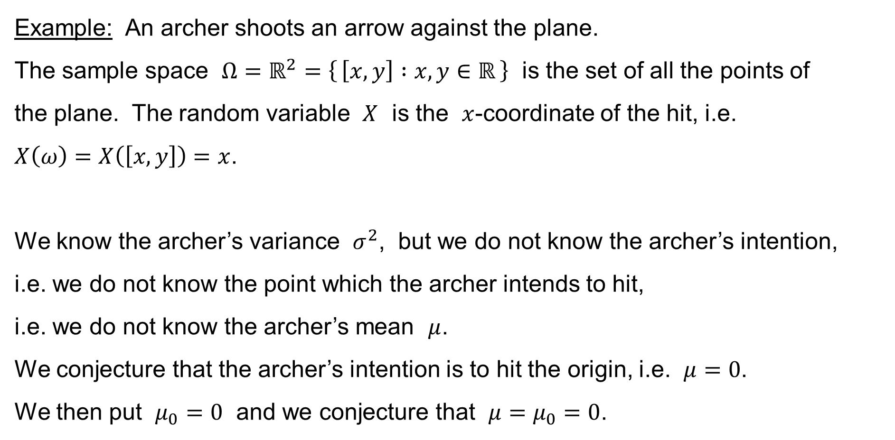
One-sample z-test for the population mean
Example: An archer shoots an arrow against the plane.
The sample space $Ω=ℝ^{2}=\left\{ \left[x,y\right] :x,y∈ℝ \right\}$ is the set of all the points of
the plane. The random variable $X$ is the $x$-coordinate of the hit, i.e.
$X\left(ω\right)=X\left(\left[x,y\right]\right)=x$.
We know the archer’s variance $σ^{2}$, but we do not know the archer’s intention,
i.e. we do not know the point which the archer intends to hit,
i.e. we do not know the archer’s mean $μ$.
We conjecture that the archer’s intention is to hit the origin, i.e. $μ=0$.
We then put $μ_{0}=0$ and we conjecture that $μ=μ_{0}=0$.

Slide 11
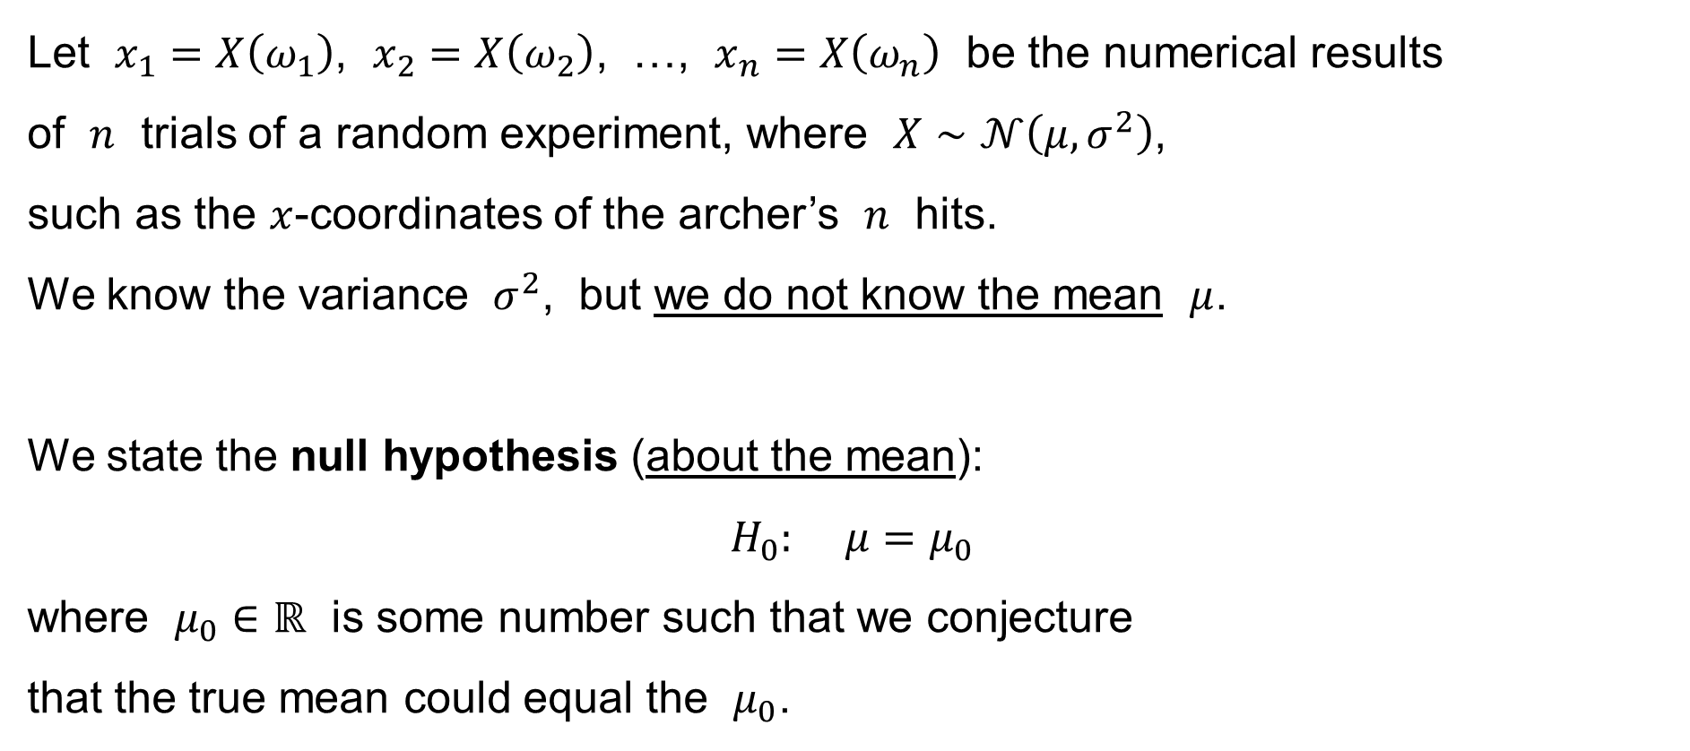
One-sample z-test for the population mean
Let $x_{1}=X\left(ω_{1}\right)$, $x_{2}=X\left(ω_{2}\right)$, …, $x_{n}=X\left(ω_{n}\right)$ be the numerical results
of $n$ trials of a random experiment, where $X∼𝒩\left(μ,σ^{2}\right)$,
such as the $x$-coordinates of the archer’s $n$ hits.
We know the variance $σ^{2}$, but we do not know the mean $μ$.
We state the null hypothesis (about the mean):
$$H_{0}: μ=μ_{0}$$
where $μ_{0}∈ℝ$ is some number such that we conjecture
that the true mean could equal the $μ_{0}$.

Slide 12
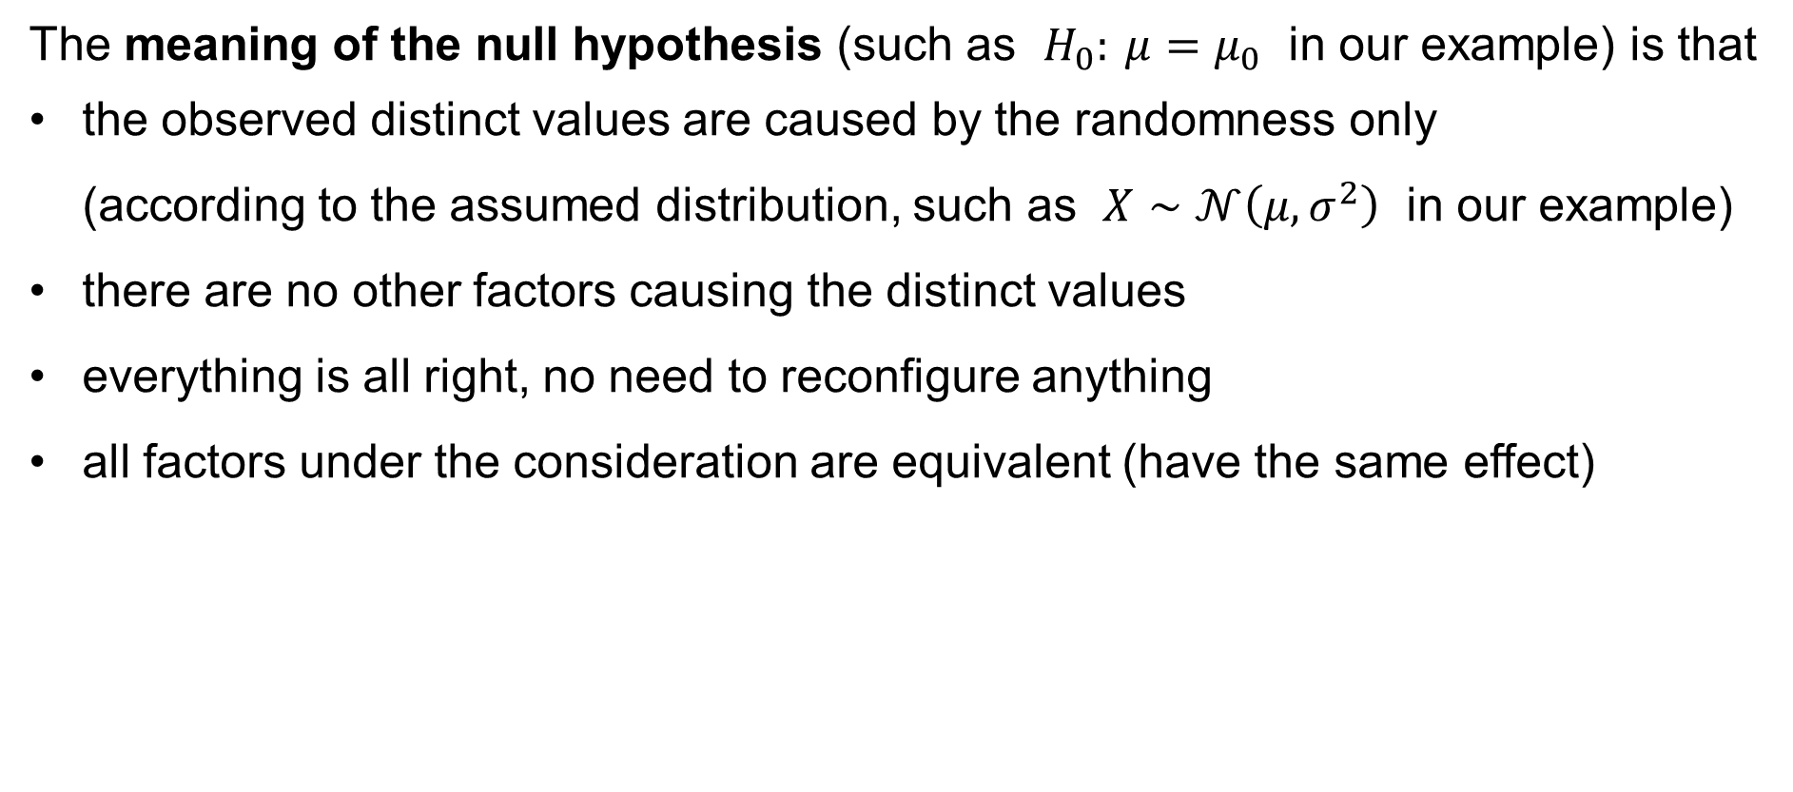
One-sample z-test for the population mean
The meaning of the null hypothesis (such as $H_{0}: μ=μ_{0}$ in our example) is that
the observed distinct values are caused by the randomness only
(according to the assumed distribution, such as $X∼𝒩\left(μ,σ^{2}\right)$ in our example)
there are no other factors causing the distinct values
everything is all right, no need to reconfigure anything
all factors under the consideration are equivalent (have the same effect)

Slide 13
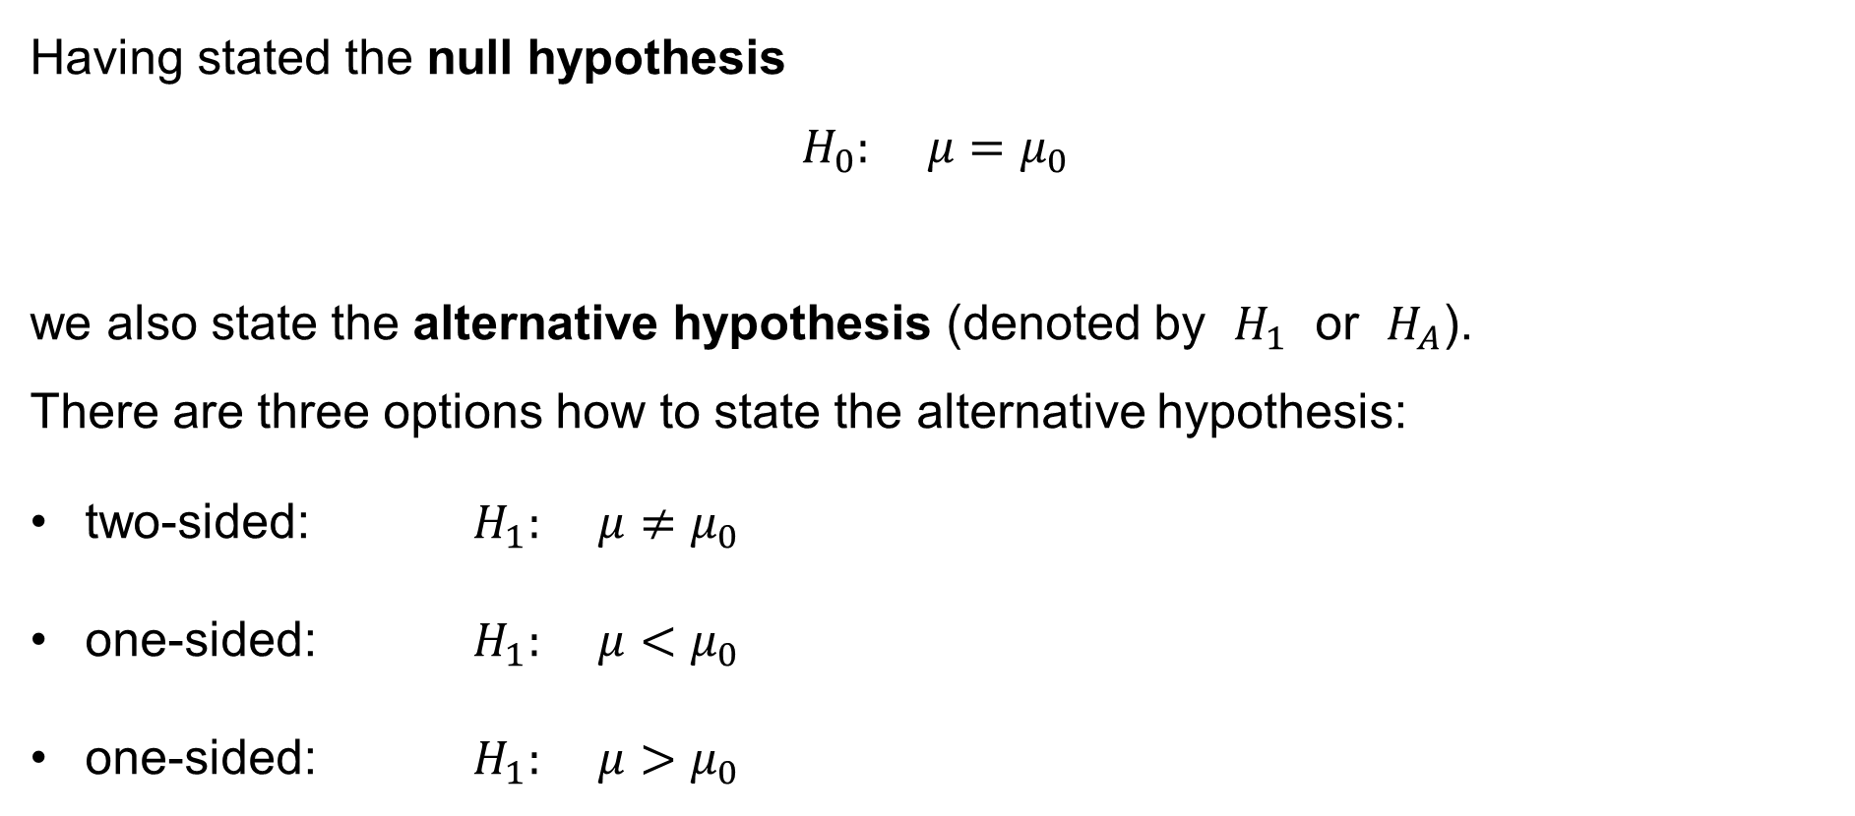
One-sample z-test for the population mean
Having stated the null hypothesis
$$H_{0}: μ=μ_{0}$$
we also state the alternative hypothesis (denoted by $H_{1}$ or $H_{A}$).
There are three options how to state the alternative hypothesis:
two-sided: $H_{1}: μ≠μ_{0}$
one-sided: $H_{1}: μ<μ_{0}$
one-sided: $H_{1}: μ>μ_{0}$

Slide 14
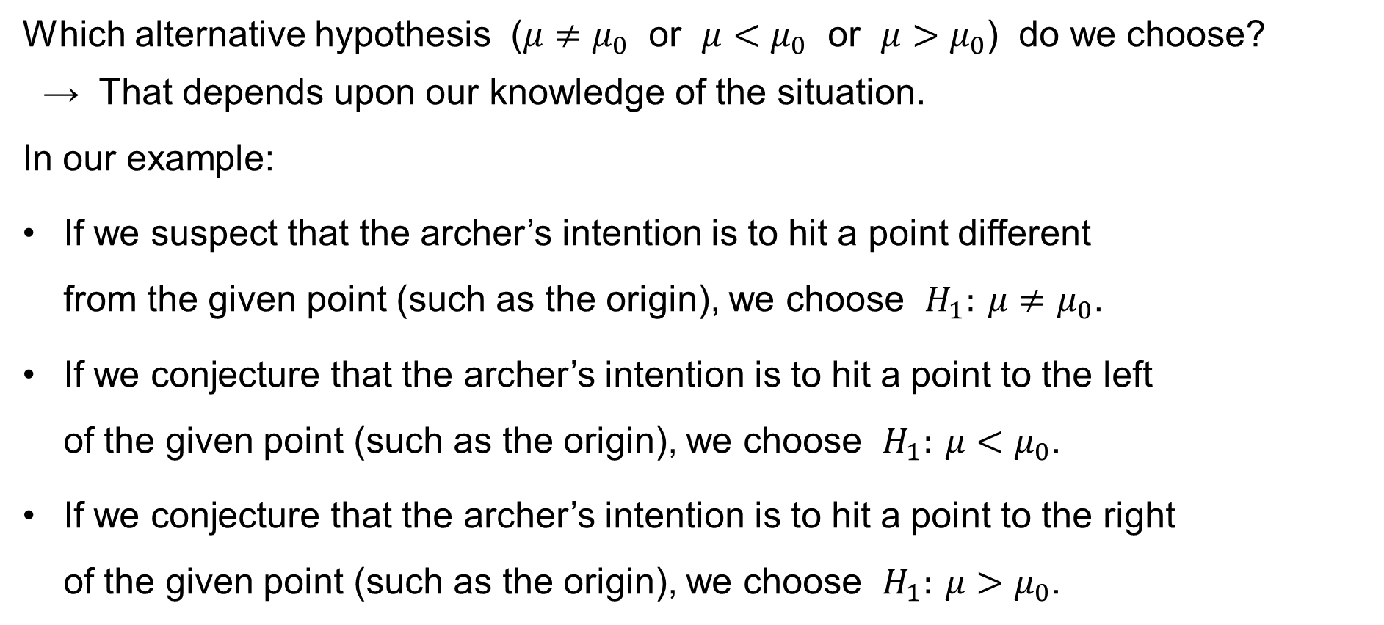
One-sample z-test for the population mean
Which alternative hypothesis ($μ≠μ_{0}$ or $μ<μ_{0}$ or $μ>μ_{0}$) do we choose?
→ That depends upon our knowledge of the situation.
In our example:
If we suspect that the archer’s intention is to hit a point different
from the given point (such as the origin), we choose $H_{1}: μ≠μ_{0}$.
If we conjecture that the archer’s intention is to hit a point to the left
of the given point (such as the origin), we choose $H_{1}: μ<μ_{0}$.
If we conjecture that the archer’s intention is to hit a point to the right
of the given point (such as the origin), we choose $H_{1}: μ>μ_{0}$.

Slide 15
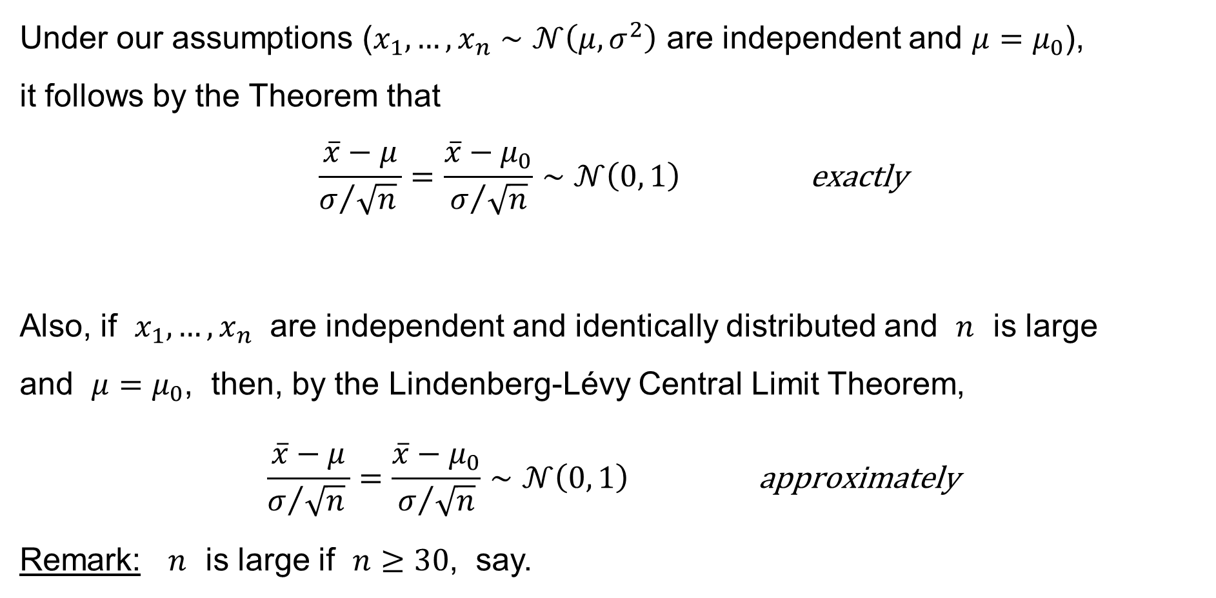
One-sample z-test for the population mean
Under our assumptions ($x_{1},…,x_{n}∼𝒩\left(μ,σ^{2}\right)$ are independent and $μ=μ_{0}$),
it follows by the Theorem that
$$\frac{\overline{x}−μ}{σ/{\sqrt{n}} }=\frac{\overline{x}−μ_{0}}{σ/{\sqrt{n}}}∼𝒩\left(0, 1\right) \text{exactly}$$
Also, if $x_{1},…,x_{n}$ are independent and identically distributed and $n$ is large
and $μ=μ_{0}$, then, by the Lindenberg-Lévy Central Limit Theorem,
$$\frac{\overline{x}−μ}{σ/{\sqrt{n}} }=\frac{\overline{x}−μ_{0}}{σ/{\sqrt{n}}}∼𝒩\left(0, 1\right) \text{approximately}$$
Remark: $n$ is large if $n≥30$, say.

Slide 16
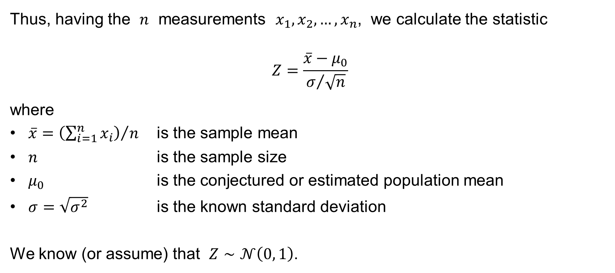
One-sample z-test for the population mean
Thus, having the $n$ measurements $x_{1},x_{2},…,x_{n}$, we calculate the statistic
$$Z=\frac{\overline{x}−μ_{0}}{σ/{\sqrt{n}}}$$
where
$\overline{x}={\left(\sum_{i=1}^{n}{x_{i}}\right)}/n$ is the sample mean
$n$ is the sample size
$μ_{0}$ is the conjectured or estimated population mean
$σ=\sqrt{σ^{2}}$ is the known standard deviation
We know (or assume) that $Z∼𝒩\left(0, 1\right)$.

Slide 17

One-sample z-test for the population mean
We have $Z=\frac{\overline{x}−μ_{0}}{σ/{\sqrt{n}} }∼𝒩\left(0, 1\right)$.
Then, if $−∞≤a<b≤+∞$, the probability that $a<Z<b$ is
$$P\left(a<Z<b\right)=\int_{a}^{b}{φ\left(x\right) dx}$$
where
$$φ\left(x\right)=\frac{1}{\sqrt{2π} }e^{−\frac{x^{2}}{2}}$$
is the density of the normalized normal distribution.

Slide 18
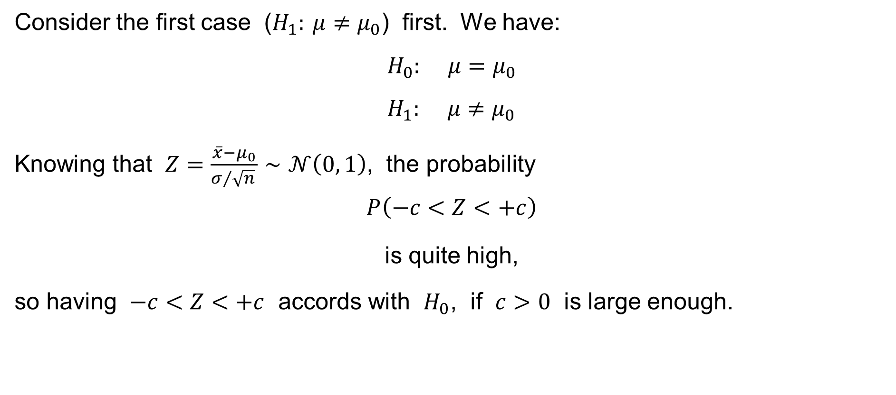
One-sample z-test for the population mean
Consider the first case ($H_{1}: μ≠μ_{0}$) first. We have:
$$H_{0}: μ=μ_{0} \\ H_{1}: μ≠μ_{0}$$
Knowing that $Z=\frac{\overline{x}−μ_{0}}{σ/{\sqrt{n}} }∼𝒩\left(0, 1\right)$, the probability
$$P\left(−c<Z<+c\right)$$
is quite high,
so having $−c<Z<+c$ accords with $H_{0}$, if $c>0$ is large enough.

Slide 19
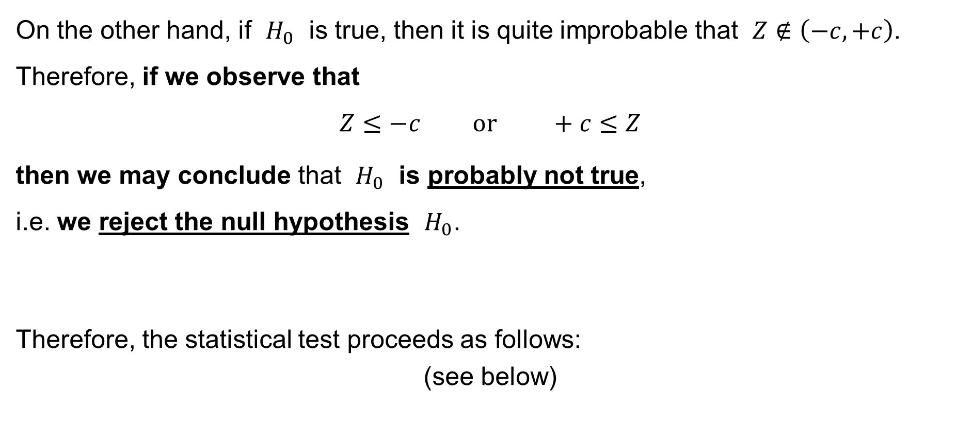
One-sample z-test for the population mean
On the other hand, if $H_{0}$ is true, then it is quite improbable that $Z∉\left(−c,+c\right)$. Therefore, if we observe that
$$Z≤−c \text{or} +c≤Z$$
then we may conclude that $H_{0}$ is probably not true,
i.e. we reject the null hypothesis $H_{0}$.
Therefore, the statistical test proceeds as follows:
(see below)

Slide 20
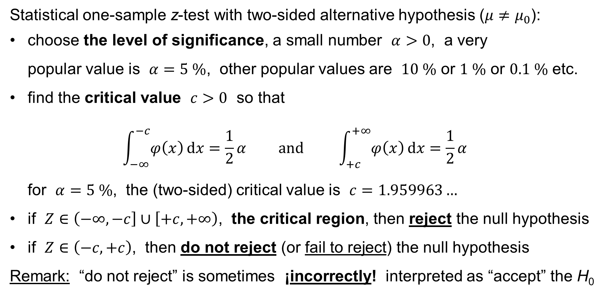
One-sample z-test for the population mean
Statistical one-sample z-test with two-sided alternative hypothesis ($μ≠μ_{0}$):
choose the level of significance, a small number $α>0$, a very
popular value is $α=5 \%$, other popular values are $10 \%$ or $1 \%$ or $0.1 \%$ etc.
find the critical value $c>0$ so that
$\int_{−∞}^{−c}{φ\left(x\right) dx}=\frac{1}{2}α \text{and} \int_{+c}^{+∞}{φ\left(x\right) dx}=\frac{1}{2}α$
for $α=5 \%$, the (two-sided) critical value is $c=1.959963…$
if $Z∈\left(−∞,−c\right]∪\left[+c,+∞\right)$, the critical region, then reject the null hypothesis
if $Z∈\left(−c,+c\right)$, then do not reject (or fail to reject) the null hypothesis
Remark: “do not reject” is sometimes ¡incorrectly! interpreted as “accept” the H₀

Slide 21
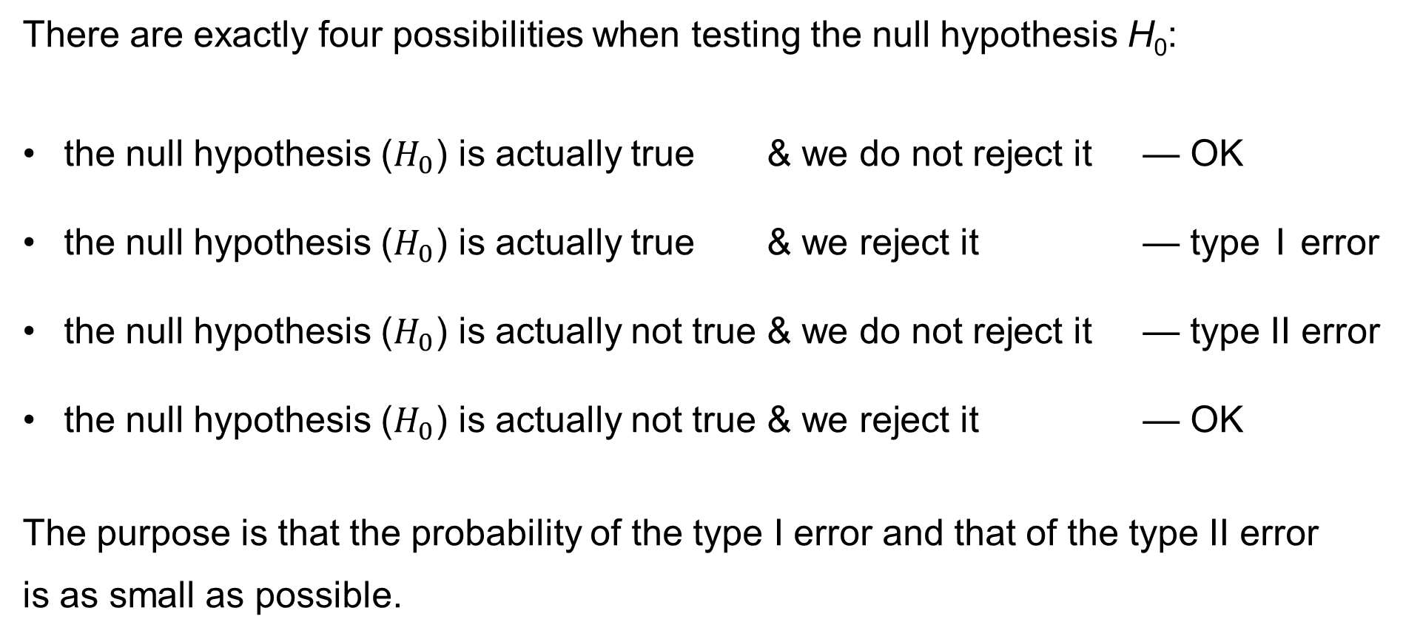
Type I and Type II error
There are exactly four possibilities when testing the null hypothesis H₀:
the null hypothesis ($H_{0}$) is actually true & we do not reject it — OK
the null hypothesis ($H_{0}$) is actually true & we reject it — type I error
the null hypothesis ($H_{0}$) is actually not true & we do not reject it — type II error
the null hypothesis ($H_{0}$) is actually not true & we reject it — OK
The purpose is that the probability of the type I error and that of the type II error
is as small as possible.

Slide 22
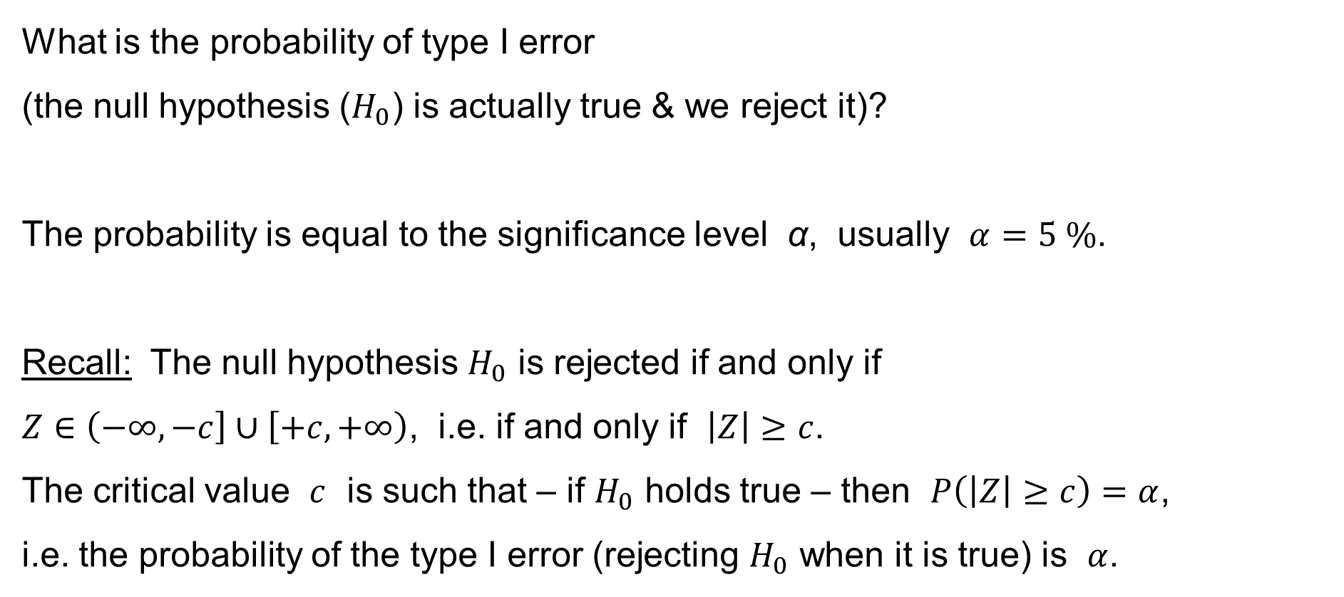
Type I and Type II error
What is the probability of type I error
(the null hypothesis ($H_{0}$) is actually true & we reject it)?
The probability is equal to the significance level α, usually $α=5 \%$.
Recall: The null hypothesis $H_{0}$ is rejected if and only if
$Z∈\left(−∞,−c\right]∪\left[+c,+∞\right)$, i.e. if and only if $\left|Z\right|≥c$.
The critical value $c$ is such that – if $H_{0}$ holds true – then $P\left(\left|Z\right|≥c\right)=α$,
i.e. the probability of the type I error (rejecting $H_{0}$ when it is true) is $α$.

Slide 23
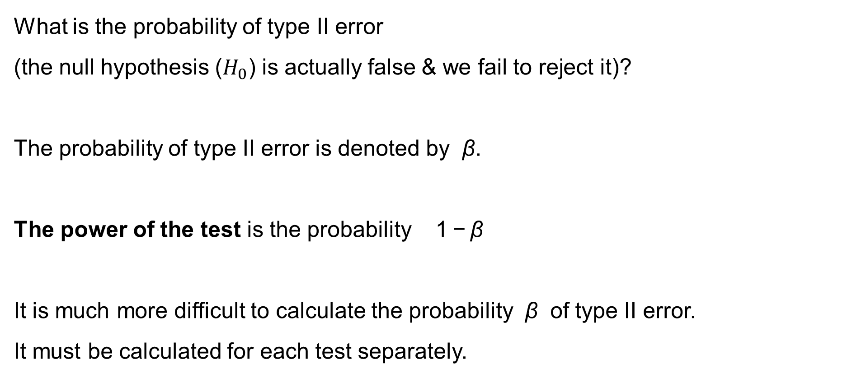
Type I and Type II error
What is the probability of type II error
(the null hypothesis ($H_{0}$) is actually false & we fail to reject it)?
The probability of type II error is denoted by β.
The power of the test is the probability 1 − β
It is much more difficult to calculate the probability β of type II error.
It must be calculated for each test separately.

Slide 24
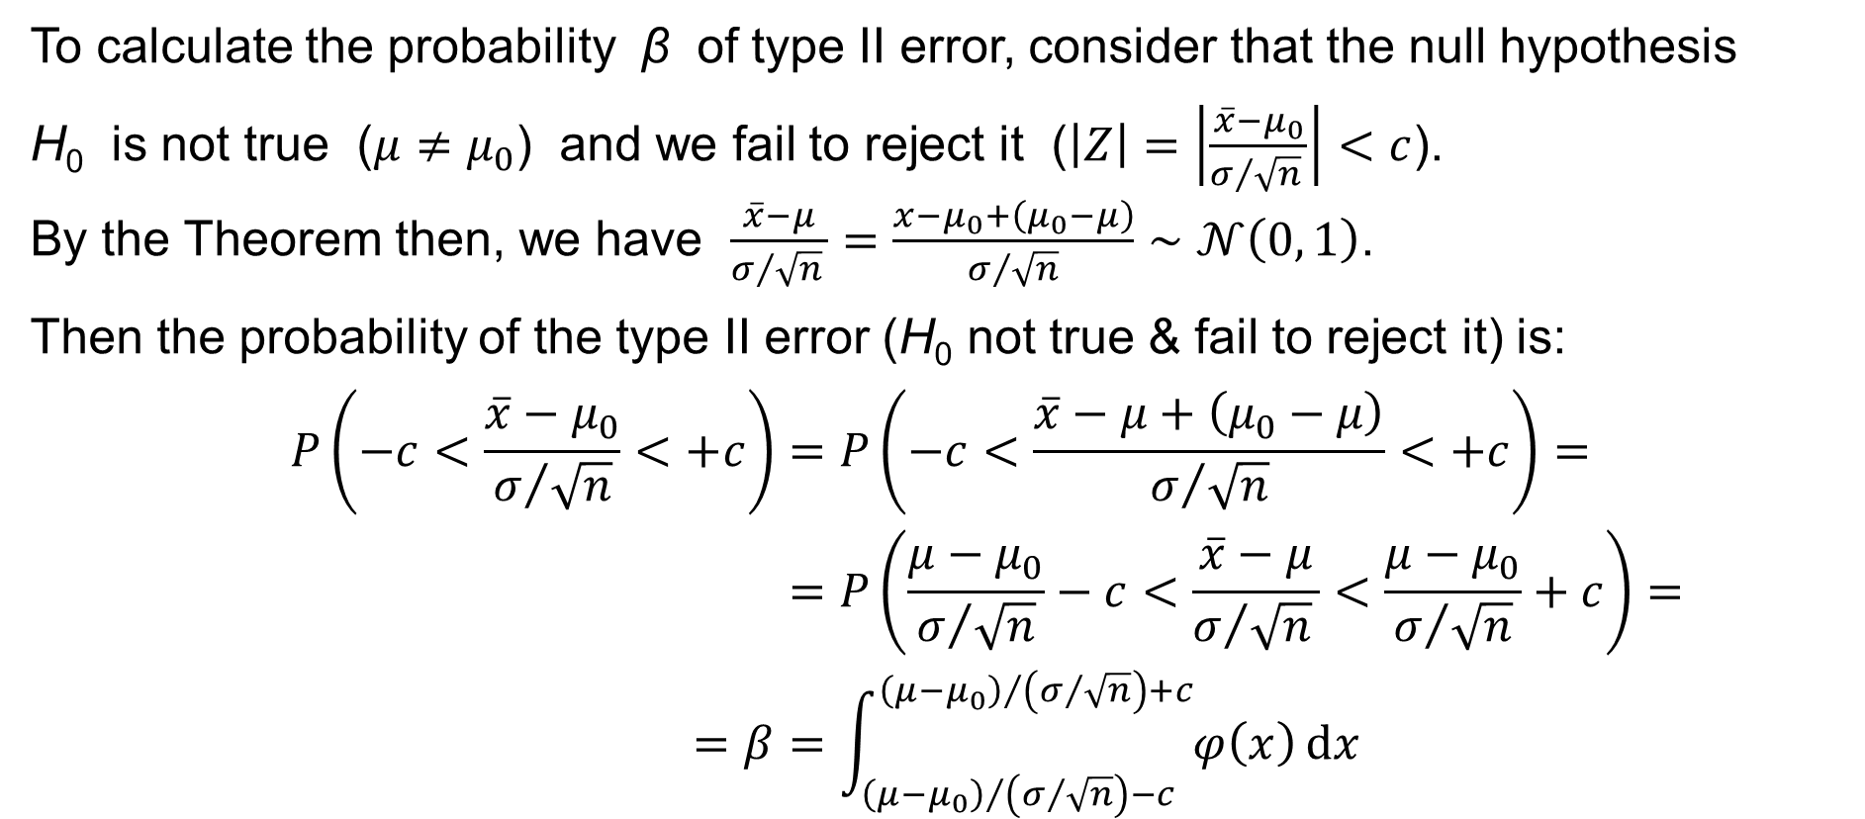
Type I and Type II error
To calculate the probability β of type II error, consider that the null hypothesis
H₀ is not true ($μ≠μ_{0}$) and we fail to reject it ($\left|Z\right|=\left|\frac{\overline{x}−μ_{0}}{σ/{\sqrt{n}} }\right|<c$).
By the Theorem then, we have $\frac{\overline{x}−μ}{σ/{\sqrt{n}} }=\frac{x−μ_{0}+\left(μ_{0}−μ\right)}{σ/{\sqrt{n}}}∼𝒩\left(0, 1\right)$.
Then the probability of the type II error (H₀ not true & fail to reject it) is:
$$P\left(−c<\frac{\overline{x}−μ_{0}}{σ/{\sqrt{n}}}<+c\right)=P\left(−c<\frac{\overline{x}−μ+\left(μ_{0}−μ\right)}{σ/{\sqrt{n}}}<+c\right)= \\ =P\left(\frac{μ−μ_{0}}{σ/{\sqrt{n}}}−c<\frac{\overline{x}−μ}{σ/{\sqrt{n}} }<\frac{μ−μ_{0}}{σ/{\sqrt{n}}}+c\right)= \\ =β=\int_{{\left(μ−μ_{0}\right)}/{\left(σ/{\sqrt{n}}\right)}−c}^{{\left(μ−μ_{0}\right)}/{\left(σ/{\sqrt{n}}\right)}+c}{φ\left(x\right) dx}$$

Slide 25
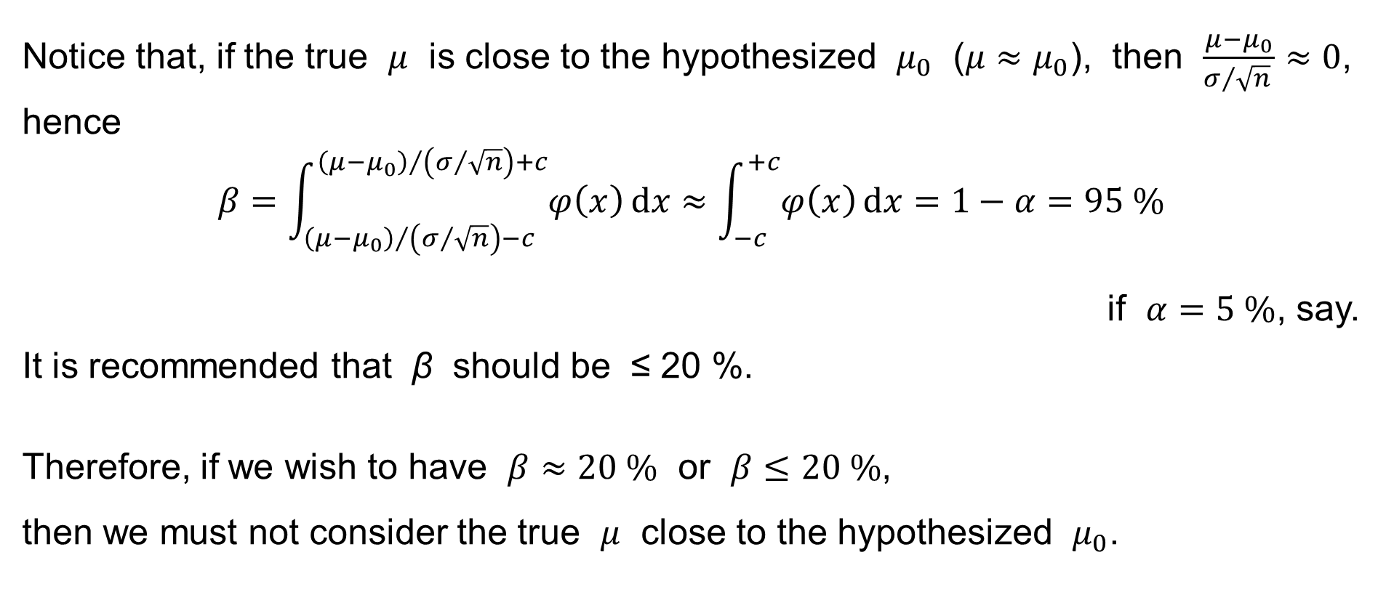
Type I and Type II error
Notice that, if the true $μ$ is close to the hypothesized $μ_{0}$ ($μ≈μ_{0}$), then $\frac{μ−μ_{0}}{σ/{\sqrt{n}} }≈0$,
hence
$$β=\int_{{\left(μ−μ_{0}\right)}/{\left(σ/{\sqrt{n}}\right)}−c}^{{\left(μ−μ_{0}\right)}/{\left(σ/{\sqrt{n}}\right)}+c}{φ\left(x\right) dx}≈\int_{−c}^{+c}{φ\left(x\right) dx}=1−α=95 \%$$
if $α=5 \%$, say.
It is recommended that β should be ≤ 20 %.
Therefore, if we wish to have $β≈20 \%$ or $β≤20 \%$,
then we must not consider the true $μ$ close to the hypothesized $μ_{0}$.

Slide 26
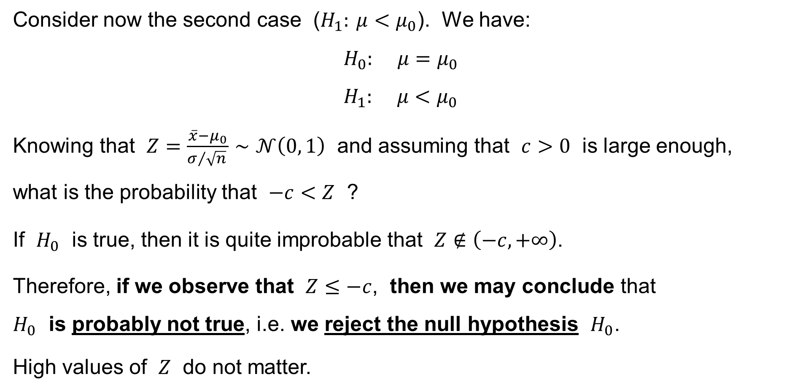
One-sample z-test for the population mean
Consider now the second case ($H_{1}: μ<μ_{0}$). We have:
$$H_{0}: μ=μ_{0} \\ H_{1}: μ<μ_{0}$$
Knowing that $Z=\frac{\overline{x}−μ_{0}}{σ/{\sqrt{n}} }∼𝒩\left(0, 1\right)$ and assuming that $c>0$ is large enough,
what is the probability that $−c<Z$ ?
If $H_{0}$ is true, then it is quite improbable that $Z∉\left(−c,+∞\right)$.
Therefore, if we observe that $Z≤−c$, then we may conclude that
$H_{0}$ is probably not true, i.e. we reject the null hypothesis $H_{0}$.
High values of $Z$ do not matter.

Slide 27
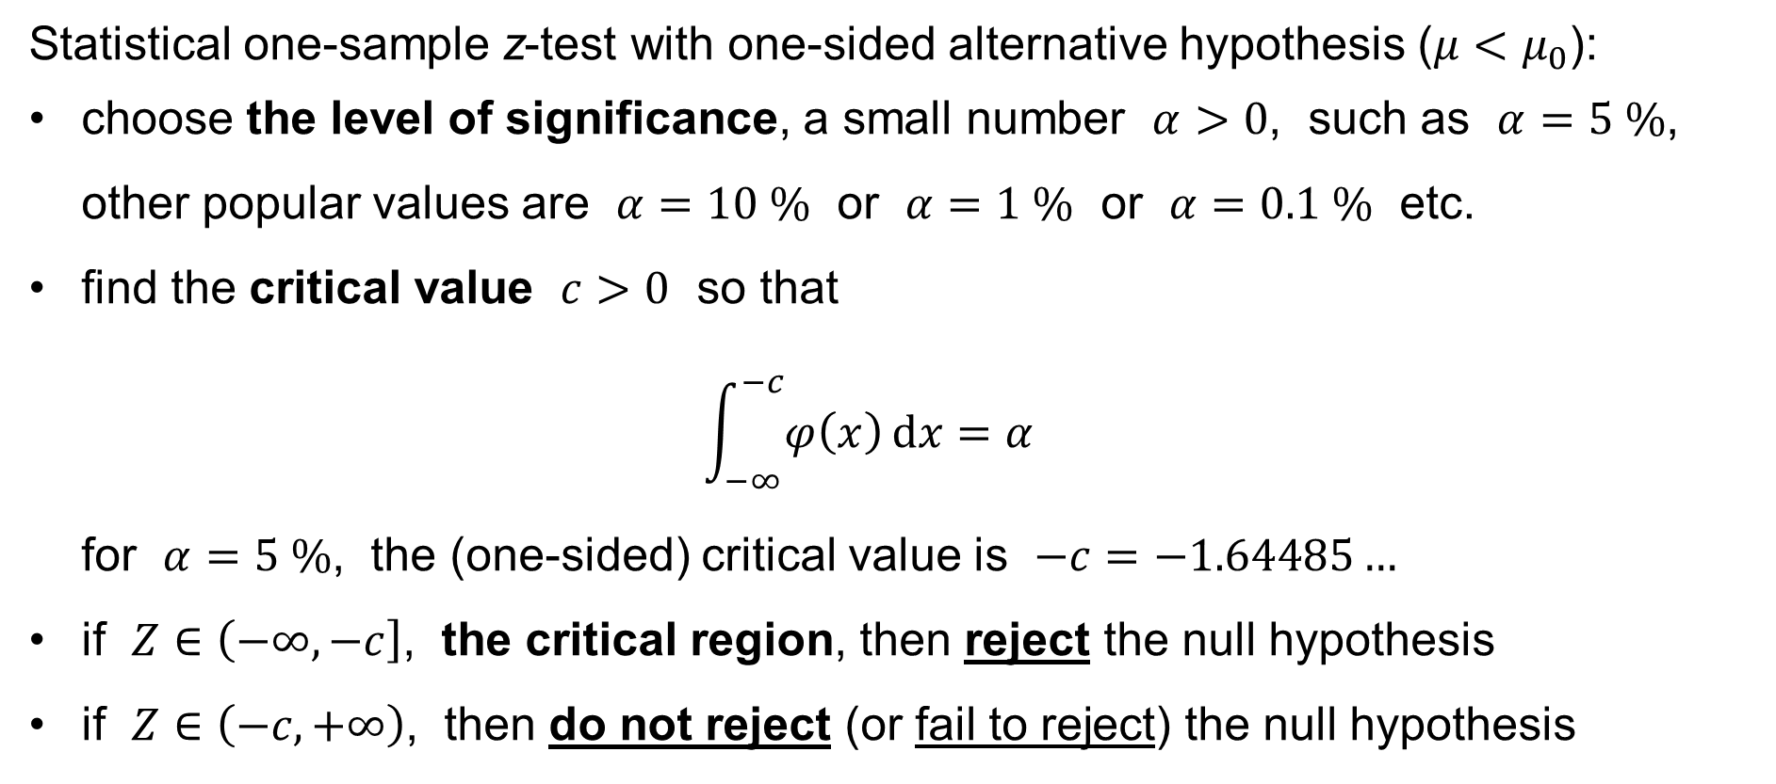
One-sample z-test for the population mean
Statistical one-sample z-test with one-sided alternative hypothesis ($μ<μ_{0}$):
choose the level of significance, a small number $α>0$, such as $α=5 \%$, other popular values are $α=10 \%$ or $α=1 \%$ or $α=0.1 \%$ etc.
find the critical value $c>0$ so that
$\int_{−∞}^{−c}{φ\left(x\right) dx}=α$
for $α=5 \%$, the (one-sided) critical value is $−c=−1.64485…$
if $Z∈\left(−∞,−c\right]$, the critical region, then reject the null hypothesis
if $Z∈\left(−c,+∞\right)$, then do not reject (or fail to reject) the null hypothesis

Slide 28
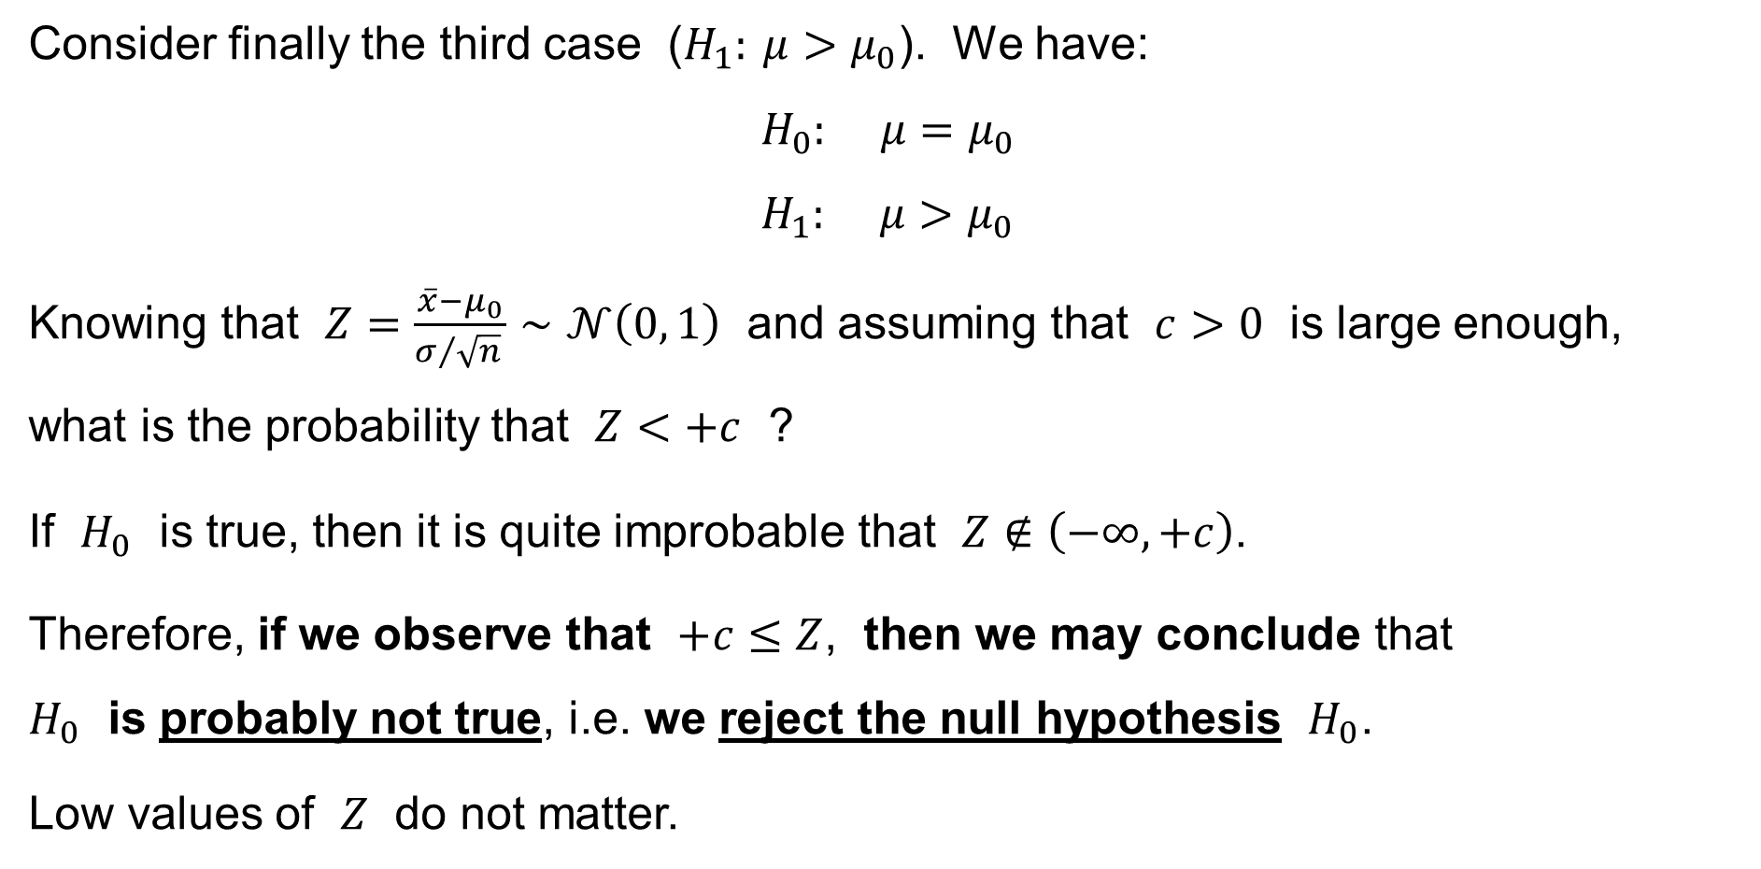
One-sample z-test for the population mean
Consider finally the third case ($H_{1}: μ>μ_{0}$). We have:
$$H_{0}: μ=μ_{0} \\ H_{1}: μ>μ_{0}$$
Knowing that $Z=\frac{\overline{x}−μ_{0}}{σ/{\sqrt{n}} }∼𝒩\left(0, 1\right)$ and assuming that $c>0$ is large enough,
what is the probability that $Z<+c$ ?
If $H_{0}$ is true, then it is quite improbable that $Z∉\left(−∞,+c\right)$.
Therefore, if we observe that $+c≤Z$, then we may conclude that
$H_{0}$ is probably not true, i.e. we reject the null hypothesis $H_{0}$.
Low values of $Z$ do not matter.

Slide 29
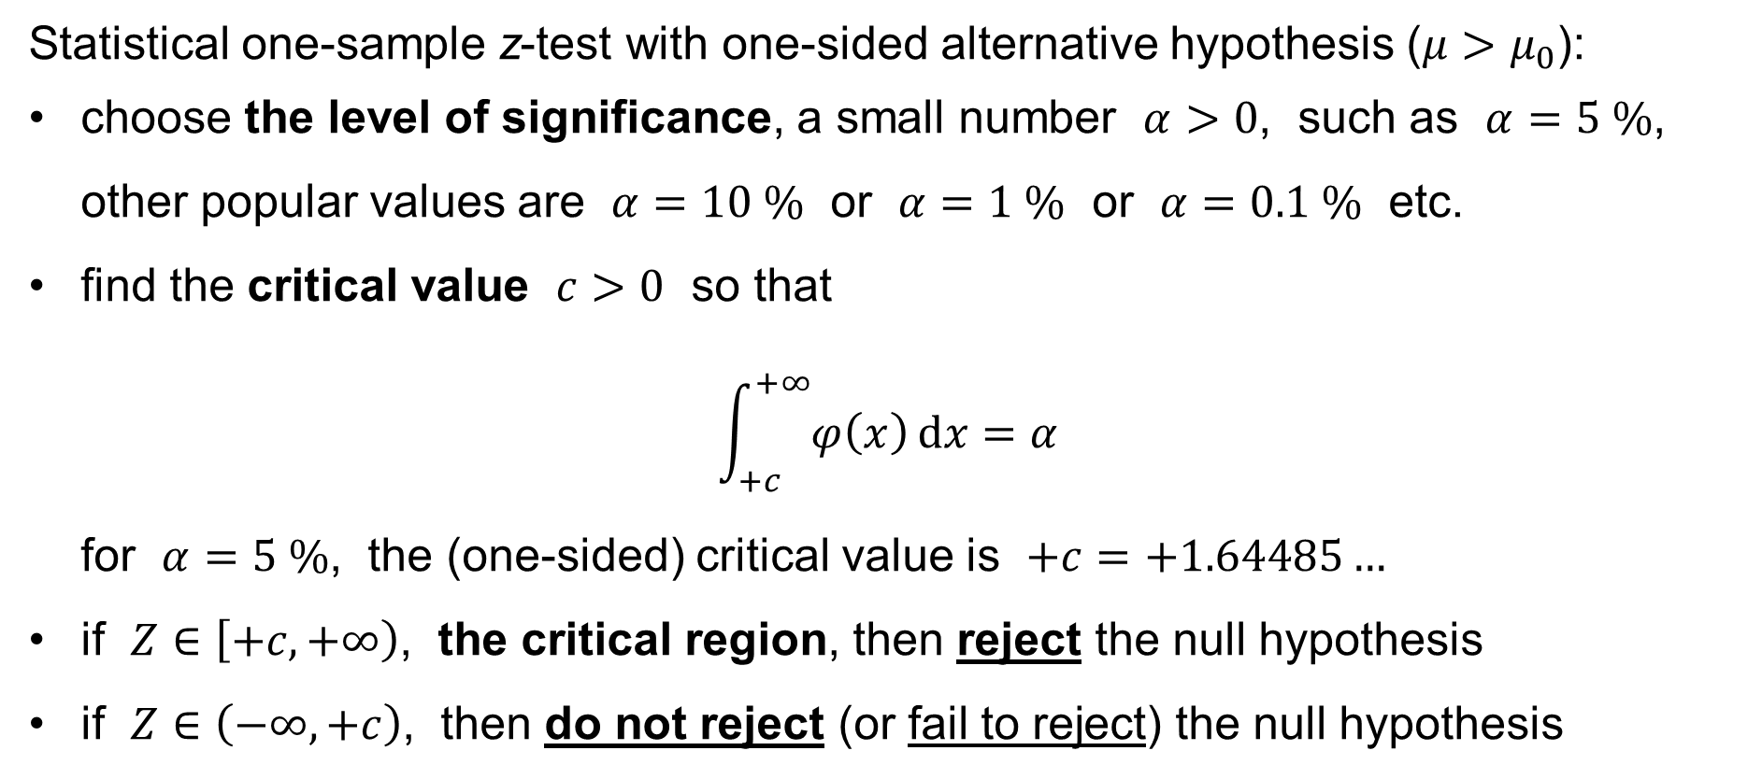
One-sample z-test for the population mean
Statistical one-sample z-test with one-sided alternative hypothesis ($μ>μ_{0}$):
choose the level of significance, a small number $α>0$, such as $α=5 \%$, other popular values are $α=10 \%$ or $α=1 \%$ or $α=0.1 \%$ etc.
find the critical value $c>0$ so that
$\int_{+c}^{+∞}{φ\left(x\right) dx}=α$
for $α=5 \%$, the (one-sided) critical value is $+c=+1.64485…$
if $Z∈\left[+c,+∞\right)$, the critical region, then reject the null hypothesis
if $Z∈\left(−∞,+c\right)$, then do not reject (or fail to reject) the null hypothesis

Slide 30
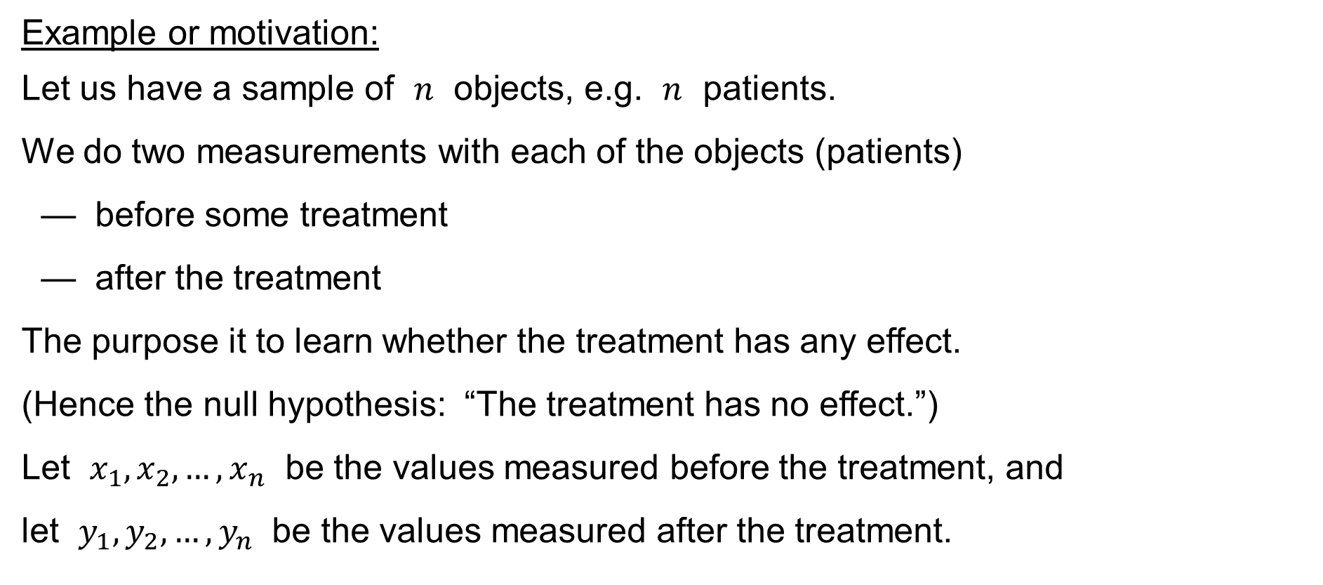
Paired-sample z-test for the difference of the pop.means
Example or motivation:
Let us have a sample of $n$ objects, e.g. $n$ patients.
We do two measurements with each of the objects (patients)
— before some treatment
— after the treatment
The purpose it to learn whether the treatment has any effect.
(Hence the null hypothesis: “The treatment has no effect.”)
Let $x_{1},x_{2},…,x_{n}$ be the values measured before the treatment, and
let $y_{1},y_{2},…,y_{n}$ be the values measured after the treatment.

Slide 31
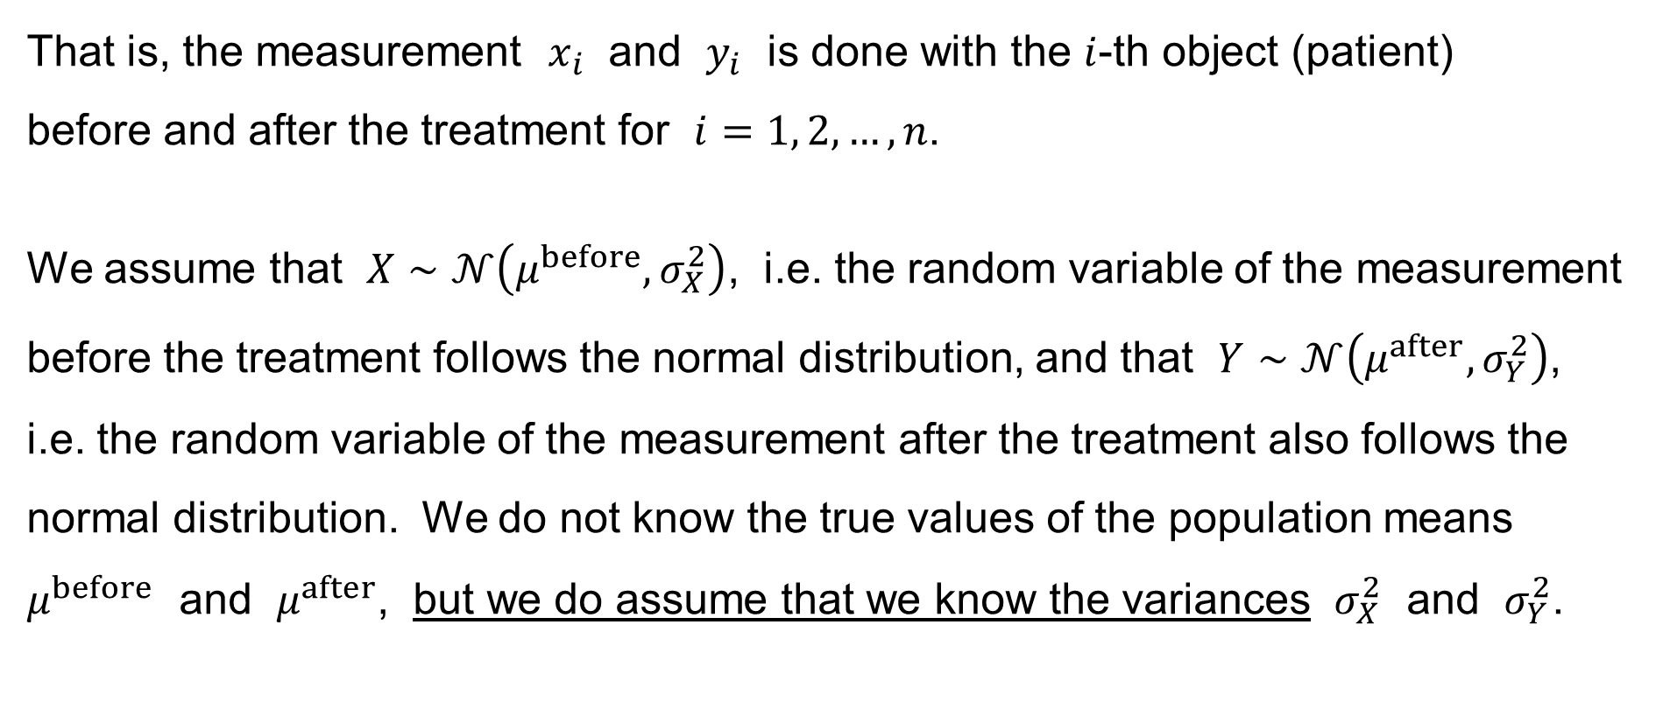
Paired-sample z-test for the difference of the pop.means
That is, the measurement $x_{i}$ and $y_{i}$ is done with the $i$-th object (patient)
before and after the treatment for $i=1, 2,…,n$.
We assume that $X∼𝒩\left(μ^{before},σ_{X}^{2}\right)$, i.e. the random variable of the measurement before the treatment follows the normal distribution, and that $Y∼𝒩\left(μ^{after},σ_{Y}^{2}\right)$, i.e. the random variable of the measurement after the treatment also follows the normal distribution. We do not know the true values of the population means $μ^{before}$ and $μ^{after}$, but we do assume that we know the variances $σ_{X}^{2}$ and $σ_{Y}^{2}$.

Slide 32
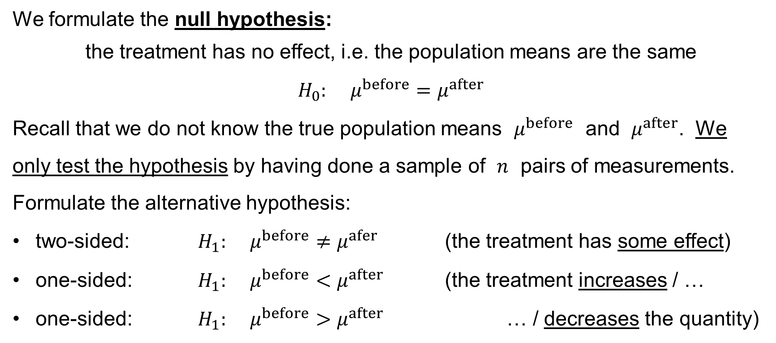
Paired-sample z-test for the difference of the pop.means
We formulate the null hypothesis:
the treatment has no effect, i.e. the population means are the same
$$H_{0}: μ^{before}=μ^{after}$$
Recall that we do not know the true population means $μ^{before}$ and $μ^{after}$. We
only test the hypothesis by having done a sample of $n$ pairs of measurements.
Formulate the alternative hypothesis:
two-sided: $H_{1}: μ^{before}≠μ^{afer}$ (the treatment has some effect)
one-sided: $H_{1}: μ^{before}<μ^{after}$ (the treatment increases / …
one-sided: $H_{1}: μ^{before}>μ^{after}$ … / decreases the quantity)

Slide 33
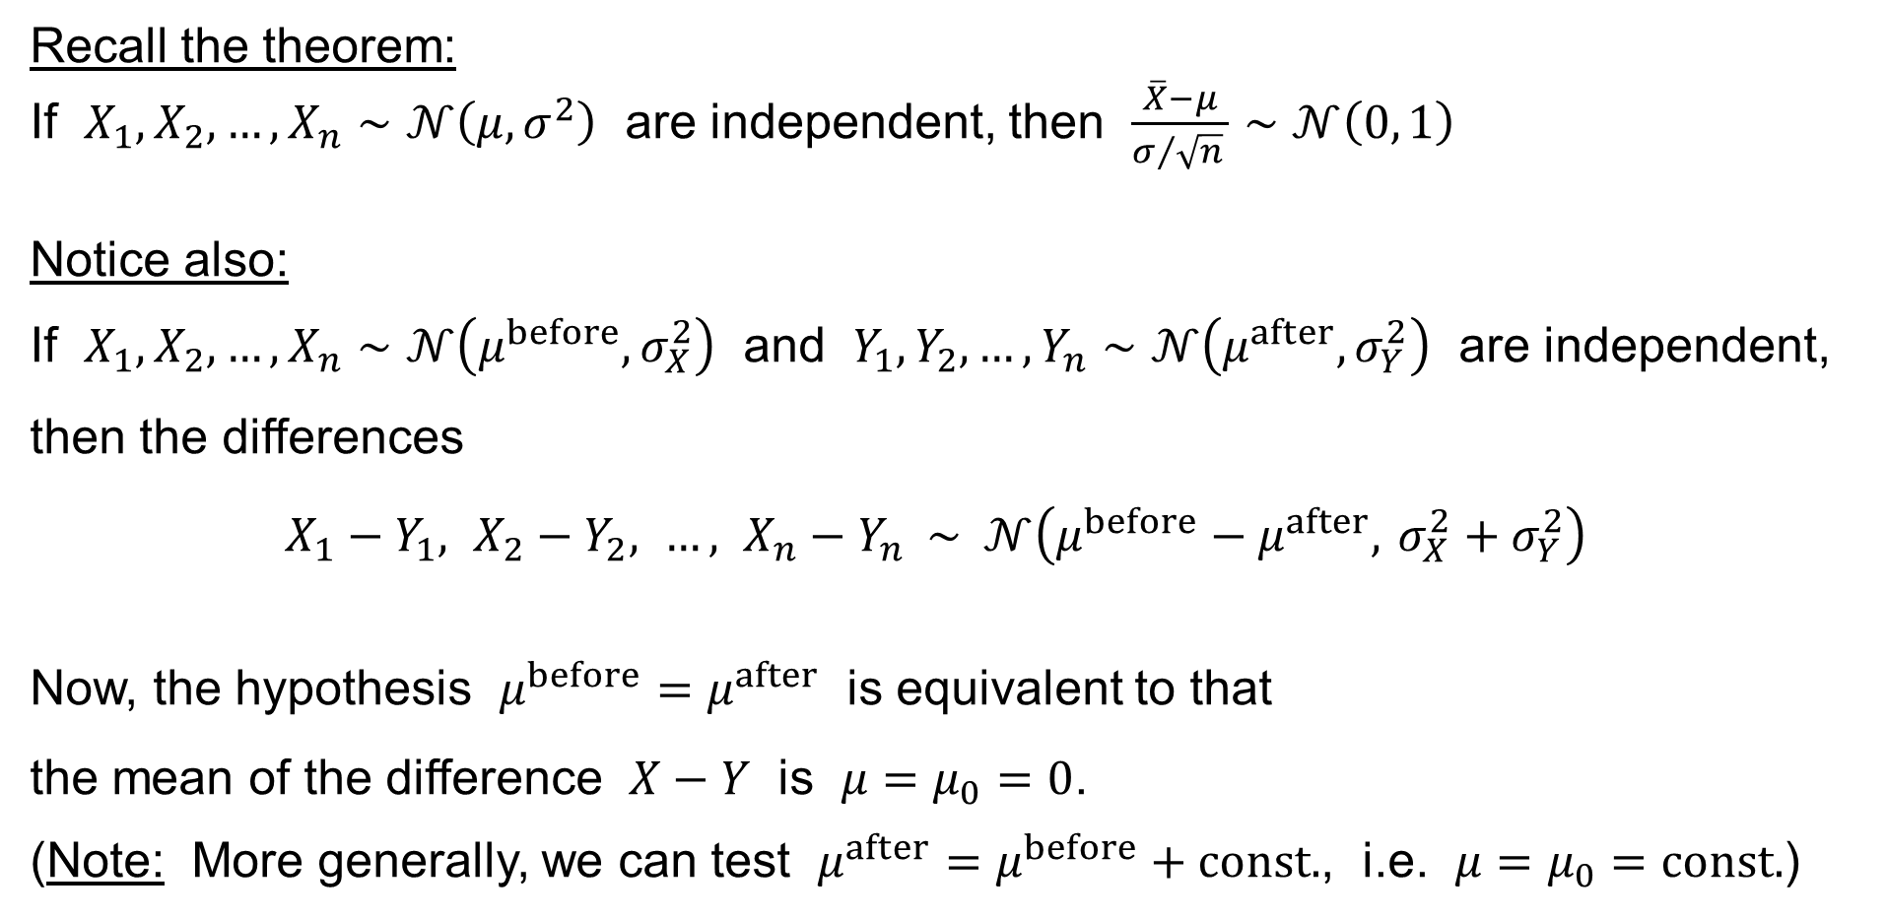
Paired-sample z-test for the difference of the pop.means
Recall the theorem:
If $X_{1},X_{2},…,X_{n}∼𝒩\left(μ,σ^{2}\right)$ are independent, then $\frac{\overline{X}−μ}{σ/{\sqrt{n}} }∼𝒩\left(0, 1\right)$
Notice also:
If $X_{1},X_{2},…,X_{n}∼𝒩\left(μ^{before},σ_{X}^{2}\right)$ and $Y_{1},Y_{2},…,Y_{n}∼𝒩\left(μ^{after},σ_{Y}^{2}\right)$ are independent, then the differences
$$X_{1}−Y_{1}, X_{2}−Y_{2}, …, X_{n}−Y_{n} ∼ 𝒩\left(μ^{before}−μ^{after}, σ_{X}^{2}+σ_{Y}^{2}\right)$$
Now, the hypothesis $μ^{before}=μ^{after}$ is equivalent to that
the mean of the difference $X−Y$ is $μ=μ_{0}=0$.
(Note: More generally, we can test $μ^{after}=μ^{before}+const.$, i.e. $μ=μ_{0}=const.$)

Slide 34
Paired-sample z-test for the difference of the pop.means
We have thus
reduced
the paired-sample z-test for the difference of the population means
to
the one-sample z-test for the population mean,
which we already know.

Slide 35
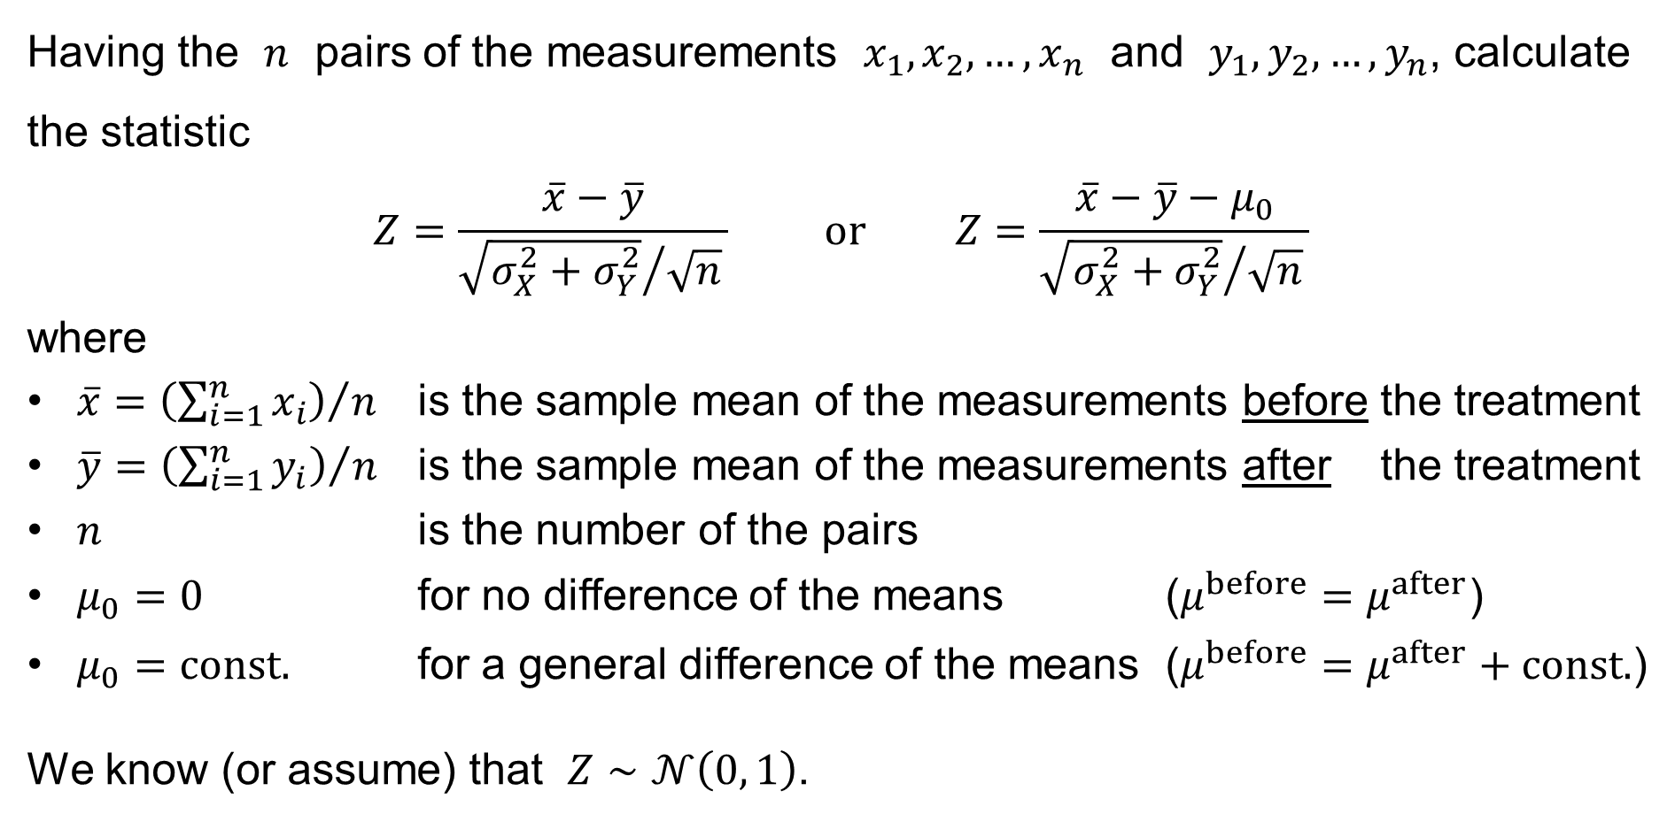
Paired-sample z-test for the difference of the pop.means
Having the $n$ pairs of the measurements $x_{1},x_{2},…,x_{n}$ and $y_{1},y_{2},…,y_{n}$, calculate the statistic
$$Z=\frac{\overline{x}−\overline{y}}{{\sqrt{σ_{X}^{2}+σ_{Y}^{2}}}/{\sqrt{n}} } \text{or} Z=\frac{\overline{x}−\overline{y}−μ_{0}}{{\sqrt{σ_{X}^{2}+σ_{Y}^{2}}}/{\sqrt{n}} }$$
where
$\overline{x}={\left(\sum_{i=1}^{n}{x_{i}}\right)}/n$ is the sample mean of the measurements before the treatment
$\overline{y}={\left(\sum_{i=1}^{n}{y_{i}}\right)}/n$ is the sample mean of the measurements after the treatment
$n$ is the number of the pairs
$μ_{0}=0$ for no difference of the means ($μ^{before}=μ^{after}$)
$μ_{0}=const.$ for a general difference of the means ($μ^{before}=μ^{after}+const.$)
We know (or assume) that $Z∼𝒩\left(0, 1\right)$.

Slide 36
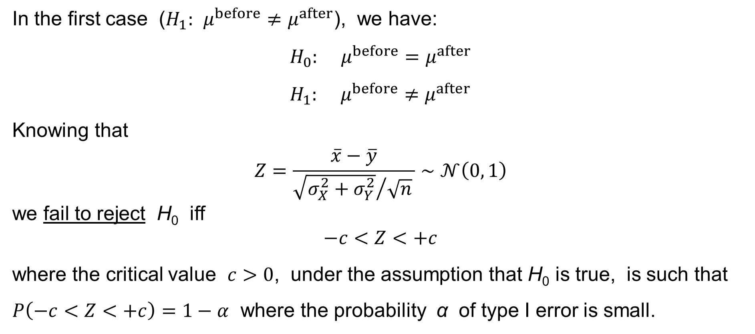
Paired-sample z-test for the difference of the pop.means
In the first case ($H_{1}: μ^{before}≠μ^{after}$), we have:
$$H_{0}: μ^{before}=μ^{after} \\ H_{1}: μ^{before}≠μ^{after}$$
Knowing that
$$Z=\frac{\overline{x}−\overline{y}}{{\sqrt{σ_{X}^{2}+σ_{Y}^{2}}}/{\sqrt{n}} }∼𝒩\left(0, 1\right)$$
we fail to reject H₀ iff
$$−c<Z<+c$$
where the critical value $c>0$, under the assumption that H₀ is true, is such that $P\left(−c<Z<+c\right)=1−α$ where the probability α of type I error is small.

Slide 37
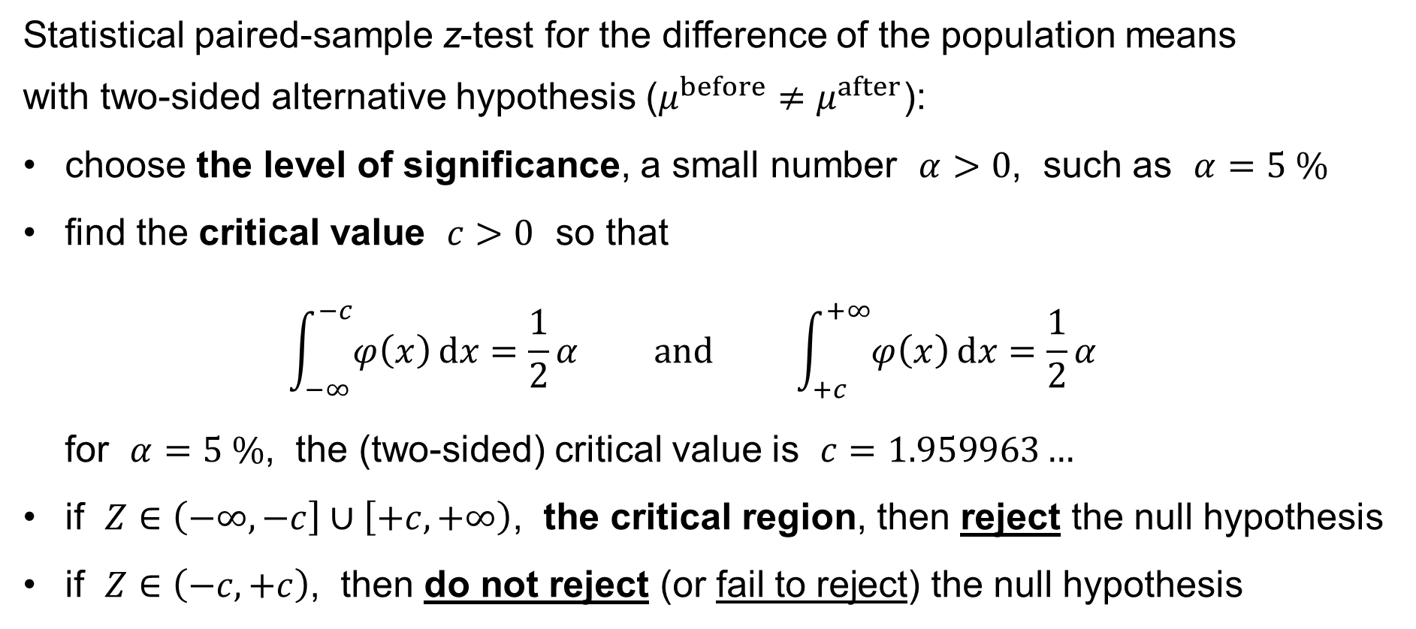
Paired-sample z-test for the difference of the pop.means
Statistical paired-sample z-test for the difference of the population means
with two-sided alternative hypothesis ($μ^{before}≠μ^{after}$):
choose the level of significance, a small number $α>0$, such as $α=5 \%$
find the critical value $c>0$ so that
$\int_{−∞}^{−c}{φ\left(x\right) dx}=\frac{1}{2}α \text{and} \int_{+c}^{+∞}{φ\left(x\right) dx}=\frac{1}{2}α$
for $α=5 \%$, the (two-sided) critical value is $c=1.959963…$
if $Z∈\left(−∞,−c\right]∪\left[+c,+∞\right)$, the critical region, then reject the null hypothesis
if $Z∈\left(−c,+c\right)$, then do not reject (or fail to reject) the null hypothesis

Slide 38
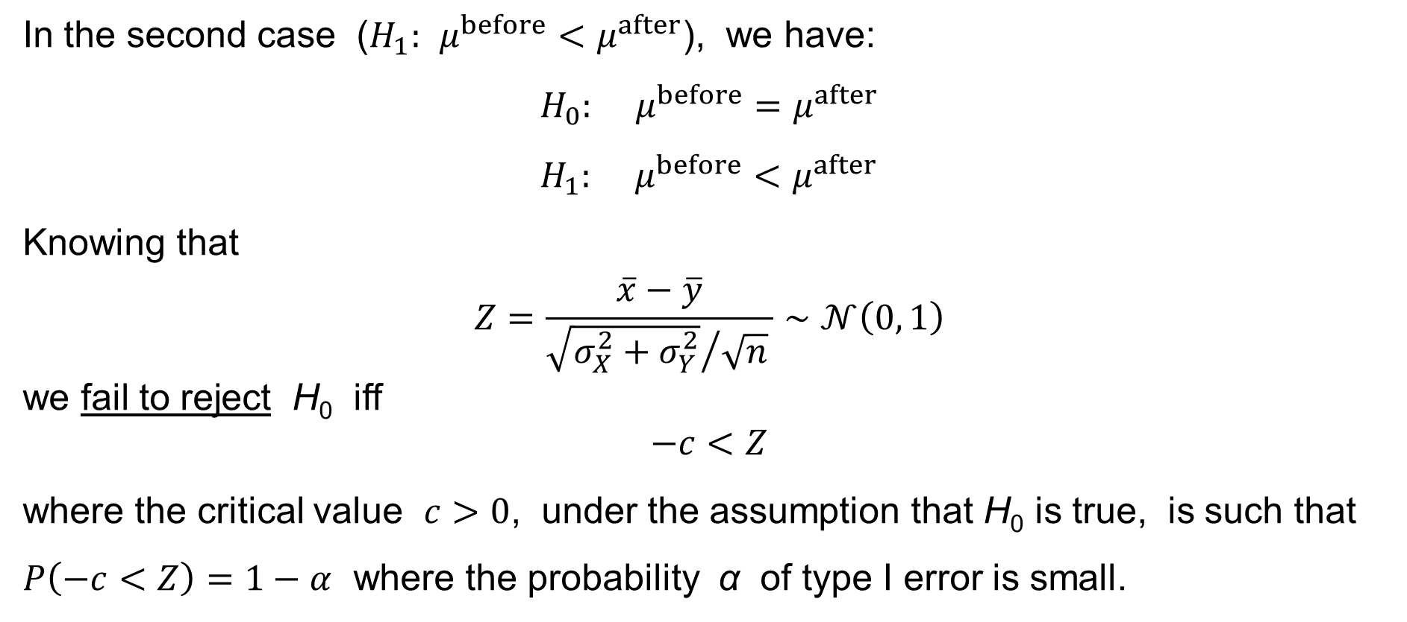
Paired-sample z-test for the difference of the pop.means
In the second case ($H_{1}: μ^{before}<μ^{after}$), we have:
$$H_{0}: μ^{before}=μ^{after} \\ H_{1}: μ^{before}<μ^{after}$$
Knowing that
$$Z=\frac{\overline{x}−\overline{y}}{{\sqrt{σ_{X}^{2}+σ_{Y}^{2}}}/{\sqrt{n}} }∼𝒩\left(0, 1\right)$$
we fail to reject H₀ iff
$$−c<Z$$
where the critical value $c>0$, under the assumption that H₀ is true, is such that $P\left(−c<Z\right)=1−α$ where the probability α of type I error is small.

Slide 39
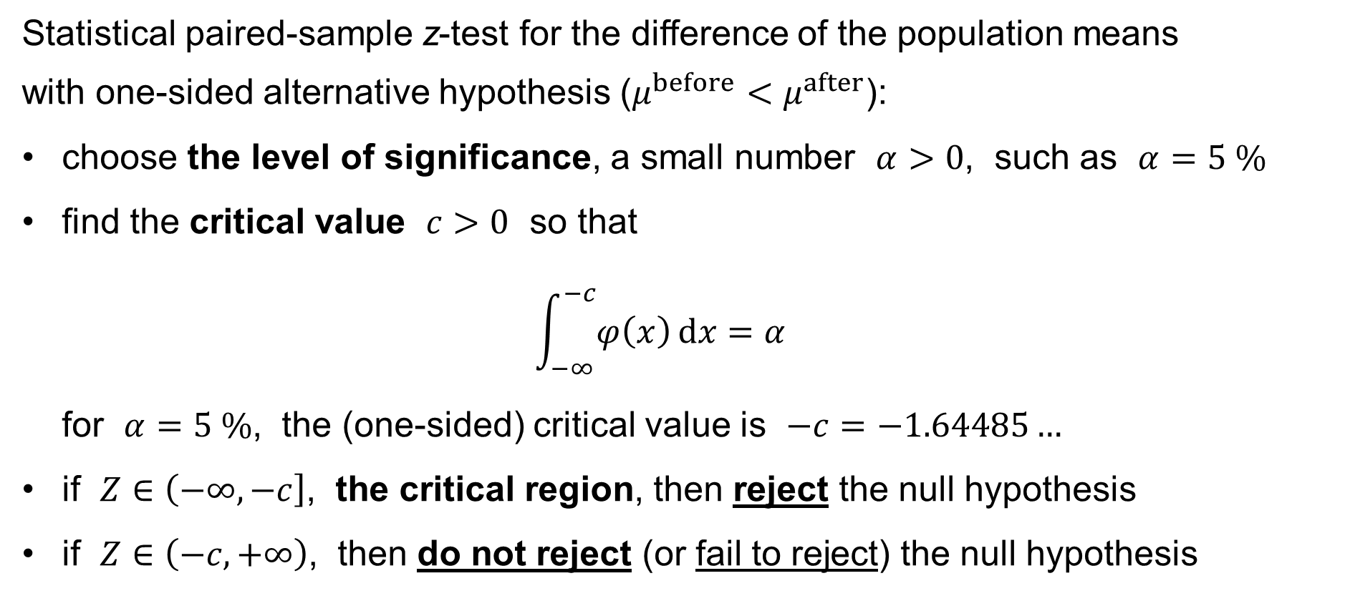
Paired-sample z-test for the difference of the pop.means
Statistical paired-sample z-test for the difference of the population means
with one-sided alternative hypothesis ($μ^{before}<μ^{after}$):
choose the level of significance, a small number $α>0$, such as $α=5 \%$
find the critical value $c>0$ so that
$\int_{−∞}^{−c}{φ\left(x\right) dx}=α$
for $α=5 \%$, the (one-sided) critical value is $−c=−1.64485…$
if $Z∈\left(−∞,−c\right]$, the critical region, then reject the null hypothesis
if $Z∈\left(−c,+∞\right)$, then do not reject (or fail to reject) the null hypothesis

Slide 40
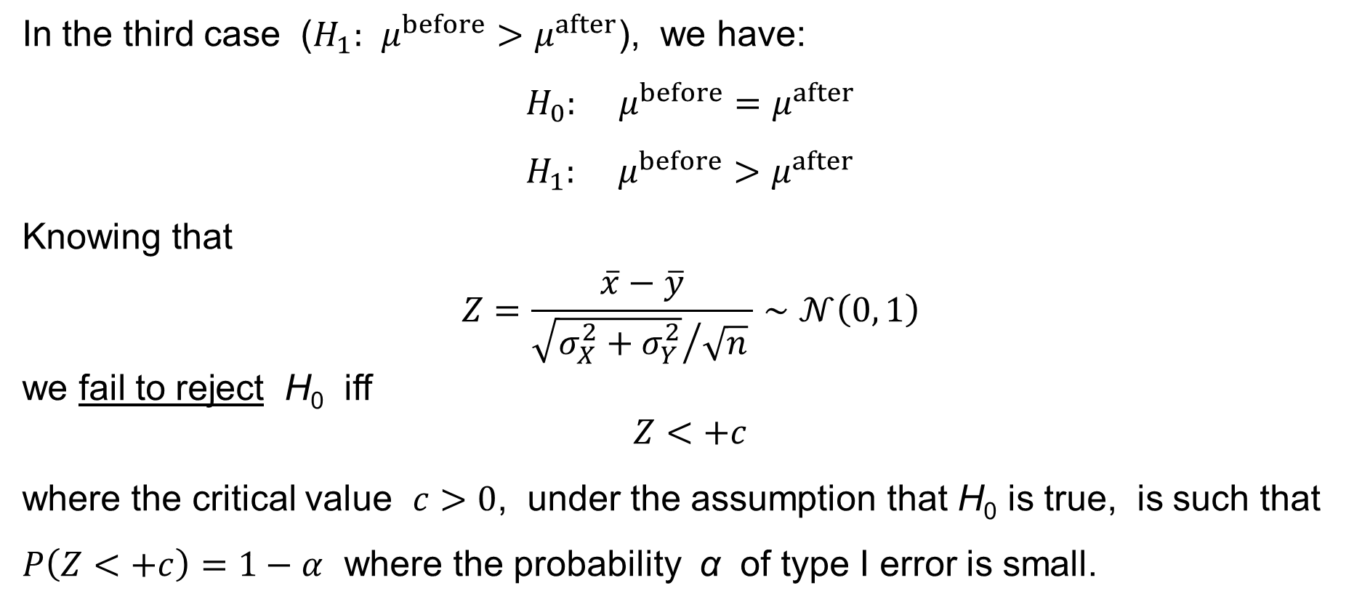
Paired-sample z-test for the difference of the pop.means
In the third case ($H_{1}: μ^{before}>μ^{after}$), we have:
$$H_{0}: μ^{before}=μ^{after} \\ H_{1}: μ^{before}>μ^{after}$$
Knowing that
$$Z=\frac{\overline{x}−\overline{y}}{{\sqrt{σ_{X}^{2}+σ_{Y}^{2}}}/{\sqrt{n}} }∼𝒩\left(0, 1\right)$$
we fail to reject H₀ iff
$$Z<+c$$
where the critical value $c>0$, under the assumption that H₀ is true, is such that $P\left(Z<+c\right)=1−α$ where the probability α of type I error is small.

Slide 41
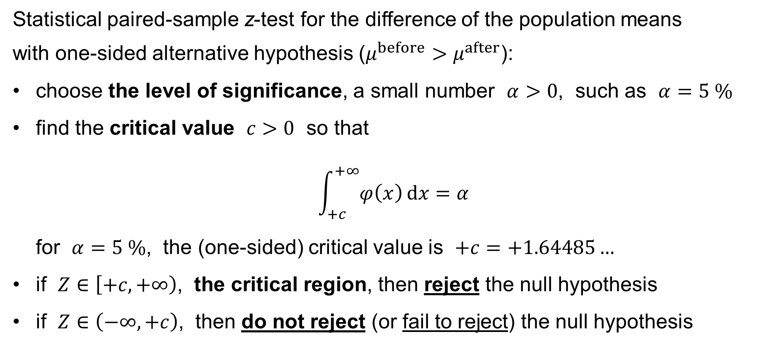
Paired-sample z-test for the difference of the pop.means
Statistical paired-sample z-test for the difference of the population means
with one-sided alternative hypothesis ($μ^{before}>μ^{after}$):
choose the level of significance, a small number $α>0$, such as $α=5 \%$
find the critical value $c>0$ so that
$\int_{+c}^{+∞}{φ\left(x\right) dx}=α$
for $α=5 \%$, the (one-sided) critical value is $+c=+1.64485…$
if $Z∈\left[+c,+∞\right)$, the critical region, then reject the null hypothesis
if $Z∈\left(−∞,+c\right)$, then do not reject (or fail to reject) the null hypothesis

Slide 42
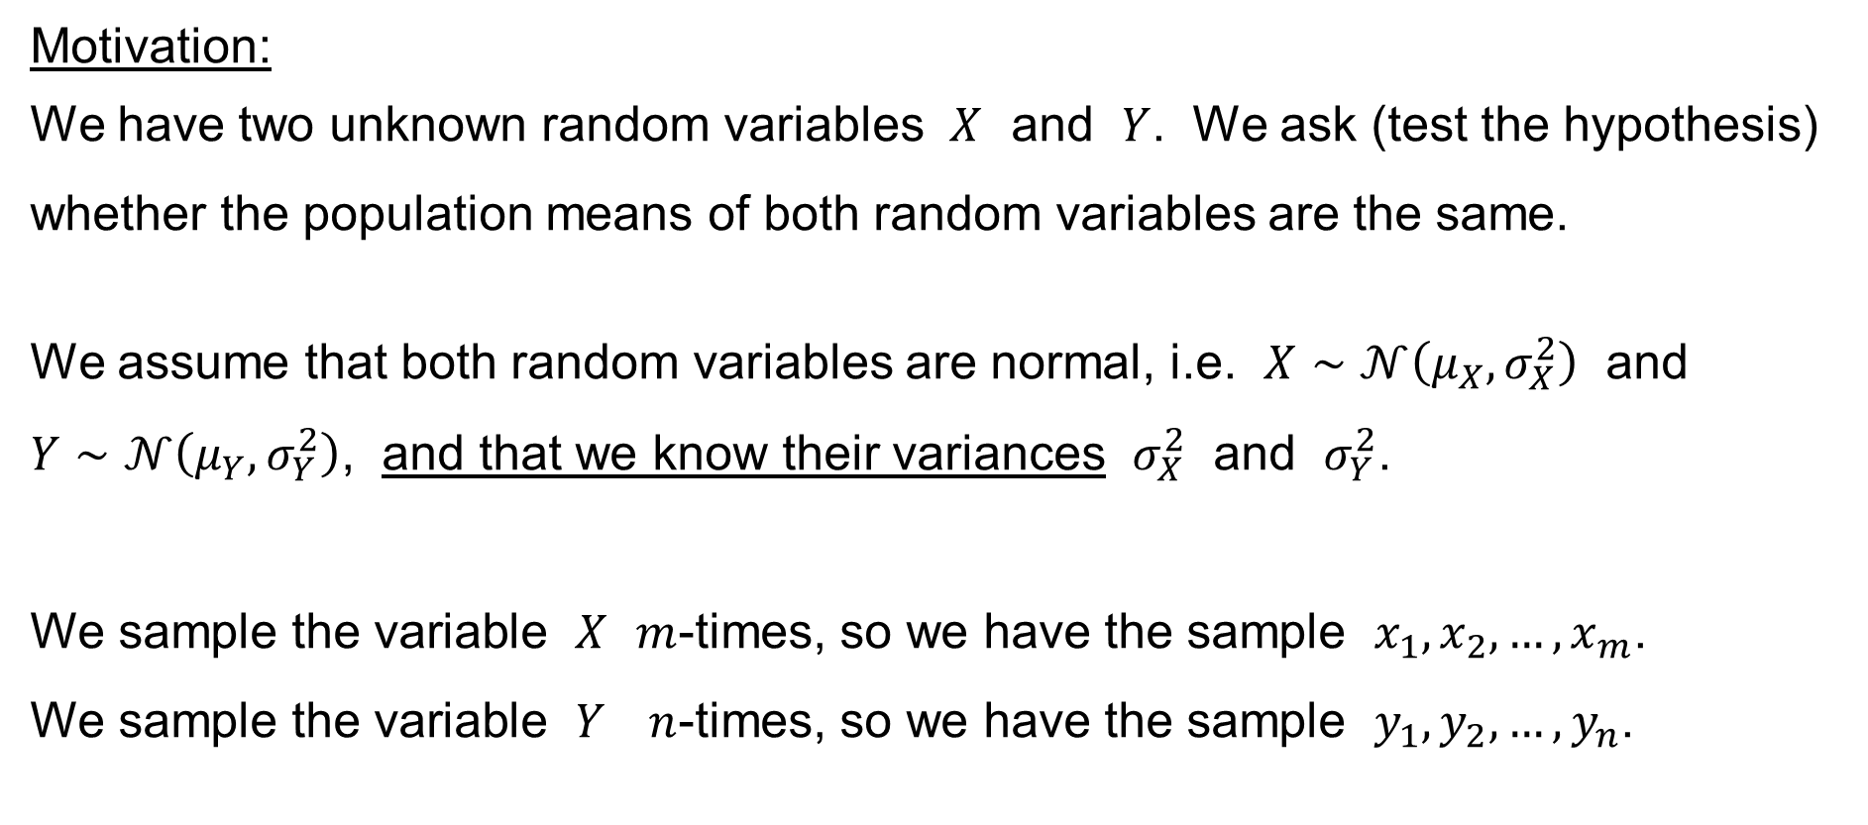
Two-sample z-test for the difference of the popul. means
Motivation:
We have two unknown random variables $X$ and $Y$. We ask (test the hypothesis) whether the population means of both random variables are the same.
We assume that both random variables are normal, i.e. $X∼𝒩\left(μ_{X},σ_{X}^{2}\right)$ and
$Y∼𝒩\left(μ_{Y},σ_{Y}^{2}\right)$, and that we know their variances $σ_{X}^{2}$ and $σ_{Y}^{2}$.
We sample the variable $X$ $m$-times, so we have the sample $x_{1},x_{2},…,x_{m}$.
We sample the variable $Y$ $n$-times, so we have the sample $y_{1},y_{2},…,y_{n}$.

Slide 43
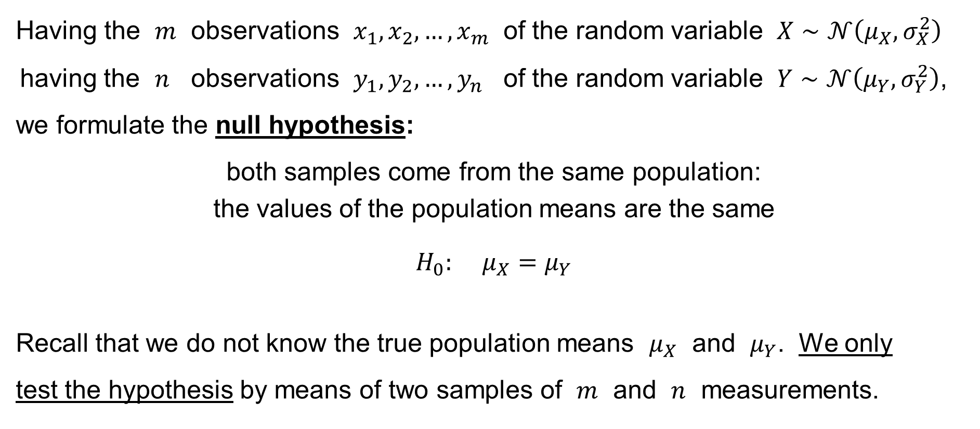
Two-sample z-test for the difference of the popul. means
Having the $m$ observations $x_{1},x_{2},…,x_{m}$ of the random variable $X∼𝒩\left(μ_{X},σ_{X}^{2}\right)$
having the $n$ observations $y_{1},y_{2},…,y_{n}$ of the random variable $Y∼𝒩\left(μ_{Y},σ_{Y}^{2}\right)$,
we formulate the null hypothesis:
both samples come from the same population:
the values of the population means are the same
$$H_{0}: μ_{X}=μ_{Y}$$
Recall that we do not know the true population means $μ_{X}$ and $μ_{Y}$. We only
test the hypothesis by means of two samples of $m$ and $n$ measurements.
and

Slide 44
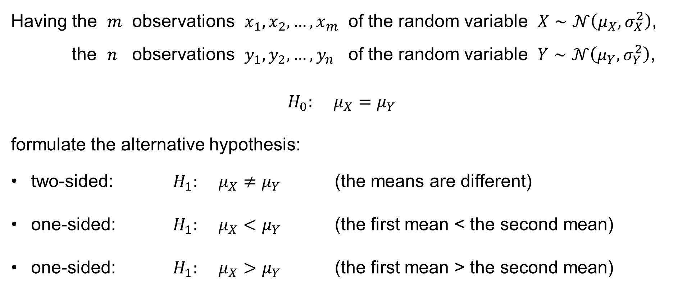
Two-sample z-test for the difference of the popul. means
Having the $m$ observations $x_{1},x_{2},…,x_{m}$ of the random variable $X∼𝒩\left(μ_{X},σ_{X}^{2}\right)$,
the $n$ observations $y_{1},y_{2},…,y_{n}$ of the random variable $Y∼𝒩\left(μ_{Y},σ_{Y}^{2}\right)$,
$$H_{0}: μ_{X}=μ_{Y}$$
formulate the alternative hypothesis:
two-sided: $H_{1}: μ_{X}≠μ_{Y}$ (the means are different)
one-sided: $H_{1}: μ_{X}<μ_{Y}$ (the first mean < the second mean)
one-sided: $H_{1}: μ_{X}>μ_{Y}$ (the first mean > the second mean)
and

Slide 45
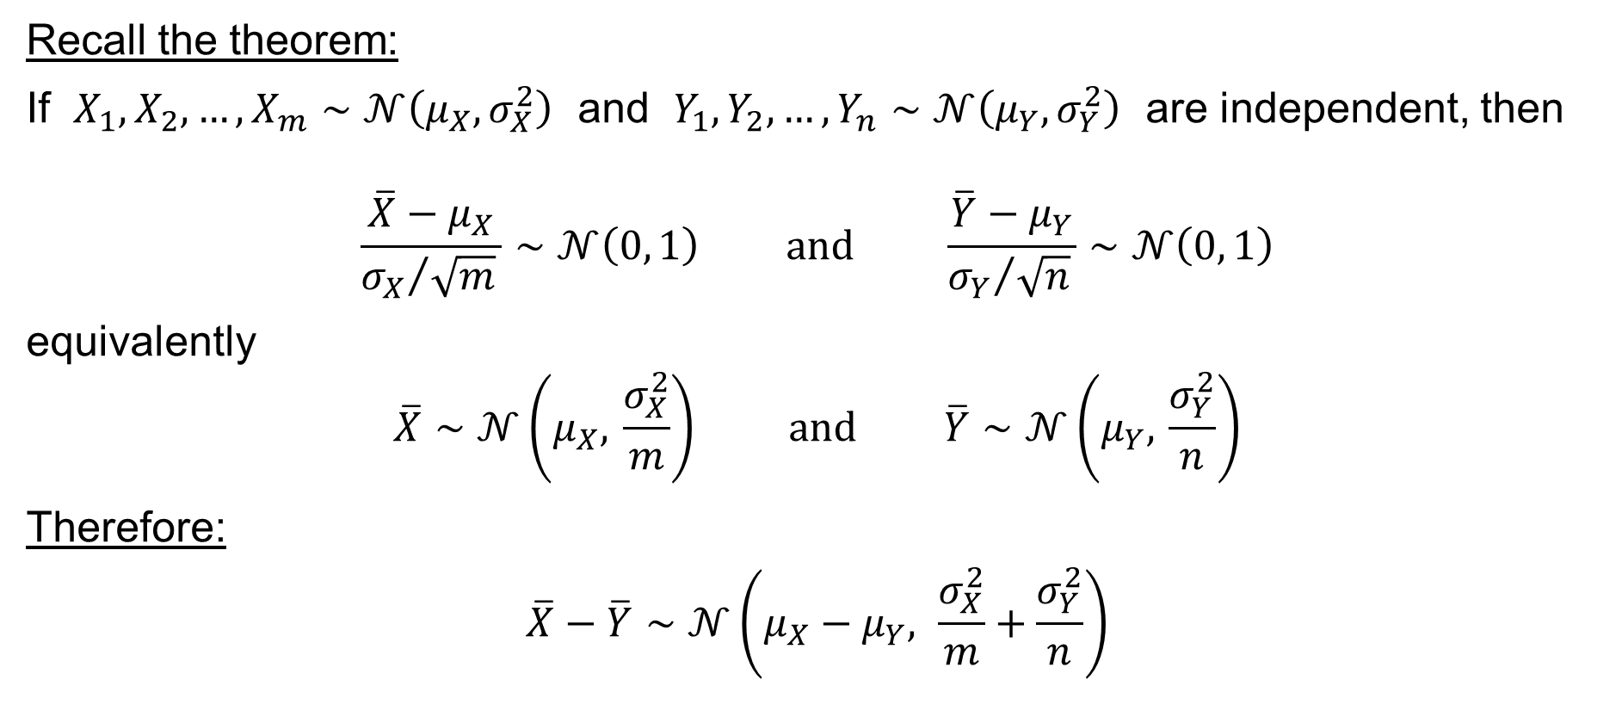
Two-sample z-test for the difference of the popul. means
Recall the theorem:
If $X_{1},X_{2},…,X_{m}∼𝒩\left(μ_{X},σ_{X}^{2}\right)$ and $Y_{1},Y_{2},…,Y_{n}∼𝒩\left(μ_{Y},σ_{Y}^{2}\right)$ are independent, then
$$\frac{\overline{X}−μ_{X}}{{σ_{X}}/{\sqrt{m}} }∼𝒩\left(0, 1\right) \text{and} \frac{\overline{Y}−μ_{Y}}{{σ_{Y}}/{\sqrt{n}} }∼𝒩\left(0, 1\right)$$
equivalently
$$\overline{X}∼𝒩\left(μ_{X}, \frac{σ_{X}^{2}}{m}\right) \text{and} \overline{Y}∼𝒩\left(μ_{Y}, \frac{σ_{Y}^{2}}{n}\right)$$
Therefore:
$$\overline{X}−\overline{Y}∼𝒩\left(μ_{X}−μ_{Y}, \frac{σ_{X}^{2}}{m}+\frac{σ_{Y}^{2}}{n}\right)$$

Slide 46

Two-sample z-test for the difference of the popul. means
We have shown:
If $X_{1},X_{2},…,X_{m}∼𝒩\left(μ_{X},σ_{X}^{2}\right)$ and $Y_{1},Y_{2},…,Y_{n}∼𝒩\left(μ_{Y},σ_{Y}^{2}\right)$ are independent, then
$$\overline{X}−\overline{Y}∼𝒩\left(μ_{X}−μ_{Y}, \frac{σ_{X}^{2}}{m}+\frac{σ_{Y}^{2}}{n}\right)$$
equivalently
$$\frac{\left(\overline{X}−\overline{Y}\right)−\left(μ_{X}−μ_{Y}\right)}{\sqrt{ \frac{σ_{X}^{2}}{m}+\frac{σ_{Y}^{2}}{n} }}∼𝒩\left(0, 1\right)$$

Slide 47
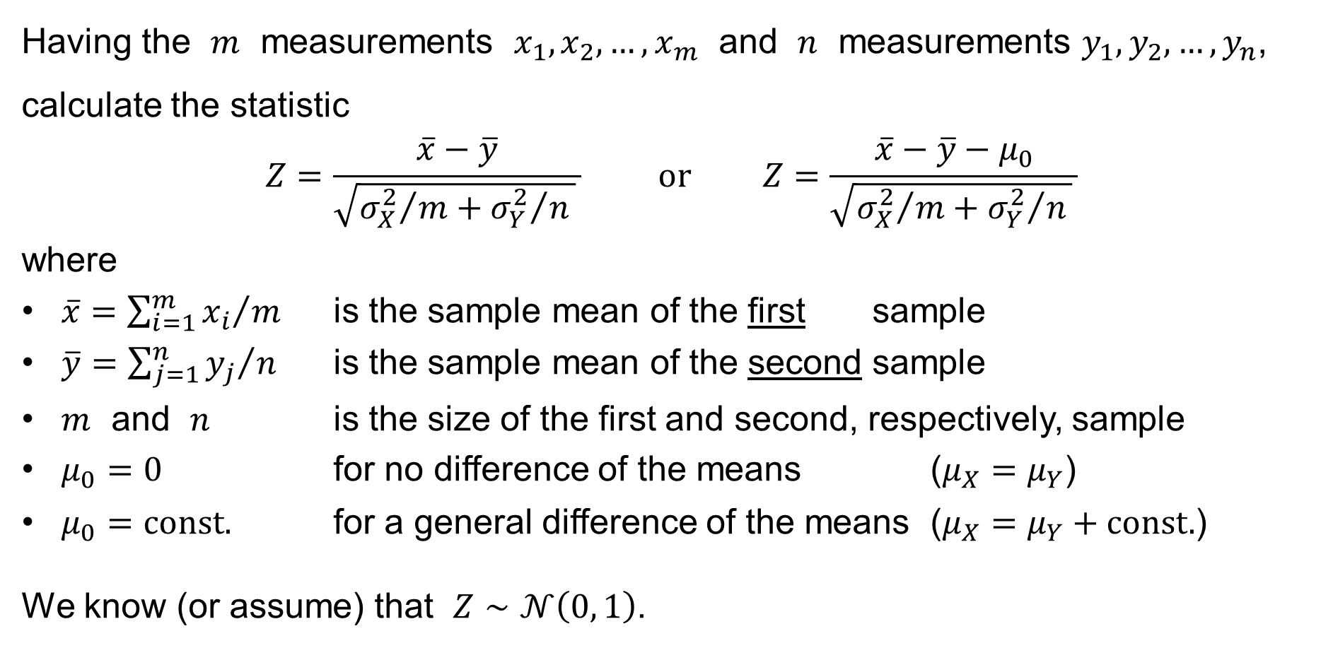
Two-sample z-test for the difference of the popul. means
Having the $m$ measurements $x_{1},x_{2},…,x_{m}$ and $n$ measurements $y_{1},y_{2},…,y_{n}$, calculate the statistic
$$Z=\frac{\overline{x}−\overline{y}}{\sqrt{{σ_{X}^{2}}/m+{σ_{Y}^{2}}/n } } \text{or} Z=\frac{\overline{x}−\overline{y}−μ_{0}}{\sqrt{{σ_{X}^{2}}/m+{σ_{Y}^{2}}/n } }$$
where
$\overline{x}={\left.\sum_{i=1}^{m}{x_{i}}\right.}/m$ is the sample mean of the first sample
$\overline{y}={\left.\sum_{j=1}^{n}{y_{j}}\right.}/n$ is the sample mean of the second sample
$m$ and $n$ is the size of the first and second, respectively, sample
$μ_{0}=0$ for no difference of the means ($μ_{X}=μ_{Y}$)
$μ_{0}=const.$ for a general difference of the means ($μ_{X}=μ_{Y}+const.$)
We know (or assume) that $Z∼𝒩\left(0, 1\right)$.

Slide 48
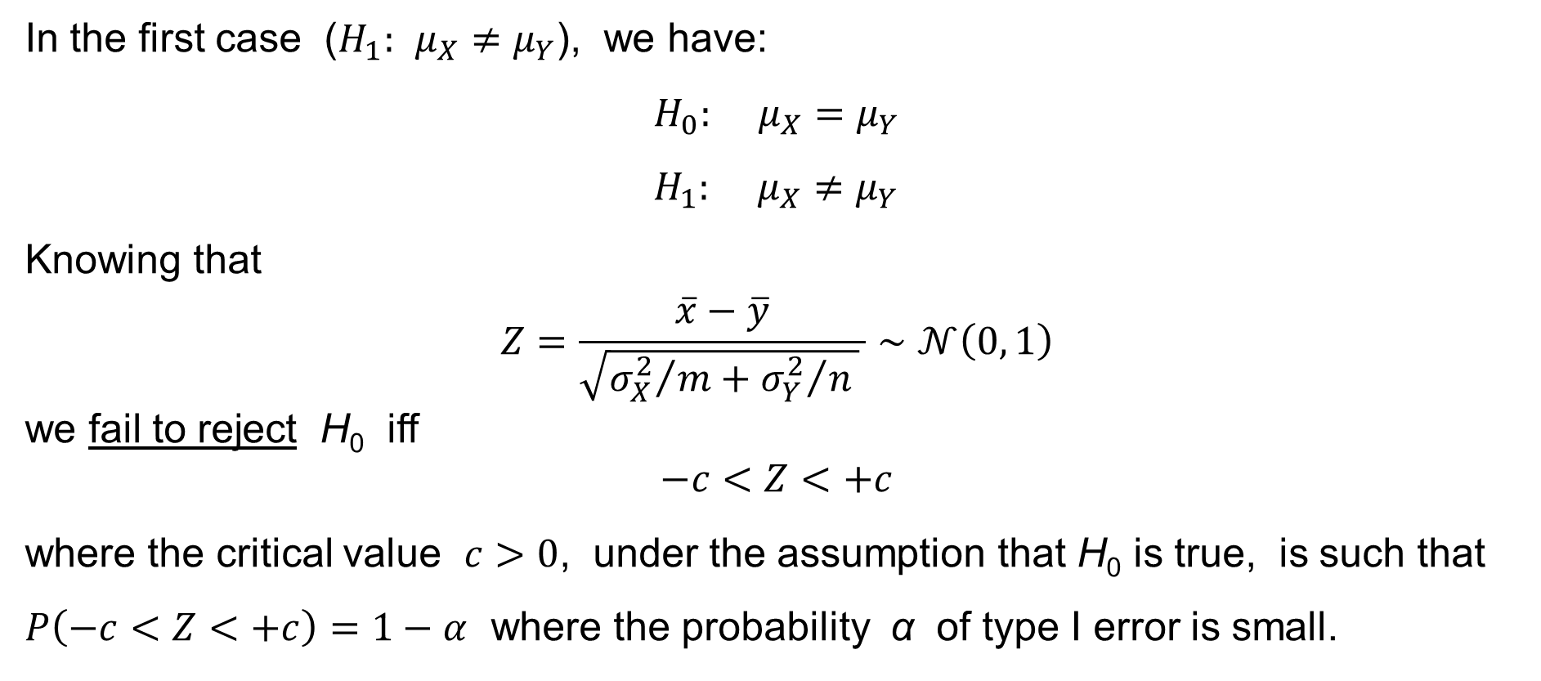
Two-sample z-test for the difference of the popul. means
In the first case ($H_{1}: μ_{X}≠μ_{Y}$), we have:
$$H_{0}: μ_{X}=μ_{Y} \\ H_{1}: μ_{X}≠μ_{Y}$$
Knowing that
$$Z=\frac{\overline{x}−\overline{y}}{\sqrt{{σ_{X}^{2}}/m+{σ_{Y}^{2}}/n } }∼𝒩\left(0, 1\right)$$
we fail to reject H₀ iff
$$−c<Z<+c$$
where the critical value $c>0$, under the assumption that H₀ is true, is such that $P\left(−c<Z<+c\right)=1−α$ where the probability α of type I error is small.

Slide 49
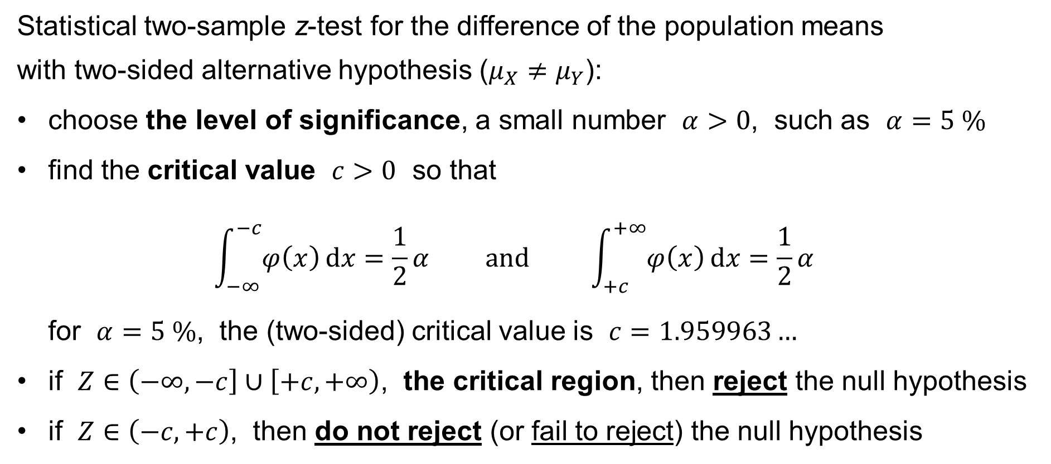
Two-sample z-test for the difference of the popul. means
Statistical two-sample z-test for the difference of the population means
with two-sided alternative hypothesis ($μ_{X}≠μ_{Y}$):
choose the level of significance, a small number $α>0$, such as $α=5 \%$
find the critical value $c>0$ so that
$\int_{−∞}^{−c}{φ\left(x\right) dx}=\frac{1}{2}α \text{and} \int_{+c}^{+∞}{φ\left(x\right) dx}=\frac{1}{2}α$
for $α=5 \%$, the (two-sided) critical value is $c=1.959963…$
if $Z∈\left(−∞,−c\right]∪\left[+c,+∞\right)$, the critical region, then reject the null hypothesis
if $Z∈\left(−c,+c\right)$, then do not reject (or fail to reject) the null hypothesis

Slide 50
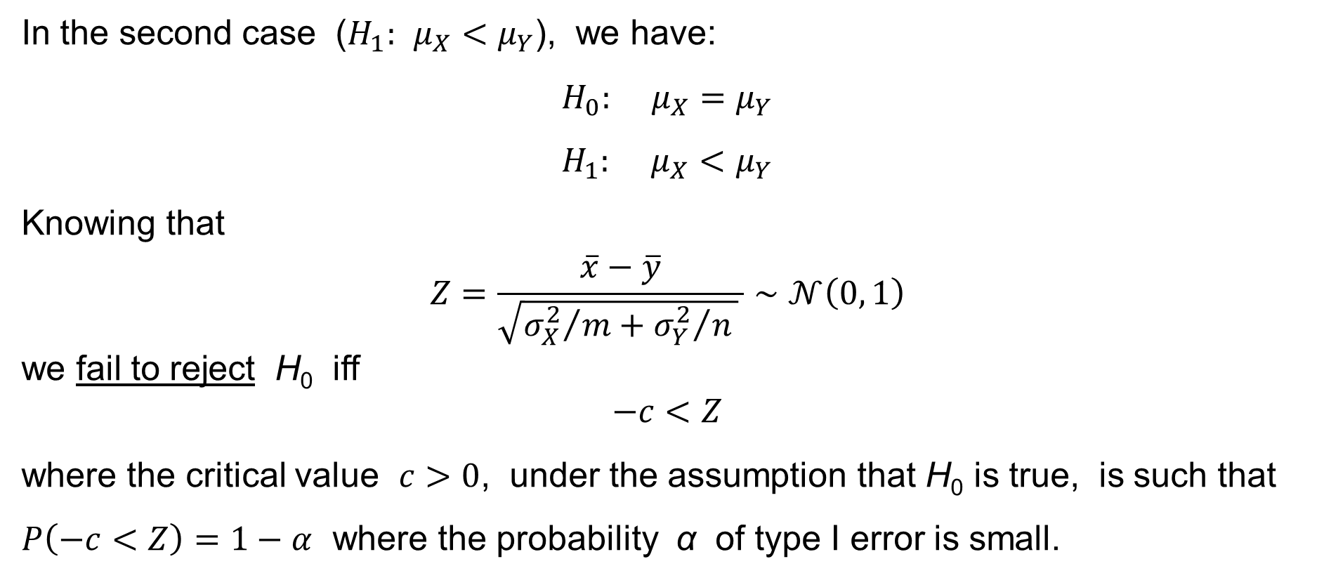
Two-sample z-test for the difference of the popul. means
In the second case ($H_{1}: μ_{X}<μ_{Y}$), we have:
$$H_{0}: μ_{X}=μ_{Y} \\ H_{1}: μ_{X}<μ_{Y}$$
Knowing that
$$Z=\frac{\overline{x}−\overline{y}}{\sqrt{{σ_{X}^{2}}/m+{σ_{Y}^{2}}/n } }∼𝒩\left(0, 1\right)$$
we fail to reject H₀ iff
$$−c<Z$$
where the critical value $c>0$, under the assumption that H₀ is true, is such that $P\left(−c<Z\right)=1−α$ where the probability α of type I error is small.

Slide 51
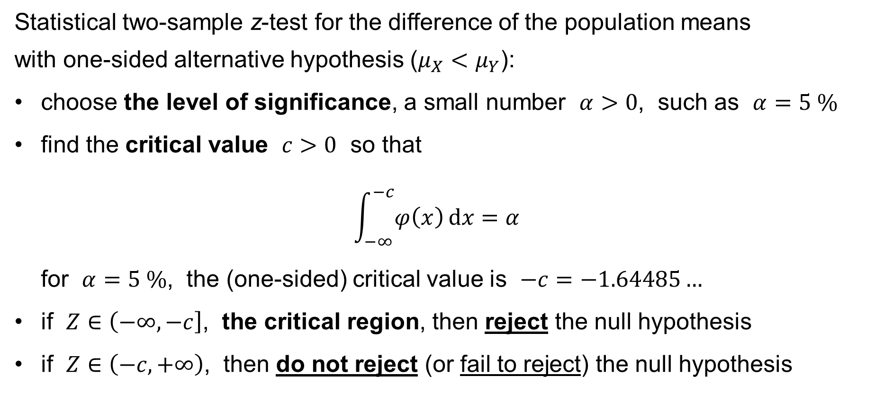
Two-sample z-test for the difference of the popul. means
Statistical two-sample z-test for the difference of the population means
with one-sided alternative hypothesis ($μ_{X}<μ_{Y}$):
choose the level of significance, a small number $α>0$, such as $α=5 \%$
find the critical value $c>0$ so that
$\int_{−∞}^{−c}{φ\left(x\right) dx}=α$
for $α=5 \%$, the (one-sided) critical value is $−c=−1.64485…$
if $Z∈\left(−∞,−c\right]$, the critical region, then reject the null hypothesis
if $Z∈\left(−c,+∞\right)$, then do not reject (or fail to reject) the null hypothesis

Slide 52
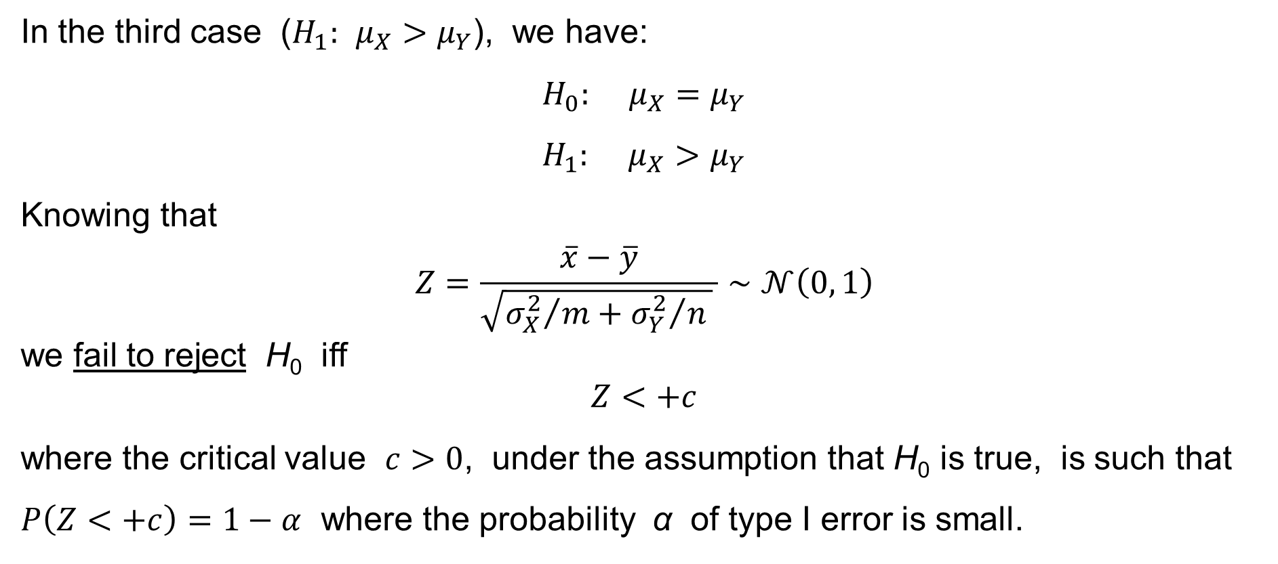
Two-sample z-test for the difference of the popul. means
In the third case ($H_{1}: μ_{X}>μ_{Y}$), we have:
$$H_{0}: μ_{X}=μ_{Y} \\ H_{1}: μ_{X}>μ_{Y}$$
Knowing that
$$Z=\frac{\overline{x}−\overline{y}}{\sqrt{{σ_{X}^{2}}/m+{σ_{Y}^{2}}/n } }∼𝒩\left(0, 1\right)$$
we fail to reject H₀ iff
$$Z<+c$$
where the critical value $c>0$, under the assumption that H₀ is true, is such that $P\left(Z<+c\right)=1−α$ where the probability α of type I error is small.

Slide 53
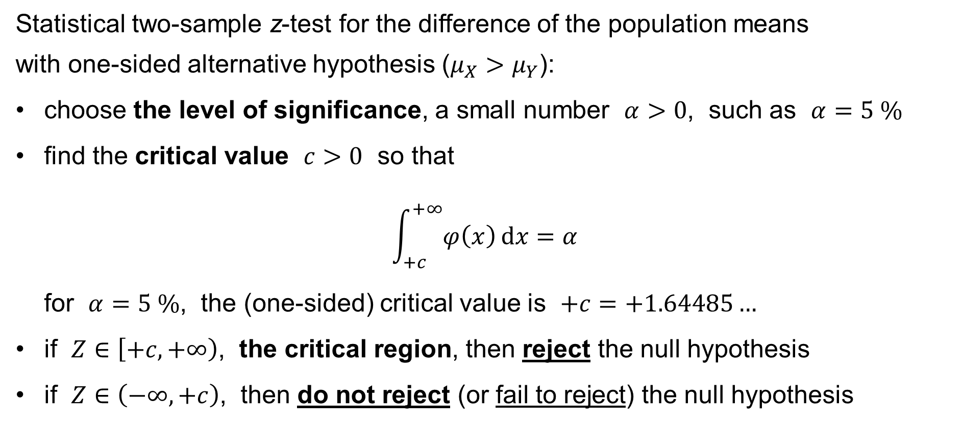
Two-sample z-test for the difference of the popul. means
Statistical two-sample z-test for the difference of the population means
with one-sided alternative hypothesis ($μ_{X}>μ_{Y}$):
choose the level of significance, a small number $α>0$, such as $α=5 \%$
find the critical value $c>0$ so that
$\int_{+c}^{+∞}{φ\left(x\right) dx}=α$
for $α=5 \%$, the (one-sided) critical value is $+c=+1.64485…$
if $Z∈\left[+c,+∞\right)$, the critical region, then reject the null hypothesis
if $Z∈\left(−∞,+c\right)$, then do not reject (or fail to reject) the null hypothesis

Slide 54
t-tests for the means
One-sample t-test for
the population mean
Paired-sample t-test for
the difference of the population means
Two-sample t-test for
the difference of the population means

Slide 55
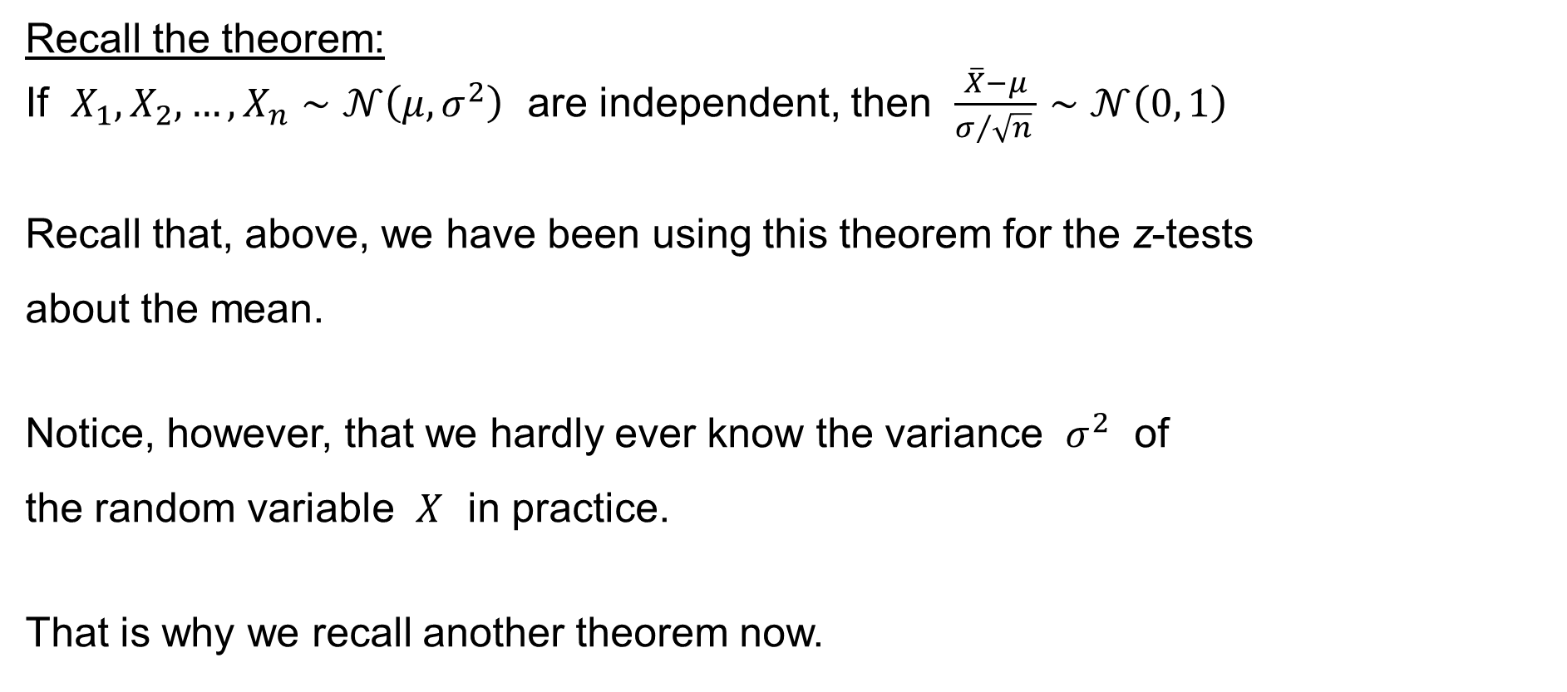
One-sample t-test for the population mean
Recall the theorem:
If $X_{1},X_{2},…,X_{n}∼𝒩\left(μ,σ^{2}\right)$ are independent, then $\frac{\overline{X}−μ}{σ/{\sqrt{n}} }∼𝒩\left(0, 1\right)$
Recall that, above, we have been using this theorem for the z-tests
about the mean.
Notice, however, that we hardly ever know the variance $σ^{2}$ of
the random variable $X$ in practice.
That is why we recall another theorem now.

Slide 56

One-sample t-test for the population mean
Recall another theorem:
If $X_{1},X_{2},…,X_{n}∼𝒩\left(μ,σ^{2}\right)$ are independent, then $\frac{\left(n−1\right)s^{2}}{σ^{2}}∼χ_{n−1}^{2}$
where
$s^{2}={\left.\sum_{i=1}^{n}{{\left(X_{i}−\overline{X}\right)}^{2}}\right.}/{\left(n−1\right)}$ is the sample variance of the random variables
$χ_{n−1}^{2}$ is Pearson’s χ²-distribution
with $n−1$ degrees of freedom

Slide 57

One-sample t-test for the population mean
Recall the corollary of the two theorems:
If $X_{1},X_{2},…,X_{n}∼𝒩\left(μ,σ^{2}\right)$ are independent, then $\frac{\overline{X}−μ}{s/{\sqrt{n}} }∼t_{n−1}$
where
$\overline{X}={\left.\sum_{i=1}^{n}{X_{i}}\right.}/n$ is the sample mean of the random variables
$s=\sqrt{{\left.\sum_{i=1}^{n}{{\left(X_{i}−\overline{X}\right)}^{2}}\right.}/{\left(n−1\right)}}$ is the sample standard deviation of the random
variables
$t_{n−1}$ is Student’s t-distribution
with $n−1$ degrees of freedom

Slide 58

One-sample t-test for the population mean
Recall the corollary:
If $X_{1},X_{2},…,X_{n}∼𝒩\left(μ,σ^{2}\right)$ are independent, then $\frac{\overline{X}−μ}{s/{\sqrt{n}} }∼t_{n−1}$
Example or motivation:
Assume that $X∼𝒩\left(μ,σ^{2}\right)$ is a random variable following the normal probability distribution with some mean $μ∈ℝ$ and with some variance $σ^{2}∈ℝ_{0}^{+}$.
Knowing neither the variance $σ^{2}$ nor the true value of the population mean $μ∈ℝ$, we conjecture / we assume / we … / that the population mean $μ=μ_{0}$, i.e.
the (unknown) population mean $μ$ is equal to some prescribed value $μ_{0}∈ℝ$.

Slide 59

One-sample t-test for the population mean
Example: An archer shoots an arrow against the plane.
The sample space $Ω=ℝ^{2}=\left\{ \left[x,y\right] :x,y∈ℝ \right\}$ is the set of all the points of
the plane. The random variable $X$ is the $x$-coordinate of the hit, i.e.
$X\left(ω\right)=X\left(\left[x,y\right]\right)=x$.
We do not know the archer’s variance $σ^{2}$ and we do not know the archer’s intention, i.e. we do not know the point which the archer intends to hit,
i.e. we do not know the archer’s mean $μ$.
We conjecture that the archer’s intention is to hit the origin, i.e. $μ=0$.
We then put $μ_{0}=0$ and we conjecture that $μ=μ_{0}=0$.

Slide 60

One-sample t-test for the population mean
Let $x_{1}=X\left(ω_{1}\right)$, $x_{2}=X\left(ω_{2}\right)$, …, $x_{n}=X\left(ω_{n}\right)$ be the numerical results
of $n$ trials of a random experiment, where $X∼𝒩\left(μ,σ^{2}\right)$,
such as the $x$-coordinates of the archer’s $n$ hits.
We do not know the variance $σ^{2}$ and we do not know the mean $μ$.
We state the null hypothesis (about the mean):
$$H_{0}: μ=μ_{0}$$
where $μ_{0}∈ℝ$ is some number such that we conjecture
that the true mean could equal the $μ_{0}$.

Slide 61

One-sample t-test for the population mean
Having stated the null hypothesis
$$H_{0}: μ=μ_{0}$$
we also state the alternative hypothesis:
two-sided: $H_{1}: μ≠μ_{0}$
one-sided: $H_{1}: μ<μ_{0}$
one-sided: $H_{1}: μ>μ_{0}$

Slide 62
One-sample t-test for the population mean
Which alternative hypothesis ($μ≠μ_{0}$ or $μ<μ_{0}$ or $μ>μ_{0}$) do we choose?
→ That depends upon our knowledge of the situation.
In our example:
If we suspect that the archer’s intention is to hit a point different
from the given point (such as the origin), we choose $H_{1}: μ≠μ_{0}$.
If we conjecture that the archer’s intention is to hit a point to the left
of the given point (such as the origin), we choose $H_{1}: μ<μ_{0}$.
If we conjecture that the archer’s intention is to hit a point to the right
of the given point (such as the origin), we choose $H_{1}: μ>μ_{0}$.

Slide 63

One-sample t-test for the population mean
Under our assumptions ($x_{1},…,x_{n}∼𝒩\left(μ,σ^{2}\right)$ are independent and $μ=μ_{0}$),
it follows by the Theorem that
$$\frac{\overline{x}−μ}{s/{\sqrt{n}} }=\frac{\overline{x}−μ_{0}}{s/{\sqrt{n}}}∼t_{n−1}$$
Thus, having the $n$ measurements $x_{1},x_{2},…,x_{n}$, we calculate the statistic
$$T=\frac{\overline{x}−μ_{0}}{s/{\sqrt{n}}}$$
We know (or assume) that $T∼t_{n−1}$.

Slide 64

One-sample t-test for the population mean
We have $T=\frac{\overline{x}−μ_{0}}{s/{\sqrt{n}} }∼t_{n−1}$.
Then, if $−∞≤a<b≤+∞$, the probability that $a<T<b$ is
$$P\left(a<T<b\right)=\int_{a}^{b}{f\left(x\right) dx}$$
where
$$f\left(x\right)=\frac{Γ\left(\frac{n}{2}\right)}{Γ\left(\frac{n−1}{2}\right)\sqrt{π\left(n−1\right) } }{\left(1+\frac{x^{2}}{n−1}\right)}^{−\frac{k}{2}}$$
is the density of Student’s t-distribution with $n−1$ degrees of freedom.

Slide 65

The gamma function
$$Γ\left(z\right)=\int_{0}^{+∞}{x^{z}e^{−x} dx} \text{for} z∈ℂ \text{such} \text{that} \operatorname{Re}\left(z\right)>0$$
It is easy to calculate:
$$Γ\left(1\right)=1 \\ Γ\left(z+1\right)=zΓ\left(z\right)$$
Therefore:
$$Γ\left(n+1\right)=n! \text{for} n=0, 1, 2, 3,…$$

Slide 66

The gamma function – another definition (due to Euler)
$$Γ\left(z\right) = \frac{1}{z}\prod_{n=1}^{∞}{\frac{{\left(1+\frac{1}{n}\right)}^{z}}{1+\frac{z}{n}}} \text{for} z∈ℂ∖\left\{0,−1,−2,−3,…\right\}$$

Slide 67

One-sample t-test for the population mean
Consider the first case ($H_{1}: μ≠μ_{0}$) first. We have:
$$H_{0}: μ=μ_{0} \\ H_{1}: μ≠μ_{0}$$
Knowing that $T=\frac{\overline{x}−μ_{0}}{s/{\sqrt{n}} }∼t_{n−1}$, the probability
$$P\left(−c<T<+c\right)$$
is quite high,
so having $−c<T<+c$ accords with $H_{0}$, if $c>0$ is large enough.

Slide 68

One-sample t-test for the population mean
On the other hand, if $H_{0}$ is true, then it is quite improbable that $T∉\left(−c,+c\right)$. Therefore, if we observe that
$$T≤−c \text{or} +c≤T$$
then we may conclude that $H_{0}$ is probably not true,
i.e. we reject the null hypothesis $H_{0}$.
Therefore, the statistical test proceeds as follows:
(see below)

Slide 69

One-sample t-test for the population mean
Statistical one-sample t-test with two-sided alternative hypothesis ($μ≠μ_{0}$):
choose the level of significance, a small number $α>0$, a very
popular value is $α=5 \%$, other popular values are $10 \%$ or $1 \%$ or $0.1 \%$ etc.
find the critical value $c>0$ so that
$\int_{−∞}^{−c}{f\left(x\right) dx}=\frac{1}{2}α \text{and} \int_{+c}^{+∞}{f\left(x\right) dx}=\frac{1}{2}α$
where $f$ is the density of the t-distribution with $n−1$ degrees of freedom
if $T∈\left(−∞,−c\right]∪\left[+c,+∞\right)$, the critical region, then reject the null hypothesis
if $T∈\left(−c,+c\right)$, then do not reject (or fail to reject) the null hypothesis
Remark: “do not reject” is sometimes ¡incorrectly! interpreted as “accept” the H₀

Slide 70

Type I and Type II error
There are exactly four possibilities when testing the null hypothesis H₀:
the null hypothesis ($H_{0}$) is actually true & we do not reject it — OK
the null hypothesis ($H_{0}$) is actually true & we reject it — type I error
the null hypothesis ($H_{0}$) is actually not true & we do not reject it — type II error
the null hypothesis ($H_{0}$) is actually not true & we reject it — OK
The probability of the type I error is the significance level α
The probability of the type II error is β
The power of the test is the probability 1 − β

Slide 71

One-sample t-test for the population mean
Consider now the second case ($H_{1}: μ<μ_{0}$). We have:
$$H_{0}: μ=μ_{0} \\ H_{1}: μ<μ_{0}$$
Knowing that $T=\frac{\overline{x}−μ_{0}}{s/{\sqrt{n}} }∼t_{n−1}$ and assuming that $c>0$ is large enough,
what is the probability that $−c<T$ ?
If $H_{0}$ is true, then it is quite improbable that $T∉\left(−c,+∞\right)$.
Therefore, if we observe that $T≤−c$, then we may conclude that
$H_{0}$ is probably not true, i.e. we reject the null hypothesis $H_{0}$.
High values of $T$ do not matter.

Slide 72

One-sample t-test for the population mean
Statistical one-sample t-test with one-sided alternative hypothesis ($μ<μ_{0}$):
choose the level of significance, a small number $α>0$, such as $α=5 \%$, other popular values are $α=10 \%$ or $α=1 \%$ or $α=0.1 \%$ etc.
find the critical value $c>0$ so that
$\int_{−∞}^{−c}{f\left(x\right) dx}=α$
where $f$ is the density of the t-distribution with $n−1$ degrees of freedom
if $T∈\left(−∞,−c\right]$, the critical region, then reject the null hypothesis
if $T∈\left(−c,+∞\right)$, then do not reject (or fail to reject) the null hypothesis

Slide 73

One-sample t-test for the population mean
Consider finally the third case ($H_{1}: μ>μ_{0}$). We have:
$$H_{0}: μ=μ_{0} \\ H_{1}: μ>μ_{0}$$
Knowing that $T=\frac{\overline{x}−μ_{0}}{s/{\sqrt{n}} }∼t_{n−1}$ and assuming that $c>0$ is large enough,
what is the probability that $T<+c$ ?
If $H_{0}$ is true, then it is quite improbable that $T∉\left(−∞,+c\right)$.
Therefore, if we observe that $+c≤T$, then we may conclude that
$H_{0}$ is probably not true, i.e. we reject the null hypothesis $H_{0}$.
Low values of $T$ do not matter.

Slide 74

One-sample t-test for the population mean
Statistical one-sample t-test with one-sided alternative hypothesis ($μ>μ_{0}$):
choose the level of significance, a small number $α>0$, such as $α=5 \%$, other popular values are $α=10 \%$ or $α=1 \%$ or $α=0.1 \%$ etc.
find the critical value $c>0$ so that
$\int_{+c}^{+∞}{f\left(x\right) dx}=α$
where $f$ is the density of the t-distribution with $n−1$ degrees of freedom
if $T∈\left[+c,+∞\right)$, the critical region, then reject the null hypothesis
if $T∈\left(−∞,+c\right)$, then do not reject (or fail to reject) the null hypothesis

Slide 75

Paired-sample t-test for the difference of the pop.means
Example or motivation:
Let us have a sample of $n$ objects, e.g. $n$ patients.
We do two measurements with each of the objects (patients)
— before some treatment
— after the treatment
The purpose it to learn whether the treatment has any effect.
(Hence the null hypothesis: “The treatment has no effect.”)
Let $x_{1},x_{2},…,x_{n}$ be the values measured before the treatment, and
let $y_{1},y_{2},…,y_{n}$ be the values measured after the treatment.

Slide 76

Paired-sample t-test for the difference of the pop.means
That is, the measurement $x_{i}$ and $y_{i}$ is done with the $i$-th object (patient)
before and after the treatment for $i=1, 2,…,n$.
We assume that $X∼𝒩\left(μ^{before},σ_{X}^{2}\right)$, i.e. the random variable of the measurement before the treatment follows the normal distribution, and that $Y∼𝒩\left(μ^{after},σ_{Y}^{2}\right)$, i.e. the random variable of the measurement after the treatment also follows the normal distribution, for some $μ^{before},μ^{after}∈ℝ$ and for some $σ_{X}^{2},σ_{Y}^{2}∈ℝ_{0}^{+}$.
We do not know the true values of the population means $μ^{before}$ and $μ^{after}$, and we do not know the true values of the variances $σ_{X}^{2}$ and $σ_{Y}^{2}$.

Slide 77
Paired-sample t-test for the difference of the pop.means
We formulate the null hypothesis:
the treatment has no effect, i.e. the population means are the same
$$H_{0}: μ^{before}=μ^{after}$$
Recall that we do not know the true population means $μ^{before}$ and $μ^{after}$. We
only test the hypothesis by having done a sample of $n$ pairs of measurements.
Formulate the alternative hypothesis:
two-sided: $H_{1}: μ^{before}≠μ^{afer}$ (the treatment has some effect)
one-sided: $H_{1}: μ^{before}<μ^{after}$ (the treatment increases / …
one-sided: $H_{1}: μ^{before}>μ^{after}$ … / decreases the quantity)

Slide 78

Paired-sample t-test for the difference of the pop.means
Recall the theorem:
If $X_{1},X_{2},…,X_{n}∼𝒩\left(μ,σ^{2}\right)$ are independent, then $\frac{\overline{X}−μ}{s/{\sqrt{n}} }∼t_{n−1}$
Notice also:
If $X_{1},X_{2},…,X_{n}∼𝒩\left(μ^{before},σ_{X}^{2}\right)$ and $Y_{1},Y_{2},…,Y_{n}∼𝒩\left(μ^{after},σ_{Y}^{2}\right)$ are independent, then the differences
$$X_{1}−Y_{1}, X_{2}−Y_{2}, …, X_{n}−Y_{n} ∼ 𝒩\left(μ^{before}−μ^{after}, σ_{X}^{2}+σ_{Y}^{2}\right)$$
Now, the hypothesis $μ^{before}=μ^{after}$ is equivalent to that
the mean of the difference $X−Y$ is $μ=μ_{0}=0$.
(Note: More generally, we can test $μ^{after}=μ^{before}+const.$, i.e. $μ=μ_{0}=const.$)

Slide 79
Paired-sample t-test for the difference of the pop.means
We have thus
reduced
the paired-sample t-test for the difference of the population means
to
the one-sample t-test for the population mean,
which we already know.

Slide 80

Paired-sample t-test for the difference of the pop.means
Having the $n$ pairs of the measurements $x_{1},x_{2},…,x_{n}$ and $y_{1},y_{2},…,y_{n}$, calculate the statistic
$$T=\frac{\overline{x}−\overline{y}}{{\sqrt{s^{2}}}/{\sqrt{n}} } \text{or} T=\frac{\overline{x}−\overline{y}−μ_{0}}{{\sqrt{s^{2}}}/{\sqrt{n}} }$$
where
$\overline{x}={\left(\sum_{i=1}^{n}{x_{i}}\right)}/n$ is the sample mean of the measurements before the treatment
$\overline{y}={\left(\sum_{i=1}^{n}{y_{i}}\right)}/n$ is the sample mean of the measurements after the treatment
$μ_{0}=0$ for no difference of the means ($μ^{before}=μ^{after}$)
$μ_{0}=const.$ for a general difference of the means ($μ^{before}=μ^{after}+const.$)
$s^{2}={\left(\sum_{i=1}^{n}{{\left(x_{i}−y_{i}−\overline{x}+\overline{y}\right)}^{2}}\right)}/{\left(n−1\right)}$ is the sample variance of the differences
We know (or assume) that $T∼t_{n−1}$.

Slide 81

Paired-sample t-test for the difference of the pop.means
In the first case ($H_{1}: μ^{before}≠μ^{after}$), we have:
$$H_{0}: μ^{before}=μ^{after} \\ H_{1}: μ^{before}≠μ^{after}$$
Knowing that
$$T=\frac{\overline{x}−\overline{y}}{{\sqrt{s^{2}}}/{\sqrt{n}} }∼t_{n−1}$$
we fail to reject H₀ iff
$$−c<T<+c$$
where the critical value $c>0$, under the assumption that H₀ is true, is such that $P\left(−c<T<+c\right)=1−α$ where the probability α of type I error is small.

Slide 82

Paired-sample t-test for the difference of the pop.means
Statistical paired-sample t-test for the difference of the population means
with two-sided alternative hypothesis ($μ^{before}≠μ^{after}$):
choose the level of significance, a small number $α>0$, such as $α=5 \%$
find the critical value $c>0$ so that
$\int_{−∞}^{−c}{f\left(x\right) dx}=\frac{1}{2}α \text{and} \int_{+c}^{+∞}{f\left(x\right) dx}=\frac{1}{2}α$
where $f$ is the density of the t-distribution with $n−1$ degrees of freedom
if $T∈\left(−∞,−c\right]∪\left[+c,+∞\right)$, the critical region, then reject the null hypothesis
if $T∈\left(−c,+c\right)$, then do not reject (or fail to reject) the null hypothesis

Slide 83

Paired-sample t-test for the difference of the pop.means
In the second case ($H_{1}: μ^{before}<μ^{after}$), we have:
$$H_{0}: μ^{before}=μ^{after} \\ H_{1}: μ^{before}<μ^{after}$$
Knowing that
$$T=\frac{\overline{x}−\overline{y}}{{\sqrt{s^{2}}}/{\sqrt{n}} }∼t_{n−1}$$
we fail to reject H₀ iff
$$−c<T$$
where the critical value $c>0$, under the assumption that H₀ is true, is such that $P\left(−c<T\right)=1−α$ where the probability α of type I error is small.

Slide 84

Paired-sample t-test for the difference of the pop.means
Statistical paired-sample t-test for the difference of the population means
with one-sided alternative hypothesis ($μ^{before}<μ^{after}$):
choose the level of significance, a small number $α>0$, such as $α=5 \%$
find the critical value $c>0$ so that
$\int_{−∞}^{−c}{f\left(x\right) dx}=α$
where $f$ is the density of the t-distribution with $n−1$ degrees of freedom
if $T∈\left(−∞,−c\right]$, the critical region, then reject the null hypothesis
if $T∈\left(−c,+∞\right)$, then do not reject (or fail to reject) the null hypothesis

Slide 85

Paired-sample t-test for the difference of the pop.means
In the third case ($H_{1}: μ^{before}>μ^{after}$), we have:
$$H_{0}: μ^{before}=μ^{after} \\ H_{1}: μ^{before}>μ^{after}$$
Knowing that
$$T=\frac{\overline{x}−\overline{y}}{{\sqrt{s^{2}}}/{\sqrt{n}} }∼t_{n−1}$$
we fail to reject H₀ iff
$$T<+c$$
where the critical value $c>0$, under the assumption that H₀ is true, is such that $P\left(T<+c\right)=1−α$ where the probability α of type I error is small.

Slide 86

Paired-sample t-test for the difference of the pop.means
Statistical paired-sample t-test for the difference of the population means
with one-sided alternative hypothesis ($μ^{before}>μ^{after}$):
choose the level of significance, a small number $α>0$, such as $α=5 \%$
find the critical value $c>0$ so that
$\int_{+c}^{+∞}{f\left(x\right) dx}=α$
where $f$ is the density of the t-distribution with $n−1$ degrees of freedom
if $T∈\left[+c,+∞\right)$, the critical region, then reject the null hypothesis
if $T∈\left(−∞,+c\right)$, then do not reject (or fail to reject) the null hypothesis

Slide 87

Two-sample t-test for the diff. of the pop. means // σ_{X}=σ_{Y}
Motivation:
We have two unknown random variables $X$ and $Y$. We ask (test the hypothesis) whether the population means of both random variables are the same.
We assume that both random variables are normal, i.e. $X∼𝒩\left(μ_{X},σ_{X}^{2}\right)$ and
$Y∼𝒩\left(μ_{Y},σ_{Y}^{2}\right)$, for some $μ_{X},μ_{Y}∈ℝ$ and for some $σ_{X}^{2},σ_{Y}^{2}∈ℝ_{0}^{+}$.
Although we do not know the means $μ_{X},μ_{Y}$ nor the variances $σ_{X}^{2},σ_{Y}^{2}$,
we assume that
$$\text{¡}\text{¡¡} \text{¡¡¡} \text{¡¡}\text{¡} σ_{X}^{2}=σ_{Y}^{2} \text{‼! !!! !!!}$$
In the following, let $σ^{2}=σ_{X}^{2}=σ_{Y}^{2}$ denote the common variance.

Slide 88

Two-sample t-test for the diff. of the pop. means // σ_{X}=σ_{Y}
Having the $m$ observations $x_{1},x_{2},…,x_{m}$ of the random variable $X∼𝒩\left(μ_{X},σ^{2}\right)$
having the $n$ observations $y_{1},y_{2},…,y_{n}$ of the random variable $Y∼𝒩\left(μ_{Y},σ^{2}\right)$,
we formulate the null hypothesis:
both samples come from the same population:
the values of the population means are the same
$$H_{0}: μ_{X}=μ_{Y}$$
Recall that we do not know the true population means $μ_{X}$ and $μ_{Y}$. We only
test the hypothesis by means of two samples of $m$ and $n$ measurements
with the same variance.
and

Slide 89

Two-sample t-test for the diff. of the pop. means // σ_{X}=σ_{Y}
Having the $m$ observations $x_{1},x_{2},…,x_{m}$ of the random variable $X∼𝒩\left(μ_{X},σ^{2}\right)$,
the $n$ observations $y_{1},y_{2},…,y_{n}$ of the random variable $Y∼𝒩\left(μ_{Y},σ^{2}\right)$,
$$H_{0}: μ_{X}=μ_{Y}$$
formulate the alternative hypothesis:
two-sided: $H_{1}: μ_{X}≠μ_{Y}$ (the means are different)
one-sided: $H_{1}: μ_{X}<μ_{Y}$ (the first mean < the second mean)
one-sided: $H_{1}: μ_{X}>μ_{Y}$ (the first mean > the second mean)
and

Slide 90

Two-sample t-test for the diff. of the pop. means // σ_{X}=σ_{Y}
Recall the theorem:
If $X_{1},X_{2},…,X_{m}∼𝒩\left(μ_{X},σ^{2}\right)$ and $Y_{1},Y_{2},…,Y_{n}∼𝒩\left(μ_{Y},σ^{2}\right)$ are independent, then
$$\frac{\overline{X}−μ_{X}}{σ/{\sqrt{m}} }∼𝒩\left(0, 1\right) \text{and} \frac{\overline{Y}−μ_{Y}}{σ/{\sqrt{n}} }∼𝒩\left(0, 1\right)$$
equivalently
$$\overline{X}∼𝒩\left(μ_{X}, \frac{σ^{2}}{m}\right) \text{and} \overline{Y}∼𝒩\left(μ_{Y}, \frac{σ^{2}}{n}\right)$$
Therefore:
$$\overline{X}−\overline{Y}∼𝒩\left(μ_{X}−μ_{Y}, \frac{σ^{2}}{m}+\frac{σ^{2}}{n}\right)$$

Slide 91

Two-sample t-test for the diff. of the pop. means // σ_{X}=σ_{Y}
We have shown:
If $X_{1},X_{2},…,X_{m}∼𝒩\left(μ_{X},σ^{2}\right)$ and $Y_{1},Y_{2},…,Y_{n}∼𝒩\left(μ_{Y},σ^{2}\right)$ are independent, then
$$\overline{X}−\overline{Y}∼𝒩\left(μ_{X}−μ_{Y}, \frac{σ^{2}}{m}+\frac{σ^{2}}{n}\right)$$
equivalently
$$\frac{\left(\overline{X}−\overline{Y}\right)−\left(μ_{X}−μ_{Y}\right)}{σ\sqrt{ \frac{1}{m}+\frac{1}{n} }}∼𝒩\left(0, 1\right)$$

Slide 92

Two-sample t-test for the diff. of the pop. means // σ_{X}=σ_{Y}
Recall the other theorem:
If $X_{1},X_{2},…,X_{m}∼𝒩\left(μ_{X},σ^{2}\right)$ and $Y_{1},Y_{2},…,Y_{n}∼𝒩\left(μ_{Y},σ^{2}\right)$ are independent, then
$$\frac{\left(m−1\right)s_{X}^{2}}{σ^{2}}∼χ_{m−1}^{2} \text{and} \frac{\left(n−1\right)s_{Y}^{2}}{σ^{2}}∼χ_{n−1}^{2}$$
Therefore:
$$\frac{\left(m−1\right)s_{X}^{2}+\left(n−1\right)s_{Y}^{2}}{σ^{2}}∼χ_{m+n−2}^{2}$$

Slide 93

Two-sample t-test for the diff. of the pop. means // σ_{X}=σ_{Y}
Recall also that, if
$$Z=\frac{\left(\overline{X}−\overline{Y}\right)−\left(μ_{X}−μ_{Y}\right)}{σ\sqrt{ \frac{1}{m}+\frac{1}{n} }}∼𝒩\left(0, 1\right)$$
and
$$Y=\frac{\left(m−1\right)s_{X}^{2}+\left(n−1\right)s_{Y}^{2}}{σ^{2}}∼χ_{m+n−2}^{2}$$
then
$$T=\frac{Z}{\sqrt{\frac{Y}{ m+n−2 } } }∼t_{m+n−2}$$
by the definition of Student’s t-distribution.
Putting all the facts together, we obtain: (see below)

Slide 94

Two-sample t-test for the diff. of the pop. means // σ_{X}=σ_{Y}
Therefore:
$$\frac{\left(\overline{X}−\overline{Y}\right)−\left(μ_{X}−μ_{Y}\right)}{\sqrt{\frac{\left(m−1\right)s_{X}^{2}+\left(n−1\right)s_{Y}^{2}}{m+n−2} }\sqrt{ \frac{1}{m}+\frac{1}{n} } } = \frac{\frac{\left(\overline{X}−\overline{Y}\right)−\left(μ_{X}−μ_{Y}\right)}{σ\sqrt{ \frac{1}{m}+\frac{1}{n} }}}{\sqrt{\frac{ \frac{\left(m−1\right)s_{X}^{2}+\left(n−1\right)s_{Y}^{2}}{σ^{2}} }{m+n−2} } } ∼ t_{m+n−2}$$
where
$$s_{X}^{2}=\frac{\sum_{i=1}^{m}{{\left(X_{i}−\overline{X}\right)}^{2}}}{m−1} \text{and} s_{Y}^{2}=\frac{\sum_{j=1}^{n}{{\left(Y_{i}−\overline{Y}\right)}^{2}}}{n−1}$$
are the sample variances.

Slide 95

Two-sample t-test for the diff. of the pop. means // σ_{X}=σ_{Y}
Having the $m$ measurements $x_{1},x_{2},…,x_{m}$ and $n$ measurements $y_{1},y_{2},…,y_{n}$, recall that
$\overline{x}={\left.\sum_{i=1}^{m}{x_{i}}\right.}/m$ is the sample mean of the first sample
$\overline{y}={\left.\sum_{j=1}^{n}{y_{j}}\right.}/n$ is the sample mean of the second sample
$s_{x}^{2}={\sum_{i=1}^{m}{{\left(x_{i}−\overline{x}\right)}^{2}}}/{\left(m−1\right)}$ is the sample variance of the first sample
$s_{y}^{2}={\sum_{j=1}^{n}{{\left(y_{j}−\overline{y}\right)}^{2}}}/{\left(n−1\right)}$ is the sample variance of the second sample
$m$ is the size of the first sample
$n$ is the size of the second sample

Slide 96

Two-sample t-test for the diff. of the pop. means // σ_{X}=σ_{Y}
Having the $m$ measurements $x_{1},x_{2},…,x_{m}$ and $n$ measurements $y_{1},y_{2},…,y_{n}$, calculate the statistic
$$T=\frac{\left.\overline{x}−\overline{y}\right.}{\sqrt{\frac{\left(m−1\right)s_{x}^{2}+\left(n−1\right)s_{y}^{2}}{m+n−2} }\sqrt{ \frac{1}{m}+\frac{1}{n} } }$$
for no difference of the means ($μ_{X}=μ_{Y}$)
We know (or assume) that $T∼t_{m+n−2}$

Slide 97

Two-sample t-test for the diff. of the pop. means // σ_{X}=σ_{Y}
Or, having the $m$ measurements $x_{1},x_{2},…,x_{m}$ and $n$ measurements $y_{1},y_{2},…,y_{n}$, calculate the statistic
$$T=\frac{\left.\overline{x}−\overline{y}\right.−μ_{0}}{\sqrt{\frac{\left(m−1\right)s_{x}^{2}+\left(n−1\right)s_{y}^{2}}{m+n−2} }\sqrt{ \frac{1}{m}+\frac{1}{n} } }$$
for a general difference of the means ($μ_{X}=μ_{Y}+μ_{0}$)
We know (or assume) that $T∼t_{m+n−2}$

Slide 98

Two-sample t-test for the diff. of the pop. means // σ_{X}=σ_{Y}
In the first case ($H_{1}: μ_{X}≠μ_{Y}$), we have:
$$H_{0}: μ_{X}=μ_{Y} \\ H_{1}: μ_{X}≠μ_{Y}$$
Knowing that
$$T∼t_{m+n−2}$$
we fail to reject H₀ iff
$$−c<T<+c$$
where the critical value $c>0$, under the assumption that H₀ is true, is such that $P\left(−c<T<+c\right)=1−α$ where the probability α of type I error is small.

Slide 99

Two-sample t-test for the diff. of the pop. means // σ_{X}=σ_{Y}
Statistical two-sample t-test for the difference of the population means
with two-sided alternative hypothesis ($μ_{X}≠μ_{Y}$) and with the same variances:
choose the level of significance, a small number $α>0$, such as $α=5 \%$
find the critical value $c>0$ so that
$\int_{−∞}^{−c}{f\left(x\right) dx}=\frac{1}{2}α \text{and} \int_{+c}^{+∞}{f\left(x\right) dx}=\frac{1}{2}α$
where $f$ is the density of the t-distribution with $m+n−2$ degrees of freedom
if $T∈\left(−∞,−c\right]∪\left[+c,+∞\right)$, the critical region, then reject the null hypothesis
if $T∈\left(−c,+c\right)$, then do not reject (or fail to reject) the null hypothesis

Slide 100

Two-sample t-test for the diff. of the pop. means // σ_{X}=σ_{Y}
In the second case ($H_{1}: μ_{X}<μ_{Y}$), we have:
$$H_{0}: μ_{X}=μ_{Y} \\ H_{1}: μ_{X}<μ_{Y}$$
Knowing that
$$T∼t_{m+n−2}$$
we fail to reject H₀ iff
$$−c<T$$
where the critical value $c>0$, under the assumption that H₀ is true, is such that $P\left(−c<T\right)=1−α$ where the probability α of type I error is small.

Slide 101

Two-sample t-test for the diff. of the pop. means // σ_{X}=σ_{Y}
Statistical two-sample t-test for the difference of the population means
with one-sided alternative hypothesis ($μ_{X}<μ_{Y}$) and with the same variances :
choose the level of significance, a small number $α>0$, such as $α=5 \%$
find the critical value $c>0$ so that
$\int_{−∞}^{−c}{f\left(x\right) dx}=α$
where $f$ is the density of the t-distribution with $m+n−2$ degrees of freedom
if $T∈\left(−∞,−c\right]$, the critical region, then reject the null hypothesis
if $T∈\left(−c,+∞\right)$, then do not reject (or fail to reject) the null hypothesis

Slide 102

Two-sample t-test for the diff. of the pop. means // σ_{X}=σ_{Y}
In the third case ($H_{1}: μ_{X}>μ_{Y}$), we have:
$$H_{0}: μ_{X}=μ_{Y} \\ H_{1}: μ_{X}>μ_{Y}$$
Knowing that
$$T∼t_{m+n−2}$$
we fail to reject H₀ iff
$$T<+c$$
where the critical value $c>0$, under the assumption that H₀ is true, is such that $P\left(T<+c\right)=1−α$ where the probability α of type I error is small.

Slide 103

Two-sample t-test for the diff. of the pop. means // σ_{X}=σ_{Y}
Statistical two-sample t-test for the difference of the population means
with one-sided alternative hypothesis ($μ_{X}>μ_{Y}$):
choose the level of significance, a small number $α>0$, such as $α=5 \%$
find the critical value $c>0$ so that
$\int_{+c}^{+∞}{f\left(x\right) dx}=α$
where $f$ is the density of the t-distribution with $m+n−2$ degrees of freedom
if $T∈\left[+c,+∞\right)$, the critical region, then reject the null hypothesis
if $T∈\left(−∞,+c\right)$, then do not reject (or fail to reject) the null hypothesis

Slide 104

Two-sample t-test for the diff. of the pop. means // σ_{X}≠σ_{Y}
Consider two normal random variables $X∼𝒩\left(μ_{X},σ_{X}^{2}\right)$ and $Y∼𝒩\left(μ_{Y},σ_{Y}^{2}\right)$,
for some $μ_{X},μ_{Y}∈ℝ$ and for some $σ_{X}^{2},σ_{Y}^{2}∈ℝ_{0}^{+}$.
We ask (test the hypothesis) whether the population means of both random variables are the same.
Once $σ_{X}^{2}=σ_{Y}^{2}$ is not assumed, the things get complicated.
We have an approximate result only.

Slide 105

Theorem (Satterthwaite’s approximation):
If the random variables $X_{1},X_{2},…,X_{m}∼𝒩\left(μ_{X},σ_{X}^{2}\right)$ and $Y_{1},Y_{2},…,Y_{n}∼𝒩\left(μ_{Y},σ_{Y}^{2}\right)$ are independent, then the statistic
$$T=\frac{\left(\overline{X}−\overline{Y}\right)−\left(μ_{X}−μ_{Y}\right)}{\sqrt{ \frac{s_{X}^{2}}{m}+\frac{s_{Y}^{2}}{n} }}∼t_{ν} \text{approximately}$$
where
$$ν=\frac{{\left(\frac{s_{X}^{2}}{m}+\frac{s_{Y}^{2}}{n}\right)}^{2}}{ \frac{s_{X}^{4}}{m^{2}\left(m−1\right)}+\frac{s_{Y}^{4}}{n^{2}\left(n−1\right)} }$$

Slide 106
Two-sample t-test for the diff. of the pop. means // σ_{X}≠σ_{Y}
Exercise:
Use the last Theorem (Satterthwaite’s approximation) to formulate
a statistical two-sample t-test for the difference of the population means
with two-sided / one-sided alternative hypothesis
(not assuming the same variance).

Slide 107
χ²-test for the variance
χ²-test for the variance

Slide 108

χ²-test for the population variance
Recall the theorem:
If $X_{1},X_{2},…,X_{n}∼𝒩\left(μ,σ^{2}\right)$ are independent, then $\frac{\left(n−1\right)s^{2}}{σ^{2}}∼χ_{n−1}^{2}$
Example or motivation:
Assume that $X∼𝒩\left(μ,σ^{2}\right)$ is a random variable following the normal probability distribution. We do not know the population mean $μ∈ℝ$ and we do not know the true value of the population variance $σ^{2}∈ℝ^{+}$ either.
We conjecture / We assume / We … / that the population variance $σ^{2}=σ_{0}^{2}$, i.e.
the (unknown) population variance $σ^{2}$ is equal to some prescribed value $σ_{0}^{2}∈ℝ^{+}$.

Slide 109

χ²-test for the population variance
Example: An archer shoots an arrow against the plane.
The sample space $Ω=ℝ^{2}=\left\{ \left[x,y\right] :x,y∈ℝ \right\}$ is the set of all the points of
the plane. The random variable $X$ is the $x$-coordinate of the hit, i.e.
$X\left(ω\right)=X\left(\left[x,y\right]\right)=x$.
We do not know the archer’s mean $μ$ and
we do not know the archer’s variance $σ^{2}$.
We conjecture that the archer’s variance could be $σ^{2}=σ_{0}^{2}$
where $σ_{0}^{2}∈ℝ^{+}$ is some prescribed value.

Slide 110

χ²-test for the population variance
Let $x_{1}=X\left(ω_{1}\right)$, $x_{2}=X\left(ω_{2}\right)$, …, $x_{n}=X\left(ω_{n}\right)$ be the numerical results
of $n$ trials of a random experiment, where $X∼𝒩\left(μ,σ^{2}\right)$,
such as the $x$-coordinates of the archer’s $n$ hits.
We do not know the mean $μ$ and we do not know the variance $σ^{2}$.
We state the null hypothesis (about the variance):
$$H_{0}: σ^{2}=σ_{0}^{2}$$
where $σ_{0}^{2}∈ℝ^{+}$ is some number such that we conjecture
that the true variance could equal the $σ_{0}^{2}$.

Slide 111

χ²-test for the population variance
Having stated the null hypothesis
$$H_{0}: σ^{2}=σ_{0}^{2}$$
we also state the alternative hypothesis:
two-sided: $H_{1}: σ^{2}≠σ_{0}^{2}$
one-sided: $H_{1}: σ^{2}<σ_{0}^{2}$
one-sided: $H_{1}: σ^{2}>σ_{0}^{2}$

Slide 112

χ²-test for the population variance
Under our assumptions ($x_{1},…,x_{n}∼𝒩\left(μ,σ^{2}\right)$ are independent and $σ^{2}=σ_{0}^{2}$),
it follows by the Theorem that
$$\frac{\left(n−1\right)s^{2}}{σ^{2}}=\frac{\left(n−1\right)s^{2}}{σ_{0}^{2}}∼χ_{n−1}^{2}$$
Thus, having the $n$ measurements $x_{1},x_{2},…,x_{n}$, we calculate the statistic
$$X^{2}=\frac{\left(n−1\right)s^{2}}{σ_{0}^{2}}$$
We know (or assume) that $X^{2}∼χ_{n−1}^{2}$.

Slide 113

χ²-test for the population variance
Consider the first case ($H_{1}: σ^{2}≠σ_{0}^{2}$) first. We have:
$$H_{0}: σ^{2}=σ_{0}^{2} \\ H_{1}: σ^{2}≠σ_{0}^{2}$$
Knowing that $X^{2}=\frac{\left(n−1\right)s^{2}}{σ_{0}^{2}}∼χ_{n−1}^{2}$ and assuming that $0<c<d$ is small enough and large enough, respectively, what is the probability that $c<X^{2}<d$ ?
If $H_{0}$ is true, then it is quite improbable that $X^{2}∉\left(c,d\right)$.
Therefore, if we observe that $X^{2}≤c$ or $d≤X^{2}$, then we may conclude that
$H_{0}$ is probably not true, i.e. we reject the null hypothesis $H_{0}$.

Slide 114

χ²-test for the population variance
Statistical χ²-test with two-sided alternative hypothesis ($σ^{2}≠σ_{0}^{2}$):
choose the level of significance, a small number $α>0$, such as $α=5 \%$, other popular values are $α=10 \%$ or $α=1 \%$ or $α=0.1 \%$ etc.
find the critical values $0<c<d$ so that
$\int_{0}^{c}{f\left(x\right) dx}=\frac{α}{2} \text{and} \int_{d}^{+∞}{f\left(x\right) dx}=\frac{α}{2}$
where $f$ is the density of the χ²-distribution with $n−1$ degrees of freedom
if $X^{2}∈\left[0,c\right]∪\left[d,+∞\right)$, the critical region, then reject the null hypothesis
if $X^{2}∈\left(c,d\right)$, then do not reject (or fail to reject) the null hypothesis

Slide 115

χ²-test for the population variance
Consider now the second case ($H_{1}: σ^{2}<σ_{0}^{2}$). We have:
$$H_{0}: σ^{2}=σ_{0}^{2} \\ H_{1}: σ^{2}<σ_{0}^{2}$$
Knowing that $X^{2}=\frac{\left(n−1\right)s^{2}}{σ_{0}^{2}}∼χ_{n−1}^{2}$ and assuming that $0<c$ is small enough,
what is the probability that $c<X^{2}$ ?
If $H_{0}$ is true, then it is quite improbable that $X^{2}∉\left(c,+∞\right)$.
Therefore, if we observe that $X^{2}≤c$, then we may conclude that
$H_{0}$ is probably not true, i.e. we reject the null hypothesis $H_{0}$.
High values of $X^{2}$ do not matter.

Slide 116

χ²-test for the population variance
Statistical χ²-test with one-sided alternative hypothesis ($σ^{2}<σ_{0}^{2}$):
choose the level of significance, a small number $α>0$, such as $α=5 \%$, other popular values are $α=10 \%$ or $α=1 \%$ or $α=0.1 \%$ etc.
find the critical value $c>0$ so that
$\int_{0}^{c}{f\left(x\right) dx}=α$
where $f$ is the density of the χ²-distribution with $n−1$ degrees of freedom
if $X^{2}∈\left[0,c\right]$, the critical region, then reject the null hypothesis
if $X^{2}∈\left(c,+∞\right)$, then do not reject (or fail to reject) the null hypothesis

Slide 117

χ²-test for the population variance
Consider finally the third case ($H_{1}: σ^{2}>σ_{0}^{2}$). We have:
$$H_{0}: σ^{2}=σ_{0}^{2} \\ H_{1}: σ^{2}>σ_{0}^{2}$$
Knowing that $X^{2}=\frac{\left(n−1\right)s^{2}}{σ_{0}^{2}}∼χ_{n−1}^{2}$ and assuming that $d>0$ is large enough,
what is the probability that $X^{2}<d$ ?
If $H_{0}$ is true, then it is quite improbable that $X^{2}∉\left[0,d\right)$.
Therefore, if we observe that $d≤X^{2}$, then we may conclude that
$H_{0}$ is probably not true, i.e. we reject the null hypothesis $H_{0}$.
Low values of $X^{2}$ do not matter.

Slide 118

χ²-test for the population variance
Statistical χ²-test with one-sided alternative hypothesis ($σ^{2}>σ_{0}^{2}$):
choose the level of significance, a small number $α>0$, such as $α=5 \%$, other popular values are $α=10 \%$ or $α=1 \%$ or $α=0.1 \%$ etc.
find the critical value $d>0$ so that
$\int_{d}^{+∞}{f\left(x\right) dx}=α$
where $f$ is the density of the χ²-distribution with $n−1$ degrees of freedom
if $X^{2}∈\left[d,+∞\right)$, the critical region, then reject the null hypothesis
if $X^{2}∈\left[0,d\right)$, then do not reject (or fail to reject) the null hypothesis

Slide 119
z-test for the population proportion
One-sample binomial test for
the population proportion
One-sample z-test for
the population proportion

Slide 120

One-sample z-test for the population proportion
Motivation: We are tossing a coin repeatedly, and we ask:
¿ Is the coin fair ?
More generally:
Consider a Bernoulli trial, with the probability of the success being $p∈\left(0, 1\right)$,
and with the probability of the failure being $q=1−p$.
We do not know the true probability $p$.
We conjecture / We assume / We … / that the probability $p=p_{0}$, i.e.
the (unknown) probability $p$ is equal to some prescribed value $p_{0}∈\left(0, 1\right)$,
e.g., in the case of the coin, conjecture that $p_{0}=50 \%$ (meaning the coin is fair).

Slide 121

One-sample z-test for the population proportion
Let $X_{1},X_{2},X_{3},…$ be a sequence of random variables, each of which represents
the result of a Bernoulli Trial (independent of the other trials), attaining the value $X_{i}=1$ (success) with a fixed probability $p∈\left(0, 1\right)$ and attaining the value
$X_{i}=0$ (failure) with the fixed probability $q=1−p$. (So that $p+q=1$
and $p,q>0$.) We do not know the probability $p$.
We conjecture / We assume / We … / that the probability $p=p_{0}$, i.e.
the (unknown) probability $p$ is equal to some prescribed value $p_{0}∈\left(0, 1\right)$.

Slide 122

One-sample z-test for the population proportion
Having stated the null hypothesis
$$H_{0}: p=p_{0}$$
we also state the alternative hypothesis:
two-sided: $H_{1}: p≠p_{0}$
one-sided: $H_{1}: p<p_{0}$
one-sided: $H_{1}: p>p_{0}$

Slide 123

One-sample binomial test for the population proportion
Let $x_{1}=X\left(ω_{1}\right)$, $x_{2}=X\left(ω_{2}\right)$, …, $x_{n}=X\left(ω_{n}\right)$ be the outcomes
of the $n$ Bernoulli trials where the probability of success (“1”) is $p$
and the probability of failure (“0”) is $q=1−p$.
For every $k∈\left\{0, 1,…,n\right\}$, the probability that $\sum_{i=1}^{n}{x_{i}}=k$ is $\left({n \atop k}\right)p^{k}q^{n−k}$.
Let $K,L∈\left\{0, 1,…,n\right\}$ be such that $K<L$.
The probability that $\sum_{i=1}^{n}{x_{i}}∈\{0, 1,…,K\}$ is $\sum_{k=0}^{K}{\left({n \atop k}\right)p^{k}q^{n−k}}$.
The probability that $\sum_{i=1}^{n}{x_{i}}∈\{L,L+1,…,n\}$ is $\sum_{k=L}^{n}{\left({n \atop k}\right)p^{k}q^{n−k}}$.

Slide 124

One-sample binomial test for the population proportion
Consider the first case ($H_{1}: p≠p_{0}$) first. We have: $H_{0}: p=p_{0}$
$H_{1}: p≠p_{0}$
choose the level of significance, a small number $α>0$, such as $α=5 \%$
find the critical values $K,L∈\left\{0, 1,…,n\right\}$ so that
$K$ is the largest number and $L$ is the least number such that
$$\sum_{k=0}^{K}{\left({n \atop k}\right)p_{0}^{k}q_{0}^{n−k}}≤\frac{α}{2} \text{and} \sum_{k=L}^{n}{\left({n \atop k}\right)p_{0}^{k}q_{0}^{n−k}}≤\frac{α}{2}$$
if $\sum_{i=1}^{n}{x_{i}}∈\left\{0,…,K\right\}∪\left\{L,…,n\right\}$, the critical region, then reject the null hyp.
if $\sum_{i=1}^{n}{x_{i}}∈\left\{K+1,…,L−1\right\}$, then do not reject (or fail to reject) the null hyp.
where $q_{0}=1−p_{0}$

Slide 125

One-sample binomial test for the population proportion
Consider now the second case ($H_{1}: p<p_{0}$). We have: $H_{0}: p=p_{0}$
$H_{1}: p<p_{0}$
choose the level of significance, a small number $α>0$, such as $α=5 \%$
find the critical value $K∈\left\{0, 1,…,n\right\}$ so that $K$ is the largest number such that
$$\sum_{k=0}^{K}{\left({n \atop k}\right)p_{0}^{k}q_{0}^{n−k}}≤α$$
if $\sum_{i=1}^{n}{x_{i}}∈\left\{0,…,K\right\}$, the critical region, then reject the null hypothesis
if $\sum_{i=1}^{n}{x_{i}}∈\left\{K+1,…,n\right\}$, then do not reject (or fail to reject) the null hypothesis
where $q_{0}=1−p_{0}$

Slide 126

One-sample binomial test for the population proportion
Consider finally the third case ($H_{1}: p>p_{0}$). We have: $H_{0}: p=p_{0}$
$H_{1}: p>p_{0}$
choose the level of significance, a small number $α>0$, such as $α=5 \%$
find the critical value $L∈\left\{0, 1,…,n\right\}$ so that $L$ is the least number such that
$$\sum_{k=L}^{n}{\left({n \atop k}\right)p_{0}^{k}q_{0}^{n−k}}≤α$$
if $\sum_{i=1}^{n}{x_{i}}∈\left\{L,…,n\right\}$, the critical region, then reject the null hypothesis
if $\sum_{i=1}^{n}{x_{i}}∈\left\{0,…,L−1\right\}$, then do not reject (or fail to reject) the null hypothesis
where $q_{0}=1−p_{0}$

Slide 127

One-sample z-test for the population proportion
It is inconvenient to calculate the sums $\sum_{k=0}^{K}{\left({n \atop k}\right)p_{0}^{k}q_{0}^{n−k}}$ and $\sum_{k=L}^{n}{\left({n \atop k}\right)p_{0}^{k}q_{0}^{n−k}}$
if $n$ is large. It is more convenient then to approximate the sums by using
the de Moivre-Laplace Central Limit Theorem:
Let $p∈\left(0, 1\right)$ be the probability of success in a Bernoulli Trial, and let $q=1−p$ be the probability of failure in the trial. Whenever $−∞≤a<b≤+∞$, it then holds
$$\frac{ \sum_{\begin{aligned}k=A_{n}\end{aligned}}^{B_{n}}{\left({n \atop k}\right)p^{k}q^{n−k}}−np }{\sqrt{npq}}⟶\underset{Φ\left(b\right)−Φ\left(a\right)}{\underbrace{\int_{a}^{b}{\frac{1}{\sqrt{2π} }e^{−\frac{t^{2}}{2}} dt}}} \text{as} n→∞$$
where $A_{n}=\left\lceil np+a\sqrt{npq}\right\rceil ≥0$ and $B_{n}=\left\lfloor np+b\sqrt{npq}\right\rfloor ≤n$ if $n≥\max\left( \frac{q}{p}a^{2}, \frac{p}{q}b^{2} \right)$.
Moreover, the convergence is uniform with respect to $a$ and $b$.

Slide 128

One-sample z-test for the population proportion
De Moivre-Laplace Central Limit Theorem (reformulated):
Let $X∼Bi(n,p)$ with $p∈\left(0, 1\right)$, and put $q=1−p$ for short.
Whenever $−∞≤a<b≤+∞$, it then holds
$$P\left(a<\frac{X−np}{\sqrt{npq}}<b\right)⟶\underset{Φ\left(b\right)−Φ\left(a\right)}{\underbrace{\int_{a}^{b}{\frac{1}{\sqrt{2π} }e^{−\frac{t^{2}}{2}} dt}}} \text{as} n→∞$$
and the convergence is uniform with respect to $a$ and $b$.

Slide 129

One-sample z-test for the population proportion
Consider the first case ($H_{1}: p=p_{0}$) first. We have: $H_{0}: p=p_{0}$
$H_{1}: p≠p_{0}$
choose the level of significance, a small number $α>0$, such as $α=5 \%$
find $c>0$ so that
$$\int_{−∞}^{−c}{\frac{1}{\sqrt{2π} }e^{−\frac{t^{2}}{2}} dt}=\frac{α}{2} \text{and} \int_{+c}^{+∞}{\frac{1}{\sqrt{2π} }e^{−\frac{t^{2}}{2}} dt}=\frac{α}{2}$$
if $\sum_{i=1}^{n}{x_{i}}≤np_{0}−c\sqrt{np_{0}q_{0}}$ or $np_{0}+c\sqrt{np_{0}q_{0}}≤\sum_{i=1}^{n}{x_{i}}$, the critical region, then reject the null hypothesis
if $np_{0}−c\sqrt{np_{0}q_{0}}<\sum_{i=1}^{n}{x_{i}}<np_{0}+c\sqrt{np_{0}q_{0}}$,
then do not reject (or fail to reject) the null hypothesis
where $q_{0}=1−p_{0}$ & the sample is sufficiently large, i.e. $np_{0}≥10$ and $nq_{0}≥10$

Slide 130

One-sample z-test for the population proportion
Consider now the second case ($H_{1}: p<p_{0}$). We have: $H_{0}: p=p_{0}$
$H_{1}: p<p_{0}$
choose the level of significance, a small number $α>0$, such as $α=5 \%$
find $c>0$ so that
$$\int_{−∞}^{−c}{\frac{1}{\sqrt{2π} }e^{−\frac{t^{2}}{2}} dt}=α$$
if $\sum_{i=1}^{n}{x_{i}}≤np_{0}−c\sqrt{np_{0}q_{0}}$, the critical region, then reject the null hypothesis
if $np_{0}−c\sqrt{np_{0}q_{0}}<\sum_{i=1}^{n}{x_{i}}$, then do not reject (or fail to reject) the null hyp.
where $q_{0}=1−p_{0}$ & the sample is sufficiently large, i.e. $np_{0}≥10$ and $nq_{0}≥10$

Slide 131

One-sample z-test for the population proportion
Consider finally the third case ($H_{1}: p>p_{0}$). We have: $H_{0}: p=p_{0}$
$H_{1}: p>p_{0}$
choose the level of significance, a small number $α>0$, such as $α=5 \%$
find $c>0$ so that
$$\int_{+c}^{+∞}{\frac{1}{\sqrt{2π} }e^{−\frac{t^{2}}{2}} dt}=α$$
if $np_{0}+c\sqrt{np_{0}q_{0}}≤\sum_{i=1}^{n}{x_{i}}$, the critical region, then reject the null hypothesis
if $\sum_{i=1}^{n}{x_{i}}<np_{0}+c\sqrt{np_{0}q_{0}}$, then do not reject (or fail to reject) the null hyp.
where $q_{0}=1−p_{0}$ & the sample is sufficiently large, i.e. $np_{0}≥10$ and $nq_{0}≥10$

Slide 132
p-value of the test
The general outline
of a statistical hypothesis test
The p-value of a test

Slide 133

The general outline of a statistical hypothesis test
A statistical test consists in the study of the outcomes of a random experiment.
We put down a hypothesis about the probability distribution of the outcomes
of the random experiment.
We also make up a statistic $S$ – a formula, i.e. a mathematical expression –
and we prove (!) as a mathematical Theorem that, under our hypotheses,
the statistic $S$ follows a certain probability distribution.
We carry out the random experiment several (or many) times.
We put down the results of the experiment, i.e., count positive results,
count the negative results, and so on.

Slide 134

The general outline of a statistical hypothesis test
We substitute the results (the counts, and so on) into the mathematical expression-statistic $S$, which is a random variable thus
(its value depends on the results of the random experiment).
We then choose the significance level α – a small probability – such as
α = 5 % = 0.05 (i.e. “one error per twenty trials”).
(Other popular choices include α = 10 % = 0.1 or α = 1 % = 0.01.)
By using the mathematical Theorem, which we proved (see above),
we find the critical region $C⊆ℝ$ so that – if our hypotheses are true –
then the probability of the event that $S∈C$ is ≤ α.

Slide 135

The general outline of a statistical hypothesis test
The critical region $C$ is usually a closed interval or the union of two closed intervals.
Finally, make a statistical conclusion:
If $S∈C$, then reject the hypothesis.
If the hypotheses are true, then it is quite improbable that $S∈C$ ;
the probability is ≤ α. So we are making a mistake – type I error,
i.e. rejecting a hypothesis which is true – about once per twenty trials,
if α = 5 %.

Slide 136

The general outline of a statistical hypothesis test
If $S∉C$, then do not reject (or fail to reject) the hypothesis.
The fact that we fail to reject the hypothesis is not a confirmation
that the hypothesis is true!
Since the statistic $S$ is a random variable, it may happen by chance
that $S∉C$ even if the hypothesis is false.
This situation – failing to reject a false hypothesis – is a type II error.
The probability of type II error is β, and this probability is difficult to calculate…
If α = 5 %, then the probability β should be ≤ 20 %. (Is it ≤ 20 %?)
The probability 1 − β is the power of the test.

Slide 137

The p-value of the test
The above outline of the test is as follows:
Choose the significance level α (such as α = 5 %).
Depending upon the α, find the critical region $C_{α}⊆ℝ$ so that –
if the hypothesis is true – then the probability that $\left(S∈C_{α}\right)$ is ≤ α.
Carry out the experiment, enumerate the expression $S$, and see if $S∈C_{α}$.
Another procedure:
Carry out the experiment and enumerate the expression $S$.
Find the least number $p∈\left(0, 1\right)$ such that $S∈C_{p}$.
This value $p$ is the p-value of the test.
(If $p≤α$, then reject the hypothesis. If $p>α$, then fail to reject the
hypothesis.)

