Slide 1

Mathematics in economics
Lecture 4
Mgr. Jiří Mazurek, Ph.D.
Mathematics in Economics/PMAT

Slide 2
Lecture 4
Differential calculus of two real variables
Many economic functions contain more then one variable.
For example, Cobb-Douglas function includes labour L and
capital K as well as the technological parameter A:
We will limit ourselved to functions of two variables. A graph
of a function of two real variables is a plane in 3D space,
See the next slide.

Slide 3
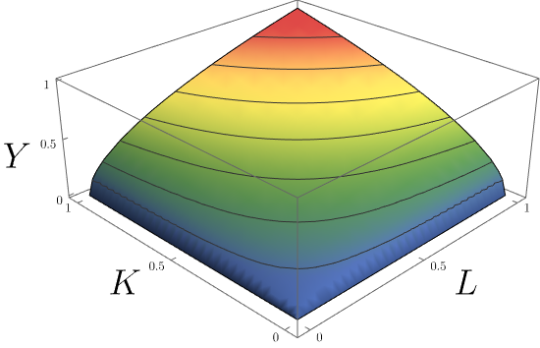
Lecture 4
A graph of Cobb-Douglas function

Slide 4
Lecture 4
The domain of a function of two real variables
By the domain of a function we mean all ordered pairs for which the function f is defined.
The domain is usually a subspace of Cartesian coordinate
system (CCS).
In the problems solved later, we will depict the domain by
shadowing an appropriate part of CCS.
,

Slide 5
Lecture 4
Finding a domain of a function – Problem 1
Find the domain of the function .
Solution: , (1)
Now we change the inequality into the equality:
This is the quation of a linear function (a line), which we draw
in CCS (see the picture on the next slied). Then, we must find
whether the domain lies on the left or right hand side to the
line via one suitable point. We know that point [0,0] is on the left.
We substitute this point into (1). Because (1) is untrue, the
domain is on the right side of the line.

Slide 6
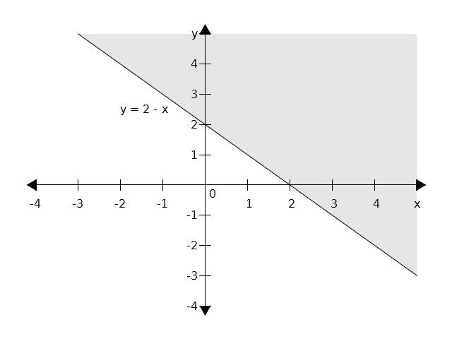
Lecture 4
Problem 1 – cont.

Slide 7
Lecture 4
Finding a domain of a function – Problem 2
Find the domain of the function: .
Solution:
From the square root we get: (1).
Transforming the inequality into equality yields:
This is the equation of the circle with a radius r = 3
and a centre [0,0]. Again, one point will decide whether the
domain is inside or outside of the circle. We can use [0,0]
again: is untrue, so the domain is outside
of the circle, including the circle.

Slide 8
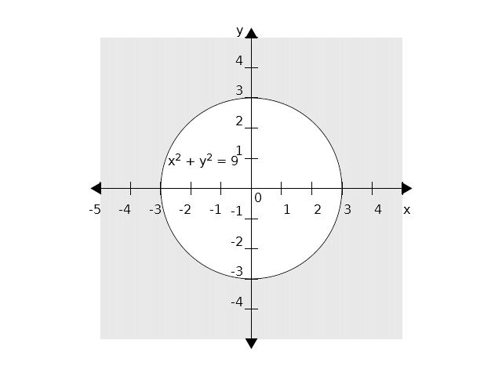
Lecture 4
Finding a domain of a function – Problem 2

Slide 9
Lecture 4
A derivative of a function of two real variables
Let f (x,y) be a function of two real varibles. Then, this function
can be differentiated with regard to x and/or y. These derivatives
are called partial derivatives and are denoted as follows:
Definition:

Slide 10
Lecture 4
Partial derivatives – Problem 3
Find partial derivatives of the function: .
Solution: when differentiating with regard to x, we consider
x to be a variable while y is considered a constant, and
vice versa.

Slide 11
Lecture 4
Second derivatives of a function of two real variables
If first derivatives are differentiable again, we obtain
second derivatives:
The latter two derivatives are called mixed derivatives. It can be
prooved they are equal:

Slide 12
Lecture 4
Second derivatives – Problem 4
Find all four second derivatives of a function:
Solution:
We start with the first derivatives:
Then, we compute the second derivatives:

Slide 13
Lecture 4
Cobb – Douglas function
C-D function: .
Usually, we assume that .
Then, C-D:
Marginal product of labour:
Marginal product of capital:

Slide 14
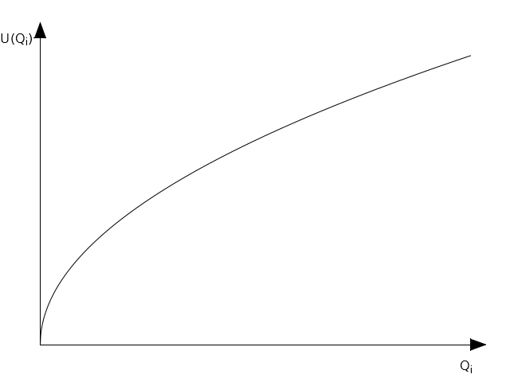
Lecture 4
A utility function
Let n be the number of different types of good. Let Q1, Q2, …. Be the amount of the good 1, 2, etc.
Then a function is called the utility function. Typically, a utility function is concave:

Slide 15
Lecture 4
Marginal utility
Marginal utility is defined as follows:
etc.
Example:
Find marginal utilities of the utility function .
Solution:

Slide 16
Lecture 4
A tangent plane
be a differentiable function at a point .
Then the tangent plane to the function f at the point C is:
The norm vector is given as follows:

Slide 17
Lecture 4
A tangent plane – Problem 5
Find the tangent plane to the function at the
point C [2,1,10].
Solution:
We compute the first derivatives:
Then, we substitute point C:
Therefore, we obtain:
And finally:

Slide 18
Lecture 4
A total differential
Let be differentiable at a point .
Then, the total differential is given as:
The total differential expresses (approximately) an increment of a function, which depends on increments of x (dx) and y (dy).

Slide 19
Lecture 4
A total differential – Problem 6
Find the total differential of the function , at
the point C [1,1,9] and for dx = 0,1, dy = 0,2 .
Solution:
We start with the first derivatives:
Substituting into general form yields:
Substituting C and differentials:

Slide 20
Lecture 4
Problems to solve 1 (Assignment 6)
Find the domain of the following functions:

Slide 21
Lecture 4
Problems to solve 2 (Assignment 6)
Find the partial derivatives of the first and second order:

Slide 22
Lecture 4
Problems to solve 3 (Assignment 6)
Find marginal products of labour and capital:
Find the total differential of the function .

Slide 23
Lecture 4
Problems to solve 4 (skip it)
Find the tangent plane of the function at the
point C [–2,2, ?].
Find the marginal utilities of the function at the
point Q1 = 9 and Q2 = 8.

Slide 24
Lecture 4
Problems to solve 5 (skip it)
A mathematical model of revenue R based on a price P and
advertisement costs A has the following form:
Find:
a) change of R with regard to the change of p,
b) change of R with regard to the change of A,
c) write a total differential of R.

Slide 25
Lecture 4
Thank you for your attention

