Slide 1
7. TOPIC individuals in the organization motivation
Ing. Pavel Adámek, Ph.D.
adamek@opf.slu.cz

Slide 2

How the lecture will be conducted?
The lecture is divided into two blocks, where each block introduces an issue associated with:
  Different ways in which the term motivation is used.
  The nature of motives and motivation processes as influences on behaviour.
  Characteristics of motivation theories and continuing contemporary interest in this field.
We use MS Teams, a shared whiteboard for your engagement and reactions, brainstorming ideas and for sharing answers.
The lecture is completed by quizzes in Vevox, the link is always in the presentation.

Slide 3
Contents
PART (45 min.)
Different ways in which the term motivation is used.
The nature of motives and motivation processes as influences on behaviour.
2. PART (45 min.)
Characteristics of motivation theories and continuing contemporary interest in this field (examples).

Slide 4
Learning objectives
After studying this topic, you should be able to:
Recognize the importance of motivation, appropriately identify motivational factors.
Gain knowledge of motivational approaches and methods.
Use knowledge of contemporary interest in the motivation approach that you can apply in practice.

Slide 5
Key readings
You can find support in the following sources:
Book – Huczynski, A. (2013). Organizational Behaviour. Chapter 9., p. 285

Slide 6

PART 1
Different ways in which the term motivation is used.
The nature of motives and motivation processes as influences on behaviour.
A motivated workforce can be a sign of a successful organization. How is that achieved?

Slide 7
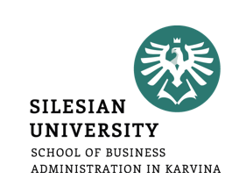
Why study motivation?
Each of us has a different reason for getting out of bed in the morning.
Our motives – from the Latin movere, to move – are key determinants of our behaviour.
If we understand your motives (desire for more leisure), we can influence your behaviour (take a day’s holiday if you finish that assignment).
What motivates you?
Share your ideas in Whiteboard in MS Teams

Slide 8
Why study motivation?
The top career goals for UK university students were:
1. to have work-life balance
2. to be competitively or intellectually challenged
3. to be secure or stable in my job
4. to be dedicated to a cause or to feel that I am serving a greater good
5. to have an international career
6. to be entrepreneurial or creative and innovative
7. to be a leader or manager of people
8. to be a technical or functional expert
9. to be autonomous or independent.

Slide 9
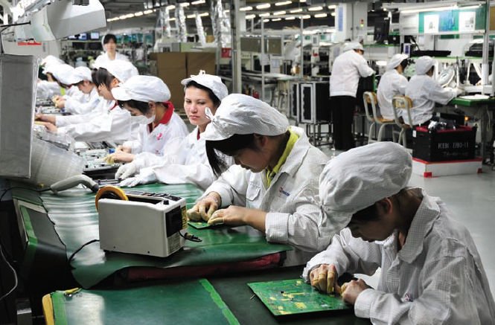
A demotivated workforce, on the other hand, can be disastrous!!!
When Apple released the iPad in May 2010, pictures of iPhones were burned in Hong Kong and protesters called for a global boycott of Apple products.
This followed a series of employee suicides at Foxconn, a contract manufacturer which makes products for Apple and other electronics companies at Foxconn City, an industrial park in Shenzen.
Foxconn City has 15 multistorey manufacturing buildings where there were twelve suicides in one year. These deaths raised questions about ‘sweatshop’ working conditions. Although Foxconn paid the Shenzen minimum wage, employees compared the company facilities to a prison, said that they were forced to work illegal overtime and night shifts, were exposed to hazardous materials, and had their privacy invaded by management.
In response to the suicides, the company put nets around its buildings, hired counsellors, and brought in Buddhist monks to pray. The chief executive denied that he was running a ‘sweatshop’, but Apple, Foxconn, and other companies had already suffered ‘bad press’ (The Economist, 2010).

Slide 10
Why study motivation?
However, is more money really more motivating? Douglas McGregor (1960) set out two sets of motivational propositions, which he called ‘Theory X’ and ‘Theory Y’.
Managers who subscribe to Theory X believe in giving orders and direct supervision, and in the motivating power of money.
Managers who subscribe to Theory Y believe in giving autonomy and responsibility, and in the motivating power of interesting jobs.
McGregor argued that Theory Y was a more accurate description of most people’s attitudes to work, and that Theory X in practice demotivated people.
  In other words, nonfinancial rewards can be as powerful, if not more powerful, motivators than money, as we also value recognition, jobs with a worthwhile purpose, flexible working, and personal development.

Slide 11
Extreme jobs
Some of us are motivated by the extreme job which involves long hours, frequent travel across different time zones, and multiple other pressures. The characteristics of extreme jobs include:
• physical presence in the office of at least 10 hours a day
• tight deadlines and fast working pace
• unpredictable workflow
• inordinate scope of responsibility
• frequent travel
• after-hours work events
• availability to clients 24/7
• responsibility for profit and loss
• responsibility for mentoring and recruiting.

Slide 12
Extreme jobs
Long hours and intense pressure are also exhausting, and have implications for family life.
Women in extreme jobs are concerned that their children are less disciplined, eat more junk food, and watch too much television as a result of their frequent absence.
Results show:
• 53 per cent of women in extreme jobs say that their job interferes with their sex life;
• 65 per cent of men say their extreme jobs damage relationships with their children.
Research has shown that extreme jobs with long hours are associated with higher satisfaction, better career prospects, and higher salary, but with also with higher levels of stress, more psychosomatic symptoms, lower family satisfaction, and poorer emotional health.

Slide 13
Boreout
Demotivation is common, especially among office workers, and is caused by repetitive, uninteresting, unchallenging work, leading to boreout. They estimate that 15 per cent of office workers are affected.
Boreout leads to high levels of sick leave and reduces company loyalty.
If you suffer boreout, you turn up for work lacking energy and enthusiasm, and spend your time surfing the internet, chatting to colleagues, and trying to look busy.

Slide 14
Boreout
The employee who answers ‘yes’ to four or more of these questions may be suffering boreout:
1. Do you complete private tasks at work?
2. Do you feel under-challenged or bored?
3. Do you sometimes pretend to be busy?
4. Are you tired and apathetic after work even if you experienced no stress in the office?
5. Are you unhappy with your work?
6. Do you find your work meaningless?
7. Could you complete your work quicker than you are doing?
8. Are you afraid of changing your job because you might take a salary cut?
9. Do you send private emails to colleagues during working hours?
10. Do you have little or no interest in your work?

Slide 15
Drives, motives, and motivation
Motivation can be explored from three distinct but related perspectives:
1. Goals. What are the main motives for our behaviour?
  Wealth, status, and power trigger behaviours directed towards their achievement. This perspective views motivation in terms of our desired outcomes or goals. This question is addressed by content theories of motivation.
2. Decisions. Why do we choose to pursue certain goals? Why do you study hard to earn distinctions while a friend has a full social life and is happy with pass grades?
  This perspective views motivation in terms of the cognitive decision-making processes influencing an individual’s choice of goals. This question is addressed by process theories of motivation.
3. Influence. How can we get you to work harder? Managers want to motivate employees to turn up on time and be helpful to customers.
  This perspective views motivation as a social influence process and is addressed by job enrichment theories.

Slide 16
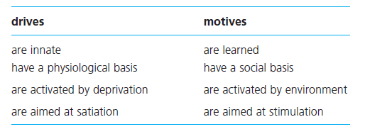
Drives, motives, and motivation
Our behaviour is influenced by our biological equipment.
We appear to have an innate need for survival. Our needs for oxygen, water, food, shelter, warmth, and se can be overpowering.
These needs are triggered by deprivation and are known as drives.
Motive a socially acquired need activated by a desire for fulfilment.
Motives appear to be acquired through experience.

Slide 17
Drives, motives, and motivation
Motivation is a broad concept which includes preferences for particular outcomes, strength of effort (half-hearted or enthusiastic), and persistence (in the face of problems and barriers).
These are the factors that we have to understand in order to explain your motivation and behaviour. These are the factors which a manager has to appreciate in order to motivate employees to behave in organizationally desirable ways.
Motivation the cognitive decision-making process through which goal-directed behaviour is initiated, energized, directed, and maintained.

Slide 18
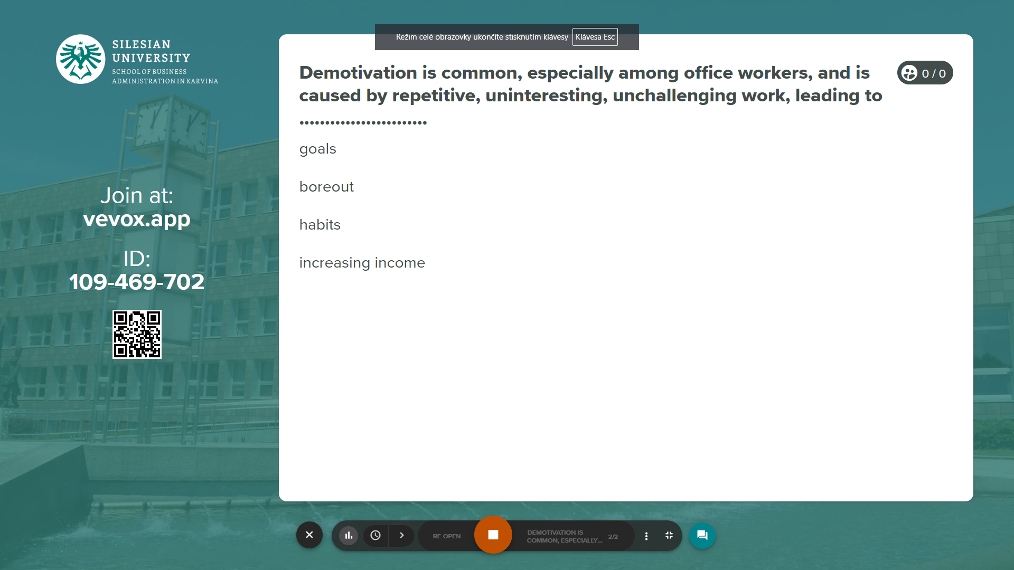
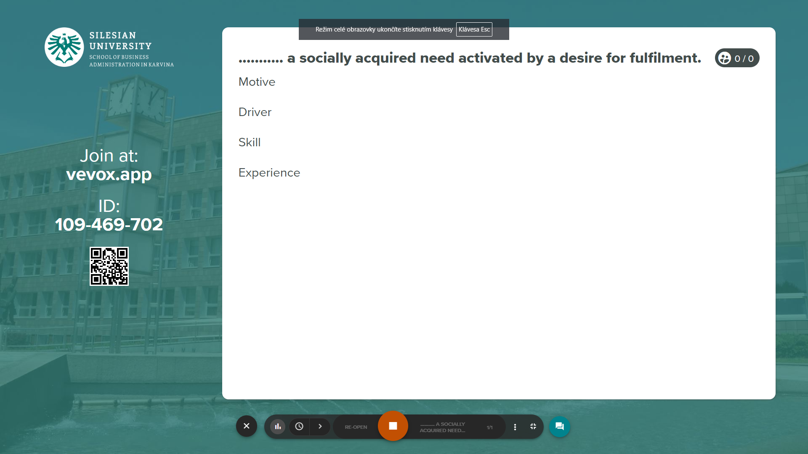
Vevox questions
https://silesianuniversity.vevox.com/#/meeting/450457/polls

Slide 19

PART 1
Characteristics of motivation theories and continuing contemporary interest in this field.

Slide 20
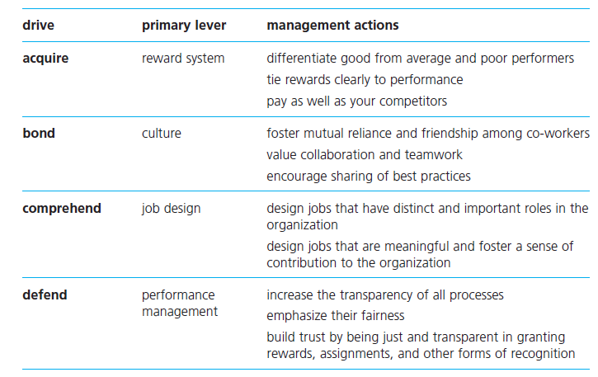
Content theories
The ‘emotional needs’ theory claims that we are driven by four basic and innate (‘hardwired’) drives:
the drive to acquire (obtain scarce goods, develop social status);
the drive to bond (form connections with other individuals and groups);
the drive to comprehend (satisfy our curiosity, master our environment);
the drive to defend (protect against threats, promote justice).

Slide 21
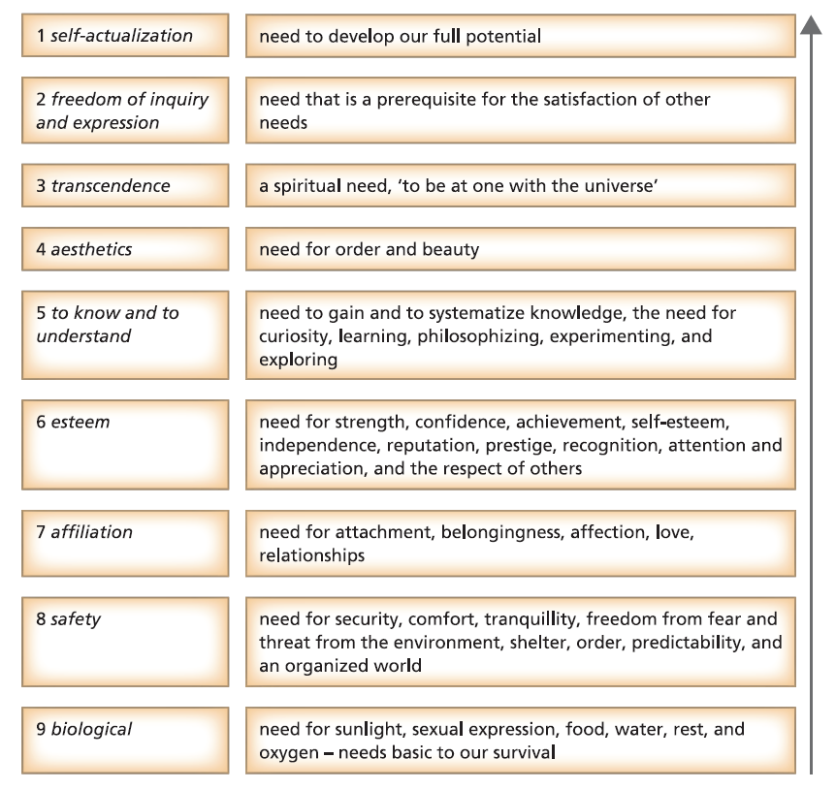
Content theories - Abraham Maslow’s needs hierarchy

Slide 22
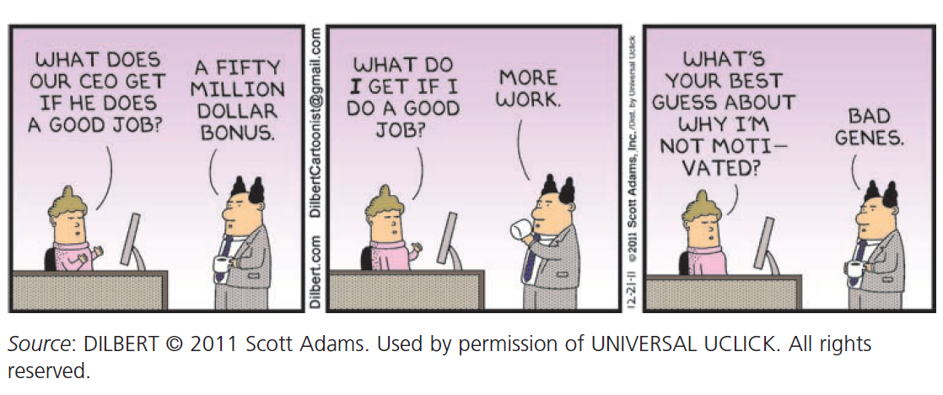
Content theories

Slide 23
Process theories
Theories of motivation that focus on how we make choices with respect to goals are known as process theories.
Unlike content theories, process theories give us a decision-making role in choosing our goals and how to pursue them. Individuals are motivated by different outcomes.
We will explore four process theories of work motivation:
equity theory,
expectancy theory,
goal-setting theory, and
inner work life theory.

Slide 24
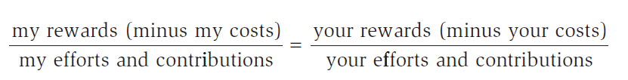
Equity theory
Equity theory a process theory of motivation which argues that perception of unfairness leads to tension, which motivates the individual to resolve that unfairness.
The calculation of what is just or equitable depends on the comparisons we make with others.
How do you calculate inequity? We compare our rewards (pay, recognition) and contributions (time, effort, ideas) with the outputs and inputs of others. Equity thus exists when these ratios are equal:
Rewards can include a range of tangible and intangible factors: pay, status symbols, fringe benefits, promotion prospects, satisfaction, job security.
Inputs similarly relate to any factor that you believe you bring to the situation, including age, experience, skill, education, effort, loyalty, and commitment. The relative priority or weighting of these various factors depends on the individual’s perception.

Slide 25
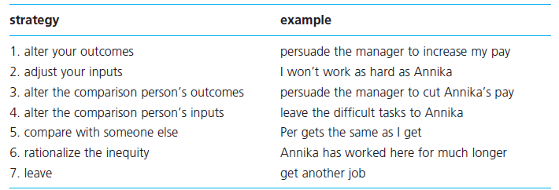
Equity theory
Strategies for reducing inequity

Slide 26
Expectancy theory
A motive is an outcome that has become desirable. The process through which outcomes become desirable is explained by the expectancy theory of motivation.
For work motivation to be high, productive work has to be seen as a path to valued goals. If you need more money, and if you expect to get more money for working hard, then we can predict that you will work hard.
If you still need more money, but if you expect that hard work will only result in happy smiles from the boss, then we can predict that you will decide not to work hard (unless you value happy smiles).

Slide 27
Expectancy theory
The American psychologist Victor H. Vroom (1964) developed the first expectancy theory of work motivation, based on three concepts: valence, instrumentality, and expectancy.
Valence the perceived value or preference that an individual has for a particular outcome; can be positive, negative, or neutral.
Instrumentality the perceived probability that good performance will lead to valued rewards; measured on a scale from 0 (no chance) to 1 (certainty).
Expectancy the perceived probability that effort will result in good performance; measured on a scale from 0 (no chance) to 1 (certainty).
Total rewards - All aspects of work that are valued by employees, including recognition, development opportunities, organization culture, and attractive work environment, as well as pay and other financial benefits.

Slide 28
Goal-setting theory
Goal-setting theory a process theory of motivation which argues that work motivation is influenced by goal difficulty, goal specificity, and knowledge of results.
The main positive feature of goal-setting theory concerns the clarity of the practical implications:
Goal difficulty: set goals for performance at levels which will stretch employees, but which are not beyond their ability levels.
Goal specificity: express goals in clear and precise language, if possible in quantifiable terms, and avoid setting vague and ambiguous goals.
Participation: allow employees to take part in the goal-setting process to increase the acceptability of and their commitment to goals.
Acceptance: if goals are set by management, ensure that they are adequately explained and justified, so that those concerned understand and accept them.
Feedback: provide information on the results of past performance to allow employees to adjust their behaviour, if necessary, to improve future performance.

Slide 29
Goal-setting theory
Goal-setting theory has established four propositions which are well-supported by research:
1. Challenging goals lead to higher levels of performance than simple and unchallenging goals. Difficult goals are also called ‘stretch’ goals because they encourage us to try harder (unless the goal is beyond our level of ability).
2. Specific goals lead to higher levels of performance than vague goals such as ‘try harder’ or ‘do your best’. It is easier to adjust our behaviour when we know precisely what is required of us, and goal specificity avoids confusion. Goals should thus be SMART: specific, measurable, attainable, realistic and time-related.
3. Participation in goal-setting, particularly when this is expected, can improve performance by increasing commitment to those goals, but managerially assigned goals that are adequately explained and justified can also lead to high performance.
4. Knowledge of results of past performance – feedback – is necessary for effective goal achievement. Feedback contains information and is also motivational.

Slide 30
Inner work life theory
Equity, expectancy, and goal-setting theories of motivation allow us to make choices, implying a rational, logical, reasoned approach to the decisions that shape our behaviour. They do not allow for the influence of emotions.
The inner work life theory developed by Teresa Amabile and Steven Kramer (2007) argues that our behaviour and work performance are influenced by the way in which our perceptions, motives, and emotions interact with each other, triggered by everyday events.
Our private thoughts and feelings may not be visible to others, but we do not leave them at home when we go to work.

Slide 31
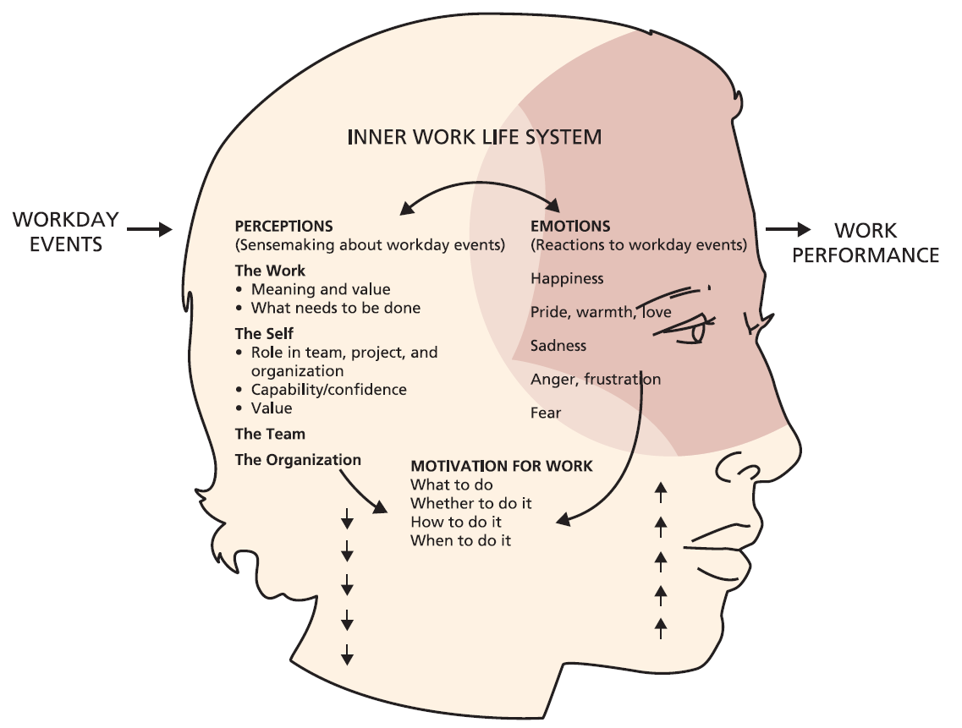
Inner work life theory
The ‘inner work life’ model of work performance. One of the most important implications of this perspective concerns the role of emotions.
Neuroscience has shown that cognition (including perception) and emotion are closely linked. Events at work trigger a combination of perceptual, emotional, and motivational processes.
The way in which these processes interact shapes our behaviour and our performance at work

Slide 32
The social process of motivating others
The general question is, how do we motivate others to do what we want them to do?
The question for management is, how do we motivate employees to perform well? Many jobs are still designed using the methods of the American engineer Frederick Winslow Taylor (1911). Taylor’s scientific management approach to designing jobs is as follows:
Decide on the optimum degree of task fragmentation, breaking down a complex job into a sequence of simple steps.
Decide the one best way to perform the work, through studies to discover the most effective method for doing each step, including workplace layout and design of tools.
Train employees to carry out these simple fragmented tasks in the manner specified.
Reward employees financially for meeting performance targets.

Slide 33
The social process of motivating others
Task fragmentation has advantages:
employees do not need expensive and time-consuming training;
repeating one small specialized task makes employees very proficient;
unskilled work gets lower pay; and
some of the problems of achieving controlled performance are simplified.
The disadvantages include:
repetitive work is very boring;
the individual’s contribution to the organization is meaningless and insignificant;
monotony leads to apathy, dissatisfaction, and carelessness; and
the employee does not develop skills that might lead to promotion.

Slide 34
The social process of motivating others
Taylor’s approach to job design appears logical and efficient, but it creates jobs that do not stimulate motivation or improve performance.
Taylor had a simplified view of human motivation, regarding ‘lower level’ employees as ‘coin operated’ and arguing that the rewards for working as instructed should be financial.
Managers are thus interested in theories of motivation as sources of alternative methods for encouraging motivation and high performance.
During the 1960s and 1970s, these concerns created the Quality of Working Life (QWL) movement; its language and methods are still influential today. One QWL technique is job enrichment.

Slide 35
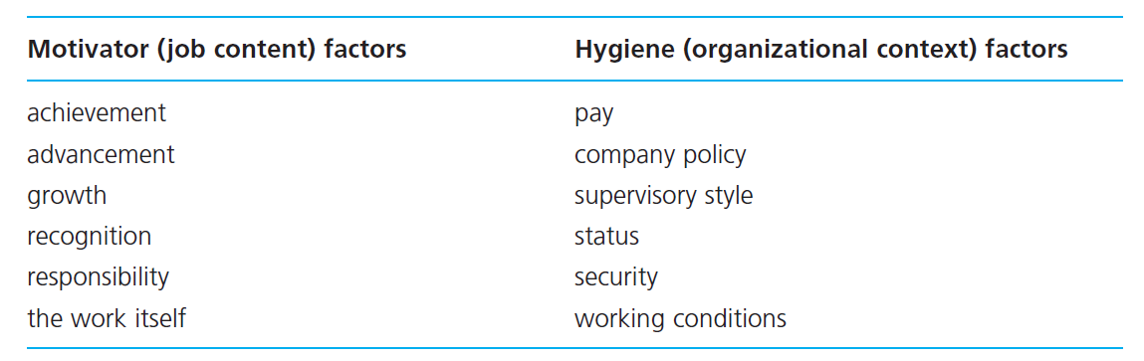
The social process of motivating others
The concept of job enrichment was first developed by the American psychologist Frederick Herzberg (1968).
Job enrichment a technique for broadening the experience of work to enhance employee need satisfaction and to improve motivation and performance.
Herzberg called this a ‘two factor theory of motivation’, the two sets of factors being motivator factors and hygiene factors.
Motivators are also known as (job) content factors, while hygiene factors are known as (organizational) context factors.

Slide 36
The social process of motivating others
Herzberg (1968) put the way in which a job is designed determines the rewards available, and what the individual has to do to get those rewards. It helps to distinguish between intrinsic rewards and extrinsic rewards.
Intrinsic rewards valued outcomes or benefits which come from the individual, such as feelings of satisfaction, competence, self-esteem, and accomplishment.
  Mountaineers, poets, athletes, authors, painters, and musicians are usually familiar with the concept of intrinsic reward
Extrinsic rewards valued outcomes or benefits provided by others, such as promotion, pay increases, a bigger office desk, praise, and recognition.

Slide 37
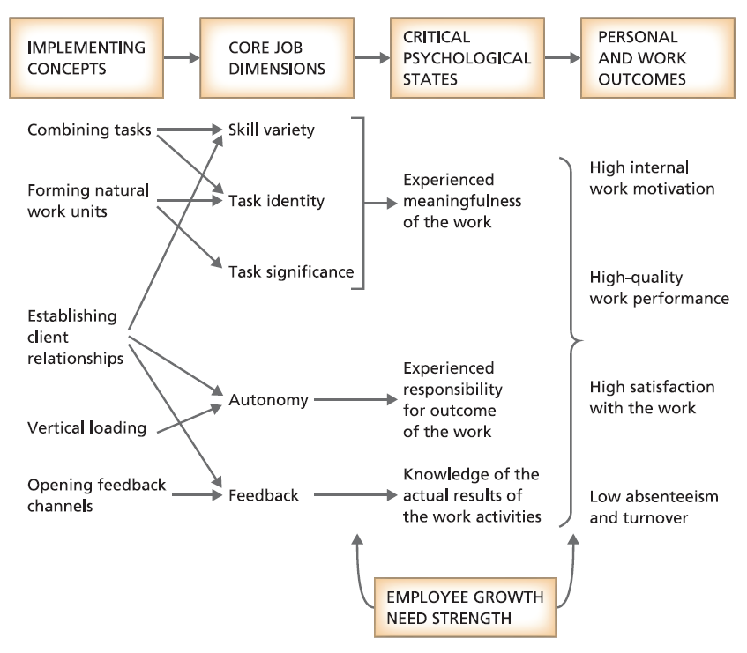
The Job Characteristics Model

Slide 38
The social process of motivating others
The JOB CHARACTERISTICS MODEL suggests that jobs can be analysed in terms of five core dimensions:
skill variety: the extent to which a job makes use of different skills and abilities;
task identity: the extent to which a job involves a ‘whole’ and meaningful piece of work;
task significance: the extent to which a job affects the work of others;
autonomy: the extent to which a job provides independence and discretion;
feedback: the extent to which performance information is related back to the individual.

Slide 39
Empowerment, engagement, and high performance
Practice in many organizations has gone beyond the enrichment of individual jobs, to focus on teamworking, organizational culture change, and other forms of employee empowerment.
As a result, many organizations during the 1990s reconsidered job enrichment and other approaches to improve quality of working life, through employee empowerment. In the twenty-first century, this has been linked with the related concept of employee engagement.
Empowerment organizational arrangements that give employees more autonomy, discretion, and decision-making responsibility.
Engagement the extent to which people enjoy and believe in what they do, and feel valued for doing it.

Slide 40
Empowerment, engagement, and high performance
Techniques for improving motivation and performance through empowerment and engagement fall into two broad categories: individual job enrichment, and self-managing or autonomous teamwork.
These approaches converge in the high performance work system – form of organization that operates at levels of excellence far beyond those of comparable systems.

Slide 41
Empowerment, engagement, and high performance
Organizations, or groups, are a high performance system if they
perform excellently against a known external standard;
perform beyond what is assumed to be their potential best;
perform excellently in relation to what they did before;
are judged by observers to be substantially better than comparable groups;
are achieving levels of performance with fewer resources than necessary;
are seen to be exemplars, as a source of ideas and inspiration;
are seen to achieve the ideals of the culture;
are the only organizations that have been able to do what they do at all, even though it might seem that what they do is not so difficult or mysterious.

Slide 42
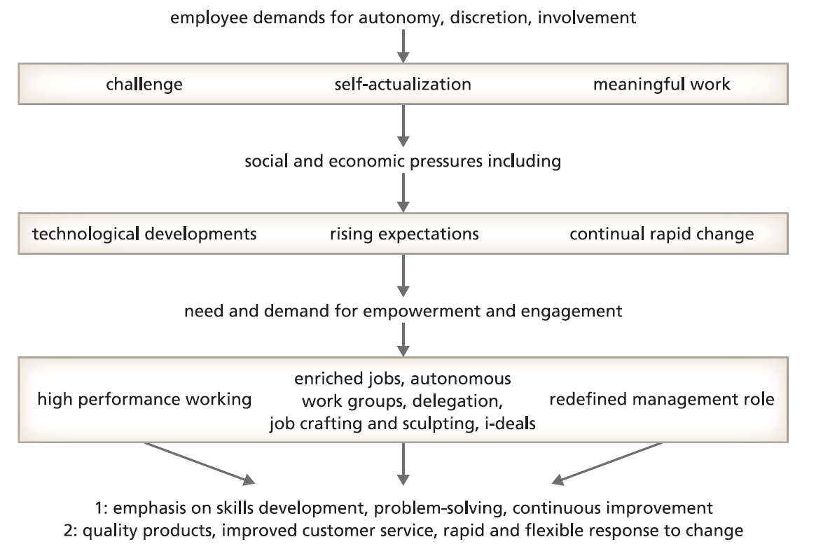
The case for high performance work systems

Slide 43
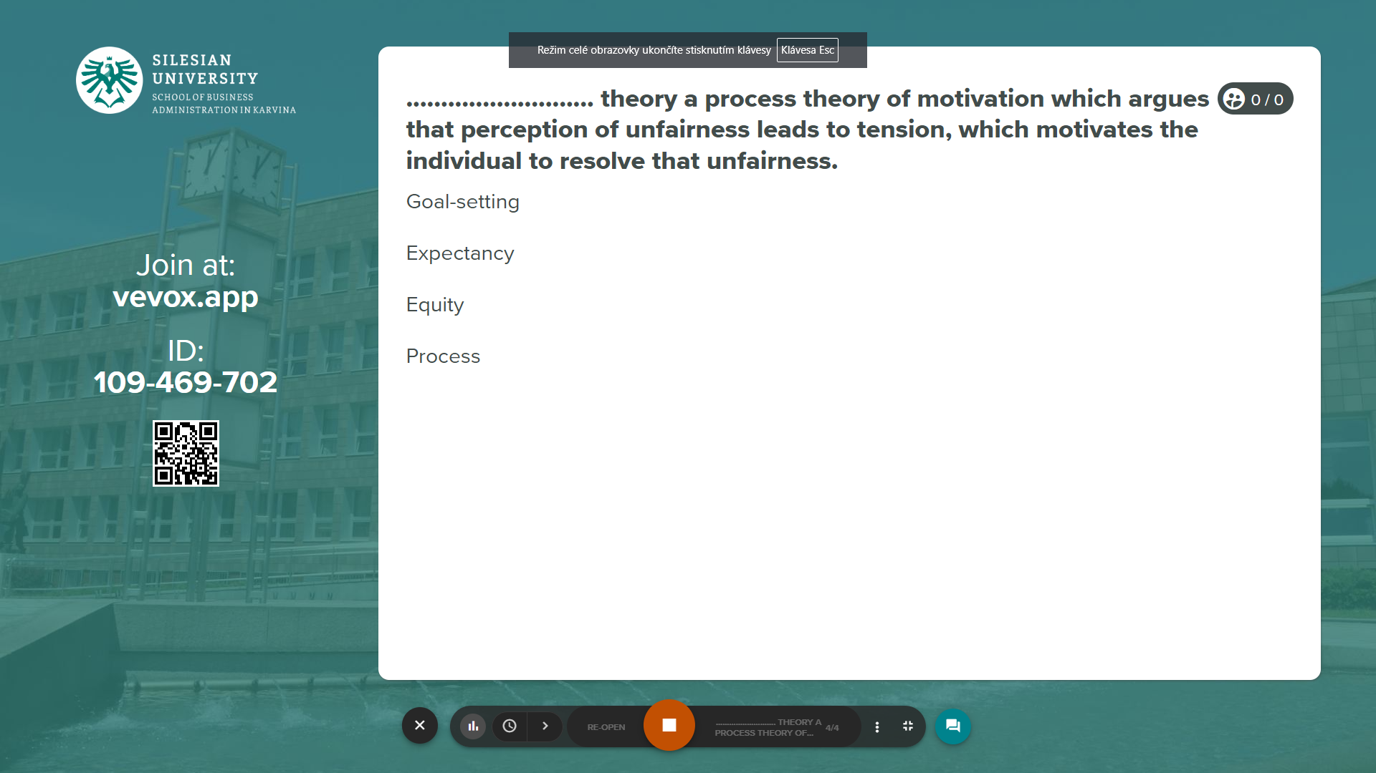
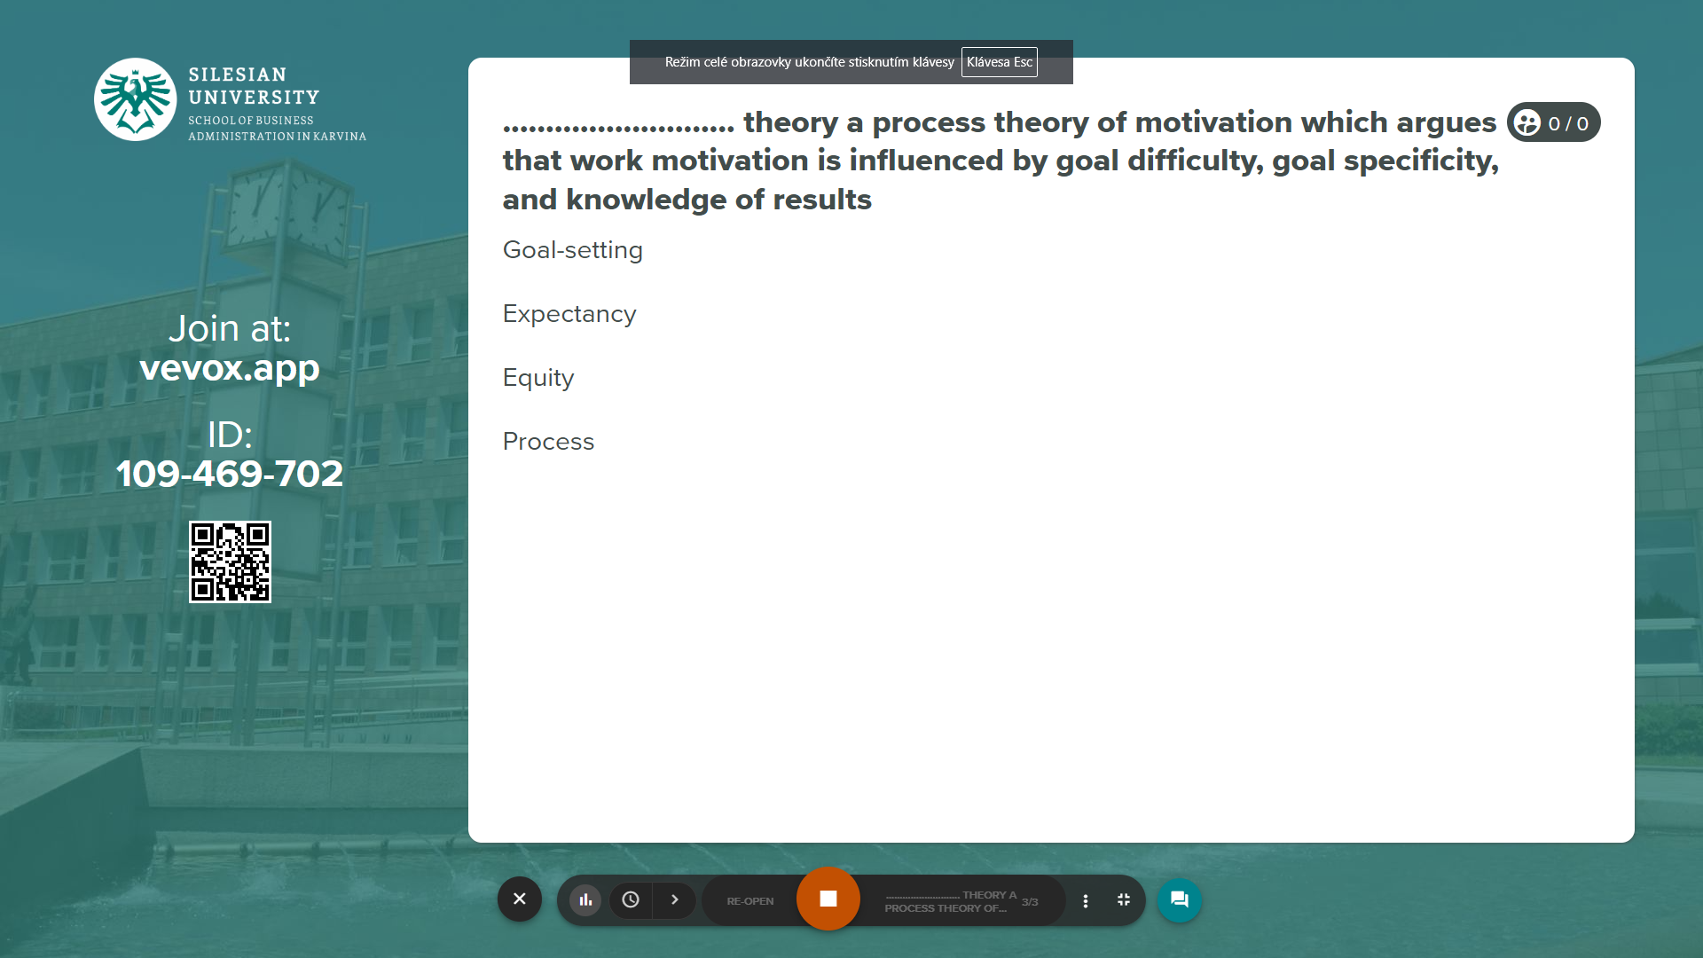
Vevox questions
https://silesianuniversity.vevox.com/#/meeting/450457/polls

Slide 44
RECAP
Motivation can refer to desired goals which we as individuals have or acquire.
Motivation can refer to the individual decision-making process through which goals are chosen and pursued.
Motivation can refer to social influence attempts to change the behaviour of others.
Motives as desirable goals can be innate (drives) or acquired (socially learned).
Content theories of motivation explain behaviour in terms of innate drives and acquired motives.
Equity theory explains motivation in terms of perceived injustice or unfairness.
Expectancy theory explains motivation in terms of valued outcomes and the subjective probability of achieving those outcomes.
Goal-setting theory explains behaviour in terms of goal difficulty and goal specificity.
Inner work life theory explains behaviour in terms of the interactions between perceptions, motives, and emotions.

Slide 45
RECAP
A job will only be motivating if it leads to rewards which the individual values.
Rewards motivate high performance when the link between effort and reward is clear.
Hygiene factors can overcome dissatisfaction but do not lead to motivation.
Content factors lead to job satisfaction, motivation, and high performance.
Jobs can be enriched by applying vertical job loading factors.
The motivating potential of a job can be increased by improving skill variety, task identity, task significance, autonomy, and feedback.
Job enrichment will not improve the performance of individuals with low Growth Need Strength.
Some people are motivated by extreme jobs, working long hours under pressure, for the adrenalin rush, high pay, status, and power, but with personal and social problems.
In a rapidly changing competitive business environment, organizations need to motivate employees to be flexible, adaptable, committed, and creative, not just to turn up on time and follow instructions.

Slide 46
We can share our thoughts and ask questions
☺
Pavel Adámek
adamek@opf.slu.cz

